Slide 1

COLOR RECOGNITION
Project Supervisor : Dr.A.Viji Amutha Mary
Name of the Student : Sravya Namburu
Register Number : 39110962

Slide 2

Introduction
Objectives
Scope
Ideation Map / System Architecture
Software and Hard ware Requirements
Algorithms and Methods
Results
Conclusion
References

Slide 3
INTRODUCTION
Our goal for this project is to build color recognizer with simple and machine learning using Open CV.we will create a application that will help us to identify colors in the image.This process is also known as color detection.
This program will also return RGB values of the color.
Color recognition is the process of segmenting the colorsand identifying the segmented colors.
It is one of the human to computer interaction

Slide 4
OBJECTIVES
Aim of the this project is to build color recognizer using Open CV .
Color recognition using Open CV also allows the identifying of a specific color in live stream video.
To create a color recognition app which will help users to detect color in the image .
We will use three main modules for this project Numpy, Pandas, Open Cv. Open CV is a highly optimized library with a focus on real time applications.
Our aim is to retrieve rgb values from an image and determine the color

Slide 5
Scope of the project
Computer Vision – Color recognition is the basic and important step for proceeding in computer vision.
Object Segregration – An oject can be segregrated(seperated ) on the basis of color.
Object Tracking – A moving object can be tracked on the basis of its color.

Slide 6
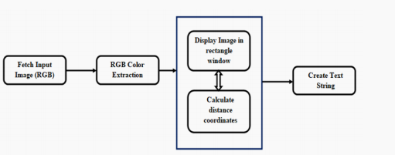
IDEATION MAP/SYSTEM ARCHITECTURE

Slide 7



HARDWARE AND SOFTWARE REQUIREMNTS
HARDWARE REQUIREMENTS: A laptop with a good internet connection.
SOFTWARE REQUIREMENTS : Anaconda software and jupyter notebook.

Slide 8
MODULE IMPLEMENTATION
Numpy - Supports large Multi-dimesional arrays and matrices, along with a large collection of high-level mathematical function to operate on the arrays.
Pandas – Pandas is a software library written for the python programming language for data manipulation and analysis.
Matplotlib – Matplotlib is a plotting library for the python programming language and its numerical mathematics extension Numpy.
CV2 – Open CV is a library of programming function at real time computer vision and it is a python wrapper.It makes use of Numpy.

Slide 9
Open CV
Open CV (Open source computer vision) is a huge open source library for the machine learning and image processing and it plays in important role in real time operation.
Open CV was built tom provide a common infrastructure for computer vision applications.
This library has more than 2500 optimized algorithms.These algorithms can be used to detect and recognize faces,identify objects, classify human actions in videos etc…

Slide 10
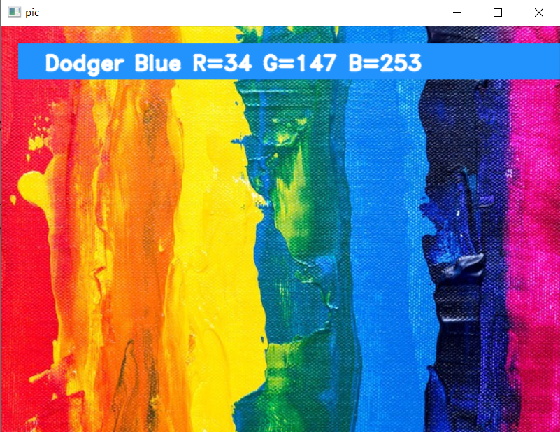
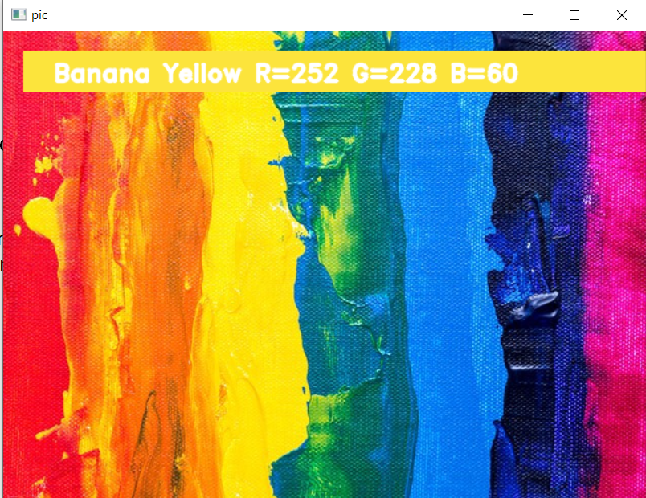
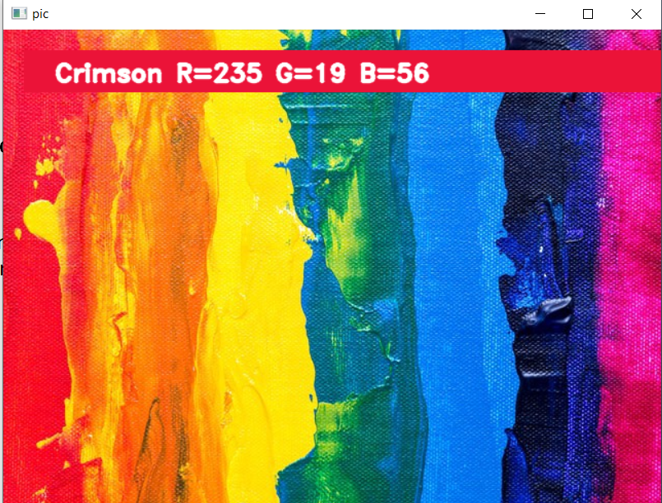
Results

Slide 11
CONCLUSION
In this project , we have created a color recognizer using open CV Python.
We learned about colors and how we can extract color RGB values and the color name.
In this study we defined to get the required color field from an RGB image .In the various steps are imlemented using open CV paltform.
The main Positive point of the method is its color differentiation of a mono color.

Slide 12
REFERENCES
https://pyimagesearch.com/2014/08/04/opencv-python-color-detection/
https://data-flair.training/blogs/project-in-python-colour-detection/
https://morioh.com/p/35907c154459

