Slide 1

FINAL REVIEW
Privacy-Preserving Healthcare Device Authentication via Edge-AI and Federated Learning
Guide:
D. Sai Venkata Gowtham
(Assistant Professor)
Batch - 7
Members:
G. Vincy : 22X41A4414
N. Yaswanth : 22X41A4436
O. Nagendra : 22X41A4439
K. Satyavathi : 22X41A4418
N. Vasu Deva Naga Sai : 22X41A4437
Sk. Yasin Ali : 22X41A4453

Slide 2
CONTENTS :
ABSTRACT
INTRODUCTION
LITERATURE REVIEW
EXISTING PROBLEM
RESEARCH OBJECTIVES
PROPOSED METHODOLOGY
RESULTS & DISCUSSIONS
CONCLUSION
REFERENCES
PAPER PUBLICATION

Slide 3
Abstract :
Internet of Medical Things (IoMT) and hospital-edge devices to monitor patient health have accelerated the process of generating sensitive medical data. Although this type of data can make a significant contribution to the detection of the disease with the help of artificial intelligence (AI) but also traditional model faced several limitation such as data privacy, computational cost and over-fitting issues. To overcome the limitation this paper suggests a privacy-preserving Federated Learning (FL) model that incorporates a token-based dual-layer authentication and high-level medical image classification. The suggested system requires that hospitals will initially be registered in a Centralized Authorization Authority (CAA) where metadata of devices and hospital credentials are checked and HMAC-SHA256 tokens are generated. FL only accepts authenticated hospitals that possess active tokens, and rest of the nodes are not allowed, therefore safe and reliable participation is guaranteed.

Slide 4
To train locally, each hospital applies Optimized Spatial Densely Connected Swin Transformer (OSDSTran), an architecture with a combination of spatial attention and transformer layers to successfully discern local and global characteristics of the chest X-ray images to classify the disease. The Prairie Dog Optimization Algorithm (PDOA) is then used to refine the hyper-parameters and to provide an accurate result. Authorized updates are fully secured by FedAvg, and the patient information is all local, which guarantees a high level privacy protection. The proposed method has been proven to be efficient in secure and reliable medical image classification with accuracy of 98.88% and precision of 98.65%, which will improve the model.

Slide 5
INTRODUCTION :
Internet of Medical Things (IoMT) devices are widely used in healthcare for real-time patient monitoring.
These devices generate large amounts of sensitive medical data.
Advanced technologies like AI, Machine Learning, and Cloud Computing improve healthcare efficiency.
However, data privacy and security are major concerns in healthcare systems.
Unauthorized access to medical data can lead to privacy violations and financial loss.
Traditional AI models require centralized data storage, increasing risk of data breaches.

Slide 6
Federated Learning (FL) allows training models without sharing raw data.
It ensures data remains local, improving privacy protection.
However, existing FL systems lack strong authentication mechanisms.
This may allow unauthorized or malicious devices to participate.
IoMT systems are vulnerable to cyber-attacks and data leakage.
Therefore, there is a need for a secure, privacy-preserving, and reliable healthcare system.
Increasing use of IoMT devices leads to high computational cost and scalability challenges in healthcare systems.

Slide 7
LITERATURE REVIEW :
Traditional healthcare AI models used centralized data, leading to privacy and security risks
Federated Learning (FL) enabled privacy-preserving training without sharing raw data
Existing FL models improved privacy but lacked strong authentication mechanisms
Deep learning models enhanced medical image classification accuracy
Advanced approaches increased performance but introduced high computational cost and complexity
Limitations like poor generalization, authentication delay, and security vulnerabilities still exist
Existing models suffer from reduced operational time due to frequent authentication
Different hospital nodes or IoT devices require high local training, increasing computational cost
Many approaches show limited generalization and reduced reliability in real-time clinical use

Slide 8
Author name & References | Models | Performance | Disadvantages
Ahmed et al. [16] | Medical Edge-devices privacy enhanced technique based on the federated learning | Accuracy of 96% | The model may suffer reduced operational time due to the frequent authentication
Ayyappan et al. [17] | Ayyappan et al. [17] | Accuracy of 91.2% | Different hospital nodes or IoT devices may requires high training.
Yang et al. [18] | Clu-FDL | Precision of 93% | Clu-FDL model required high computational power in training time this may increase computational cost.
Eshwarappa et al. [19] | Edge-Avg | Accuracy of 93.94% | The dependence on image quality was affected in reliability of real-time clinical use
Chen et al. [20] | AQ-FDNF | Accuracy of 93.8% | The complexity of the model was limited generalization issues this may degrade model performance.

Slide 9
EXISTING PROBLEM :
Traditional centralized AI models lead to data privacy risks and possible data breaches
Existing Federated Learning systems lack strong authentication, allowing unauthorized devices participation
Frequent authentication mechanisms cause increased delay and reduced operational efficiency
Heterogeneous hospital nodes require high computational power and training time
Many models depend on high-quality images, reducing reliability in real-time clinical applications
Existing approaches suffer from poor generalization and high model complexity
Existing systems are vulnerable to cyber-attacks and data leakage due to insecure data transmission and storage
Centralized and traditional models involve data sharing over cloud systems, increasing risk of exposure to untrusted parties

Slide 10
RESEARCH OBJECTIVES :
To develop a privacy-preserving healthcare system using Federated Learning (FL)
To implement a secure authentication mechanism (HMAC-SHA256) for verifying hospitals and devices
To design a dual-layer authentication system to prevent unauthorized participation
To build an Optimized Spatial Densely Connected Swin Transformer (OSDSTran) for accurate disease classification
To apply Prairie Dog Optimization Algorithm (PDOA) for hyperparameter tuning and performance improvement
To ensure secure model aggregation using FedAvg without sharing raw patient data
To improve overall system performance in terms of accuracy, privacy, and computational efficiency

Slide 11
PROPOSED METHODOLOGY :
Use Federated Learning (FL) to enable collaborative model training without sharing raw patient data.
Introduce a Centralized Authorization Authority (CAA) for hospital verification.
Apply HMAC-SHA256 based token authentication with a dual-layer security mechanism.
Ensure only authenticated hospitals can participate in global model updates.
Keep medical data locally stored at hospital edge devices to preserve privacy.
Develop OSDSTran (Optimized Spatial Densely Connected Swin Transformer) for accurate disease classification.
Employ Prairie Dog Optimization Algorithm (PDOA) to enhance classification performance.
Securely aggregate local updates to build a robust and trustworthy global model.
Reduce computational cost, latency, and improve real-time clinical usability.

Slide 12
ARCHITECTURE :
The system follows a Federated Learning (FL)-based distributed architecture with multiple hospitals as clients
Each hospital first registers with a Centralized Authorization Authority (CAA) for verification
HMAC-SHA256 based token authentication is used to allow only authorized devices into the network
After authentication, hospitals perform local model training using OSDSTran on chest X-ray data
Raw patient data remains local, ensuring privacy and no direct data sharing
Trained local models send secure updates to the central server
The central server performs global model aggregation using FedAvg algorithm

Slide 13
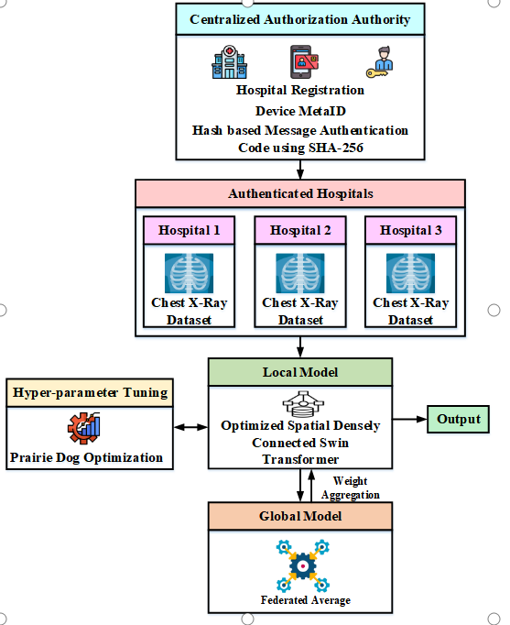

Slide 14
RESULTS & DISCUSSION :
The proposed privacy-preserving Federated Learning model with OSDSTran achieved high performance in medical image classification, with accuracy of 98.88%, precision of 98.65%, recall of 98.75%, and F1-score of 98.81%, outperforming existing models such as VGG, ResNet, Xception, and ViT. It also showed improved efficiency with reduced computation time and low latency, making it suitable for real-time healthcare applications. High AUC and PRC values further confirm its strong classification capability.
The system enhances data privacy by keeping patient data local using Federated Learning, while HMAC-SHA256 authentication ensures secure participation of authorized hospitals. The OSDSTran model effectively captures important image features, and PDOA optimization improves accuracy with reduced complexity. Overall, the proposed approach overcomes limitations like security risks, high cost, and poor generalization, providing a reliable healthcare solution.

Slide 15
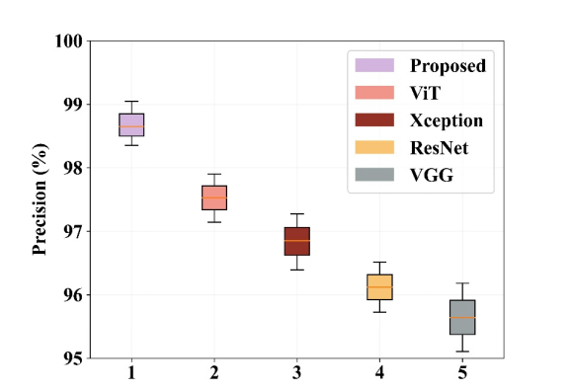
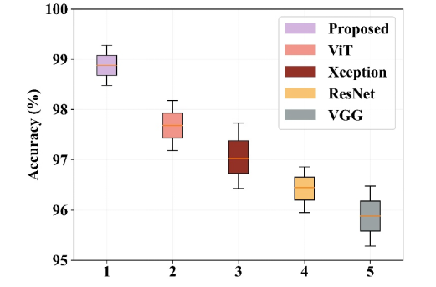
Figure 1: Analysis of accuracy for proposed and existing models Figure 2: Analysis of precision for proposed and existing models

Slide 16
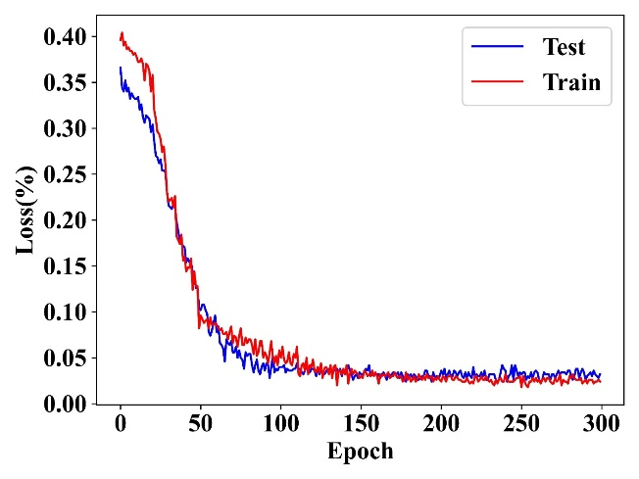
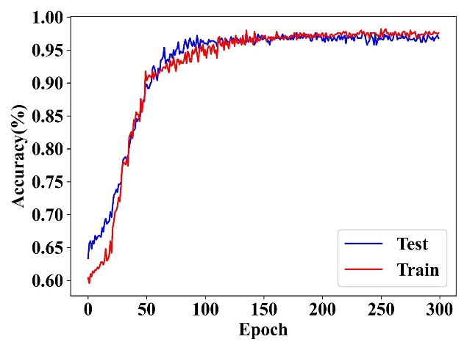
Figure 3: Analysis of training, testing loss and accuracy of the proposed model

Slide 17
CONCLUSION :
Our project successfully proposes a privacy-preserving healthcare system using Edge-AI and Federated Learning.
By using Federated Learning, patient data remains on local devices, ensuring data privacy and confidentiality.
The integration of HMAC-based authentication ensures that only authorized and trusted devices can participate in model training.
The system effectively prevents data tampering and unauthorized access, improving overall security.
The use of a deep learning model enables accurate medical image classification, enhancing healthcare decision-making.
Overall, the proposed system achieves a balance between privacy, security, and performance, making it suitable for real-world healthcare applications.

Slide 18
References :
Ahmed et al. [16] – Proposed a federated learning–based medical edge-device authentication framework using dual-layer token validation via CAA, achieving 96% accuracy but with increased operational time due to frequent authentication.
Ayyappan et al. [17] – Developed a privacy-preserving federated edge AI model for diabetes prediction using Fed Avg, achieving 91.2% accuracy, though high training cost was required for heterogeneous hospital nodes.
Yang et al. [18] – Introduced clustering-based federated deep learning (Clu-FDL) with personalized model training using Simple RNN, achieving 93% precision at the expense of high computational complexity.
Eshwar appa et al. [19] – Proposed an Edge-Average federated learning approach for skin cancer image classification, achieving 93.94% accuracy, but performance was affected by dependency on high-quality medical images.
Chen et al. [20] – Presented an Adaptive Quantized Federated Dual-Network Framework (AQ-FDNF) combining TCN and A-GRU for real-time health monitoring, achieving 93.8% accuracy with limited generalization due to model complexity.

Slide 19
Chen et al. [20] – Proposed an Adaptive Quantized Federated Dual-Network Framework (AQ-FDNF) using TCN and A-GRU for real-time health monitoring, achieving 93.8% accuracy but limited generalization due to model complexity.
Singh et al. [10] – Presented a federated learning framework for healthcare data privacy, ensuring secure data sharing, but lacking strong authentication mechanisms for device verification.
Ali et al. [11] – Provided a comprehensive survey on federated learning in healthcare, highlighting privacy benefits but identifying challenges in security and communication efficiency.
Li et al. [13] – Proposed a privacy-preserving machine learning model for cyber-physical healthcare systems, achieving reliable predictions but facing concerns in secure data transmission and scalability.

Slide 20
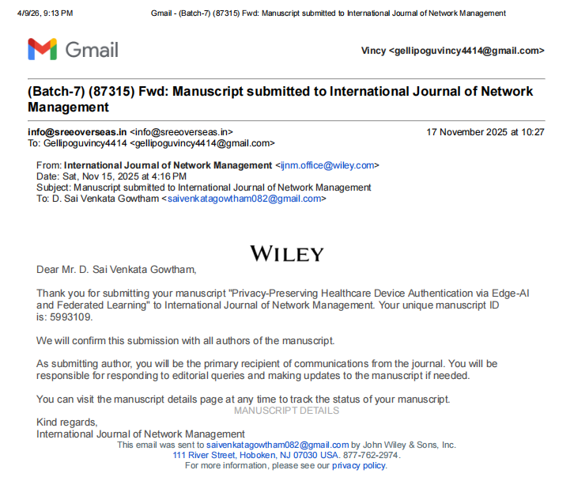
PAPER PUBLICATION :

Slide 21
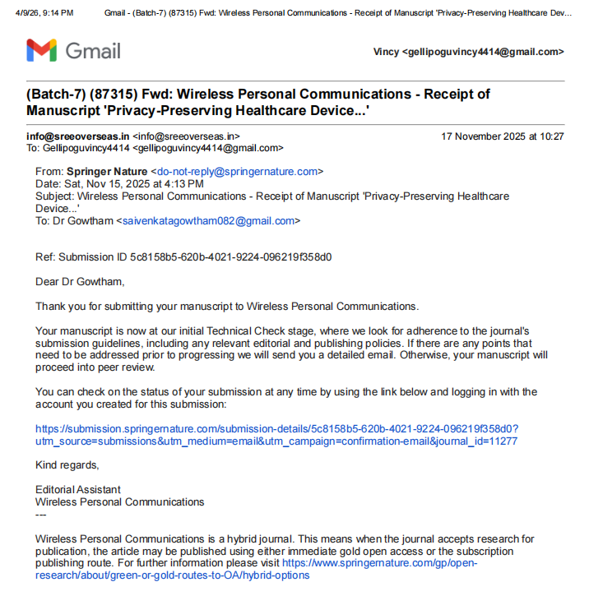

Slide 22
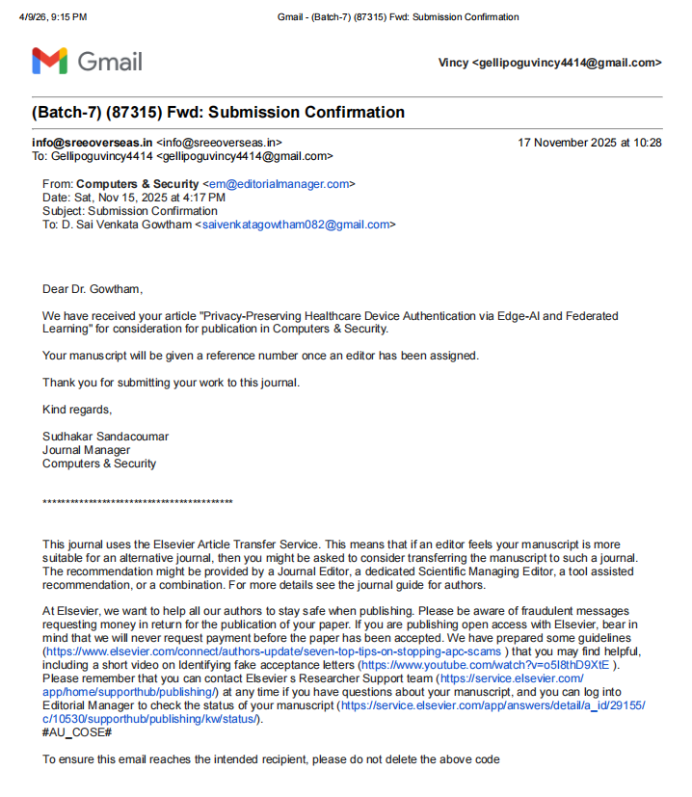

Slide 23
THANK YOU

