Slide 1
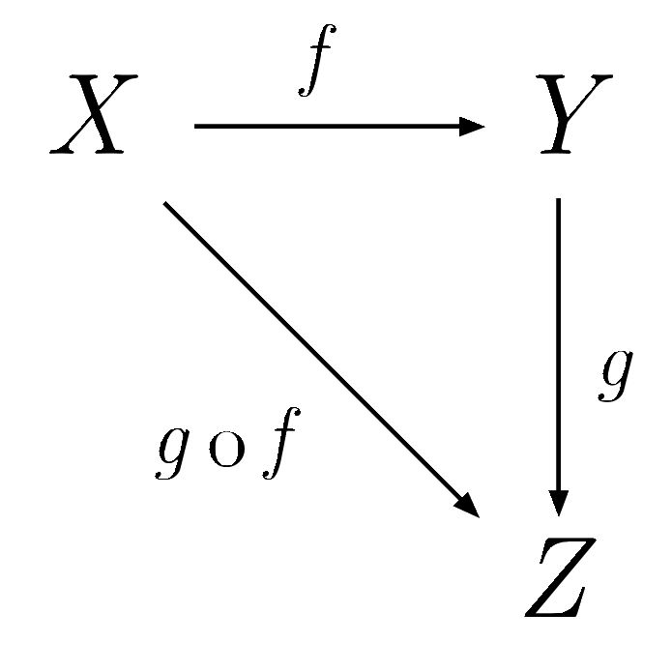
FECAPI
General Abstract Nonsense with an Application to DSP Using GNU Radio
Nicholas McCarthy
namccart@gmail.com

Slide 2

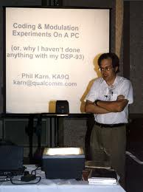


The State of Play
Iterative Solutions.
  Broad selection of mostly Viterbi-based turbo decoders (actual, useful standards), RS.
  Matlab and C MEX, open source.
KA9Q.
  Convolutional (FANO and Viterbi, common parameters), Reed Soloman (already “in” GR).
  Hand-vectorized.
Spiral.
  Parameterizable Convolutional (Viterbi).
  Machine-vectorized (intrinsics, mostly better than KA9Q).
OpenFEC
  Only AL-FEC (LDPC “staircase” and Reed Solomon).
  Nice, unified API with performance applications.
Tip of the iceberg... journal papers, masters' theses, information theory hobbyists, proprietary implementations.

Slide 3
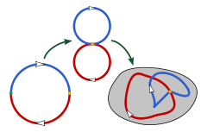
Saunders Mac Lane
Frequently in modern mathematics there occur
phenomena of "naturality": a "natural" isomorphism between two groups
or between two complexes, a "natural" homeomorphism of two spaces
and the like. --Saunders Mac Lane, 1942
Working with error correction involves specialized knowledge in applied math, programing, and information theory.
Tendency for project to reach it's endpoint after developing only the minimal amount of connective tissue (lots of .h and README files).
Generally performance critical. Generally implementation specific.
Inherently difficult to categorize usefully.
A lot of structural parallels between coders.
Abstraction saves work and lowers the barrier to entry.

Slide 4
FECAPI Concepts
product application_2
development application_1
deployment_2,1
product application_2
deployment_1
development application_2
deployment_2,0
deployment_3
product application_2
Interface (inherit virtual base class)
Codecs can have multiple
implementations.
Deployments can be used
heirarchically.
Applications can use the
interface directly.
As long as a class
inheriting from the base
exists, FECAPI grows
stronger.
codec_a,
implementation_1
codec_a,
implementation_2
codec_b,
implementation_1

Slide 5
The Interface
class FEC_API generic_decoder
Pure virtuals:
  generic_work(void*, void*)
  int get_input_size()... (k,n)
  int get_output_size()... (n,k)
Default overrides (virtuals):
  get_history()
  get_conversion()
  get_input_item_size()
  get_output_conversion()
  get_output_item_size()
  destructive()
  set_framebits(int)
Defaults:
  no frame overlap.
  soft float inputs, unpacked bit output.
  fixed frame size (or simulated frame).
  no buffered input (memcpy).
Intensions: inheritance should be easy,
and the interface should have as little
impact as possible on codec design.

Slide 6
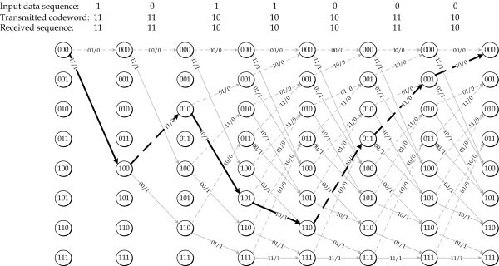
Codec: cc_decoder
class FEC_API cc_decoder : public generic_decoder
Features.
  8-bit fixed-point implementation using 16-way vectorization (Spiral).
  r=1/2, k=7.
  Parameterizable length.
  Parameterizable defining polynomials.
  Supports terminated, streaming, tailbiting, and truncated modes.
Utilizes out-of-tree volk module (volk_fecapi) kernel.
Mechanism for loading new rate/constraint length-specific kernels as added.
Intensions: Make Spiral decoder
immediately useful to GR. Provide
example using all FECAPI aspects.

Slide 7
Other Codecs
Reed-Solomon.
  Karn implementation.
  rs_char version.
  8-bit symbols (255 byte codeword).
  Arbitrary shortening.
LDPC.
  Manu,
  Tracie.

Slide 8
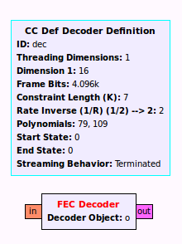
Basic Deployment (Streams)
class FEC_API fec_decoder
gr_block
  Fixed rate decimation.
  History with no zero-fill.
  Requires sprt to interface object.
  Work decodes as many frames as possible.
  Supports destructive (copy)/non-destructive (non-copy) modes.
Oddities.
  Does not inherit from sync_decimator.
  Does not use set_history (output_multiple manipulation).
Intensions: Promote code into GR
without having to (re)implement basic
gnuradio inheritance details.

Slide 9
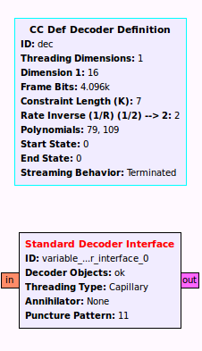
Ordinary Deployment (Streams)
extended_decoder_interface.py
GRC variable: create a list of generic_decoder objects.
Standard Decoder Interface.
  Type conversion based on interface virtual functions.
  Threading via instantiation of fec_decoder blocks (capillary, ordinary).
  Access common utilities.
Intensions: Provide a 90% solution for
threading, type-converting and soft-bit
manipulation.

Slide 10
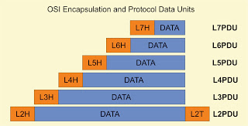
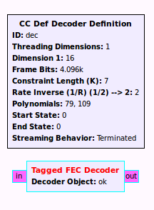
Framed Deployment (Tagged Streams)
class FEC_API tagged_fec_decoder
Localized buffer with max size.
Framesize adjustment.
Intensions: Replicate the basic
deployment for variable-length frames
in tagged_stream format.

Slide 11

Pooled Resource Deployment (Events)
pooled_resource.h, pooled_decoder.h
pooled_resource
  Type-templated lockfree queue.
  Grows upon contention (to stated max).
managed_resource_pool
  Map of pooled_resource objects.
  Map indexed by input to a factory function.
  One pool, different parameterizations of the same resource class.
decoder_pool
  Standard implementation of m.r.p. for generic_decoder.
  Requires static member “make” factory function
  Make maps indices to parameterizations.
pooled_decoder<managed_cc_decoder> cc_dec;
cc_dec.decode(in, out, framesize, VARIANT_0);
Intensions: threadsafe, runtime
configurable resource management
with dynamic growth.

Slide 12
BER Comparison Development Ap

Slide 13
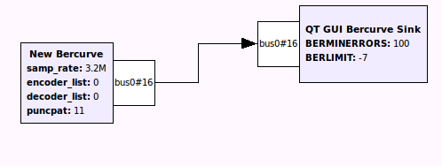
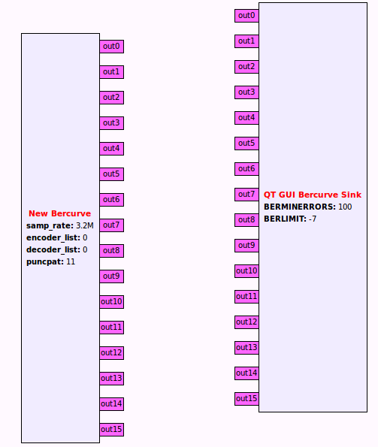
New Feature: Busports
Notionally, busports act as ganged sources or sinks.
A connection between busports represents connection(s) between the underlying ports.

Slide 14
Other Features
fec_corr_bb.
fec_puncture.
fec_reinflate.
fec_interleave.
fec_deinterleave.

Slide 15
Coming Attractions
Tagged stream ordinary deployment.
  Deinterleave.
  Interleave.
Tagged stream/ resource pool deployment.
Rate measurement application.

