Slide 1




Credit Risk Analytics
Analysis of risk for Residential Mortgage and Equity
Group 2: Aditee Bhattarai,
Nam Dang, Zihan Huang, Jingxin Yao

Slide 2
AGENDA
Industry Review
Data-Driven Analysis
Business problem

Slide 3
Industry Review
z

Slide 4
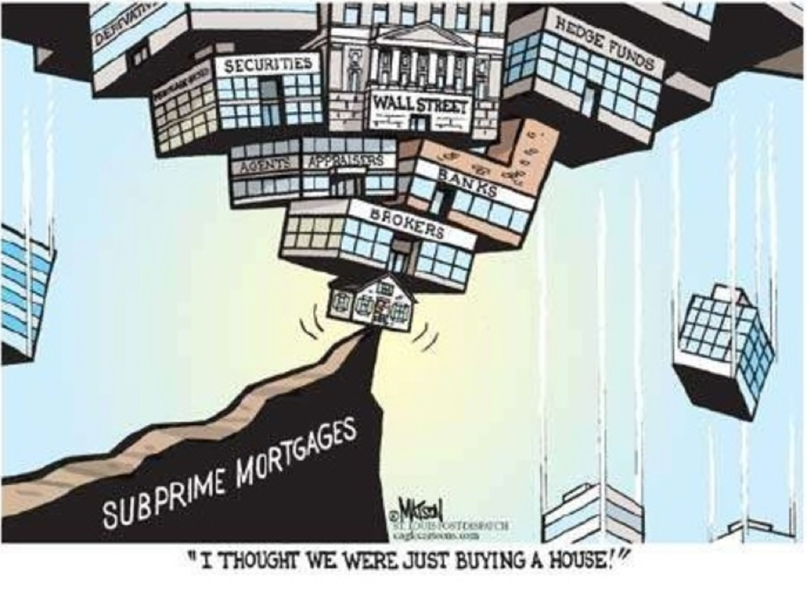
Housing Bubble 2008
The 2008 Housing Bubble Burst (Magdoff & Yates, 2010):
At 2006-2007:
Unemployment rate at 4.4%
Wages rising by 4.2%
Dow Jones index hit all-time high
Real estate market became core of the economy
At 2008 - 2009:
Unemployment rate at 9.5% (actual rate could be at 16.5%)
Housing prices fell by 9.5%
Dow Jones index witnessed largest drop in intraday trading
Source: https://medium.com/@maggiepolk/the-2008-mortgage-crisis-afdec4a92923

Slide 5
Basel Capital Accord
BASEL Standard (Edward et al., 2010): Perceive failings of deregulation & prevent the credit losses
Shift the focus to data mining in credit risk management
3 Key Estimation Parameters for Loan Portfolios
PD: Probability of default in the next 12 months
LGD: Loss given default
EAD: Exposure at default
Main approaches to model LGD
Ordinary Least Squares (OLS) Regression
Two-Stage Approach
Tobit Regression
Censored Gamma Regression
Zero-inflated Gamma Model

Slide 6
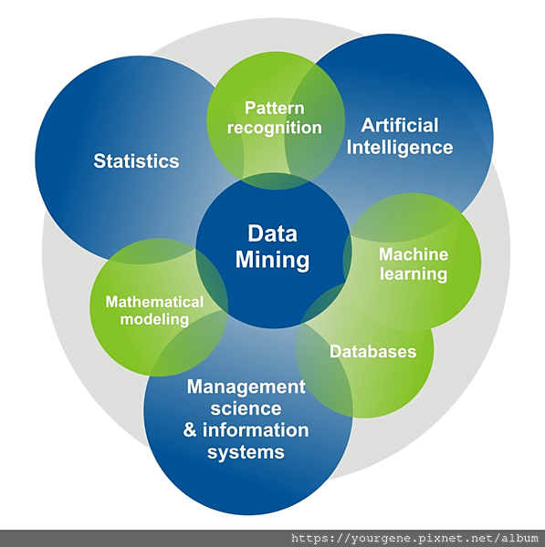
Data mining Techniques
Unsupervised Models
Extract patterns that represent and describe distinct features of the data.
Supervised Models
Use input variables to classify data or predict values for output variables.
Algorisms used in loan default prediction
Classification and Regression Tree (Feldman et al., 2005)
Logistic Regression (Butaru, Chen et al., 2006)
Random Forest (Butaru, Chen et al., 2006)
Neural Network (Atiya, 2001; Bahrammirzaee, 2010 )
Support Vector Machines (Pérez-Martín & Vaca，2018）

Slide 7
Business Problem
z

Slide 8
Business Problem
Analyze two loan datasets using analytics and modelling techniques
Mortgage Dataset
Goal
Understand loan customers
Predict customer creditworthiness
Analytics
Modelling
Home Equity Dataset

Slide 9
Data-Driven Analysis
z

Slide 10

MORTGAGE DATASET
z

Slide 11
Data Description
Original Dataset
622,489 Rows
21 Variables
8,146 Rows
Sample Dataset
27 Variables
Data Aggregation

Slide 12
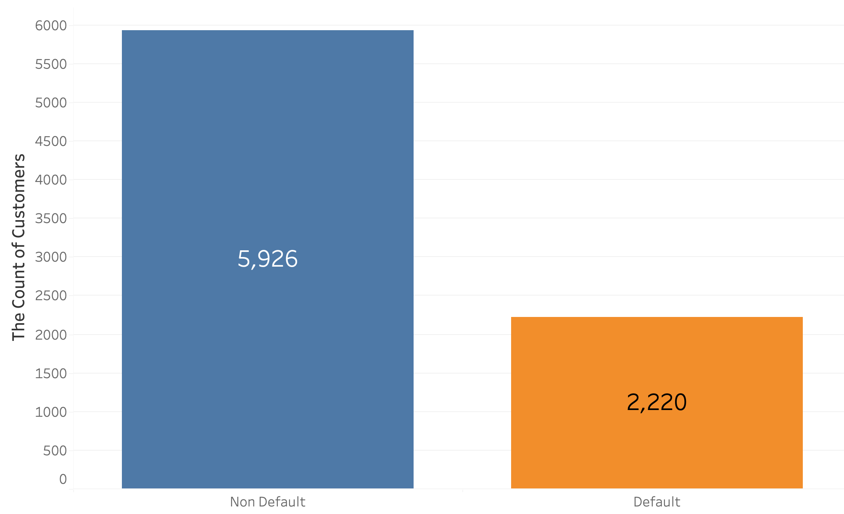
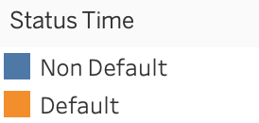
Data Description
5 nominal variables: real estate type, customer identity, mortgage status.
21 numerical variables: Time stamps, and values of mean and standard deviation for Loan-to-value ratio(LTV), GDP, unemployment rate, etc.
Target variable- Mortgage Loan Status
- 0: Non-Default
- 1: Default
The Scale of Mortgage Loan Status

Slide 13
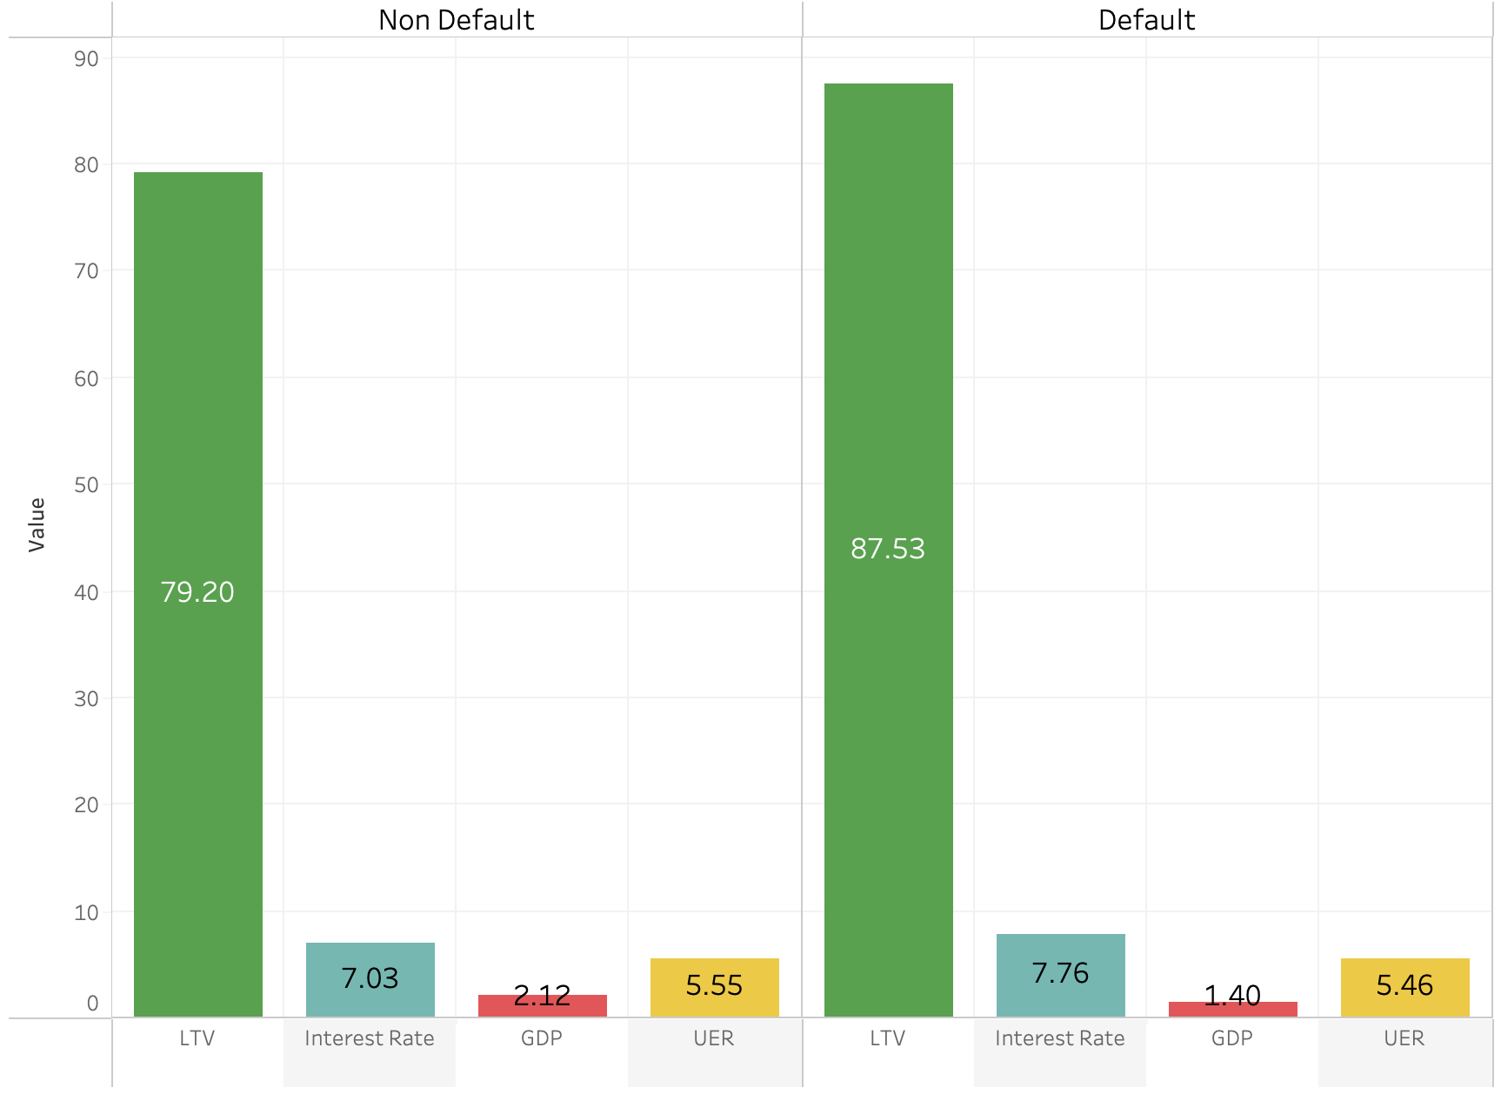
Data Exploration
The Avg. Values of Loan Parameters in Customer Groups
The bar chart shows the difference in average values between customer groups across all measurable parameters for the mortgage loan.
Default customers have higher average values in both LTV and interest rate during the observation duration.

Slide 14
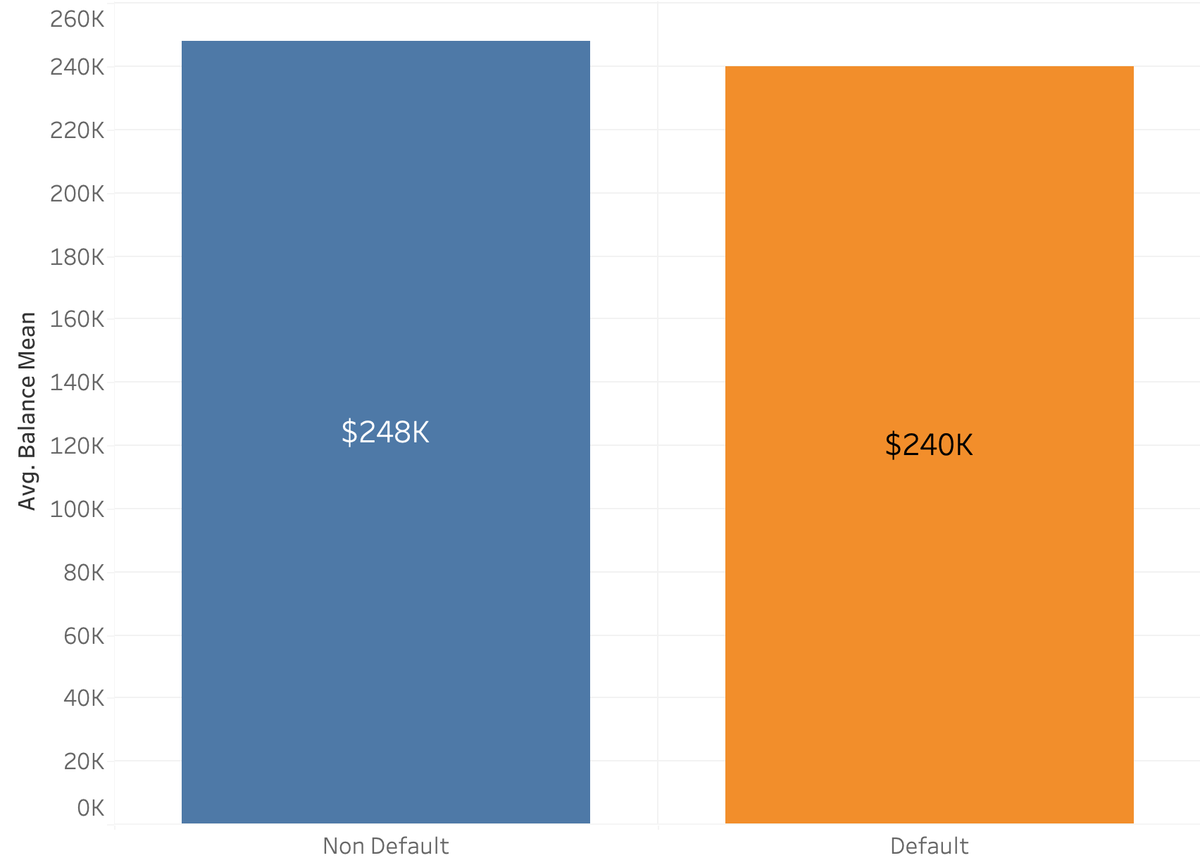
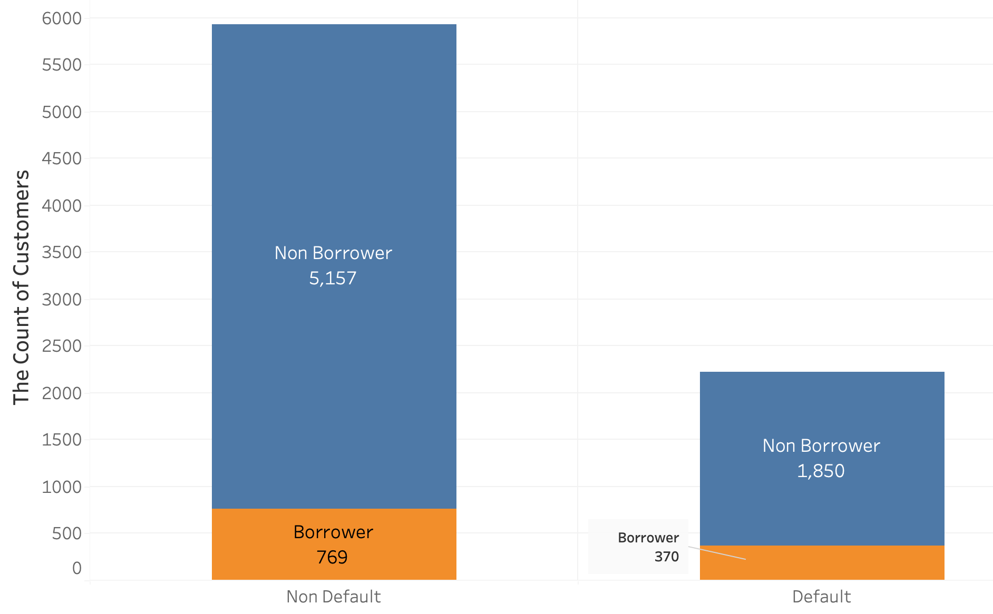
Data Exploration
The Average Outstanding Balance Amount for Customers
The Count of Investors among Customers
Default customers have less outstanding balance amount on average.
Most customers are not borrowers for each group.

Slide 15
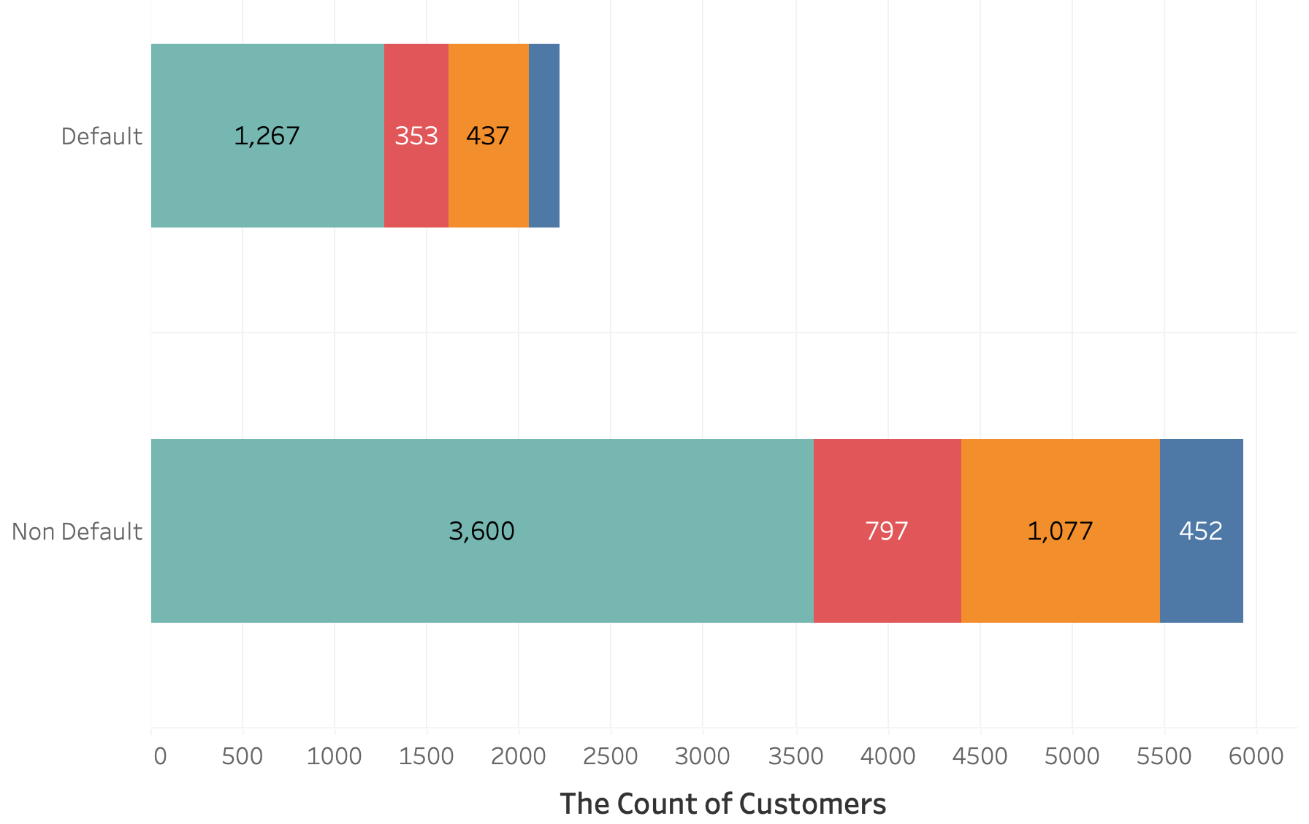
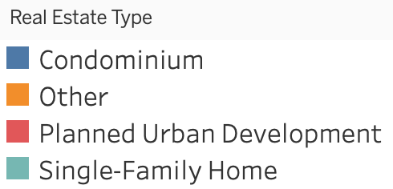
Data Exploration
The Mortgage Loan Status Distribution by Real Estate Type
The distributions of all types of real estate have the same scales in two customer groups.
Single-family home (SF) is the majority among all customers.

Slide 16
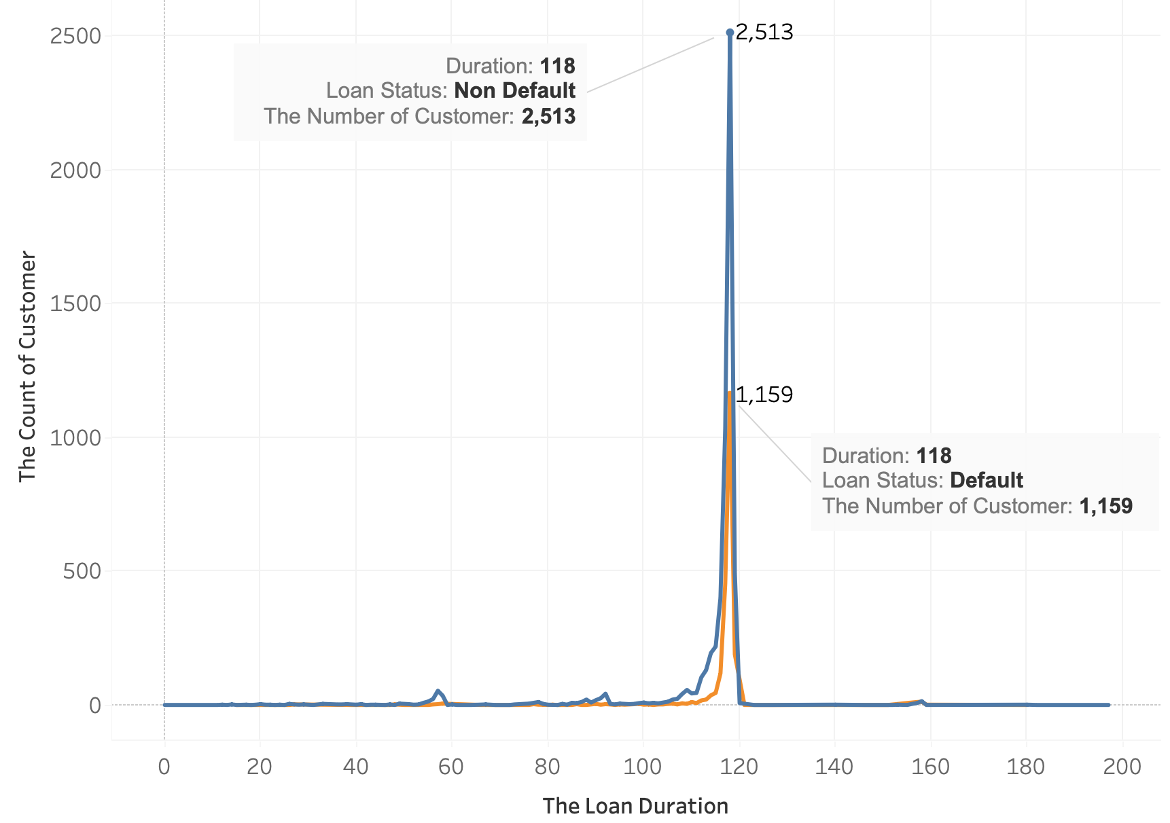
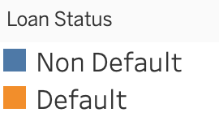
Data Exploration
Observe in the loan duration: Maturity Time - Origin Time
Loan Actions are typically manipulated at the loan duration of 110-120.
The Line Chart of the Relation between Loan Duration and Status

Slide 17
Data Preparation
Dummy variables for real estate type
Recodes value( > 0) as 1
85% for training and 15% for testing
Missing Value
Data Binarization
Data Normalization
Outliers
Data splitting
Class Rescaling
Raw Sample Data
Data Analysis
Sparse Variables
Impute with 0
Makes value between 0 and 1
Remove 8 extremely distributed observations
- Class weighting: 0.689 to Non-Default, 1.824 to Default
- SMOTE: Create artificial data

Slide 18
Model Performance: Overall
Model​ | Training |  | Testing
Parameters​ (Instruction)​ | Accuracy​ | Kappa​ | Accuracy​ | Kappa​
Decision Tree​ | 0.8474 | 0.6552 | 0.7731 | 0.4947
SVM​ | 0.8406 | 0.5767 | 0.8264 | 0.5390
kNN​ | 0.8152 | 0.4906 | 0.7929 | 0.4189
Deep Learning​ | 0.8388 | 0.6776 | 0.8133 | 0.6267
SVM performed better in model accuracy.

Slide 19
Model Performance: Class Level
Model​ | Training |  |  |  |  | Testing
Parameters​ (Instruction)​ | Sensitivity | Specificity | Precision | Recall | F1 Value | Sensitivity | Specificity | Precision | Recall | F1 Value
Decision Tree​ | 0.9020 | 0.8267 | 0.6627 | 0.9020 | 0.7641 | 0.7934 | 0.7655 | 0.6627 | 0.7934 | 0.6567
SVM​ | 0.6233 | 0.9226 | 0.7527 | 0.6233 | 0.6818 | 0.5988 | 0.9121 | 0.7194 | 0.5988 | 0.6536
kNN​ | 0.5252 | 0.9238 | 0.7207 | 0.5252 | 0.6076 | 0.4625 | 0.9155 | 0.6725 | 0.4625 | 0.5480
Deep Learning​ | 0.8078 | 0.8698 | 0.8191 | 0.8698 | 0.8437 | 0.7770 | 0.8497 | 0.7916 | 0.8497 | 0.8196
Deep Learning performed better in correctly predicting mortgage default.

Slide 20
HOME EQUITY DATASET
z

Slide 21
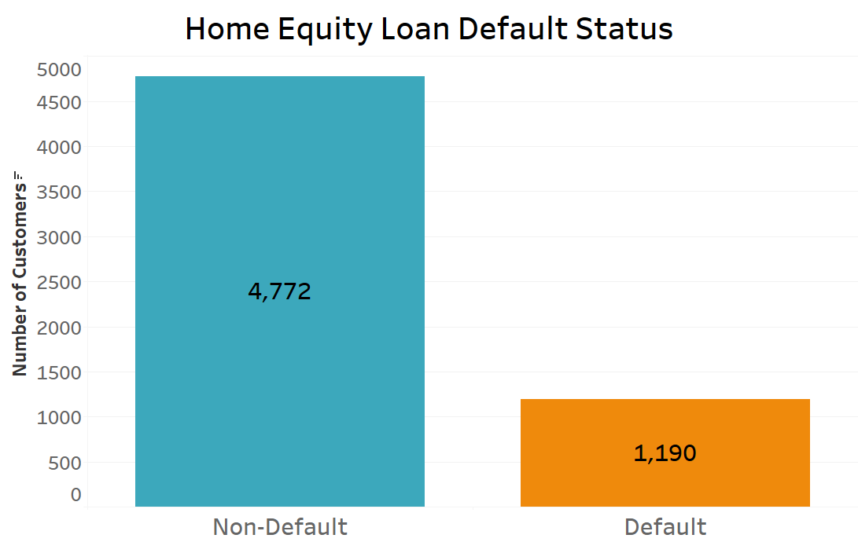
Data Description
Dataset has 5964 rows and 14 columns.
2 categorical variables: Reason for Home Equity and Occupation
10 numerical variables: Including Loan Amount, Mortgage Balance, Home Value, Credit Line Age, Number of Delinquent Credit Line
Target variable: Default 0: No default 1 : Default
Class Imbalance exists in Target Variable

Slide 22
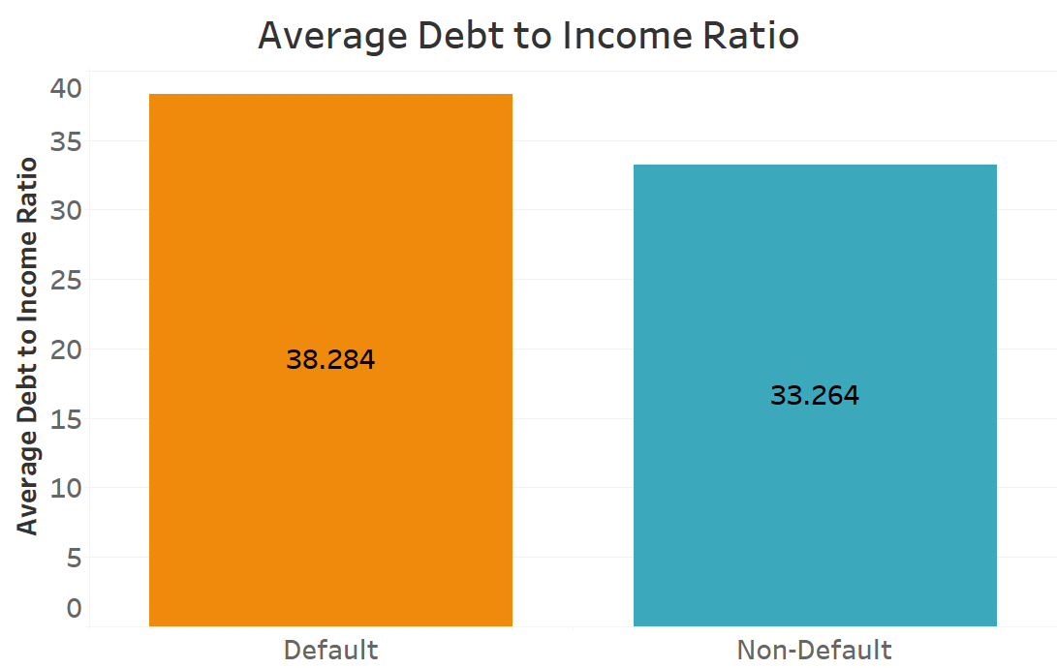
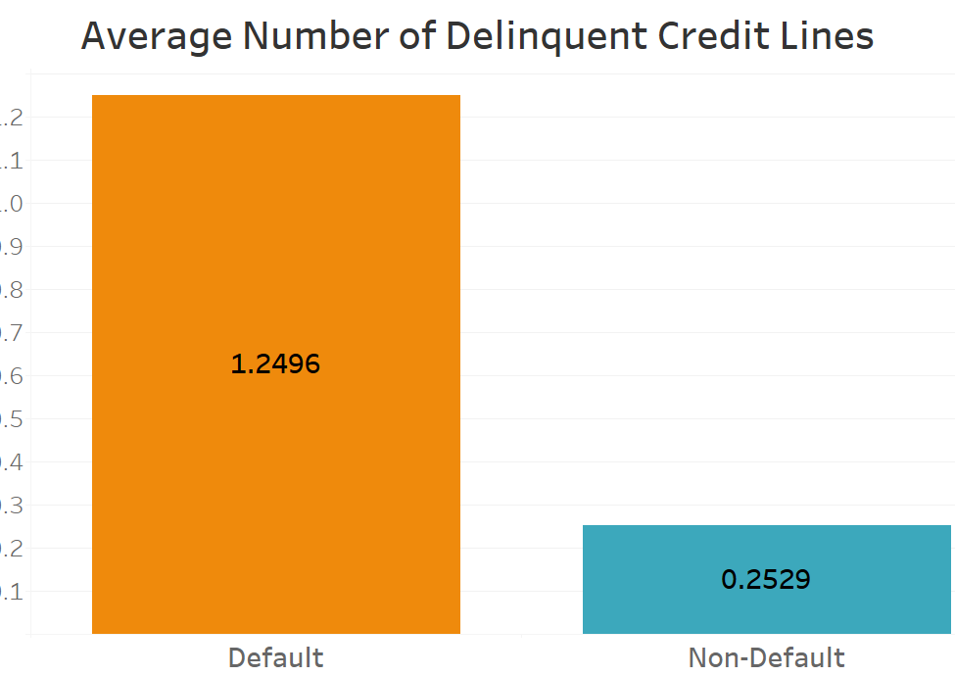
Data Exploration
Debt to income ratio is higher in defaulters.
People with a higher number of delinquent credit lines have a higher rate of default.
People with higher-than-average number of derogatory reports also have higher rate of default.

Slide 23
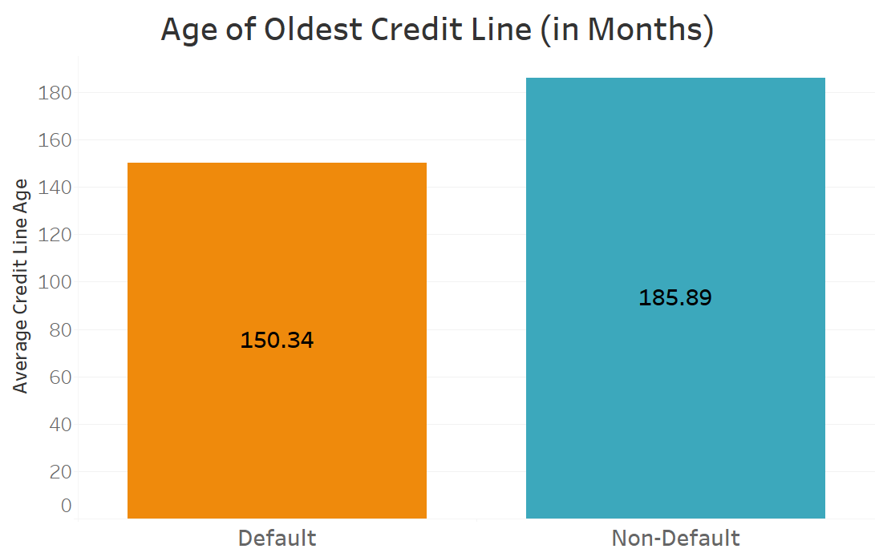
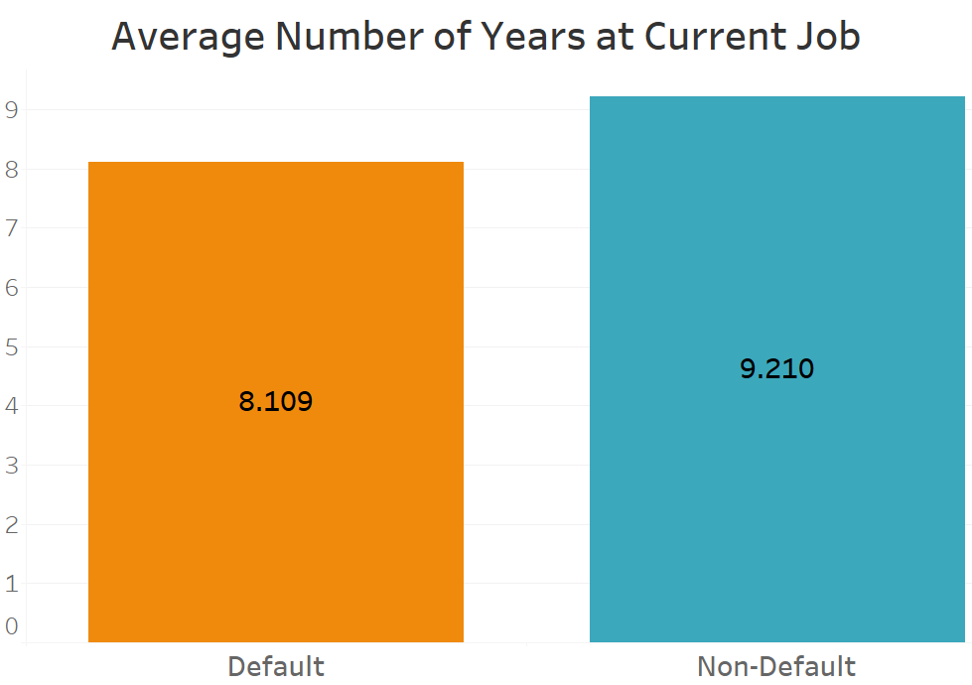
Data Exploration
Credit Line Age is lower among people who default.
Years on current job is lower among people who default.

Slide 24
Data Preparation
Missing Value
Data Binarization
Data Normalization
Outliers
Data splitting
Class Rescaling
Raw Sample Data
Data Analysis
Duplicate Values
Variable Selection
Removed
Dropped irrelevant and redundant variables
Makes value between
0 and 1
80% for training,
20% for testing
Impute
with MICE
Dummy variables for categorical variables
Identified using z-score
Class weighting:
0.625 to Non-Default,
2.505 to Default

Slide 25
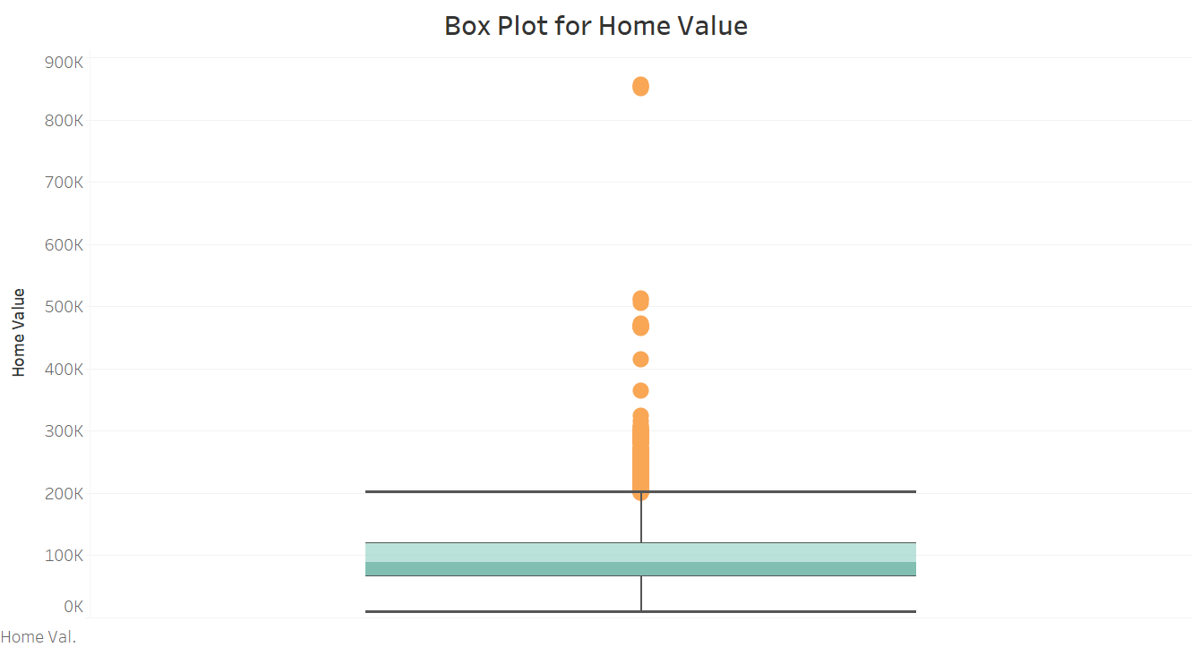
Data Preparation
Outliers
Most numerical variables also have outliers.
Do these outliers make sense?
Should consider models that are robust to outliers for analysis.

Slide 26
Data Preparation
Duplicate values There are 2 duplicate entries within the dataset.
Missing values There are 2620 entries with at least 1 missing value. That is 43% of the entire dataset.
Reasons: Censored Data? Sensitive information?
No non-random pattern in the Missing Values.
Test for missing value at random: T-test to compare the means of cases with missing data versus not missing data on Loan Amount Variable.
Result of the test: MAR – best approach is to use model-based imputation (Hair et al., 2019).

Slide 27
Model Performance: Overall
Model | Training (Tuned) |  | Testing (Tuned)
Parameters (Instruction) | Accuracy | Kappa | Accuracy | Kappa
Decision Tree | 0.783 | 0.566 | 0.793 | 0.416
SVM | 0.93 | 0.79 | 0.89 | 0.67
KNN | 0.829 | 0.224 | 0.865 | 0.469
Naïve Bayes | 0.716 | 0.432 | 0.825 | 0.445
SVM performs better in predicting Home Equity Loan Default.

Slide 28
Model Performance: Class Level
Model | Training |  |  |  |  | Testing
Parameters | Sensitivity | Specificity | Precision | Recall | F1 | Sensitivity | Specificity | Precision | Recall | F1
Decision Tree | 0.72 | 0.845 | 0.823 | 0.720 | 0.768 | 0.623 | 0.836 | 0.486 | 0.623 | 0.546
SVM | 0.99 | 0.91 | 0.73 | 0.99 | 0.84 | 0.81 | 0.91 | 0.68 | 0.81 | 0.74
KNN | 0.157 | 0.997 | 0.933 | 0.157 | 0.269 | 0.387 | 0.984 | 0.862 | 0.387 | 0.534
Naïve Bayes | 0.522 | 0.910 | 0.853 | 0.522 | 0.648 | 0.544 | 0.895 | 0.563 | 0.544 | 0.554
SVM performs better in predicting Home Equity Loan Default.

Slide 29
References
Pérez-Martín*, A. Pérez-Torregrosa, M. Vaca. (2018), Big Data techniques to measure credit banking risk in home equity loans. Journal of business research, 2018, Vol.89, p.448-454 Retrieved from Big Data techniques to measure credit banking risk in home equity loans - ScienceDirect (drexel.edu)
Amadeo, K. (2022). When and why did the stock market crash in 2008? The Balance. Retrieved July 8, 2022, from https://www.thebalance.com/stock-market-crash-of-2008-3305535#:~:text=The%20stock%20market%20crash%20of%202008%20occurred%20on%20September%2029,largest%20point%20drop%20in%20history.
Chad Cowden, Frank J. Fabozzi, and Abdolreza Nazemi. (2019), Default Prediction of Commercial Real Estate Properties Using Machine Learning Techniques. Journal of portfolio management, 2019, Vol.45 (7), p.55-67. Retrieved from Default Prediction of Commercial Real Estate Properties Using Machine Learning Techniques - ProQuest
Christie, L. (2009, February 12). Home prices in Record Plunge. CNNMoney. Retrieved July 8, 2022, from https://money.cnn.com/2009/02/12/real_estate/Latest_median_prices/#:~:text=The%20median%20price%20for%20a,1.6%25%20between%202006%20and%202007
Edward N.C. Tong∗, Christophe Mues & Lyn Thomas (2013). A zero-adjusted gamma model for mortgage loan loss given default, International Journal of Forecasting, 29 (4), 548-562. Retrieved from https://doi.org/10.1016/j.ijforecast.2013.03.003
Emad Azhar Ali, Syed; Sajjad Hussain Rizvi, Syed; Lai, Fong-Woon; Faizan Ali, Rao; Ali Jan, Ahmad (2021), Predicting Delinquency on Mortgage Loans: An Exhaustive Parametric Comparison of Machine Learning Techniques. International Journal of Industrial Engineering and Management, 2021, Vol.12 (Issue 1), p.1-13. Retrieved from Predicting Delinquency on Mortgage Loans: An Exhaustive Parametric Comparison of Machine Learning Techniques - ProQuest (drexel.edu)
Feibelman, A. (2022). BANKRUPTCY AND THE STATE. Emory Bankruptcy Developments Journal, 38(1), 1-50. Retrieved from http://ezproxy2.library.drexel.edu/login?url=https://www.proquest.com/scholarly-journals/bankruptcy-state/docview/2637689114/se-2?accountid=10559
Goolsbee, Austan D., and Alan B. Krueger. 2015. "A Retrospective Look at Rescuing and Restructuring General Motors and Chrysler." Journal of Economic Perspectives, 29 (2): 3-24.DOI: 10.1257/jep.29.2.3
Jackson, J. R., & Kaserman, D. L. (1980). Default risk on home mortgage loans: A test of competing hypotheses: ABSTRACT. Journal of Risk and Insurance (Pre-1986), 47(4), 678. Retrieved from http://ezproxy2.library.drexel.edu/login?url=https://www.proquest.com/scholarly-journals/default-risk-on-home-mortgage-loans-test/docview/235110404/se-2?accountid=10559
Kim, Dong-sup; Shin, Seungwoo, THE ECONOMIC EXPLAINABILITY OF MACHINE LEARNING AND STANDARD ECONOMETRIC MODELS-AN APPLICATION TO THE U.S. MORTGAGE DEFAULT RISK. International journal of strategic property management, 2021, Vol.25 (5), p.396-412. Retrieved from THE ECONOMIC EXPLAINABILITY OF MACHINE LEARNING AND STANDARD ECONOMETRIC MODELS-AN APPLICATION TO THE U.S. MORTGAGE DEFAULT RISK. - Document - Gale Academic OneFile (drexel.edu)
Magdoff, F., & Yates, M. D. (2010). ABCs of the economic crisis: What Working People Need To Know. Aakar Books. Retrieved from https://books.google.com/books?hl=en&lr=&id=LzIVCgAAQBAJ&oi=fnd&pg=PA9&dq=what+happens+after+economic+crisis&ots=Pd0VyZNGJW&sig=hnlfe1t32HVBmMj1hIpiN7UXPVY#v=onepage&q=what%20happens%20after%20economic%20crisis&f=false.
Mitrašević, M., & Bardarova, S. (2020). CAUSES OF NON-PAYMENT OF MORTGAGE LOANS: THEORETICAL AND PRACTICAL ASPECTS. UTMS Journal of Economics, 11(2), 138-150. Retrieved from http://ezproxy2.library.drexel.edu/login?url=https://www.proquest.com/scholarly-journals/causes-non-payment-mortgage-loans-theoretical/docview/2571154652/se-2
Song, G. (2022). Large US bank takeovers in 2008: Performance and implications. Journal of Capital Markets Studies, 6(1), 33-47. https://doi.org/10.1108/JCMS-06-2021-0021
Teng, Huei-Wen; Lee, Michael. (2019), Estimation Procedures of Using Five Alternative Machine Learning Methods for Predicting Credit Card Default. Review of Pacific basin financial markets and policies, 2019, Vol.22 (3), p.1950021. Retrieved from Estimation Procedures of Using Five Alternative Machine Learning Methods fo...: EBSCOhost (drexel.edu)
THE FINANCIAL CRISIS INQUIRY COMMISSION (2011), Final Report of the Causes of the Financial and Economic Crisis in the United States. Retrieved from https://cybercemetery.unt.edu/archive/fcic/20110310173545/http://c0182732.cdn1.cloudfiles.rackspacecloud.com/fcic_final_report_full.pdf

Slide 30
Thank You
Credit Risk Analytics
z
Group 2

