Slide 1
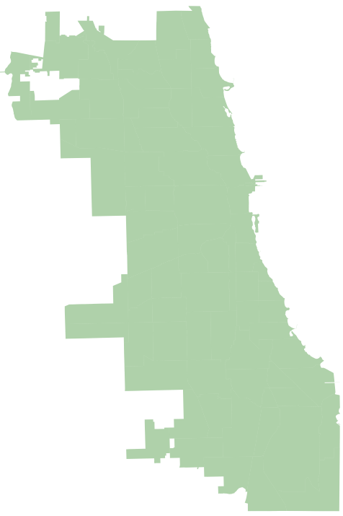

Slide 2
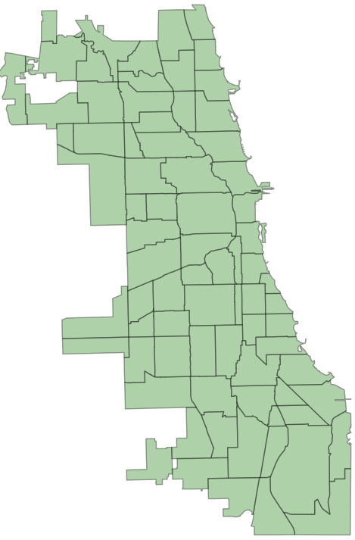
“77” Community Areas

Slide 3
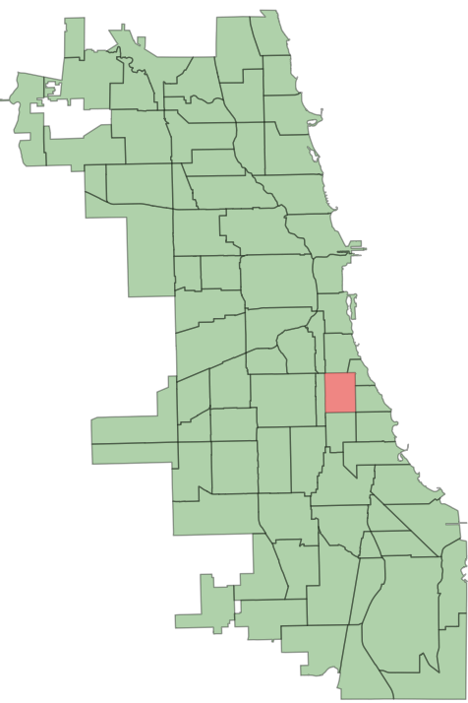

Slide 4

Community Area 1

Slide 5
TIF region
Community Area 1

Slide 6
Census Block Group 1
Census Block Group 2
Census Block Group 3
Census Block Group 4
Census Block Group 5
Census Block Group 6
TIF region
Census Block Group 7
Census Block Group 8
Census Block Group 9
Community Area 1

Slide 7
Census Block Group 1
Census Block Group 2
Census Block Group 3
Census Block Group 4
Census Block Group 5
Census Block Group 6
Census Block Group 5
Census Block Group 6
TIF region
Census Block Group 7
Census Block Group 8
Census Block Group 9
Non-TIF region

Slide 8
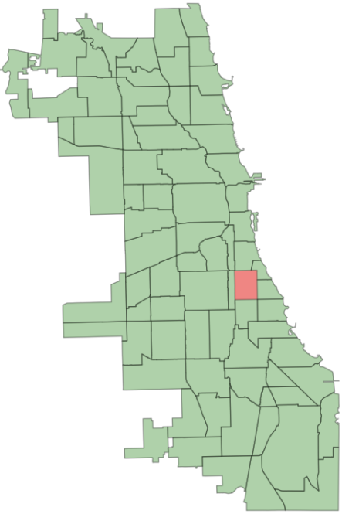
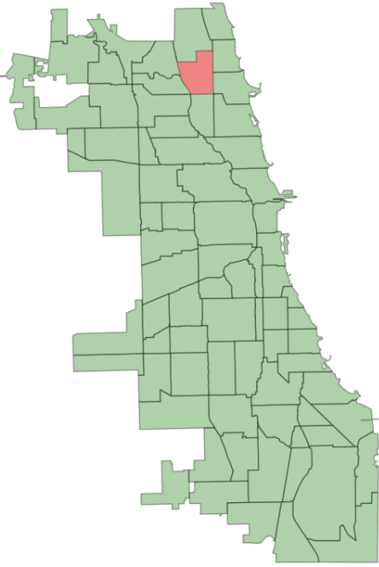
2017
Community | White Population Inside TIF | White Population outside TIF | Black Population Inside TIF | Black Population outside TIF | Latino Population Inside TIF | Latino Population outside TIF
1 | A | A’ | B | B’ | C | C’

Slide 9
2017
Community | White Population Inside TIF | White Population outside TIF | Black Population Inside TIF | Black Population outside TIF | Latino Population Inside TIF | Latino Population outside TIF
1 | A | A’ | B | B’ | C | C’
2 | D | D’ | E | E’ | F | F’

Slide 10
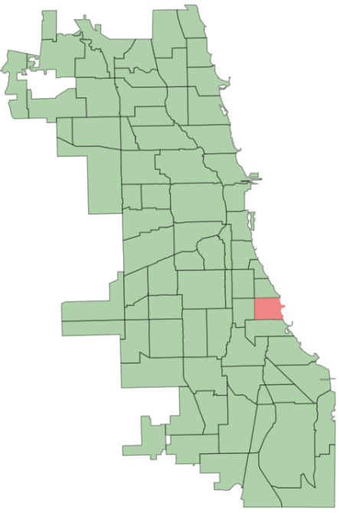
2017
Community | White Population Inside TIF | White Population outside TIF | Black Population Inside TIF | Black Population outside TIF | Latino Population Inside TIF | Latino Population outside TIF
1 | A | A’ | B | B’ | C | C’
2 | D | D’ | E | E’ | F | F’
3 | G | G’ | H | H’ | I | I’

Slide 11
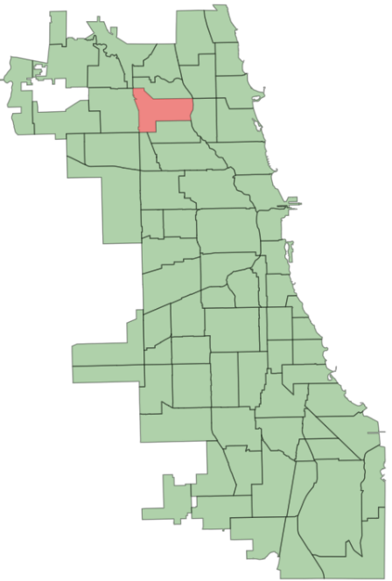
2017
Community | White Population Inside TIF | White Population outside TIF | Black Population Inside TIF | Black Population outside TIF | Latino Population Inside TIF | Latino Population outside TIF
1 | A | A’ | B | B’ | C | C’
2 | D | D’ | E | E’ | F | F’
3 | G | G’ | H | H’ | I | I’
4 | L | L’ | M | M’ | N | N’

Slide 12
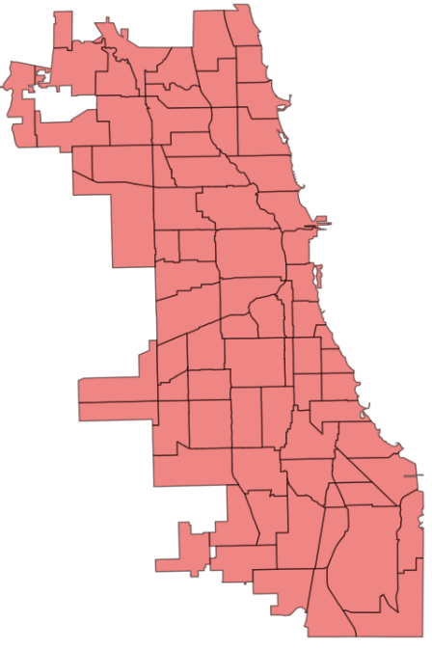
2017
Community | White Population Inside TIF | White Population outside TIF | Black Population Inside TIF | Black Population outside TIF | Latino Population Inside TIF | Latino Population outside TIF
1 | A | A’ | B | B’ | C | C’
2 | D | D’ | E | E’ | F | F’
3 | G | G’ | H | H’ | I | I’
4 | L | L’ | M | M’ | N | N’

Slide 13
2017 ~ 2018
Community | White Population Inside TIF | White Population outside TIF | Black Population Inside TIF | Black Population outside TIF | Latino Population Inside TIF | Latino Population outside TIF
1 | A | A’ | B | B’ | C | C’
2 | D | D’ | E | E’ | F | F’
3 | G | G’ | H | H’ | I | I’
4 | L | L’ | M | M’ | N | N’

Slide 14
2017 ~ 2019
Community | White Population Inside TIF | White Population outside TIF | Black Population Inside TIF | Black Population outside TIF | Latino Population Inside TIF | Latino Population outside TIF
1 | A | A’ | B | B’ | C | C’
2 | D | D’ | E | E’ | F | F’
3 | G | G’ | H | H’ | I | I’
4 | L | L’ | M | M’ | N | N’

Slide 15
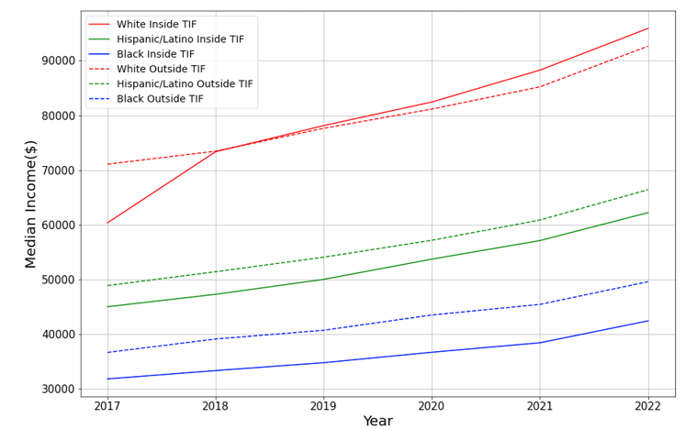
2017 ~ 2022
Community | White Population Inside TIF | White Population outside TIF | Black Population Inside TIF | Black Population outside TIF | Latino Population Inside TIF | Latino Population outside TIF
1 | A | A’ | B | B’ | C | C’
2 | D | D’ | E | E’ | F | F’
3 | G | G’ | H | H’ | I | I’
4 | L | L’ | M | M’ | N | N’
Annual median Income for Chicago for inside/outside TIF

Slide 16
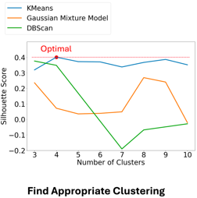

Slide 17
K-means clustering

Slide 18
K-means clustering
C1
C3
C2

Slide 19
C1
C3
C2

Slide 20
C1
C3
C2

Slide 21
C1
C3
C2

Slide 22
C1
C3
C2

Slide 23
C1
C3
C2

Slide 24
C1
C3
C2

Slide 25
C1
C3
C2

Slide 26
C1
C3
C2

Slide 27
Until the position of clusters no longer change
C1
C3
C2

