Slide 1

SOFTWARE TESTING SEMINAR • GROUP T02
Web Automation
Testing
End-to-end testing at speed—
and the AI promised land under human control
Theory • tool survey • Playwright API mocking • EShop pilot • 25-minute activity
CS423 / CSC15003
Notes:
Welcome the class and frame the session as a progression: define trustworthy automation, compare tool categories, examine network-level test doubles, and finish with a measurable EShop pilot. Emphasize that AI accelerates drafting but does not become the test oracle.
[Sources]
- C:\Users\Nam\.codex\attachments\3ffc3a06-0f9b-4927-8423-bddb6ed575b2\pasted-text.txt
- C:\Code\SoftwareTesting\ST-Group\Seminar\Final\Report.md
- Generated cover asset: .codex-tmp\deck-build\assets\web-automation-hero.png

Slide 2
WELCOME
One story, three workstreams, six beats
TEAM T02
SEMINAR FLOW
01
Seminar lead
Automation theory Narrative & slide design
01
Automation foundations & quality
02
Traditional vs. AI-augmented tools
02
Automation engineering
Playwright setup E2E flows & API mocking
03
Test doubles & API mocking
04
EShop pilot and flakiness metrics
03
AI research & activity
Tool survey Locator Brawl design
05
Locator Brawl activity
06
Recommendation and approval
T02 • WEB AUTOMATION TESTING
02
Notes:
Introduce the team by workstream if member names are not being shown. The agenda is intentionally cumulative: the theory defines the evaluation criteria, the criteria drive the tool selection, and the selection is validated through a pilot rather than by opinion.
[Sources]
- C:\Users\Nam\.codex\attachments\3ffc3a06-0f9b-4927-8423-bddb6ed575b2\pasted-text.txt
- C:\Code\SoftwareTesting\ST-Group\Seminar\Final\Report.md

Slide 3
WHY AUTOMATE
Modern web apps turn timing and state into the real test problem
01
02
03
Dynamic UI
Asynchronous state
Continuous delivery
SPAs re-render without full page loads. Deep DOM trees and changing component structure make selectors fragile.
AJAX and Fetch update the interface on their own schedule. Race conditions punish hard-coded waits.
Regression must cover browsers and releases repeatedly. Manual-only execution becomes a pipeline bottleneck.
Automation earns its place when the work is repeatable, the expected result is clear, and feedback must arrive faster than a human regression cycle.
T02 • WEB AUTOMATION TESTING
03
Notes:
Connect each technical characteristic to a testing consequence. The goal is not to claim that manual testing is obsolete; it is to show why repeatable regression and cross-browser checks need automation while exploratory and usability work still need people.
[Sources]
- C:\Code\SoftwareTesting\ST-Group\Seminar\Final\Report.md, sections 1.1 and 1.5
- https://www.istqb.org/specifications/certified-tester-foundation-level-syllabus/

Slide 4
FOUNDATIONS
Automation is a lifecycle - not a pile of scripts
DECIDE
BUILD
OPERATE
Feasibility
Tool selection
Architecture
Implementation
Execution
Analysis
Maintenance
Choose valuable cases and evaluate fit before writing code.
Design fixtures, data, locators, assertions, and reusable structure.
Run, diagnose, improve, and remove flakiness as the SUT changes.
A test that passes today but cannot be diagnosed or maintained is unfinished automation.
T02 • WEB AUTOMATION TESTING
04
Notes:
Walk through the seven lifecycle steps grouped into three phases. Stress that result analysis and maintenance are first-class activities; the lifecycle continues after the initial test turns green.
[Sources]
- C:\Code\SoftwareTesting\ST-Group\Seminar\Final\Report.md, section 1.2
- https://www.istqb.org/wp-content/uploads/2024/11/ISTQB_CTAL-TAE_Syllabus_v2.0.pdf

Slide 5
EVALUATION MODEL
A credible solution must satisfy R1-R10 - and four quality outcomes
CORE CAPABILITIES
QUALITY OUTCOMES
R1–R3
Execution, resilient locators, synchronization
01
Correctness
Tests the requirement, not just the screen.
R4–R6
Assertions, isolated data, reusable structure
02
Reliability
Produces stable results under the same conditions.
R7–R9
Cross-browser/parallel, evidence, CI/CD
03
Maintainability
Survives UI change without widespread rewrites.
R10
AI assistance that remains auditable
04
Diagnosability
Leaves traceable evidence when it fails.
Guard against brittle locators, weak oracles, polluted data, false positives, self-healing errors, and AI hallucination.
T02 • WEB AUTOMATION TESTING
05
Notes:
Explain that R1–R9 describe the execution platform, while R10 describes an assistance layer. The four outcomes are the lens for judging whether the capability is trustworthy in practice.
[Sources]
- C:\Code\SoftwareTesting\ST-Group\Seminar\Final\Report.md, sections 1.3–1.5

Slide 6
TOOL SURVEY
Three tool families serve different jobs
CODE-FIRST FRAMEWORKS
AI CODING ASSISTANTS
AI-NATIVE / LOW-CODE
Playwright
Cypress
Selenium 4
GitHub Copilot
OpenAI Codex
Antigravity
Testim • mabl
Virtuoso QA • ACCELQ
Maximum control over execution, data, assertions, and CI. Best for exposing the mechanics students need to learn.
Draft or refactor test code and suggest locators. They still require a framework, a test oracle, and human review.
Cloud-managed authoring, smart locators, and self-healing. Strong breadth, but reproducibility depends on licence and account access.
Selection context: EShop fit • student learning curve • local reproducibility • 25-minute activity • licence constraints
T02 • WEB AUTOMATION TESTING
06
Notes:
Keep the categories distinct. A coding assistant may produce Playwright code, but it does not provide browser control, assertions, reports, or CI on its own. AI-native platforms bundle more features, but introduce practical access constraints for a classroom.
[Sources]
- C:\Code\SoftwareTesting\ST-Group\Seminar\Final\Report.md, sections 2 and 3
- https://playwright.dev/
- https://docs.cypress.io/app/core-concepts/best-practices
- https://www.selenium.dev/documentation/grid/

Slide 7
CAPABILITY MAPPING
AI assists; frameworks execute
Tool | Execution | Locator & sync | Assertion | Data & structure | Cross-browser | Report & CI | AI
Playwright | ● | ● | ● | ● | ● | ● | ◐
Cypress | ● | ● | ● | ● | ◐ | ● | ◐
Selenium 4 | ● | ◐ | ◐ | ◐ | ● | ◐ | —
Testim / mabl | ● | ● | ● | ● | ● | ● | ●
Copilot / Codex | — | △ | △ | △ | — | △ | ●
● native / primary ◐ partial or configured △ indirect assistance — not a function
Copilot can help write a test. Playwright executes, waits, asserts, records evidence, and integrates with CI.
T02 • WEB AUTOMATION TESTING
07
Notes:
Read the matrix horizontally. The AI-native tools cover many cells in one product, while Playwright covers the runtime core transparently. Copilot and Codex score highly only in the assistance column because they are not test runners.
[Sources]
- C:\Code\SoftwareTesting\ST-Group\Seminar\Final\Report.md, section 4.2
- https://playwright.dev/
- https://docs.github.com/en/copilot/using-github-copilot/guides-on-using-github-copilot/writing-tests-with-github-copilot

Slide 8
SELECTED DIRECTION
Playwright + Copilot keeps the mechanism visible
SELECTED STACK
AI assistant • draft & refactor
Primary framework
Playwright — native multi-browser execution, auto-wait, fixtures, reports, and trace.
AI assistance
GitHub Copilot — drafts and reviews code inside the developer workflow.
Backups
Cypress for code-first comparison; Testim or mabl if licence access allows.
Human audit • oracle • locators
Playwright • POM • fixtures • trace
EShop + APIs • real / mocked
The framework owns execution. Humans own expected results. AI supports the work between them.
T02 • WEB AUTOMATION TESTING
08
Notes:
Present the separation of responsibilities. Copilot accelerates the draft; the team audits the locator, wait strategy, assertion, and assumptions; Playwright executes and collects evidence; EShop remains the SUT.
[Sources]
- C:\Code\SoftwareTesting\ST-Group\Seminar\Final\Report.md, section 5
- https://playwright.dev/
- https://docs.github.com/en/copilot/responsible-use/code-review

Slide 9
DEEP DIVE
Test doubles trade realism for isolation—deliberately
Type | Returns data | Records calls | Verifies behavior | Best use
Dummy | No | No | No | Fill an irrelevant required parameter
Stub | Prepared | No | No | Supply deterministic responses
Fake | Working shortcut | No | No | Replace a heavy service or database
Spy | Optional | Yes | No | Inspect arguments and invocation history
Mock | Optional | Yes | Yes | Verify expected collaboration
UNIT TESTING
WEB AUTOMATION
Replace objects or functions inside the language runtime.
Intercept protocols or data stores while the browser runs the UI.
T02 • WEB AUTOMATION TESTING
09
Notes:
Clarify the vocabulary: a mock is not a synonym for every test double. In the seminar, the practical emphasis is the stub-like behavior of route.fulfill and the error simulation enabled by route.abort.
[Sources]
- C:\Code\SoftwareTesting\ST-Group\Seminar\Final\Report.md, section 1.6
- https://martinfowler.com/articles/mocksArentStubs.html
- https://xunitpatterns.com/

Slide 10
API MOCKING
Playwright intercepts at the browser boundary
TYPESCRIPT
await page.route(
'**/api/products',
async (route) => {
await route.fulfill({
status: 200,
contentType:
'application/json',
body: JSON.stringify(
mockProducts
)
});
}
);
Browser
EShop frontend
Playwright route
interceptor
Backend API
bypassed
Mock response
200 OK + JSON
page.route() • route.fulfill() • route.continue() • route.abort()
T02 • WEB AUTOMATION TESTING
10
Notes:
Explain the request lifecycle from left to right. The interceptor pauses a matching request and chooses whether to fulfill, continue, or abort it. This supports deterministic UI states and hard-to-trigger error cases, but does not verify the real backend integration.
[Sources]
- C:\Code\SoftwareTesting\ST-Group\Seminar\Final\Report.md, sections 1.6.7–1.6.10
- https://playwright.dev/docs/network

Slide 11
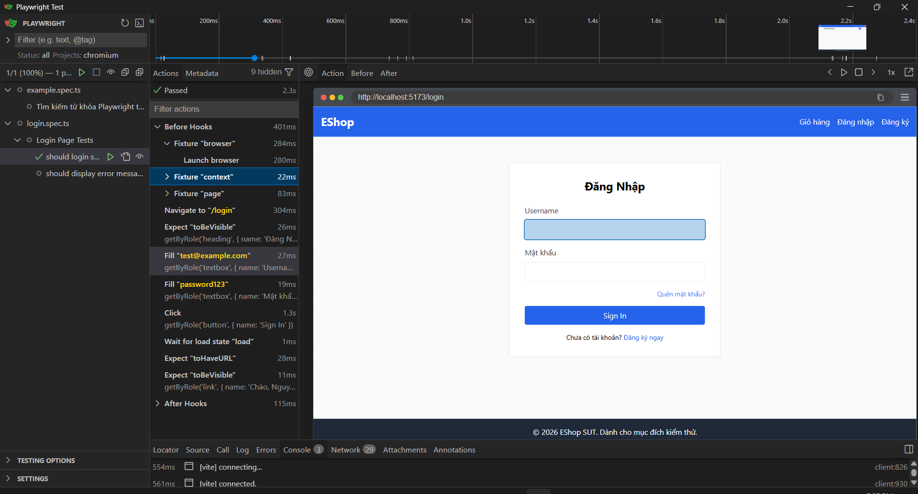
PRACTICAL DEMO
The EShop pilot targets three business-critical flows
FR-02
Login & account lockout
Authentication success, invalid input, and temporary lock behavior.
FR-07
Add to cart
Cart state, quantity rules, duplicate items, and removal.
FR-08
Checkout & coupon
Access control, discount rules, and payment confirmation.
Existing evidence: a passed Playwright trace for the EShop login flow. One run is evidence of execution—not proof of long-run stability.
T02 • WEB AUTOMATION TESTING
11
Notes:
Use the screenshot as evidence that the team has executed an EShop login flow in Playwright. Do not generalize the visible 2.3-second trace into a benchmark. Introduce the three flow families that the pilot will compare and measure.
[Sources]
- C:\Code\SoftwareTesting\ST-Group\Seminar\Report_05\api_mocking.png
- C:\Code\SoftwareTesting\ST-Group\Seminar\Final\scripts\login.spec.ts
- C:\Code\SoftwareTesting\ST-Group\Seminar\Final\scripts\add-to-cart.spec.ts
- C:\Code\SoftwareTesting\ST-Group\Seminar\Final\scripts\checkout.spec.ts
- https://playwright.dev/docs/trace-viewer-intro

Slide 12
PILOT PROTOCOL
Measure the pilot before claiming speed or stability
STATUS: measurement plan — no synthetic execution times or flakiness rates are presented as results.
Metric | How to measure | Decision signal
Functional correctness | Check the required business state | Assertion matches the requirement
Repeatability | Run the same flow 10 times | Stable pass rate under fixed conditions
Flakiness | Count failures not caused by SUT defects | Lower unexplained failure rate
Locator quality | Apply a small DOM change | Fewer selectors require repair
Debuggability | Inspect report, screenshot, and trace | Root cause can be identified quickly
AI effort | Log draft time and human corrections | Acceleration without weakened checks
Compare the same Login → Add to Cart → Assert cart state flow across: manual Playwright • AI-assisted Playwright • one backup tool if feasible.
T02 • WEB AUTOMATION TESTING
12
Notes:
This slide resolves the tension between the draft brief and the report. The report explicitly requires measured evidence and forbids AI-generated metrics. The comparison should use the same scenario, data, environment, and run count.
[Sources]
- C:\Code\SoftwareTesting\ST-Group\Seminar\Final\Report.md, sections 6 and 7

Slide 13
IN-CLASS ACTIVITY
Locator Brawl exposes what AI-generated code gets wrong
00–03
03–15
15–25
Launch the target
Build and stress
Review the evidence
Moderator demonstrates Login → Add to Cart → Assert badge count.
Team A uses role/test-id. Team B uses AI suggestions. Run each script three times on Slow 3G.
Compare breakage, waits, assertions, and agree on a Good Locator Rubric.
BRITTLE
RESILIENT
div.card > div:nth-child(2) > button.btn-primary
page.getByRole('button', { name: 'Add' })
T02 • WEB AUTOMATION TESTING
13
Notes:
The activity is not a speed contest. The class should evaluate locator intent, synchronization, assertion quality, and the evidence available after failure. Close by writing a rubric that prioritizes role, label, test-id, and business-state assertions.
[Sources]
- C:\Users\Nam\.codex\attachments\3ffc3a06-0f9b-4927-8423-bddb6ed575b2\pasted-text.txt
- C:\Code\SoftwareTesting\ST-Group\Seminar\Final\Report.md, sections 1.5 and 6
- https://playwright.dev/docs/locators

Slide 14
RECOMMENDATION
Use Playwright; keep AI on a short leash
Playwright
+ resilient locators
+ selective API mocking
AI-assisted testing audit
✓
Human defines preconditions, data, and expected result
✓
AI produces a draft—not an execution result
✓
Human audits locators, waits, assertions, and assumptions
This is the best fit for the EShop seminar constraints—not a universal “best tool” claim.
✓
Run on EShop; save code, trace, metrics, and corrections
Portfolio principle: fast mocked UI checks for controlled states + a small real E2E smoke suite for integration confidence.
T02 • WEB AUTOMATION TESTING
14
Notes:
State the recommendation with its scope. Playwright is selected because it covers the seminar’s technical criteria, is reproducible locally, and exposes the mechanisms students need to understand. Retain real end-to-end smoke tests because fully mocked UI tests cannot verify integration.
[Sources]
- C:\Code\SoftwareTesting\ST-Group\Seminar\Final\Report.md, sections 5, 7, and 8
- https://playwright.dev/
- https://docs.github.com/en/copilot/responsible-use/code-review

Slide 15
Q&A
What should we trust,
automate, and measure?
TRUST
AUTOMATE
MEASURE
Evidence and business-state assertions
Repeatable flows with clear oracles
Stability, maintainability, and human correction
Group T02 • Software Testing Seminar
Notes:
Invite questions by returning to the three decisions the seminar is designed to support: which results deserve trust, which checks are good automation candidates, and which metrics should be collected before making performance or reliability claims.
[Sources]
- C:\Code\SoftwareTesting\ST-Group\Seminar\Final\Report.md
- https://www.istqb.org/wp-content/uploads/2024/11/ISTQB_CTAL-TAE_Syllabus_v2.0.pdf
- https://martinfowler.com/articles/mocksArentStubs.html
- https://xunitpatterns.com/
- https://playwright.dev/docs/network
- https://playwright.dev/docs/locators

