Slide 1

FPT UNIVERSITY
FPT POLYTECHNIC COLLEGE
Department of English
Topic: ART
Student’s name:Đỗ Thành Nam – PS04995
Student’sname:Nguyễn Xuân Quang - PS04973
Instructor:Nguyễn Thị Thùy Nhiên
Class:EN12202_1

Slide 2
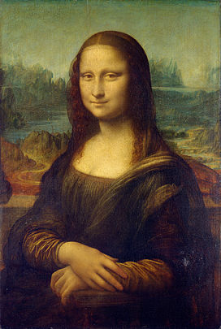
INTRODUCTION
‣‣ The Mona Lisa is a portrait painting by the Italian Renaissance artist Leonardo Da Vinci
‣‣ Leonardo may have continued working on it as late as 1517
‣‣ Permanent display at the Louvre Museum in Paris since 1797.
Mona Lisa

Slide 3
OUTLINE
STORY
MEANING
VALUE
CONCLUSISON

Slide 4
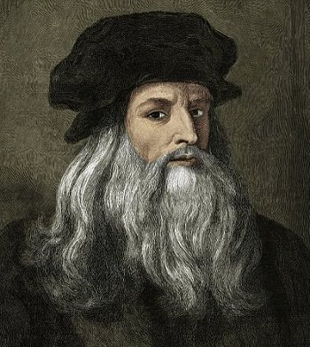
STORY
‣‣ The Mona Lisa was painted between 1504 and 1519,and is a half body for a woman named Lisa Gherardini.
‣‣ The Mona Lisa is famous for a variety of reasons.
Leonardo da Vinci

Slide 5
MEANING
‣‣ The painting was painted with oil on a piece of poplar wood. It's the image of a 24 year old girl named Mona Lisa.
‣‣ The name comes from a description by Giorgio Vasari in his da Vinci biography published in 1550, 31 years after the artist's death.

Slide 6
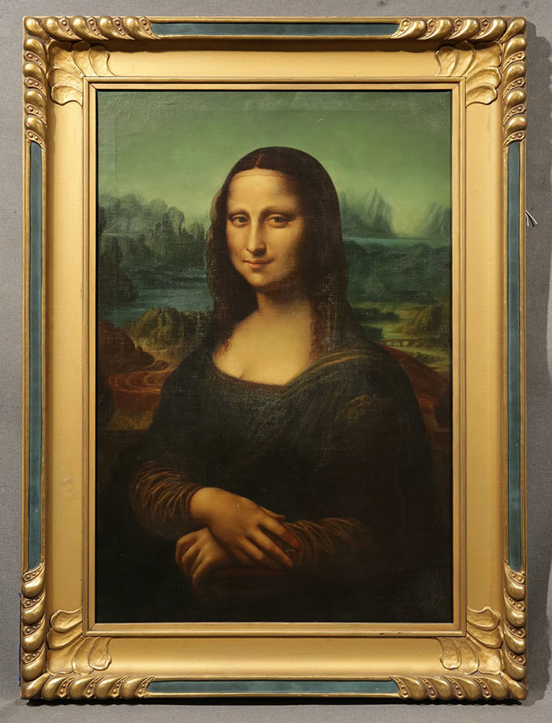
VALUE
‣‣ 300 paintings and 2,000 advertisements.
‣‣ The painting is the most widely recognized work of art in the entire world.

Slide 7
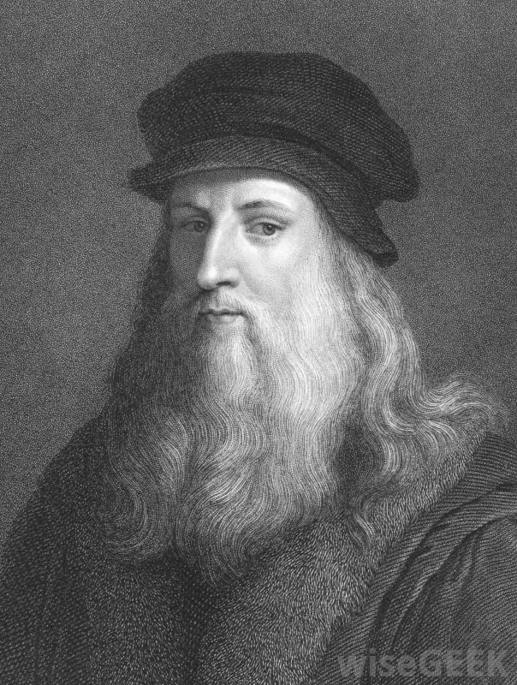
CONCLUSISON
‣‣ Mona Lisa is a testimony to the talented, intellectual.
‣‣ Aesthetic eyes of a talented painter.

Slide 8

THANKS FOR WATCHING

