Slide 1


CEMS -the Ultimate Tool for Emission Regulation
Central Pollution Control Board

Slide 2
Outline of presentation
CEMS – Definition
Benefits of CEMS
Components of CEMS
Methods and Options for Source emission monitoring
Location of installation of CEMS
In-situ CEMS
Extractive CEMS PM CEMS Technology Selection Matrix
PM CEMS Calibration issues
CEMS Options for Gaseous pollutants
Available International quality certification of CEMS
Minimum Quality Control Requirement
Options for continuous Velocity measurement technologies
Parameter-wise Regulatory requirement of CEMS in 17 categories of industries and HWI
Proposed steps in implementation of CEMS in regulatory framework

Slide 3
CEMS (Continuous Emissions Monitoring System)
The system composed of Equipment, Instrument to draw, condition, analyze the flue gas sample and provide permanent record of emissions or process control parameters continuously at real time basis is called Continuous Emissions Monitoring System (CEMS)

Slide 4
Benefits of CEMS
Provides real time data.
Remotely accessible to operator/regulator.
Greater transparency in monitoring of performance.
Continuous performance check of Air Pollution Control Devices and optimization of resources used.
Time series analysis possible with continuous data.
Reduction in regulatory cost as well as long term monitoring cost.
Expected better compliance through self regulation by industry hence lower emission.
Primary requirement for participation in market driven pollution control venture (ETS)

Slide 5
COMPONENTS OF A CEMS
Sample Collection — sampling device
Interface – Sample conditioning & transportation wherever required
Analyzer — Specific to pollutants, generates an output signal proportional to the concentration
Calibration devices – Analyzer control system, calibration gases, recording etc
Data Acquisition – Data logging system record electrical signals in defined number of channels
Data Handling System— Pick, calculate, record, transfer the data in report form to desired destination
Additionally Flow Rate Monitor (where applicable)—Senses flue gas velocity, used to determine the mass emissions rate of the pollutant

Slide 6
Methods & Options for Source Emission Monitoring
Stack Emission Monitoring
CEMS
Portable / Reference Methods
Predictive
EMS
Extractive
In-situ
Dilution
Hot Wet
Cold Dry
PD
In Stack
Out of Stack
Point Type
Cross Stack
Automatic
Manual

Slide 7
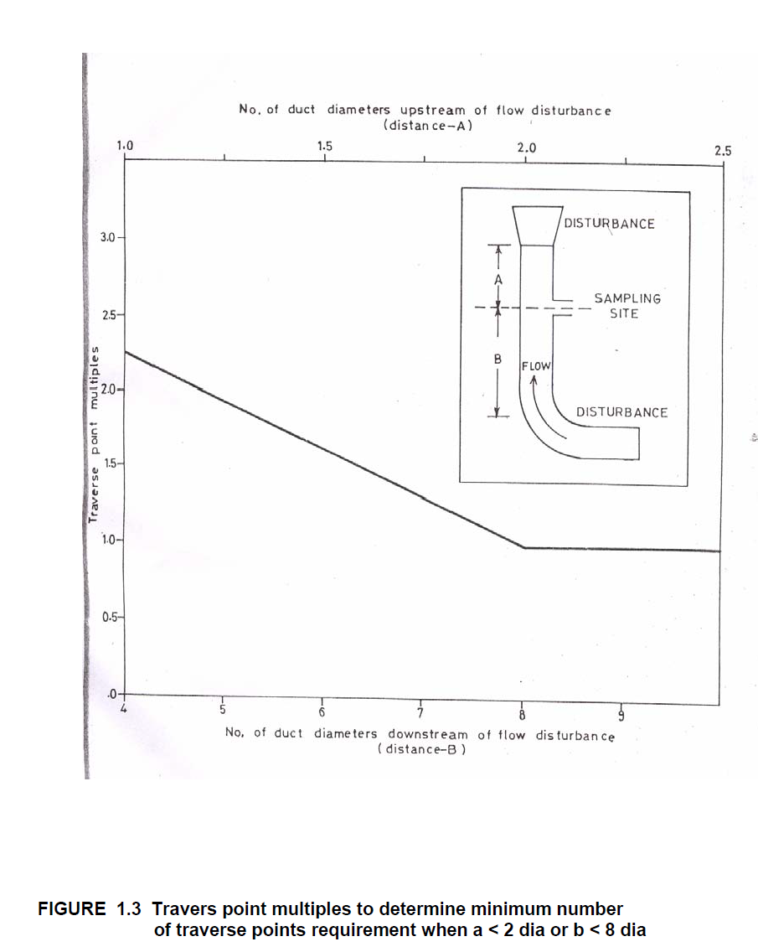
Location of Installation for CEMS
Firstly The location satisfies the minimum siting criteria of Emission Regulation Part III (i.e., the location is greater than or equal to eight stack duct diameters downstream and two diameters upstream from a flow disturbance

Slide 8
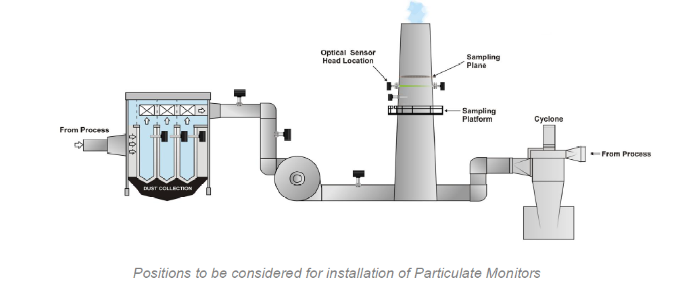
Secondly It should be at the plane 500 mm above the Isokinetic testing Port, so, that the reference monitoring methods are not disturbed
The installation should have logistic support like easy approach for calibration, maintenance etc.

Slide 9
In-situ CEMS

Slide 10
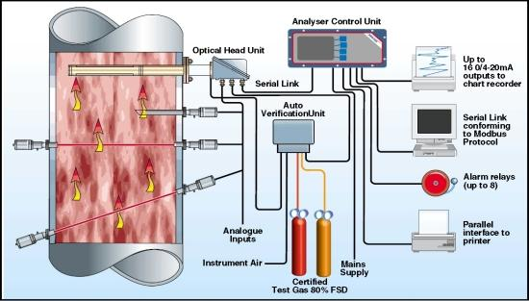
SCHEMATIC CEMS MONITORING MODULE
Sampling / in-situ analyzer Segment
Transfer Interface
Analyzer
Data acquisition & Handling

Slide 11
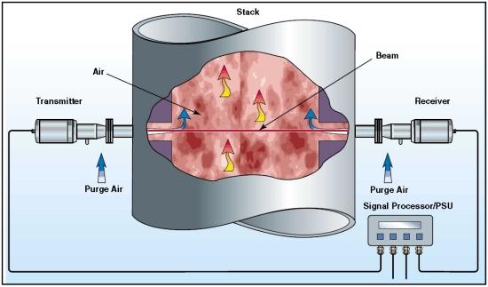
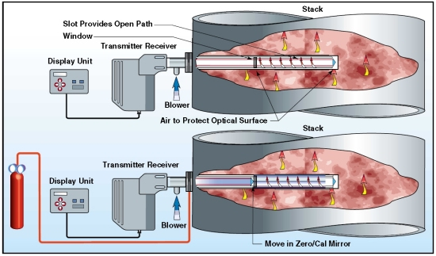
Available Technologies for Non Extractive CEMS for gas and PM
I. In-situ Cross Duct/Stack
Gas is being measured passing by a specific ‘line of sight’ of the monitor, typically ranging from a few feet, to the full distance across the interior diameter of the stack/ duct
e.g. Opacity, DOAS, FTIR, Optical Scintllation, Light Scattering etc.
In-situ Probe Type
Gas is being measured at one specific point or along a short path in the stack or duct
e.g, Probe Electrification (DC and AC triboelectric)

Slide 12
Extractive CEMS

Slide 13
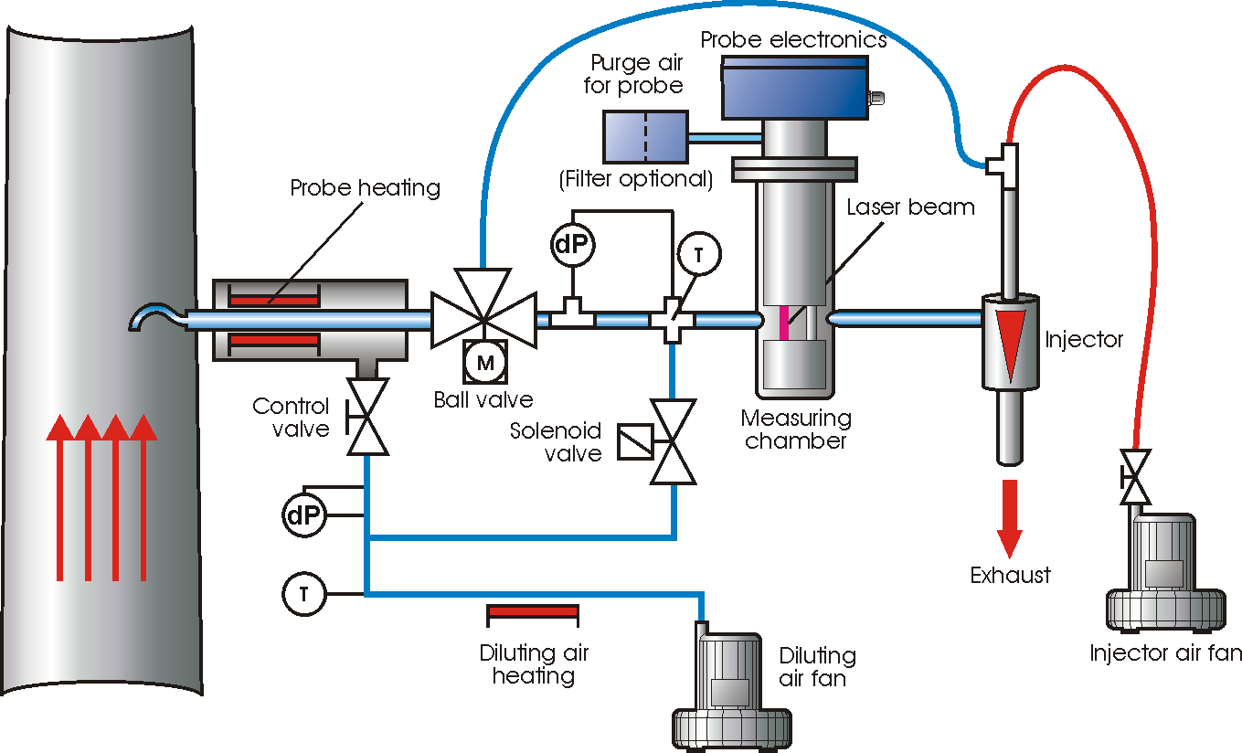
Extractive PM CEMS
Scatter-light Wet
Principle is same as dry but the gas is extracted and heated to vaporise the water droplets and moisture.
Dust measuring in moisture saturated gases in waste incinerators, emission in wet scrubbers, in desulphurization plants & other wet gas in industrial processes

Slide 14
Beta attenuation Technique (Extractive)
Attenuation of a Beta ray (electrons) emitted by a radioactive source emitter by the particles collected on a suitable filter matrix

Slide 15
Challenges for Extractive CEMS
PM Sample has to be drawn from Stack iso-kinetically
Distance from source and analyzer
Positive Bias of Secondary PM
Advantages of Extractive CEMS
Wet Stack emission can be monitored
Measurement Ranges of analyzer may be maximized
Size fractionation is possible
Maintenance is less compared to in-situ system

Slide 16
PM CEMS Technology Selection – Stack Characteristics Matrix
Parameter | DC Tribo | AC Tribo | Light Scatter | Opacity | Light Scintillation | Extractive
 |  |  |  |  |  | Light Scatter | BAM
Units of Measured Value | g/s, kg/hr | mg/m3, g/s, kg/hr | mg/m3 | mg/m3 | mg/m3 | mg/m3 | mg/m3
Velocity Monitor Required | X | ✓ | ✓ | ✓ | ✓ | ✓ | ✓
Duct < 1m Diameter | ✓ | ✓ | ✓ | X | X | ✓* | ✓*
Duct >1m to 4m Diameter | ✓ | ✓ | ✓ | ✓ | ✓ | ✓* | ✓*
Duct > 4m Diameter | X | X | X | ✓ | ✓ | ✓* | ✓*
Electrostatic Precipitator | X | ✓*** | ✓ | ✓ | ✓ | ✓ | ✓
Stack Gas Temperature > 500⁰C | X | ✓*** | ✓ | ✓ | ✓ | ✓ | ✓
Wet Scrubber or Water Droplet <70⁰C | X | ✓*** | X | X | X | ✓ | ✓
Large particles > 20um | ✓ | ✓ | X | ✓ | ✓ | X | ✓
Dust> 100 mg/m3 | ✓ | ✓ | ✓**** | ✓ | ✓ | X | ✓
Varying gas velocity | ✓ | ✓*** | ✓ | ✓ | ✓ | ✓** | ✓
* Primary Wet Stack, ** Worked on slowly varying velocity, *** ESP/Wet scrubber, *** Meas.upto 300 mg/m³

Slide 17
Calibration, Verification of Calibration and certification of PM CEMS
Instrument functioning validity
Valid Zero status
Valid drift criteria
Limitation in PM CEMS – there is no Reference standard for SPAN Check except standard filters for photometric principles.
Calibration of signal against Gravimetric PM Measurement is the only way to evolve a Dust Factor

Slide 18
Steps for Calibration of CEMS
Perform repeated isokinetic sampling (minimum 6 points)
Convert the manual reference method test data into measurement units ( e.g., mg / NM³ or mg/sec) consistent with the measurement conditions of PM CEMS.
Calculate the correlation equation(s) by drawing Regression curve (Linear)
Do the variability test (statistical accuracy test)

Slide 19
PM CEMS Calibration Procedure
STEP I
Date of sampling | Time period of sampling | Normalized Concentration of PM Emission(iso-kinetic sampling)** Y_{i} (mg/Nm³) | Factory Operating Condition (Production capacity (%); APCD on/off)
Recommended for 15 points calibration at different load factor to ensure linearity in detection range At least 6 times if load variation is not possible Supporting parameters like velocity, % Moisture, CO₂ and O₂ makes the system full proof for regulatory purposes.

Slide 20
PM CEMS Calibration Procedure
Step 2: Draw the scatter plot and fit the regression line
In the scatter plot, CEMS reading
should be on X-axis and Iso-kinetic
reading on Y-axis.
Find out the equation : y = a + bx
i.e: New CEMS reading = a + b*
(Old CEMS un-calibrated reading)
Sr. No. | CEMS reading | Iso-kinetic reading
 | 0 | 0
1 | 25.2 | 44.2
2 | 26.1 | 53.4
3 | 24.1 | 46
4 | 28.3 | 59.8
5 | 21.1 | 38.1
6 | 18.1 | 36.8

Slide 21
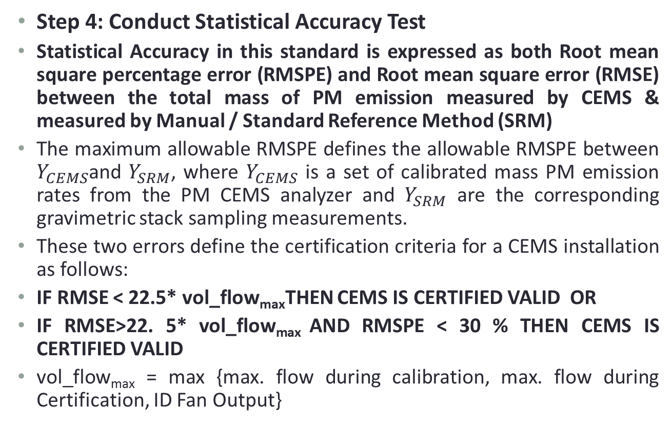
Statistical Accuracy Test

Slide 22
CEMS for Gaseous Pollutants

Slide 23
Cold Dry Extractive System
Heated
filter
Blow Back
Probe
(at stack)
To distantly located analyzers thro’ Heated sample line
Walk-in shelter
Analyzers
Condenser
Pump
SO₂
NOx
CO
CO₂
Output Signal to DAS
Drain
Calibration gas supply
to analyzers

Slide 24
Hot Wet Extractive System
Blow Back
Heated
filter
Probe
(at stack)
To distantly located analyzer - heated line
Walk-in shelter
Heated Analyzer
SO₂
Heated Pump
NOx
CO
CO₂
Output Signal to DAS
Calibration gas supply
to analyzers

Slide 25
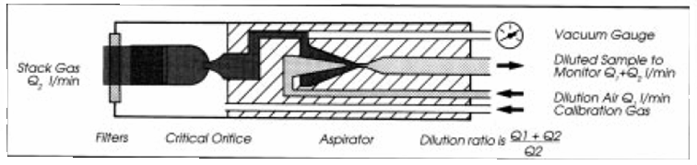
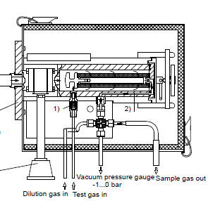
Dilution Probe

Slide 26
In-situ Gaseous Pollutants Measuring Techniques
IR – GFC (Gas Filter Correlation)
IR – IFC (Interference Filter Photometric Correlation)
UV DOAS
TDLS (Tunable Diode Laser)
Zirconia

Slide 27
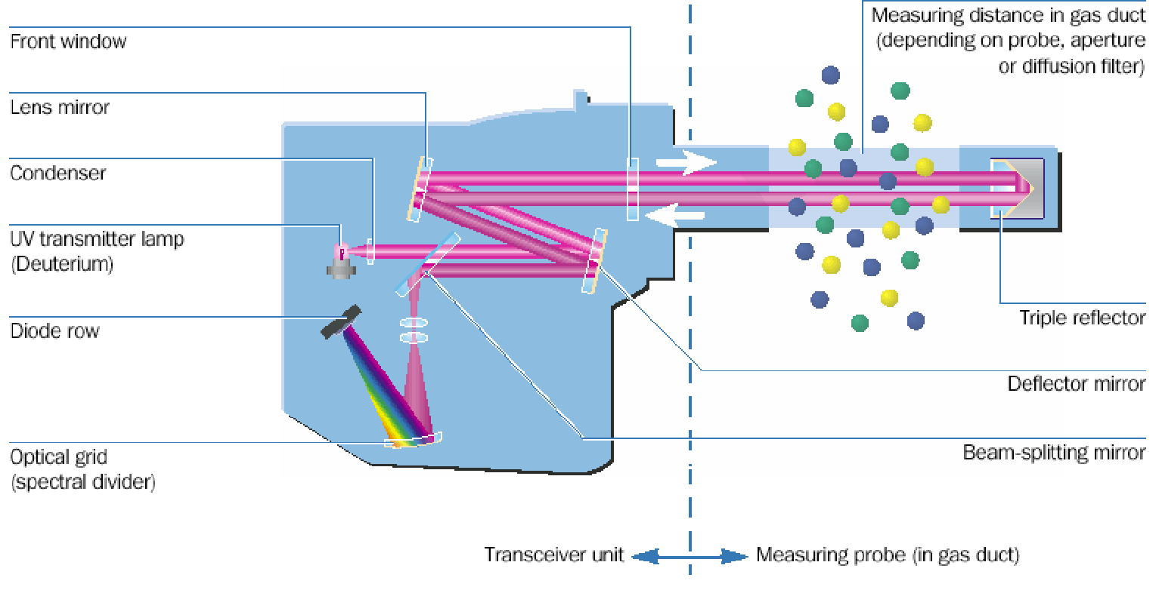
Optical Components
An example for In-situ Multiple gas analyzer
DOAS
Differential
Optical
Absorption
Spectroskopy

Slide 28
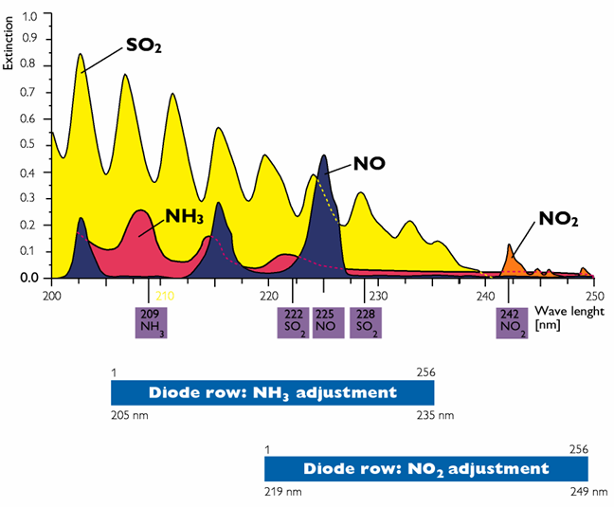
In-situ gas analyzers
DOAS
Differential
Optical
Absorption
Spectroskopy
DOAS
Differential
Optical
Absorption
Spectroskopy

Slide 29
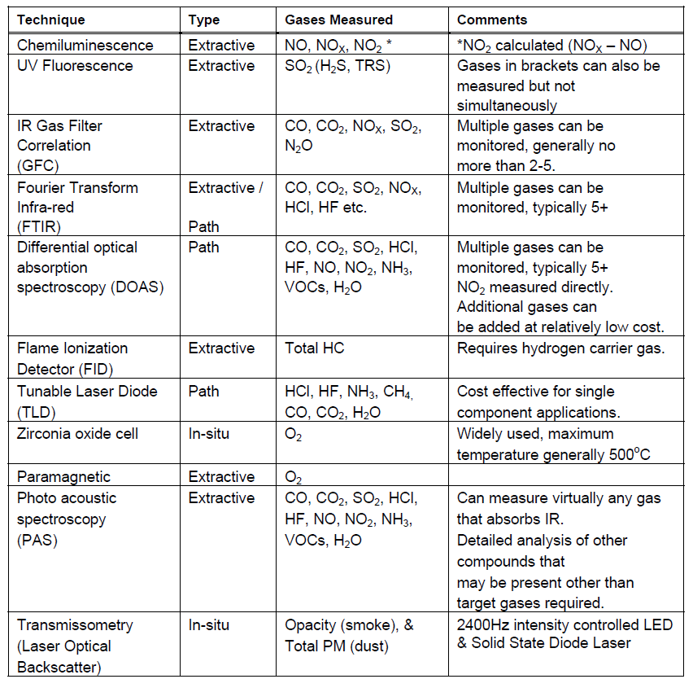
Summary of CEMS Technology Options

Slide 30
Typical Schematic presentation of an Analyzer

Slide 31
Typical Analyzer with Calibration System

Slide 32
International Certification for PM-CEMS
European Union | USA
QAL 1 (EN) (Quality assurance level 1) QAL 2 & QAL 3 (EN) Performance Standard | MACT (Maximum Achievable Control Technology); this is an objective oriented quality certification applicable to US only
TUV (Germany) (Technical watch-over Association) – a Product standard | EPA Technology approval system
MCERTS (UK) (Monitoring Certification Schemes) – a Product standard | PS-1 to PS 11 (USEPA) It is a performance Standard

Slide 33
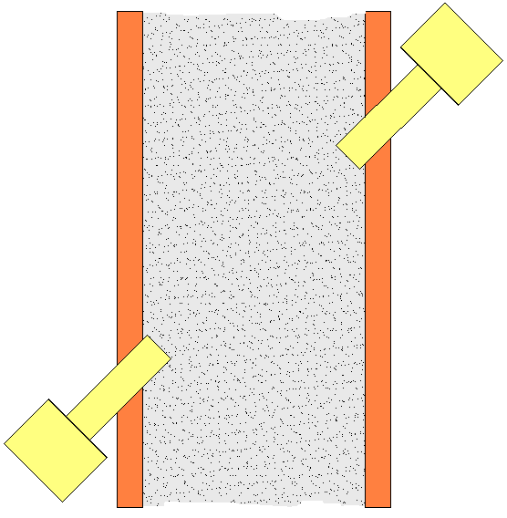
Continuous Velocity / Flow Measurement
Pitot Tube / DP
Differential pressure developed due to the flow between two points is proportional to the square of the flow rate.
Ultrasonic
Transit time difference between upstream and downstream signal is proportional to the velocity of flue gas.
Differential Pressure
Microprocessor
Measuring Transducer
Evaluation Unit
Cross Over
Absolute
Temperature
Cock
Pressure
Measuring
Measuring
Transducer
Transducer
(optional)
Flow Probe
(optional)
Flow
Direction

Slide 34
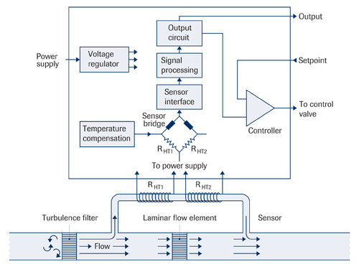
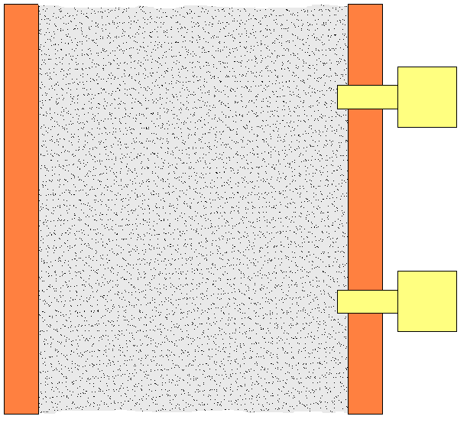
Continuous Velocity / Flow Measurement
Thermal Mass Flow
The energy required to maintain the constant temperature between two probes is directly proportional to the mass flow rate.
IR-Time Correlation Technique
Measured gas velocity using a time delay correlation of flue gas infrared emission received by two detectors spaced a fixed distance apart.
Det 2
Det 1

Slide 35
Minimum Quality Control Requirements
CEMS Specification should have compliance with one or more of the international standards e.g. US-EPA, German TUV and MCERTS, UK. It is not necessary to meet all three.
b) All CEMS shall be installed operated, maintained and calibrated in a manner consistent with the manufacturer’s recommendations
c) The CEMS must to perform a daily system calibration check automatically
The system calibration check must be performed daily at 2 levels: a low level (0-20% of span value) and at a high level of 1.5 times the emission limits.
For extractive systems, the calibration gases are to be introduced upstream of all filters and sample conditioning system as close to the tip of the probe as possible.
ii) Opacity monitor calibration checks must be performed daily at 2 levels; a low level (0-10%) and span level of (40-60%). PM monitors must conduct a daily calibration at a low level (0-10%) and span level of (50-100%) of the full scale range (max. mg/m3).
iii) Flow monitor calibration checks shall be at a low value of (0-10%) and a span level of (40-60% of 125% x maximum velocity)

Slide 36
d) Daily drift checking
For opacity monitors daily drift is limited to +/-2% opacity
For PM’s the daily drift is limited to +/-3% of span
For flow monitors the daily drift is limited to +/-3% of span
Daily records must be kept and adjustments shall be made if the drift is greater than 10% of the calibration gas value
e) The CEMS must operate continuously collecting and recording valid data for at least 95% for all required parameters.
Allowable period of Downtime in following situations
i) Monitor breakdown
ii) Schedule monitor maintenance
iii) Daily zero and span checks
iv) Performance specification testing.
If data robustness fall below 55%, Specific accuracy test is mandatory.
Minimum QC Requirements

Slide 37
Flow meter Selection Matrix
Type |  | Impact Differential Pressure (Pitot Tube) |  | Thermal anemometer ¹ | Bi-directional ultrasonic | Infrared correlation
 |  | Single point | Multiport
Irregular Flow |  | X | ✓ | ✓² | ✓² | ✓
Max Flue Gas Temperature |  | Up to 550°C | Up to 550°C | 200 – 300ºC (model specific) | 450° C - 850 °C (model specific) | Up to 1000ºC
Wet stack |  | X | X | X | ✓ | ✓
Low speed |  | X (minimum 5 m/s) |  | ✓ | ✓ | 1 m/s – 50m/s
High Speed |  | ✓ | ✓ | ✓ | Up to 40 m/s (model specific) | 1 m/s – 50m/s
Calibration |  | Factory+Site | Factory+Site | Factory+Site ³ | Factory+Site | Factory+Site
1 | Pressure Transmitter (PT) and Temperature Transmitter (TT) are not installed with a Thermal Anemometer as it directly measures Mass Flow which is usually the required quantity. However, for the purpose of ETS in Type 2 CEMS configuration, Volumetric Flow is required and hence PT and TT are necessary to calculate density and convert mass flow calculated by the anemometer to volumetric flow.
2 | Can be accounted for by using multiple probes/sensors
3 | Calibration depends on physical properties (thermal conductivity, specific heat) of the gas whose flow is to be measured. Thus variation in properties of stack gas from factory calibrated values can result in inaccurate measurement.

Slide 38
Hardware SpecificationS
Industry should select a vendor fulfilling the following requirements:
  CEMS device should be tamper proof
  PM CEMS device should ideally measure and report both the uncalibrated data to the DAS.
  PM CEMS device and flow meter should meet following specifications of key operating parameters:
Name of Parameter | Specifications
 | PM CEMS Device | Flow Meter
Measurement range | User defined | User Defined
Instrument detectable concentration | 10 mg/Nm³ or less | 1 m/s (minimum detectable limit)
Data acquisition | 1 minute | 1 minute
Data transmission | 1 minute | 1 minute
Deviation in the raw reading | < 5% of measurement range | <2% of measurement range
Drift | < 1% per month | Overall zero & span drift should be < 1% per month
Power supply | 220 +/- 10 V at 50 Hz
Data Availability | 90% or higher under normal operation | 90% or higher under normal operation

Slide 39
17 Categories of Industry, their emission standards and probable options for CEMS
SN | Industries | Pollutants Emission Limits | Recommended CEMS Options
1 | Aluminium Smelting |  | In situ PM CEMS NDIR for CO FTIR for CO and F DOAS for all
 | Raw Material Handling | PM – 150
 | Calcinations | PM – 250 CO – 1% (Max)
 | Green Anode Shop | PM – 150
 | Anode Bake Oven | PM – 50 Total Fluoride – 0.3 Kg/MT of Al
 | Pot room | PM – 150 Total Fluoride – 2.8 Kg/MT of Al for Soderberg Technology Total Fluoride – 0.8 kg/t for Pre-baked Technology
2 | Basic Drugs & Pharmaceuticals | For incinerator PM – 50 SO2 – 200 CO – 100 TOC – 20 PCDDs /F – 0.2ng TEQ/NM³ (existing) PCDDs /F – 0.1ng TEQ/NM³ (New commissioned after July 2009) Metals – 1.5 | Preferably Extractive PM CEMS NDIR for CO IR GFC, FTIR, DOAS for multi-gas analysis FID for HC (TOC) PCDDs, Metal not possible by CEMS
3 | Chlor Alkali (Hg Cell) (H₂ Gas stream) ( Hypo tower) (HCl Plant) | Hg – 0.2 Cl₂ – 15 HCl vapour and Mists – 35 | FTIR for multi-gas
4 | Cement (200TPD and above) | PM – 250 | In-situ PM CEMS Preferably Extractive PM CEMS NDIR for CO IR GFC, FTIR, DOAS for multi-gas analysis FID for HC (TOC) PCDDs, Metal not possible by CEMS
 | Plant within 5 KM radious of urban agglomeration with more than 5 Lakh population | PM – 100
 | New Cement Plants | PM – 50
 | Cement Plants with Co-incineration | All parameters as CHWI

Slide 40
17 Categories of Industry, their emission standards and probable options for CEMS
SN | Industries | Pollutants Emission Limits | Recommended CEMS Options
5 | Copper Smelting (Old Units) Copper Smelting (New Units) | PM – 100 PM – 75 | In-situ PM CEMS
 | SO2 recovery units upto 300 T SO2 recovery units above 300 T | SO2 – 1370 (Existing) 1250 (New) Acid Mist and Sulphur Trioxide – 90 (Existing); 70 (New) SO2 – 1250 (Existing); 950 (New) Acid Mist and Sulphur Trioxide – 70 (Existing); 50 (New) | UV Fluorescence, FTIR, DOAS
6 | Dyes and Dye Intermediate |  | In situ PM CEMS IR GFC, FTIR, DOAS TLD, PAS for multi-gas analysis FID for TOC PCDDs, Metal not possible by CEMS
 | Process | SO2 – 200 HCl (Mist) – 35 NH3 – 30 Cl2 – 15
 | Captive Incinerator | PM – 50 SO2 – 200 HCl (Mist) – 50 CO – 100 TOC – 20 PCDDs /F – 0.1ng TEQ/NM³ Metals – 1.5
7 | Fermentation (Distillery) | Boiler Standard | In situ System for PM
8 | Fertiliser (Phosphate) | PM – 150 Total Fluoride – 25 | In situ System for PM FTIR, DOAS TLD, PAS for F Velocity monitor
 | Fertiliser (Urea) Old plants Fertiliser (Urea) New plants | PM – 150 or 2Kg/MT product Total Fluoride – 50 or 0.5Kg/MT product
9 | Integrated Iron & Steel |  | In situ System for PM NDIR for CO Velocity monitor
 | Sintering plant | PM – 150
 | Steel making | PM – 150 (Normal Operation); PM – 450 (Oxygen Lancing)
 | Rolling Mill | PM – 150
 | Coke Oven | PM – 50 CO – 3 Kg/T coke
 | Refractory Material Plant | PM – 150

Slide 41
17 Categories of Industry, their emission standards and probable options for CEMS
SN | Industries | Pollutants Emission Limits |  |  | Recommended CEMS Options
10 | Leather Processing Tanneries | Boilers Standard |  |  | In situ PM CEMS
11 | Oil Refinery
 | Furnace, Boiler and captive power plant Gas based | Polutants | Before 2008 | After 2008
 |  | SO2 NOX PM CO Ni + V H₂S | 50 350 10 150 5 150 | 50 250 5 100 5 150 | BAM for PM IR GFC, FTIR, DOAS TLD, PAS
 | Furnace, Boiler and captive power plant Liquid Fuel based | SO2 NOX PM CO Ni + V H₂S | 1700 450 100 200 5 150 | 850 350 50 150 5 150 | In situ PM CEMS IR GFC, FTIR, DOAS TLD, PAS for multi-gas analysis or individual technology specific to pollutants CEMS Not Applicable for Metals Opacity
 | FCC Regenerator |  | Hydro | Others
 |  | SO2 NOX PM CO Ni + V % Opac. | 500 400 100 400 5 30 | 1700 450 350 (N) 100 50 (N) 400 300 (N) 2 (N) 2 30
 | SRU | H₂S NOX CO | 15 350 150 | 10 (N) 250 100 | IR GFC

Slide 42
17 Categories of Industry, their emission standards and probable options for CEMS
SN | Industries | Pollutants Emission Limits |  |  | Recommended CEMS Options
12 | Pesticide | HCl – 20 CL2 – 5 H2S – 5 P2O5 (as H3PO4) - 10 NH3 – 30 PM with Pesticide – 20 CH3Cl – 20 HBr – 5 |  |  | IR GFC, FTIR, DOAS TLD, PAS P2O5, PM with Pesticide and CH3Cl Are not conventional CEMS parameter
13 | Pulp & Paper | PM – 250 H₂S – 10 |  |  | In situ System for PM IR GFC for H2S
14 | Petrochemical | Polutants | Before 2007 | After 2007 | In situ PM CEMS IR GFC, FTIR, DOAS TLD, PAS for multi-gas analysis or individual technology specific to pollutants
 |  | SO2 NOX PM CO | 1700 (Liquid) 350 (Gas) 400 (Liquid) 150 (Liquid) 150 | 850 150 250 100 150
15 | Sugar | Boiler Standard |  |  | In situ PM CEMS
16 | Thermal Power Plants Less than 210 MW More than 210 MW | PM – 350 PM – 150 In situ PM CEMS |  |  | In situ PM CEMS

Slide 43
17 Categories of Industry, their emission standards and probable options for CEMS
SN | Industries | Pollutants Emission Limits | Recommended CEMS Options
17 | Zinc Smelting (Old Units) Zinc Smelting (New Units) | PM – 100 PM – 75 | In situ PM CEMS
 | SO2 recovery units upto 300 T SO2 recovery units above 300 T | SO2 – 1370 (Existing);1250 (New) Acid Mist and Sulphur Trioxide – 90 (Existing); 70 (New) SO2 – 1250 (Existing) ;950 (New) Acid Mist and Sulphur Trioxide – 70 (Existing); 50 (New) | FTIR, DOAS
 | Boilers (According to capacity) Less than 2 T / hr 2 – 15 T/hr Above 15 T/hr. Steam Generation less than 2 2 to less than 10 10 to less than 15 15 and above | Particulate Matter 1600 1200 150 Particulate Matter 1200 800 600 150 All above concentrations are subject to 12 % CO2 correction | In situ PM CEMS
Notes:
Wherever load based standards are notified Flow/Velocity Monitor is mandatory
O2, CO2 monitoring is essential where the standards are to be corrected for.
CO2 monitoring is a complementary part of monitoring if extractive dilution system is selected.

Slide 44
COMMON HAZARDOUS WASTE INCINERATOR
A. Emission
 | Limiting concentration in mg/Nm³ unless stated | Sampling Duration in (minutes) unless stated
Particulate Matter | 50 | 30
HCL | 50 | 30
SO₂ | 200 | 30
CO | 100 | 30
 | 50 | 24 hours
Total Organic Carbon | 20 | 30
HF | 4 | 30
NO_{x} (NO and NO₂, expressed as NO₂ | 400 | 30
Total dioxins and Furans | 0.1 ngETQ/Nm³ | 8 hours
Cd+Th+their Compounds | 0.05 | 2 hours
Hg and its Compounds | 0.05 | 2 hours
Sb+As+Pb+Co+Cr+Cu+Mn+Ni+ V+ their Compounds | 0.50 | 2 hours
Notes: All monitored values shall be corrected to 11 % oxygen on dry basis. The CO₂ concentration in tail gas shall not be less than 7%. In case, halogenated organic waste is less than 1% by weight in input waste, all the facilities in twin chamber incinerators shall be designed to achieve a minimum temperature of 950ºC in secondary combustion chamber and with a gas residence time in secondary combustion chamber not less than 2 (two) seconds. In case halogenated organic waste is more than 1% by weight in input waste, waste shall be incinerated only in twin chamber incinerators and all the facilities shall be designed to achieve a minimum temperature of 1100ºC in secondary combustion chamber with a gas residence time in secondary combustion chamber not less than 2 (two seconds). Incineration plants shall be operated (combustion chambers) with such temperature, retention time and turbulence, as to achieve Total Organic Carbon (TOC) content in the slag and bottom ashes less than 3%, or their loss on ignition is less than 5% of the dry weight].

Slide 45
Steps in Implementation of CEMS in Regulatory Frame Work
Recommending Technologies and their suitability for specific pollutants in specific emission through guideline
Ensure quality of instruments by specifying international product standards
Certification of CEMS installed based on their suitability, compliance on installation and basic operational criteria (operational criteria like data robustness may be evolved for India through discussion)
Recommending minimum Quality Control criteria at initial stage (may be little relaxed than international practices)
Building Data base during first one Year
Basic statistical Data analysis to fix the range of variation against time for specific industry and specific pollutants
Fixing variability criteria for specific industry against specific pollutants for compliance monitoring through regulatory mechanism
Until the variability criteria is fixed the industries should be allowed to adopt existing compliance practice
Guidelines for Quality assurance and performance may be prepared afterwards and implemented as a full proof system

Slide 46
Thank You

