Slide 1
Introduction to Measurement Techniques in
Environmental Physics
University of Bremen, summer term 2006
Differential Optical Absorption Spectroscopy (DOAS)
Andreas Richter ( richter@iup.physik.uni-bremen.de )
Date | 9 – 11 | 11 – 13 | 14 – 16
April 19 | Atmospheric Remote Sensing I (Savigny) | Oceanography (Mertens) | Atmospheric Remote Sensing II (Savigny)
April 26 | DOAS (Richter) | Radioactivity (Fischer) | Measurement techniques in Meteorology (Richter)
May 3 | Chemical measurement techniques (Richter) | Soil gas ex- change (Savigny) | Measurement Techniques in Soil physics (Fischer)

Slide 2
Overview
Principle of DOAS measurements
DOAS instrument
calibration of DOAS measurements
DOAS data analysis
DOAS applications

Slide 3
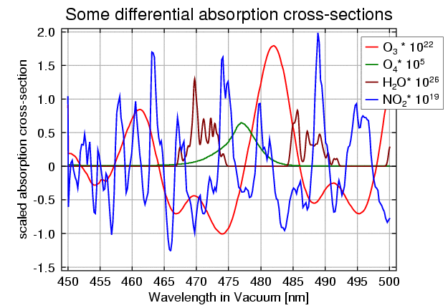
Basic ideas of DOAS measurements
remote sensing measurement of atmospheric trace gases in the atmosphere
measurement is based on absorption spectroscopy in the UV and visible wavelength range
to avoid problems with extinction by scattering or changes in the instrument throughput, only signals that vary rapidly with wavelength are analysed (thus the differential in DOAS)
measurements are taken at moderate spectral resolution to identify and separate different species
when using the sun or the moon as light source, very long light paths can be realised in the atmosphere which leads to very high sensitivity
even longer light paths are obtained at twilight when using scattered light
scattered light observations can be taken at all weather conditions without significant loss in accuracy for stratospheric measurements
use of simple, automated instruments for continuous operation

Slide 4
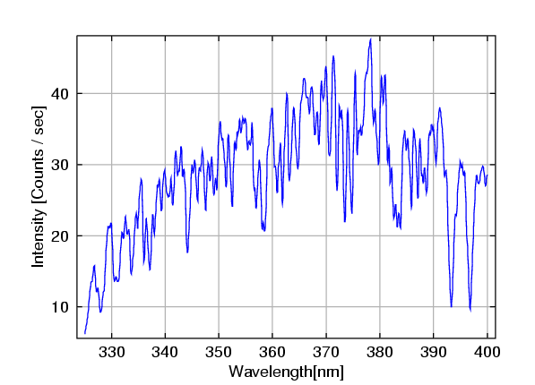
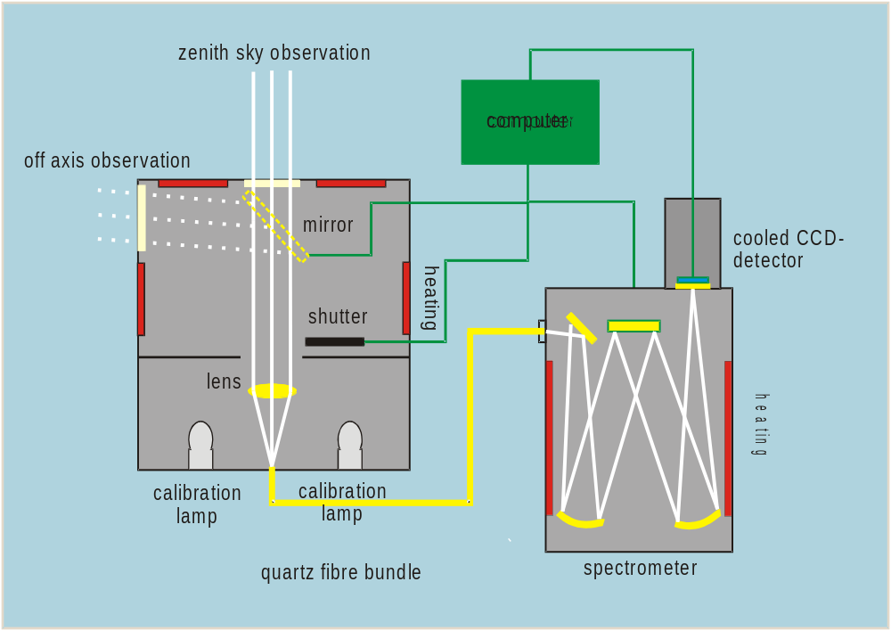
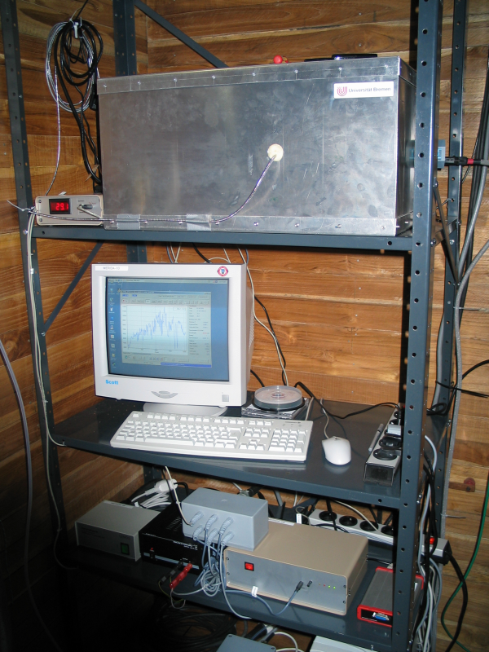
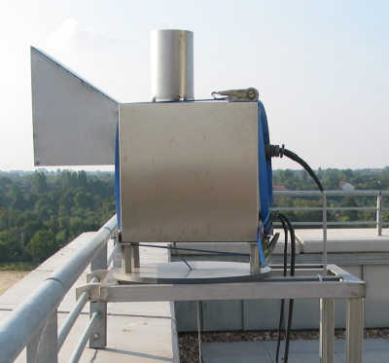
The MAXDOAS instrument
MAXDOAS = Multi Axis Differential Optical
Absorption Spectroscopy
Measured Spectrum
Schematic
Instrument
Telescope

Slide 5
The (MAX)DOAS instrument
Differential Optical Absorption Spectroscopy
idea: similar as for Dobson Spectrophotometer, but measurements at many wavelengths facilitating simultaneous retrieval of several absorbers.
observation of scattered light in the zenith or horizon directions to achieve long light paths
temperature stabilised grating spectrometer to guarantee high stability
cooled diode arrays or CCD detectors to minimize noise and provide simultaneous measurements at all wavelengths
spectral range between 320 and 700 nm
spectral resolution 0.2 – 1 nm
use of depolarizing quartz fibre bundles or polarized instrument tracking the solar azimuth to minimize impact of polarisation dependency
target species: O₃, NO₂, BrO, IO, OClO, SO₂, H₂O, HCHO, O₄, O₂, ...
operation from ground, ship, aircraft, balloons, satellites

Slide 6
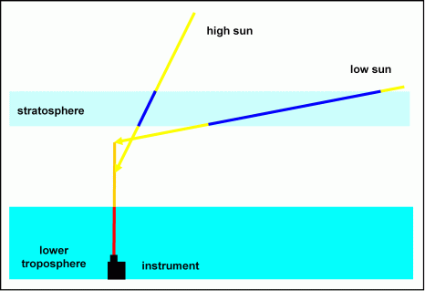
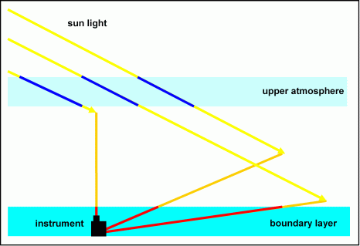
Light paths for scattered light observations
zenith-sky pointing
short light path through the troposphere
longer light path through the stratosphere
very long light path through the stratosphere at low sun
clouds don’t change the light path in the stratosphere
=> twilight is best time for stratospheric measurements
horizon pointing
long light path through the lower troposphere
constant light path through the stratosphere
the lower the measurement is pointed, the longer the light path gets
small dependence on sun position
clouds strongly change light path
=> tropospheric measurements work best during the day

Slide 7
Multiple light paths
In practice, many light paths through the atmosphere contribute to the measured signal.
Intensity measured at the surface consist of light scattered in the atmosphere from different altitudes
For each altitude, we have to consider
extinction on the way from the top of the atmosphere
scattering probability
extinction on the way to the surface
in first approximation, the observed absorption is then the absorption along the individual light paths weighted with the respective intensity.
SZA Θ
Offset for clarity only!

Slide 8
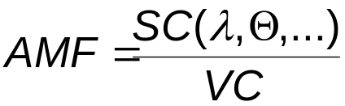
Airmass factors
SC
VC
The airmass factor (AMF) is the ratio of the measured slant column (SC) to the vertical column (VC) in the atmosphere:
The AMF depends on a variety of parameters such as
wavelength
geometry
vertical distribution of the species
clouds
aerosol loading
surface albedo
The basic idea is that the sensitivity of the measurement depends on many parameters but if they are known, signal and column are proportional

Slide 9
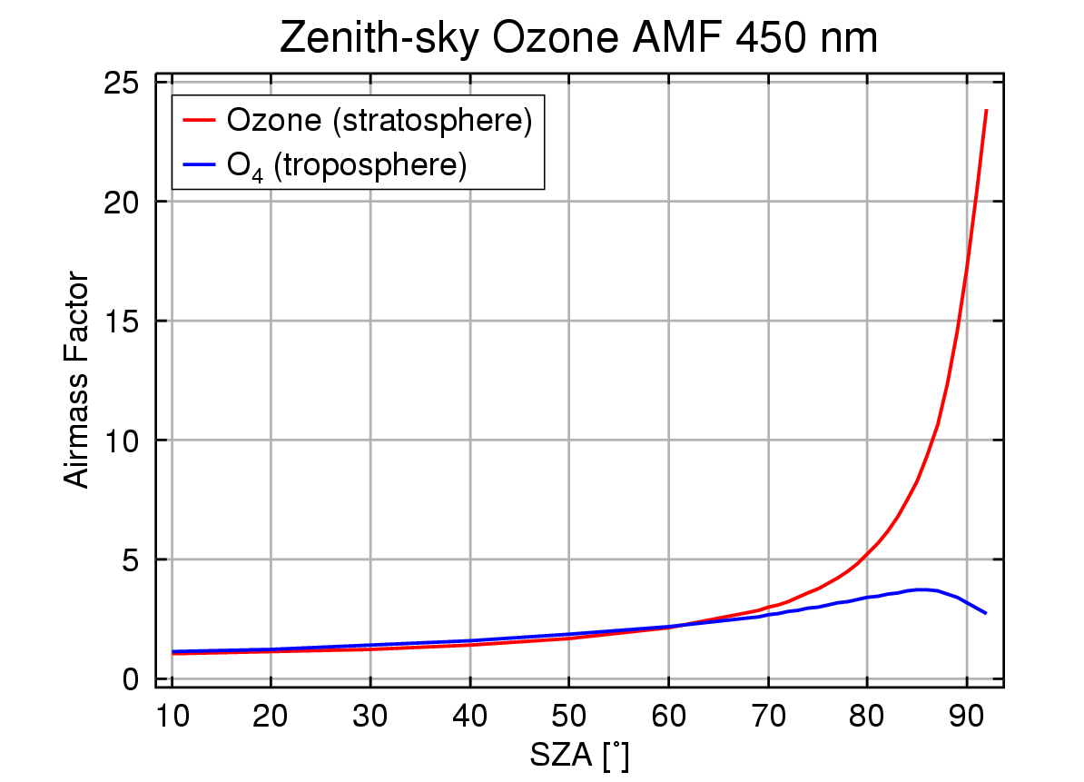
Airmass factors: dependence on solar zenith angle (SZA)
For a stratospheric absorber, the AMF strongly increases with solar zenith angle (SZA) for ground-based, airborne and satellite measurements.
Reason: increasing light path in the upper atmosphere (geometry)
For an absorber close to the surface, the AMF is small, depends weakly on SZA but at large SZA rapidly decreases.
Reason: light path in the lowest atmosphere is short as it is after the scattering point for zenith observation.
=> stratospheric sensitivity is highest at large SZA (twilight)
=> tropospheric sensitivity is largest at high sun (noon)
=> diurnal variation of slant column carries information on vertical profile

Slide 10
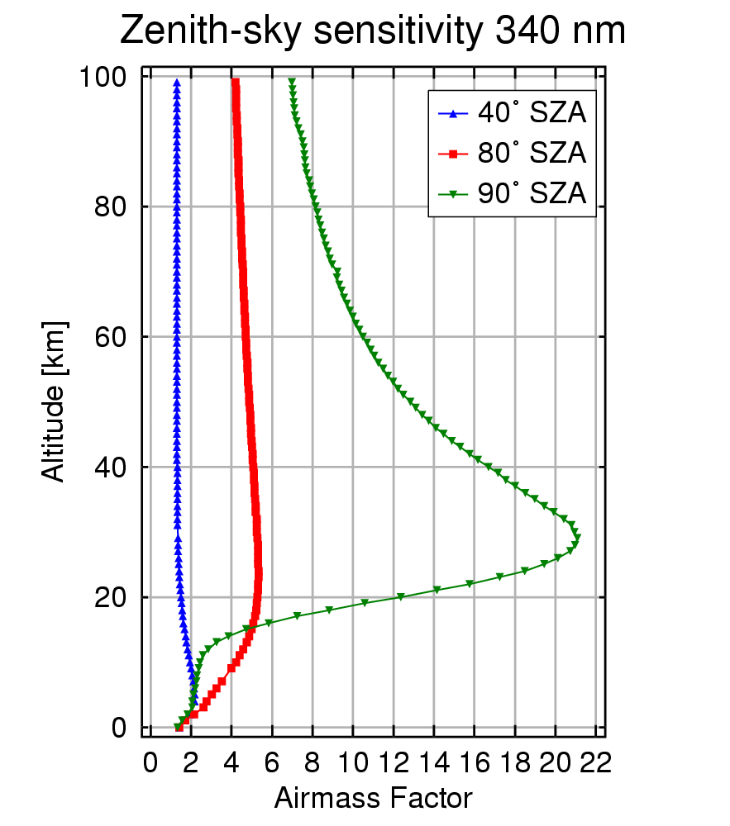
Airmass factors: dependence on absorber altitude
The AMF depends on the vertical profile of the absorber. The shape of the vertical dependence depends on wavelength, viewing geometry and surface albedo.
For zenith-viewing measurements, the sensitivity increases with altitude (geometry).
For satellite nadir observations, the sensitivity is low close to the surface over dark surfaces (photons don’t reach the surface) but large over bright surfaces (multiple scattering).
=> the vertical profile must be known for the calculation of AMF

Slide 11
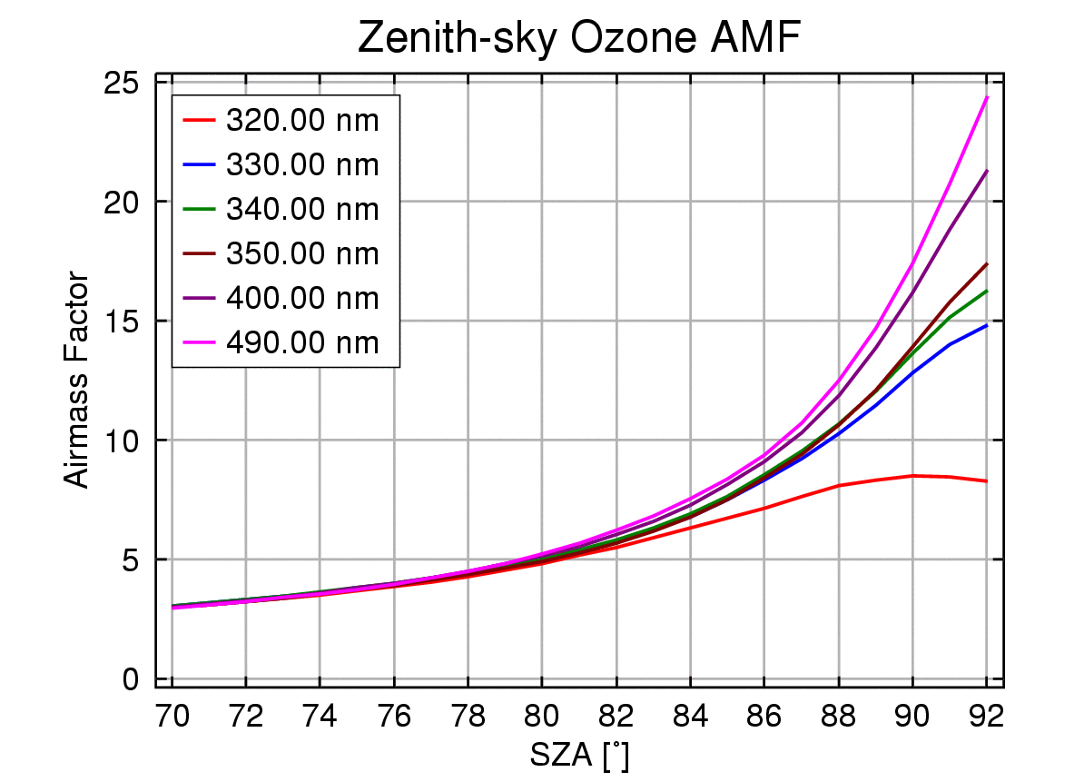
Airmass factors: dependence on wavelength
the AMF depends on wavelength as Rayleigh scattering is a strong function of wavelength and also the absorption varies with wavelength
at low sun, the AMF is smaller in the UV than in the visible as more light is scattered before travelling the long distance in the atmosphere.
at high sun, the opposite is true as a result of multiple scattering
UV measurements are more adequate for large absorption
in the case of large absorptions, the nice separation of fit and radiative transfer is not valid anymore as AMF and absorption are correlated
different wavelengths “see” different parts of the atmosphere which can be used for profile retrieval

Slide 12
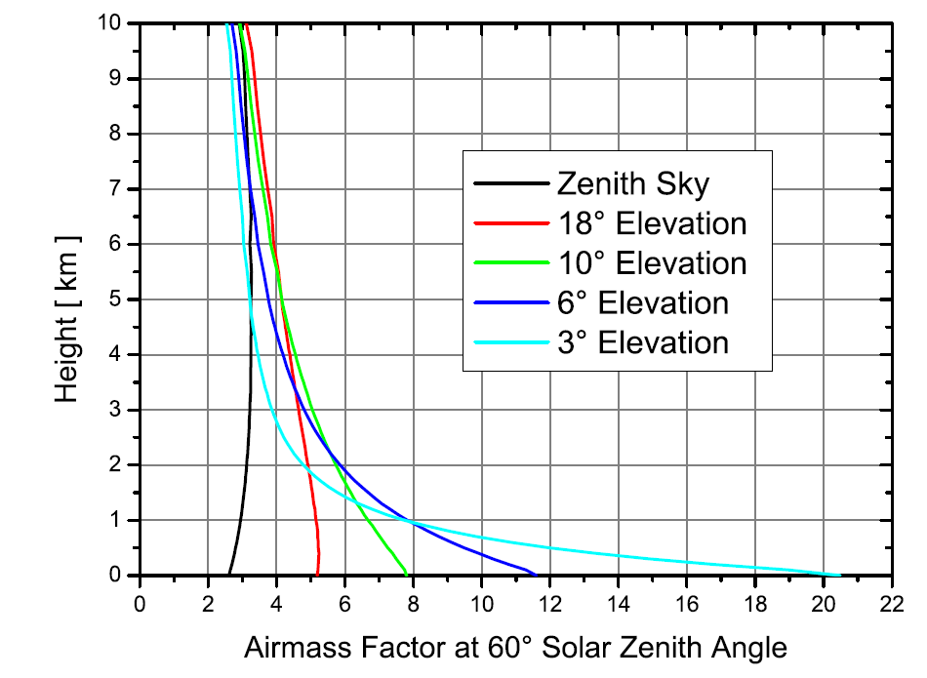
Airmass factors: dependence on viewing direction
by looking at the horizon, the light path in the lower atmosphere is greatly enhanced
the lower the pointing, the larger the sensitivity
good visibility is needed (no effect in fog)
combining measurements in different directions can be used to derive vertical profile information

Slide 13
DOAS equation I
The intensity measured at the instrument is the extraterrestrial intensity weakened by absorption, Rayleigh scattering and Mie scattering along the light path:
scattering efficiency
integral over light path
unattenuated intensity
absorption by all trace gases j
extinction by Mie scattering
extinction by Rayleigh scattering
exponential from Lambert Beer’s law

Slide 14
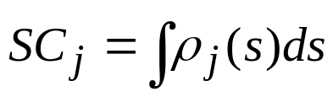
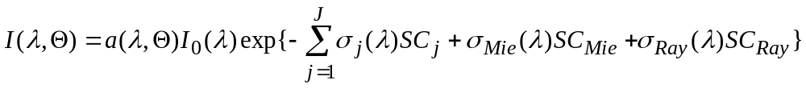
DOAS equation II
if the absorption cross-sections do not vary along the light path, we can simplify the equation by introducing the slant column SC, which is the total amount of the absorber per unit area integrated along the light path through the atmosphere:

Slide 15




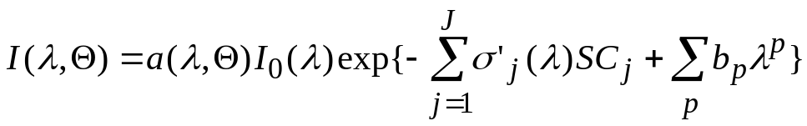
DOAS equation III
As Rayleigh and Mie scattering efficiency vary smoothly with wavelength, they can be approximated by low order polynomials. Also, the absorption cross-sections can be separated into a high (“differential”) and a low frequency part, the later of which can also be included in the polynomial:
differential cross-section
slant column
polynomial

Slide 16
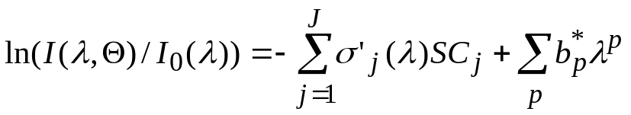
DOAS equation IV
Finally, the logarithm is taken and the scattering efficiency included in the polynomial. The result is a linear equation between the optical depth, a polynomial and the slant columns of the absorbers. by solving it at many wavelengths (least squares approximation), the slant columns of several absorbers can be determined simultaneously.
intensity with absorption (the measurement result)
absorption cross-sections (measured in the lab)
intensity without or with less absorption (reference measurement)
slant columns
SC_{j} are fitted
polynomial (b_{p}* are fitted)

Slide 17
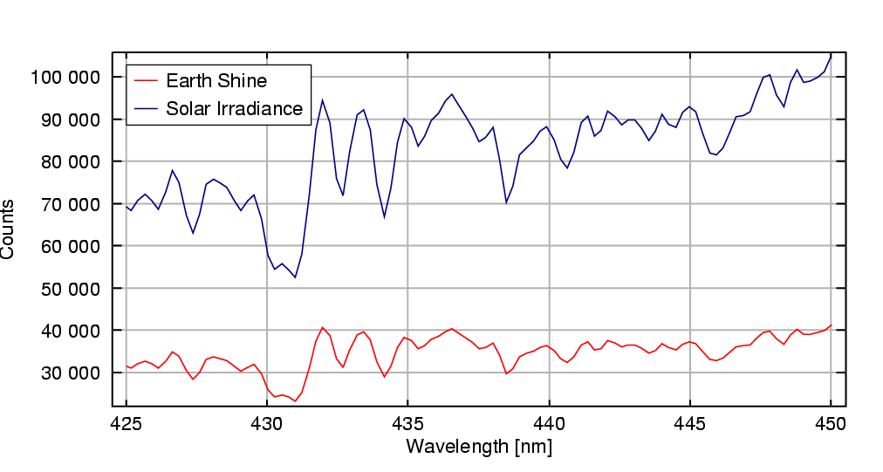
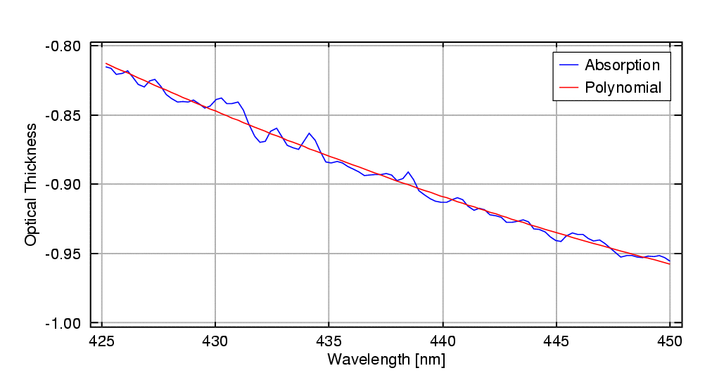
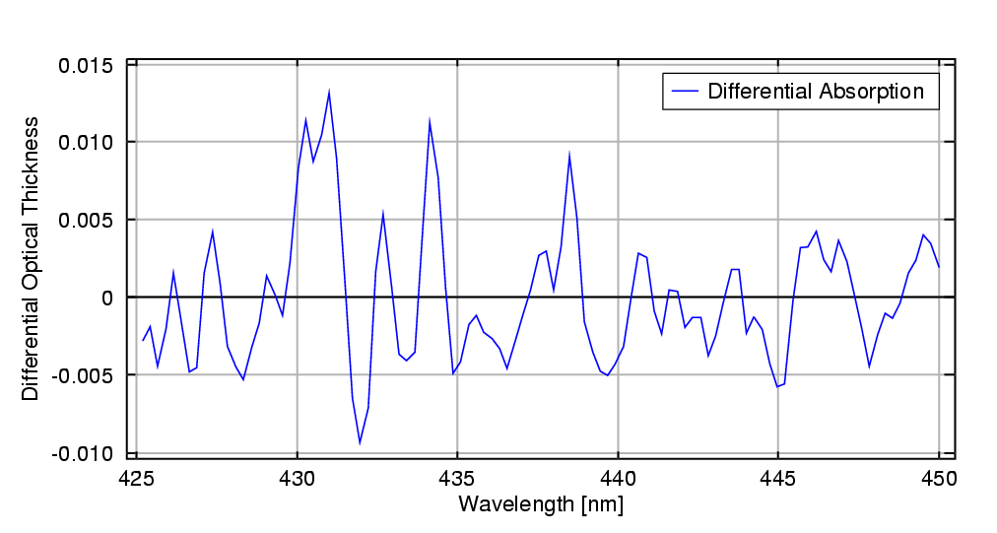
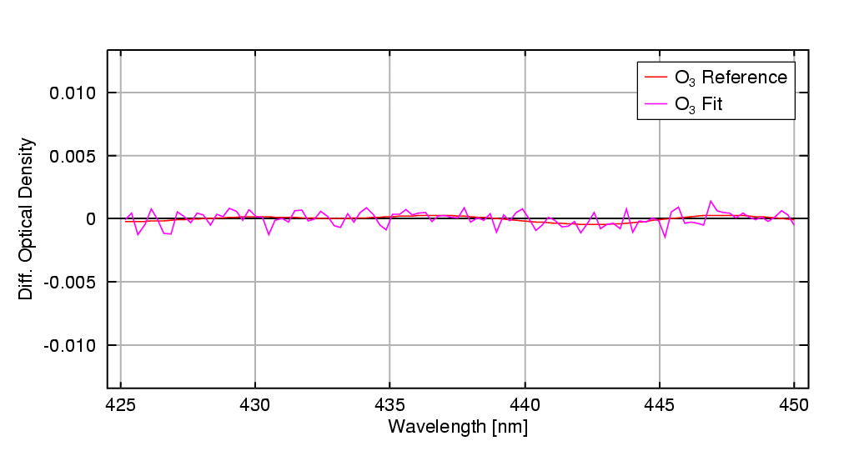
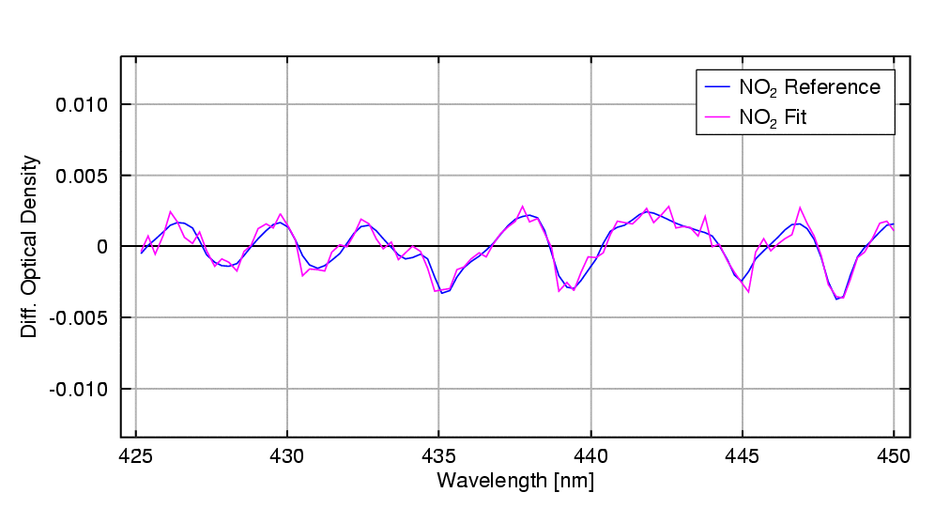
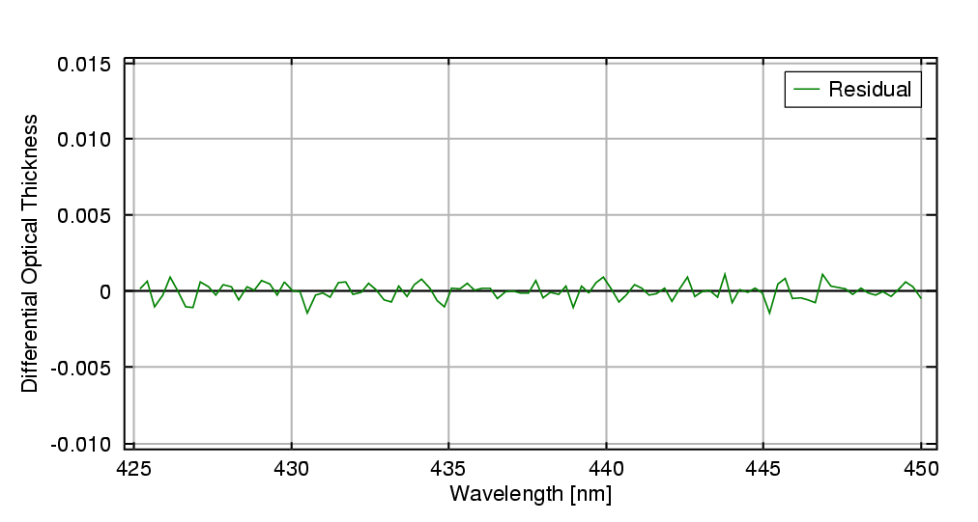
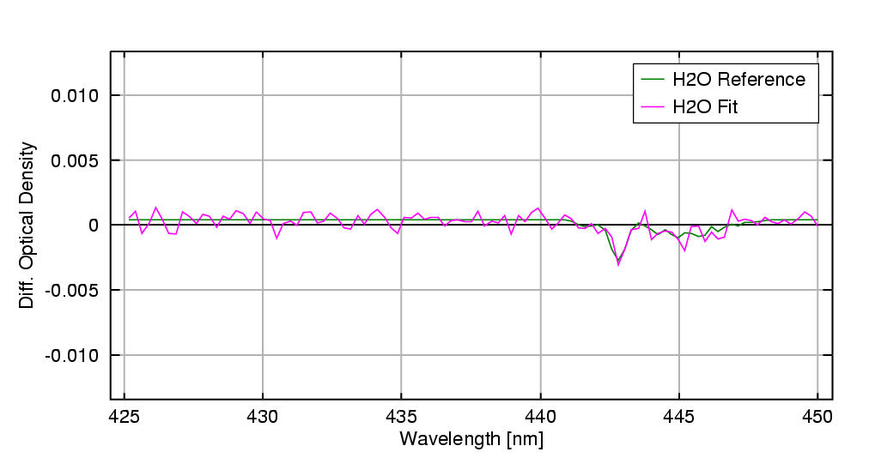
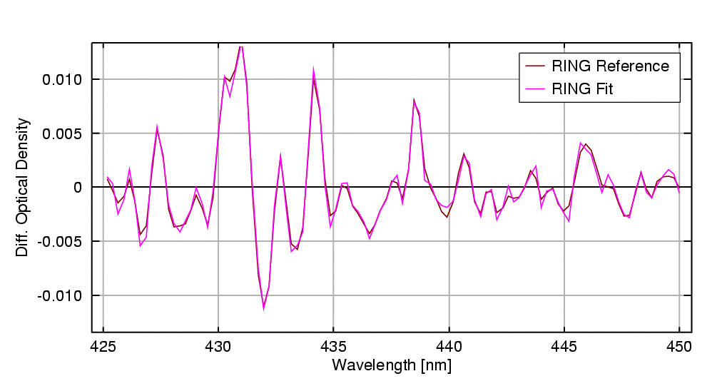
Example of DOAS data analysis
measurement
optical depth
differential optical depth
O₃
NO₂
residual
H₂O
Ring

Slide 18
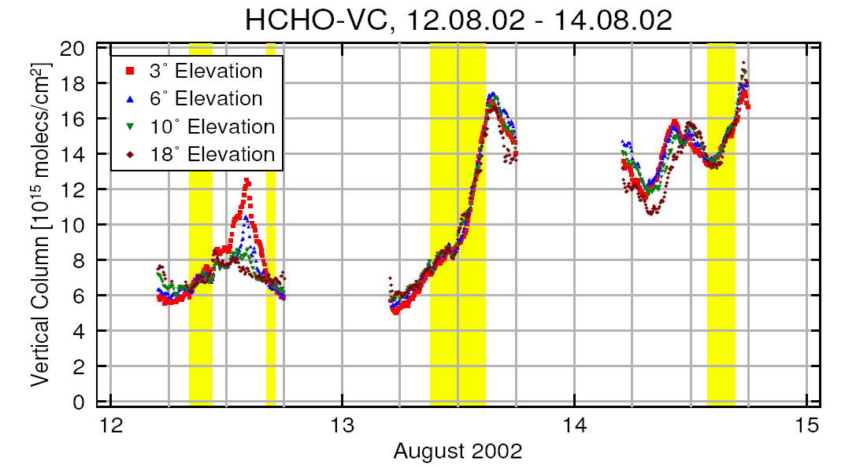
Application example: MAXDOAS measurements of HCHO
Formaldehyde (HCHO) is an intermediate product in atmospheric oxidation of hydrocarbons
key role in ozone smog formation
sources of precursors both biogenic and anthropogenic
multi-axis measurements in Po valley (Italy)
different viewing directions provide profile information
large increase as wind direction changed and brought air from Milano to measurement site
good agreement with independent in-situ measurements
Heckel, A., A. Richter, T. Tarsu, F. Wittrock, C. Hak, I. Pundt, W. Junkermann, and J. P. Burrows, MAX-DOAS measurements of formaldehyde in the Po-Valley, Atmos. Chem. Phys. Discuss., 4, 1151–1180, 2004

Slide 19
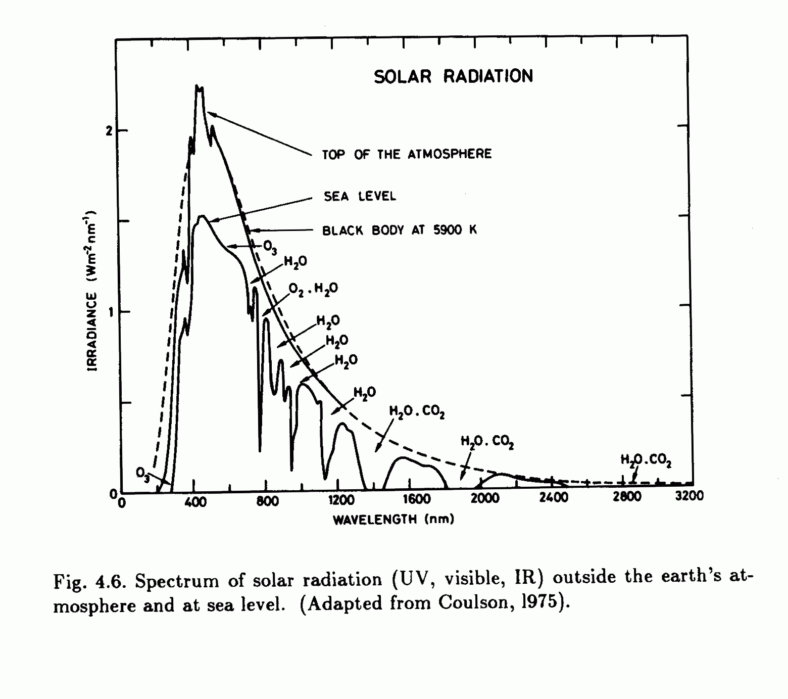
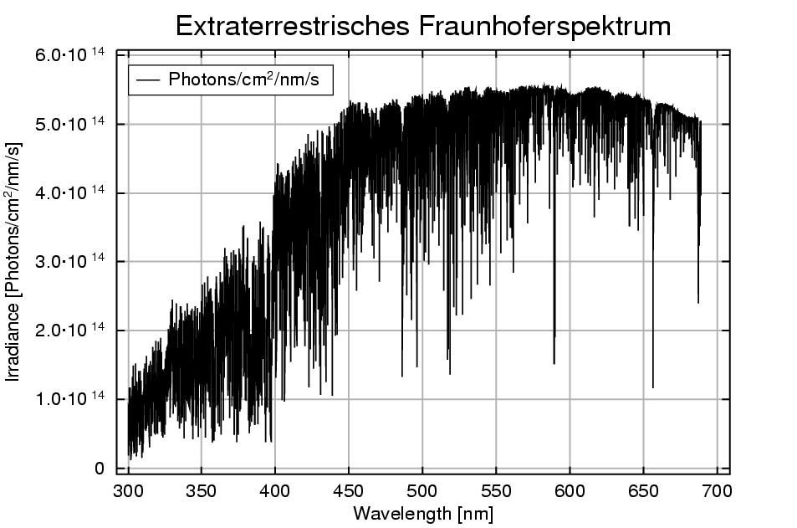
The sun as a light source
the solar spectrum can be approximated by a black body at temperature 5780K
absorption in the solar atmosphere leads to Fraunhofer lines
in the atmosphere, the solar radiation is attenuated by scattering and absorption
strong absorption by O₃, O₂, H₂O und CO₂
there are some atmospheric windows where absorption is small
multitude of Fraunhofer lines
11 year solar cycle, particularly relevant at short wavelengths λ < 300 nm
spectrum varies over the solar disk
Doppler shift resulting from rotation of sun
variation of intensity due to changes in distance sun - earth
=> sun is not an ideal light source!

Slide 20
Wavelength calibration for DOAS measurements
The raw signal measured on the detector needs to get an accurate wavelength assignment
Basic idea:
several emission lines of known wavelength position are recorded
linear regression between detector number / grating position and wavelength provides dispersion
Problems:
dispersion is not necessary linear
emission lines are not evenly distributed
reproducibility not always guaranteed
Solution:
measurements of solar light can use Fraunhofer lines for calibration
higher order polynomials can be used as calibration function
Intensity
Pixel
a
Wavelength [nm]
b
Pixel
Wavelength[nm] = a Pixel + b

Slide 21
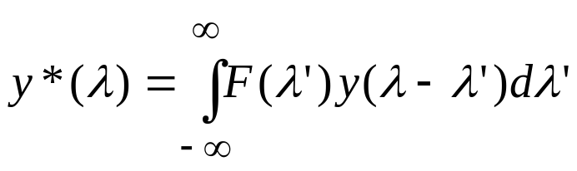
Instrument function for DOAS measurements
The Instrument Response Function IRF (often also called slit function) is the response of the instrument to a monochromatic input
For an arbitrary input signal, the output can be computed by convolution of the input y(λ) with the IRF F(λ):
The IRF can be measured by illuminating the instrument with a monochromatic light source.
The IRF also depends on how well the entrance aperture of a diffraction monochromator is illuminated (=> problems with partially cloudy skies).
Sometimes the IRF is numerically degraded by smoothing the measurements to reduce noise.
Instrument

Slide 22
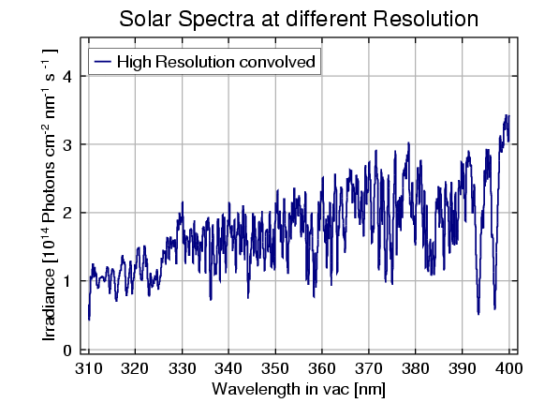
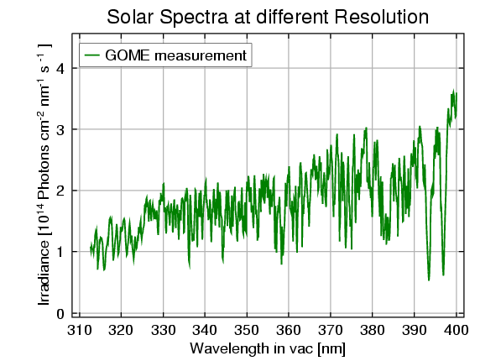
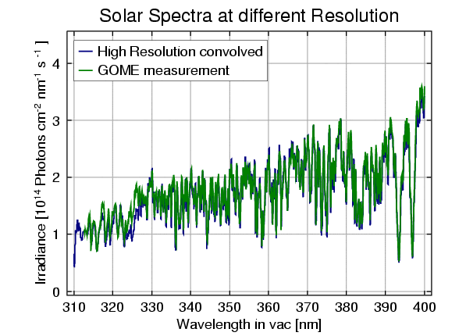
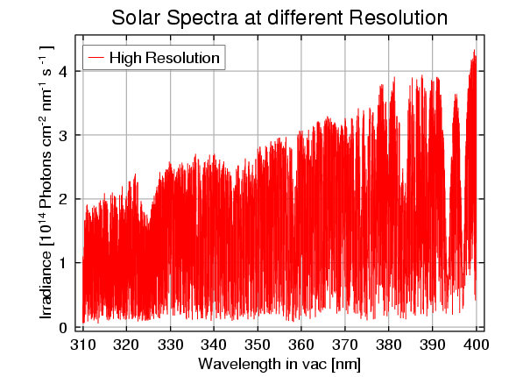
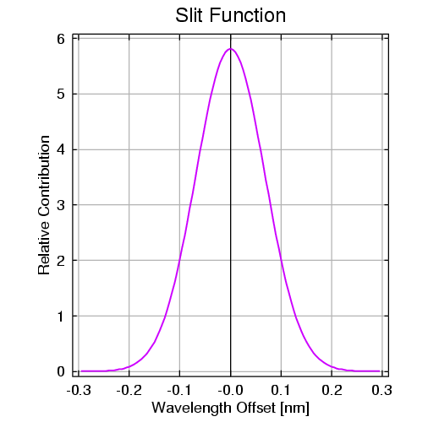
Example: Instrument function
GOME slit function is approximated by Gauss function of varying FWHM
=> Only after two data sets have been brought to the same spectral resolution (not sampling!) they can be compared.

Slide 23
Long Path DOAS measurements
Instrument:
open path DOAS system using a lamp as light source
retro reflectors for simplified set-up
white cells (multi reflection) for enhanced light path possible
advantages:
measurements at night
well defined light path
extension to UV (no ozone layer in between)
disadvantages:
shorter light path
need for bright lamp (+ power)
usually not fully automated
spectrometer
detector
quartz fibre
retro reflectors
telescope
open path through the atmosphere
lamp

Slide 24
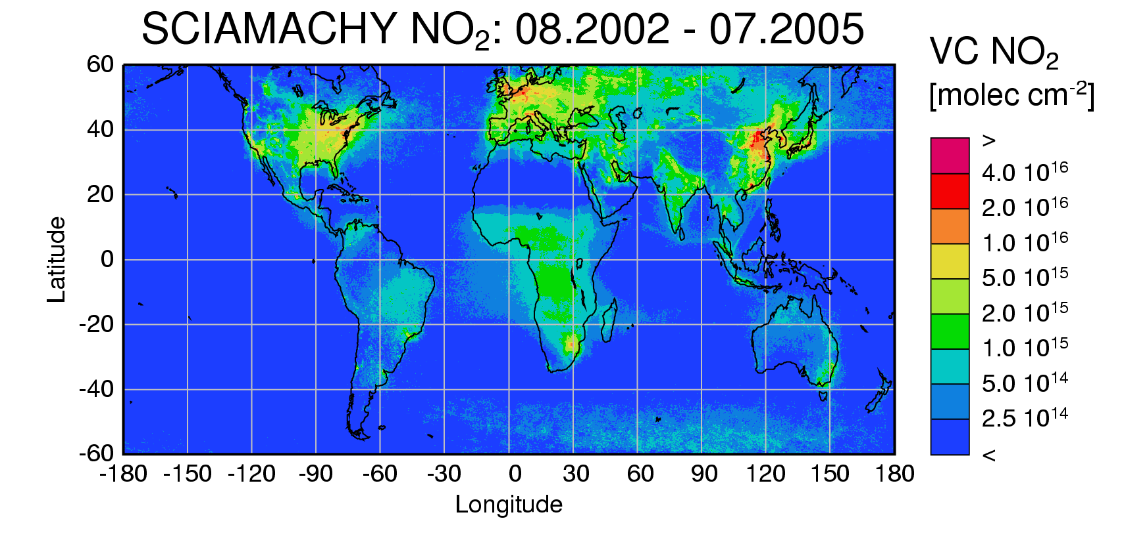
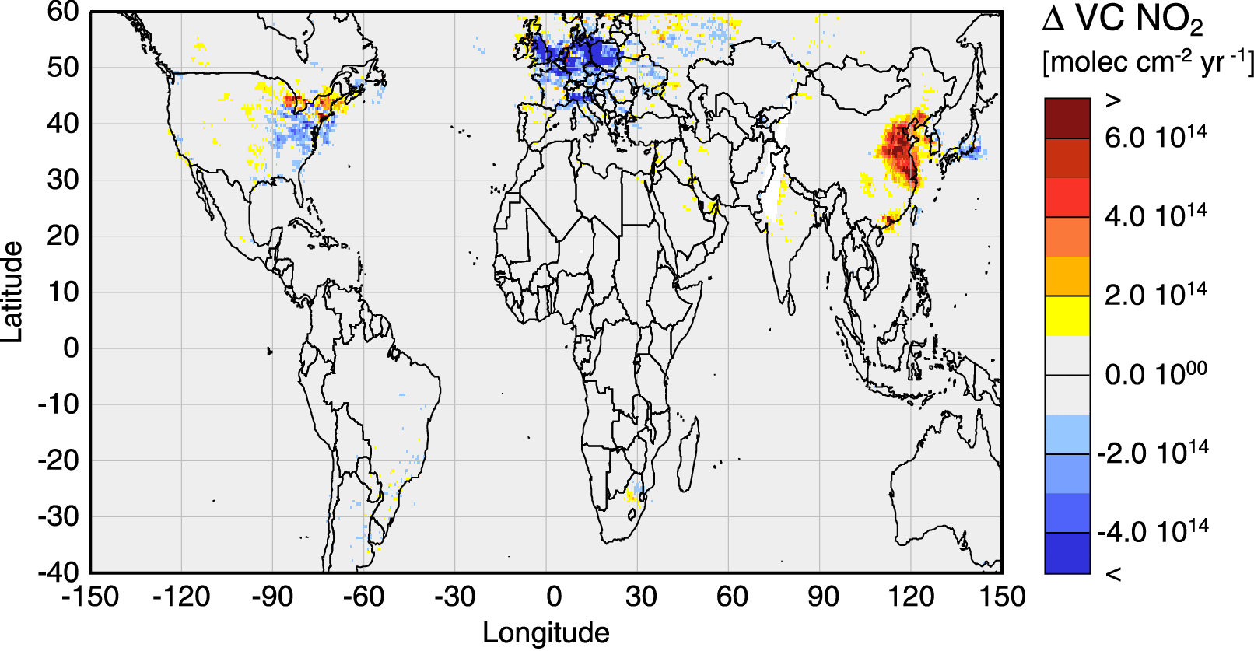
Example for satellite DOAS measurements
Nitrogen dioxide (NO₂) and NO are key species in tropospheric ozone formation
they also contribute to acid rain
sources are mainly anthropogenic (combustion of fossil fuels) but biomass burning, soil emissions and lightning also contribute
GOME and SCIAMACHY are satellite borne DOAS instruments observing the atmosphere in nadir
data can be analysed for tropospheric NO₂ providing the first global maps of NO_{x} pollution
after 10 years of measurements, trends can also be observed
GOME annual changes in tropospheric NO₂
1996 - 2002
A. Richter et al., Increase in tropospheric nitrogen dioxide over China observed from space, Nature, 437 2005

Slide 25
Summary
DOAS measurements use absorption spectroscopy to detect trace gases in the atmosphere
the basic law applied is Lambert Beer’s law
only the “differential” part, i.e. the high frequency component is used to separate molecular absorption from extinction by scattering
as light source, the sun (or moon or stars), scattered light or a lamp can be used
for scattered light applications, computation of the light path through the atmosphere is the most difficult part of the data analysis
the instruments used are grating spectrometers with diode array or CCD detectors connected to a telescope
high stability is needed to minimise artefacts from solar Fraunhofer lines
DOAS instruments can be operated from all kind of platforms including satellites

