Slide 1
Proficiency Tests
John H McB Miller
Laboratory Department (DLab)
European Department for the Quality of Medicines
Council of Europe
Strasbourg, France

Slide 2
Interlaboratory Studies
Interlaboratory Testing
Proficiency testing
Collaborative study
Certification study
Co-operative study
Description
Continuing assessment of technical competence
Validation of a specific method
Establishing the best estimate of the time value of an analyte in a reference material
Laboratory assessment of samples and methods (eg educational studies)

Slide 3
Proficiency testing by interlaboratory comparisons
To determine the competence of individual laboratories to perform specific tests or measurements
To monitor the performance of laboratories overtime

Slide 4
ISO Guide 43-1
Interlaboratory comparisons may be used to:
a) determine the performance of individual labs for specific tests or measurements and to monitor labs’ continuing performance;
b) identify problems in labs & initiate remedial actions which may be related to, for example, individual staff performance or calibration of instrumentation;

Slide 5
ISO Guide 43-1
c) establish the effectiveness & compatibility of new test or measurement methods & similarly to monitor established methods
d) provide additional confidence to lab clients;
e) identify interlaboratory differences;

Slide 6
ISO Guide 43-1
Interlaboratory comparisons are conducted for a number of purposes and may be used by participating laboratories and other parties eg establishment of a reference material

Slide 7
ISO Guide 43-2
6. Use of results by laboratory accreditation bodies
6.1 The results from proficiency testing schemes are useful for both participating laboratories & accreditation bodies. There are, however, limitations ............. that proficiency testing alone should not be used by laboratory accreditation bodies in their accreditation processes.

Slide 8
ISO Guide 43-2
6.2 If a laboratory submits a result(s) which fall outside acceptance criteria for a specific scheme, a laboratory accreditation body should have procedures for acting on such results
6.3 Such procedures should include early reporting to the laboratory of its results with an invitation for the laboratory to investigate and comment on its performance.

Slide 9
Quality Manual
Laboratories should have a section in their Quality Manuals:
covering participation in proficiency testing
how the results are used to demonstrate the competence of the laboratory
procedures to be followed when unsatisfactory performance is reported
records of participation in PT scheme
corrective action reports

Slide 10
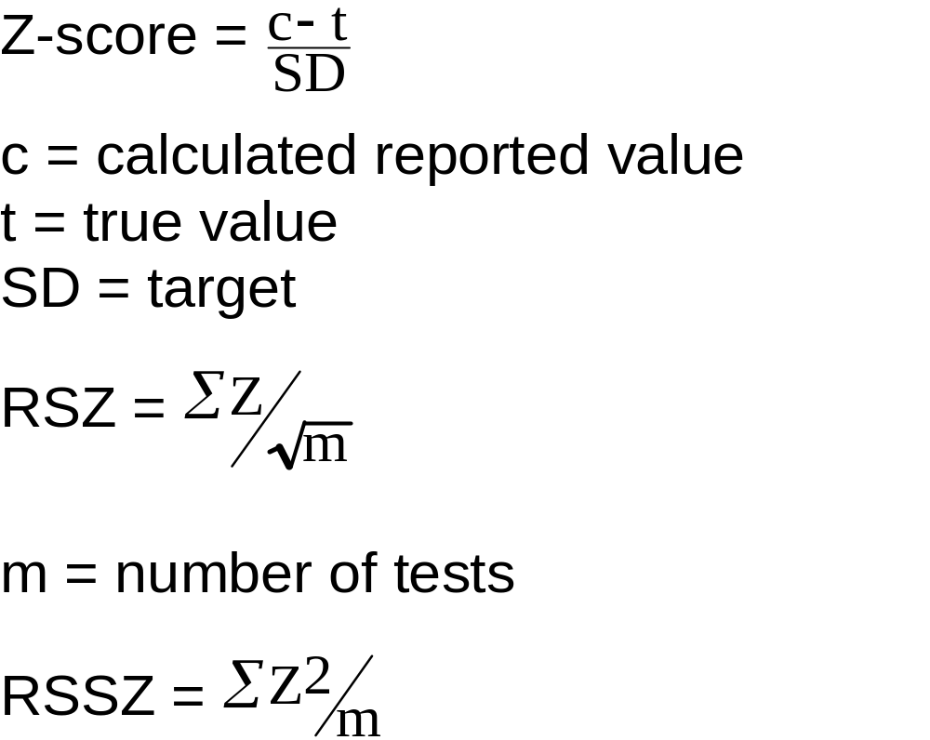
PT Scoring System

Slide 11


Assigned Value,
The assigned value ( ) may be the “true” or the consensus value.
True value may be a theoretical value or known value from “spiking’ of known quantity of a known quantity of analyte to a sample.
Consensus value based on the results of the participants. The consensus value is determined by the application of robust statistics (eg median value, mean interquartile range, Huber’s robust mean), to avoid the influence of “outliers” in the overall mean.

Slide 12
Target standard deviation (TSD)
This is set based on experience, reported or expected precision of the techniques used and according to fitness-for-purpose.
The TSD must be realistic.
The TSD should be consistently applied from round to round for the same technique/procedure in a PT scheme so that performance can be assessed over time.

Slide 13
Ranking
Z-score ≼ 2 satisfactory
≽ 2≼ 3 questionable
> 3 unsatisfactory

Slide 14
Outliers are indicated using three test statistics:
Cochran’s test for outlying variances, Grubbs’ single test for outlying means and Grubbs’ paired test for outlying means, to be applied in this order. If a laboratory is excluded, the cycle is repeated from Cochran’s test until no outliers remain.

Slide 15
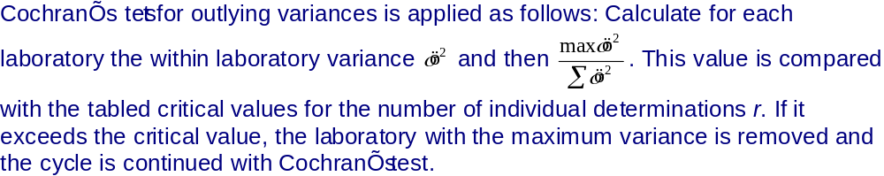

Slide 16
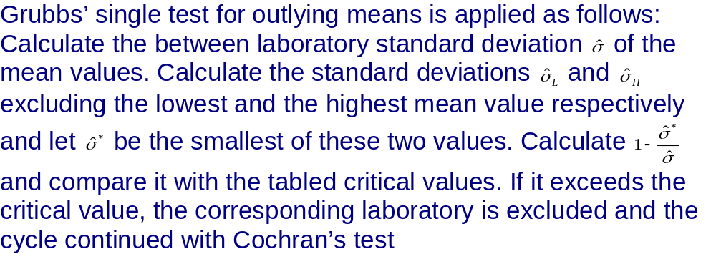

Slide 17
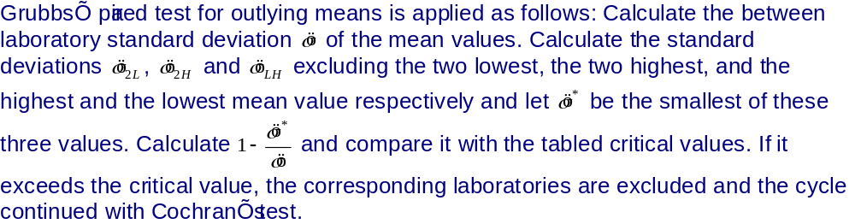

Slide 18
Robust Statistics
Huber’s mean for calculation of the « consensus » value is preferred to using elimination of results by tests for outliers

Slide 19
Scoring over time
RSD - Used for detecting consistent bias
RSSZ - Magnitude of deviations.
Cancellation of significant Z-scores if opposite sign is limited

Slide 20
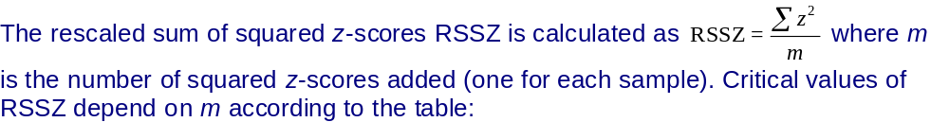

Slide 21
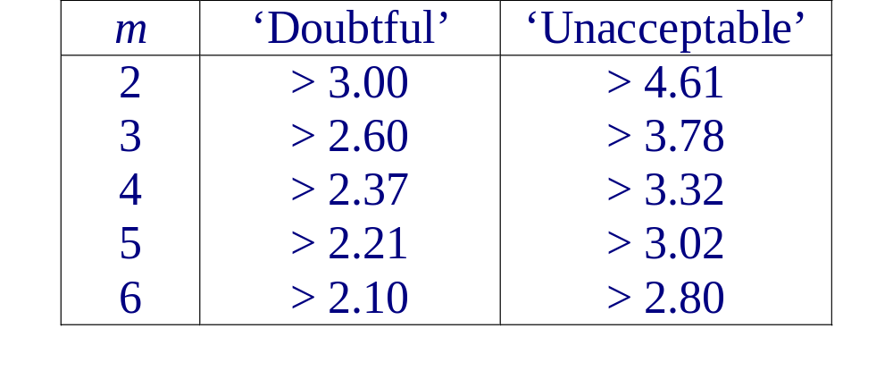

Slide 22
Proficiency Testing
Corrective actions:
PT schemes can be either mandatory or voluntary
Voluntary schemes: PT records examined by external auditors during ISO 17025 assessment
Mandatory schemes: Corrective action reports must be set within a defined time limit to the organisers for assessment and approval (or not). Failure to do so will result in a sanction

Slide 23
OMCL Network
Proficiency Testing Scheme
Initially open to OMCls of the European Union & other OMCLs associated with the European Pharmacopoeia (member & observer states)
Now open to any lab. on a fee paying basis
minimum of 4 tests/year
voluntary scheme

Slide 24
WHO External Quality Assurance Assessment Scheme (EQAAS)
Started in 2001 for selected regional medicines control laboratories
Phase 4 began in 2007

Slide 25
PTS 20
Atomic Absorption Spectrophotometry
Incorrect programming of instrument resulting in insufficient significant figures
Calibration 1 significant figure 1200 ppm K
3 significant figure 1290 ppm K
11/28 questionnaire/unsatisfactory results

Slide 26
PTS 025
Titration of the conjugate acid of organic bases
* Corrected for water content (not required)
A lab. reported a difference of 2% in results between potentiometric & visual end-point. However, incorrect standardisation procedure was employed
* Deterioration in response of the electrode
23/46 questionnaire/unsatisfactory results

Slide 27
Liquid Chromatography Assay of Indapamide
98.33}
98.64} Mean = 98.7 RSD = 0.40
98.11}
True value:- 99.75 z-score: 2.13
Repeatability of ref. sol. (n=6) :- 0.57

Slide 28
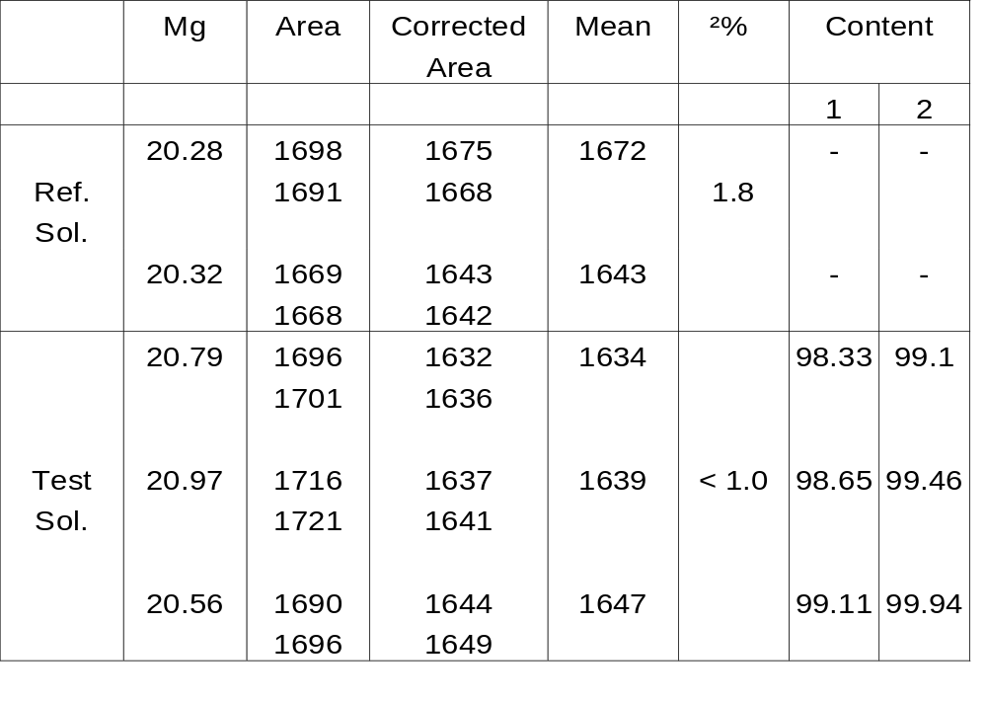
Liquid Chromatography Assay of Indapamide

Slide 29
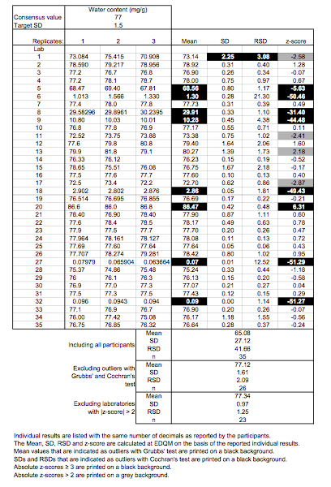
Phase 4 : Procedure 1 - Table 1
Raw data & scoring of participating laboratories
Semi-micro determination of water

Slide 30
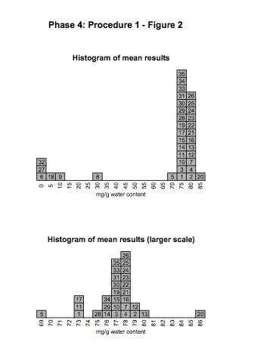

Slide 31
EQAS on water content by Karl Fischer
Number & percentage of participating laboratories having shown satisfactory performance (z-score < 2)
Water content | Phase 1 (2001) | Phase 3 (2005) | Phase 4 (2007)
No of Participants | 7 | 33 | 35
No of labs with satisfactory results | 4 | 19 | 23
% of labs with satisfactory results | 57% | 58% | 66%

Slide 32
EQAAS
Comments:
From the 3 participants who failed on the first exercise, 2 of them did not participate in the subsequent studies. Concerning the 3rd one their results slightly improve Phase 3 and were satisfactory in Phase 4.
From the 14 participants who failed in the second exercise, 8 of them reported satisfactory results on the 3rd one (3 did not participate and 3 didn’t show any improvement)
There doesn’t seem to be an improvement in the general trend. The overall performance of laboratories using this technique is not very satisfactory and could be improved. However, it has to be pointed out that the determination of water by Karl-Fischer is problematic even for experienced laboratories as we can see from the results reported by the laboratories (including OMCLs) participating in our regular PTS programme.

Slide 33
