Slide 1
Fundamentals of Testing
Chapter 1
Software Testing
ISTQB / ISEB Foundation Exam Practice
1 Fundamentals
2 Lifecycle
3 Static testing
4 Test design
techniques
5 Management
6 Tools

Slide 2
Contents
Principles
1
2
3
ISTQB / ISEB Foundation Exam Practice
4
5
6
Why testing is necessary
What is testing
Testing principles
Fundamental test process
Psychology of testing
Code of Ethics

Slide 3
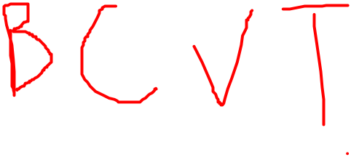
Who am I?
Trần Đình Quế, Ph.D, Assoc. Prof.
Research: Intelligent computing, Analysing social networks, Data Mining, Machine Learning, Deep Learning, Intelligence System Dev
Teaching
artificial intelligence, machine learning, data mining (gradudate)
software engineering, software requirement, software testing, software analysis & design, software architecture & design, intelligence system development, programming languages (undergraduate)
2001 Canada, Calgary University
1995-1998: Melbourne University, Australia
Mail: tdque@yahoo.com, quetd2@fe.edu.vn
Phone: 0904066883

Slide 4
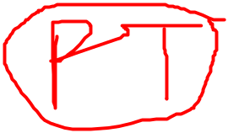
EVALUATION
1) On-going Assessment - At least 3 progress tests: 20% - 01 group presentation: 10% - 04 Labs: 30% 2) Final exam: 40% 3) Final Result: 100% Completion Criteria: 1) Every on-going assessment component >0 2) Final Exam Score >=4 & Final Result >=5

Slide 5






Thinking? Studying?
Teaching: slide + text book
Software engineering JOBS: https://en.wikipedia.org/wiki/Software_engineering
Activities????? All are activity VIEW!
Software Process/software life cycle?
Testing?? activities
Requirement?? activities
Design??? Activities
Coding ??? activities

Slide 6
Software Quality Assurance (SQA)
& Testing?
SQA & Testing: Difference???
https://www.softwaretestinghelpcom/software-quality-assurance/
SoftwareTesting???
https://www.guru99.com/software-testing.html
Requirement & Testing???
Architecture Design/ detailed design & testing
Coding & testing

Slide 7
What is testing? Testing terminology
No generally accepted set of testing definitions used world wide
https://www.guru99.com/software-testing.html
New standard BS 7925-1
  Glossary of testing terms (emphasis on component testing)
  most recent
  developed by a working party of the BCS SIGIST
  adopted by the ISEB / ISTQBa\

Slide 8
Software Development Models
https://cynoteck.com/blog-post/top-software-development-models-to-choose-from/
https://www.javatpoint.com/software-engineering-sdlc-models
https://www.scnsoft.com/blog/software-development-models

Slide 9
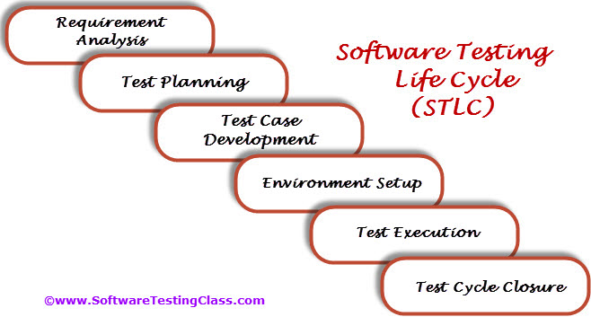
What is Software Testing Life Cycle (STLC)?
Software Testing Life Cycle refers to a testing process which has specific steps to be executed in a definite sequence to ensure that the quality goals have been met. In the STLC process, each activity is carried out in a planned and systematic way
Software Testing Life Cycle (STLC) identifies what test activities to carry out and when to accomplish those test activities.
http://softwaretestingfundamentals.com/software-testing-life-cycle/
https://www.softwaretestingmaterial.com/stlc-software-testing-life-cycle/

Slide 10
























“The More You Know The More You Realize You Don’t Know” Aristotle
===
You should discover this link
https://ardalis.com/the-more-you-know-the-more-you-realize-you-dont-know
How to study the subject? Slide/BOOK reading

Slide 11
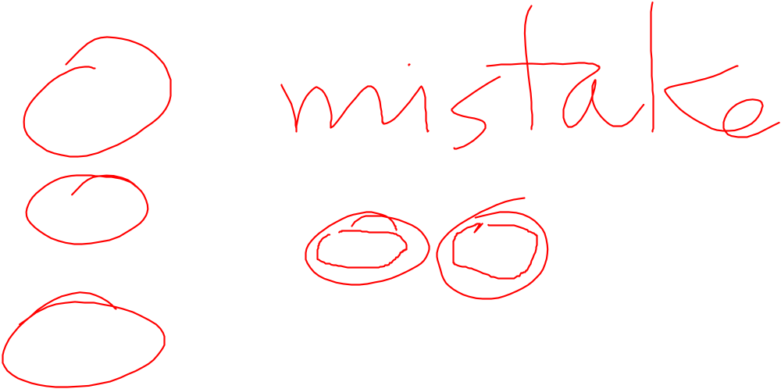
What is a “bug”?
Error: a human action that produces an incorrect result
Fault: a manifestation of an error in software
  also known as a defect or bug
  if executed, a fault may cause a failure
Failure: deviation of the software from its expected delivery or service
  (found defect)
Failure is an event; fault is a state of
the software, caused by an error

Slide 12
Error - Fault - Failure
A person makes
an error ...
… that creates a
fault in the
software ...
… that can cause
a failure
in operation

Slide 13
Reliability versus faults
Reliability: the probability that software will not cause the failure of the system for a specified time under specified conditions
  Can a system be fault-free? (zero faults, right first time)
  Can a software system be reliable but still have faults?
  Is a “fault-free” software application always reliable?

Slide 14

Why do faults occur in software?
software is written by human beings
  who know something, but not everything
  who have skills, but aren’t perfect
  who do make mistakes (errors)
under increasing pressure to deliver to strict deadlines
  no time to check but assumptions may be wrong
  systems may be incomplete
if you have ever written software ...

Slide 15
What do software faults cost?
11 of the most costly software errors in history [2019 update]
https://raygun.com/blog/costly-software-errors-history/

Slide 16
What do software faults cost?
huge sums
  Ariane 5 ($7billion)
  Mariner space probe to Venus ($250m)
  American Airlines ($50m)
very little or nothing at all
  minor inconvenience
  no visible or physical detrimental impact
software is not “linear”:
  small input may have very large effect

Slide 17
Safety-critical systems
software faults can cause death or injury
  radiation treatment kills patients (Therac-25)
  train driver killed
  aircraft crashes (Airbus & Korean Airlines)
  Being 737Max
  How the Boeing 737 Max Disaster Looks to a Software Developer
  https://spectrum.ieee.org/aerospace/aviation/how-the-boeing-737-max-disaster-looks-to-a-software-developer

Slide 18
So why is testing necessary?
  because software is likely to have faults
  to learn about the reliability of the software
  to fill the time between delivery of the software and the release date
  to prove that the software has no faults
  because testing is included in the project plan
  because failures can be very expensive
  to avoid being sued by customers
  to stay in business

Slide 19
Why not just "test everything"?
Avr. 4 menus
3 options / menu
system has
20 screens
Average: 10 fields / screen
2 types input / field
(date as Jan 3 or 3/1)
(number as integer or decimal)
Around 100 possible values
Total for 'exhaustive' testing:
  20 x 4 x 3 x 10 x 2 x 100 = 480,000 tests
If 1 second per test, 8000 mins, 133 hrs, 17.7 days
(not counting finger trouble, faults or retest)
10 secs = 34 wks, 1 min = 4 yrs, 10 min = 40 yrs

Slide 20
Exhaustive testing?
What is exhaustive testing?
  when all the testers are exhausted
  when all the planned tests have been executed
  exercising all combinations of inputs and preconditions
How much time will exhaustive testing take?
  infinite time
  not much time
  impractical amount of time

Slide 21
How much testing is enough?
  it’s never enough
  when you have done what you planned
  when your customer/user is happy
  when you have proved that the system works correctly
  when you are confident that the system works correctly
  it depends on the risks for your system

Slide 22
How much testing?
It depends on RISK
  risk of missing important faults
  risk of incurring failure costs
  risk of releasing untested or under-tested software
  risk of losing credibility and market share
  risk of missing a market window
  risk of over-testing, ineffective testing

Slide 23
So little time, so much to test ..
test time will always be limited
use RISK to determine:
  what to test first
  what to test most
  how thoroughly to test each item
}
i.e. where to
place emphasis
  what not to test (this time)
use RISK to
  allocate the time available for testing by prioritising testing ...

Slide 24
Most important principle
Prioritise tests
so that,
whenever you stop testing,
you have done the best testing
in the time available.

Slide 25

Testing and quality
testing measures software quality
testing can find faults; when they are removed, software quality (and possibly reliability) is improved
what does testing test?
  system function, correctness of operation
  non-functional qualities: reliability, usability, maintainability, reusability, testability, etc.

Slide 26
Other factors that influence testing
contractual requirements
legal requirements
industry-specific requirements
  e.g. pharmaceutical industry (FDA), compiler standard tests, safety-critical or safety-related such as railroad switching, air traffic control
It is difficult to determine
how much testing is enough
but it is not impossible

Slide 27
Contents
Principles
1
2
3
ISTQB / ISEB Foundation Exam Practice
4
5
6
Why testing is necessary
What is testing
Testing principles
Fundamental test process
Psychology of testing
Code of Ethics

Slide 28
Seven Testing Principles
Testing shows the presence of defects
Exhaustive testing is impossible
Early testing
Defect clustering
Pesticide paradox
Testing is context dependent
Absence-of-errors fallacy
https://www.guru99.com/software-testing-seven-principles.html

Slide 29
Contents
Principles
1
2
3
ISTQB / ISEB Foundation Exam Practice
4
5
6
Why testing is necessary
What is testing
Testing principles
Fundamental test process
Psychology of testing
Code of Ethics

Slide 30
Test Planning - different levels
Test
Policy
Company level
Test
Strategy
High Level
Test Plan
Project level (IEEE 829)
(one for each project)
High Level
Test Plan
Detailed
Test Plan
Test stage level (IEEE 829)
(one for each stage within a project,
e.g. Component, System, etc.)
Detailed
Test Plan
Detailed
Test Plan
Detailed
Test Plan

Slide 31
The test process
Planning (detailed level)
specification
execution
recording
check
completion

Slide 32
Test planning
how the test strategy and project test plan apply to the software under test
document any exceptions to the test strategy
  e.g. only one test case design technique needed for this functional area because it is less critical
other software needed for the tests, such as stubs and drivers, and environment details
set test completion criteria

Slide 33
Test specification
Planning (detailed level)
specification
execution
recording
check
completion
Identify conditions
Design test cases
Build tests

Slide 34
A good test case
Finds faults
effective
exemplary
evolvable
economic
Represents others
Easy to maintain
Cheap to use

Slide 35
Test specification
test specification can be broken down into three distinct tasks:
  1. identify: determine ‘what’ is to be tested (identify
  test conditions) and prioritise
  2. design: determine ‘how’ the ‘what’ is to be tested
  (i.e. design test cases)
  3. build: implement the tests (data, scripts, etc.)

Slide 36
Task 1: identify conditions
(determine ‘what’ is to be tested and prioritise)
list the conditions that we would like to test:
  use the test design techniques specified in the test plan
  there may be many conditions for each system function or attribute
  e.g.
    “life assurance for a winter sportsman”
    “number items ordered > 99”
    “date = 29-Feb-2004”
prioritise the test conditions
  must ensure most important conditions are covered

Slide 37
Selecting test conditions
Importance

Best set

First set
Time

Slide 38
Task 2: design test cases
(determine ‘how’ the ‘what’ is to be tested)
design test input and test data
  each test exercises one or more test conditions
determine expected results
  predict the outcome of each test case, what is output, what is changed and what is not changed
design sets of tests
  different test sets for different objectives such as regression, building confidence, and finding faults

Slide 39
Designing test cases
Most important
test conditions
Least important
test conditions
Importance
Test cases
Time

Slide 40
Task 3: build test cases
(implement the test cases)
prepare test scripts
  less system knowledge tester has the more detailed the scripts will have to be
  scripts for tools have to specify every detail
prepare test data
  data that must exist in files and databases at the start of the tests
prepare expected results
  should be defined before the test is executed

Slide 41
How to Write Test Cases: Sample Template with Examples
https://www.guru99.com/test-case.html
https://www.softwaretestinghelp.com/how-to-write-effective-test-cases-test-cases-procedures-and-definitions/
http://softwaretestingfundamentals.com/test-case/

Slide 42
Test execution
Planning (detailed level)
specification
execution
recording
check
completion

Slide 43
Execution
Execute prescribed test cases
  most important ones first
  would not execute all test cases if
    testing only fault fixes
    too many faults found by early test cases
    time pressure
  can be performed manually or automated

Slide 44
Test recording
Planning (detailed level)
specification
execution
recording
check
completion

Slide 45
Test recording 1
The test record contains:
  identities and versions (unambiguously) of
    software under test
    test specifications
Follow the plan
  mark off progress on test script
  document actual outcomes from the test
  capture any other ideas you have for new test cases
  note that these records are used to establish that all test activities have been carried out as specified

Slide 46
Test recording 2
Compare actual outcome with expected outcome. Log discrepancies accordingly:
  software fault
  test fault (e.g. expected results wrong)
  environment or version fault
  test run incorrectly
Log coverage levels achieved (for measures specified as test completion criteria)
After the fault has been fixed, repeat the required test activities (execute, design, plan)

Slide 47
Check test completion
Planning (detailed level)
specification
execution
recording
check
completion

Slide 48
Check test completion
Test completion criteria were specified in the test plan
If not met, need to repeat test activities, e.g. test specification to design more tests
Coverage too low
specification
execution
recording
check
completion
Coverage
OK

Slide 49
Test completion criteria
Completion or exit criteria apply to all levels of testing - to determine when to stop
  coverage, using a measurement technique, e.g.
    branch coverage for unit testing
    user requirements
    most frequently used transactions
  faults found (e.g. versus expected)
  cost or time

Slide 50
Comparison of tasks
Governs the
quality of tests
Planning
Intellectual
one-off
activity
Specification
Good to
automate
activity
repeated
many times
Execute
Recording
Clerical

Slide 51
Contents
Principles
1
2
3
ISTQB / ISEB Foundation Exam Practice
4
5
6
Why testing is necessary
What is testing
Testing principles
Fundamental test process
Psychology of testing
Code of Ethics

Slide 52
Why test?
build confidence
prove that the software is correct
demonstrate conformance to requirements
find faults
reduce costs
show system meets user needs
assess the software quality

Slide 53
Confidence
Confidence
Fault found
Faults found
Time
No faults found = confidence?

Slide 54
Assessing software quality
You think
you are here
High
Few
Faults
Many
Faults
Few
Faults
Low
High
Software Quality
Few
Faults
Test
Quality
Few
Faults
You may
be here
Low

Slide 55
A traditional testing approach
Show that the system:
  does what it should
  doesn't do what it shouldn't
Goal: show working
Success: system works
Fastest achievement: easy test cases
Result: faults left in

Slide 56
A better testing approach
Show that the system:
  does what it shouldn't
  doesn't do what it should
Goal: find faults
Success: system fails
Fastest achievement: difficult test cases
Result: fewer faults left in

Slide 57
The testing paradox
Finding faults destroys confidence
Purpose of testing: to find faults
Purpose of testing: destroy confidence
Purpose of testing: build confidence
The best way to build confidence
is to try to destroy it

Slide 58
Who wants to be a tester?
A destructive process
Bring bad news (“your baby is ugly”)
Under worst time pressure (at the end)
Need to take a different view, a different mindset (“What if it isn’t?”, “What could go wrong?”)
How should fault information be communicated (to authors and managers?)

Slide 59
Testers have the right to:
  accurate information about progress and changes
  insight from developers about areas of the software
  deliver code tested to an agreed standard
  be regarded as a professional (no abuse!)
  find faults!
  challenge specifications and test plans
  have reported faults taken seriously (non-reproducible)
  make predictions about future fault levels
  improve your own testing process

Slide 60
Testers have responsibility to:
  follow the test plans, scripts etc. as documented
  report faults objectively and factually (no abuse!)
  check tests are correct before reporting s/w faults
  remember it is the software, not the programmer, that you are testing
  assess risk objectively
  prioritise what you report
  communicate the truth

Slide 61
Independence (1.5.1)
Test your own work?
  find 30% - 50% of your own faults
  same assumptions and thought processes
  see what you meant or want to see, not what is there
  emotional attachment
    don’t want to find faults
    actively want NOT to find faults

Slide 62
Levels of independence
None: tests designed by the person who wrote the software
Tests designed by a different person
Tests designed by someone from a different department or team (e.g. test team)
Tests designed by someone from a different organisation (e.g. agency)
Tests generated by a tool (low quality tests?)

Slide 63
Contents
Principles
1
2
3
ISTQB / ISEB Foundation Exam Practice
4
5
6
Why testing is necessary
What is testing
Testing principles
Fundamental test process
Psychology of testing
Code of Ethics

Slide 64
Code of Ethics
ISTQB Code of Ethics:
  PUBLIC
  CLIENT AND EMPLOYER
  PRODUCT
  JUDGMENT
  MANAGEMENT
  PROFESSION
  COLLEAGUES
  SELF

Slide 65
Summary: Key Points
Principles
1
2
3
ISTQB / ISEB Foundation Exam Practice
4
5
6
Why testing is necessary
What is testing
Testing principles
Fundamental test process
Psychology of testing
Code of Ethics

