Slide 1
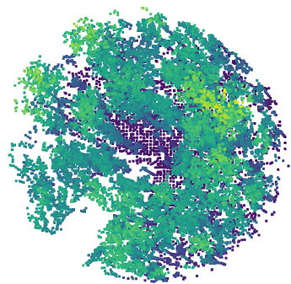
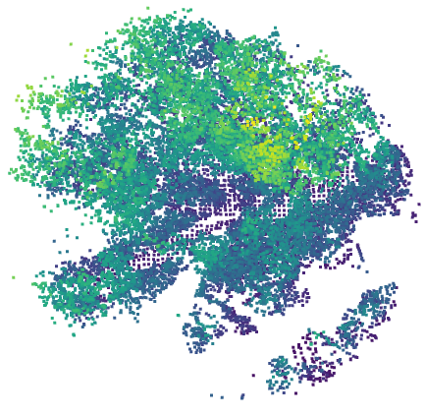

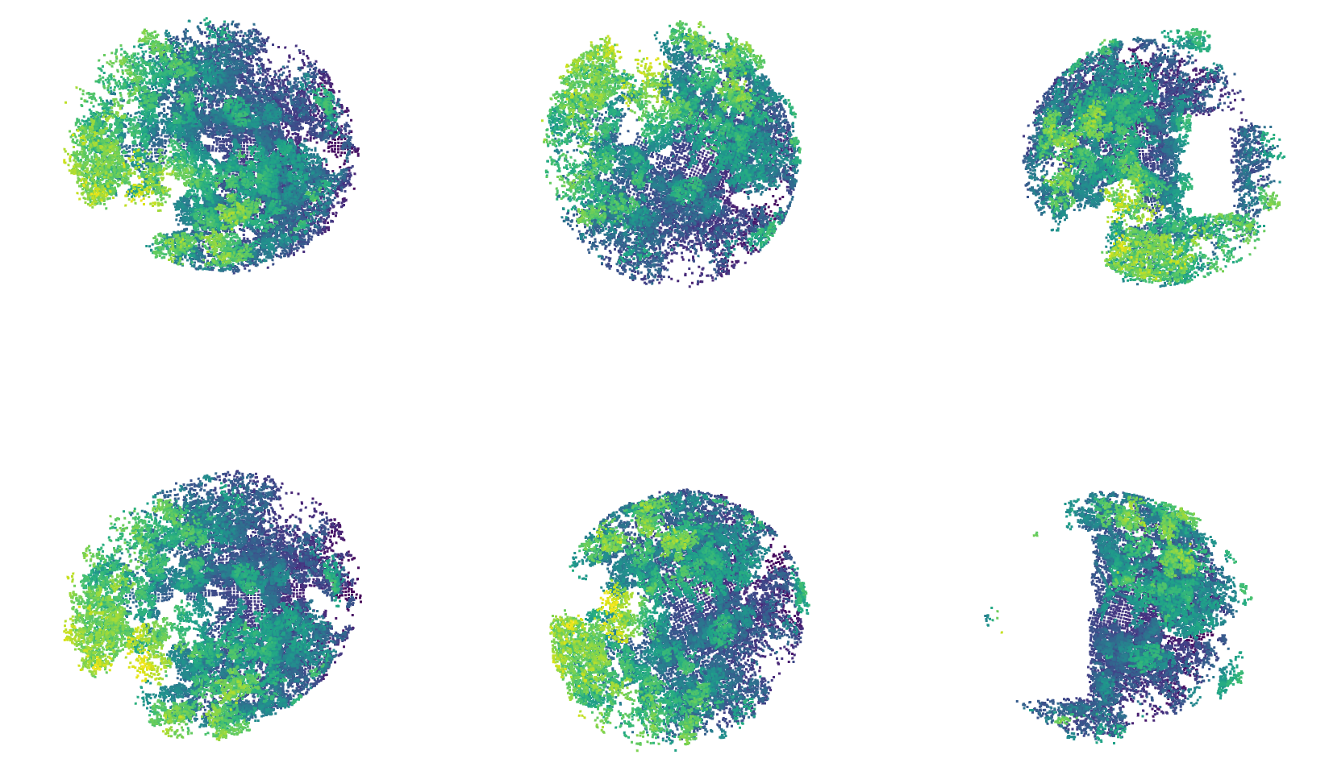
Training from scratch —— Supervision
Random Large Batch Construction
Loss function: Surrogate Recall@K、Metric Regularization
Descriptor Space
Similarity Matrix
- | 0.8 | 0.4 | 0.5
0.8 | - | 0.7 | 0.9
0.4 | 0.7 | - | 0.4
0.5 | 0.9 | 0.4 | -
🔥
g
🔥
. . .
Encoder
. . .
Retrievaler
Prediction
GT
Evaluation Phase
Retrievaler
Query Descriptor
❄️
Similarity Vector
Differential
Transformer
Blocks
Retrievaler
0.7 | 0.8 | 0.4 | 0.5
Similarity
Results
Database Descriptor
. . .
. . .
Prediction

