Slide 1
Named Data Networking Community Meeting
Sep 10-11, 2020 virtual event hosted by NIST
Panel 3 – lessons learned
Fri Sep 11, 10:45am – 12:15pm

Slide 2


NDNcomm Panel 3
Lessons Learned Over the Last 10 years
Panelists
Jeff Burke (UCLA REMAP)
David Clark (MIT)
Darleen Fisher (NSF)
Van Jacobson (Google)
Christos Papadopoulos (University of Memphis)
Lan Wang (University of Memphis)
Beichuan Zhang (University of Arizona)
Lixia Zhang (UCLA)
Moderator
Christian Tschudin (University of Basel)

Slide 3
NDNcomm Panel 3
Round 1
What are highlights of the last ten years?
Round 2
Where things could be improved
Round 3, closing statements
Where are we now?

Slide 4
Round 1:
What are highlights of the last ten years?

Slide 5
Round 1 / "What are highlights of the last ten years?"
Van Jacobson,
“spiritus rector” / researcher
IP is a communications framework that implements the Shannow-Weaver communication model (sender-channel-receiver).
I wanted a framework that could implement richer models, e.g., Barnlund's, that include broadcast channels, multiparties, asymmetric roles, intent, reciprocity, "speech acts", etc. NDN is such a framework.

Slide 6
Round 1 / "What are highlights of the last ten years?"
Jeff Burke
“driving NDN through use cases, library dev”
Emotional highlights were hackathons,
other problem-solving focused efforts:
way-clever approaches
emerging from data-centric thinking
"messy vitality"
- approaches were hybrid/compromising/accomodating,
- rather than architectually pure/clean/excluding

Slide 7
Round 1 / "What are highlights of the last ten years?"
Dave Clark
“one of the original designers of the Internet”
Excited about NDN is the boldness of its divergence
from current thinking (most of the FIA proposals were somewhat incremental)
NDN explores what can be done if there is per-packet state in the router.
The approach to security evolved/emerged over time:
to me that is clearly something that worked out well.
I think what is interesting is to track how the research team evolved their thinking (→ “where we could improve”)

Slide 8
Round 1 / "What are highlights of the last ten years?"
Darleen Fisher
“Program Director, Networking Research, NSF”
A Good Idea
Funding Surge
  A Legacy
  A Research Infrastructure and Research to Run on it
  A Secure Internet
  GENI & FIA
A Paper
A Zealous Champion
A Dedicated Persistent Team
Rich Research Problems
Other Funders
The Right Stuff: Architecture, Code, Libraries, etc.
Building of Community
Applications and Use Cases
Users

Slide 9
Round 1 / "What are highlights of the last ten years?"
Christos Papadopoulos
“working with NDN since 2010”
robust NDN community,
improvements in NFD
and beginning adoption by industry.

Slide 10
Round 1 / "What are highlights of the last ten years?"
Lan Wang
“contributor to NDN architecture development”
  routing protocol as an example NDN app (sync, security)
  largely static routing + adaptive forwarding
  decentralized apps: social media, smarthome, …

Slide 11
Round 1 / "What are highlights of the last ten years?"
Beichuang Zhang
“University of Arizona”
Biggest highlight is the one idea (naming the data) that changes the foundation of how we design and build networked systems.
In terms of the process:
the emergence of the ICN/NDN research community
the development of a number of NDN apps and forwarder on different platforms are notable achievements.

Slide 12
Round 1 / "What are highlights of the last ten years?"
Lixia Zhang
“orchestrated the original NDN proposal to NSF, lead PI of the NDN project, keeping the team going”
NDN got the basic idea right:
semantically named, secured data
as the basic architecture building block

Slide 13
Round 2:
Where things could be improved

Slide 14
Round 2 / “where things could be improved”
Van Jacobson,
“researcher”
Most NDN 'research' has focused on how to make NDN behave like IP.

Slide 15
Round 2 / “where things could be improved”
Jeff Burke
“driving NDN through use cases, library dev”
Emotional highlights were hackathons,
other problem-solving focused efforts:
way-clever approaches
emerging from data-centric thinking
"messy vitality"
- approaches were hybrid/compromising/accomodating,
- rather than architectually pure/clean/excluding

Slide 16
Round 2 / “where things could be improved”
Dave Clark
“one of the original designers of the Internet”
Excited about NDN was the boldness of its divergence from current thinking (most of the FIA proposals were somewhat incremental)
NDN explores what can be done if there is per-packet state in the router.
The approach to security evolved/emerged over time:
to me that is clearly something that worked out well.
I think what is interesting is to track how the research team evolved their thinking

Slide 17
Round 2 / “where things could be improved”
Darleen Fisher
“Program Director, Networking Research, NSF”
Finding Funding
Broader Research Community Support
  Publications (ACM ICN)
  Jobs for Students
  Proposals hard to fund
Framing/Selling the “Product”—Context Switching
  What it Enables
  How it Compares to Other Products
  What is New
Transitions are Challenging: e.g. from:
  Concept to Architecture
  Architecture to an Internet
  Research to Engineering and Back
  Research to Development to Deployment
  Clunky to Ease of Use
  From Research Network to Production Network
    Academic to Commercial-Grade Code
    Embracing Other’s Develppments
    Securing NDN Itself

Slide 18
Round 2 / “where things could be improved”
Christos Papadopoulos
“working with NDN since 2010”
NDN needs a success story that clearly demonstrates
its advantages over host-based communication
We need to focus more on applications for maximum impact.

Slide 19
Round 2 / “where things could be improved”
Lan Wang
“contributor to NDN architecture development”
  routing protocol as an example NDN app (sync, security)
  largely static routing + adaptive forwarding
  decentralized apps: social media, smarthome, …

Slide 20
Round 2 / “where things could be improved”
Beichuang Zhang
“University of Arizona”
We should have a common user-friendly API:
without exposing too much low level interest/data information
for non-network developers to write apps without understanding low-level mechanisms.
This involves both the API design (understand what apps want), and API implementation (what the network can do).

Slide 21
Round 2 / “where things could be improved”
Lixia Zhang
“orchestrated the original NDN proposal to NSF, lead PI of the NDN project”
- being truly app-drive architecture development, building usable apps
where we are now
- the end of the beginning:
learned where the difficulties are in pushing out NDN,
and learned how to get there: edge-in

Slide 22
Round 3:
Where are we now?
(closing statements)

Slide 23
Round 3 / “where are we now”
Van Jacobson,
“researcher”
Who is "we"?

Slide 24
Round 3 / “where are we now”
Jeff Burke
“driving NDN through use cases, library dev”
At an inflection point
for two "faces" of the NDN architecture:
- user-focused
- research community-focused

Slide 25
Round 3 / “where are we now”
Dave Clark
“one of the original designers of the Internet”

Slide 26
Round 3 / “where are we now” or closing statement
Darleen Fisher
“Program Director, Networking Research, NSF”

Slide 27
Round 3 / “where are we now”
Christos Papadopoulos
“working with NDN since 2010”
We are still an important research project that is slowly gaining momentum.
However, we have not broken out of that mold to the broader networking community.

Slide 28
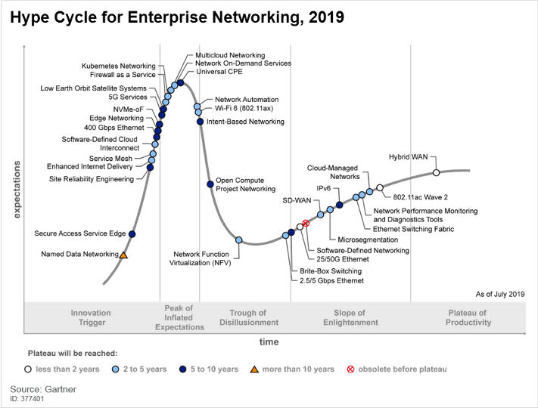
Round 3 / “where are we now”
Lan Wang
“contributor to NDN architecture development”

Slide 29
Round 3 / “where are we now”
Beichuang Zhang
“University of Arizona”
Using the house analogy, I think we have a foundation here with the basic protocol, implementation, and libraries.
But much need to do to fully explore the potential (e.g., security/trust management, in-network storage and computation, etc.) with applications.

Slide 30
Round 3 / “where are we now”
Lixia Zhang
“orchestrated the original NDN proposal to NSF, lead PI of the NDN project, keeping the team going”
The end of the beginning:
- learned where the difficulties are in pushing out NDN
- and learned how to get there: edge-in

Slide 31
End of Panel 3
Thank you, panelists!

