Slide 1






Publishing Genomics Datasets into an NDN Testbed and Integrating with Cloud Workflows
F. Alex Feltus^{1,2,*}, Cameron Ogle⁴, Rini Pauly², David Reddick⁵, Coleman McKnight¹, Tyler Biggs⁶, Josh Burns⁶, Stephen P. Ficklin⁶, Susmit Shannigrahi⁵
⁴Clemson University School of Computing, Clemson, SC 29634, USA
⁵Tennessee Tech University Department of Computer Science, Cookeville, TN38505, USA
⁶Washington State University Department of Horticulture, Pullman, WA 99164, USA
F. Alex Feltus, Ph.D.
¹Clemson Dept. of Genetics & Biochemistry (Professor)
²CU-MUSC Biomedical Data Science & Informatics Program (Member)
*CU Center for Human Genetics (Member)
*Praxis AI LLC (co-Founder)
*Internet2 Board of Trustees (Member)
ffeltus@clemson.edu
NDNcomm2020: 10 September 2020 10.15am
https://bluejeans.com/449993504

Slide 2
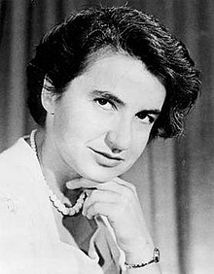
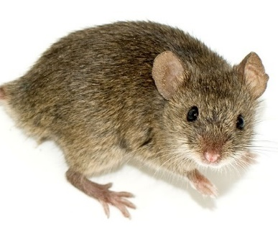
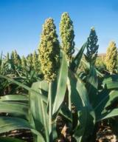
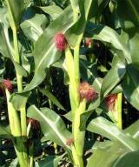
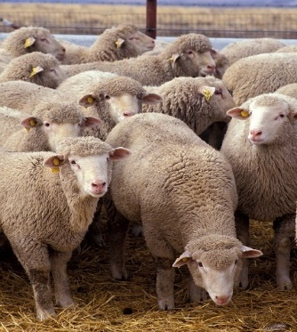
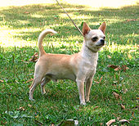
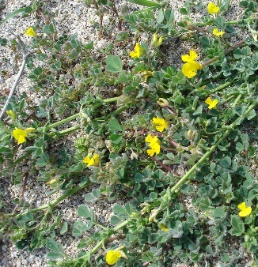
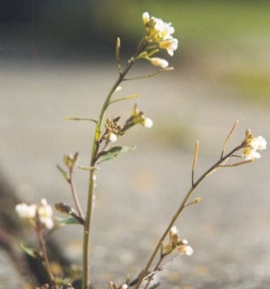
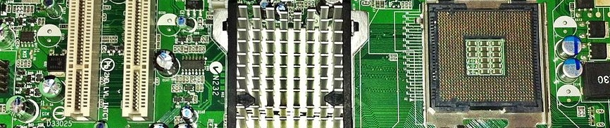
We Do Computational Biology Research
Vertebrates
Angiosperms
Bioinformatics + Cyberinfrastructure
Source: Wikipedia; Feltus Lab

Slide 3
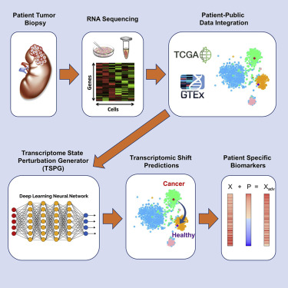
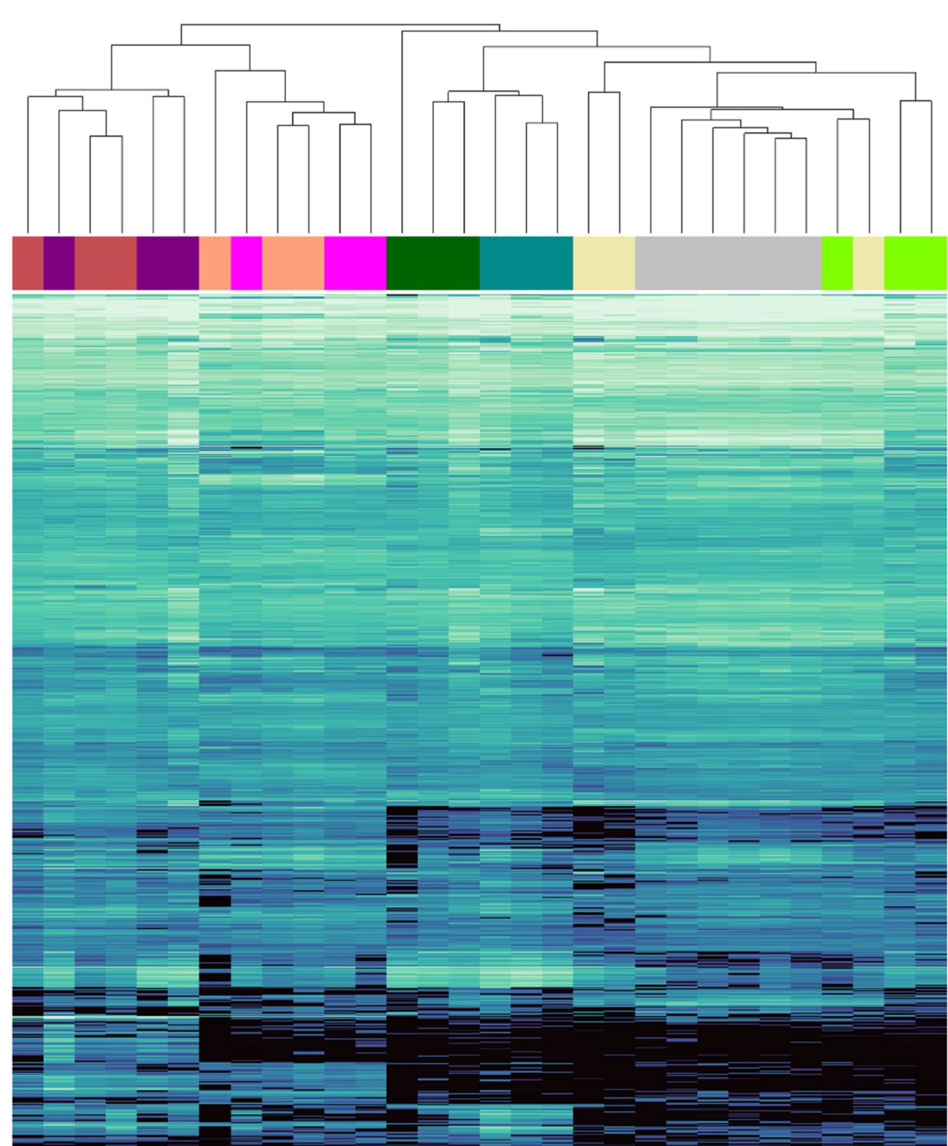
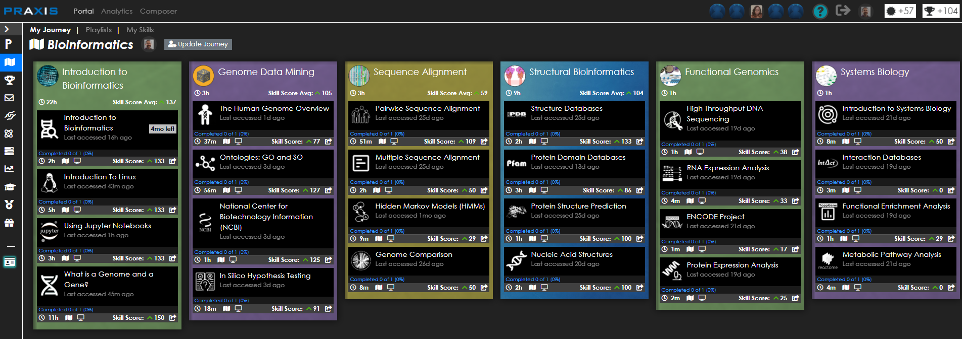

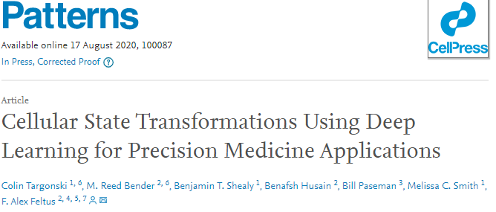
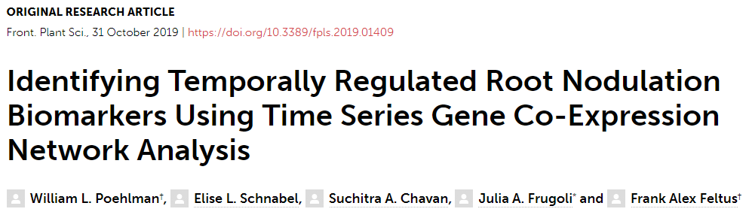
Active Research Project Examples
Leverage AI for Precision Medicine
Find Symbiosis Genes that may Reduce Fertilizer Usage in Agriculture
Scalable Bioinformatics Training
prxai.com

Slide 4
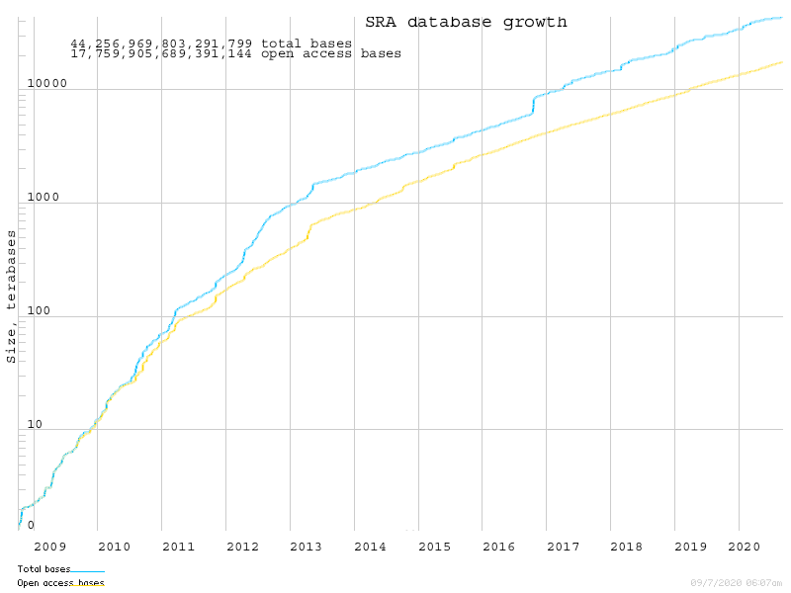
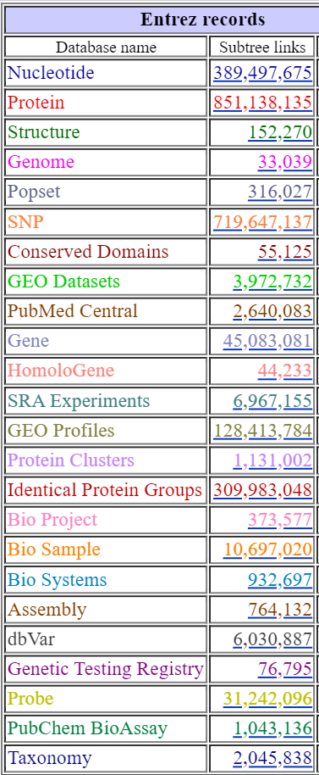




High Resolution DNA Datasets are Stored in NCBI SRA, NASA GeneLab, Local Disks, and Community Databases
44.3 PBs
478K Species

Slide 5
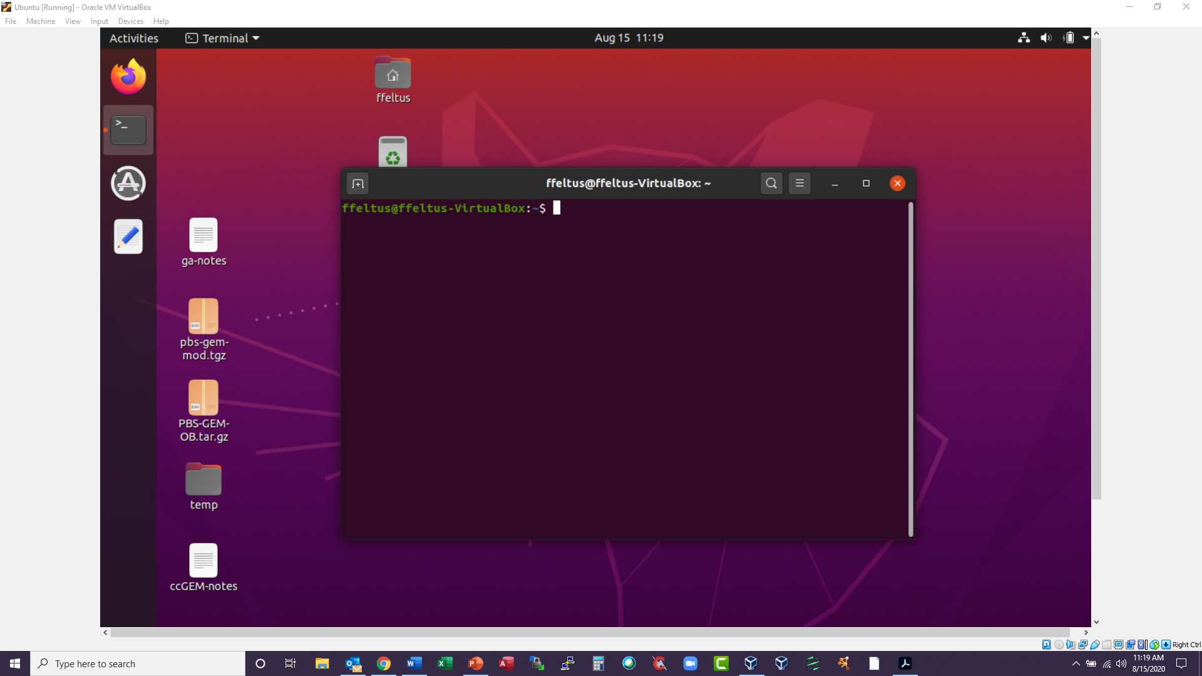
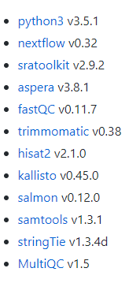

Genomic Data Flow Through the Cloud
User Laptop
Kubernetes (K8s) Cluster
TACC, PRP, GCP
Nextflow API
/SystemsGenetics/GEMmaker
Namespace PVC
GitHub/DockerHub
Workflow
Containers
Data Transfer Pod (DTP)
Local Storage
NDN
NCBI-SRA
NDN Testbed
EBI Ensembl
NASA GeneLab
https://github.com/SciDAS/dtp
https://github.com/SystemsGenetics/GEMmaker

Slide 6
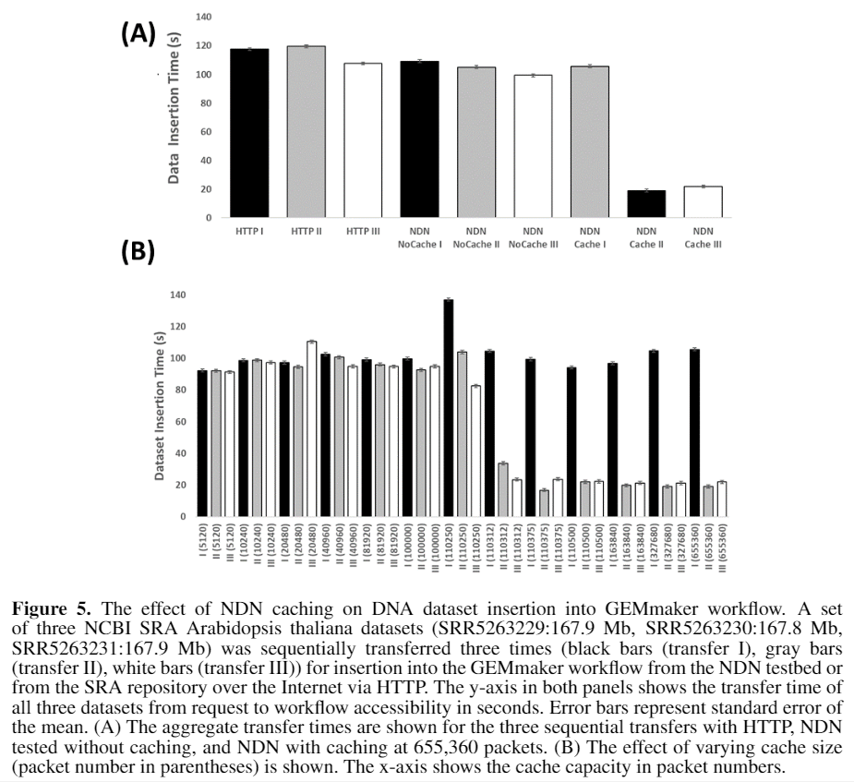
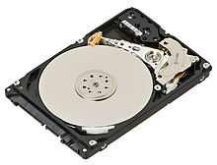
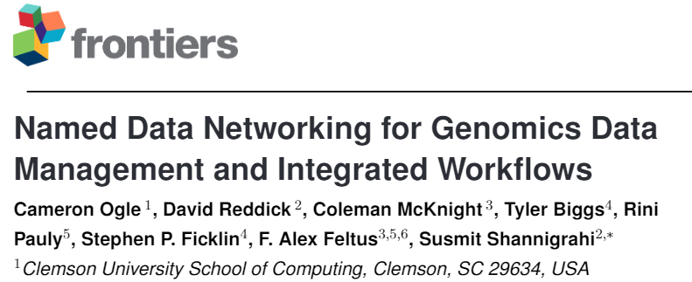
Genomics Data Problems Addressed With NDN
Datasets are enormous and distributed.
NDN:::Caching
FAIR data principles: Findability, Accessibility, Interoperability, and Reusability.
Local Storage
Common File Formats (FASTA, SRA, FASTQ)
Preindexed Genomes (Pynome)
NDN:::Data Access from Heterogenous Data Sources is Abstracted from the Consumer
Alternate metadata schemas and APIs
APIs may not exist
In review

Slide 7
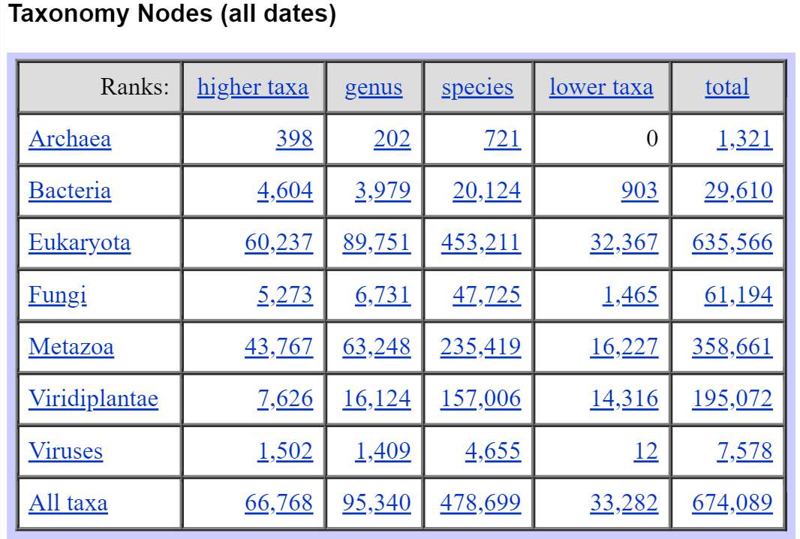
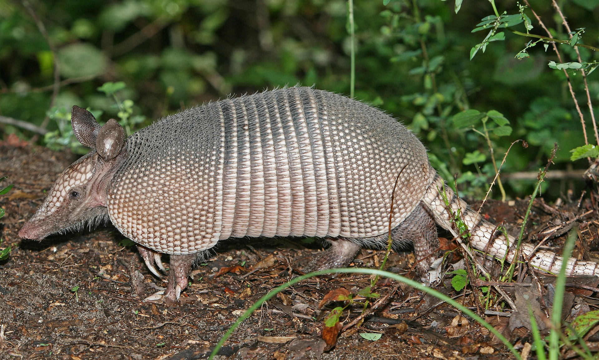
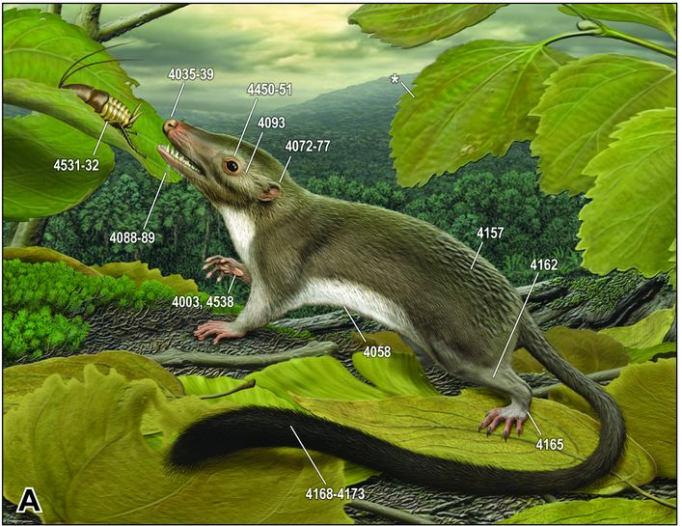
Genomics Data is Organized by Evolution and Measurement
By http://www.birdphotos.com - Own work, CC BY 3.0, https://commons.wikimedia.org/w/index.php?curid=4325104
Boreoeutheria
Xenarthra
60,000,000 years
Armadillo
cellular organisms; Eukaryota; Opisthokonta; Metazoa; Eumetazoa; Bilateria; Deuterostomia; Chordata; Craniata; Vertebrata; Gnathostomata; Teleostomi; Euteleostomi; Sarcopterygii; Dipnotetrapodomorpha; Tetrapoda; Amniota; Mammalia; Theria; Eutheria; Xenarthra; Cingulata; Dasypodidae; Dasypus; Dasypus novemcinctus
Human
cellular organisms; Eukaryota; Opisthokonta; Metazoa; Eumetazoa; Bilateria; Deuterostomia; Chordata; Craniata; Vertebrata; Gnathostomata; Teleostomi; Euteleostomi; Sarcopterygii; Dipnotetrapodomorpha; Tetrapoda; Amniota; Mammalia; Theria; Eutheria; Boreoeutheria; Euarchontoglires; Primates; Haplorrhini; Simiiformes; Catarrhini; Hominoidea; Hominidae; Homininae; Homo sapiens
MA O'Leary et al. The Placental Mammal Ancestor and the Post–K-Pg Radiation of Placentals. 2013 Vol. 339 no. 6120 pp. 662-667).
Source: NCBI Taxonomy Browser

Slide 8
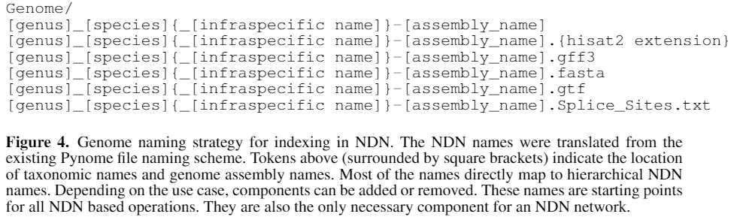
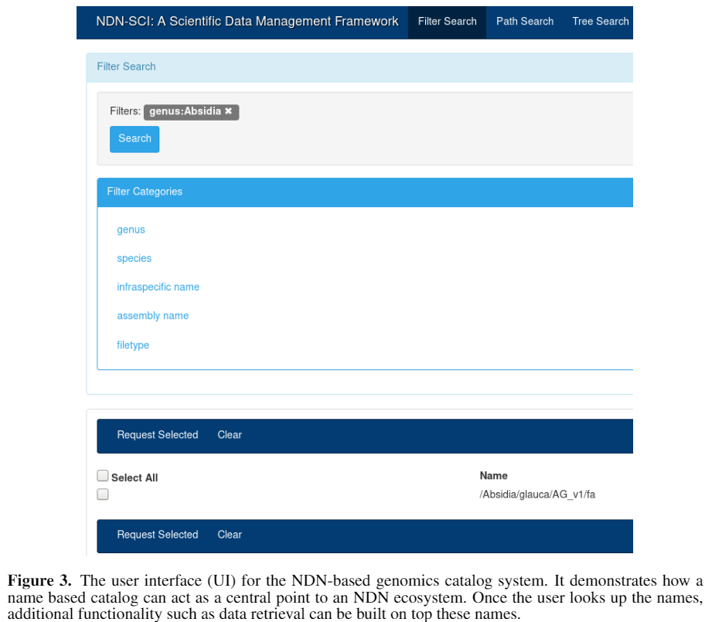
Named Genomics Datasets
REFERENCE GENOMES
https://github.com/SystemsGenetics/pynome
RNA Expression Datasets
/BIOLOGY/SRA/9605/9606/NaN/RNA-Seq/ILLUMINA/TRANSCRIPTOMIC/PAIRED/Kidney/PRJNA359795/SRP095950/SRX2458154/SRR5139398/1
In Review

Slide 9
Datasets We Are Moving into NDN Testbed
NCBI-SRA-Animal_Example:(0.16 TB; 36X2 SRA Samples; Human kidney): https://www.ncbi.nlm.nih.gov/bioproject/359795
Transcriptome sequencing (RNA-Seq) of non-tumor kidney tissues from 36 patients undergoing nephrectomy for exploring the metabolic mechanism of sorafenib and identifying the major transcriptional regulation factors in sorafenib metabolism in kidney
NCBI-SRA-Plant_Example: (1.14 TB; 475X2 SRA Samples; Rice leaves):
Rice gene expression in heat stress and dehydration stress - time series
https://www.ncbi.nlm.nih.gov/bioproject/?term=PRJNA301554
Indexed Ensembl Genomes (~1000)
In progress…
Pynome Indexed Ensembl Genomes (All of them)
NASA-GeneLab-SpacePlants (ISS grown plants and ground based controls):
https://www.ncbi.nlm.nih.gov/bioproject/?term=PRJNA301554
NCBI SRA-Primates-Triggered (40.5 PB; 6,258,789 experiments; 661,303 species)
NASA-Genelab Space Genomics Datasets (All)

Slide 10
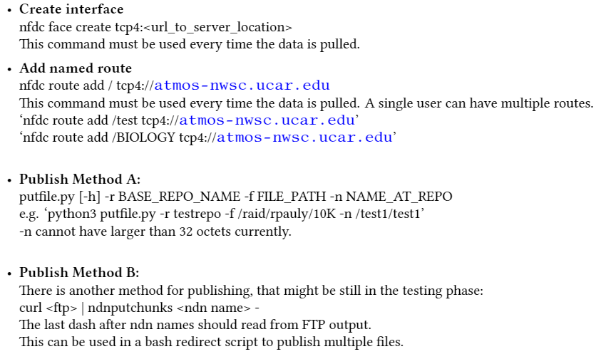
Workflow-NDN Testbed Interaction
NDN Tech Report 68
Publish Data to NDN Test Bed
K8s Data Transfer Pod
Google Cloud Products
Globus Connect Personal
iRODS
Name-Defined Networking(NDN)
Hybrid Information-Centric Networking (hICN)
Aspera
Amazon Web Services
MinIO
SRA Toolkit(NCBI)
Local transfers
Pull Data from NDN Test Bed
ndncatchunks -v -T -D /BIOLOGY/SRA/9605/9606/NaN/RNA-Seq/ILLUMINA/TRANSCRIPTOMIC/PAIRED/Kidney/PRJNA359795/SRP095950/SRX2458154/SRR5139398/1 > SRR5139398_1.fastq.gz

Slide 11














Acknowledgements
Feltus Lab
Yuqing Hang (<PhD, G&B)
Allison Hickman (<PhD, G&B)
Ben Shealy (<PhD, ECE)
Yueyao Gao (<PhD, G&B)
Rini Pauly (<PhD, G&B)
Cole McKnight (Cloud Architect)
Reed Bender (<MSc, BioE)
Cameron Ogle (BSc, CS)
Ethan Bensman (<BSc, G&B)
Kaitlyn Gmitro (<BSc, G&B)
Meghan Mobley (<BSc, G&B)
Brad Selee (<BSc, ECE)
Nicole Nelligan (<BSc, G&B)
Recent alumni
Benafsh Husain (PhD, BDSI)
Will Poehlman (PhD, G&B)
Jordan Little (BSc, G&B)
Rachel Eimen (Bsc, ECE)
Courtney Shearer (BSc, CS)
Melissa Judge (<BSc, BioE)
Colin Targonski (MSc, , ECE)
Leland Dunwoodie (<MD, G&B)
Olivia Feltus (<BSc, Intern)
Nick Watts (Software Engineer)
Zach Gerstner (<MS, BDSI)
Cole Younginer (<MSc, ECE)
@ Clemson
Melissa Smith (ECE)
KC Wang (ECE)
Walt Ligon (ECE)
Nick Mills (ECE)
Jon Calhoun (ECE)
Brian Dean (CS)
Marc Birtwistle (ChemE)
Brian Booth (BioE)
Julia Frugoli (G&B)
Suchitra Chavan (G&B)
Elise Schnabel (G&B)
Susan Duckett (AVS)
Corey Ferrier (CCIT)
Jim Pepin (CCIT)
Xizhou Feng (CCIT)
Will Robinson (CCIT)
@ Earth
Stephen Ficklin (WSU)
Josh Burns (WSU)
Tyler Biggs (WSU)
Dorrie Main (WSU)
Sook Jung (WSU)
Joe Breen (Utah)
Jill Wegrzyn (UCONN)
Meg Staton (UTK)
Jim Bottum (Internet2)
Dana Brunson (Internet2)
John Hicks (Internet2)
Marvin Weinstein (Quantum Insights LLC)
Ken Matusow (Synergity)
Karan Sapra (nVidia)
David Clarke (Toolwire)
@ Earth (cont.)
Mats Rynge (USC-OSG)
Bala Desinghu (U Chicago-OSG)
Andrew Paterson (UGA)
Claris Castillo (RENCI)
Steve Cox (RENCI)
Ray Idaszak (RENCI)
Paul Ruth (RENCI)
Michael Stealy (RENCI)
Isma Gilani (RENCI)
Fan Jiang (RENCI)
Mert Cevik (RENCI)
Ananya Mukherghee (RENCI)
Emily Casanova (USC-GHS)
Manual Casanova (USC-GHS)
Alex Bowers (Columbia U.)
Josh Vandenbrink (Louisiana Tech)
Ann Loraine (UNCC)
Colleen Doherty (NCSU)
John Graham (UCSD)
Wallace Chase (REANNZ)
Christos Papadopoulos (Memphis)
Susmit Shannigrahi (Tennessee Tech)
Chengyu Fan (CSU)
Many many more

