Slide 1
Data-Centric Ecosystems for
Large-Scale Data-Intensive Science
Edmund Yeh

Slide 2
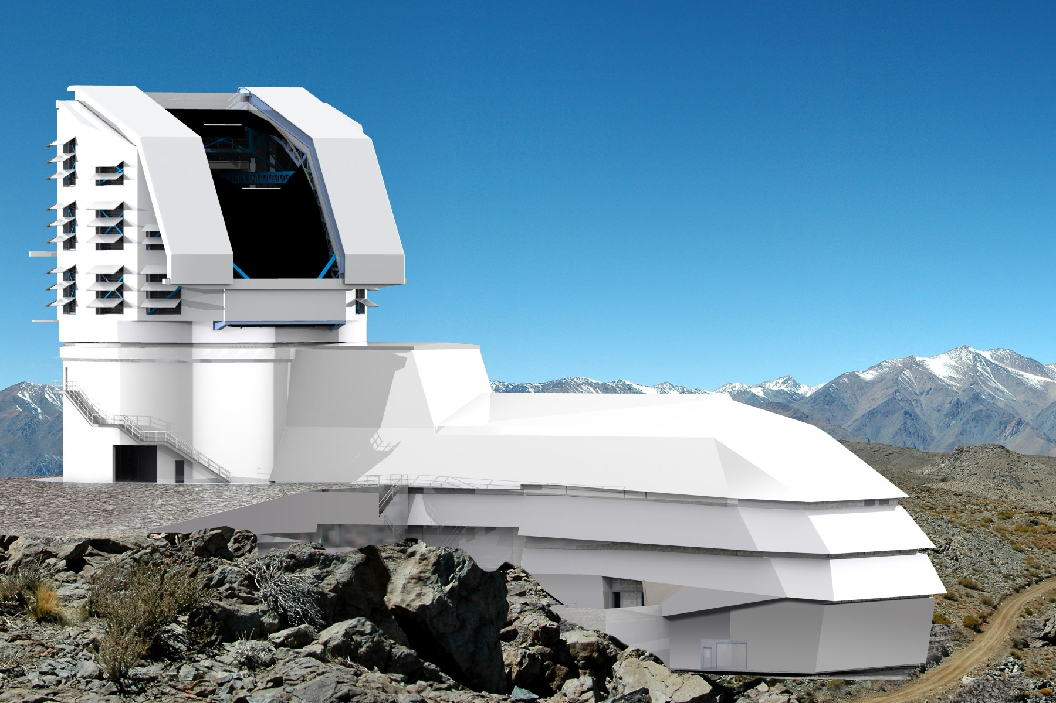
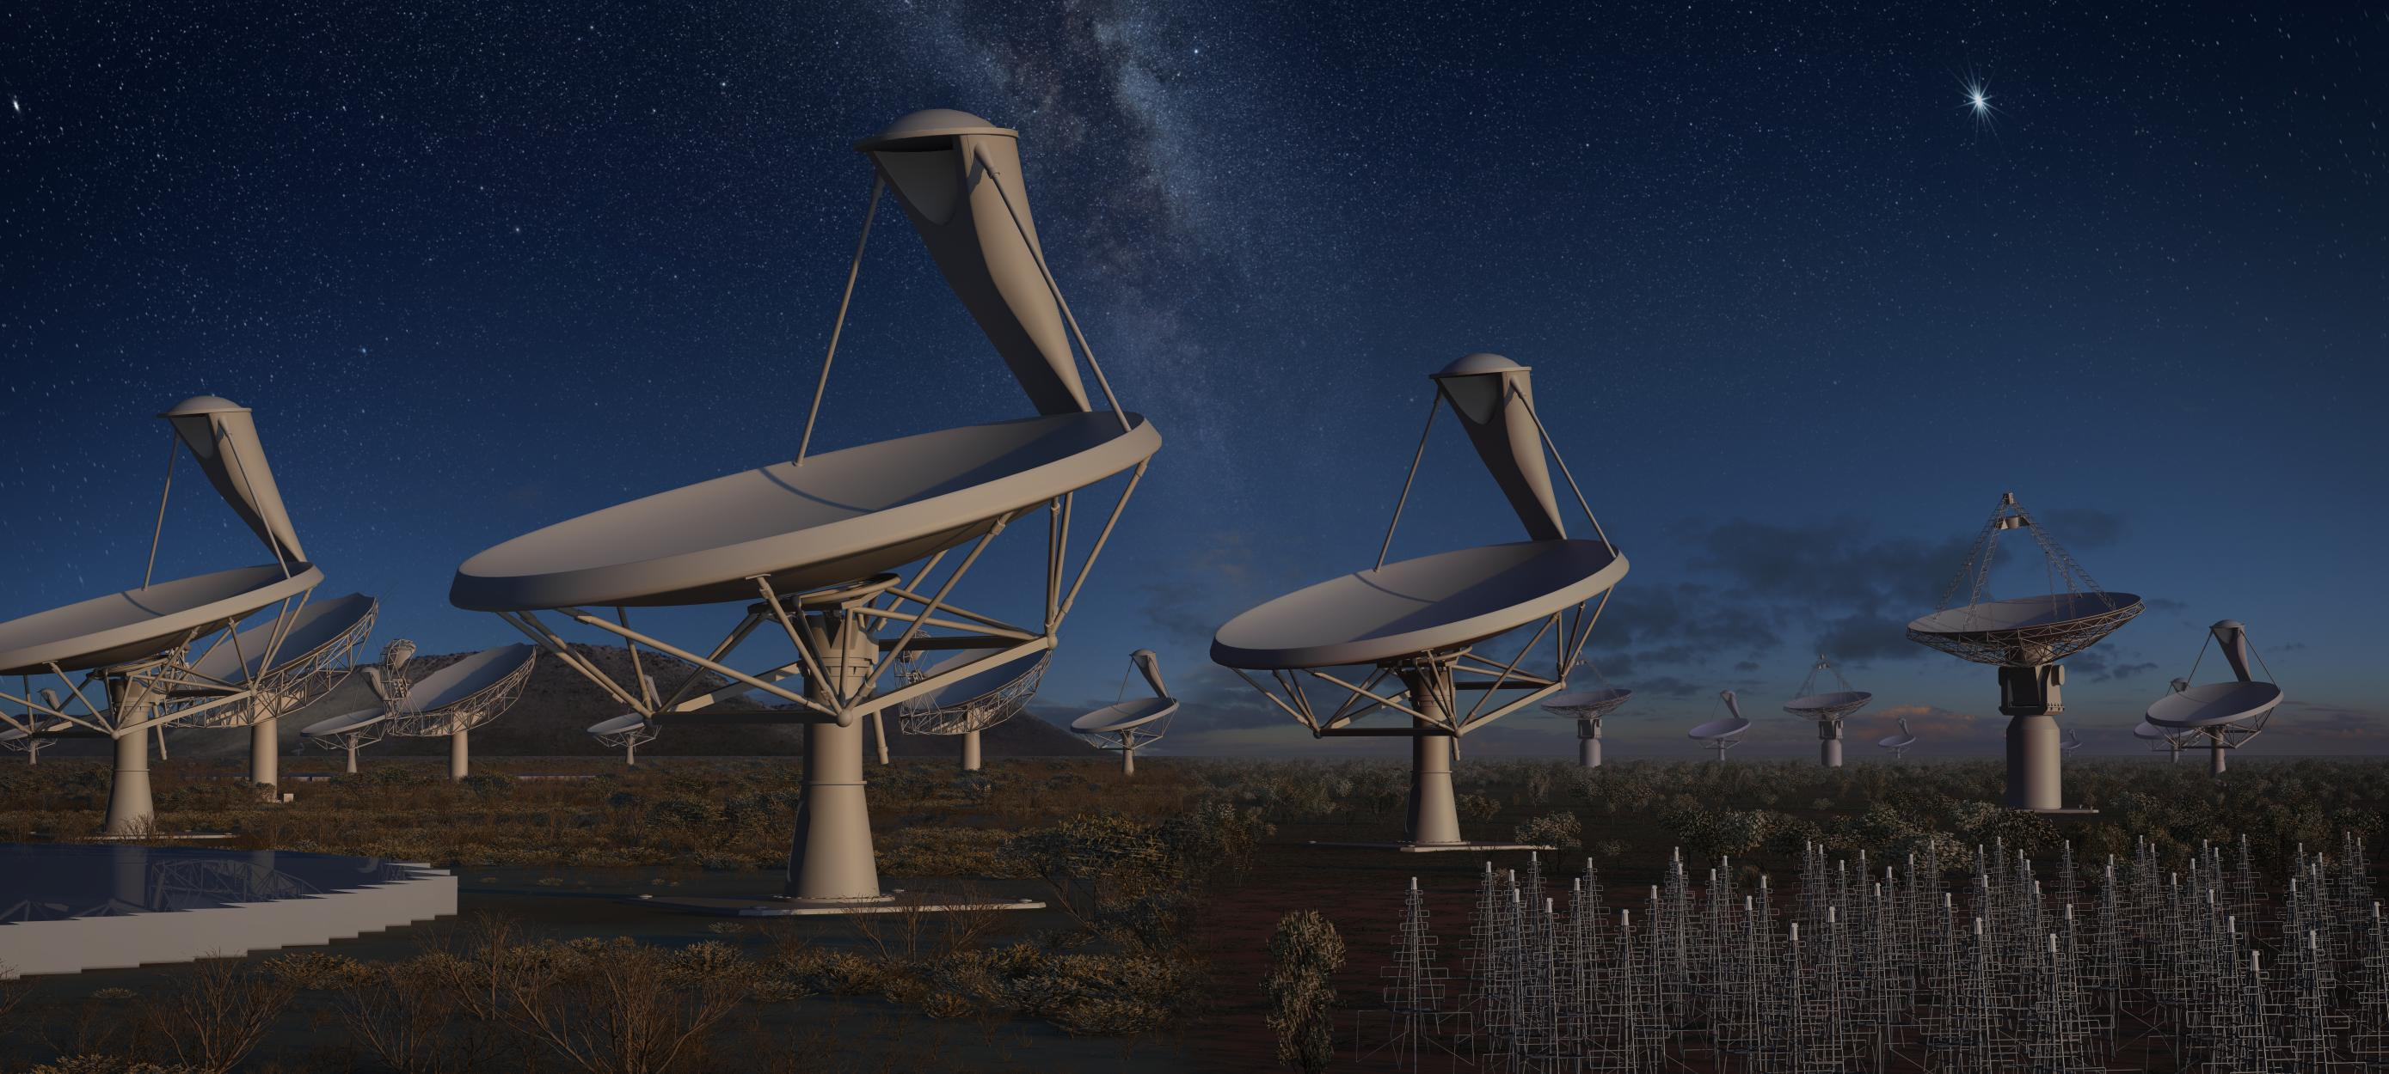
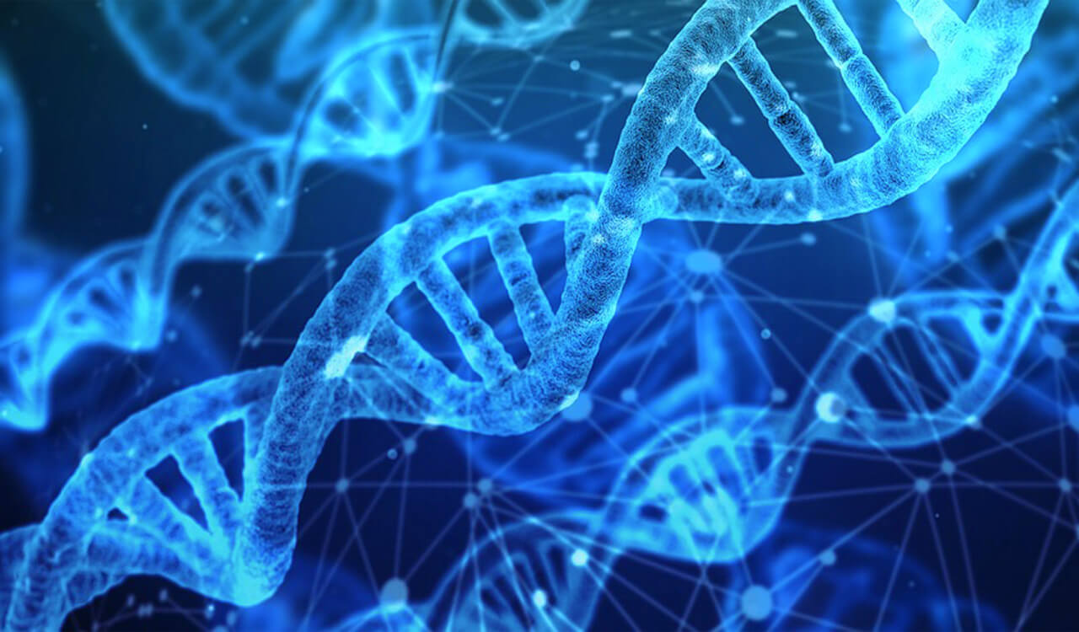
Data-Intensive Science
LHC: Large Hadron Collider
LSST: Large Synoptic Survey Telescope
SKA: Square Kilometer Array
Genomics

Slide 3
Challenges of Data-Intensive Science
Data-intensive applications face similar set of problems:
  - LHC high energy physics, LSST, LIGO, genomics
System challenges:
  - Indexing, security, storage, distribution, analysis, learning
  - Coordinated use of computing, storage, network resources
Today: domain experts are dealing with these systems problems
  - Incremental solutions; developed in isolation; replicated efforts
Gap between application needs and existing networks/systems
  - Current computer networks/systems focus on addresses, processes, servers, connections
  - Consequently existing security solutions focus on securing data containers and delivery pipes
  - Applications care about data

Slide 4
Data-Centric Networking
Data-centric approach to system and network design
Providing system support through the whole data lifecycle:
  - Data production: naming, securing data directly
  - Delivering data using names enables scalable data retrieval
    - in-network caching
    - automated joint caching and forwarding
    - multicast delivery
Common framework to support different application domains
Named Data Networking (NDN): http://named-data.net

Slide 5
NSF SANDIE Project
  NSF CC* SANDIE: SDN Assisted NDN for Data Intensive Experiments (started July 2017)
  Team:
  - Northeastern (PI: E. Yeh), Caltech (Co-PI: H. Newman), Colorado State
  (Co-PI: C. Papadopoulos/C. Partridge)
  - In partnership with other LHC sites and NDN project team
  Approach: Use SDN-assisted NDN to redesign LHC HEP network; optimize workflow
Solutions:
  - Development of NDN naming scheme for fast access and efficient communication in HEP and other fields - - Deployment of NDN edge caches with SSDs at multiple sites
  - Simultaneously optimization of caching (“hot” datasets) and forwarding

Slide 6
SANDIE Results
Feasibility of NDN-based data distribution system for LHC first demonstrated at SC 18 (Dallas)
SANDIE demo at SC 19 (Denver) showed greatly improved throughput and delay performance by leveraging:
  - VIP jointly optimized caching and forwarding algorithms developed by
  Northeastern (Yeh et al. 2014)
  - High-speed NDN-DPDK forwarder developed by NIST (Shi et al. 2019)
  - NDN-DPDK-based consumer and producer developed by Caltech
  (Iordache, et al. 2019)
Demo over SANDIE transcontinental layer-2 demo testbed (SC19 – Caltech – Northeastern – Colorado State)
Achieved over 6.7 Gbps throughput (single thread) between NDN-DPDK-based consumer and producer
Optimized caching and forwarding algorithms decreased download times by a factor of 10.

Slide 7
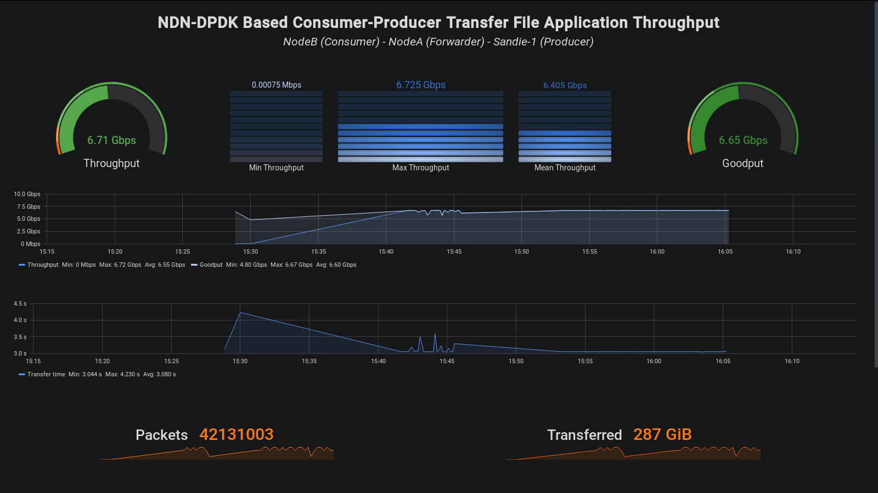
XRootD with NDN-DPDK: Throughput (1 Thread)
Notes:
PPS results indicate payloads with the same number of fragments have similar results
Both Payload 3000 and 4000 have 3 fragments
Both Payload 6000 and 7000 have 5 fragments
Goodput results show fully utilizing the fragments could get better results
The last fragment of 4000 is more than the last fragment of 3000
The last fragment of 7000 is more than the last fragment of 6000
In our experiments, we sometimes encountered the “tokenHt-full” errors, which may hurt the performance.

Slide 8
NSF N-DISE Project
NSF CC* N-DISE: NDN for Data Intensive Science Experiments (Starting 2020)
Team:
  Northeastern (PI: E. Yeh), Caltech (Co-PI: H. Newman), UCLA (Co-PIs: L. Zhang and J. Cong), Tennessee Tech (Co-PI: S. Shannigrahi)
  In partnership with LHC, genomics collaborators and NDN project team
Challenges:
  LHC data volume to grow 10x due to High Luminosity LHC (2027): increased data complexity
  Human genome data, Earth Biogenome (~ exabyte range)
  Need to use diverse computation, storage, networking resources
Approach: build data-centric ecosystem to provide agile, integrated, interoperable, scalable, robust and trustworthy solutions for heterogeneous data-intensive domains

Slide 9
N-DISE Goals
Deploy, commission first prototype production-ready NDN-based petascale data distribution, caching, access, computation system serving major science programs
LHC high energy physics program as leading target use case. BioGenome, human genome projects, ATLAS, LSST, SKA as future use cases
Leverage NDN protocols, high throughput forwarding/caching methods, containerization techniques
Integrated with SDN methods and FPGA acceleration subsystems
Deliver LHC data over wide area network at throughputs ~ 100 Gbps
Dramatically decrease download times by using optimizing caching
Enhanced testbed with high performance NDN data cache servers

Slide 10
N-DISE Research Agenda
NDN-DPDK Consumer and Producer
  Multi-threaded consumer and producer applications: linear throughput scaling
  Integrate with NDN-DPDK XRootD plugin
Containers for NDN-DPDK and applications
  For diverse server equipment and interfaces
  Docker containers: host guest OS, state restoration, ease upgrading
Data integrity and provenance
  Data origin authentication
  Authenticated tracing as data goes through multiple processing steps
  Data manifest: compute hashes of data segments, sign hashes

Slide 11
N-DISE Research Agenda
Congestion control and retransmission: NETBLT at network layer
Caching and Storage
  Multi-threaded VIP caching and forwarding
  Hierarchical cache system (SSDs, Intel Optane, etc.) for handling data volume
FPGA acceleration
  Programming adaptive, high throughput, low latency, energy efficiency
  Accelerate hash functions and lookups in NDN-DPDK Name Dispatch Table (NDT), PIT-CS Composite Table (PCCT), and FIB

Slide 12
Discussion
Data-intensive science applications require fundamental network/systems solutions to address common needs
NDN provides data-centric system support through whole data lifecycle - - natural fit for LHC, genomics and other data-intensive applications
High performance NDN: SANDIE showed throughput at 6.7 Gbps over WAN
  - NDN-DPDK forwarder
  - VIP jointly optimized caching and forwarding algorithms
N-DISE: toward first prototype production-ready NDN system: integration with SDN, FPGA, containerization
Seeking long-term collaboration with domain science, networking and computer systems communities

Slide 13
N-DISE Genomics Pilot
Genomics use case complements HEP use case
  Both static and dynamic data sets
  Centralized (e.g. NCBI) and distributed data publishers
N-DISE genomics agenda:
  High-speed data transfer between arbitrary entities (e.g. institutional labs)
  Porting tools and protocols developed for HEP community into genomics
    e.g. data discovery, optimized caching algorithm
  Containerize NDN-forwarder and applications which benefit both HEP and genomics
    e.g. lessons from deploying kubernetes based genomics workflows can help HEP communities to deploy their workflows to the cloud

