Slide 1
mGuard: A Secure Real-time Data Distribution System with Fine-Grained Access Control for mHealth Research
Lan Wang, U. Memphis
Santosh Kumar, U. Memphis
Lixia Zhang, UCLA
NDNComm 2020

Slide 2
Introduction
Data collected by embedded and wearable sensors enables research on health and wellness issues.
Existing mobile health (mHealth) data infrastructure lacks support for
  Fine-grained access control
  Data subscription and notification
  Real-time data distribution
mGuard: new NSF project to apply NDN’s name-based data-centric approach to solve the above problems in collaboration with the NIH MD2K center.
Notes:
Thanks to rapid growth in sensors embedded in smartphones, wearables, and environments, the quantity and richness of health-related sensor data is exploding, enabling researchers to investigate a wide range of health and wellness issues such as smoking, overeating, stress, congestive heart failure, oral health, cocaine use, opioid use, chronic pain, behavior change, and workplace performance.

Slide 3
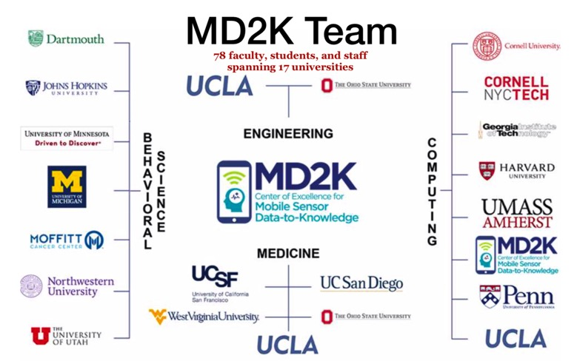
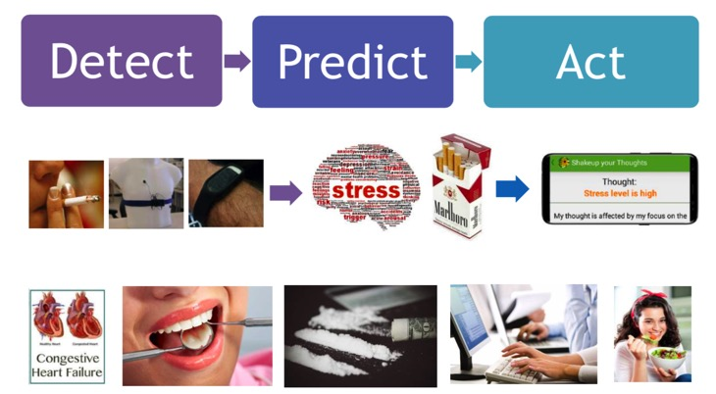
MD2K (Mobile Sensor Data to Knowledge)
MD2K: one of 11 national NIH Big Data Centers of Excellence led by Santosh Kumar
Develop tools to gather, analyze and interpret health data generated by mobile and wearable sensors
MD2K Mission

Slide 4
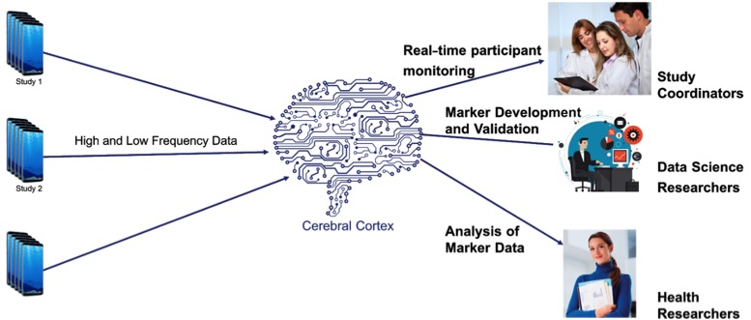
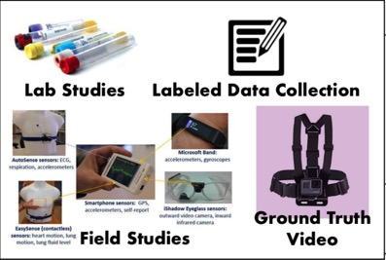
MD2K’s mHealth Data Collection and Distribution Process
2,200+ participants, 100,000+ participant-days
4.7 trillion data points, 300TB total data size

Slide 5
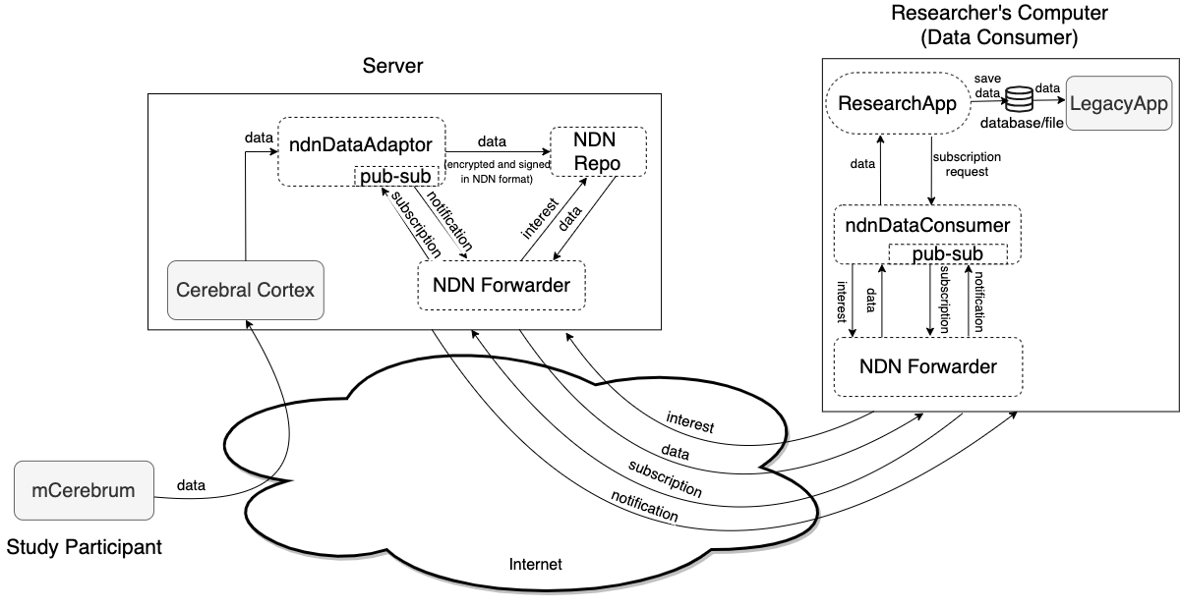
mGuard System Overview
Existing MD2K components:
mCerebrum
  data collection platform
Cerebral Cortex:
  cloud-based big data companion of mCereburm
mGuard components:
ndnDataAdaptor
ndnDataConsumer
ResearchApp
NDN Repo
NDN forwarder

Slide 6
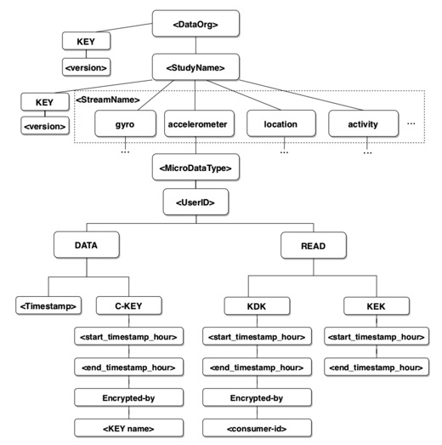
mGuard Naming Scheme

Slide 7
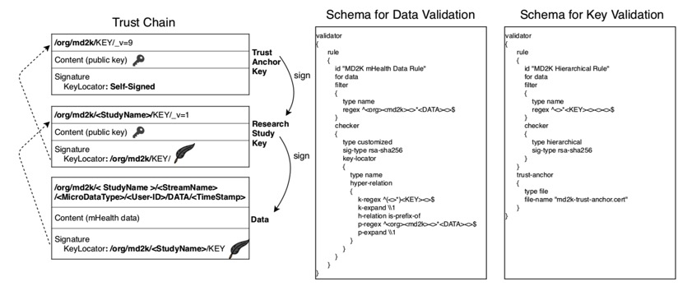
Trust Model

Slide 8
Real-Time Data Distribution and Access Control
Consumers use PSync [1] to discover and subscribe to data streams, e.g., /org/md2k/mOral20/gyro
Producers use a Name-based Access Control (NAC) [2] scheme to protect the data.
  Data is encrypted at production time based on policies, e.g., “users:/edu/memphis/lanwang; datasets:/org/md2k/mOral20/gyro; conditions: timestamp is between 9am and 6pm, location is in office; permissions: read”
  Keys are accessible by users with the right access rights.
  We have developed a NAC scheme that can enforce spatio-temporal policies (Laqin Fan).
[1] M. Zhang, V. Lehman, and L. Wang, “Scalable Name-based Data Synchronization for Named Data Networking,” in Proceedings of INFOCOM, May 2017.
[2] Z. Zhang, Y. Yu, S. K. Ramani, A. Afanasyev, and L. Zhang, “NAC: Automating access control via Named Data,” in IEEE MILCOM, 2018.

Slide 9
More Information
Project will officially start on 10/1/2020.
We plan to have trial deployment over the NDN testbed.
Team
  Lan Wang, Laqin Fan, Saurab Dulal, Muktadir Chowdhury
  Santosh Kumar, Nasir Ali
  Lixia Zhang, Zhiyi Zhang, Yufeng Zhang
Website: mguard.md2k.org

Slide 10
Questions?

Slide 11
mGuard components
ndnDataAdaptor
  retrieves data from Cerebral Cortex, packetizes and encrypts the data in NDN format, and stores the data into a local NDN Repository(repo)
NDN Repo
  stores encrypted and signed data in NDN format
ResearchApp
  An example NDN app that bridges the gap between legacy apps with NDN semantics.
ndnDataConsumer
  subscribes to data of interest, and retrieves encrypted data whenever it receives notifications of new data;
  presents the decrypted data to the ResearchApp for visualization and analysis.
  utilizes NAC to support data access control
NDN forwarder
  runs on server and researcher’s computer as well.
  utilizes existing NDN overlay network for mGuard deployment and evaluation

