Slide 1
On the Prefix Granularity Problem in NDN Adaptive Forwarding
Teng Liang
Peng Cheng Lab
2020/09/11

Slide 2
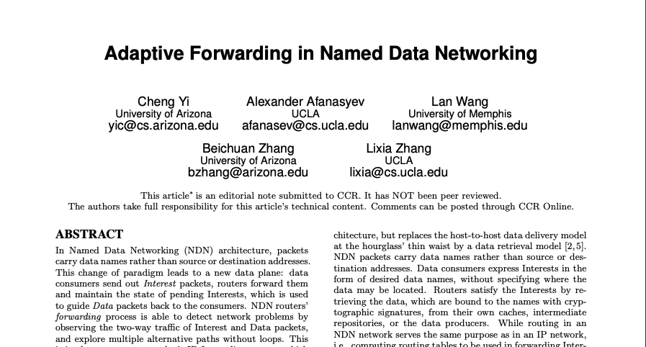
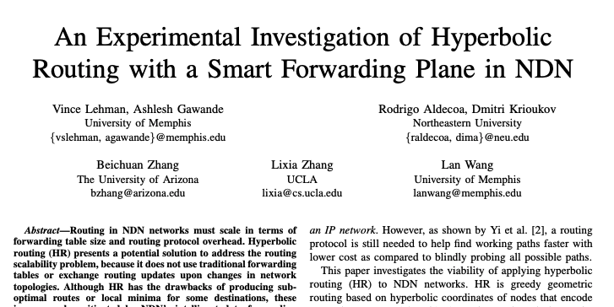
NDN Adaptive Forwarding
IP forwarding is stateless and has no adaptability
Case study
  Link failure: takes up to tens of seconds to detect
NDN’s adaptive forwarding
  Interest-Data exchange
  Stateful
Observe past data retrieval measurement on multiple paths
And use it to improve forwarding decisions future Interests

Slide 3
NDN Adaptive Forwarding
Interest
✗
Forward
CS
PIT
FIB
✓
✗
Data
Drop
NACK
Downstream
Upstream
Forward
✓
Data
PIT
Cache
✗
CS
Drop
✗
lookup miss
✓
lookup hit

Slide 4
The Prefix Granularity Problem
NDN adaptive forwarding assumes Interest Routing Locality
Interests sharing a longer name prefix is more likely to take the same forwarding path
  /a/b/seg=1 and /a/b/seg=2 are two segments of the same file
  /a/b/seg=1 and /a/c/seg=1 are segments of two different files
Problem: which name prefix length should be used to record path performance measurements?
  The longer the name prefix, the better Interest Routing locality
  However, the fewer Interests will be covered, the bigger FIB
We define it as the Prefix Granularity Problem

Slide 5
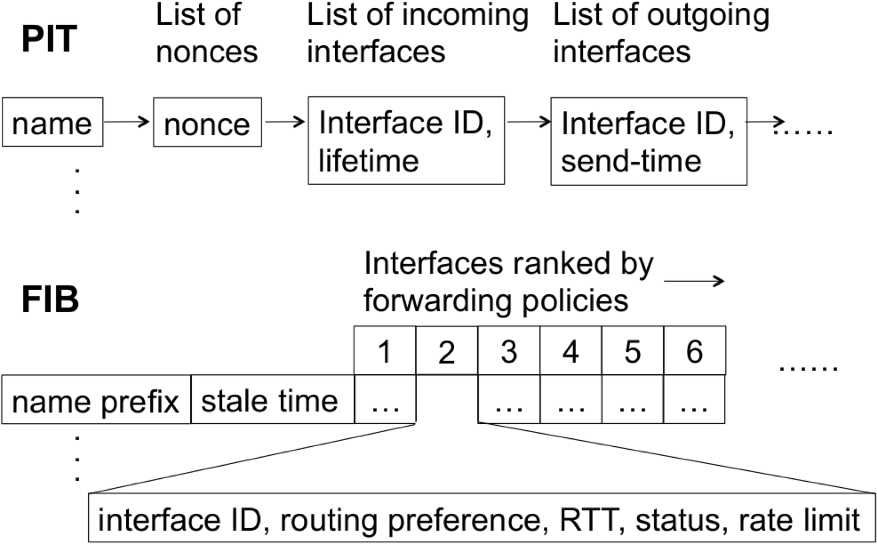
Existing Solutions
Existing designs use a static name prefix to record measurements
Interest: /edu/ua/cs/people/teng/index.html

Slide 6
The Limits of Existing Designs
Existing designs cannot handle some scenarios of partial network failures
FIB
/a, (R2,P3)
C1
P1
/a/b/<#seq>
/a/b
R1
R2
10 ms
10 ms
10 ms
C2
P2
/a/c/<#seq>
/a/c
P3
100 ms
/a

Slide 7
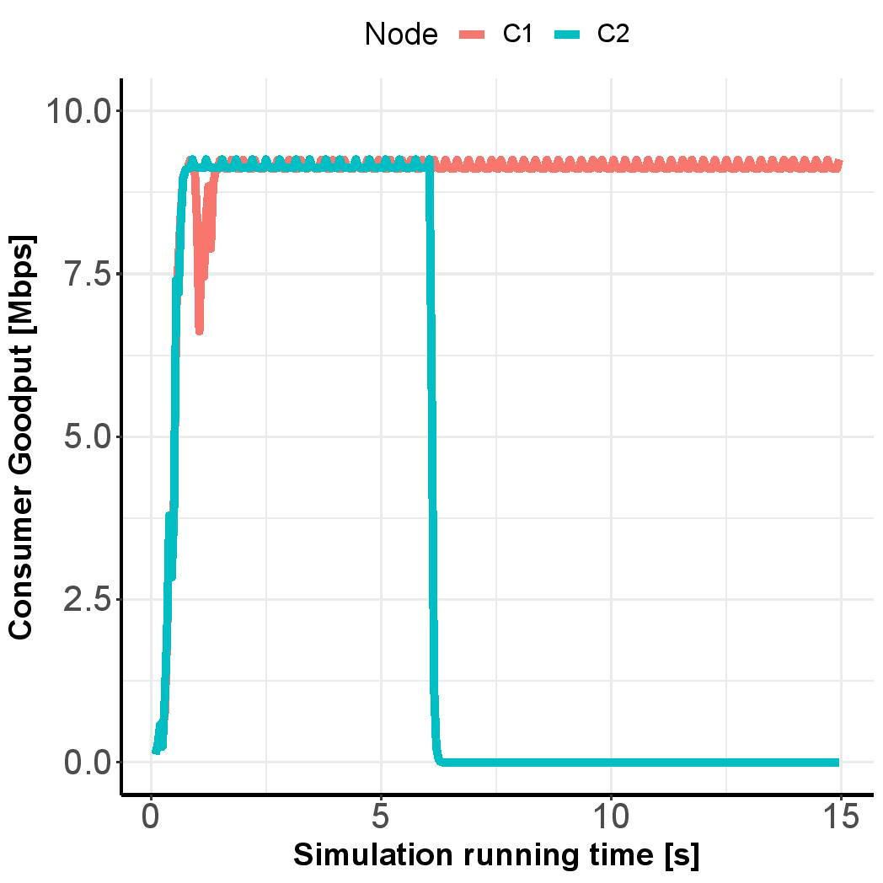
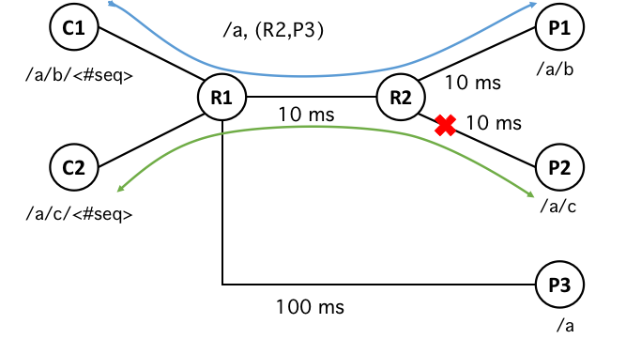
Simulation Results
The scenario is simulated in ndnSIM

Slide 8
Dynamic FIB Expanding
FIB
/a, (R2,P3)
/a/c, (P3,R2)
C1
P1
/a/b/<#seq>
/a/b
R1
R2
10 ms
10 ms
10 ms
C2
P2
/a/c/<#seq>
/a/c
P3
100 ms
/a

Slide 9
Dynamic FIB Expanding
Triggering: when a new ranking of next hops is measured
Strategies:
  Top-down: start from the FIB name and expand one level down
  Bottom-up: start from the Data name and expand one level up
  Find the Shortest Name Prefix with a Solo Ranking (SS)
Strategy evaluation:
  The number of names to be inserted
  The length of newly inserted names
Dynamic FIB Collapsing mechanisms
Interest: /edu/ua/cs/people/teng/index.html

Slide 10
Optimize NDN Adaptive Forwarding Processing
✗
lookup miss
✓
lookup hit
Forward
✓
PIT
Data
Existing Design
Update
Cache
✗
FIB/Measurement
CS
Drop
Forward
✓
PIT
Data
Our proposal
Update
Cache
✗
Filter
FIB
PIT/Measurement
CS
Drop

Slide 11
Summary
The Prefix Granularity Problem:
  To balance the trade-offs between Interest routing locality and FIB size
Key ideas:
  Dynamic FIB Expanding: disaggregating FIB names
  Dynamic FIB Collapsing: aggregating FIB names
Optimizing measurement management in Data processing to reduce FIB lookups.

Slide 12
Q/A
Thanks!

