Slide 1
m-ASF - An Adaptive SRTT-based Forwarding Strategy for Mobile Environments
Muktadir Chowdhury, Alex Lane, Lan Wang
University of Memphis

Slide 2
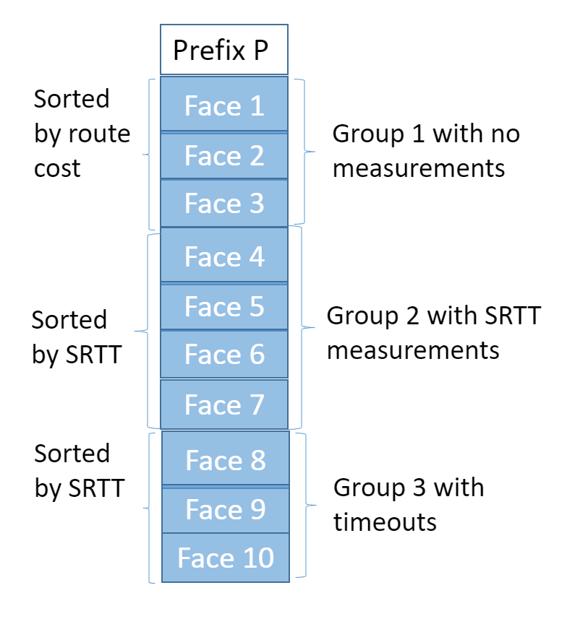
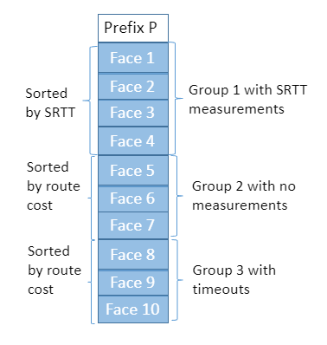
Background: ASF Strategy
Adaptive Smoothed Round-Trip Time (SRTT) based Forwarding.
  Periodically probe interfaces.
  Uses sRTT based metrics to rank faces.
Originally developed to aid Hyperbolic Routing [2] which could create persistent suboptimal paths.
Interfaces are ranked based on SRTT, Route cost, and Timeout or Nacks.
Face ranking for forwarding
Face ranking for probing
Notes:
1. Formally published in 2016, Adaptive sRTT-based Routing (or ASF) was a new forwarding strategy introduced as part of the paper “An Experimental Investigation of Hyperbolic Routing with a Smart Forwarding Plane in NDN” (Lehman et al).
2. Formally published in 2016, Adaptive sRTT-based Routing (or ASF) was a new forwarding strategy introduced as part of the paper “An Experimental Investigation of Hyperbolic Routing with a Smart Forwarding Plane in NDN” (Lehman et al).
Unlike Best Route, ASF uses sRTT based metrics to rank faces which are maintained by periodic probing- this helps with both adaptiveness to network changes and finding the shortest route despite potentially deceptive link costs.
Timeouts and nacks are handled through special ranking values.

Slide 3
Motivation
ASF designed for stable network.
    Does not perform well in mobile environments.
    Does not differentiate among faces with different kinds of failure.
  Relies solely on periodic probing to discover new path
End nodes are mostly mobile and wireless devices.
NDN’s lack of support for mobile environments.
  Routing protocols are not desirable in mobile environments.
  Currently no forwarding strategies specially for mobile networks.
Notes:
ASF as originally implemented relies on several assumptions that are only particularly applicable to wired networks:
Networks conditions are generally stable and immutable
Total failure of all faces to fulfill a prefix has a negligible chance of occurring
There is not a strong difference in kinds of link failure, and all can be treated as essentially equal
Ensuring efficient mobile NDN is a key part of ensuring that NDN continues to provide a reasonable alternative to host-centric networking.

Slide 4
Design: Ranking of Face in m-ASF
In mobile scenario a face can fail due to various causes.
  Fine-grained ranking of faces according to their statuses.
  Treat various timed-out and nack’d faces differently.
Break tie using Face Id.
Notes:
In a mobile scenario, link issues over wireless channels have a larger variety of failure causes compared to wired networks.
The amount of change over time in these networks is dramatically higher, which means that treating all timed out and nacked faces the same can lead to subpar performance.

Slide 5
Design: Forwarding Behavior
Retx Suppression Algorithm helps m-ASF decides what to do with the interest.
  Exponential Retx Suppression.
Strategy keeps tracks of the face it has been using so far: Primary Face.
Best Face is current highest ranked face for forwarding.
  Can be different from primary face if network changes.

Slide 6
Design: Probing and Oscillation Prevention
Periodically schedule probing timepoint.
  Only probe if probing is due at a particular time.
Probing is triggered by incoming interest.
While probing m-asf probes a list of faces.
  Faces it has not measured yet.
  And highest ranked face according to the probing ranking.
Probing Behavior
Topology of mobile network changes frequently.
We integrated oscillation prevention mechanism to prevent premature face switching.
Oscillation Prevention

Slide 7
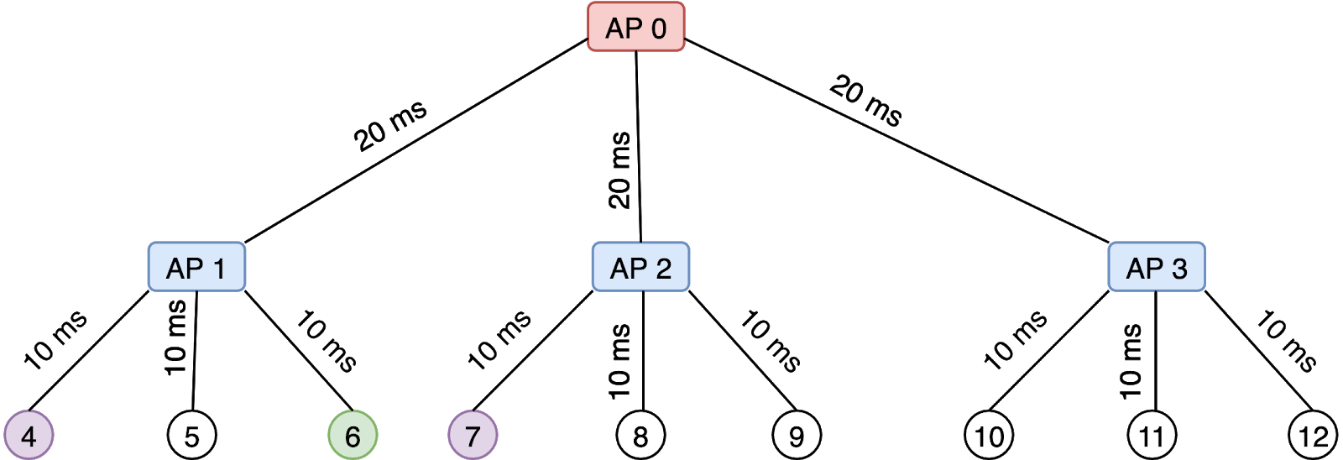
Preliminary Experiment Scenario
Link Cost = 1, no routing.
  All the faces are registered to all the prefixes.
One Consumer (node 6)
  Sends one interest per second.
Two producers can serve the data. (node 4 and 7)
  Node 4 has shorter RTT to Node 6, Node 7 is further.
  Initially both are online, then from 12th seconds they will change status (Down and Up)
Experiment timeline:
12s (#4 D)→ 21s (#4 U) → 22s (#7 D) → 32s (#7 U)→ 33s (#4 D) → 43s (#4 U) → 44s (#7 D)

Slide 8
Median Protocol Overhead and Satisfaction Ratio
Probing Interval = 2s
Probing Interval = 4s
Preliminary Results
Strategy | Interest Count | Data Count | Protocol Overhead | Satisfaction Ratio | Timeout Interest
ASF | 161 | 101 | 296 | 0.63 | 21
m-ASF | 183 | 155 | 338 | 0.93 | 4
Flooding | 360 | 193 | 553 | 1.0 | 0
NDNSim is used for simulation.
The strategy for all the Access Points is set to ASF, m-ASF, and Flooding.
  Other nodes’ strategy is set to BestRoute.
Probing Interval is 2 and 4 seconds.
Max Silent Timeout is 0.
  In mobile scenario, we quickly want to switch faces.
Duration: 60 seconds. Ran 10 times.
Strategy | Interest Count | Data Count | Protocol Overhead | Satisfaction Ratio | Timeout Interest
ASF | 184 | 134 | 317 | 0.8 | 11
m-ASF | 203 | 165 | 368 | 0.96 | 2
Flooding | 360 | 193 | 553 | 1.0 | 0

Slide 9
Observation
ASF is not suitable for unstable, short-lived links.
  Once a working face is down, it takes a long time to find another working face.
M-ASF is showing promising results in such scenario.
M-ASF’s performance can be attributed to:
  Measuring all the unmeasured faces at the same time.
  Finely grained ranking of faces for forwarding.
Some of these changes may improve performance in wired scenarios as well.

Slide 10
Conclusion and Future Work
ASF is not suitable for unstable, short-lived links.
  Once a working face is down, it takes a long time to find another working face.
  M-ASF is showing promising results in such scenario.
Run experiments for the scenario where new faces are created dynamically.
  M-ASF’s probing of unprobed faces will come in handy.
  We are fixing minindn-wifi to support this feature.
Run experiments to test oscillation prevention mechanism.
Merge the code with ASF codebase.

