Slide 1
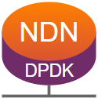


NDN-DPDK:
NDN Forwarding at 100 Gbps on Commodity Hardware
Junxiao Shi, Davide Pesavento, Lotfi Benmohamed
Advanced Network Technologies Division
National Institute of Standards and Technology

Slide 2


Quick Recap from 2018-2019
NDN-DPDK is a high-speed NDN forwarder.
Goal: line speed on commodity hardware. How to get there?
Adopt better algorithms and data structures.
  2-stage LPM in FIB.
  PIT-CS Composite Table.
Reduce overhead in library and kernel.
  Multi-threaded architecture.
  Hugepage memory pools.

Slide 3
New Features
EXPANDED platform support
NEW CoDel queues
input0
fwd0
output0
PIT+CS
input1
fwd1
output1
PIT+CS
forwarding stage
IMPROVED
packet decoder
reassembler
Name Dispatch Table
crypto
helper
FIB replica
(one per NUMA socket)
RESTRUCTURED to better support forwarding hints
input stage
disk
service
output stage

Slide 4
AQM and Congestion Control
input0
forwarding thread
output0
Interest queue
input1
Data queue
output1
Nack queue
CoDel-like active queue management.
  Applied on ingress: bottleneck is in forwarding threads, not link bandwidth.
  Each packet type has a separate queue.
  Prioritize Data over Interest: dropping Data wastes resource spent on processing the Interest.
CUBIC-like congestion control in the traffic generator.
  React to congestion marks. Retransmit based on RTO.

Slide 5
Benchmarks
Spoiler alert: we made it to 100 Gbps

Slide 6
Benchmark Topology
Two physical machines:
Forwarder.
Traffic generators:
  Each instance operates independently.
  Fetch Data from each other.
CPU: dual Intel Xeon Gold 6240.
  18 cores at 2.60 GHz, Hyper Threading disabled.
Memory: 256 GB, 2933 MHz, four channels.
  64x 1GB hugepages per NUMA socket.
NIC: Mellanox ConnectX-5 100 Gbps.
forwarder
producer /B
consumer /A
producer /A
consumer /B

Slide 7
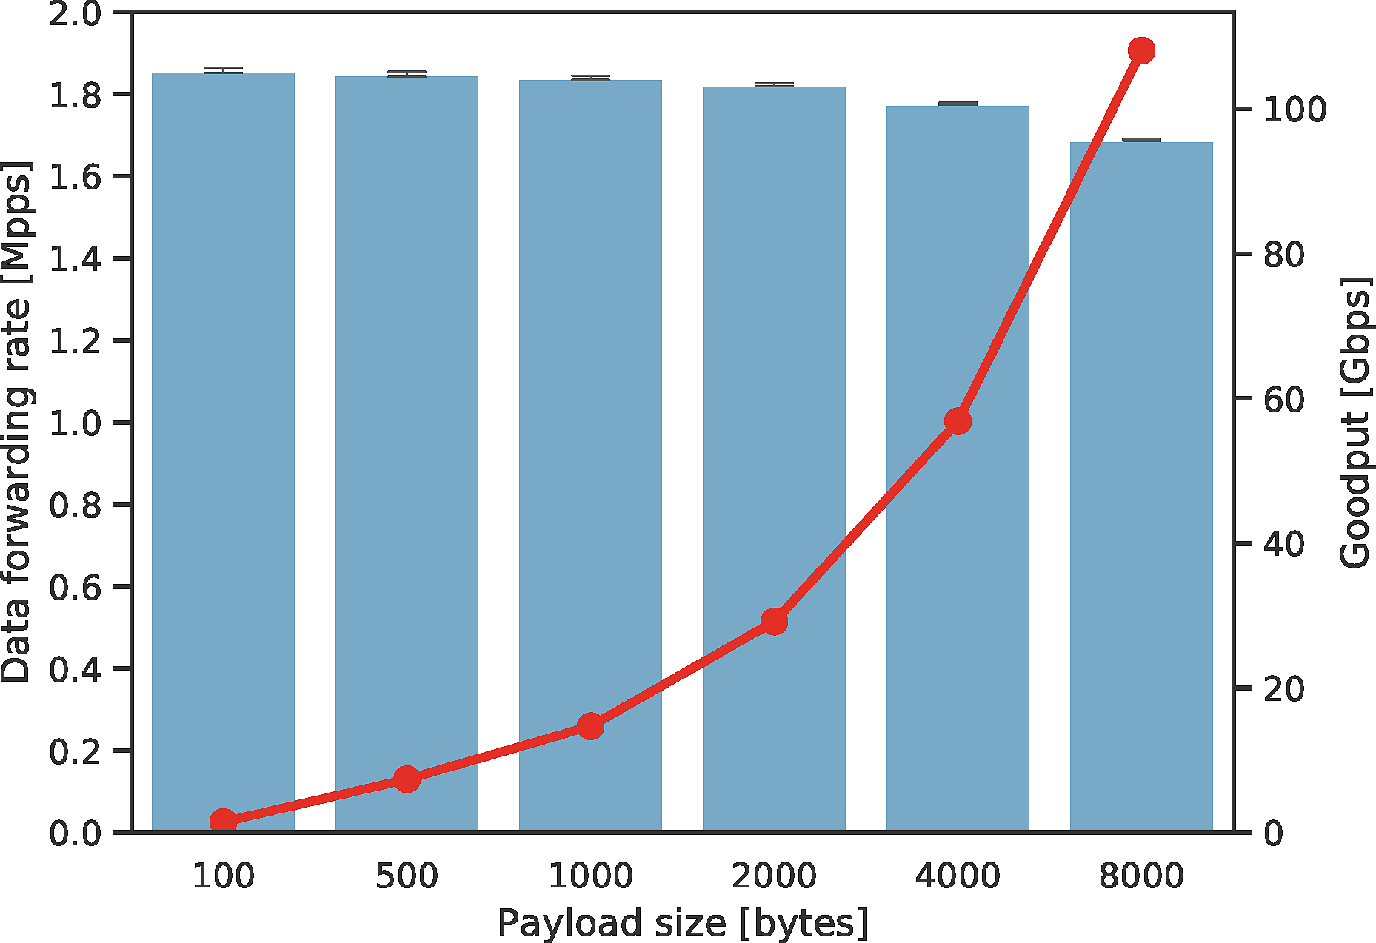
We Made It to 100 Gbps
108 Gbps
8 forwarding threads.
Measured from consumers.
Data packets only.
Not counting retransmissions.
Data payload only.

Slide 8
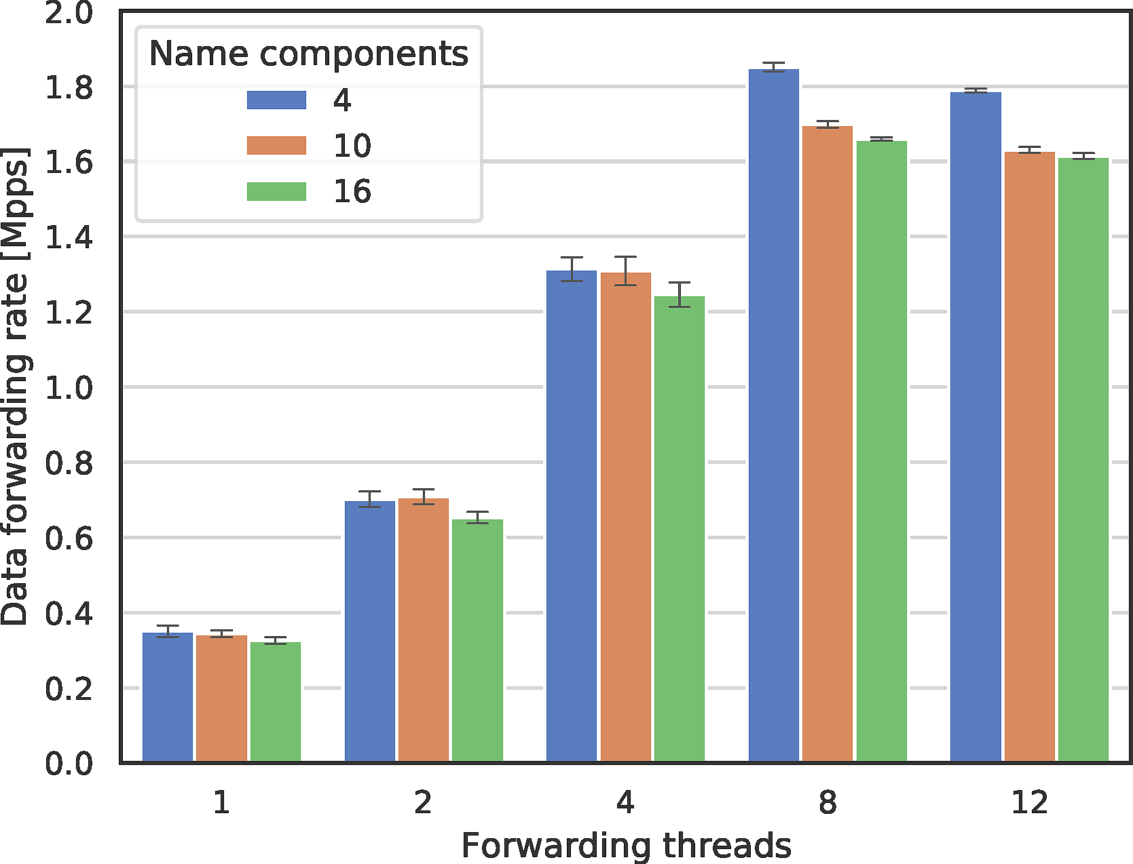
Input Thread Bottleneck
peak: 1.84 Mpps
Expectation:
  # forwarding threads
  Data forwarding rate (pps)
Reality:
  Data forwarding rate plateaus at 8 forwarding threads.
Bottleneck: input thread.
  Current architecture only allows one input thread per face.
linear growth
no improvement

Slide 9
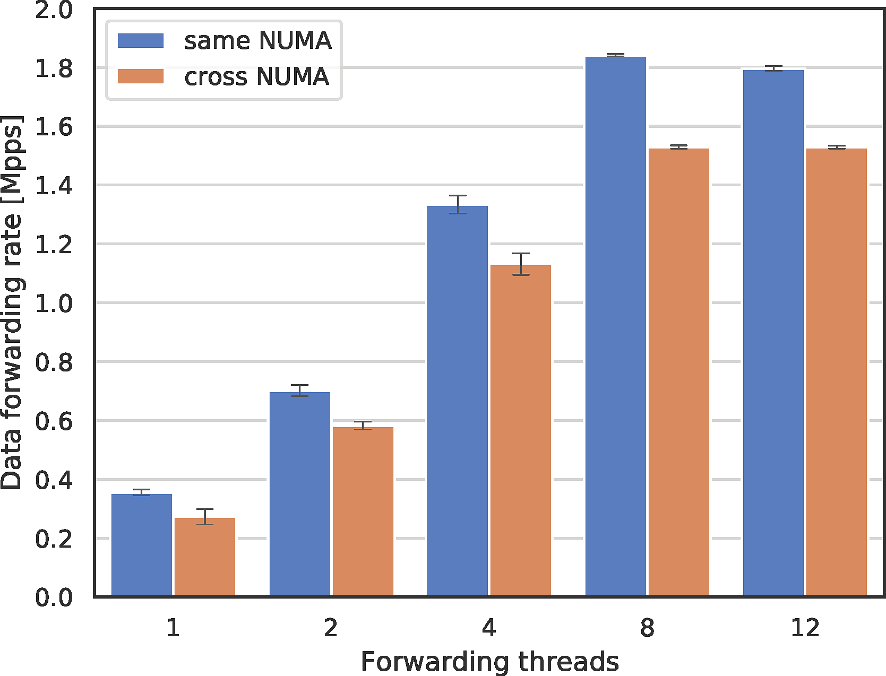
Effect of Nonlocal Memory Access
up to 20% slower
gen
gen
NUMA#0
NUMA#1
NUMA#0
NUMA#1
gen
gen
same NUMA
cross NUMA: higher memory access latency

Slide 10
Hardware Acceleration
Removing the input thread bottleneck

Slide 11
Inside an Input Thread
implement in hardware?
Name Dispatch Table
network interface
Hardware dispatches most packets directly to fwd threads.
L2 decode
input stage
Interest
dispatch by name prefix
reassembly
fwd0
L3 decode
dispatch by token
fwd1
Data or Nack
dispatch(interest, NDT[SipHash(prefix)].fwd);
dispatch(data, pitToken.fwd);

Slide 12
Receive Side Scaling (RSS)
Incoming frames are matched against RSS rules and dispatched to queues.
10/100G Ethernet adapter, receive path
Receive Side Scaling (RSS) rules
If field F has value V, dispatch to queue Q.
⁞
Otherwise, drop the packet.
queue 0
mempool
thread
ingress
queue 1
mempool
thread
queue 2
mempool
thread
Choices of F are limited by hardware functionality:
ConnectX-5 only supports fields in Ethernet/IP/UDP/TCP headers.
Some cards allow "bytes at offset I" generic fields.
NIC has ≥16 RX queues.
Configurable per queue:
thread to process packets
mempool to store packets into (ideally, on the same NUMA socket as the processing thread)

Slide 13
Input Dispatching with RSS?
Name Dispatch Table
Infeasible with RSS.
Name has variable length.
network interface
L2 decode
input stage
Interest
dispatch by name prefix
reassembly
fwd0
Infeasible with RSS, but not every packet needs reassembly.
L3 decode
dispatch by token
fwd1
Data or Nack
Possible with RSS via "bytes at offset I" field.

Slide 14


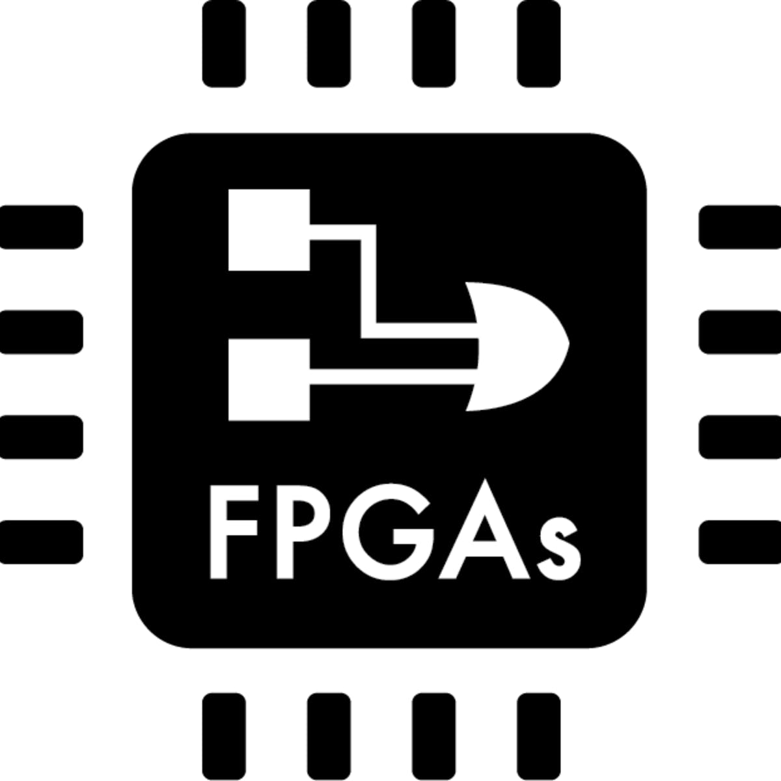
Can NIC Understand Names?
"NDN-NIC: Name-based Filtering on Network Interface Card" (ICN'16)
  if (BloomFilter(XorHash(name))) { accept(pkt); }
  else { drop(pkt); }
  Python simulation.
NDN-DPDK Interest dispatching:
  dispatch(pkt, NDT[SipHash(prefix)].queue);
We need real hardware implementation.

Slide 15




Collaboration Opportunities
Hardware implementation:
  eBPF
  P4
  FPGA
Algorithm modeling:
  Congestion control.
  Disk-based caching policies.
Real traffic trace for evaluation.
Application use case:
  Data intensive science
  Live video streaming
Library integration:
your app?
your library?

Slide 16
NDN-DPDK Codebase
https://github.com/usnistgov/ndn-dpdk
  Forwarder
  Traffic Generator
  GraphQL-based management tools
  NDNgo library

Slide 17
Expanded Platform Support
new
regularly tested
known to work
planned
Operating systems:
  Ubuntu 18.04
  Debian 10
  CentOS 8
Virtualization and containers:
  VirtualBox
  Docker
  KVM
Ethernet adapters:
  Mellanox ConnectX-5
  Intel i350 and Intel X710
  other NICs via XDP driver
Network transports:
  Ethernet
  Ethernet with VLAN
  VXLAN tunnel (UDP)
Local application support:
  shared memory transport (memif)
  NDNgo application library
Experiment platforms:
  Run NDN-DPDK on a laptop
  (e.g. 4 cores, 8GB RAM)
  Deploy on the NDN testbed
  FABRIC testbed

Slide 18
NDN-DPDK on FABRIC Testbed
NDN-DPDK Experiment Profile
Launch a network of NDN-DPDK forwarders and traffic generators across multiple locations.
You can customize:
  Applications.
  Routing protocols and forwarding strategies.
  Caching algorithms.
Collect measurements.
  Packet timing and statistics.

Slide 19
Q&A
Please attend NDN-DPDK presentation at ACM ICN 2020 conference.

