Slide 1
The Decision Maker:
NDN concepts for intelligent automation
Marie-José Montpetit
Concordia University Montreal

Slide 2
Overview

Slide 3
The challenge
Multisource multi-destination data capture and decision making
Heterogeneous environments, sensors and datasets

Slide 4
Heritage
NDN/ICN
CFN/COIN
Distributed AI/ML
Next generation IoT
Edge and cloud computing
Data driven systems
Semantic Web
Distributed networks

Slide 5
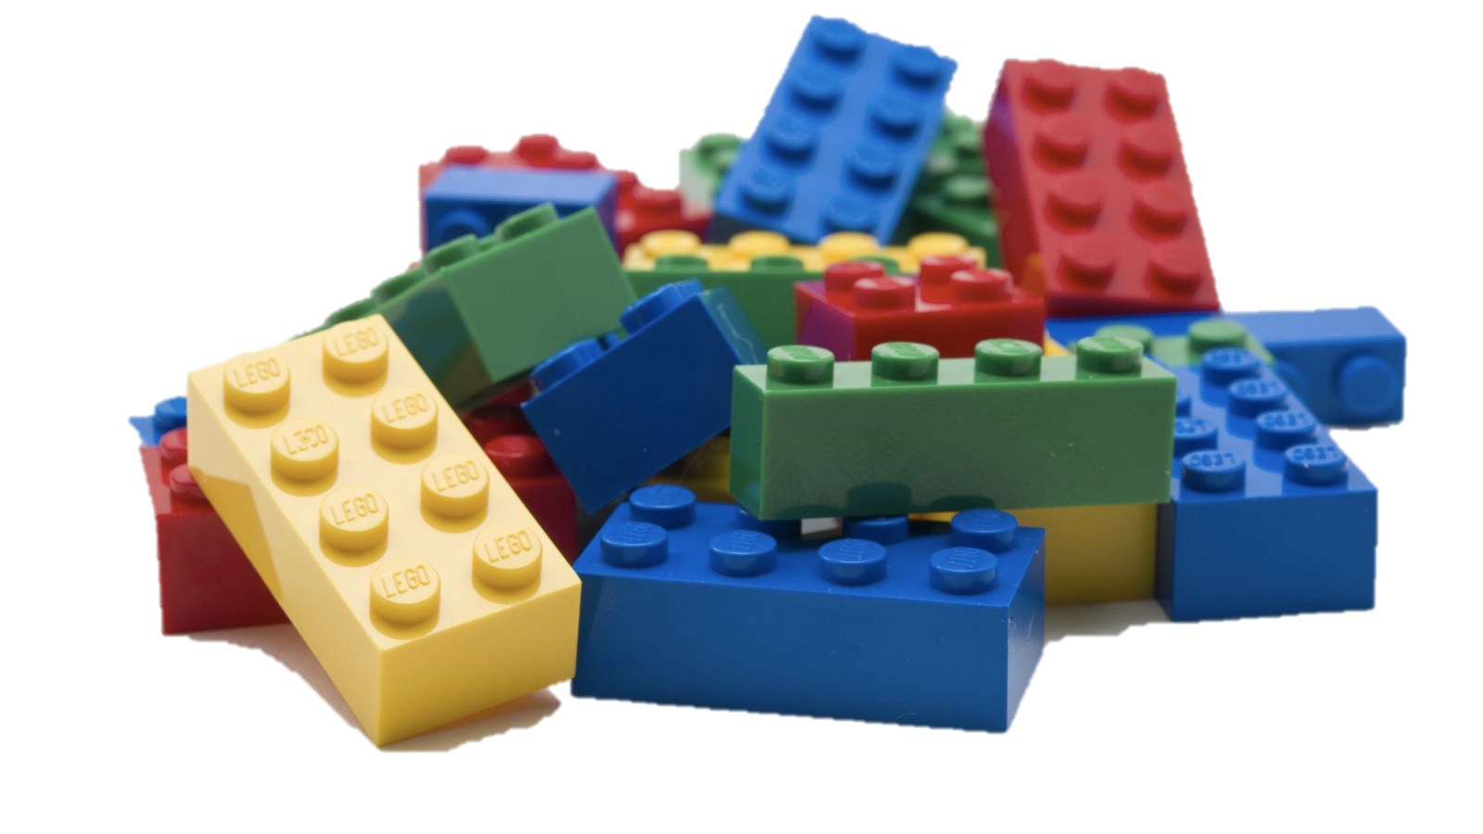
Decision Making Building Blocks

Slide 6
The Common Data Layer
Discovery and chaining
Filtering
Processing and orchestration
Local decision-making

Slide 7
Embedded Decision Layer
“Intelligence layer”
Cloud supported inference
AI/ML
Resource and data discovery is key

Slide 8
Intelligent Data Gateway
ICN/IOT heritage
Implementation of the data and intelligence layers
Data driven automation
Pub/sub (MQTT, COAP)

Slide 9
Use cases
Automotive and aerospace
Factory automation
Home controls
Vertical agriculture
Network telemetry and management
Distributed intelligence

Slide 10

Design and Manufacturing
Goals:
  IoT and digital twins
  Data-driven approaches
  Tactile/Detnet (FlexNGIA)
Building Blocks
  Edge/Information Centric Networking for distribution and QoS
  AR/VR functionality
  Blockchain for end to end provenance

Slide 11
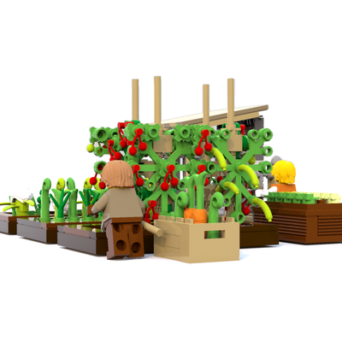
Vertical Agriculture
Goals:
  Automated climate-proof production
Building Blocks
  Data and resource discovery
  Edge sensor data acquisition and analysis
  Cloud supported decision
  Blockchain for food security
  Local Intelligence for detecting diseases

Slide 12
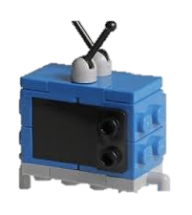
Multimedia
Goals:
  Give Power to the creators
  Enable new monetizing models
Building Blocks
  Edge/Information Centric Networking for distribution and QoS
  Artificial Intelligence for detecting trends
  Blockchain and smart contracts for trust and monetization via the token economy

Slide 13
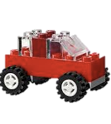
Autonomous Systems
Goals:
  Self-driving vehicles
  “Self Drivers” Insurance
  “Car as a platform”: softwarization of the car
Building Blocks
  Edge data discovery, acquisition and analysis
  Artificial Intelligence for detecting faults
  AR/VR for rider’s experience

Slide 14
Conclusion
ICN/NDN offers a framework for next generation advanced IoT and data driven automation
Combines with embedded edge with cloud support computing and networking and AI/ML
Data and intelligence layers provide targeted services and architectures and facilitate application development

Slide 15
Acknowledgements
Eve Schooler
Edgar Ramos
Roberto Morabito
Alessandro Bassi
Faten Zhani
Winterfarm, Canada
Vertical Irrigation, California

