Slide 1
MICN, a New Perspective on Network Coding with Named Data Networking
Hirah Malik, Cedric Adjih, Claudio Weidmann, Michel Kieffer
INRIA, L2S, Université Paris-Saclay
NDN Community Meeting, Sept 10-11, 2020

Slide 2
NDN & Multipath/Multisource
Goal: High throughput
  To retrieve a large content
  No knowledge of where are the servers (no FIB), no assumption (no topology known)
  Exploit available paths

Slide 3
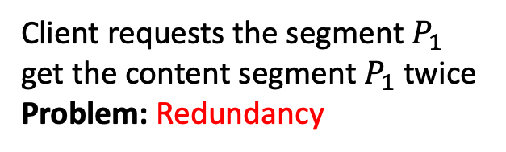
NDN & Multipath/Multisource
Client requests the segment $P_{1}$
get the content segment $P_{1}$ twice
Problem: Redundancy

Slide 4

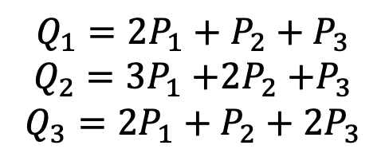

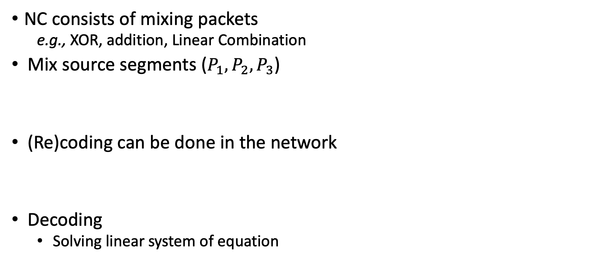



Network Coding (NC)
NC consists of mixing packets
  e.g., XOR, addition, Linear Combination
Mix source segments ($P_{1},P_{2},P_{3}$)
(Re)coding can be done in the network
Decoding
  Solving linear system of equation
$$Q_{1}=2P_{1}+P_{2}+P_{3}$$
$$Q_{2}=3P_{1}{+2P}_{2}+P_{3}$$
$$Q_{3}=2P_{1}+P_{2}+{2P}_{3}$$
$$S$$
$$P_{1}+P_{2}$$
$$P_{1}{+2P}_{2}+P_{3}$$
$$S$$
$$P_{2}+P_{3}$$

Slide 5
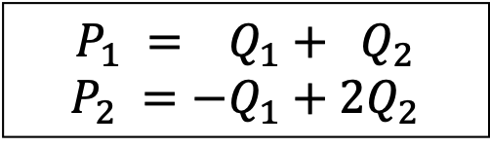
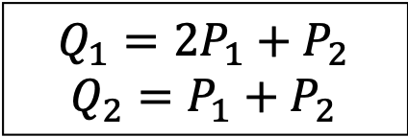
NDN & Network Coding (NC)
NC can improve ICN/NDN performance [1]
$$Q_{1}=2P_{1}+P_{2}$$
$$Q_{2}=P_{1}+P_{2}$$
$$P_{1} = Q_{1}+{ Q}_{2}$$
$$P_{2} =−Q_{1}+2Q_{2}$$
[1] M.-J. Montpetit, C. Westphal, D. Trossen, Network coding meets information-centric networking: An architectural case for information dispersion through native network coding, in: Proc. 1st ACM Workshop on Emerging Name-Oriented Mobile Networking Design-Architecture, Algorithms, and Applications, 2012, pp. 31–36.
Notes:
Linear coding, coding could be done in the network

Slide 6
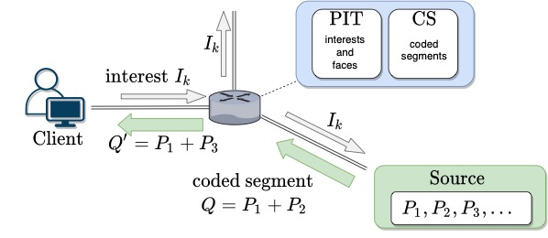
MICN: NDN with Network Coding
MICN
  Ensures high throughput by avoiding redundant content
Classical NDN + NC
  Information bases: CS, PIT, (FIB)
  Messages: Interest, Data
  Coded content (segments)
Changes in semantics
Existing: NetcodNDN [1], CodingCache [2]
[1] J. Saltarin, E. Bourtsoulatze, N. Thomos, T. Braun, NetCodCCN: A network coding approach for content-centric networks, in: Proc. of IEEE IN-FOCOM, 2016, pp. 1–9.
[2] Q. Wu, Z. Li, G. Xie, CodingCache: multipath-aware CCN cache with network coding, in: Proc. 3rd ACM SIGCOMM Workshop on Information-centric Networking, 2013, pp. 41–42.

Slide 7
MICN Semantics
Central goal: high throughput with multipath
  With no assumption of coordination
Semantics, design choices:
  For more interest propagation
    Forwarding strategy: Multicast
    Modified Interest processing: no merging interests for different users
  Constant flow of content
    Multiple parallel Interests

Slide 8
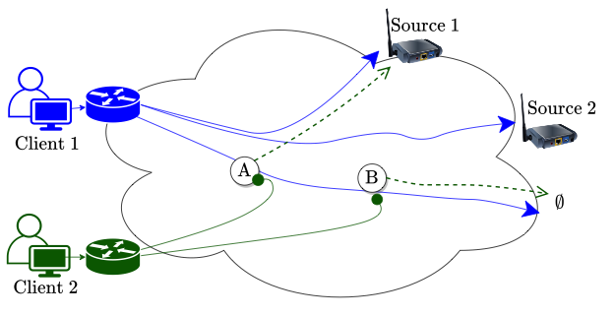
MICN Interest Processing
Classical NDN Interest processing
  Efficient (limit Interest diffusing)
MICN Interest processing
  Not suppressing Interests
  Effectively allowing interests
  from all clients reach all sources
Alternates ?

Slide 9
Multiple Parallel Interests (Pipelining)
Uninterrupted flow of content
  Multiple parallel Interests (pipelining)
Problem:
  Avoid getting back redundant content (linearly dependent)

Slide 10

MILIC
(Multiple Interests for Linearly Independent Contents)
Indexed Interests: $I_{1},I_{2}⋯$ $I_{n}$ for $n$ source segments
MILIC (Multiple Interests for Linearly Independent Contents)
  Constraints on content satisfying each Interest $I_{k}$
  Materialized by “subsets” $𝒜_{1},𝒜_{2}⋯𝒜_{n}$

Slide 11

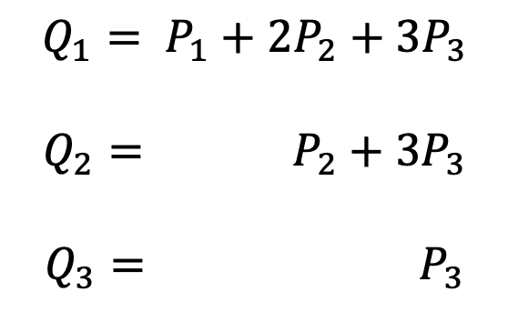
MILIC
(Multiple Interests for Linearly Independent Contents)
Indexed Interests: $I_{1},I_{2}⋯$ $I_{n}$ for $n$ source segments
MILIC (Multiple Interests for Linearly Independent Contents)
  Constraints on content satisfying each Interest $I_{k}$
  Materialized by “subsets” $𝒜_{1},𝒜_{2}⋯𝒜_{n}$
$${ P}_{1} P_{2} P_{3}$$
$$Q_{1}= P_{1}+2P_{2}+3P_{3}$$
$$Q_{2}= P_{2}+3P_{3}$$
$$Q_{3}= P_{3}$$

Slide 12

MILIC Properties
Property 1: replies to $I_{1},I_{2}⋯I_{n}$independent (by construction)
Property 2: several replies to $I_{k}$have high chance to be independent
Property 3: several replies to $I_{k}$ can be used to get content for $I_{i≠k}$

Slide 13
Additional Protocol Enhancements
Just-in-time re-encoding
Interest cancellation (MICN-IC)
Content redirection

Slide 14
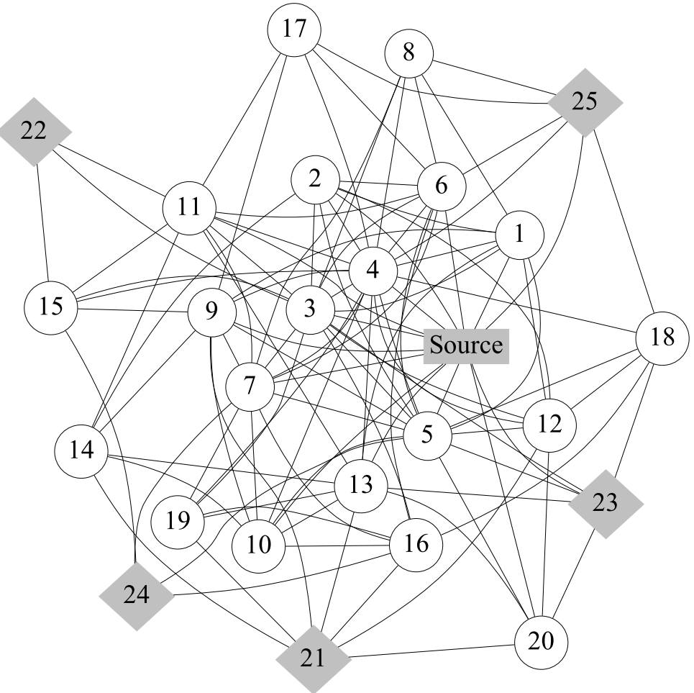
MICN in action

Slide 15
MICN in action
Cumulative Data Traffic

Slide 16
Conclusions
Presented a new approach on NC + NDN: MICN
Everything relies on MILIC (cornerstone)
  Avoids redundant content
Many critical improvements:
  Suppression of Interest, MILIC, Interest cancellation …
Future work
  Improve Interest forwarding

Slide 17
Thank you !
Questions ?

