Slide 1



A Named Data Networking Architecture Design to Internet of Underwater Things
10/24/2019 @ WUWNET 19’
09/11/2020 @ NDNComm 20’
Qi Zhao
University of California, Los Angeles
Zheng Peng
The City College of New York
Xiaoyan Hong
The University of Alabama

Slide 2
Outline
IoUT Communication
Named Data Networking
IoUT Challenges
NDN Architecture Implementation to IoUT
Conclusion

Slide 3
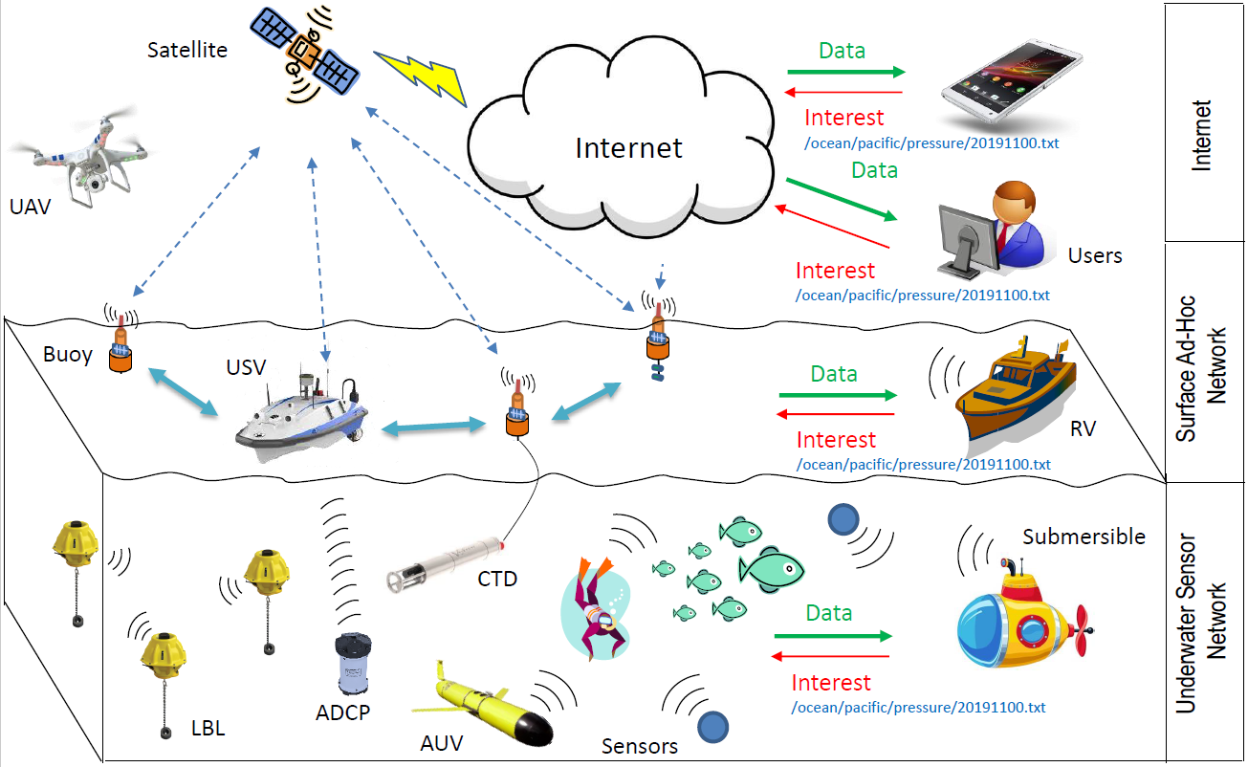
IoUT Communication
Underwater sensors, positioning systems, underwater vehicles, etc.
Communication links, including acoustics, RF, cellular or satellite, etc.
Network topology (single hop or multiple hops)
Users can be nearby sensors, AUVs or surface ships, etc.

Slide 4
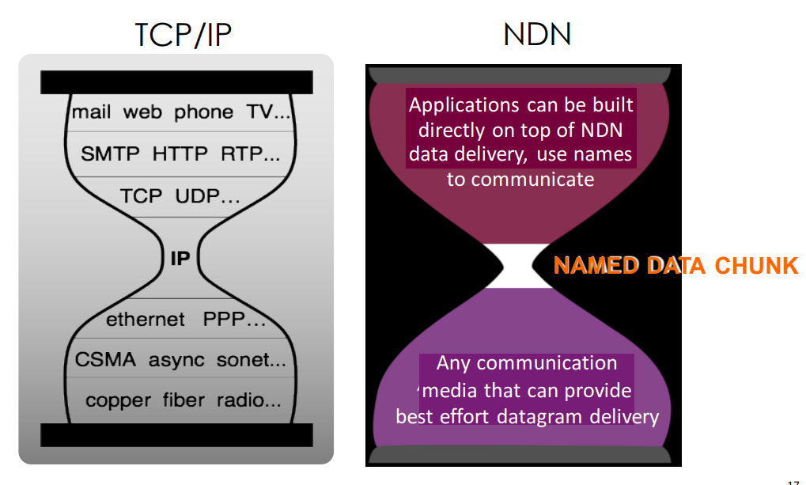
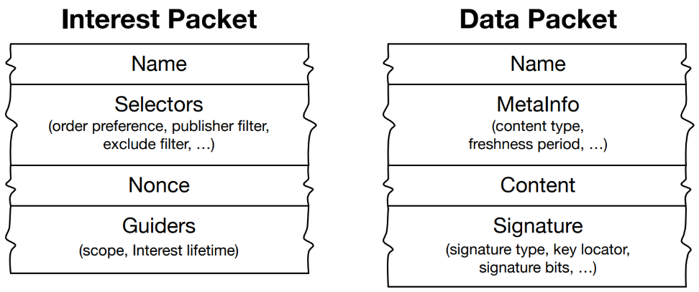
Named Data Networking
The Narrow waist: common interface, the network layer
  IP -- address format, IP packet forwarding
  NDN – data name format, NDN Interest/Data forwarding
Name data, not the container
  tell the network what you want..
    Consumers: send Interest packets
  let the network find it for you
    Producers: return “pulled” content Data packets
From https://named-data.net/
From https://named-data.net/

Slide 5
NDN Brings in New Capabilities
Interest/Data exchange retrieves named data from anywhere
Naming: names facilitate key management and trust derivation.
End-to-end security: data is signed by producer and verified by consumers.
Sync: enable multiple parties of a distributed application to keep synchronized state.
Repo: persistent storage helps producers store and publish data.

Slide 6
IoUT Challenges
Complex Communication Solution
  Various communication technologies (acoustic, optical, magneto-inductive, etc.) bring in various radios, interfaces, links, addressing schemes, IP subnets, etc.
  Identification and tracking technologies are quite different
    Leads to complicated addressing of the “thing”
  Middleware/remote cloud, which is required to manage the data flow, is hard to be built on top of host-to-host communication model
    Ever harder in a dynamic mobile scenario
  In terms of “dynamic mobile scenario”
    Requires intensive resources and operations
    Extremely hard for users who are not networking experts
Notes:
ndn standardized interfaces ease the diversity of the complex communication solution
Domain scientists handle the naming/users handle the application development

Slide 7
IoUT Challenges – cont’d
Energy Efficiency
  IoUT devices have limited operation life time due to space limit for batteries
  Acoustic communications are power hungry (35-150W vs WiFi: 100mW)
  Unlike IoT, replacing batteries could be a logistic nightmare
Bandwidth and Mobility
  Big Data era
Reliability
  Acoustic communication suffers from very high bit error rate (10⁻¹ vs 10⁻⁵)
  Data is required to be received in sequence without loss (TCP is ineffective)
Security
  Data is private to some applications (Data breach)
  Devices are normally costly (Device tampering)
  Current solutions do not fit for IoUT
    TCP/IP’s session-end security is brittle in IoUT
    Cloud-based security violates the trend of edge computing in IoUT
Notes:
In-network cache can reduce the amount of data/less energy for retransmission
Communication capacity is limited -> in-network storage/communication source used only for the data of interest
Hop-by-hop -> reduce lots of retransmission for the whole session or multi-hops
Data-centric built-in security simplifies the security implementation in diverse IoUT network

Slide 8
NDN fits IoUT
Naming Convention -> An open environment for applications and services to cooperate and function together
By naming data instead of IP address, NDN enables host multihoming and seamlessly utilizes all communication interfaces
Content multicast and in-network caching
Securing data directly instead of relying on secured sessions
Secure IoUT system with local trust anchors instead of remote cloud servers
Simpler application development

Slide 9
NDN Architecture Implementation to IoUT
…
Application
Application
Application
Application
Adaptation Layer
…
Bootstrapping
Access Control
Service Discovery
Synchronization
NDN
Security Support
Adaptation Layer
…
Acoustic
Optical
Magneto-inductive

Slide 10


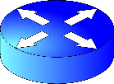

IoUT Data and Naming
User
User
Interest
/Surface/Sensor-397/Temperature
/1907250202
Data
Root prefix
The scope
Middle components
The IoUT devices
Tail components
The specific data
Unique, meaningful, hierarchical Name
Name prefix matching for fetching the data
Interest packets can be used to express the control commands
  /Surface/move-left/50m
Interest
Data
/Surface/Sensor-397/Temperature/1907250202
MetaInfo
Data Content
Signature
Sensor-397

Slide 11




Named-based Routing and Forwarding
Data producers advertise hierarchical name prefixes
Users send Interests to published prefix
Name prefix matching will direct data back to the user
Data is cached into the network
/Surface/Sensor-397/Temperature
/Surface/Sensor-397/Temperature
/Surface/Sensor-397/Temperature
Sensor-397
Sensor-398

Slide 12

In-network Storage
Consumer
Application in-memory storage
  Allocated in memory
  Managed by applications
Forwarder content store
  Managed by routers
  Opportunistic
Repository
  Managed by application users or third party
  Long-term persistent storage
Repo
Forwarder
content store
In-memory
Storage
Producers

Slide 13

Bootstrapping
Goal
  The IoUT device (e.g., Temperature Sensor) learns the trust anchor of the system and obtain an identity certificate issued by the system controller (e.g., Operator’s server)
Assumptions
  The IoUT device and the controller have shared secret through out-of-band means, e.g., The user can pre-share the secret on the sensor device before the deployment
  The pre-shared secret is a crypto public key (BK), e.g., ECC/RSA public key, etc.
IoUT Sensor
/Underwater/sign-on/<ParamDigest>
Controller
<SecretDigest>; <Token-1>; <Signature-BK>
Generate Symmetric Key (TSK) with DH
<AnchorCert>,<KeyedHashMac>,<Token-2>,<HMAC-TSK>
Generate Communication Key (CK)
<HomePrefix>/cert/< ParamDigest >
<SecretDigest>; <CKPubKey>; < HMAC-TSK>
Sign device’s CK and generate cert
<DeviceCertificate>,< HMAC-TSK >,<AvailableService>
Notes:
Identify each other by verifying the possession of shared secret.
Negotiate a symmetric key for better performance
Utilize uniqueness to prevent replay attack
Use Interest parameter to save bandwidth

Slide 14

Service Discovery
Learning existing services from the controller in the last step of bootstrapping
Advertising services by broadcasting advertisements after bootstrapping
Broadcasting again when services change or restart (soft state)
Query meta data before using a service
IoUT Sensor
Periodically broadcast advertisement for some time after the bootstrapping
<HomePrefix>/SD/<DeviceIdentity>/LIST/<ServiceName>
<HomePrefix>/< DeviceIdentity>/<ServiceName>/QUERY
Another IoUT
Sensor
<SecretDigest>; <CKPubKey>; < HMAC-TSK>
<MetaInfooftheService>,< Signature-CK>

Slide 15
Access Control
Existing NDN access control systems don’t fit constrained devices
All symmetric key encryption/decryption
Use Interest parameter to save bandwidth
IoUT
Sensor
<HomePrefix>/AC/<SensorIdentity>/<ParamDigest>
<Type>; <KeyID>; <DHPubKey>; <CKSig>
Access
Controller
User
Negotiate Content
Encryption Key with DH
<DHPubKey>; <AKSig>
<HomePrefix>/AC/<UserIdentity>/<ParamDigest>
<Type>; <NameSpace>; <DHPubKey>; <CKSig>
Negotiate Key Encryption Key with DH
<EncypContentKey>; < DHPubKey >; <AKSig>

Slide 16
Adaptation Layers
The adaptation layers are placed at two places
  Lower layer: Abstract different link-layer protocols and wraps the NDN Interest and Data packets into link-layer frames
    Name Prefix <-> Interface mapping
    A separate process and communicates with NDN applications using Inter-Process Communication (IPC) or other equivalent mechanism
  Upper layer: Translate the application-level information to more meaningful data names for NDN
    Name Prefix <-> Data mapping
    Translation layer between transportation/network layer protocols and NDN
NDN App
Adaptation
Adaptation
NDN App
NDN Forwarding Process
NDN Forwarding Process
NDN App

Slide 17
Conclusion
Existing challenges of IoUT based on the state-of-the-art underwater communication research are introduced and addressed by NDN architecture.
Illustration of how to achieve the IoUT functionalities with NDN architecture, protocols and related mechanisms.
Simulation implementation based on the ndnSIM and underwater lower layer simulator is still on-going. Supports from NDN team are needed and much appreciated.

Slide 18
Thank you!
Q&A

