Slide 1
Secure Sharing of Spatio-Temporal Data through
Name-based Access Control
NO TEXT – Picture In Picture
Laqin Fan, Lan Wang
University of Memphis
NDNcomm, Sept 2020

Slide 2
Problem Statement
Mobile sensors provide a vast amount of data, dynamic and continuous on time and space.
  e.g., mobile health(mHealth) data, generated at different times and locations.
The data may expose privacy-sensitive information of a user.
  Only authorized users are allowed to access the data.

Slide 3
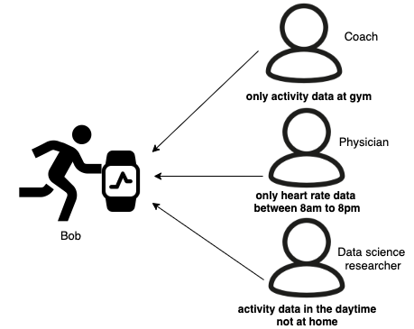
Challenges
NO TEXT – Picture In Picture
Fine-grained access control
  Access policies can contain time and location information of data.
Real-time data sharing
  To enable timely interventions based on collected data.
Example of Bob’s data sharing

Slide 4
Why Name-based Access Control^{[1]}?
NO TEXT – Picture In Picture
Provide data confidentiality and access control in NDN
  Encrypting data at the time of production
  Enabling end-to-end security without relying on third-party service
NDN provides
  hierarchical naming structure
  data-centric security
  name-based data distribution
[1] Z. Zhang, Y. Yu, S. K. Ramani, A. Afanasyev, and L. Zhang, “NAC: Automating access control via Named Data,” in IEEE MILCOM 2018, 2018.

Slide 5
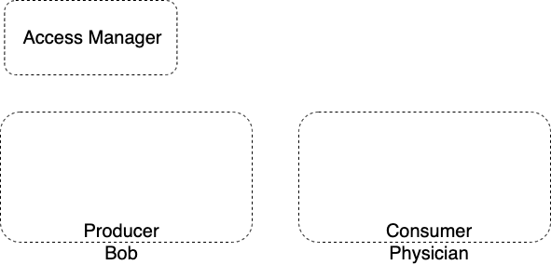





How NAC works?
Access manager
  publishes access policy as named public/private key pairs
  KEK(key encryption key)
  KDK(key decryption key)
Producer
  CK(content key), a symmetric key
  Content encrypted by CK
  publishes encrypted content and encrypted CK
Consumer
  decrypts encrypted CK using KDK
  decrypts encrypted content using CK

Slide 6
Spatio-Temporal Access Control
Provide a hierarchical naming convention related to time and location
  e.g. Bob’s activity data namespace, /Bob/activity/<geolocation>/<timestamp>/
Support granular non-real time data sharing
  Data owners could share historical data in storage
Support granular real-time data sharing
  e.g. physician retrieves heart rate data in real time for intervention timely
Specify different granularities of content key
  CK granularity could be changed depending on time and/or location.
  E.g., content key could be generated per second, per minute, or at each location.

Slide 7
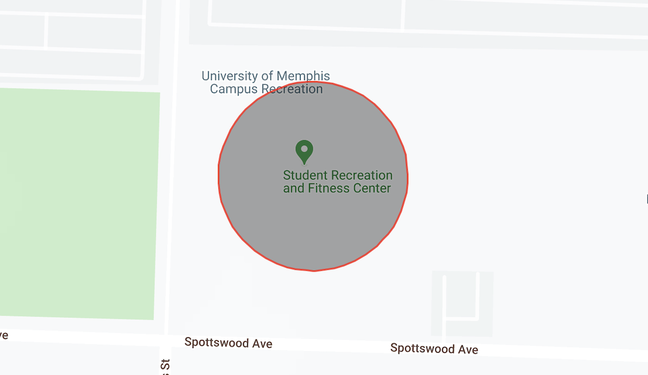
Granular Access Policy
Decide who can access what data at which granularity.
Granular access policy contains a list of constraints
  Time interval
    between 8am and 5pm Sept 1, 2020
  Spatial area
    at building, neighborhood, or city level
    home, Memphis, etc.
    represented by a center point (GPS coordinates ) and a radius(in meters)
Example of geolocation: UM Fitness center

Slide 8
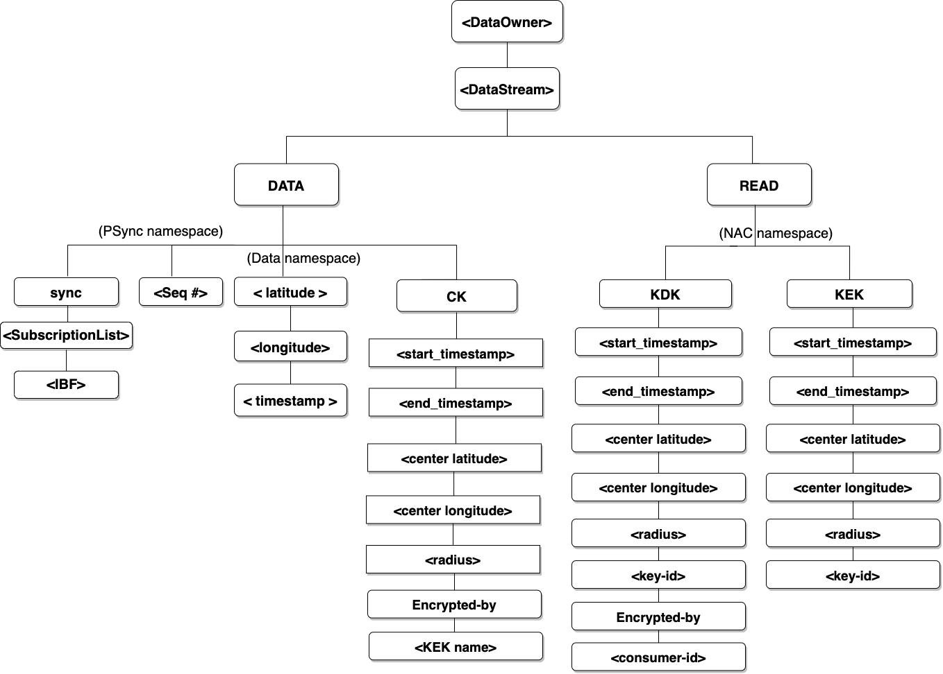
Namespace Design
<DataOwner>
  e.g., /Bob, /org/UofM
<DataStream>
  e.g.,/activity, /heart_rate
/DATA
  Data namespace
  CK namespace
  PSync namespace
/Read
  Access control namespace

Slide 9
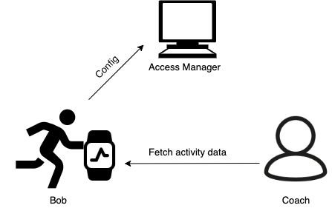
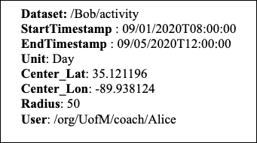
Design of Access Policy
NO TEXT – Picture In Picture
Access manager sets up access policy for data owner Bob
  Bob’s coach can access dataset: /Bob/activity generated at Fitness center, between 8am to 12pm from 09/01/2020 to 09/05/2020 daily
Example of access policy for coach Alice

Slide 10
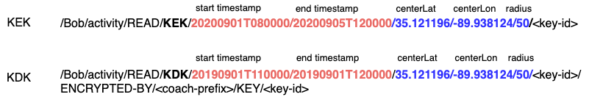
Design of Data Naming
Access Manager generates pairs of KEK and KDK
Bob generates content at 09012020T083000, fitness center.
Bob specifies CK granularity as 1m

Slide 11
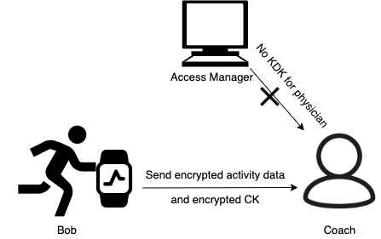
Access Failure Case
Coach can only access Bob’s activity data generated at fitness center
When coach fetches Bob’s activity data generated at home
  Coach is not authorized to access
  Cannot have the keys to decrypt the data

Slide 12
Evaluation
Experiment for data retrieval time for spatio-temporal access control
MiniNDN^{[2]} Emulation Environment
  Mininet-based NDN emulator
  Experimental topology: star topology with 102 nodes
    100 consumers, 1 producer, 1 access manager
Dataset
  Activity data, continuous time(8am-8pm), location (UM Library and CS department)
  Size: 2000 data points
Access policy
  Allow access activity data between 8am and 12pm at CS department, University of Memphis.
[2] http://minindn.memphis.edu/

Slide 13
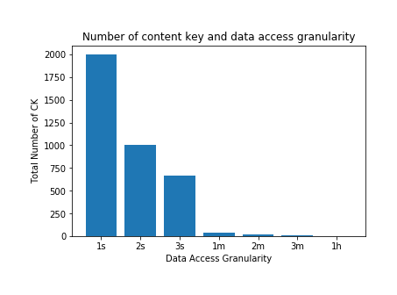
Evaluation Results
CK granularity can be specified based on data generation interval
  When data is generated per second, granularity could be 1s, or coarser
Tradeoff between finer granularity and number of CK generated
  Coarse granularity makes one CK cover more data, once the CK is compromised, those data will be exposed

Slide 14
Evaluation Results
Data generation interval: 1s
The average sync delay for each data point ≈ 20.4ms
Data production time ≈ 4.5ms
  Including CK search/generation, KEK retrieval, and data encryption
Data consumption time ≈ 30ms
  Including CK retrieval, KDK retrieval, and data decryption
Communication delay ≈ 16ms
  Data transmission delay between producer and consumer

Slide 15
Conclusion
We developed spatio-temporal access control
  Fine-grained access control, access policy defining and enforcement
  Real-time data subscription and notification
Future Work
  Specify spatial area through a map directly
  Run experiments by changing granularity of spacial area at neighborhood level, city level

Slide 16
The End
Thank You
Q&A

Slide 17
Assumptions
Assumptions from NAC
  Each entity in the system has its own public/private key pair
  Each entity is able to authenticate the data packets produced by others through digital signature validation.
Assumption for spatio-temporal data sharing
  The data contains geolocation and time information.

Slide 18
Data Subscription and Notification
Enable real-time data sharing
  Data consumers subscribe to the data prefix of their interests.
  Receive notification whenever such data is generated.
  Synchronize the new data.
PSync[2] is a sync protocol in NDN, addresses different types of data synchronization efficiently.
[2] M. Zhang, V. Lehman, and L. Wang. 2017. Scalable name-based data synchronization for Named Data Networking. In IEEE INFOCOM 2017 - IEEE Conference on Computer Communications. 1–9.

Slide 19
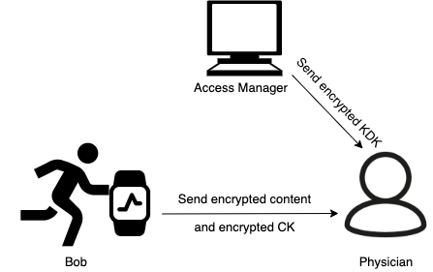
Use Case - Data Consumption
Physician fetches
  encrypted content
  encrypted CK
  encrypted KDK
Physician decrypts
  encrypted KDK using her private key
  encrypted CK using KDK
  encrypted content using CK

