Slide 1
A Full Data-centric Network Stack Integrating V-MAC and NFD
Mohammed Elbadry, Fan Ye, Peter Milder, Yuanyuan Yang
mohammed.elbadry@stonybrook.edu
Electrical and Computer Engineering Department
Stony Brook University
September 2020

Slide 2
Current MAC Falls Short
Network and discovery procedures must be established before any data-centric communication
  Beacon sharing among nodes to join address-based network incurs continuous overhead and latency
Destination must be determined before transmission
  Each frame carries a destination and a group address
Multicast support is non-existent
  Just broadcast, lowest base rate (1 or 6Mbps)

Slide 3
Data-centric MAC: Challenges and Opportunity
Wireless medium presents a very different set of challenges
  Varying reception qualities at different neighboring receivers
  Short contact durations
Wireless also presents unique opportunities
  Broadcast in nature, thus natural for one to many
  Potentiality of Eliminating network discovery
    Use data attributes for filtering

Slide 4
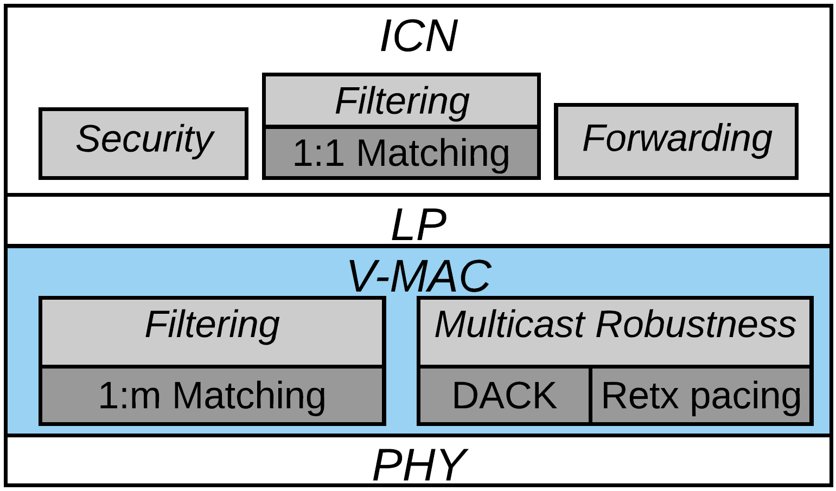
V-MAC: Data-Centric Wireless Communication
Beaconless design
  Eliminate discovery/joining latency overhead
Pending Encoding Table (PET)
  Complete data-centric design from PHY to NFD
Best-Effort Robust multicast
  Scalable (tested up to 15 receivers) low losses among all receivers with no prior-setup requirements like traditional WiFi communication
Full Stack Overview
* For more information, V-MAC paper is to appear at The Fifth ACM/IEEE Symposium on Edge Computing (SEC’20), November 11-13th

Slide 5
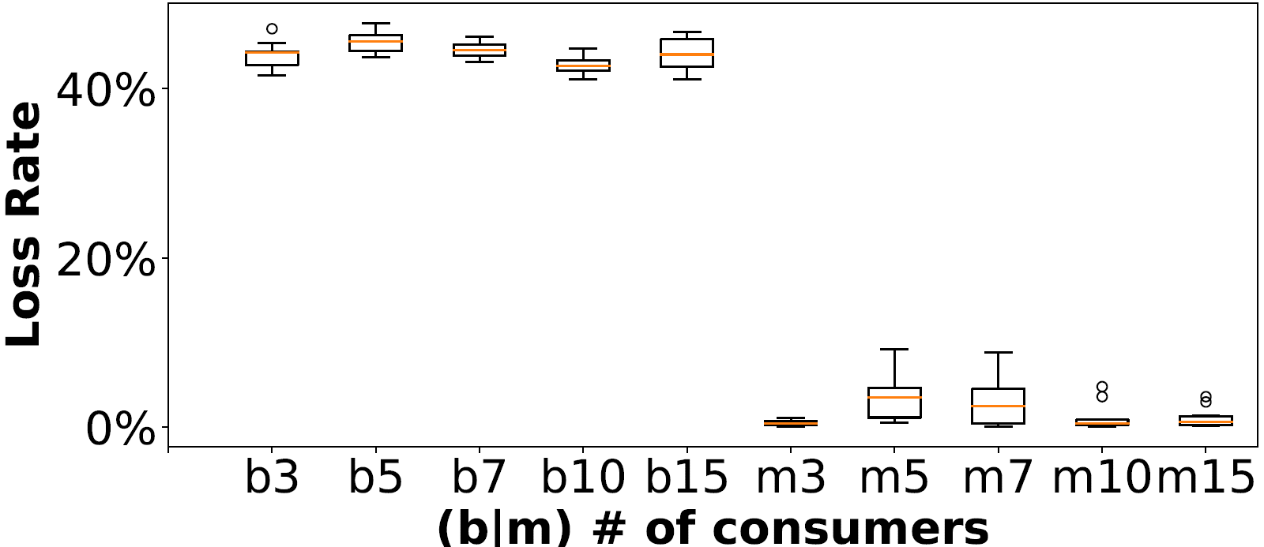
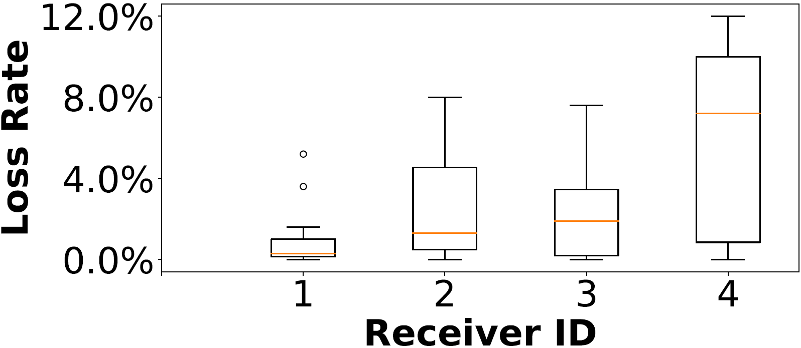
Loss Rate with V-MAC
Stationary
  54 mbps
  1 producer – 3, 5, 7, 10, 15 consumers
Real Vehicles
  54 mbps
  1 producer – 4 consumers Platoon
  25 – 35 mph
Scalability Stationary Experiment
V-MAC Real Vehicles Experiment

Slide 6
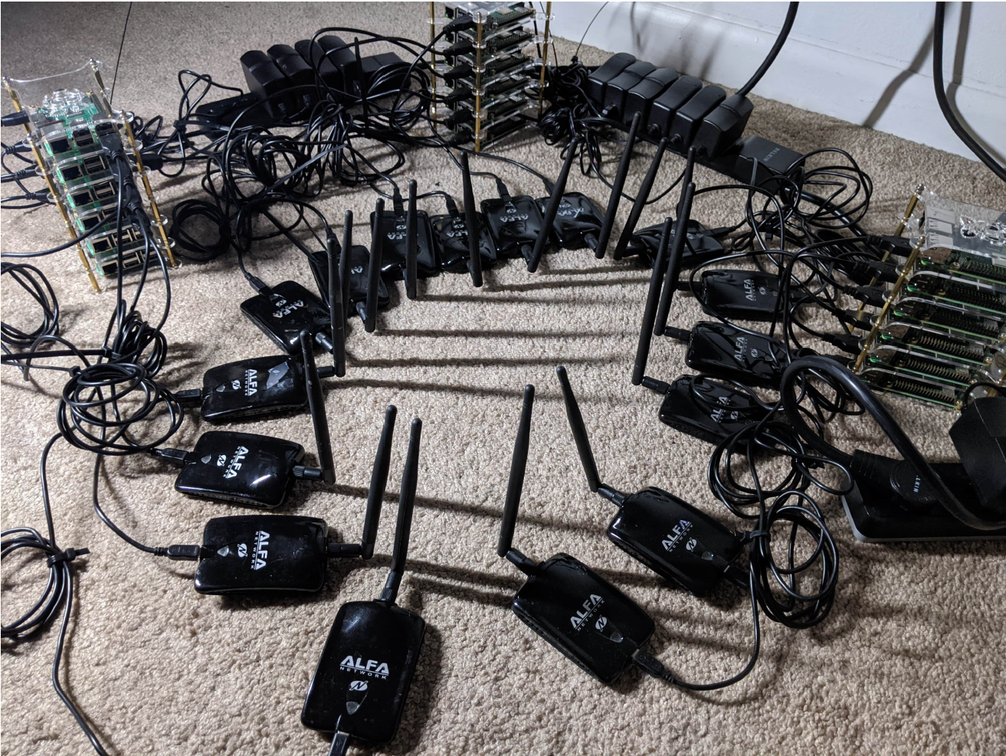
Application Performance with V-MAC
Raspberry Pi + USB Wifi dongle
v3: kernel module from scratch with provisioning for NFD Integration
Stationary testbed
Kindly Play the video

Slide 7
VNLP Benefits
Full data-centric Stack
MAC Data-centric robustness protocol
  10-90% broadcast to 1-5% multicast loss rates stationary and <15% mobile
  V-MAC’s latency < 2.5x of broadcast’s
60X and 100X latency improvements for cross-stack communications
Interoperable with ad-hoc and can co-exist with any regular WiFi
Support of high data rates

Slide 8
VMAC and NFD Full Stack Features
Types of Frames VNLP Supports
  Interest
    with best-effort DACK multicast support
    with no reliability
  Data
  Announcement
    NACK is sent as Announcement to V-MAC
  Implicit Interest
    with best-effort DACK multicast support
    with no reliability
Configurable data rates (1 – 65 mbps at 802.11n and up to 900 mbps 802.11ac)

Slide 9
Future Work
Finalize Integration and prepare for code-reviews/testing
  Code available to community expected by October given some help from NDNComm finalizing integration
  https://github.com/melbadry97/Full-Data-centric-Stack
Data-centric Multicast frame rate adaptation
Support more hardware chipsets (mediatek, 10k, 9k)
New data-centric research problems
  Unique Data-Centric Producer selection
  Data-centric beacon needs
Notes:
Producer selection

Slide 10
Thank You
Questions?
*Thank you Lixia Zhang and Asavari Limaye for the support and starting efforts integrating NFD and V-MAC
Notes:
Producer selection

