Slide 1
NDN: Plug and Play
eric newberry, Tianyuan yu, Zhiyi zhang, john Dellaverson, lixia zhang
UCLA
September 10, 2020

Slide 2
What is Plug And play
Configuration
  The setup required to talk to other nodes on the network
Reachability
  Finding the other nodes
How do these goals differ between IP and NDN?

Slide 3
IP Configuration
What is the goal of IP configuration? In a word, connectivity to the global internet
  IP config is to plug a node into an existing connected IP infrastructure.

Slide 4
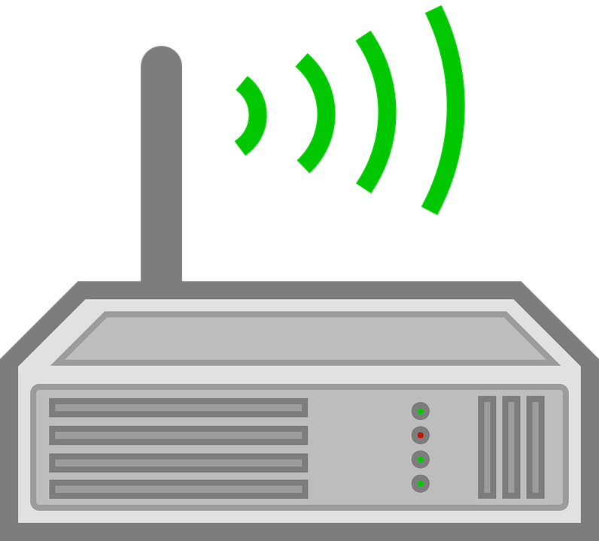

In order to join the network, a new node must connect to a DHCP server and retrieve an IP address, subnet mask, the default gateway, maybe a DNS server. Once connected, config is complete
.1 .2 .3 .4
.5 .6 .7 .8

Slide 5
IP Configuration II
Because IP is just about connectivity, everything involving trust happens on a higher layer
Can’t know if talking to the right party over just IP
Thus vulnerable on its own

Slide 6
NDN Configuration
What is NDN Configuration?
  Plug a new entity into an application namespace. Because trust relations exist within this space, also inherit the trust relations of that namespace with other names.
    Because asserting trust dynamics here, authenticity is critical.
  All about Names and Security
  All configuration can be encapsulated in getting a Name from a relevant application and Certificate from a trust anchor.
  From there, can retrieve a Trust Schema, can automatically discover namespaces.
Notes:
Know whether got right or wrong thing (Can verify)
Plugging in is the aforementioned, the ‘play’ notion includes the reachability analysis in slide 8
Mobility mention here (play around with)

Slide 7

NDN Config Visualized
Trust anchor 2. Runs /home
Trust anchor 1 runs /ndn
If a new entity wants to join the network, it must get a name (e.g. /home/b) from a relevant application, and a certificate from the trust anchor (from anchor 2)
Signs as /home/a
Data Name | Key Name | Anchor
Must prefix /ndn | Must prefix /ndn/…/key | /ndn/KEY/C/key05
Must prefix /home/a | Must prefix /home/a | /home/KEY/a/key01
Signs as /ndn/c
Signs as /ndn/a
Signs as /ndn/b
Data Name | Key Name | Anchor
Must prefix /ndn/a | Must prefix /ndn/a | /ndn/KEY/a/key01
Data Name | Key Name | Anchor
Must prefix /ndn | Must prefix /ndn/…/KEY | /ndn/KEY/c/key05

Slide 8
Multiple Ways to get reachability
Once an entity has the aforementioned essential components (Name, Certificate → Trust Schema), can get reachability in multiple ways:
Different ways of getting reachability
  NDN broadcast self-learning
  NDND
  Ndn-autoconfig (not actually an auto-configuration system)
  NLSR
Notes:
https://named-data.net/publications/on_broadcast-based_self-learning_ndn/
Separate out edge vs core – NLSR additional set up doesn’t need to have its additional set up mentioned, not our business (config doesn’t belong here).

Slide 9
Ways to implement
Provide easy ways to safely input the Trust Anchor + Certificate + Name.
Automate all reachability beyond that.
Ensure that the application itself (or the developer) doesn’t need to be concerned with anything beyond the first step.

Slide 10
Existing Code
https://github.com/tianyuan129/ndn-plugnplay
Works relatively simply
Connects to other machines in one-hop WiFi or Ethernet range
Notes:
Demo here? Do video clip instead.

Slide 11
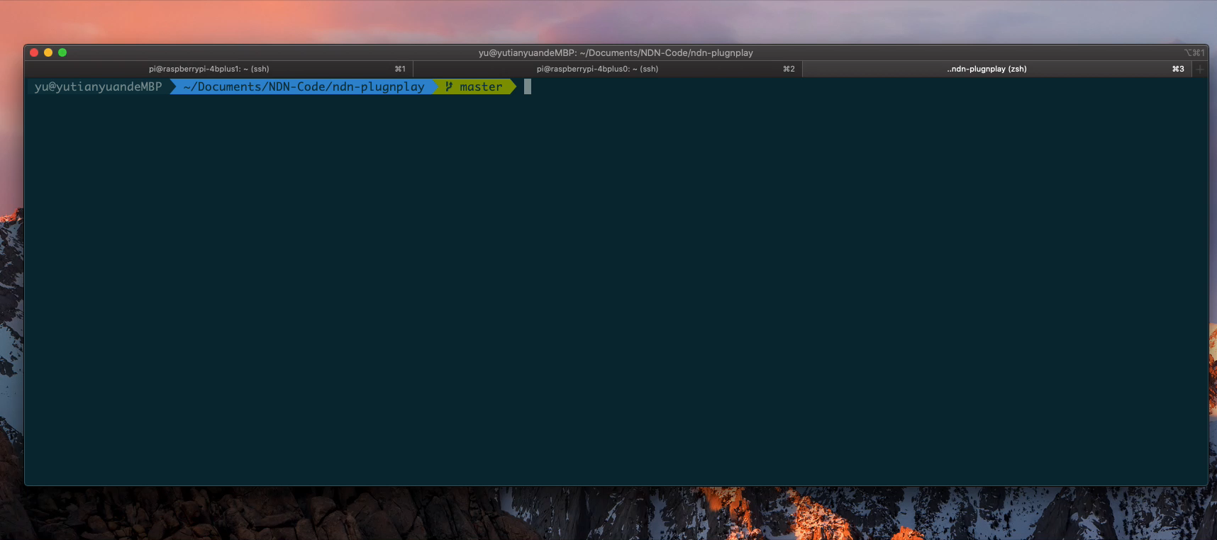
Notes:
I have 2 Pis and one Mac. Mac’s NFD was up and running, while the two Pis’ were not. Three devices were connected through Ethernet. On Mac I started a tiny little server to generate {trust anchor, certificate, schema} for devices and listen requests to distribute them. Initially, two Pis only have the default identity /localhost/operator . After their NFDs started, they fetched individual’s {trust anchor, certificate, schema} from the network (actually from Mac) by sending Interests /ndn/config/<required-info>/<nonce> . Then you can see the identity been installed. Trust anchor and trust schema were saved in hard-coded path /usr/local/etc/ndn (edited)

Slide 12
Future Directions
Further clarify the difference between IP and NDN Configuration.
Develop the automation tools for reachability.

Slide 13
Conclusion
IP Configuration is concerned solely with connectivity, so the host can send and receive IP packets.
  Application itself must configure security
NDN entities take their Name from the application, and configure their security
  Model requires authenticity to be established in this stage
Once configured, can do reachability in any number of ways
Notes:
Third bullet, with identity and security configured, reachability automatable
Third bullet is plug, once you have configuration, reachability is no-brainer as it were. Just optimization away from flooding, which still works.

