Slide 1
NDNSD: Service Publishing and Discovery in NDN
Saurab Dulal, Lan Wang
The University of Memphis
NDNcomm, 2020

Slide 2
Motivation
“NDN future lies in developing API, interfaces and reusable component”
- Mini-Retreat, April 24
Service Discovery is very important for modern applications IoT, edge, mobile, etc.
  e.g. discovering printer, computational services, storage services, etc.
Lack of service discovery mechanism in NDN, faced several challenges (e.g. manual configuration) while doing BMS/IoT project.
Existing solutions ^{[1][2]}:
  Either centralized or limited to a specific environment
  Absence of higher level API’s, applications directly interact with lower-level network primitives (face, interest, data, etc)
[1] Spyridon et.al. "Towards Service Discovery and Invocation in Data-Centric Edge Networks." 2019 IEEE 27th International Conference on Network Protocols (ICNP). IEEE, 2019.
[2] Mastorakis, Spyridon, et al. "ICedge: When Edge Computing Meets Information-Centric Networking." IEEE Internet of Things Journal (2020).

Slide 3
Research Goal
(Primary) Design a general-purpose distributed service discovery protocol for NDN that can support various types of services.
  General-purpose: covering a wide range of environments e.g. LAN, WAN, IoT, edge, mobile, etc.
(Secondary) Develop reusable library components, and provide higher-level APIs
  Facilitate application developers to implement their own logic without dealing with low-level network primitives.
Notes:
The ability to register a service under an existing service type or by creating a new one, The ability to query for a service type and receive a list of invocable services in the network, For a service name, the ability to fetch service information that is usable to the client.

Slide 4
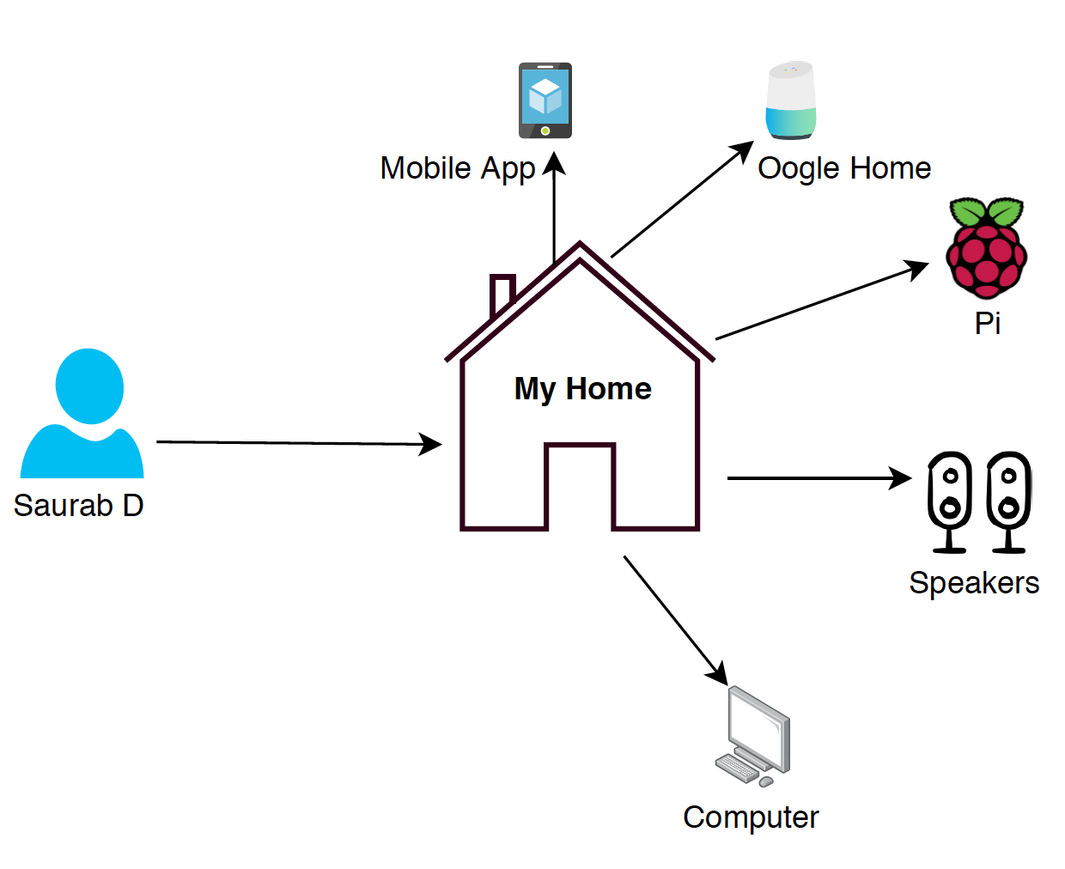
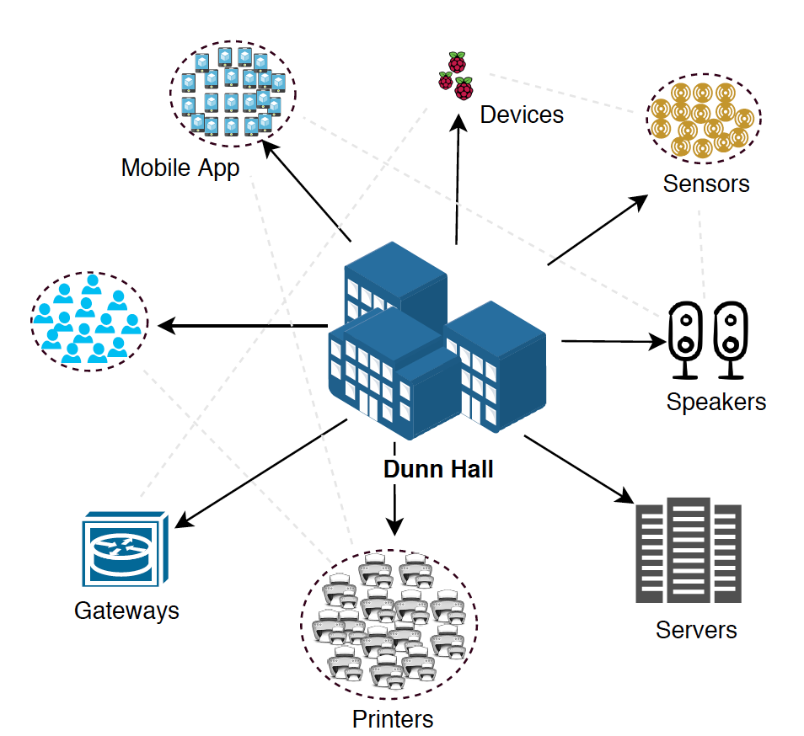
Possible Solutions
/home/npchat
request broadcast
Consumer
Flooding will work
Consumer floods their request to the entire network
Request are served by whoever provides the service
Easy to find the service available in the network
/home/bedroom/speaker
/home/saurab-pc
But things get complicated once the
size grows (edge, industrial network, mobility, etc)
Flooding will not scale
Notes:
probably need to remove these refs? they do broadcast instead of flood.
Flooding will not scale to fulfill the need of complex environments.

Slide 5


Possible Solutions
Move the discovery to a rendezvous ^{[1]}
point or to the cloud?
Smart Things, AWS IoT,
Google Chromecast, Cloudet,
Azure Sphere
[1] Arthi Padmanabhan, Lan Wang, and Lixia Zhang. Automated tunneling over ip land: run ndn anywhere. In Proceedings of the 5th ACM Conference on Information-Centric Networking, pages 188–189, 2018.

Slide 6


Possible Solutions
Hey, can we talk?
Can I talk to him?
Move the discovery to a rendezvous ^{[1]}
point or to the cloud?
Smart Things, AWS IoT,
Google Chromecast, Cloudet,
Azure Sphere
But, we don’t want centralized solutions,
single point of failure, extra round trip,
external dependencies (in some cases)
[1] Arthi Padmanabhan, Lan Wang, and Lixia Zhang. Automated tunneling over ip land: run ndn anywhere. In Proceedings of the 5th ACM Conference on Information-Centric Networking, pages 188–189, 2018.

Slide 7
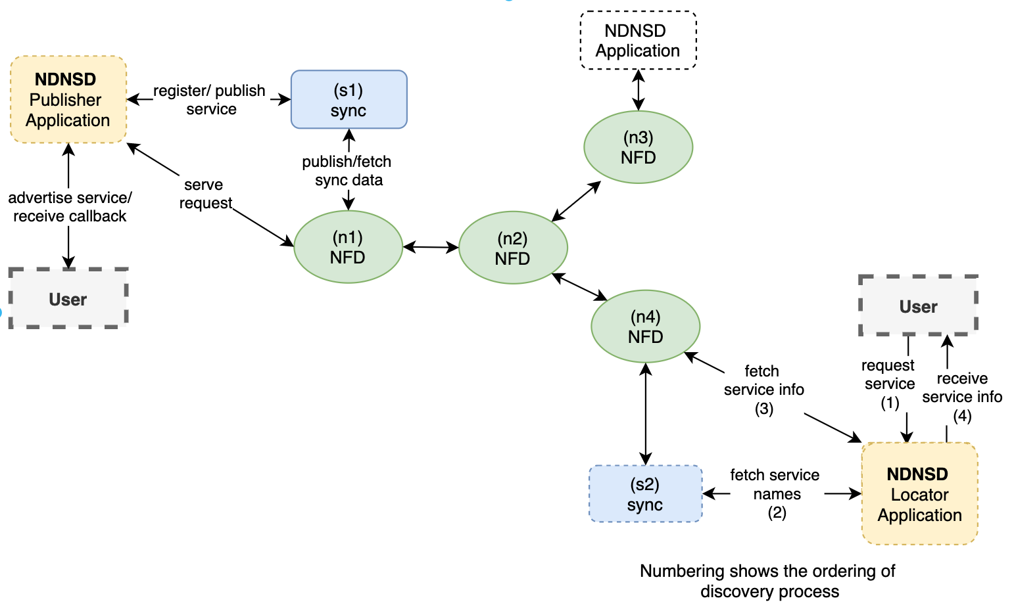
Our Solution (NDNSD)
e.g ndnsd-locator -s <printer>
printer 1, service-info
printer 2, service-info
Group services e.g. printers, servers
Use sync^{[1]} to synchronize metadata
of these services under a common prefix
e.g. /discovery/printers, /discovery/servers
Provide higher-level well-defined API for Service Discovery
  Service Publisher
  Service Locator
Why sync?
  Pub-sub simplifies the discovery process
  Flexibility to implement application semantic,
  several parties can agree on a common sync group
e.g. “ndnsd-publisher -c <producer.conf>”
Fig: NDNSD Flow diagram
[1] “Service discovery for IoT devices through PSync FullSync” https://bit.ly/3fg6KWz.
Notes:
Group service based on their service type.
Grouping different services lets consumer fetch service information
from the desired group only, join specific group and fetch or publish service info

Slide 8
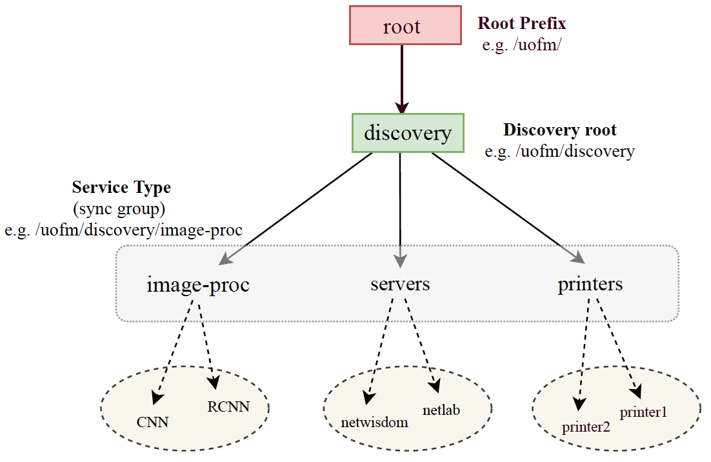
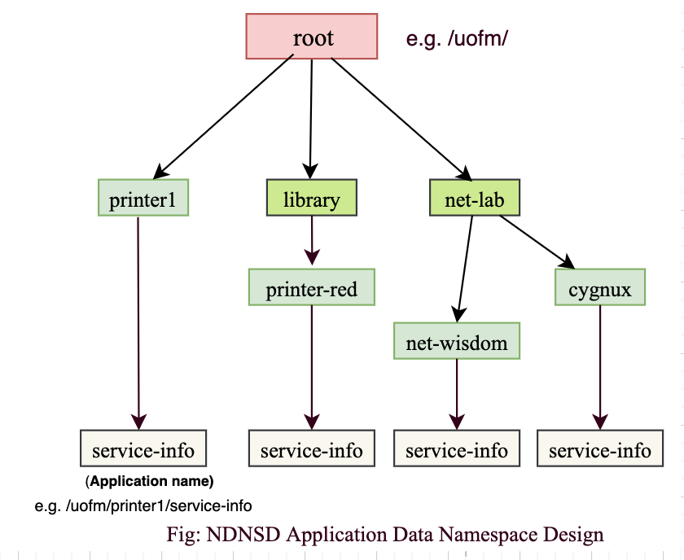
Design Features
Hierarchical Namespace
Discovery Prefix (flexible, based on service-type)
  e.g. /uofm/discovery/image-proc
Application Prefix
  e.g. /uofm/printer1/service-info, /uofm/net-lab/cygnux/service-info
Example: use of prefixes at sync level:
service-group: /uofm/discovery/printers/
(sync-group)
Content: {
/uofm/printer1/service-info/<seq#>,
/uofm/printer2/service-info/<seq#>,
…….
}
Fig: NDNSD Discovery Namespace Design

Slide 9
Design Features
> e.g. publisher conf file
required
{
serviceName image-proc
appPrefix /image-proc/R-CNN/service-info
}
; application specific service details
service-detail
{
description Mask R-CNN
releases Mask R-CNN 2.1
lifetime 50 ; in seconds
}
Service-info
Publisher can specify service-specific details
This generalizes protocol for a wide-range of environment
IoT, edge, etc.
Measurement Information via the API
Round trip time (RTT) to service
  (Can be cumulative over a period of time)
  e.g. use: to locate the closest gateway or hub
Service Stability
  Compute by periodic probing the service
Retransmission count to fetch service-info
(lifetime + publish timestamp is used to compute
service status i.e. active/expired)

Slide 10
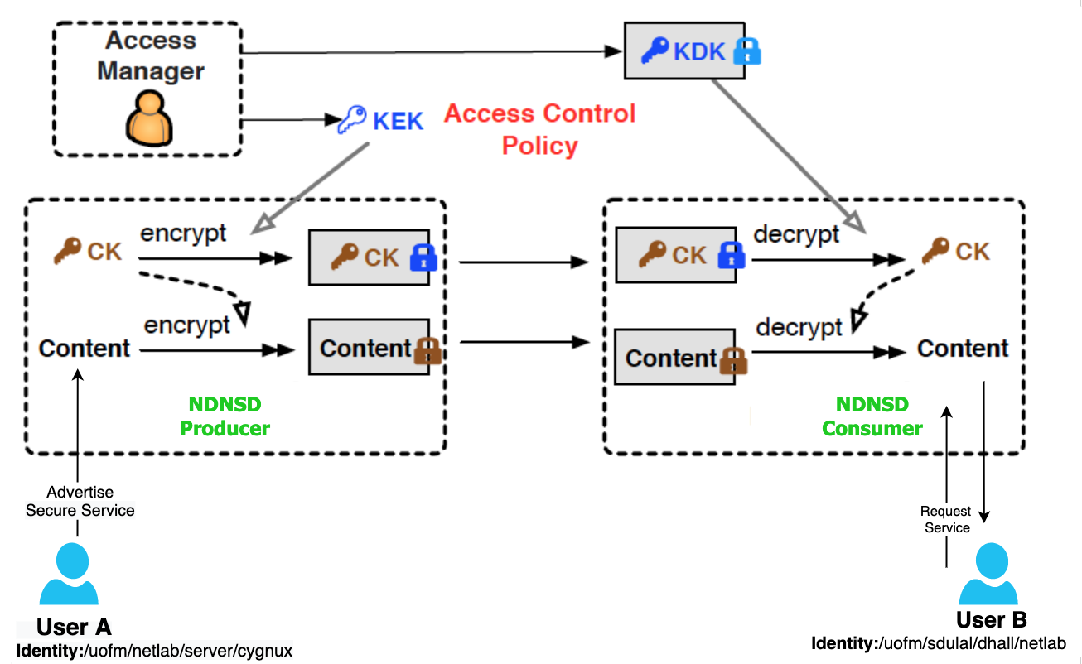
Service-info Accessibility
How to protect some sensitive service being displayed to an unauthorized audience?
  E.g. /netlab/server/cygnux/info should only be visible to the netlab members.
One who can access the service should only
be able to view the service
Use Name Based Access Control (NAC) ^{[1]}
[1] Yu, Yingdi, Alexander Afanasyev, and Lixia Zhang. "Name-based access control." Named Data Networking Project, Technical Report NDN-0034 (2015)

Slide 11
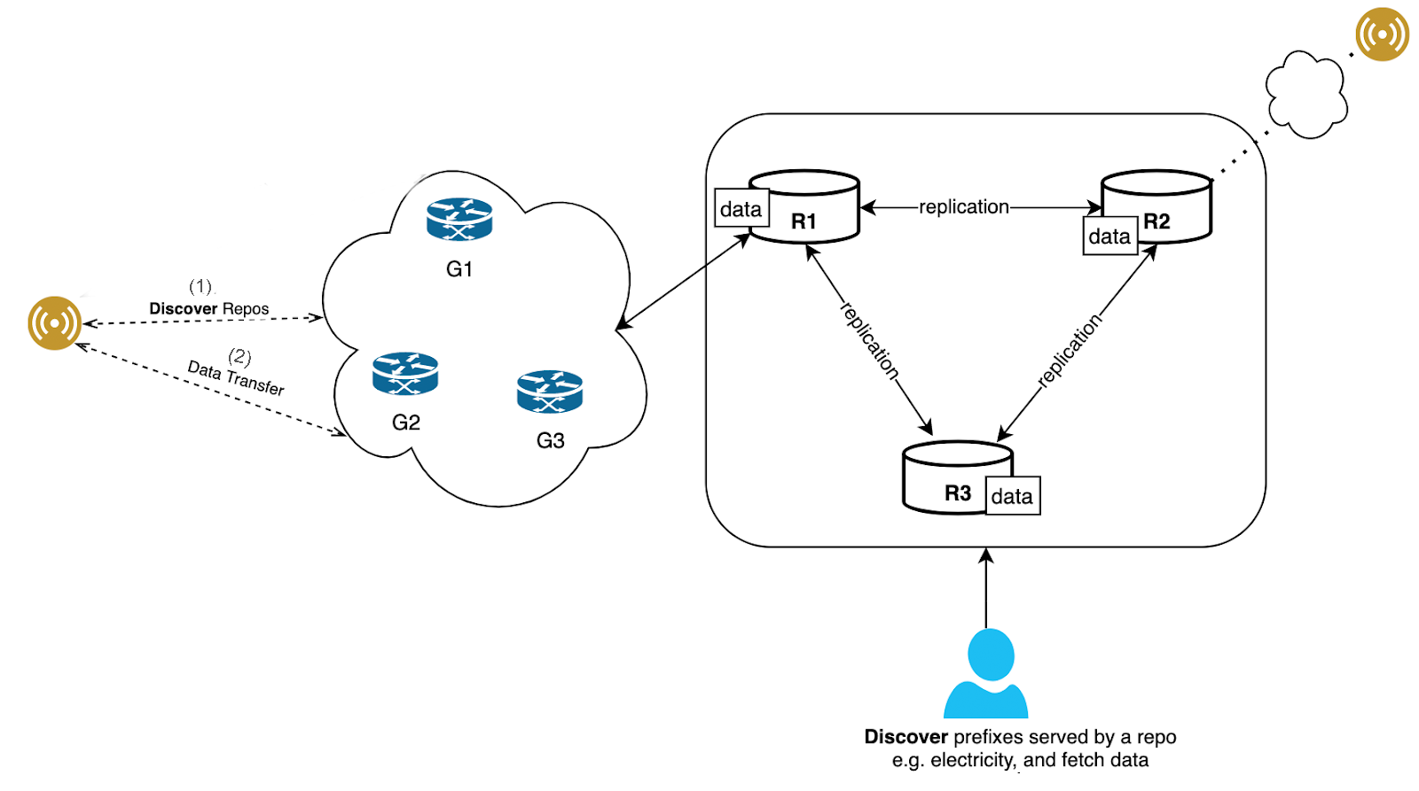
Use Case
e.g. repo group prefix: /<prefix>/discovery/repo/
via service-info
/<prefix>/repo/R1
/<prefix>/repo/R2
/<prefix>/repo/R2
….
/<prefix>/sensor2
/<prefix>/sensor1
/<prefix>/sensor1
/<prefix>/sensor2
….
via service-info
Fig: Simple Building Management System (BMS) architecture highlighting
the use of discovery service

Slide 12
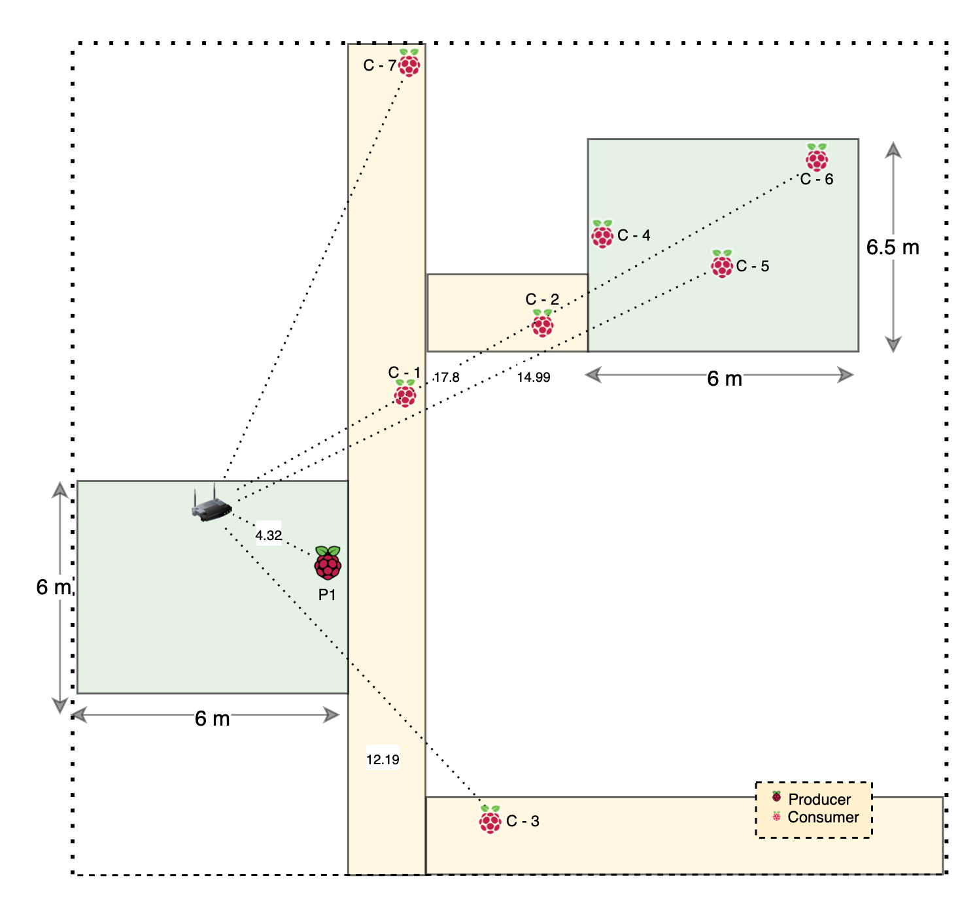
Preliminary Evaluation
Real-world Experiments
  Raspberry PI’s were distributed across Dunn Hall,
  University of Memphis
    Distance: Delay distribution based on distance
    Congestion: Delay distribution based on number
    of nodes (C = Service Consumer, P = Service Publisher)
Wired and Wireless emulations using Mini-NDN
NDNSD is implemented on top of PSync^{[1]} and Chronosync^{[2]}, can adapt to both of these protocols
  Source: https://github.com/dulalsaurab/NDNSD
Fig: Device distribution at various distances
[1] Zhang, Minsheng, Vince Lehman, and Lan Wang. "Scalable name-based data synchronization for named data networking." IEEE INFOCOM 2017-IEEE Conference on Computer Communications. IEEE, 2017.
[2] Zhu, Zhenkai, and Alexander Afanasyev. "Let's chronosync: Decentralized dataset state synchronization in named data networking." 2013 21st IEEE International Conference on Network Protocols (ICNP). IEEE, 2013.

Slide 13
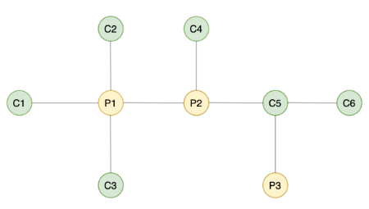
Evaluation (Emulation)
Setup
Tool: Mini-NDN (Lightweight NDN emulator)
Service-info update frequency: 900ms + 200ms jitter
Total number of updates: 300 per producer
Sync: PSync, Link-delay: 10ms/link
Delay (ms)
Hop Count | Median Delay (ms) | Average Delay (ms)
1-hop | 25.26 | 26.51
2-hop | 38.22 | 40.77
3-hop | 41.22 | 46.97
4-hop | 52.56 | 60.08
Fig: Multi-hop emulation topology
(C = Service Locator, P = Service Publisher)
Table: Service-info retrieval time in a multihop environment
Caching and sync multicast is helping to reduce the overall delay.
[1] Zhang, Minsheng, Vince Lehman, and Lan Wang. "Scalable name-based data synchronization for named data networking." IEEE INFOCOM 2017-IEEE Conference on Computer Communications. IEEE, 2017.

Slide 14
Conclusion
NDNSD
General-purpose, distributed service publishing and discovery mechanism for an NDN
Well defined pub-sub API for discovery and reusable library components
Preliminary evaluation and use-case
Challenges and Existing Difficulties
Real-world setup and experiments
Lack of multicast suppression in NFD, observed an enormous amount of unsolicited data and interest
Future Works
Perform scaling experiments in Mini-NDN, and real-world multi-hop wireless experiment
Implement/experiment some of the use-case (e.g. BMS)

Slide 15

That’s the one I am looking for
NDNSD
Thank you!

