Slide 1

NDN for In-Vehicle Networking
Zachariah Threet, Luke Lambert, Micah Jones, Alex Afanasyev, Christos Papadopoulos, Susmit Shannigrahi
Notes:
What if as you were driving on your way home today, your steering wheel stopped working and the person behind you started to accelerate ending in a crash <- Say this will be a scary situation that people have shown can be remotely orchestrated.
All of this can happen if we don’t prioritize the security of in-vehcle networks
This is not very relevant to what we are doing -> and at the same time your banking apps were hacked so you won’t have any money to pay for your medical bills when you ultimately crash.

Slide 2
Outline
Overview of current in-vehicle communication
Potential future directions of the community
NDN for in-vehicle networks
  What are the potential benefits?
A bench-top testbed and test harness
Results so far
Future directions
Notes:
Security concerns, next gen needs and intrinsic design
In vehicle networks as they are now what makes them vulnerable
Mitigation strategies and the direction industry is heading more promise in my alternative
I will briefly discuss NDN as a concept and explain why its a good fit for vehvcles
Showing what has been done and what remains to be done d
Throughout this presentation I will show how this architecture will address the security concerns on in-vehicle networks while meeting the needs of next generation vehicles and maintaining the intrinsic design of vehicle networks all with considerably less overhead than considered alternatives.
I will start by talking about vehicles as they are now and what will makes them a vulnerable target for cyber attacks
Following that I will discuss some of the mitigation strategies that academia is suggesting as well as the direction industry is currently heading and explaining why I see more promise in my alternative
I will then briefly discuss Named Data Networking as a concept and explain why it is a good fit for the next generation of in-vehicle networks. Before discussing how we have already begun to implement it in a physical test bed.
I will then conclude with a discussion of what remains to be done and how I plan to complete this work.

Slide 3
CAN Communication
DATA FRAME
Name /
Priority
Data Transfer
Engine
Controller
777#AcceleratorPedalPosition
Bus
Accelerator
Brake
Controller
[1],[3]
Notes:
Simplified
Can frame
ID
Transmission description
NEXT: however
Pictured here is a simplified rendering of how micro controllers are arranged on a bus inside of a vehicle communicating in CAN
Also included here is a CAN frame. This is what is published and received by ECUs on the network. For the purpose of our discussion the only thing that is important are the ID and the 8 byte data packet.
The 11 bit Identifier has two functions. It identifies the messages content, and acts as an arbitration ID with the highest priority messages being given the lowest IDs.
Consider this ECU to be a part of the accelerator and this to be a part of the engine controller. The accelerator sends out a message with Identifier 777 with a number of signals one of which is Accelerator Pedal Positon which is important to the engine controller and so it is programed to pay attention to Messages that are identified by 777

Slide 4
CAN Communication
DATA FRAME
Name /
Priority
Data Transfer
Engine
Controller
777#AcceleratorPedalPosition
Bus
111#BreakPedalPosition
Accelerator
Brake
Controller
[1],[3]
Notes:
Breaking info
Others know not to interfere
Can be done fast and cheap
Security - riddled with exploitable vulnrablites
However, this ECU sends out breaking information, obviously that's more important than anything else so it is given a very low identifier message like 100.
All other ECUs know not to interfere with the bus by passing less important messages until the transmission of that message is complete
All of this can be done with little computational power and memory making it fast and cheap. Because of this it has been the standard protocol for automobiles for decades
Only problem is that when CAN was made there was designed security.
As a result, CAN is riddled with exploitable vulnerabilities.

Slide 5
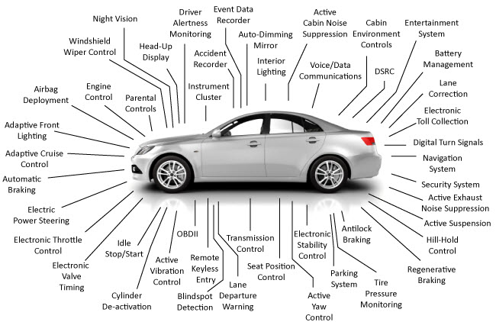
Supporting a Diverse Set of Applications
https://mpptools.com/solutions/automotive/
Notes:
Higher bandwidth for next gen sensors
AE to fix E
Less electromagnetic
At the top hierarchical architectures that connect low level protocols
The benefit of ethernet is that it can meet the higher bandwidth requirements for next generation sensors like lidar
AE is made to fix some of the problems that come from applying traditional Ethernet into vehicles.
Specifically, it is more resilient than its counterpart and can withstand more electromagnetic interference
It is being projected to be used in at the top of hierarchical architectures to connect lower layer protocols like CAN using TCP/IP

Slide 6
Vulnerabilities
No Origin Integrity
No Authentication
No Confidentiality
DoS
Replay
Custom Frame Construction
[3]
Notes:
No Auth, broadcast in the clear
Result in attacks DoS
Replay and Fuz
Think about what I said
Why isn’t this happening more
NEXT: Expanded surfaces
Most significantly, It has no authentication and all transmissions are broadcast in the clear save for some proprietary obfuscation with no attempt to identify the publisher of the message.
These vulnerabilities can result in a number of attacks, among these are DoS attacks where compromised nodes just need to broadcast the lowest ID and claim priority over the bus.
Compromised ECUs give the attacker the ability to replay captured message or to make their own to fuzz the network or manipulate the network with frame made to manipulate legitimate functionality
Think about he example I gave at the beginning of this presentation
So the question I asked when I was learning about this is if CAN is so easily exploitable and the vulnerabilities have such a high impact, are we not seeing car hacking happening every day? It’s a surface issue.
For the most part, attacks have been limited to direct access of the vehicle. And attackers like there attacks to be massive and untraceable, and plugging your laptop into the OBD port of my car isn’t massive or untraceable

Slide 7
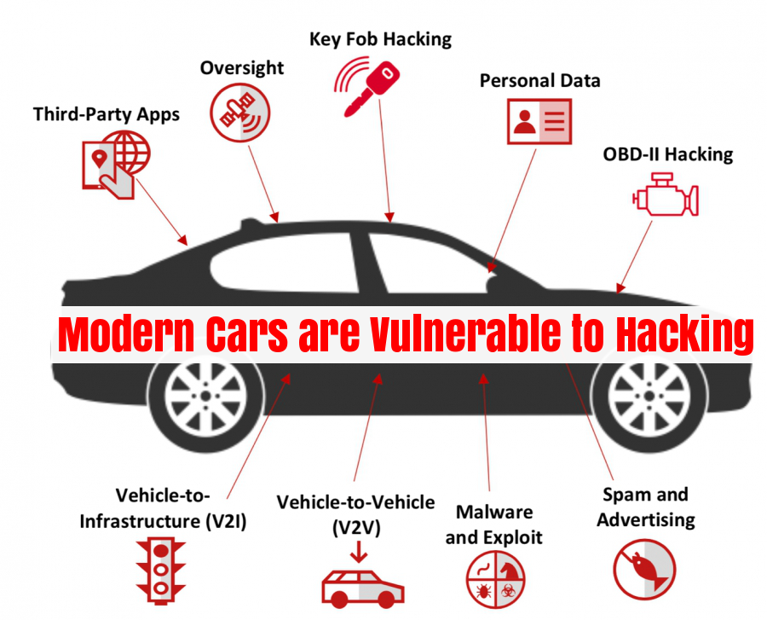
Future And Present Surfaces
Notes:
Surfaces and bandwidth

Slide 8
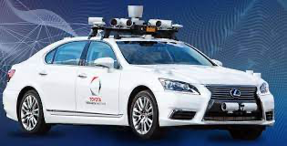
Can CAN Support New Applications?
CAN
Next-Gen Application
LIDAR based ADAS sensor for lane detection
17.5 Kbs
to
70.2 Kbs
70Mbps
https://www.einfochips.com/blog/automotive-ethernet-driving-in-vehicle-communication-for-new-age-vehicular-functions/
A Comprehensible Guide to Controller Area Network
Notes:
Bandwidth present and future

Slide 9
Outline
Overview of current in-vehicle communication
Potential future directions of the community
NDN for in-vehicle networks
  What are the potential benefits?
A bench-top testbed and test harness
Results so far
Future directions
Notes:
Security concerns, next gen needs and intrinsic design
In vehicle networks as they are now what makes them vulnerable
Mitigation strategies and the direction industry is heading more promise in my alternative
I will briefly discuss NDN as a concept and explain why its a good fit for vehvcles
Showing what has been done and what remains to be done d
Throughout this presentation I will show how this architecture will address the security concerns on in-vehicle networks while meeting the needs of next generation vehicles and maintaining the intrinsic design of vehicle networks all with considerably less overhead than considered alternatives.
I will start by talking about vehicles as they are now and what will makes them a vulnerable target for cyber attacks
Following that I will discuss some of the mitigation strategies that academia is suggesting as well as the direction industry is currently heading and explaining why I see more promise in my alternative
I will then briefly discuss Named Data Networking as a concept and explain why it is a good fit for the next generation of in-vehicle networks. Before discussing how we have already begun to implement it in a physical test bed.
I will then conclude with a discussion of what remains to be done and how I plan to complete this work.

Slide 10
Automotive Ethernet at Layer 2
What is it?
  High bandwidth
  Fault resilient
Implement a middleware to replace CAN (SOME/IP))?
  Probably not
How to connect traditional and future technologies together via a hierarchical network?

Slide 11
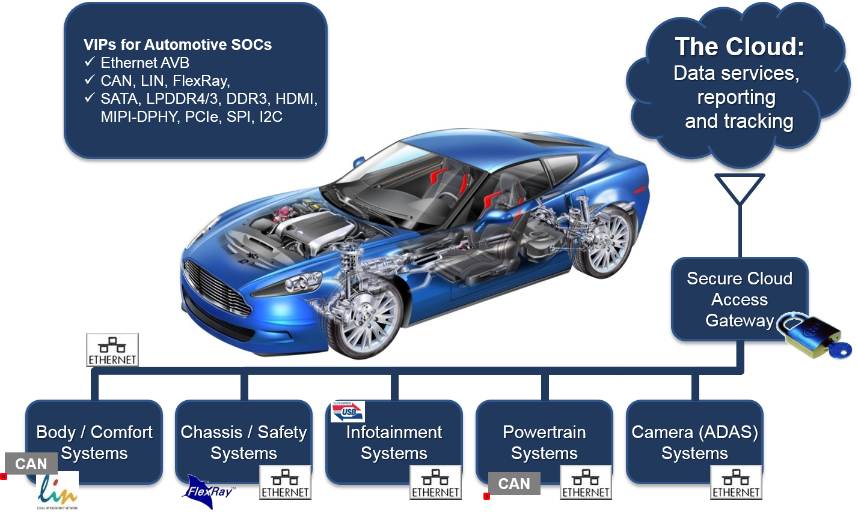
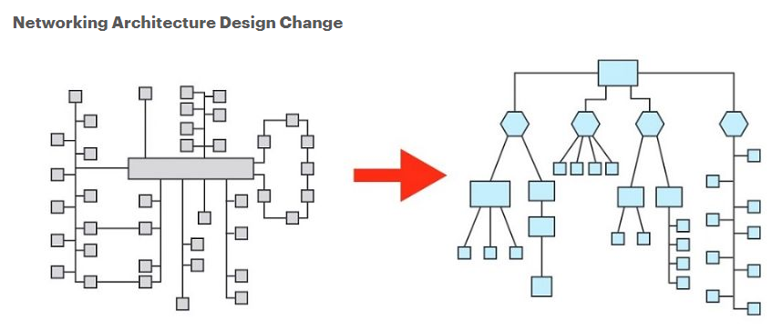
Potentially a Hybrid Layer 2
Real-time
High Bandwidth
CAN
Automotive Ethernet
https://blogs.synopsys.com/vip-central/2016/04/26/synopsys-extends-verification-ip-portfolio-for-automotive-applications/
https://blogs.keysight.com/blogs/tech/sim-des.entry.html/2021/06/10/automotive_ethernet-E6FB.html
Notes:
Higher bandwidth for next gen sensors
AE to fix E
Less electromagnetic
At the top hierarchical architectures that connect low level protocols
The benefit of ethernet is that it can meet the higher bandwidth requirements for next generation sensors like lidar
AE is made to fix some of the problems that come from applying traditional Ethernet into vehicles.
Specifically, it is more resilient than its counterpart and can withstand more electromagnetic interference
It is being projected to be used in at the top of hierarchical architectures to connect lower layer protocols like CAN using TCP/IP

Slide 12
Outline
Overview of current in-vehicle communication
Potential future directions of the community
NDN for in-vehicle networks
  What are the potential benefits?
A bench-top testbed and test harness
Results so far
Future directions
Notes:
Security concerns, next gen needs and intrinsic design
In vehicle networks as they are now what makes them vulnerable
Mitigation strategies and the direction industry is heading more promise in my alternative
I will briefly discuss NDN as a concept and explain why its a good fit for vehvcles
Showing what has been done and what remains to be done d
Throughout this presentation I will show how this architecture will address the security concerns on in-vehicle networks while meeting the needs of next generation vehicles and maintaining the intrinsic design of vehicle networks all with considerably less overhead than considered alternatives.
I will start by talking about vehicles as they are now and what will makes them a vulnerable target for cyber attacks
Following that I will discuss some of the mitigation strategies that academia is suggesting as well as the direction industry is currently heading and explaining why I see more promise in my alternative
I will then briefly discuss Named Data Networking as a concept and explain why it is a good fit for the next generation of in-vehicle networks. Before discussing how we have already begun to implement it in a physical test bed.
I will then conclude with a discussion of what remains to be done and how I plan to complete this work.

Slide 13
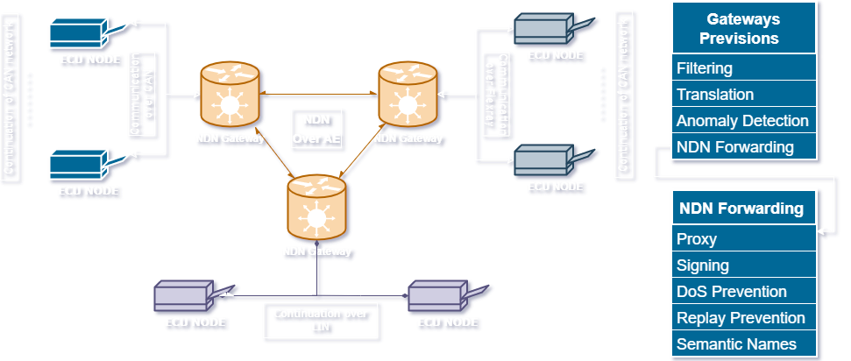
NDN as the Layer 3 Protocol
Apply Security
By Design
Maintain
Content Based Addressing
Modular
Development
Maintain
Multicast
Notes:
New apps on the top
New Links
What goes in the middle
This arch segments based on 1 their functionality and 2 their low level protocol
Shown here
Connected to NDN GW
By securing the entrance we remove costume security and overhead let them work uninhibited until the need something else
Mesh Removes the need for switch or GW
Modularity through semantic naming, common language for content on diverse set of protocols
Ndn preserves the design paradigm with less overhead making space for security needed regardless of layer 3
NEXT: We have already made lots of progress.
The architecture we invision would look something like this
In this architecture, Segments would be defined based on their functionality and internal networking protocol. In this rendering, we see 3 different protocols,
CAN shown in blue to the left - Battery Management Systems
Flexray in grey to the right - Power train module
and Lin networked in purple - for the AC
All connected to computationally capable gateways and networked together over a peer to peer NDN network
By securing the entrance and exit into a segment we limit the need for customized security within the domain, reducing any overhead that would impose. Allowing the segments to operate inhibited up until the point they need something from another segment. Because memebrship into the segment is defined based on functionality, the majority of the information an ecu needs to operare will be available inside their segment. Recudeing the load of the gateways.
The mesh connections of the of the gateways will mitigate against the risk of a signal point of failure that currently exist in projections for TCP/IP networks that rely on a central switch
To provide modularity, The Content transmitted on the NDN network would be named based on a semantic naming scheme that would act as a common language for content being generated on different segments running a potentially diverse set of protocols.
Most significantly, Networking these together using NDN allows us to preserve the current design paradigm of a multicast CDN while implimenting the majority of security without overlay. This will save bandwith and CPU cycles that can be apllied towards out of bounds security intrusion detection that will be needed regardless of the what is implimented on layer 3.

Slide 14
NDN’s Mitigations CAN and TCP Vulnerabilities
NDN Mitigation
CAN Vulnerability |  |  | TCP Vulnerability
Masquerading & Injection Attack | Signing | N/A | Sync flooding
Eavesdropping | Out of band Encryption | N/A | Rst Attacks
Replay Attack | No Unsolicited Data | N/A | Session Hijacking
DoS | No Unsolicited Data | Resend Packets | Channel Errors
Notes:
Fit for Vehicles networks
Integrated security
No DoS because content can’t be unsolicited
Signing for replay
Nothing for eavesdropping require out of bounds
NEXT: No intrinsic TCP
NDN turns out to be an incredible fit for in vehicle networking.
NDN’s security is implemented by its design.
Because of this NDN naturally provides mitigations for many common vehicle attacks. For instance, Because content has to be requested before it is transmitted, norma Replay attacks are not possible.
And by default the name of data, its content and author are all connected to each other via signing and validation that is integrated by the protocol. therefore it is able to mitigate against masquerading and injection attacks.
It does not have any intrinsic mitigations for eaves dropping, and so would require some out of bounds methodology to implement confidentiality. However this is no different than any proposed alternative.

Slide 15
Outline
Overview of current in-vehicle communication
Potential future directions of the community
NDN for in-vehicle networks
  What are the potential benefits?
A benchtop testbed and test harness
Results so far
Future directions
Notes:
Security concerns, next gen needs and intrinsic design
In vehicle networks as they are now what makes them vulnerable
Mitigation strategies and the direction industry is heading more promise in my alternative
I will briefly discuss NDN as a concept and explain why its a good fit for vehvcles
Showing what has been done and what remains to be done d
Throughout this presentation I will show how this architecture will address the security concerns on in-vehicle networks while meeting the needs of next generation vehicles and maintaining the intrinsic design of vehicle networks all with considerably less overhead than considered alternatives.
I will start by talking about vehicles as they are now and what will makes them a vulnerable target for cyber attacks
Following that I will discuss some of the mitigation strategies that academia is suggesting as well as the direction industry is currently heading and explaining why I see more promise in my alternative
I will then briefly discuss Named Data Networking as a concept and explain why it is a good fit for the next generation of in-vehicle networks. Before discussing how we have already begun to implement it in a physical test bed.
I will then conclude with a discussion of what remains to be done and how I plan to complete this work.

Slide 16
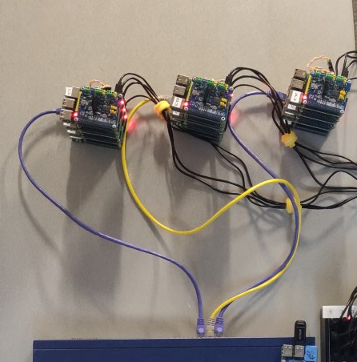
Physical Testbed
Segments:
A B C
Raspberry Pis with CAN HAT
3 Segments
Each Segment Has
  3 ECUs
  1 NDN Gateways
ECUs connected with CAN
Gateways Connected with NDN Over ethernet
Software
  SocketCan via CANUtils
  NFD
NDN Over Ethernet
Notes:
I have already built of Pi3
Each equipped with CAN hat to communicate to Aautomoblie
Those GW equipped with software for NDN over Ethernet
Python code to integrate this tech together distributed to the GW
This pic is the original implementation. Middle are GW
Each is connected to another acting as ECU segment replaying or receiving Real CAN
Palim security tests
Each GW was consumer or Producer
CAN Producer can replay logs NDN producer listened Consumer requested
NEXT: For the first test
I have already built a physical testbed made of Raspberry Pi 3.
Each of which is equipped with a CAN hat to emulate automotive communication
Those acting as GWs were equipped with software that enables it to communicate with NDN over ethernet
I designed python code to integrate these technologies together. And distributed lacrosse to the Gateways.
This is a picture of our original implementation. The two in the middle act as the proposed gateways.
To each of them is connected another Pi that emulates a can segments of multiple ECUs by replaying and receiving real CAN logs.
We have already run a number of preliminary performance and security tests
Originally, each GW was limited to functioning only as a Producer or a Consumer and given a can segment with equivalent functionality
For these tests we replayed real can frames on one Producer CAN segment and had an NDN producing GW listening to that traffic, while another NDN Consuming GW requested that content via NDN interests

Slide 17
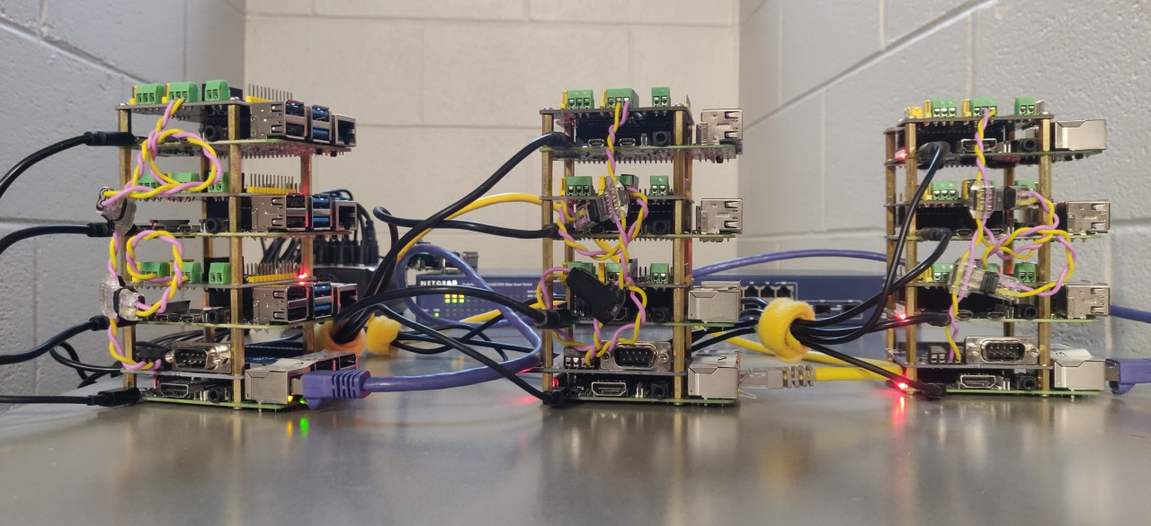
Physical Testbed
Power
ECU_1
ECU_2
ECU_3
GW
CAN connection
CAN Hats
GW: Both CAN and Ethernet
Notes:
I have already built of Pi3
Each equipped with CAN hat to communicate to Aautomoblie
Those GW equipped with software for NDN over Ethernet
Python code to integrate this tech together distributed to the GW
This pic is the original implementation. Middle are GW
Each is connected to another acting as ECU segment replaying or receiving Real CAN
Palim security tests
Each GW was consumer or Producer
CAN Producer can replay logs NDN producer listened Consumer requested
NEXT: For the first test
I have already built a physical testbed made of Raspberry Pi 3.
Each of which is equipped with a CAN hat to emulate automotive communication
Those acting as GWs were equipped with software that enables it to communicate with NDN over ethernet
I designed python code to integrate these technologies together. And distributed lacrosse to the Gateways.
This is a picture of our original implementation. The two in the middle act as the proposed gateways.
To each of them is connected another Pi that emulates a can segments of multiple ECUs by replaying and receiving real CAN logs.
We have already run a number of preliminary performance and security tests
Originally, each GW was limited to functioning only as a Producer or a Consumer and given a can segment with equivalent functionality
For these tests we replayed real can frames on one Producer CAN segment and had an NDN producing GW listening to that traffic, while another NDN Consuming GW requested that content via NDN interests

Slide 18
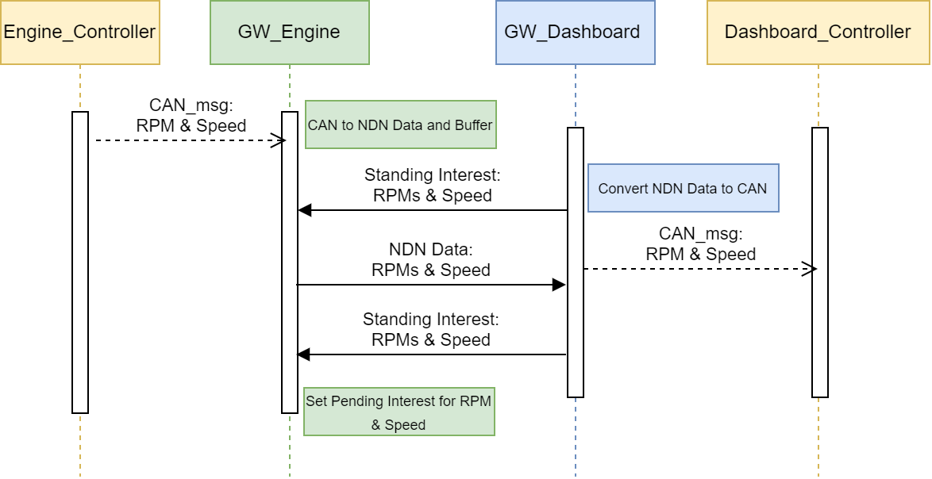
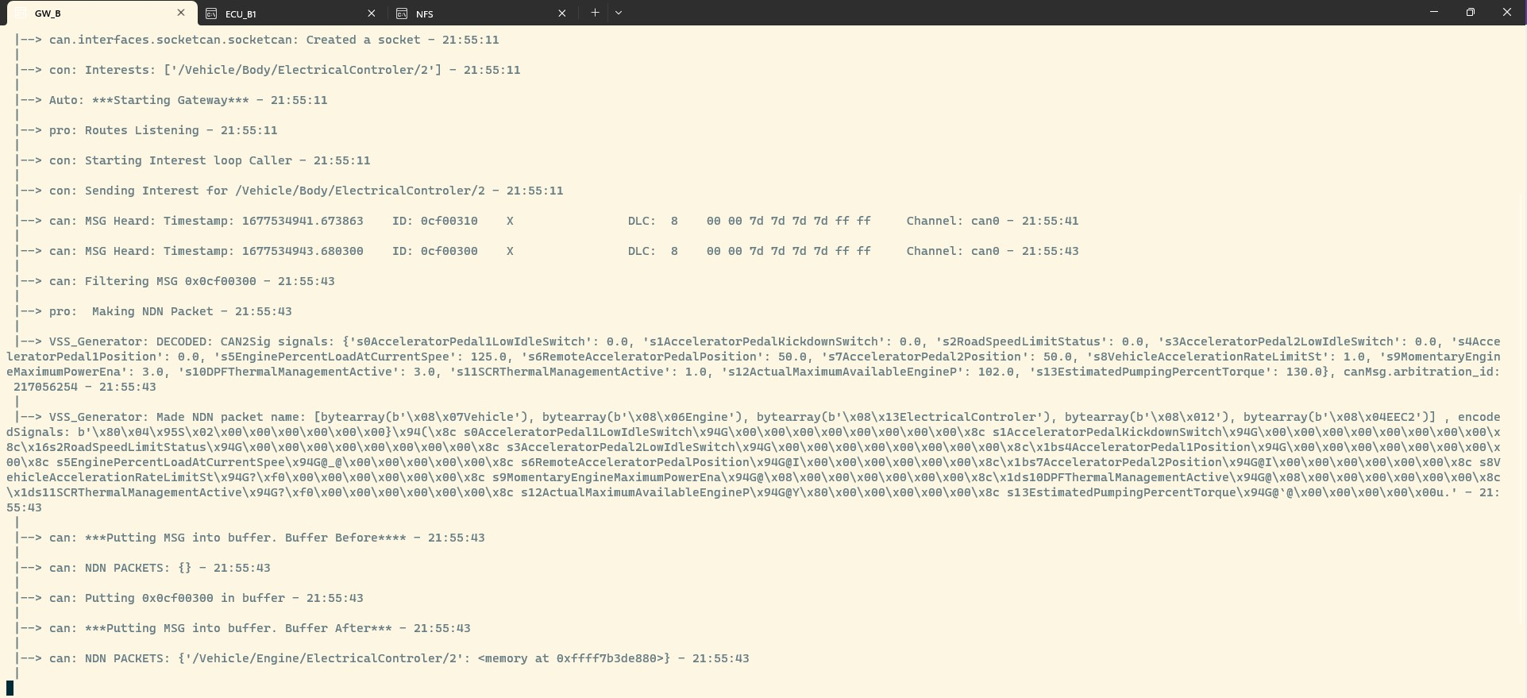
Notes:
I have already built of Pi3
Each equipped with CAN hat to communicate to Aautomoblie
Those GW equipped with software for NDN over Ethernet
Python code to integrate this tech together distributed to the GW
This pic is the original implementation. Middle are GW
Each is connected to another acting as ECU segment replaying or receiving Real CAN
Palim security tests
Each GW was consumer or Producer
CAN Producer can replay logs NDN producer listened Consumer requested
NEXT: For the first test
I have already built a physical testbed made of Raspberry Pi 3.
Each of which is equipped with a CAN hat to emulate automotive communication
Those acting as GWs were equipped with software that enables it to communicate with NDN over ethernet
I designed python code to integrate these technologies together. And distributed lacrosse to the Gateways.
This is a picture of our original implementation. The two in the middle act as the proposed gateways.
To each of them is connected another Pi that emulates a can segments of multiple ECUs by replaying and receiving real CAN logs.
We have already run a number of preliminary performance and security tests
Originally, each GW was limited to functioning only as a Producer or a Consumer and given a can segment with equivalent functionality
For these tests we replayed real can frames on one Producer CAN segment and had an NDN producing GW listening to that traffic, while another NDN Consuming GW requested that content via NDN interests

Slide 19
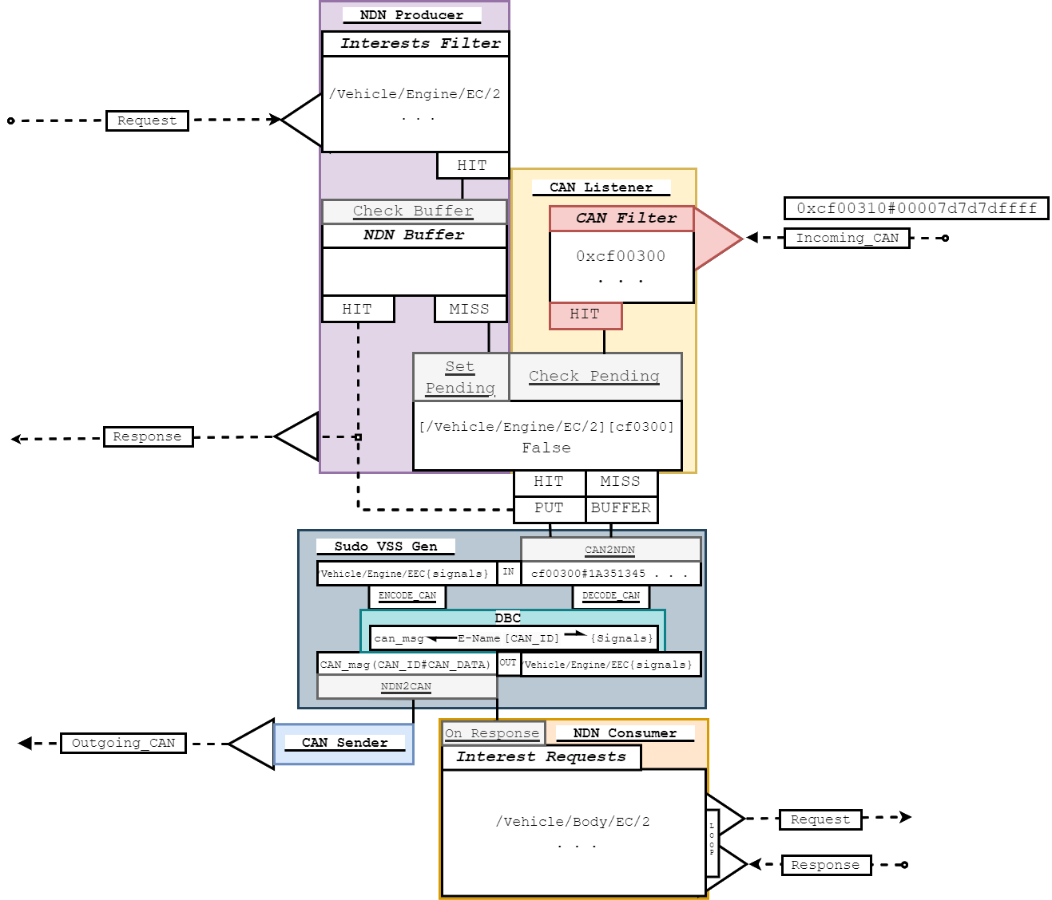
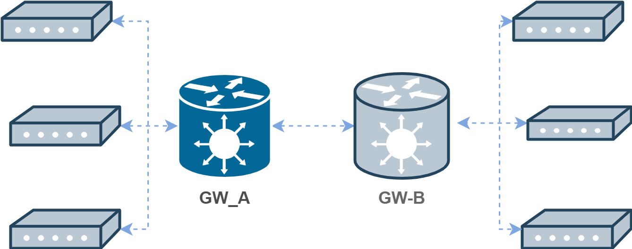
|--> can: MSG Heard: ID: 0cf00310
00 00 7d 7d 7d 7d ff ff
Channel: can0 - 21:55:41
GW_A
Notes:
I have already built of Pi3
Each equipped with CAN hat to communicate to Aautomoblie
Those GW equipped with software for NDN over Ethernet
Python code to integrate this tech together distributed to the GW
This pic is the original implementation. Middle are GW
Each is connected to another acting as ECU segment replaying or receiving Real CAN
Palim security tests
Each GW was consumer or Producer
CAN Producer can replay logs NDN producer listened Consumer requested
NEXT: For the first test
I have already built a physical testbed made of Raspberry Pi 3.
Each of which is equipped with a CAN hat to emulate automotive communication
Those acting as GWs were equipped with software that enables it to communicate with NDN over ethernet
I designed python code to integrate these technologies together. And distributed lacrosse to the Gateways.
This is a picture of our original implementation. The two in the middle act as the proposed gateways.
To each of them is connected another Pi that emulates a can segments of multiple ECUs by replaying and receiving real CAN logs.
We have already run a number of preliminary performance and security tests
Originally, each GW was limited to functioning only as a Producer or a Consumer and given a can segment with equivalent functionality
For these tests we replayed real can frames on one Producer CAN segment and had an NDN producing GW listening to that traffic, while another NDN Consuming GW requested that content via NDN interests

Slide 20
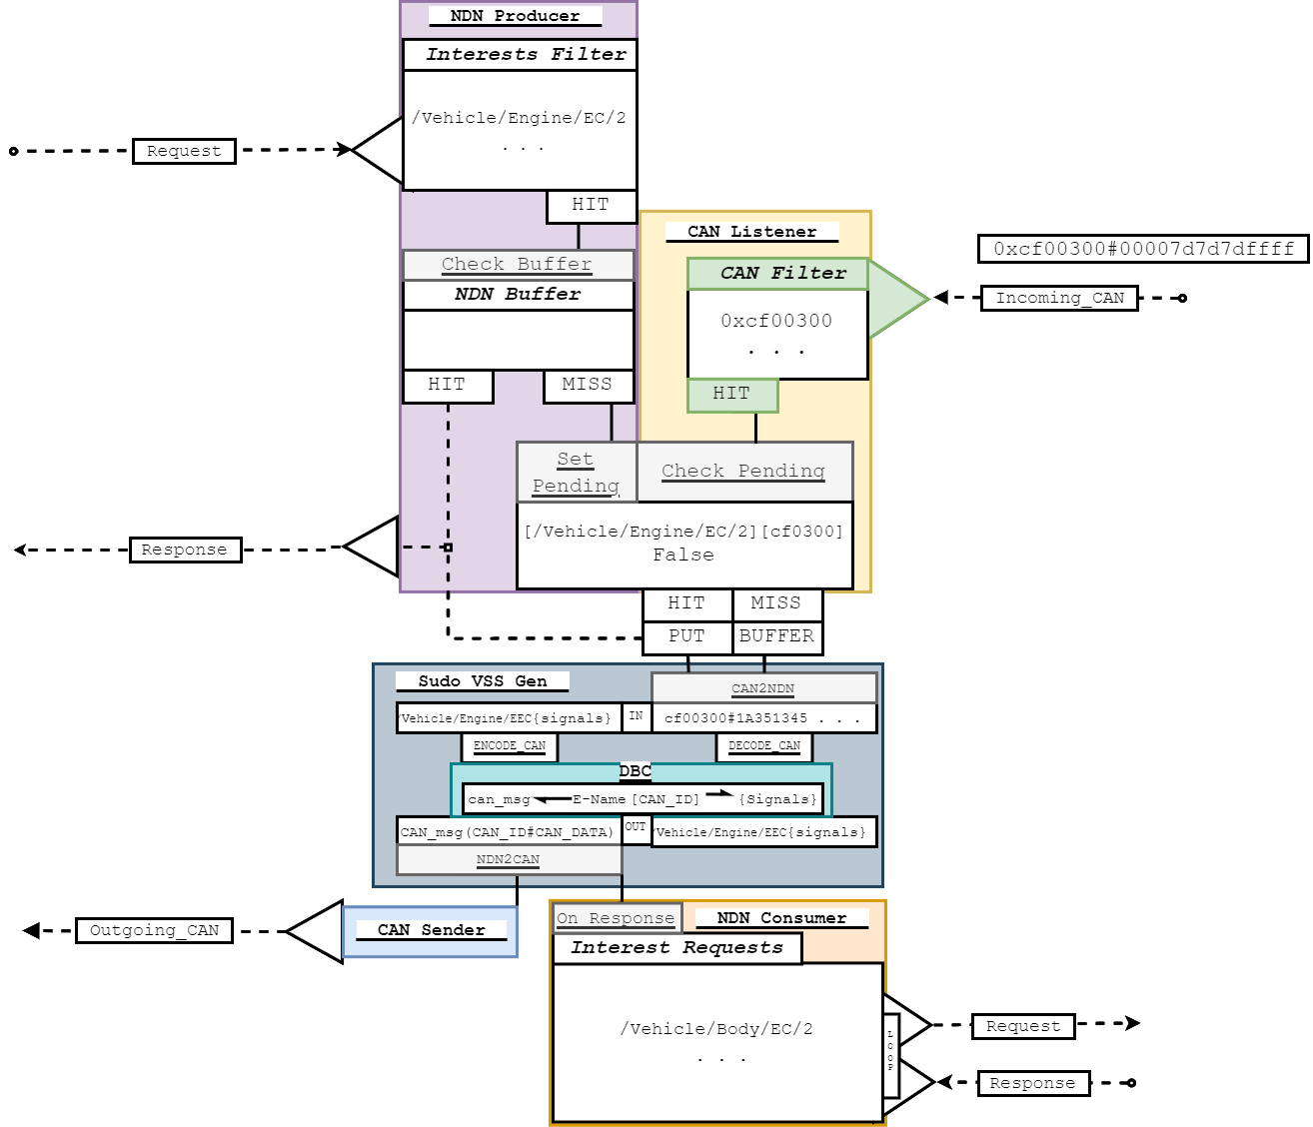
|--> can: MSG Heard: ID: 0cf00310
00 00 7d 7d 7d 7d ff ff
|--> can: MSG Heard: ID: 0cf00300
00 00 7d 7d 7d 7d ff ff
|--> can: Filtering MSG 0x0cf00300
GW_A
Notes:
I have already built of Pi3
Each equipped with CAN hat to communicate to Aautomoblie
Those GW equipped with software for NDN over Ethernet
Python code to integrate this tech together distributed to the GW
This pic is the original implementation. Middle are GW
Each is connected to another acting as ECU segment replaying or receiving Real CAN
Palim security tests
Each GW was consumer or Producer
CAN Producer can replay logs NDN producer listened Consumer requested
NEXT: For the first test
I have already built a physical testbed made of Raspberry Pi 3.
Each of which is equipped with a CAN hat to emulate automotive communication
Those acting as GWs were equipped with software that enables it to communicate with NDN over ethernet
I designed python code to integrate these technologies together. And distributed lacrosse to the Gateways.
This is a picture of our original implementation. The two in the middle act as the proposed gateways.
To each of them is connected another Pi that emulates a can segments of multiple ECUs by replaying and receiving real CAN logs.
We have already run a number of preliminary performance and security tests
Originally, each GW was limited to functioning only as a Producer or a Consumer and given a can segment with equivalent functionality
For these tests we replayed real can frames on one Producer CAN segment and had an NDN producing GW listening to that traffic, while another NDN Consuming GW requested that content via NDN interests

Slide 21
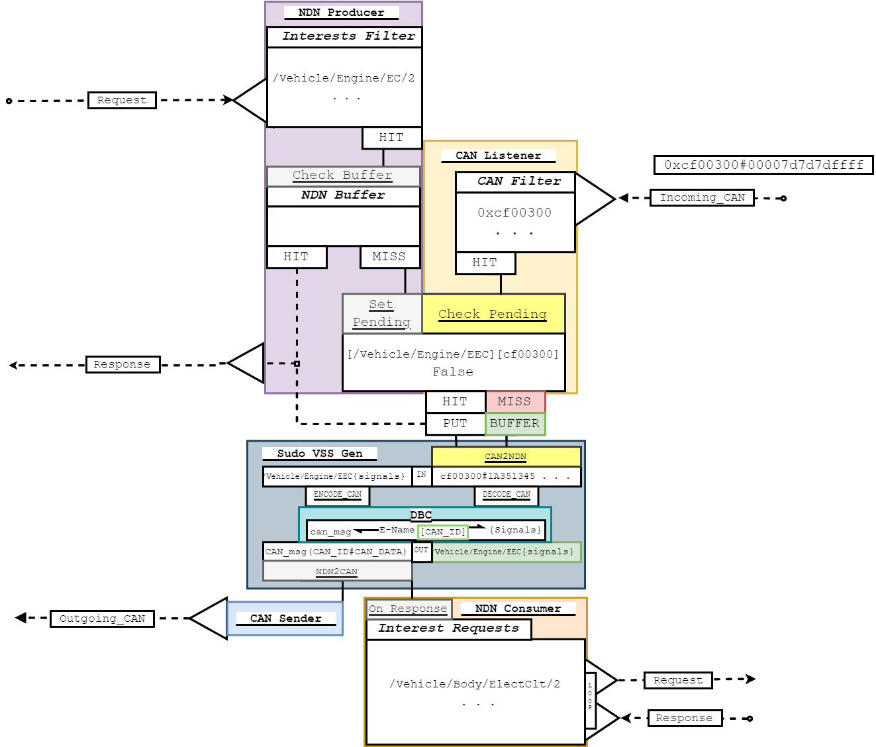
|--> pro: Making NDN Packet |
|--> VSS_Generator: DECODED: CAN2Sig signals:
AcceleratorPedal1LowIdleSwitch:0 EnginePercentLoadAtCurrentSpee: 125.0
|--> VSS_Generator: Made NDN packet:
/Vehicle/Engine/ElectricalController/2
GW_A
Notes:
I have already built of Pi3
Each equipped with CAN hat to communicate to Aautomoblie
Those GW equipped with software for NDN over Ethernet
Python code to integrate this tech together distributed to the GW
This pic is the original implementation. Middle are GW
Each is connected to another acting as ECU segment replaying or receiving Real CAN
Palim security tests
Each GW was consumer or Producer
CAN Producer can replay logs NDN producer listened Consumer requested
NEXT: For the first test
I have already built a physical testbed made of Raspberry Pi 3.
Each of which is equipped with a CAN hat to emulate automotive communication
Those acting as GWs were equipped with software that enables it to communicate with NDN over ethernet
I designed python code to integrate these technologies together. And distributed lacrosse to the Gateways.
This is a picture of our original implementation. The two in the middle act as the proposed gateways.
To each of them is connected another Pi that emulates a can segments of multiple ECUs by replaying and receiving real CAN logs.
We have already run a number of preliminary performance and security tests
Originally, each GW was limited to functioning only as a Producer or a Consumer and given a can segment with equivalent functionality
For these tests we replayed real can frames on one Producer CAN segment and had an NDN producing GW listening to that traffic, while another NDN Consuming GW requested that content via NDN interests

Slide 22
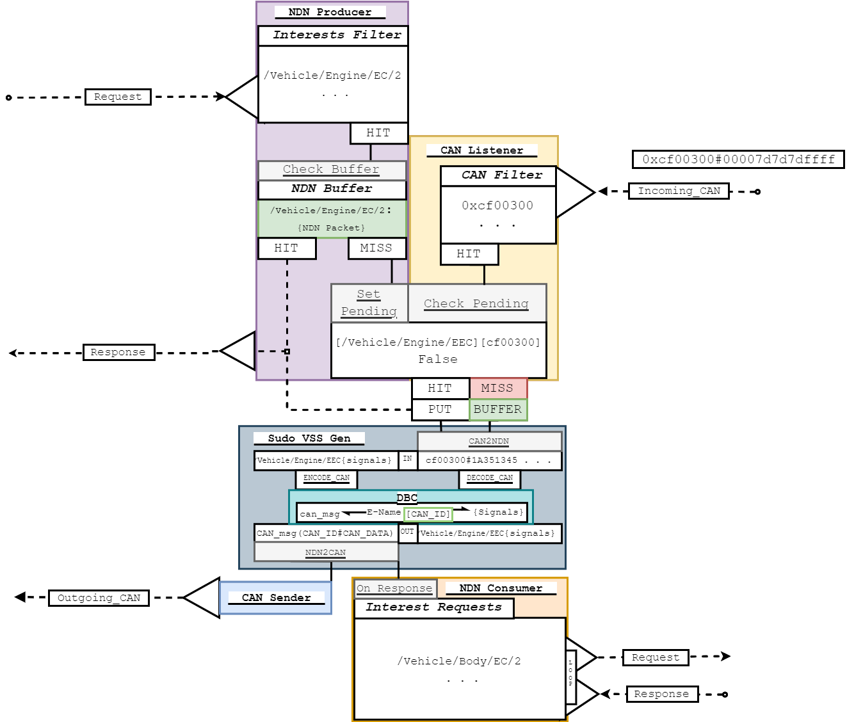
|--> can: Putting MSG into
buffer. Buffer Before
|--> can: NDN PACKETS: {} |
|--> can: Putting 0x0cf00300 in
buffer
|--> can: Putting MSG into buffer.
|--> can: NDN PACKETS:
{'/Vehicle/Engine/ElectricalCo
ntroller/2/EEC2'}
GW_A
Notes:
I have already built of Pi3
Each equipped with CAN hat to communicate to Aautomoblie
Those GW equipped with software for NDN over Ethernet
Python code to integrate this tech together distributed to the GW
This pic is the original implementation. Middle are GW
Each is connected to another acting as ECU segment replaying or receiving Real CAN
Palim security tests
Each GW was consumer or Producer
CAN Producer can replay logs NDN producer listened Consumer requested
NEXT: For the first test
I have already built a physical testbed made of Raspberry Pi 3.
Each of which is equipped with a CAN hat to emulate automotive communication
Those acting as GWs were equipped with software that enables it to communicate with NDN over ethernet
I designed python code to integrate these technologies together. And distributed lacrosse to the Gateways.
This is a picture of our original implementation. The two in the middle act as the proposed gateways.
To each of them is connected another Pi that emulates a can segments of multiple ECUs by replaying and receiving real CAN logs.
We have already run a number of preliminary performance and security tests
Originally, each GW was limited to functioning only as a Producer or a Consumer and given a can segment with equivalent functionality
For these tests we replayed real can frames on one Producer CAN segment and had an NDN producing GW listening to that traffic, while another NDN Consuming GW requested that content via NDN interests

Slide 23
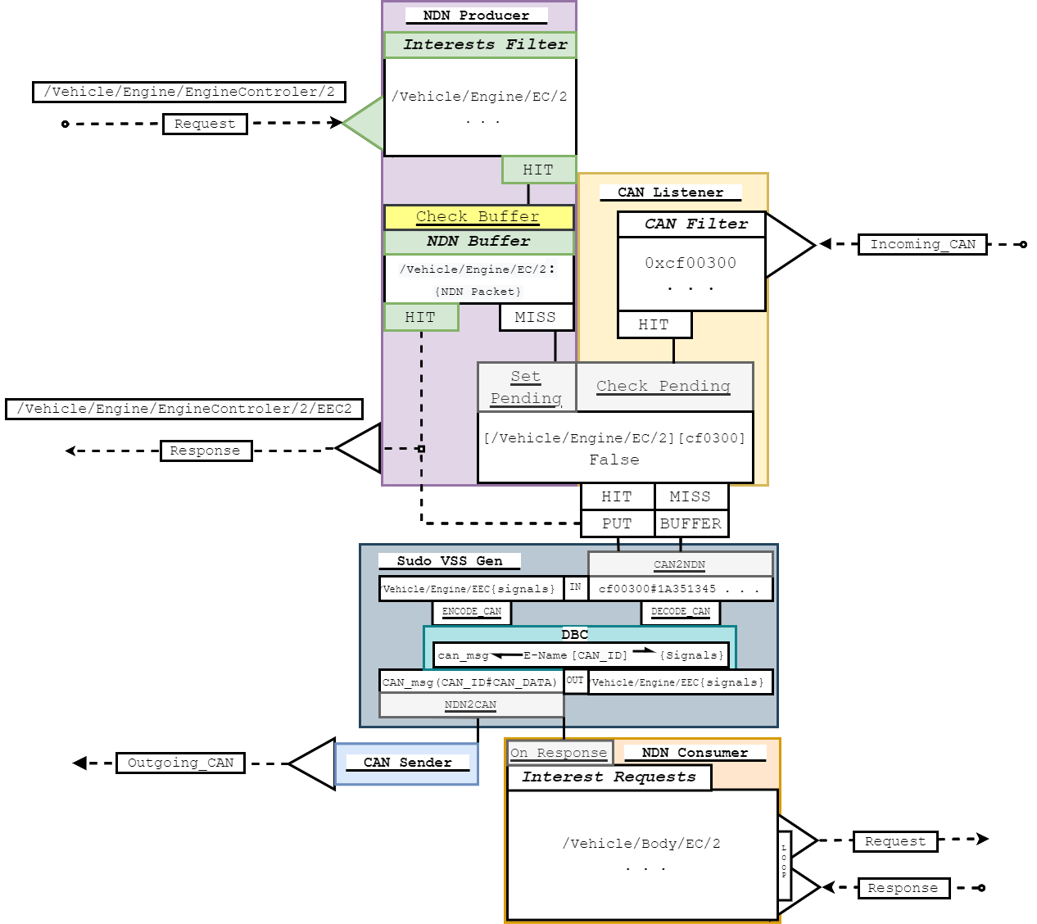
|--> pro: Msg Recieved: /Vehicle/Engine/ElectricalController/2
|
|--> pro: KeyRequest: /Vehicle/Engine/ElectricalController/2 in filter
|
|--> pro: Data found in can buffer
|
GW_A
Notes:
I have already built of Pi3
Each equipped with CAN hat to communicate to Aautomoblie
Those GW equipped with software for NDN over Ethernet
Python code to integrate this tech together distributed to the GW
This pic is the original implementation. Middle are GW
Each is connected to another acting as ECU segment replaying or receiving Real CAN
Palim security tests
Each GW was consumer or Producer
CAN Producer can replay logs NDN producer listened Consumer requested
NEXT: For the first test
I have already built a physical testbed made of Raspberry Pi 3.
Each of which is equipped with a CAN hat to emulate automotive communication
Those acting as GWs were equipped with software that enables it to communicate with NDN over ethernet
I designed python code to integrate these technologies together. And distributed lacrosse to the Gateways.
This is a picture of our original implementation. The two in the middle act as the proposed gateways.
To each of them is connected another Pi that emulates a can segments of multiple ECUs by replaying and receiving real CAN logs.
We have already run a number of preliminary performance and security tests
Originally, each GW was limited to functioning only as a Producer or a Consumer and given a can segment with equivalent functionality
For these tests we replayed real can frames on one Producer CAN segment and had an NDN producing GW listening to that traffic, while another NDN Consuming GW requested that content via NDN interests

Slide 24
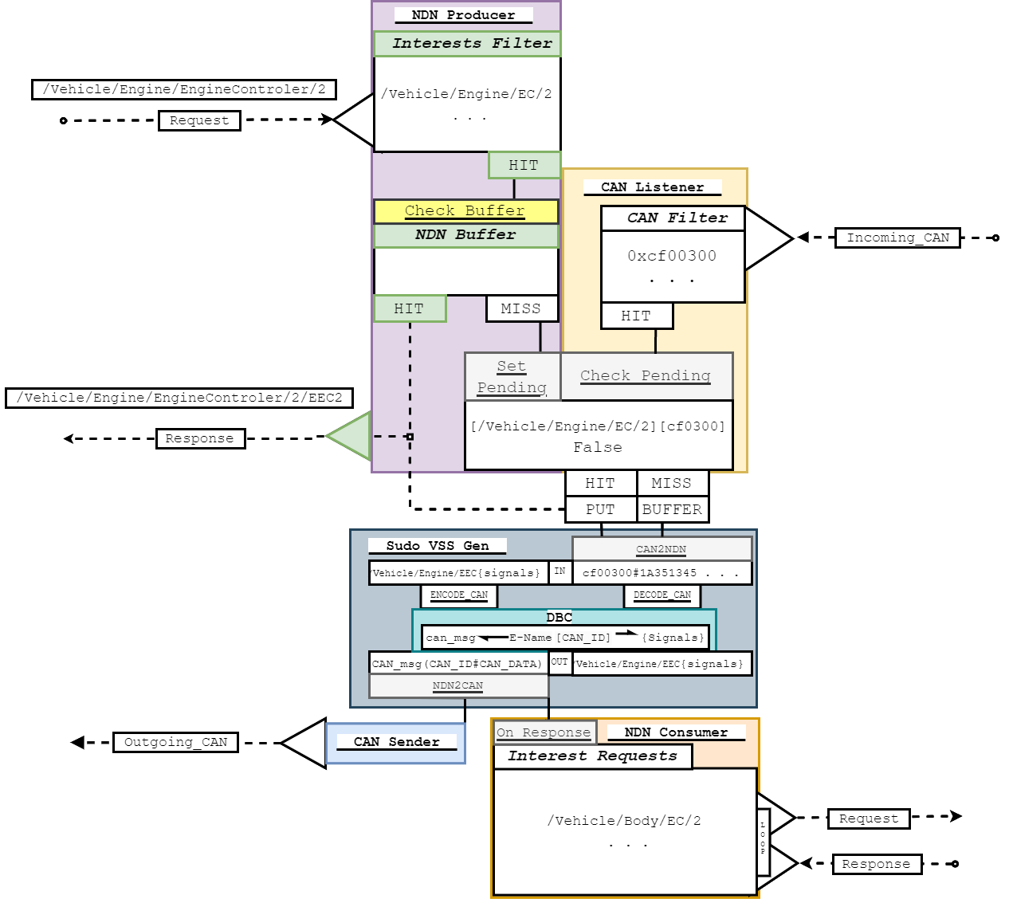
|--> can: Buffer Before Removal: {'/Vehicle/Engine/ElectricalController/2': <memory at 0xffff7b3de880>}
|
|--> can: Buffer After Removal: {} |
|--> pro: Sending <memory at 0xffff7b3de880>
GW_A
Notes:
I have already built of Pi3
Each equipped with CAN hat to communicate to Aautomoblie
Those GW equipped with software for NDN over Ethernet
Python code to integrate this tech together distributed to the GW
This pic is the original implementation. Middle are GW
Each is connected to another acting as ECU segment replaying or receiving Real CAN
Palim security tests
Each GW was consumer or Producer
CAN Producer can replay logs NDN producer listened Consumer requested
NEXT: For the first test
I have already built a physical testbed made of Raspberry Pi 3.
Each of which is equipped with a CAN hat to emulate automotive communication
Those acting as GWs were equipped with software that enables it to communicate with NDN over ethernet
I designed python code to integrate these technologies together. And distributed lacrosse to the Gateways.
This is a picture of our original implementation. The two in the middle act as the proposed gateways.
To each of them is connected another Pi that emulates a can segments of multiple ECUs by replaying and receiving real CAN logs.
We have already run a number of preliminary performance and security tests
Originally, each GW was limited to functioning only as a Producer or a Consumer and given a can segment with equivalent functionality
For these tests we replayed real can frames on one Producer CAN segment and had an NDN producing GW listening to that traffic, while another NDN Consuming GW requested that content via NDN interests

Slide 25
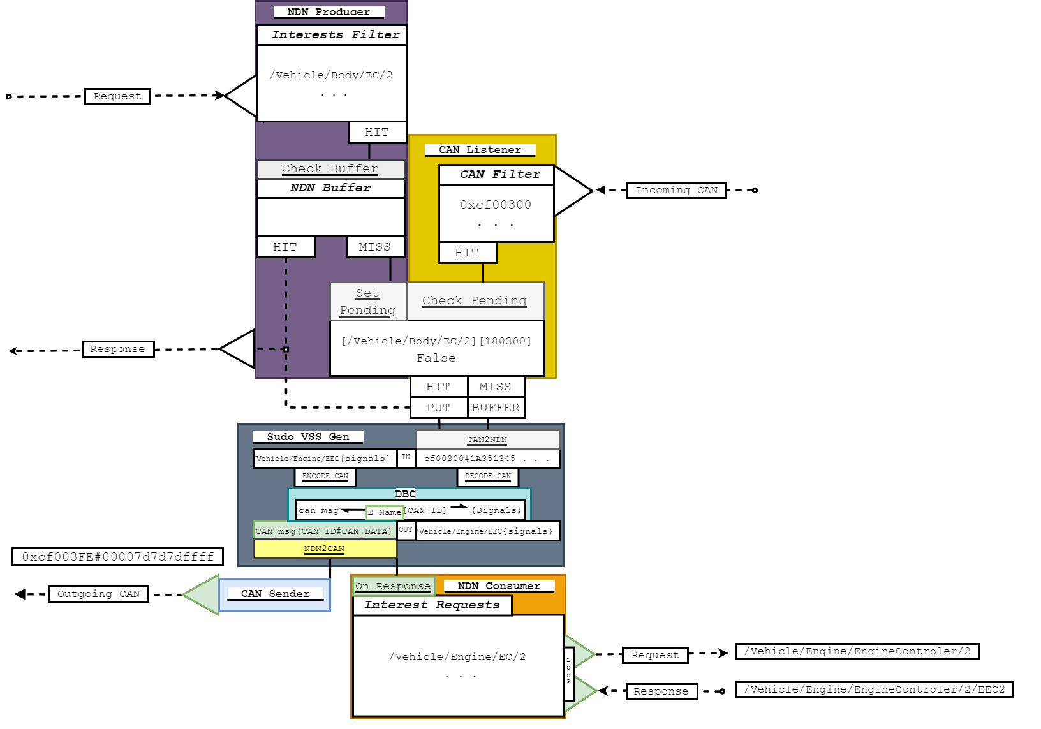
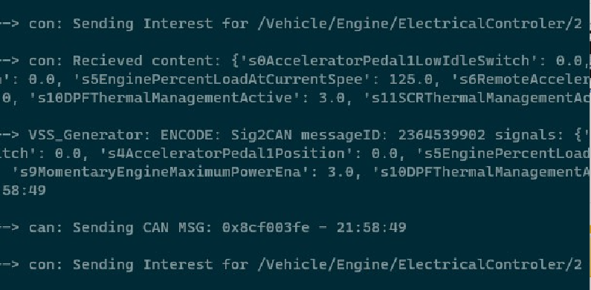
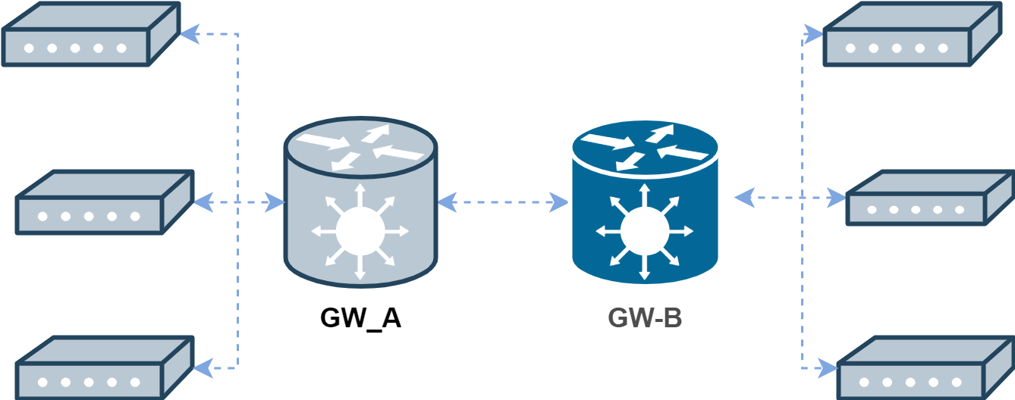
GW_B
Notes:
I have already built of Pi3
Each equipped with CAN hat to communicate to Aautomoblie
Those GW equipped with software for NDN over Ethernet
Python code to integrate this tech together distributed to the GW
This pic is the original implementation. Middle are GW
Each is connected to another acting as ECU segment replaying or receiving Real CAN
Palim security tests
Each GW was consumer or Producer
CAN Producer can replay logs NDN producer listened Consumer requested
NEXT: For the first test
I have already built a physical testbed made of Raspberry Pi 3.
Each of which is equipped with a CAN hat to emulate automotive communication
Those acting as GWs were equipped with software that enables it to communicate with NDN over ethernet
I designed python code to integrate these technologies together. And distributed lacrosse to the Gateways.
This is a picture of our original implementation. The two in the middle act as the proposed gateways.
To each of them is connected another Pi that emulates a can segments of multiple ECUs by replaying and receiving real CAN logs.
We have already run a number of preliminary performance and security tests
Originally, each GW was limited to functioning only as a Producer or a Consumer and given a can segment with equivalent functionality
For these tests we replayed real can frames on one Producer CAN segment and had an NDN producing GW listening to that traffic, while another NDN Consuming GW requested that content via NDN interests

Slide 26
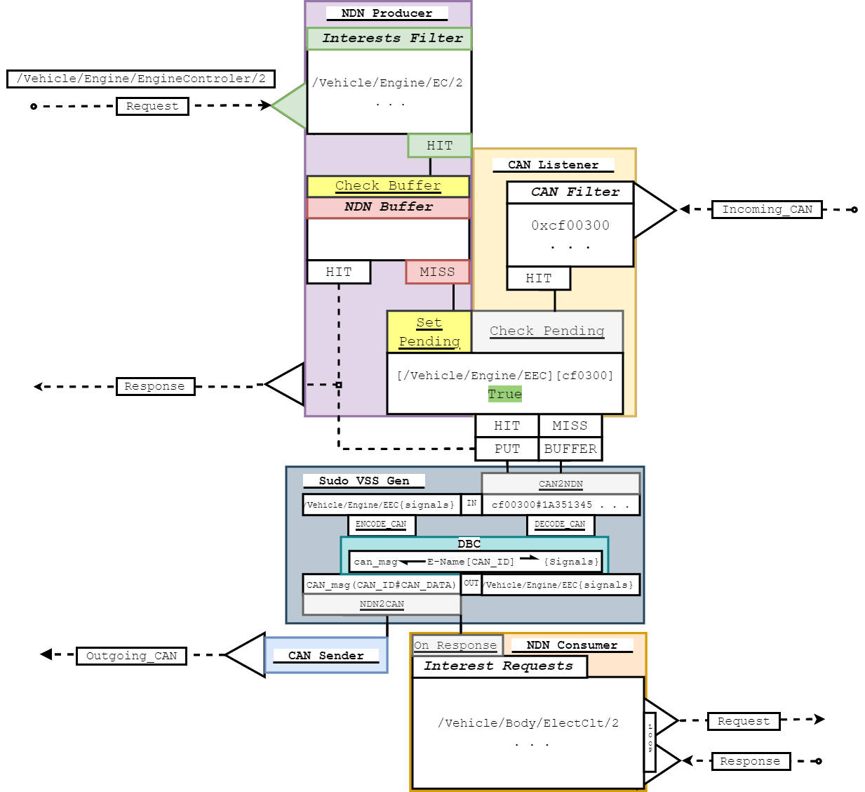
|--> pro: Msg Recieved: /Vehicle/Engine/ElectricalController/2
|--> pro: KeyRequest: /Vehicle/Engine/ElectricalController/2 in filter - 21:58:49
|--> pro: Buffer: {} Request: /Vehicle/Engine/ElectricalController/2 - |--> pro: No Data Found in buffer. Setting Pending flag and waiting
GW_A
Notes:
I have already built of Pi3
Each equipped with CAN hat to communicate to Aautomoblie
Those GW equipped with software for NDN over Ethernet
Python code to integrate this tech together distributed to the GW
This pic is the original implementation. Middle are GW
Each is connected to another acting as ECU segment replaying or receiving Real CAN
Palim security tests
Each GW was consumer or Producer
CAN Producer can replay logs NDN producer listened Consumer requested
NEXT: For the first test
I have already built a physical testbed made of Raspberry Pi 3.
Each of which is equipped with a CAN hat to emulate automotive communication
Those acting as GWs were equipped with software that enables it to communicate with NDN over ethernet
I designed python code to integrate these technologies together. And distributed lacrosse to the Gateways.
This is a picture of our original implementation. The two in the middle act as the proposed gateways.
To each of them is connected another Pi that emulates a can segments of multiple ECUs by replaying and receiving real CAN logs.
We have already run a number of preliminary performance and security tests
Originally, each GW was limited to functioning only as a Producer or a Consumer and given a can segment with equivalent functionality
For these tests we replayed real can frames on one Producer CAN segment and had an NDN producing GW listening to that traffic, while another NDN Consuming GW requested that content via NDN interests

Slide 27
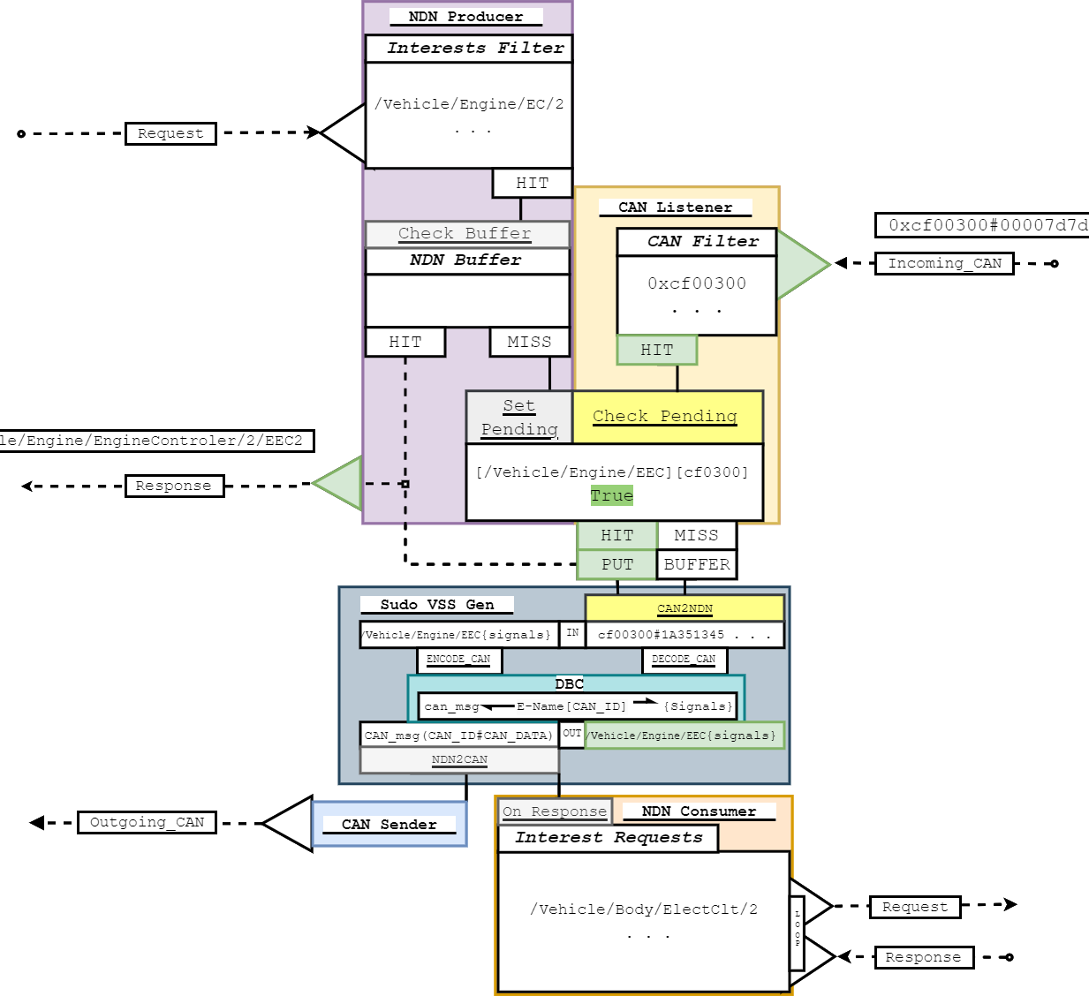
|--> can: MSG Heard: ID: 0cf00300
00 00 7d 7d 7d 7d ff ff
|--> can: Filtering MSG 0x0cf00300
|--> pro: Making NDN Packet
|--> VSS_Generator: DECODED: CAN2Sig
|--> VSS_Generator: Made NDN packet:
/Vehicle/Engine/ElectricalController/2
|--> pro: Sending <memory at 0xffff7b3de880>
GW_A
Notes:
I have already built of Pi3
Each equipped with CAN hat to communicate to Aautomoblie
Those GW equipped with software for NDN over Ethernet
Python code to integrate this tech together distributed to the GW
This pic is the original implementation. Middle are GW
Each is connected to another acting as ECU segment replaying or receiving Real CAN
Palim security tests
Each GW was consumer or Producer
CAN Producer can replay logs NDN producer listened Consumer requested
NEXT: For the first test
I have already built a physical testbed made of Raspberry Pi 3.
Each of which is equipped with a CAN hat to emulate automotive communication
Those acting as GWs were equipped with software that enables it to communicate with NDN over ethernet
I designed python code to integrate these technologies together. And distributed lacrosse to the Gateways.
This is a picture of our original implementation. The two in the middle act as the proposed gateways.
To each of them is connected another Pi that emulates a can segments of multiple ECUs by replaying and receiving real CAN logs.
We have already run a number of preliminary performance and security tests
Originally, each GW was limited to functioning only as a Producer or a Consumer and given a can segment with equivalent functionality
For these tests we replayed real can frames on one Producer CAN segment and had an NDN producing GW listening to that traffic, while another NDN Consuming GW requested that content via NDN interests

Slide 28
Outline
Overview of current in-vehicle communication
Potential future directions of the community
NDN for in-vehicle networks
  What are the potential benefits?
A bench-top testbed and test harness
Results so far
Future directions
Notes:
Security concerns, next gen needs and intrinsic design
In vehicle networks as they are now what makes them vulnerable
Mitigation strategies and the direction industry is heading more promise in my alternative
I will briefly discuss NDN as a concept and explain why its a good fit for vehvcles
Showing what has been done and what remains to be done d
Throughout this presentation I will show how this architecture will address the security concerns on in-vehicle networks while meeting the needs of next generation vehicles and maintaining the intrinsic design of vehicle networks all with considerably less overhead than considered alternatives.
I will start by talking about vehicles as they are now and what will makes them a vulnerable target for cyber attacks
Following that I will discuss some of the mitigation strategies that academia is suggesting as well as the direction industry is currently heading and explaining why I see more promise in my alternative
I will then briefly discuss Named Data Networking as a concept and explain why it is a good fit for the next generation of in-vehicle networks. Before discussing how we have already begun to implement it in a physical test bed.
I will then conclude with a discussion of what remains to be done and how I plan to complete this work.

Slide 29
Data Sets
CSU Heavy Trucks data sets
J1939 (CAN standard)
2014 Kenworth T270
10 hours plus of driving
https://www.engr.colostate.edu/~jdaily/
Notes:
New apps on the top
New Links
What goes in the middle
This arch segments based on 1 their functionality and 2 their low level protocol
Shown here
Connected to NDN GW
By securing the entrance we remove costume security and overhead let them work uninhibited until the need something else
Mesh Removes the need for switch or GW
Modularity through semantic naming, common language for content on diverse set of protocols
Ndn preserves the design paradigm with less overhead making space for security needed regardless of layer 3
NEXT: We have already made lots of progress.
The architecture we invision would look something like this
In this architecture, Segments would be defined based on their functionality and internal networking protocol. In this rendering, we see 3 different protocols,
CAN shown in blue to the left - Battery Management Systems
Flexray in grey to the right - Power train module
and Lin networked in purple - for the AC
All connected to computationally capable gateways and networked together over a peer to peer NDN network
By securing the entrance and exit into a segment we limit the need for customized security within the domain, reducing any overhead that would impose. Allowing the segments to operate inhibited up until the point they need something from another segment. Because memebrship into the segment is defined based on functionality, the majority of the information an ecu needs to operare will be available inside their segment. Recudeing the load of the gateways.
The mesh connections of the of the gateways will mitigate against the risk of a signal point of failure that currently exist in projections for TCP/IP networks that rely on a central switch
To provide modularity, The Content transmitted on the NDN network would be named based on a semantic naming scheme that would act as a common language for content being generated on different segments running a potentially diverse set of protocols.
Most significantly, Networking these together using NDN allows us to preserve the current design paradigm of a multicast CDN while implimenting the majority of security without overlay. This will save bandwith and CPU cycles that can be apllied towards out of bounds security intrusion detection that will be needed regardless of the what is implimented on layer 3.

Slide 30
Performance Tests
Total Overhead for
On Demand NDN Packets
Total Overhead for
Pre-generated NDN Packets
Producer | 31.2 ms
Consumer | 58.9 ms
Producer | 34.2 ms
Consumer | 28.4 ms
Signing and Validation
Overhead
Signing and Validation
Overhead
Signing | 29.9 ms | 95%
Validating | 49.3 ms | 84%
Signing | 32.3 ms | 94%
Validating | 19.5 ms | 69%
Notes:
I have already built of Pi3
Each equipped with CAN hat to communicate to Aautomoblie
Those GW equipped with software for NDN over Ethernet
Python code to integrate this tech together distributed to the GW
This pic is the original implementation. Middle are GW
Each is connected to another acting as ECU segment replaying or receiving Real CAN
Palim security tests
Each GW was consumer or Producer
CAN Producer can replay logs NDN producer listened Consumer requested
NEXT: For the first test
I have already built a physical testbed made of Raspberry Pi 3.
Each of which is equipped with a CAN hat to emulate automotive communication
Those acting as GWs were equipped with software that enables it to communicate with NDN over ethernet
I designed python code to integrate these technologies together. And distributed lacrosse to the Gateways.
This is a picture of our original implementation. The two in the middle act as the proposed gateways.
To each of them is connected another Pi that emulates a can segments of multiple ECUs by replaying and receiving real CAN logs.
We have already run a number of preliminary performance and security tests
Originally, each GW was limited to functioning only as a Producer or a Consumer and given a can segment with equivalent functionality
For these tests we replayed real can frames on one Producer CAN segment and had an NDN producing GW listening to that traffic, while another NDN Consuming GW requested that content via NDN interests

Slide 31
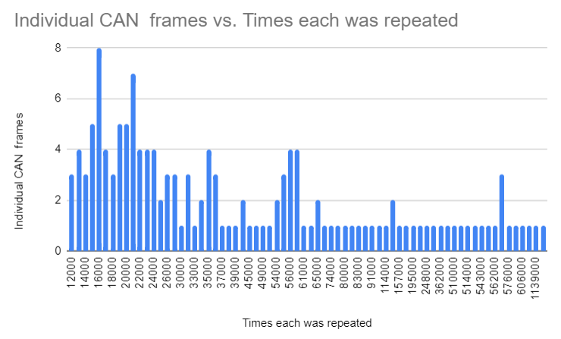
Vehicular Networks may benefits from NDN Caching
Majority
of messages in a 10 hour CAN log are duplicates
Still investigating the implications
Notes:
Fit for Vehicles networks
Integrated security
No DoS because content can’t be unsolicited
Signing for replay
Nothing for eavesdropping require out of bounds
NEXT: No intrinsic TCP
NDN turns out to be an incredible fit for in vehicle networking.
NDN’s security is implemented by its design.
Because of this NDN naturally provides mitigations for many common vehicle attacks. For instance, Because content has to be requested before it is transmitted, norma Replay attacks are not possible.
And by default the name of data, its content and author are all connected to each other via signing and validation that is integrated by the protocol. therefore it is able to mitigate against masquerading and injection attacks.
It does not have any intrinsic mitigations for eaves dropping, and so would require some out of bounds methodology to implement confidentiality. However this is no different than any proposed alternative.

Slide 32
Security Tests
NDN Attacks
ATTACK | NDN MITIGATION
Unsolicited Data | No Effect
Impersonation Attack | Caught by Signature
Interest DoS | Pending Interests
Notes:
I have already built of Pi3
Each equipped with CAN hat to communicate to Aautomoblie
Those GW equipped with software for NDN over Ethernet
Python code to integrate this tech together distributed to the GW
This pic is the original implementation. Middle are GW
Each is connected to another acting as ECU segment replaying or receiving Real CAN
Palim security tests
Each GW was consumer or Producer
CAN Producer can replay logs NDN producer listened Consumer requested
NEXT: For the first test
I have already built a physical testbed made of Raspberry Pi 3.
Each of which is equipped with a CAN hat to emulate automotive communication
Those acting as GWs were equipped with software that enables it to communicate with NDN over ethernet
I designed python code to integrate these technologies together. And distributed lacrosse to the Gateways.
This is a picture of our original implementation. The two in the middle act as the proposed gateways.
To each of them is connected another Pi that emulates a can segments of multiple ECUs by replaying and receiving real CAN logs.
We have already run a number of preliminary performance and security tests
Originally, each GW was limited to functioning only as a Producer or a Consumer and given a can segment with equivalent functionality
For these tests we replayed real can frames on one Producer CAN segment and had an NDN producing GW listening to that traffic, while another NDN Consuming GW requested that content via NDN interests

Slide 33
Outline
Overview of current in-vehicle communication
Potential future directions of the community
NDN for in-vehicle networks
  What are the potential benefits?
A bench-top testbed and test harness
Results so far
Future directions
Notes:
Security concerns, next gen needs and intrinsic design
In vehicle networks as they are now what makes them vulnerable
Mitigation strategies and the direction industry is heading more promise in my alternative
I will briefly discuss NDN as a concept and explain why its a good fit for vehvcles
Showing what has been done and what remains to be done d
Throughout this presentation I will show how this architecture will address the security concerns on in-vehicle networks while meeting the needs of next generation vehicles and maintaining the intrinsic design of vehicle networks all with considerably less overhead than considered alternatives.
I will start by talking about vehicles as they are now and what will makes them a vulnerable target for cyber attacks
Following that I will discuss some of the mitigation strategies that academia is suggesting as well as the direction industry is currently heading and explaining why I see more promise in my alternative
I will then briefly discuss Named Data Networking as a concept and explain why it is a good fit for the next generation of in-vehicle networks. Before discussing how we have already begun to implement it in a physical test bed.
I will then conclude with a discussion of what remains to be done and how I plan to complete this work.

Slide 34
What’s Next?
Security Tests
GW to GW attacks
CAN to GW attacks
Performance Tests
Real-time requirements
Latency - Throughput
Use TCP/IP with TLS on the testbed to set performance benchmarks
Notes:
Latency and throughput
Record both
Implement TCP for accurate comparison
And use results and S2-CAN to compare alternatives
Problems with analyzing NDN security BG research kinds of performance gains we are likely to see as the technology matures.
How I will make up for it : istory of similar technologies, looking at what others in the ndn community are doing to improve their code
NEXT: most curially i will research the security
--------------------------------------
The most important performance metrics for the Automotive space are Latency and Bandwidth Overhead
We will record both of these on our test bed
We will also implement TCP/IP in python to some extent on the test bed to increase the accuracy of the comparison, and capture the same metrics for it.
We will use these tests, as well as the recorded performance of S2-CAN a protocol adjustment to secure CAN, to compare the performance of these alternatives to one another
Acurately Analyzing the performance of NDN is complicated by the fact that it is novel and un-optimized, for this reason I will also be conducting some background research to approximate the kinds of performance gains we are likely to see as the technology matures.
This will include analyzing the history of similar technologies as well as make note of what is already being done in NDN research to increase its performance.

Slide 35
Conclusions
The Problem:
  CAN cannot support future security or bandwidth requirements
  A hybrid Layer 2 is likely in the future
    NDN might be a better alternative to TCP/IP as the layer 3 technology
Testbed and Test harness
  We have developed a benchtop testbed and test harness
  We are testing various scenarios using real-world data
Next steps
Compare NDN’s performance in the context of real-time requirements
  Evaluate security offerings of NDN in real-world scenarios

