Slide 1
Secure Truck-Tractor to Trailer Communications based on NDN
Ahmed Elhadeedy
NDNComm, Thursday March 2, 2023

Slide 2
Background
Reverse driving a truck with a trailer is a challenging task for human drivers and self-driving software
ADAS / autonomy sensors are needed on the trailer
Existing Tractor-Trailer data link has a limited bitrate (PLC, 10 Kbits/s)
An upgrade to Ethernet or a wireless harness is needed

Slide 3
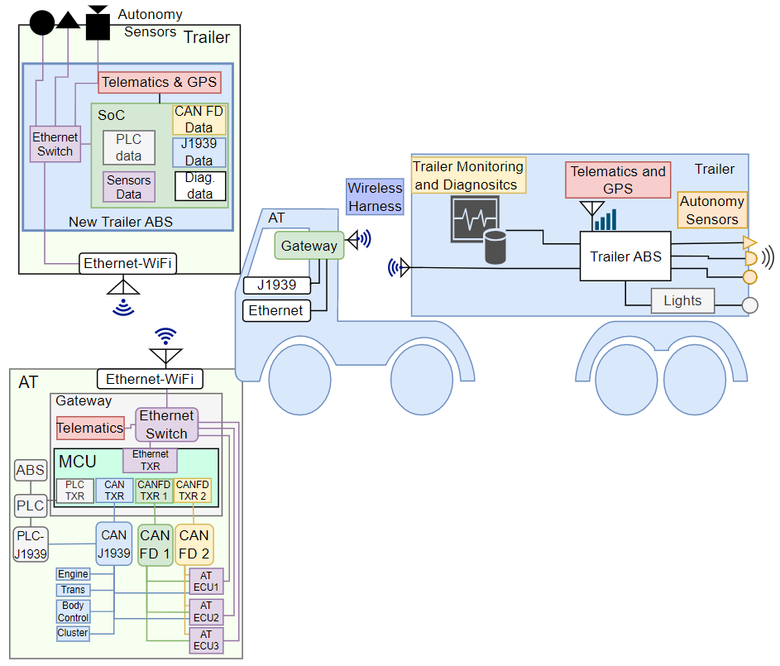
Background

Slide 4
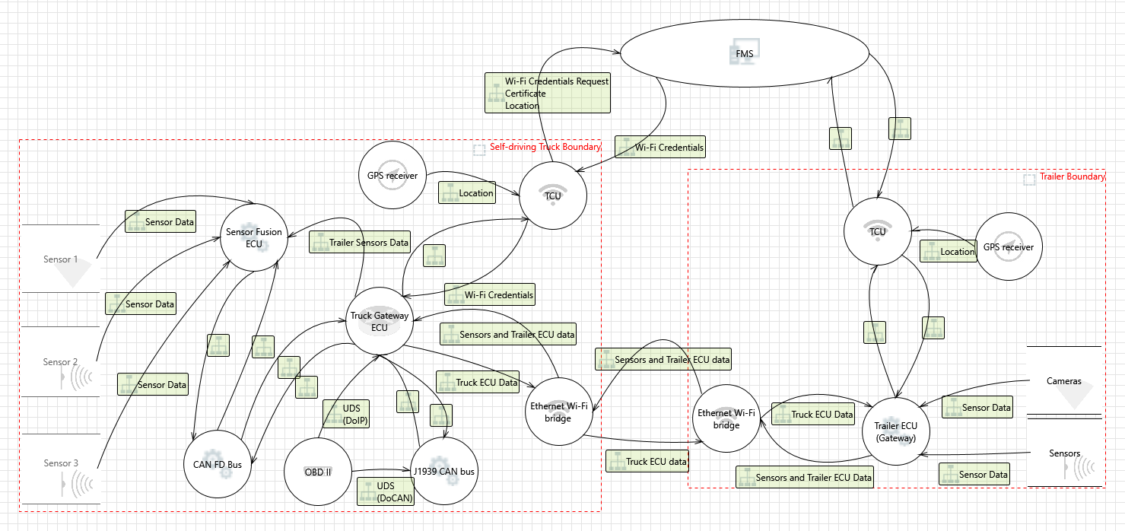
Data Flow Diagram
Fleet Management System

Slide 5
Data Flow Diagram
Fleet Management System

Slide 6


Data Flow Diagram
CA
Fleet Management System
Cert Mgmt
TLS
HTTP
TLS
TLS
SDDS/SRTP
Sensors
SecOC
SOME/IP
CAN/IP
OS 1
OS 2
TLS
Complexity in implementation and integration

Slide 7
Common Automotive Security Protocols
[1][2]
Protocol | Standard | Layer | Auth | Encrypt | Multicast | Note
TLS | IETF RFC 5246 | 4 | ● | ● | X | TCP
MACsec | IEEE 802.1AE | 2 | ● | ● | ● | Keys are required at each receiving/forwarding ECU
SecOC | AUTOSAR | 2 | ● | X | ● | CAN/Eth (Autosar-to-Autosar)
IPSec ESP | IETF RFC 4303 | 3 | ● | ● | X (autosar) | Encapsulating Security Payload (VPN, Security Association)

Slide 8

Data Flow Diagram
Authentication
Telemetry Data
Tele-operation (real-time video)
CA
Fleet Management System
NDN
NDNCert
NDN
Provisioning
NDN
/trailer/ECU/sensors/lidar
Signed
OS 1
/trailer/ECU/can/canfd
Signed
Encrypted
OS 2

Slide 9
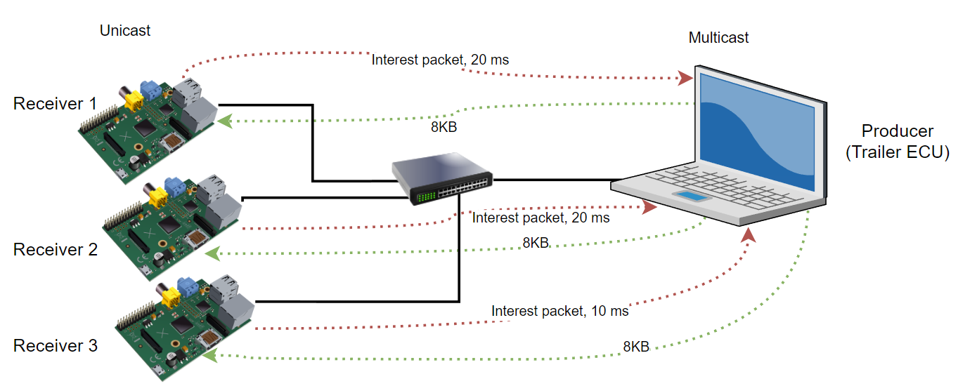
Testbed
(Performance: SOME/IP UDP vs. NDN)
Scalable service-Oriented MiddlewarE over IP
Automotive communication (AUTOSAR)
Service-oriented architecture
Remote procedure calls, event notifications and service-discovery

Slide 10
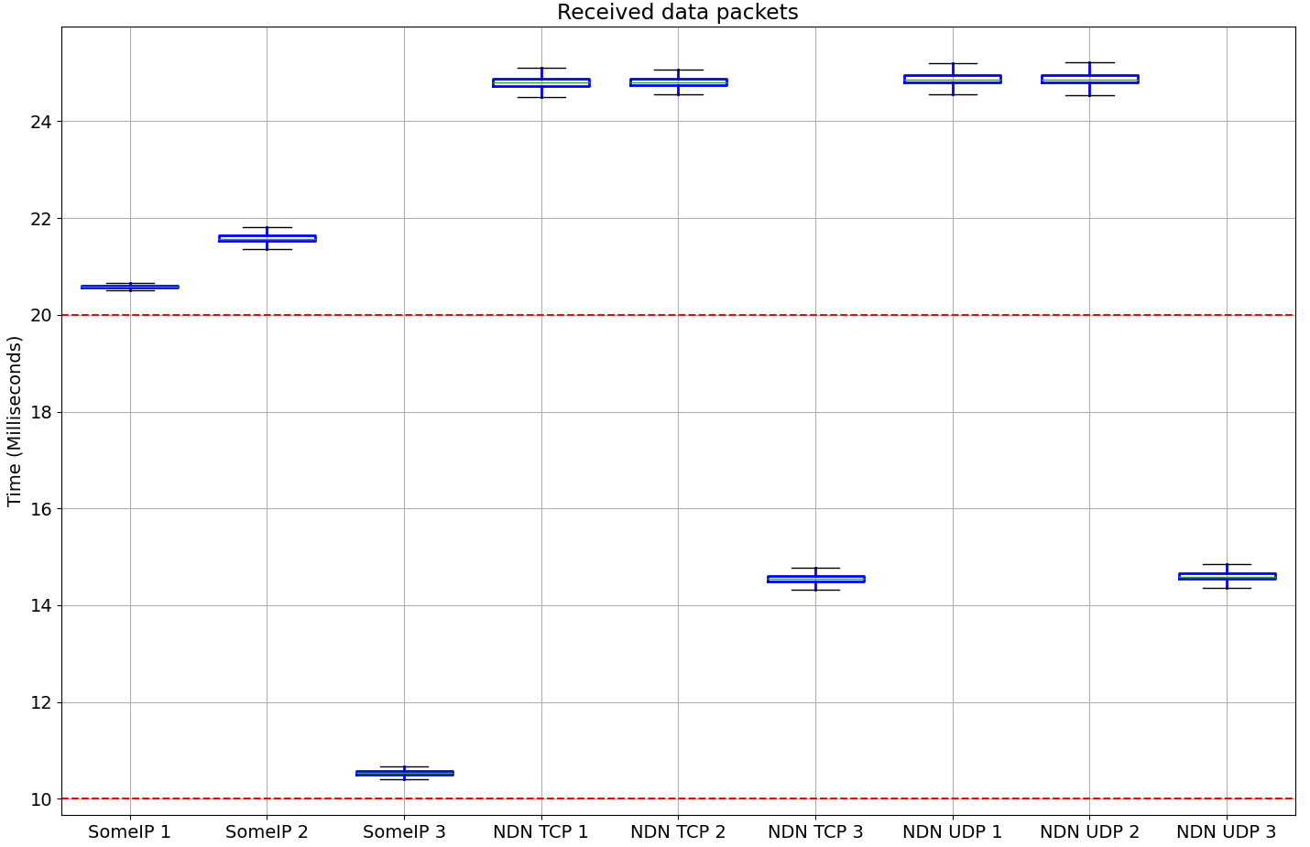
Results
Usage | Events/s | Description | Power
0.9% | 295.2 | /usr/bin/nfd --config /etc/ndn/nfd.conf | 1.18 W
6.6% | 149.1 | python3 /ndn_cam_sender.py | 692 mW
32.1% | 674.4 | python3 ./someip_cam_sender.py 192.168.10.33 --multicast 224.0.23.170 --port 6369 | 3.16 W

Slide 11
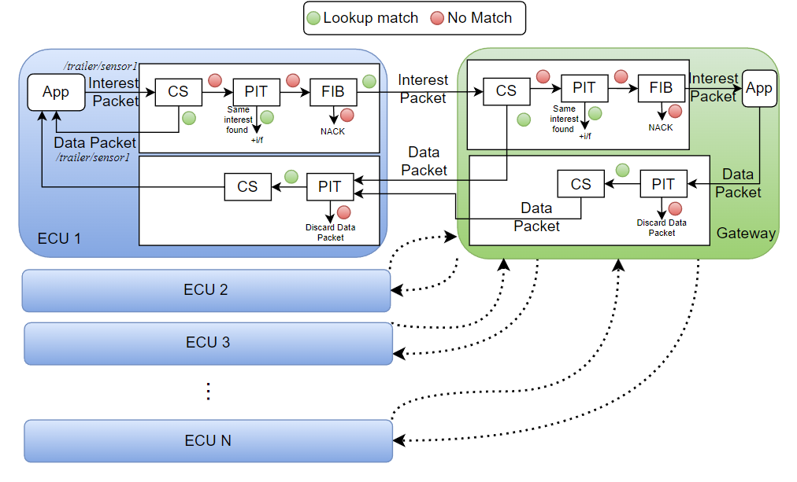
Discussion
Optimization for Automotive (AutoNDN?)
  1 interest packet to many data packets
  Symmetric keys (e.g., SecOC)
  Reduce number of lookups
  Data content struct
High number of ECUs
  N ECUs transmitting M Interest / Data packets every S milliseconds
Strong potential for NDN but needs to be standardized for automotive communication

Slide 12
Questions/Comments?

Slide 13
References
[1] R. Pallierer, M. Ziehensack, “Secure Ethernet Communication for Autonomous Driving”, Automotive Ethernet Congress (2016).
[2] C. Papadopoulos, A. Afanasyev and S. Shannigrahi, "A Name-Based Secure Communications Architecture for Vehicular Networks," 2021 IEEE Vehicular Networking Conference (VNC), Ulm, Germany, 2021, pp. 178-181, doi: 10.1109/VNC52810.2021.9644625.

