Slide 1
Performance analysis of cpu and gpu for generation of prime numbers
By:
Aashish Thyagarajan
Harman Preet Singh
Vipul SHarma

Slide 2
Problem statement
Prime numbers are of utmost importance when it comes to security and cryptography. Most cryptography systems work by using prime factors of large numbers.
Test the performance of the CPUs to GPUs when it comes to calculating prime numbers over a range of numbers

Slide 3
Objective
Testing the prime number generation using CPUs and GPUs and comparing their performance.
To try and speed up GPU significantly over the CPU.
To generate a prime number as large as possible in a given range.

Slide 4
CPU generation of prime numbers
Brute force method where we tested the primality of a number by dividing it from 2 to the square root of the given number.
Two variation to the threaded CPU generation

Slide 5
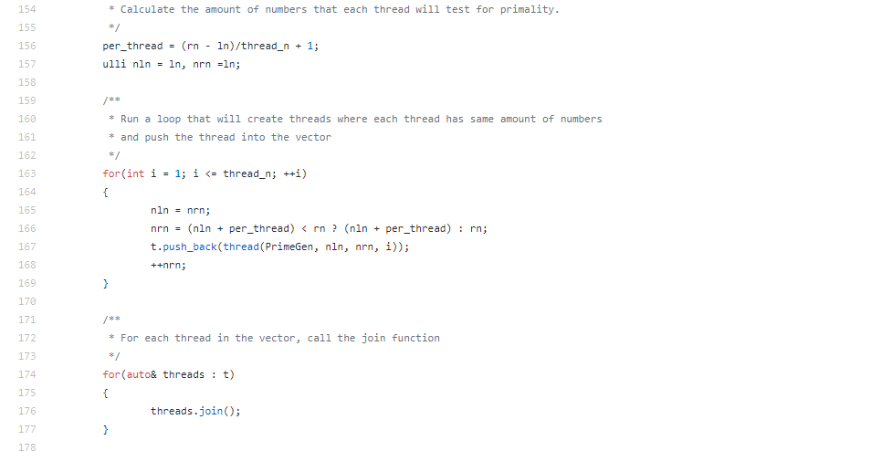
CPU Threaded V1
Equal load bearing – each thread has an equal amount of numbers for which they test primality and write results to the respective files

Slide 6
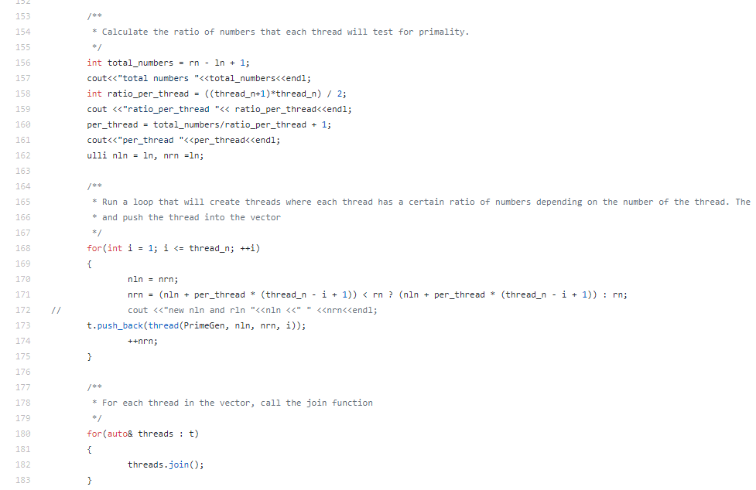
CPU Threaded v2
Unequal load bearing – first thread has highest amount of numbers, second lesser and so on based on ratio of total numbers in the range and number of threads to be created.

Slide 7
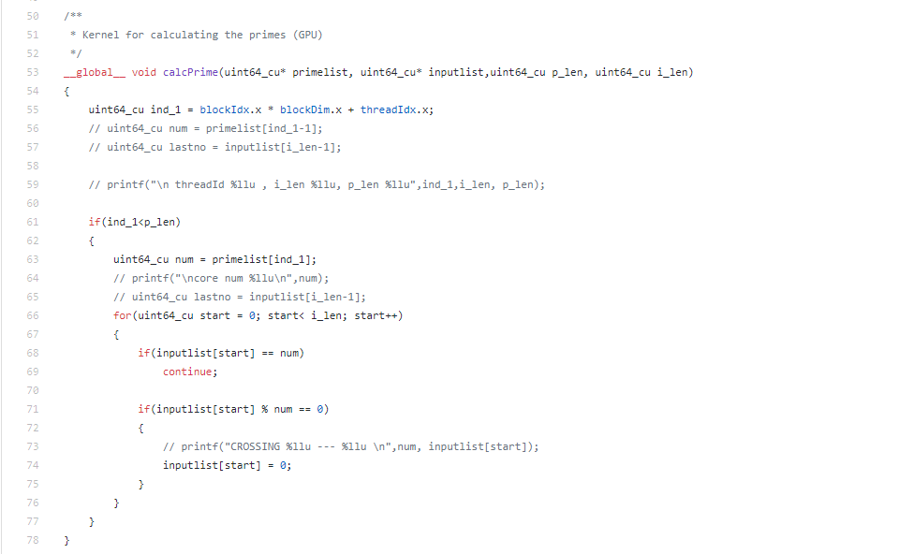
GPU generation of prime numbers
Ran and tested on Tesla K20m GPUs in Discovery Lab

Slide 8
Results
We were able to calculate prime number as large as 99999989 in the range 2 to 10^8 .
We observed that CPUs without multithreading were way slower and took large amount of time to calculate the prime numbers. With multithreading, the CPUs were faster until 10^5 and then after that point, GPUs were significantly faster.
Our implementation allows CUDA to use as many threads and this model should be faster with multiple GPUs too.

Slide 9
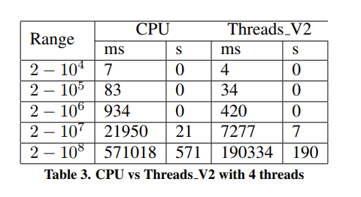
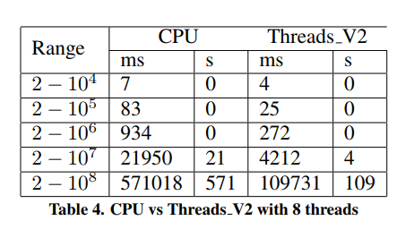
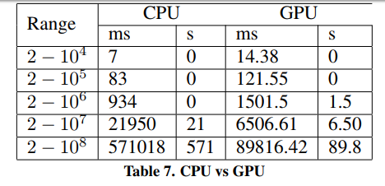
Performance in Numbers

Slide 10
Future works
Other Algorithms for CPU
Other implementations for parallelization for CPU
Narrowing range over which CPU might be faster over GPU
Extending GPU cluster with threads

Slide 11
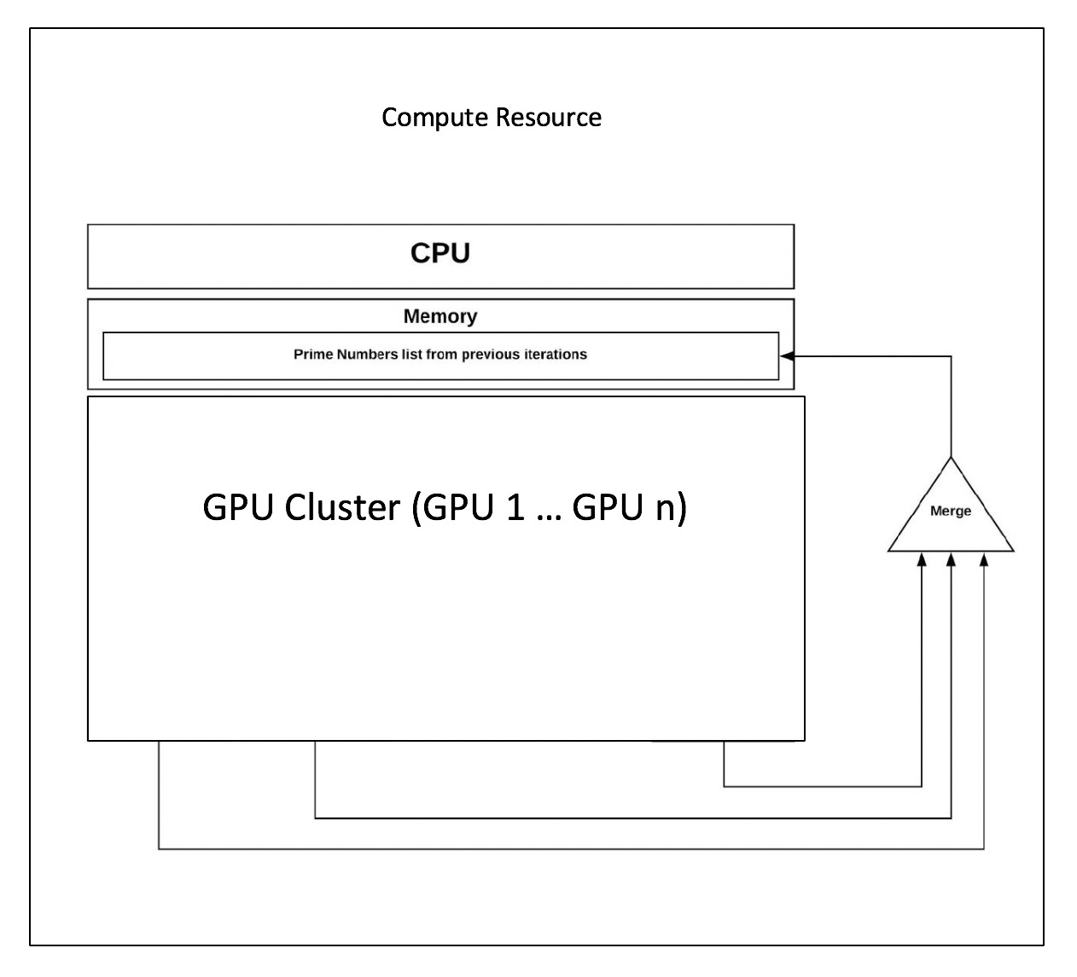
Proposed model for generation of prime numbers in future
Each GPU will have a prime numbers list and an input list which can be sieved and will generate numbers independently.

