Slide 1
TATA INNOVENT 2026
EdgeGuard AI
Vehicle Predictive Maintenance Simulation Platform
Team Forge V
Suresh Kumar • Nitin Kalinga • Jonathan Immanuel Kennedy • Balaji Kumar • Akshan

Slide 2
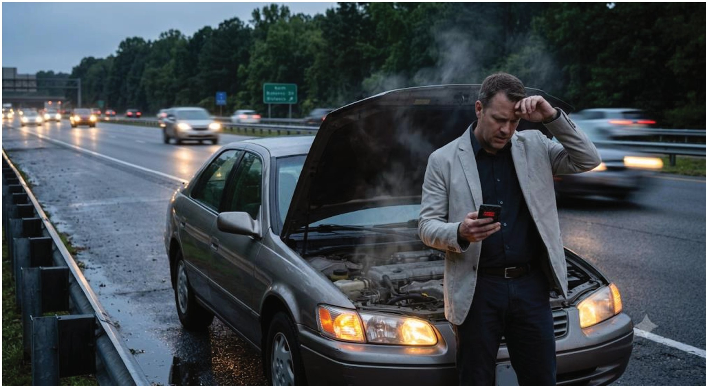
1
Problem Statement
Vehicle breakdowns and mechanical failures often happen without warning, leading to safety risks, costly repairs, and vehicle downtime.
Most traditional vehicles rely on basic dashboard indicators that only alert drivers after a problem has already occurred.
There is a growing need for a smart, real-time system that can continuously monitor vehicle parameters and predict issues before they become critical.
With the predictive maintenance market expanding rapidly, there is strong potential for AI-driven, low-cost software solutions.
Continuous Edge AI monitoring enables timely interventions before minor issues become critical failures.

Slide 3
2
Objective and Approach
1
2
Objective
Design a software-based simulation system that models vehicle health parameters (RPM, temperature, gear, road condition, tyre wear, oil condition, speed, etc.) and uses AI/rule-based logic to detect abnormal patterns, predicting potential failures before they occur.
To enable proactive vehicle maintenance by identifying potential failures before they impact safety, performance, or reliability.
Approach
Built a virtual simulation environment where users can input or simulate real-time vehicle parameters. The system processes this data using an Edge AI-inspired logic layer to continuously evaluate vehicle "health status" and generate instant alerts and recommendations.
A real-time, on-device AI simulation continuously analyses vehicle data to provide instant diagnostics, predictions, and actionable recommendations.

Slide 4
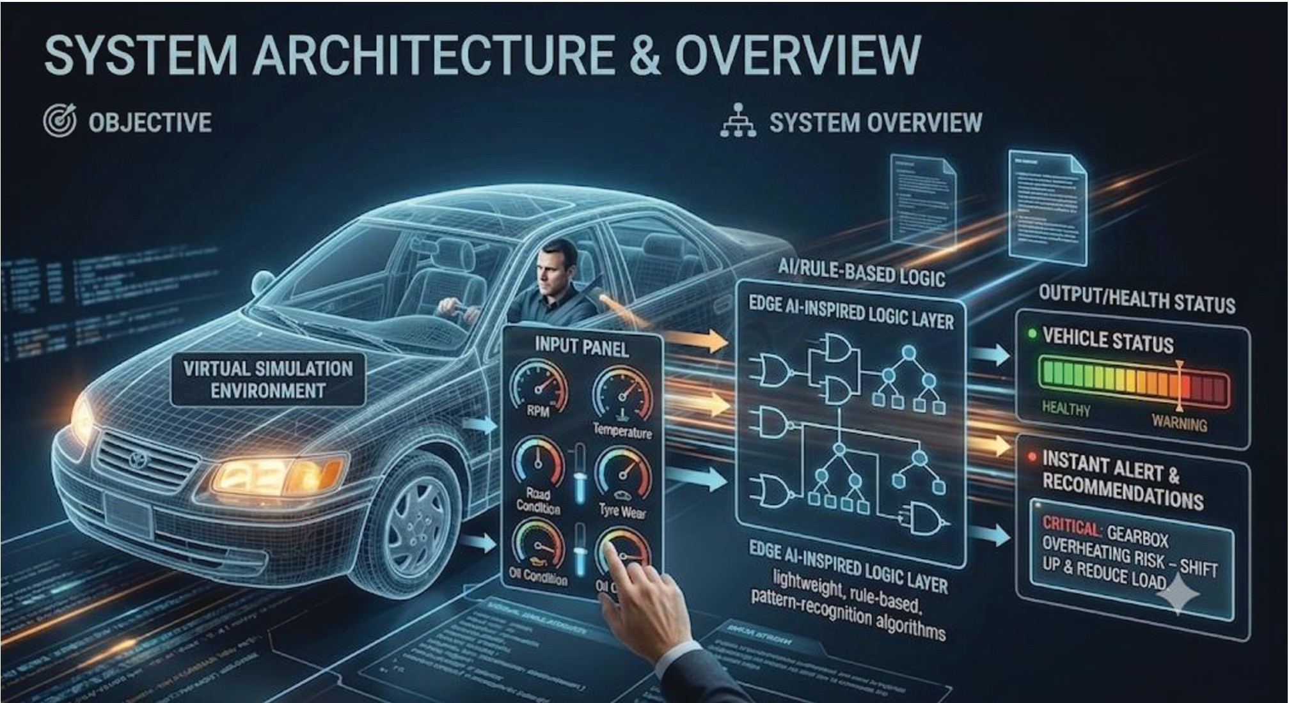
3
Solution Overview
A software-only virtual vehicle health simulator that mimics an Edge AI system embedded in a real car:
• Input Module: RPM, gear, speed, road type, oil temperature, tyre condition, engine temperature.
• Processing Engine: Threshold- and pattern-based logic detects anomalies.
• Alerts: Real-time, easy-to-understand messages for the driver.
• Status Dashboard: Visual, color-coded health format.
The novelty is simulating Edge AI decisions without physical sensors.

Slide 5
4
Challenges Faced
1
2
Realistic thresholds: Determining accurate "normal vs. abnormal" ranges without real sensor datasets.
Real-world unpredictability: Responding to combined conditions, not isolated checks.
3
4
Simplicity vs. accuracy: Keeping the AI logic lightweight yet meaningful.
User experience: Presenting technical alerts clearly for a non-expert driver.

Slide 6
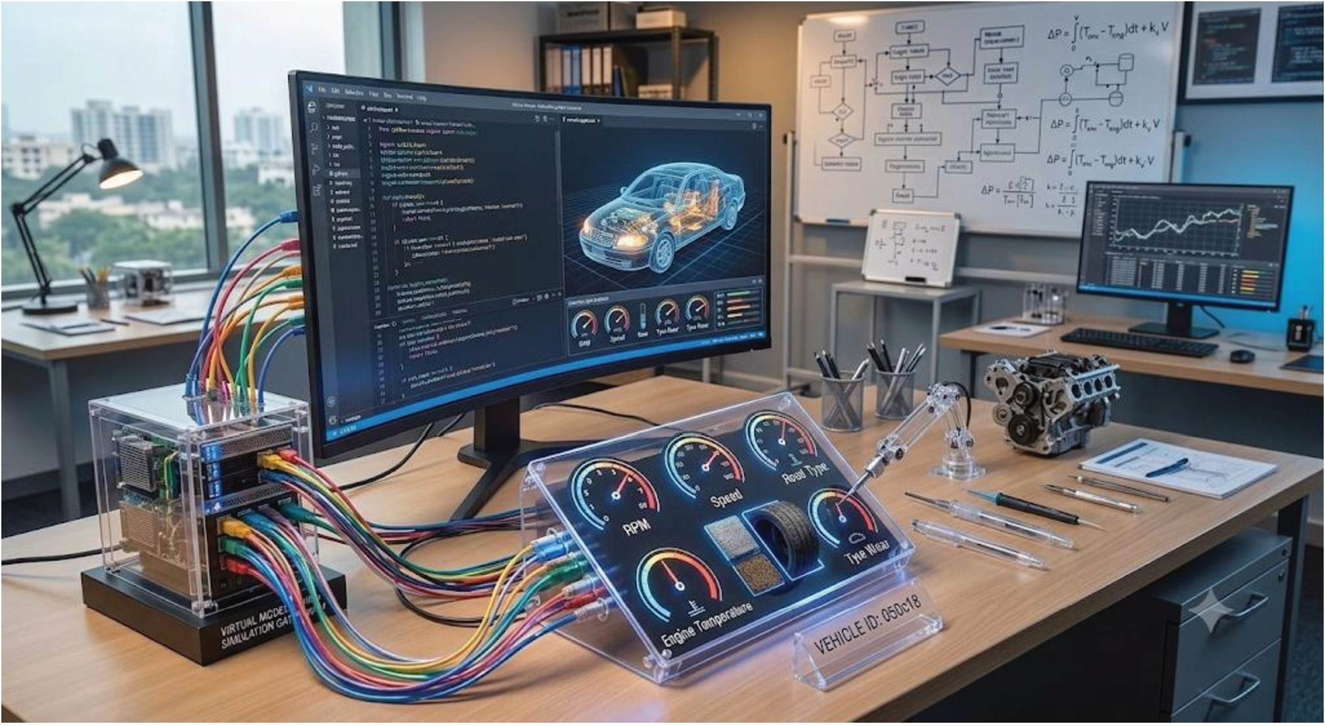
5
Technical Implementation
• Type: Fully software-based simulation.
• Core Logic: Rule-based, condition-driven AI decision-making.
• Parameters: RPM, gear, speed, road type, engine & oil temperature, tyre wear.
• Tech Stack: Python-based logic with a simple web/app interface.
• Alert Engine: Multi-condition checks for realistic risk flagging.
• Interface: A friendly dashboard showing instant health status and alerts.

Slide 7
6
Results and Achievements
Successfully simulated real-world vehicle fault scenarios with accurate, real-time alerts.
1
Combined-parameter analysis produced more realistic, useful predictive warnings than single-variable checks.
2
Built a lightweight logic engine proving feasibility for Edge AI deployment on low-power hardware.
3
Achieved a clear, intuitive alert system understandable instantly by non-technical users.
4

Slide 8
7
Future Enhancements
Integrate real sensor/IoT hardware data for a live, physical Edge AI system.
1
Incorporate ML models trained on real vehicle datasets for adaptive predictions.
2
Add historical trend analysis for long-term maintenance schedules.
3
Build a mobile app interface for real-time driver notifications.
4
Expand to fleet-level monitoring for commercial/logistics use cases.
5

Slide 9
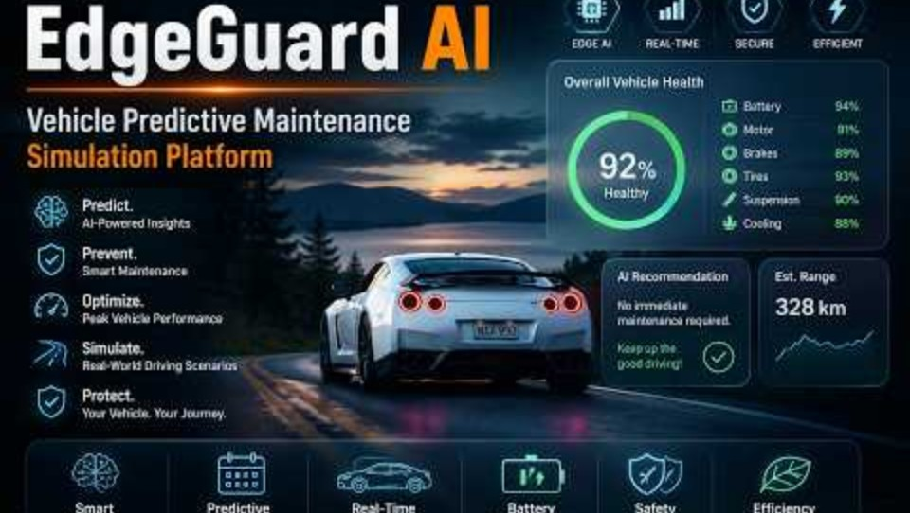
8
Interface Demo

Slide 10
9
Project Plan
Phase | Key Activities | Deliverables
Phase 1 – Research & Planning | Analyze EV systems, define AI features, design system architecture and UI/UX | Project architecture, UI wireframes, feature list
Phase 2 – Data Preparation | Generate realistic synthetic datasets for battery, driving behavior, charging, weather, and vehicle components | Structured datasets ready for AI training
Phase 3 – AI Model Development | Train Battery Health AI, Driver Behavior AI, Predictive Maintenance, and Recommendation Engine | Trained AI models with evaluation metrics
Phase 4 – Edge AI Integration | Integrate AI models into the local inference engine and optimize for offline execution | Fully functional Edge AI engine
Phase 5 – Infotainment Dashboard | Develop Driver View, Insights View, Demo Mode, vehicle visualization, and interactive UI | Complete infotainment dashboard
Phase 6 – Testing & Demonstration | End-to-end testing, simulation, performance optimization, demo video preparation | Functional PoC ready for presentation

