Slide 1

Diversity in Aerospace
April
2023
DATA 424
Team members:
Kameron Galm, Julian Rangel, Ashlyn Montgomery, and Nam Jun Lee

Slide 2
Problem Statement
For decades, public debate has been escalating over the underrepresentation and treatment of women in the technology industry.
Despite the fast-growing era, there are many problems and complaints about employment and treatment by gender in STEM workplaces.

Slide 3
Objective
The object of this project is to identify the patterns and differences between men and women in the aerospace sector so that overall STEM-related workplaces.
By identifying these trends and patterns, it is to find ways for employers in the STEM sector to promote diversity, equity, and inclusion.

Slide 4
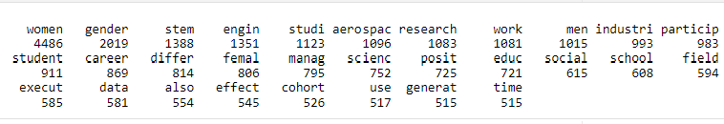
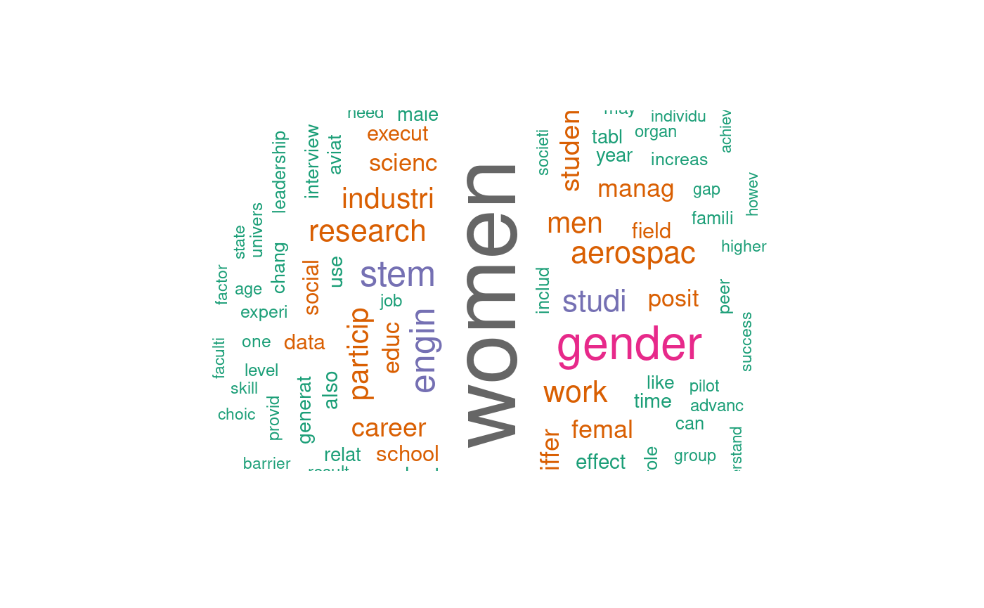
Aerospace PDFs
For the most part our PDF files seem to be talking about the topics we are researching.
It is interesting to see that almost all the terms seem to be neutral and don't seem imply anything negative about women in aerospace.

Slide 5
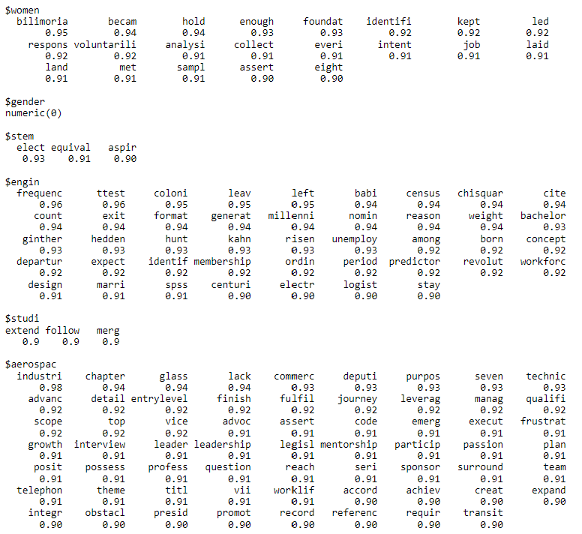
Word Associations

Slide 6
Data Collection & Processing
Extract text from PDF to CSV
PDFs
CSV 4
This dataset that was used for the collection was the Aerospace gender distribution by year data set from the DATAUSA webpage.
A total of 46 rows and 17 columns were processed to become 46 rows and 6 columns.
Text Extracted &
Cleaned
CSV 1
Average earnings by race and gender in the stem fields
CSV 3
Salary by gender in the aerospace industry
CSV 5
Survey data set for STEM field workers or non-STEM field workers
A total of 549,398 rows and 11 columns were processed to become 454,475 rows and 12 columns
CSV 2
Leadership position ratio by gender in the aerospace industry

Slide 7
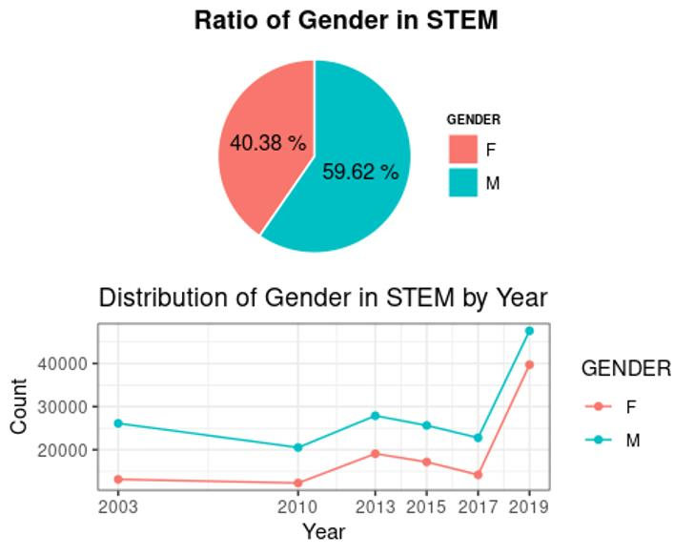
Men vs. Women
There were 270,958 male respondents and 183,517 female respondents
Throughout each year tracked, men outnumbered women
The ratio appears to be relatively constant, with the most difference appearing in 2003

Slide 8
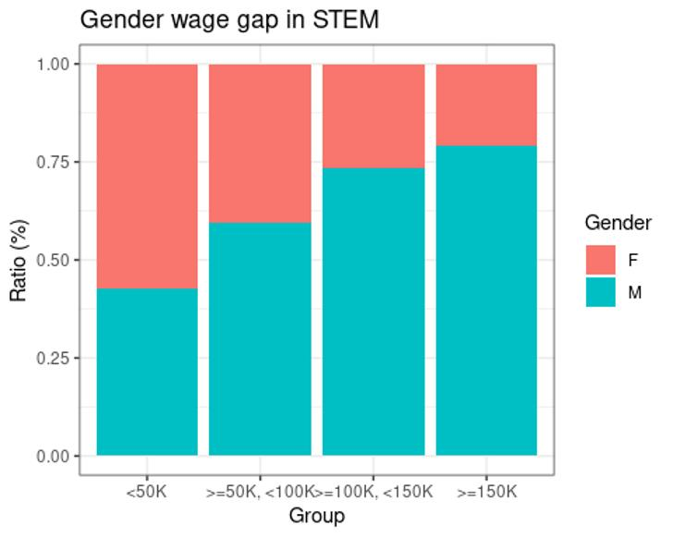
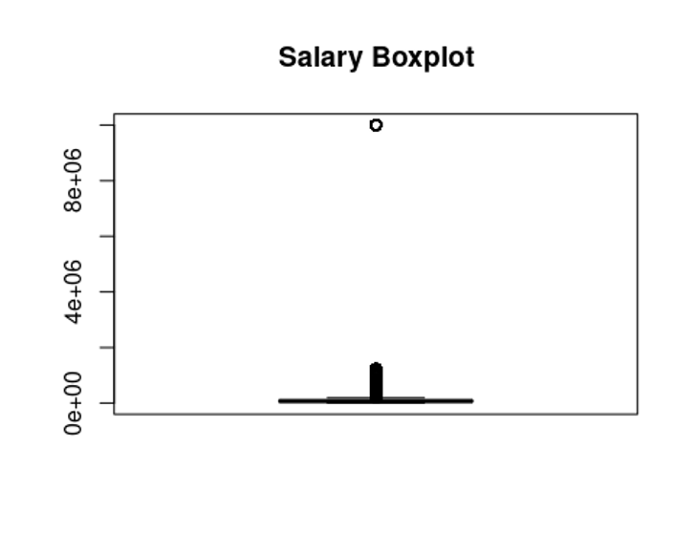
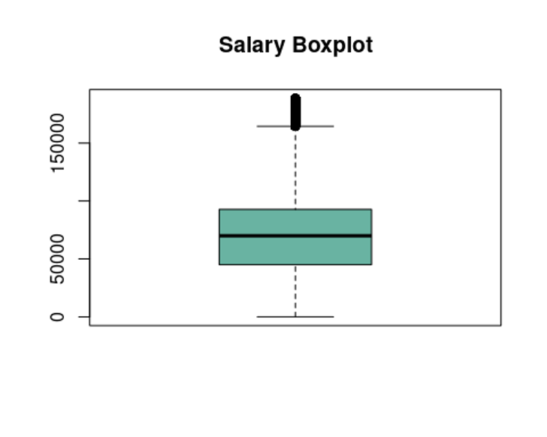
Gender Wage Gap In STEM
Replaced outliers (outside interquartile range) in the salary variable with the average salary and relocated the values in the salary group variable.
This confirmed that many women where paid less than 50,000 and those who were paid 50,000 or more were men.

Slide 9
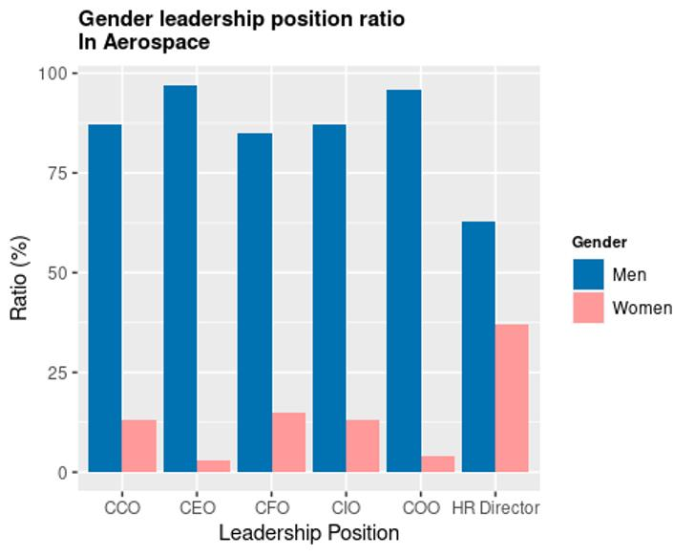
Leadership vs. Gender
The stratification between high-level positions for each gender is very apparent in tech industries, such as Aerospace.

Slide 10


Where we are going
1. What is the ratio of women to men in aerospace?
2. Is there a difference between men and women graduating from STEM fields in aerospace?
3. Is there a difference in how women and men are treated in aerospace (including by race)?
4. Does workplace productivity change based on the ratio or treatment of women within the workplace?
5. Predictions and projections of the number of female employees in the STEM fields in the next 10 years.
Answer key business questions
How can we present our analysis so non-technical users can understand how we are answering these questions?...

Slide 11

Shiny Dashboard
Use web-based Shiny application to tell a story
This dashboard will be constructed by first giving a high-level look at some key graphs and statistics that communicate our findings.
Users will be able to explore the web-based app and dig deeper into the specific business questions
Supporting Shiny Features
Slidy_Presentation (.Rmd)
ShinyThemes + .CSS file
NavBar Dashboard
Tabs
Drop-Down menus
Reactive Functionality
Plotly for ggplot visuals
DiagrammeR

Slide 12
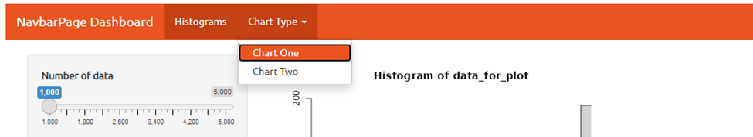
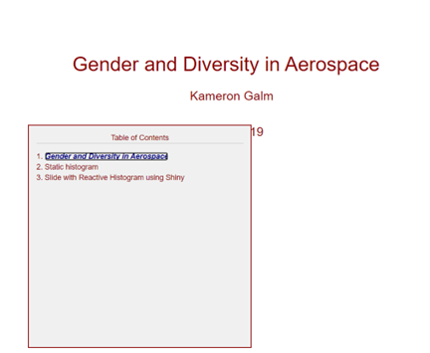
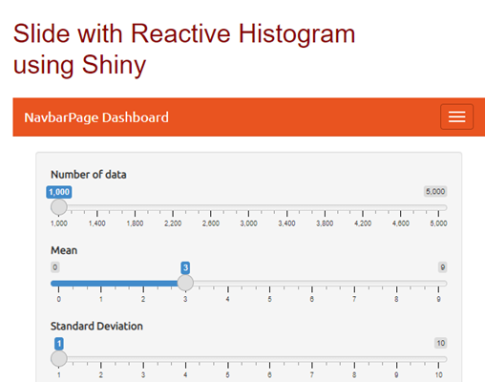
Shiny Features

Slide 13

BIG IMAGE
Questions?

