Slide 1
Procedure Call

Slide 2
Outline
Procedure call
Stack frame
Calling conventions
Recursive
Suggested reading
  Chap 3.7

Slide 3
Execution within Procedure/Function
Data Movement (e.g., movl $-17, (%rsp))
Arithmetic Operations (e.g., incq 8(%rax))
Logical Operations (e.g., xorq 8(%rsp), %rax)
Condition Codes (e.g., cmpq %rax, %rdx)
Jump Instructions (e.g., jg .L5)
How to execute cross procedures?

Slide 4
Procedure/Function call
Another type of unconditional JUMP
  SAME:
    Control from one part to another
  DIFF:
    Return
    Passing data (arguments, return values)
    Local variable
    Registers

Slide 5
Basic Concept
Terminology
  Caller
  Callee
f()
call-1
g()
call-2
h()
call-1
  Caller: f
  Callee: g
call-2
  Caller: g
  Callee: h

Slide 6
Basic Concept
Terminology
  Caller: g
  Callee: f
Control Flow
  e.g. int g() { return 1 ; }
  int f() { return g() ; }
  int main() { g(); return f(); }
g()
call
f()
main()
g()
f()
g()

Slide 7
Stack Frame Structure
The portion of stack allocated for a procedure
%rsp is used as a stack pointer to identify the top of the frame
The stack pointer can move when the procedure is executing (dynamic)
Frame
%rsp

Slide 8
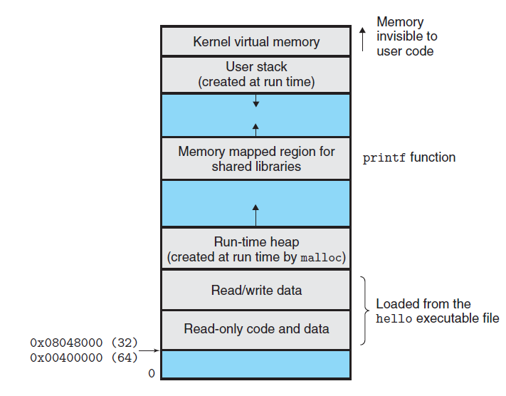
Memory Layout
7fffffffffff
%rsp
User stack
Notice the moving direction
Of the rsp
Id from the top to the bottom
%rip

Slide 9
Procedure/Function Implementation
  Invoke callee
  Return to caller
  Passing data
  Registers
  Local variable

Slide 10
Procedure/Function Implementation
  Invoke callee: call (new instructions)
  Return to caller
  Passing data
  Registers
  Local variable

Slide 11
Invoke Callee
Instruction
  call label (direct)
  call *operand (indirect)
Behavior description (by hardware)
  Save return address in the stack
  Jump to the entry of callee
call = push + jmp
  push retaddr
  jmp callee

Slide 12
Execution of call
// beginning of function multstore
400540 <multstore>:
400540: 53 push %rbx
400541: 48 89 d3 mov %rdx, %rbx
. . .
// return from function multstore
40054d: c3 retq
. . .
//call to mulstore from main
400563: e8 d8 ff ff ff callq 400540<multstore>
400568: 48 8b 54 24 08 mov 0x8(%rsp), %rdx

Slide 13
Executing call
After call
%rip | 0x400563
%rsp | 0x7fffffffffe840
%rip | 0x400540
%rsp | 0x7fffffffffe838
0xffffffffffff
0xffffffffffff
Kernel
Kernel
0x7fffffffffff
0x7fffffffffff
Stack
Stack
0x400568
Heap
Heap
Read/write data
Read/write data
Read only data
Read only data
Read only code
Read only code
0x400000
0x400000
forbidden
forbidden

Slide 14
Procedure/Function Implementation
  Invoke callee: call (new instructions)
  Return to caller: ret (new instructions)
  Passing data
  Registers
  Local variable

Slide 15
Return to Caller
Instruction
  ret
Behavior description (by hardware)
  Pop return address from stack
  Jump to return address in caller
ret = pop + jmp
  pop retaddr
  jmp retaddr

Slide 16
Execution of ret
// beginning of function multstore
400540 <multstore>:
400540: 53 push %rbx
400541: 48 89 d3 mov %rdx, %rbx
. . .
// return from function multstore
40054d: c3 retq
. . .
//call to mulstore from main
400563: e8 d8 ff ff ff callq 400540<multstore>
400568: 48 8b 54 24 08 mov 0x8(%rsp), %rdx

Slide 17
Before ret
After ret
%rip | 0x40054d
%rsp | 0x7fffffffffe838
%rip | 0x400568
%rsp | 0x7fffffffffe840
0xffffffffffff
0xffffffffffff
Kernel
Kernel
0x7fffffffffff
0x7fffffffffff
Stack
Stack
0x400568
Heap
Heap
Read/write data
Read/write data
Read only data
Read only data
Read only code
Read only code
0x400000
0x400000
forbidden
forbidden

Slide 18
Execution of call and ret
Notice the name of the registers

Slide 19
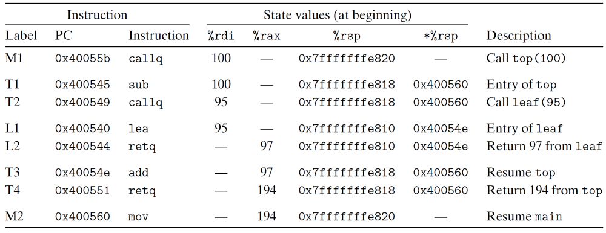
Execution of call and ret

Slide 20
Execution of call and ret

Slide 21
Execution of call and ret

Slide 22
Execution of call and ret

Slide 23
Execution of call and ret

Slide 24
Execution of call and ret

Slide 25
Execution of call and ret

Slide 26
Execution of call and ret

Slide 27
Execution of call and ret

Slide 28
Stack Frame Structure
call: save return address in the stack
  The end of caller’s frame
  The beginning of callee’s frame
Caller Frame
retaddr
Callee Frame
%rsp

Slide 29
Frame Stack
%rsp only points to the topmost frame
%rsp

Slide 30
Frame Stack
%rsp only points to the topmost frame
Frames are stacked
  1. call callee
%rsp

Slide 31
Frame Stack
%rsp only points to the topmost frame
Frames are stacked
  1. call callee
  callee:
  ………
retaddr
%rsp

Slide 32
Frame Stack
%rsp only points to the topmost frame
Frames are stacked
  1. call callee
  callee:
  ………
  ………
retaddr
%rsp

Slide 33
Frame Stack
%rsp only points to the topmost frame
Frames are stacked
  1. call callee
  callee:
  ………
  ………
  ret
retaddr
%rsp

Slide 34
Frame Stack
%rsp only points to the topmost frame
Frames are stacked
  1. call callee
  callee:
  ………
  ………
  ret
retaddr
%rsp

Slide 35
Frame Stack
%rsp only points to the topmost frame
Frames are stacked
%rsp

Slide 36
Procedure/Function Implementation
  Invoke callee: call (new instructions)
  Return to caller: ret (new instructions)
  Passing data: register, stack
  Registers
  Local variable

Slide 37
Passing Data: Arguments & Return Value
Specific registers to pass arguments
Specific register to keep the return value
  %rax is used to pass the result of callee to caller
Operand size | Argument number
 | 1 | 2 | 3 | 4 | 5 | 6
64 | %rdi | %rsi | %rdx | %rcx | %r8 | %r9
32 | %edi | %esi | %edx | %ecx | %r8d | %r9d
16 | %di | %si | %dx | %cx | %r8w | %r9w
8 | %dil | %sil | %dl | %cl | %r8b | %r9b

Slide 38
Passing Data: More than 6 Arguments
Pushed by Caller to stack
  Saved in caller frame
  Just upon of return address
  From N^{th} to 7th (from right to left)
  All data sizes are rounded up
  to be multiples of eight
How to be used by Callee
  Relative to %rsp
Caller Frame
argument N
. . . . . .
argument 7
retaddr
Callee Frame
%rsp

Slide 39
Passing Data: Arguments
push argument N
Caller Frame
%rsp
argument N

Slide 40
Passing Data: Arguments
push argument N
. . .
push argument 7
Caller Frame
argument N
. . . . . .
%rsp
argument 7

Slide 41
Passing Data: Arguments
push argument N
. . .
push argument 7
movq argument 6 %r9
Caller Frame
argument N
. . . . . .
%rsp
argument 7

Slide 42
Passing Data: Arguments
push argument N
. . .
push argument 7
movq argument 6 %r9
. . .
movq argument 1 %rdi
Caller Frame
argument N
. . . . . .
%rsp
argument 7

Slide 43
Passing Data: Arguments
push argument N
. . .
push argument 7
movq argument 6 %r9
. . .
movq argument 1 %rdi
call callee
Caller Frame
argument N
. . . . . .
argument 7
retaddr
%rsp

Slide 44
Passing Data: Arguments
  void proc(long a1, long *a1p,
  int a2, int *a2p,
  short a3, short *a3p,
  char a4, char *a4p)
  {
  *a1p += a1 ;
  *a2p += a2 ;
  *a3p += a3 ;
  *a4p += a4 ;
  }

Slide 45
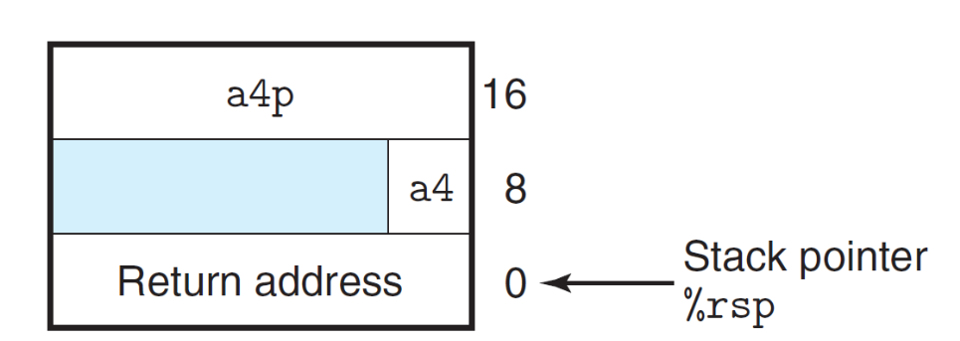
Passing Data: Arguments
  a1 in %rdi (64 bits)
  a1p in %rsi (64 bits)
  a2 in %edx (32 bits)
  a2p in %rcx (64 bits)
  a3 in %r8w (16 bits)
  a3p in %r9 (64 bits)
  a4 at %rsp+8 ( 8 bits)
  a4p at %rsp+16 (64 bits)
  proc:
  movq 16(%rsp), %rax
  addq %rdi, (%rsi)
  addl %edx, (%rcx)
  addw %r8w, (%r9)
  movl 8(%rsp), %edx
  addb %dl, (%rax)
  ret
Extra arguments are saved in the stack
The (%regester) will take memory as the
instruction requires

Slide 46
Procedure/Function Implementation
  Invoke callee: call (new instructions)
  Return to caller: ret (new instructions)
  Passing data: stack, register
  Registers: usage convention
  Local variable

Slide 47
Usage Convention
Registers act as a single resource shared by all of the procedures
  Only 1 procedure can be active
  Partition registers between caller and callee
    Caller-save register
    Callee-save register
  Only consider the registers used by the procedure

Slide 48
Usage Convention
Caller-save registers
  %rax, %rdi, %rsi, %rdx, %rcx, %r8, %r9, %r10, %r11
  Saved by caller
  Callee can use these registers freely
  The contents in these registers may be changed after return
  Caller must restore them if it tries to use them after calling

Slide 49
Caller-save Registers
push %rax
push argument N
. . .
push argument 7
movq argument 6 %r9
. . .
movq argument 1 %rdi
call callee
Caller Frame
Saved %rax
argument N
. . . . . .
argument 7
retaddr
%rsp

Slide 50
Usage Convention
Callee-save registers
  %rbx, %rbp, %r12-15
  Saved by callee
  Caller can use these registers freely
  Callee must save them before using
  Callee must restore them before return

Slide 51
Callee-save Registers
call callee
callee:
pushq %rbp
pushq %rbx
. . .
retaddr
Callee Frame
Saved %rbp
Saved %rbx
%rsp

Slide 52
Example - Usage Convention
(a) Calling function
long P(long x, long y)
{
long u = Q(y);
long v = Q(x);
return u + v;
}
(b) Generated assembly code for the calling function
long P(long x, long y)
x in %rdi, y in %rsi

Slide 53
Example - Usage Convention
1 P:
2 pushq %rbp Save %rbp
3 pushq %rbx Save %rbx
4 subq $8, %rsp Align stack frame
5 movq %rdi, %rbp Save x
6 movq %rsi, %rdi Move y to first argument
7 call Q Call Q(y)
8 movq %rax, %rbx Save result
9 movq %rbp, %rdi Move x to first argument
10 call Q Call Q(x)
11 addq %rbx, %rax Add saved Q(y) to Q(x)
12 addq $8, %rsp Deallocate last part of stack
13 popq %rbx Restore %rbx
14 popq %rbp Restore %rbp
15 ret

Slide 54
Example - Usage Convention
Stack frame for P
1 P:
2 pushq %rbp
0 | %rbp
%rsp

Slide 55
Example - Usage Convention
Stack frame for P
1 P:
2 pushq %rbp
3 pushq %rbx
+8 | %rbp
0 | %rbx
%rsp

Slide 56
Example - Usage Convention
Stack frame for P
1 P:
2 pushq %rbp
3 pushq %rbx
4 subq $8, %rsp
+10 | %rbp
+8 | %rbx
0
%rsp

Slide 57
Example - Usage Convention
Stack frame for P
1 P:
2 pushq %rbp
3 pushq %rbx
4 subq $8, %rsp
…….
12 addq $8, %rsp
+8 | %rbp
0 | %rbx
%rsp

Slide 58
Example - Usage Convention
Stack frame for P
1 P:
2 pushq %rbp
3 pushq %rbx
4 subq $8, %rsp
…….
12 addq $8, %rsp
13 popq %rbx
0 | %rbp
%rsp

Slide 59
Example - Usage Convention
Stack frame for P
1 P:
2 pushq %rbp
3 pushq %rbx
4 subq $8, %rsp
…….
12 addq $8, %rsp
13 popq %rbx
14 popq %rbp
%rsp

Slide 60
Procedure/Function Implementation
  Invoke callee: call (new instructions)
  Return to caller: ret (new instructions)
  Passing data: stack, register
  Registers: usage convention
  Local variable: stack

Slide 61
Local Variable
Why are local variables not stored in registers ?
  No enough registers
  Array and structures (e.g., a[2])
  Need address (e.g., &a)

Slide 62
Local Variable
Allocation
  Below saved regs
  move/sub %rsp, (e.g., subq $4, %rsp)
De-allocation
  move/add %rsp, (e.g., addq $4, %rsp)
Usage
  Relative to %rsp, (e.g., movq $1057, 8(%rsp))
retaddr
Callee Frame
Saved regs
Local variable
%rsp

Slide 63
Example – Local Variables on the Stack
long swap_add(long *xp, long *yp)
{
long x = *xp;
long y = *yp;
*xp = y;
*yp = x;
return x + y;
}

Slide 64
Example – Local Variables on the Stack
long caller()
{
long arg1 = 534;
long arg2 = 1057;
long sum = swap_add(&arg1, &arg2);
long diff = arg1 - arg2;
return sum * diff;
}

Slide 65
Example – Local Variables on the Stack
long caller()
1 caller:
2 subq $16, %rsp Allocate 16 bytes for stack frame
3 movq $534, (%rsp) Store 534 in arg1
4 movq $1057, 8(%rsp) Store 1057 in arg2
5 leaq 8(%rsp), %rsi Compute &arg2 as second argument
6 movq %rsp, %rdi Compute &arg1 as first argument
7 call swap_add Call swap_add(&arg1, &arg2)
8 movq (%rsp), %rdx Get arg1
9 subq 8(%rsp), %rdx Compute diff = arg1 - arg2
10 imulq %rdx, %rax Compute sum * diff
11 addq $16, %rsp Deallocate stack frame
12 ret Return

Slide 66
Example – Local Variables on the Stack
1 caller:
Stack frame for caller
%rsp

Slide 67
Example – Local Variables on the Stack
2 subq $16, %rsp
Stack frame for caller
+8
0
%rsp

Slide 68
Example – Local Variables on the Stack
2 subq $16, %rsp
3 movq $534, (%rsp)
Stack frame for caller
+8
0 | 534(arg1)
%rsp

Slide 69
Example – Local Variables on the Stack
2 subq $16, %rsp
3 movq $534, (%rsp)
4 movq $1057, 8(%rsp)
Stack frame for caller
+8 | 1057(arg2)
0 | 534(arg1)
%rsp

Slide 70
Example – Local Variables on the Stack
Stack frame for caller
2 subq $16, %rsp
3 movq $534, (%rsp)
4 movq $1057, 8(%rsp)
leaq 8(%rsp), %rsi
Compute &arg2 as second argument
+8 | 1057(arg2)
0 | 534(arg1)
%rsp

Slide 71
Example – Local Variables on the Stack
Stack frame for caller
2 subq $16, %rsp
3 movq $534, (%rsp)
4 movq $1057, 8(%rsp)
5 leaq 8(%rsp), %rsi
6 movq %rsp, %rdi
Compute &arg1 as first argument
+8 | 1057(arg2)
0 | 534(arg1)
%rsp

Slide 72
Example – Local Variables on the Stack
2 subq $16, %rsp
3 movq $534, (%rsp)
4 movq $1057, 8(%rsp)
5 leaq 8(%rsp), %rsi
6 movq %rsp, %rdi
7 call swap_add
Call swap_add(&arg1, &arg2)
Stack frame for caller
+8 | 1057(arg2)
0 | 534(arg1)
%rsp

Slide 73
Example – Local Variables on the Stack
1 swap_add
2 movq (%rdi), %r8
3 movq (%rsi), %r9
4 movq %r8, (%rsi)
5 movq %r9, (%rdi)
6 ret
Stack frame for caller
+10 | 1057(arg2)
0 | 534(arg1)
 | retaddr
%rsp

Slide 74
Example – Local Variables on the Stack
1 swap_add
2 movq (%rdi), %r8
3 movq (%rsi), %r9
4 movq %r8, (%rsi)
5 movq %r9, (%rdi)
addq
ret
Stack frame for caller
+10 | 534(arg2)
0 | 1057(arg1)
 | Retaddr
%rsp

Slide 75
Example – Local Variables on the Stack
2 subq $16, %rsp
3 movq $534, (%rsp)
4 movq $1057, 8(%rsp)
5 leaq 8(%rsp), %rsi
6 movq %rsp, %rdi
7 call swap_add
8 movq (%rsp), %rdx
9 subq 8(%rsp), %rdx
10 imulq %rdx, %rax
11 addq $16, %rsp
12 ret
Stack frame for caller
%rsp

Slide 76
Example – Local Variables on the Stack
(a) C code for calling function
long call_proc()
{
long x1 = 1; int x2 = 2;
short x3 = 3; char x4 = 4;
proc(x1, &x1, x2, &x2, x3, &x3, x4, &x4);
return (x1+x2)*(x3-x4);
}

Slide 77
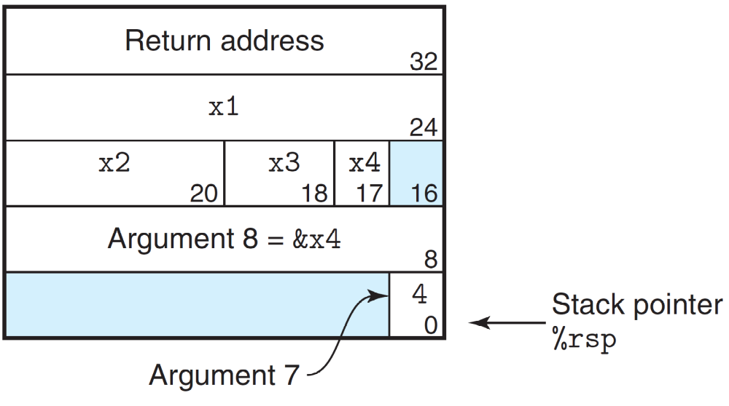
Example – Local Variables on the Stack

Slide 78
Example – Local Variables on the Stack
(b) Generated assembly code
long call_proc()
1 call_proc:
Set up arguments to proc
2 subq $32, %rsp Allocate 32-byte stack frame
3 movq $1, 24(%rsp) Store 1 in &x1
4 movl $2, 20(%rsp) Store 2 in &x2
5 movw $3, 18(%rsp) Store 3 in &x3
6 movb $4, 17(%rsp) Store 4 in &x4

Slide 79
Example – Local Variables on the Stack
1
2
3
4

Slide 80
Example – Local Variables on the Stack
7 leaq 17(%rsp), %rax Create &x4
8 movq %rax, 8(%rsp) Store &x4 as argument 8
9 movl $4, (%rsp) Store 4 as argument 7
10 leaq 18(%rsp), %r9 Pass &x3 as argument 6
11 movl $3, %r8d Pass 3 as argument 5
12 leaq 20(%rsp), %rcx Pass &x2 as argument 4
13 movl $2, %edx Pass 2 as argument 3
14 leaq 24(%rsp), %rsi Pass &x1 as argument 2
15 movl $1, %edi Pass 1 as argument 1

Slide 81
Example – Local Variables on the Stack
Call proc
16 call proc
Retrieve changes to memory
17 movslq 20(%rsp), %rdx Get x2 and convert to long
18 addq 24(%rsp), %rdx Compute x1+x2
19 movswl 18(%rsp), %eax Get x3 and convert to int
20 movsbl 17(%rsp), %ecx Get x4 and convert to int
21 subl %ecx, %eax Compute x3-x4
22 cltq Convert to long
23 imulq %rdx, %rax Compute (x1+x2) * (x3-x4)
24 addq $32, %rsp Deallocate stack frame
25 ret Return

Slide 82
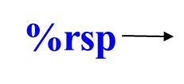
Put it Together
Caller Frame

Slide 83
Put it Together
Caller Frame
caller-save registers
1. Save caller-save registers
(%rax, %rdx, . . .)
%rsp

Slide 84
Put it Together
Caller Frame
caller-save registers
1. Save caller-save registers
(%eax, %edx, %ecx)
2. Push actual arguments
from right to left
arguments (n~7)
%rsp

Slide 85
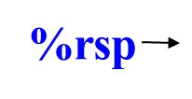
Put it Together
Caller Frame
caller-save registers
1. Save caller-save registers
(%eax, %edx, %ecx)
2. Push rest actual arguments
from right to left onto stack
3. Pass first six actual arguments
4. Call instruction
  Save return address
  Transfer control to callee
arguments (n~7)
retaddr

Slide 86
Put it Together
Caller Frame
caller-save registers
5. Save callee-save registers
(%rbx, %rbp, . . .)
arguments (n~1)
retaddr
callee-save registers
%rsp

Slide 87
Put it Together
Caller Frame
caller-save registers
5. Save callee-save registers
(%rbx, %rbp, . . .)
6. Allocate space for local
variables
arguments (n~1)
retaddr
callee-save registers
local variables
%rsp

Slide 88
Put it Together
Caller Frame
caller-save registers
. . .
n-3. save return value in %rax
arguments (n~1)
retaddr
callee-save registers
local variables
%rsp

Slide 89
Put it Together
Caller Frame
caller-save registers
. . .
n-3. save return value in %rax
n-2. de-allocate local variable
arguments (n~1)
retaddr
callee-save registers
%rsp
local variables

Slide 90
Put it Together
Caller Frame
caller-save registers
. . .
n-3. save return value in %rax
n-2. de-allocate local variable
n-1. Restore callee-save registers
arguments (n~1)
retaddr
%rsp
callee-save registers
local variables

Slide 91
Put it Together
Caller Frame
caller-save registers
. . .
n-3. save return value in %rax
n-2. de-allocate local variable
n-1. Restore callee-save registers
n. Ret instruction
  pop return address
  Transfer control to caller
arguments (n~1)
%rsp
retaddr
callee-save registers
local variables

Slide 92
Example - Recursion
1 long rfact(long n)
2 {
3 long result;
4
5 if (n <= 1)
6 result = 1;
7 else
8 result = n * rfact(n-1);
9 return result;
10 }

Slide 93
Setup code
1 rfact:
2 pushq %rbx Save %rbx
3 movq %rdi, %rbx Store n in callee-saved regs
4 movl $1, %eax Set return value = 1
5 cmpq $1, %rdi Compare n:1
6 jle .L35 If <=, goto done
7 leaq -1(%rdi), %rdi Compute n-1
8 call rfact Call rfact(n-1)
9 imulq %rbx, %rax Multiply result by n
10 .L35 done:
11 popq %rbx Restore %rbx
12 ret Return

Slide 94
Recursion
Stack frame
 | . . . .
+48 | %rbx=??
+40 | return Addr
+32 | %rbx=4
+24 | return Addr
+16 | %rbx=3
+8 | return Addr
0 | %rbx=2
Why is a callee-saved register (%rbx) used ?
  n must be saved before recursive call
  We do not know how many times the function will be called
%rsp

