Slide 1
Floating Point

Slide 2
Topics
Fractional Binary Numbers
IEEE 754 Standard
Rounding Mode
FP Operations
Floating Point in C
Suggested Reading: 2.4

Slide 3


Encoding Rational Numbers
Form V =
Very useful when >> 0 or <<1
An Approximation to real arithmetic
From programmer’s perspective
  Uninteresting
  Arcane and incomprehensive

Slide 4
Fractional Binary Numbers
2^{m}
2^{m–1}
4
• • •
2
1
b_{m}
b_{m–1}
• • •
b₂
b₁
b₀
.
b_{–1}
b_{–2}
b_{–3}
• • •
b_{–n}
1/2
1/4
• • •
1/8
2^{–n}

Slide 5
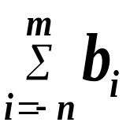
Fractional Binary Numbers
Bits to right of “binary point” represent fractional powers of 2
Represents rational number: 2^{i}

Slide 6
Fractional Numbers to Binary Bits
unsigned result_bits=0, current_bit=0x80000000
for (i=0;i<32;i++) {
x *= 2
if ( x>= 1 ) {
result_bits |= current_bit ;
if ( x == 1)
break ;
x -= 1 ;
}
current_bit >> 1 ;
}

Slide 7
Fraction Binary Number Examples
Value Binary Fraction
0.2 0.00110011[0011]
Observations:
  The form 0.11111…11 represent numbers just below 1.0 which is noted as 1.0-ε
  Binary Fractions can only exactly represent x/2^{k}
  Others have repeated bit patterns

Slide 8

Encoding Rational Numbers
Until 1980s
  Many idiosyncratic formats, fast speed, easy implementation, less accuracy
IEEE 754
  Designed by W. Kahan for Intel processors (Turing Award 1989)
  Based on a small and consistent set of principles, elegant, understandable, hard to make go fast

Slide 9
IEEE Floating-Point Representation
Numeric form
  V=(-1)^{s}×M × 2E
    Sign bit s determines whether number is negative or positive
    Significand M normally a fractional value in range [1.0,2.0).
    Exponent E weights value by power of two

Slide 10
IEEE Floating-Point Representation
Encoding
  s is sign bit
  exp field encodes E
  frac field encodes M
Sizes
  Single precision (32 bits): 8 exp bits, 23 frac bits
  Double precision (64 bits): 11 exp bits, 52 frac bits
s
exp
frac

Slide 11
Normalize Values
Condition
  exp ≠ 000…0 and exp ≠ 111…1
Exponent coded as biased value
  E = Exp – Bias
    Exp : unsigned value denoted by exp
    Bias : Bias value
      Single precision: 127 (Exp: 1…254, E : -126…127)
      Double precision: 1023 (Exp: 1…2046, E : -1022 …1023)
      In general: Bias = 2^{m-1} - 1, where m is the number of exponent bits

Slide 12
Normalize Values
Significand coded with implied leading 1
  m = 1.xxx…x₂
    xxx…x: bits of frac
    Minimum when 000…0 (M = 1.0)
    Maximum when 111…1 (M = 2.0 – ε)
    Get extra leading bit for “free”

Slide 13
Normalized Encoding Examples
Value: 12345 (Hex: 0x3039)
Binary bits: 11000000111001
Fraction representation: 1.1000000111001*2¹³
M: 10000001110010000000000
E: 10001100 (140)
Binary Encoding
  0100 0110 0100 0000 1110 0100 0000 0000
  4640E400

Slide 14
Denormalized Values
Condition
  exp = 000…0
Values
  Exponent Value: E = 1 – Bias
  Significant Value m = 0.xxx…x₂
    xxx…x: bits of frac

Slide 15
Denormalized Values
Cases
  exp = 000…0, frac = 000…0
    Represents value 0
    Note that have distinct values +0 and –0
  exp = 000…0, frac ≠ 000…0
    Numbers very close to 0.0
    Lose precision as get smaller
    “Gradual underflow”

Slide 16
Special Values
Condition
  exp = 111…1

Slide 17
Special Values
exp = 111…1, frac = 000…0
  Represents value ∞ (infinity)
  Operation that overflows
  Both positive and negative
  E.g., 1.0/0.0 = −1.0/−0.0 = +∞, 1.0/−0.0 = −∞

Slide 18
Special Values
exp = 111…1, frac ≠ 000…0
  Not-a-Number (NaN)
  Represents case when no numeric value can be determined
  E.g., sqrt(–1), ∞ − ∞

Slide 19
Summary of Real Number Encodings
−∞
+∞
-Normalized
-Denorm
+Denorm
+Normalized
NaN
−0
+0
NaN

Slide 20
8-bit Floating-Point Representations
7
6
3
2
0
s
exp
frac

Slide 21
8-bit Floating-Point Representations
Exp exp E 2E
0 0000 -6 1/64 (denorms)
1 0001 -6 1/64
2 0010 -5 1/32
3 0011 -4 1/16
4 0100 -3 1/8
5 0101 -2 1/4
6 0110 -1 1/2
7 0111 0 1
8 1000 +1 2
9 1001 +2 4
10 1010 +3 8
11 1011 +4 16
12 1100 +5 32
13 1101 +6 64
14 1110 +7 128
15 1111 n/a (inf, NaN)

Slide 22
Dynamic Range (Denormalized numbers)
s exp frac E Value
0 0000 000 -6 0
0 0000 001 -6 1/8*1/64 = 1/512
0 0000 010 -6 2/8*1/64 = 2/512
…
0 0000 110 -6 6/8*1/64 = 6/512
0 0000 111 -6 7/8*1/64 = 7/512

Slide 23
Dynamic Range
s exp frac E Value
0 0001 000 -6 8/8*1/64 = 8/512
0 0001 001 -6 9/8*1/64 = 9/512
…
0 0110 110 -1 14/8*1/2 = 14/16
0 0110 111 -1 15/8*1/2 = 15/16
0 0111 000 0 8/8*1 = 1
0 0111 001 0 9/8*1 = 9/8

Slide 24
Dynamic Range (Denormalized numbers)
s exp frac E Value
0 0111 010 0 10/8*1 = 10/8
…
0 1110 110 7 14/8*128 = 224
0 1110 111 7 15/8*128 = 240
0 1111 000 n/a inf

Slide 25
Distribution of Representable Values
6-bit IEEE-like format
  K = 3 exponent bits
  n = 2 significand bits
  Bias is 3
Notice how the distribution gets denser toward zero.

Slide 26
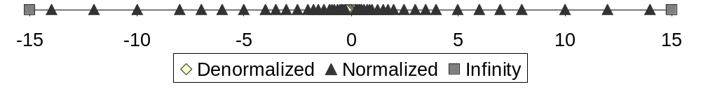
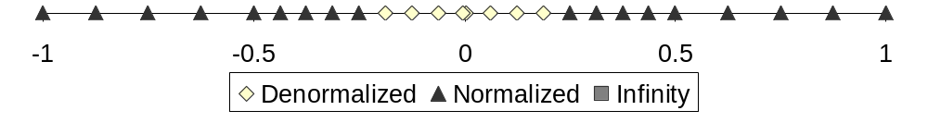
Distribution of Representable Values

Slide 27
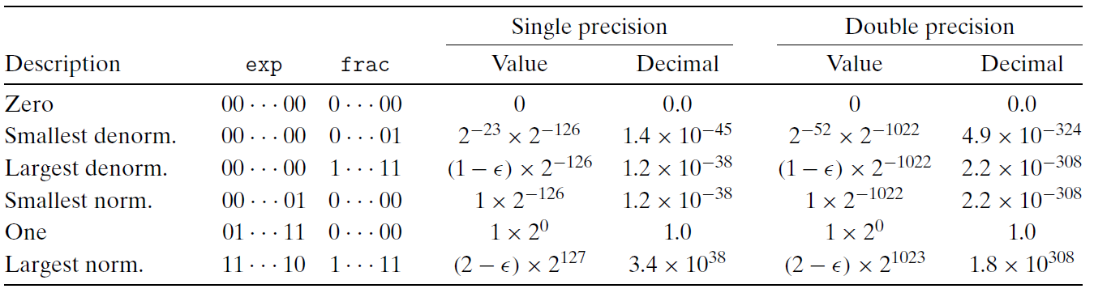
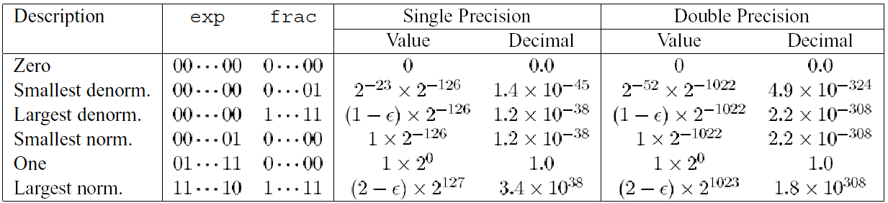
Interesting Numbers

Slide 28
Rounding Mode
Round down:
  rounded result is close to but no greater than true result.
Round up:
  rounded result is close to but no less than true result.

Slide 29
Rounding Mode
Mode | 1.40 | 1.60 | 1.50 | 2.50 | -1.50
Round-to-Even | 1 | 2 | 2 | 2 | -2
Round-toward-zero | 1 | 1 | 1 | 2 | -1
Round-down | 1 | 1 | 1 | 2 | -2
Round-up | 2 | 2 | 2 | 3 | -1

Slide 30
Round-to-Even
Default Rounding Mode
  Hard to get any other kind without dropping into assembly
  All others are statistically biased
    Sum of set of positive numbers will consistently be over- or under- estimated

Slide 31
Round-to-Even
Applying to Other Decimal Places
  When exactly halfway between two possible values
    Round so that least significant digit is even
  E.g., round to nearest hundredth
    1.2349999 1.23 (Less than half way)
    1.2350001 1.24 (Greater than half way)
    1.2350000 1.24 (Half way—round up)
    1.2450000 1.24 (Half way—round down)

Slide 32
Rounding Binary Number
“Even” when least significant bit is 0
Half way when bits to right of rounding position = 100…₂
Value | Binary | Rounded | Action | Round Decimal
2 3/32 | 10.00011 | 10.00 | Down | 2
2 3/16 | 10.0011 | 10.01 | Up | 2 1/4
2 7/8 | 10.111 | 11.00 | Up | 3
2 5/8 | 10.101 | 10.10 | Down | 2 1/2

Slide 33
Floating-Point Operations
Conceptual View
  First compute exact result
  Make it fit into desired precision
    Possibly overflow if exponent too large
    Possibly round to fit into frac

Slide 34
FP Multiplication
Operands
  (–1)^{s1} M1 2^{E1}
  (–1)^{s2} M2 2^{E2}
Exact Result
  (–1)^{s} M 2E
  Sign s : s1 ^ s2
  Significand M : M1 * M2
  Exponent E : E1 + E2

Slide 35
FP Multiplication
Fixing
  If M ≥ 2, shift M right, increment E
  If E out of range, overflow
  Round M to fit frac precision

Slide 36
FP Addition
Operands
  (–1)^{s1} M1 2^{E1}
  (–1)^{s2} M2 2^{E2}
  Assume E1 > E2
Exact Result
  (–1)^{s} M 2E
  Sign s, significand M:
    Result of signed align & add
  Exponent E : E1

Slide 37
FP Addition
E1–E2
  (–1)^{s1} m1
+
  (–1)^{s2} m2
  (–1)^{s} m

Slide 38
FP Addition
Fixing
  If M ≥ 2, shift M right, increment E
  if M < 1, shift M left k positions, decrement E by k
  Overflow if E out of range
  Round M to fit frac precision

Slide 39
Floating Point in C
C Guarantees Two Levels
  float single precision
  double double precision

Slide 40
Floating Point Puzzles
int x = …;
float f = …;
double d = …;
Assume neither d nor f is NAN or infinity

Slide 41
Floating Point Puzzles
x == (int)(float) x
x == (int)(double) x
f == (float)(double) f
d == (float) d
f == -(-f);
2/3 == 2/3.0
d < 0.0⇒ ((d*2) < 0.0)
d > f ⇒ -f < -d
d *d >= 0.0
(d+f)-d == f

Slide 42
Answers to Floating Point Puzzles
x == (int)(float) x No: 24 bit significand
x == (int)(double) x Yes: 53 bit significand
f == (float)(double) f Yes: increases precision
d == (float) d No: loses precision
f == -(-f); Yes: Just change sign bit
2/3 == 2/3.0 No: 2/3 == 0
d < 0.0⇒ ((d*2) < 0.0) Yes!
d > f ⇒ -f < -d Yes
d *d >= 0.0 Yes!
(d+f)-d == f No: Not associative

Slide 43
Answers to Floating Point Puzzles
Conversions
  Casting between int, float, and double changes numeric values
  Double or float to int
    Truncates fractional part
    Like rounding toward zero
    Not defined when out of range
      Generally saturates to TMin or TMax
  int to double
    Exact conversion, as long as int has ≤ 53 bit word size
  int to float
    Will round according to rounding mode

Slide 44
Disastrous effects on floating Point (I)
The imprecision of floating-point arithmetic
On February 25, 1991, during the first Gulf War, an American Patriot Missile battery in Dharan, Saudi Arabia, failed to intercept an incoming Iraqi Scud missile. The Scud struck an American Army barracks and killed 28 soldiers.
The Patriot system contains an internal clock, implemented as a counter that is incremented every 0.1 seconds. To determine the time in seconds, the program would multiply the value of this counter by a 24-bit quantity that was a fractional binary approximation to 1/10 .

Slide 45


Disastrous effects on floating Point (I)
The program approximated 0.1, as a value x=0.00011001100110011001100
0.1-x = 0.00000000000000000000000[1100][1100]…2
0.1-x= =
After starting 100 hrs, there are 0.343s difference
Scud travels at around 2000 m/s, 686 meters far off
Software upgrade not completed, sometimes using accurate timing, reading inaccurate timing otherwise

Slide 46
Disastrous effects on floating Point (II)
The maiden voyage of the Ariane 5 rocket, on June 4, 1996.
Just 37 seconds after liftoff, the rocket veered off its flight path, broke up, and exploded.
An overflow had occurred during the conversion of a 64-bit floating-point number to a 16-bit signed integer
The value that overflowed measured the horizontal velocity of the rocket.
In the Ariane 4, the horizontal velocity would never overflow a 16-bit number. Ariane 5 just reuses the same software with 5 times higher velocity.

Slide 47
