Slide 1
Manipulating Information

Slide 2
Outline
Bit-level operations
Suggested reading
  2.1.6~2.1.9

Slide 3
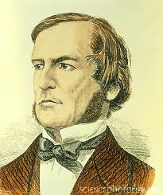

Boolean Algebra
Developed by George Boole(1815-1864)
  Algebraic representation of logic
    Encode “True” as 1
    Encode “False” as 0
Claude Shannon(1916–2001)founded the information theory
  made the connection between Boolean algebra and digital logic
Plays a central role in the design and analysis of digital systems

Slide 4
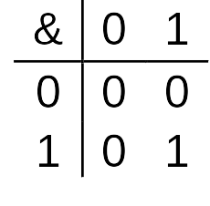
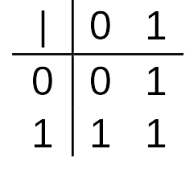
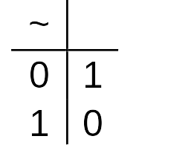
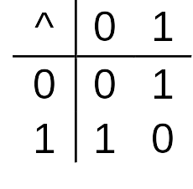
Boolean Algebra
And
  A&B = 1 when both A=1 and B=1
Or
  A|B = 1 when either A=1 or B=1
Not
  ~A = 1 when A=0
Exclusive-Or (Xor)
  A^B = 1 when either A=1 or B=1, but not both

Slide 5
General Boolean Algebras
Operate on Bit Vectors
  Operations applied bitwise
01101001
& 01010101
01000001
01101001
| 01010101
01111101
01101001
^ 01010101
00111100
~ 01010101
10101010

Slide 6
General Boolean Algebras
Representation of Sets
  Width w bit vector represents subsets of {0, …, w–1}
  a_{j} = 1 if j ∈ A
    01101001 { 0, 3, 5, 6 }
    01010101 { 0, 2, 4, 6 }
  & Intersection 01000001 { 0, 6 }
  | Union 01111101 { 0, 2, 3, 4, 5, 6 }
  ^ Symmetric difference 00111100 { 2, 3, 4, 5 }
  ~Complement 10101010 { 1, 3, 5, 7 }

Slide 7
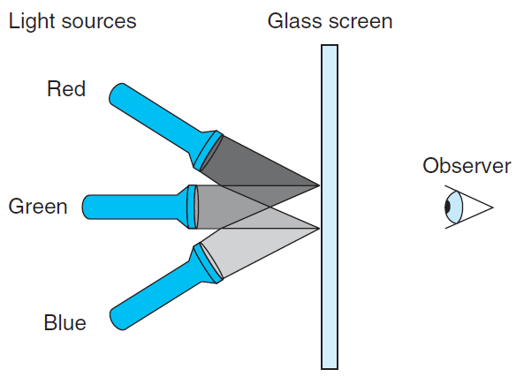
RGB Color Model

Slide 8
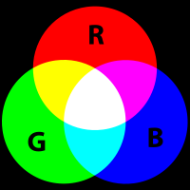
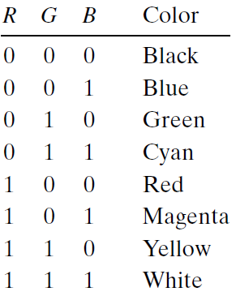
RGB Color Model
Magenta
Cyan

Slide 9
RGB Color Model
What would be the complement of each of the eight colors listed above?
  The complement of a color is formed by
    turning off the lights that are on and
    turning on the lights that are off
Describe the effect of applying Boolean operations on the following colors:
  Blue | Green =
  Yellow & Cyan =
  Red ^ Magenta =

Slide 10
Bit-Level Operations in C
Operations &, |, ~, ^ Available in C
  Apply to any “integral” data type
    long, int, short, char
  View arguments as bit vectors
  Arguments applied bit-wise

Slide 11
Bit-Level Operations in C
~0x41 | 0xBE
~0x00 | 0xFF
0x69 & 0x55 | 0X41
0x69 | 0x55 | 0x7D
~0100 0001
1011 1110
~0000 0000
1111 1111
0110 1001 & 0101 0101
0100 0001
0110 1001 | 0101 0101
0111 1101

Slide 12
Cool Stuff with Xor
Bitwise Xor is form of addition
With extra property that every value is its own additive inverse
  A ^ A = 0

Slide 13
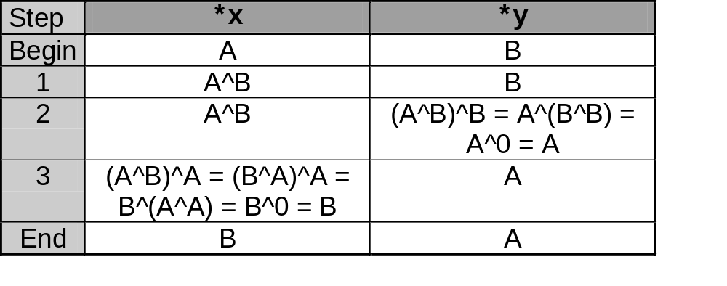
Cool Stuff with Xor
int inplace_swap(int *x, int *y)
{
*x = *x ^ *y; /* #1 */
*y = *x ^ *y; /* #2 */
*x = *x ^ *y; /* #3 */
}

Slide 14
Cool Stuff with Xor
1 void reverse_array(int a[], int cnt) {
2 int first, last;
3 for (first = 0, last = cnt-1;
4 first <= last;
5 first++,last--)
6 inplace_swap(&a[first], &a[last]);
7 }

Slide 15
Mask Operations
Bit pattern
  0xFF
    Having 1s for the least significant eight bits
    Indicates the lower-order byte of a word
Mask Operation
  X = 0x89ABCDEF
  X & 0xFF =?
Bit Pattern ~0
  Why not 0xFFFFFFFF?

Slide 16
Mask Operations
Write C expressions that work for any word size w ≥ 8
For x = 0x87654321, with w = 32
The least significant byte of x, with all other bits set to 0
  [0x00000021]
x & 0xFF

Slide 17
Mask Operations
All but the least significant byte of complemented, with the least significant byte left unchanged
  [0x789ABC21]
The least significant byte set to all 1s, and all other bytes of x left unchanged.
  [0x876543FF].
x ^ ~0xFF
x | ~0xFF

Slide 18
Bis & Bic
Set result z to x and modify it
z = bis (int x, int m) (bit set)
  Set result z to 1 at each bit position where m is 1
z = bic(int x, int m) (bit clear)
  set result z to 0 at each bit position where m is 1
The Digital Equipment VAX
Use bis anf bic to implement
  Or(int x, int y)
  Xor(int x, int y)
bis(x, y)
bis(bic(x, y), bic(y,x))

Slide 19
Logical Operations in C
Logical Operators
  &&, ||, !
    View 0 as “False”
    Anything nonzero as “True”
    Always return 0 or 1
    Early termination (short cut)

Slide 20
Logical Operations in C
Examples (char data type)
  !0x41 --> 0x00
  !0x00 --> 0x01
  !!0x41 --> 0x01
  0x69 && 0x55 --> 0x01
  0x69 || 0x55 --> 0x01

Slide 21
Short Cut in Logical Operations
a && 5/a
  If a is zero, the evaluation of 5/a is stopped
  avoid division by zero
p && *p
  Never cause the dereferencing of a null pointer
Using only bit-level and logical operations
  Implement x == y
  it returns 1 when x and y are equal, and 0 otherwise
  !(x^y)

Slide 22
Shift Operations in C
Left Shift: x << y
  Shift bit-vector x left y positions
    Throw away extra bits on left
    Fill with 0’s on right
Argument x
01100010
<< 3
00010000
Argument x
10100010
<< 3
00010000

Slide 23
Shift Operations in C
Right Shift: x >> y
  Shift bit-vector x right y positions
    Throw away extra bits on right
  Logical shift
    Fill with 0’s on left
  Arithmetic shift
    Replicate most significant bit on right
    Useful with two’s complement integer representation (especially for the negative number )
Argument x
01100010
Log. >> 2
00011000
Arith. >> 2
00011000
Argument x
10100010
Log. >> 2
00101000
Arith. >> 2
11101000

Slide 24
Shift Operations in C
What happens ?
  int lval = 0xFEDCBA98 << 32;
  int aval = 0xFEDCBA98 >> 36;
  unsigned uval = 0xFEDCBA98u >> 40;
It may be
  lval 0xFEDCBA98 (0)
  aval 0xFFEDCBA9 (4)
  uval 0x00FEDCBA (8)
Be careful about
  1<<2 + 3<<4 means 1<<(2 + 3)<<4

Slide 25
bitCount
Returns number of 1's a in word
Examples: bitCount(5) = 2, bitCount(7) = 3
Legal ops: ! ~ & ^ | + << >>
Max ops: 40

Slide 26
Sum 8 groups of 4 bits each
int bitCount(int x) {
int m1 = 0x11 | (0x11 << 8);
int mask = m1 | (m1 << 16);
int s = x & mask;
s += x>>1 & mask;
s += x>>2 & mask;
s += x>>3 & mask;

Slide 27
Combine the sums
/* Now combine high and low order sums */
s = s + (s >> 16);
/* Low order 16 bits now consists of 4 sums.
Split into two groups and sum */
mask = 0xF | (0xF << 8);
s = (s & mask) + ((s >> 4) & mask);
return (s + (s>>8)) & 0x3F;
}

Slide 28
Information Storage

Slide 29
Outline
Pointers and word size
Byte ordering
Suggested reading
  The first paragraph of 2.1
  2.1.2, 2.1.3, 2.1.4, 2.1.5
  1.7.3

Slide 30
Outline
Pointers and word size
Byte ordering

Slide 31
Computer Hardware - Von Neumann Architecture
Instructions / Program
Main
Memory
Arithmetic
Unit
Control
Unit
PC
AC
IR
SR
Addresses
Input/Output
Unit
E.g. Storage

Slide 32
Storage
The system component that remembers data values for use in computation
A wide-ranging technology
  RAM chip
  Flash memory
  Magnetic disk
  CD
Abstract model
  READ and WRITE operations

Slide 33
READ/WRITE operations
Tow important concepts
  Name and value
WRITE(name, value) value ← READ(name)
WRITE operation specifies
  a value to be remembered
  a name by which one can recall that value in the future
READ operation specifies
  the name of some previous remembered value
  the memory device returns that value

Slide 34
Memory
Bytes
Addr.
One kind of storage device
  Value has only fixed size (usually byte)
  Name belongs to a set consisting of consecutive integers started from 0
    The integer number is called address
    The set is called address space
0000
0001
0002
0003
0004
0005
0006
0007
0008
0009
0010
0011
0012
0013
0014

Slide 35
Word Size
A virtual address is encoded by
  a word with fixed size
Word size indicates the size of such kind of the word
  Which defines the maximum size of the virtual address space
  the most important system parameter determined by the word size

Slide 36
Word Size
For machine with n-bit word size
  Virtual address can range from 0 to 2^{n}-1
Most current machines are 64 bits (8 bytes)
  Potentially address ≈ 1.8 X 10¹⁹ bytes
Most current machines also support 32 bits (4 bytes)
  Limits addresses to 4GB
  Becoming too small for memory-intensive applications

Slide 37
Data Size
Machines support multiple data formats
  Always integral number of bytes

Slide 38
Data Size
C Declaration |  | Bytes
Signed | Unsigned | 32-bit | 64-bit
char | unsigned char | 1 | 1
short | unsigned short | 2 | 2
int | unsigned | 4 | 4
long | unsigned long | 4 | 8
int32_t | uint_32 | 4 | 4
int64_t | uint_64 | 8 | 8
char * |  | 4 | 8
float |  | 4 | 4
double |  | 8 | 8
Notes:
W 87

Slide 39
intN_t and uintN_t
Another class of integer types
  specifying N-bit signed and unsigned integers
  Introduced by the ISO C99 standard
  In the file stdint.h.
Typical values
  int8_t, int16_t, int32_t, int64_t
  unit8_t, uint16_t, uint32_t, uint64_t
  N are implementation dependent

Slide 40
Data Size Related Bugs
Difficulty to make programs portable across different machines and compilers
  The program is sensitive to the exact sizes of the different data types
  The C standard sets lower bounds on the numeric ranges of the different data types
  but there are no upper bounds

Slide 41
Data Size Related Bugs
32-bit machines have been the standard from 1990s to 2010s
Many programs have been written
  assuming the allocations listed as “32-bit” in the table
With the increasing of 64-bit machines
  many hidden word size dependencies show up as
    bugs in migrating these programs to new machines

Slide 42
Example
At the time 32-bit dominated, many programmers assumed that
  a program object declared as type int can be used to store a pointer
This works fine for most 32-bit machines
But leads to problems on an 64-bit machine

Slide 43
Address issues
IBM S/360: 24-bit address
PDP-11: 16-bit address
Intel 8086: 16-bit address
X86 (80386): 32-bit address
X86 32/64: 32/64-bit address

Slide 44
64-bit data models
Processors
4-bit | 8-bit | 12-bit | 16-bit | 18-bit | 24-bit | 31-bit | 32-bit | 36-bit | 48-bit | 64-bit | 128-bit
Applications
 |  |  | 16-bit |  |  |  | 32-bit |  |  | 64-bit
Data Sizes
nibble octet byte word dword qword

Slide 45
64-bit data models
Data model | short | int | long | long long | pointers | Sample operating systems
LLP64 | 16 | 32 | 32 | 64 | 64 | Microsoft Win64 (X64/IA64)
LP64 | 16 | 32 | 64 | 64 | 64 | Most Unix and Unix-like systems (Solaris, Linux, etc.)
ILP64 | 16 | 64 | 64 | 64 | 64 | HAL(Fujitsu subsidiary)
SILP64 | 64 | 64 | 64 | 64 | 64 | ?

Slide 46
Outline
Pointers and word size
Byte ordering

Slide 47
Virtual Memory
The memory introduced in previous slides
  is only an conceptual object and
  does not exist actually
It provides the program with what appears to be a monolithic byte array
It is a conceptual image presented to the machine-level program

Slide 48
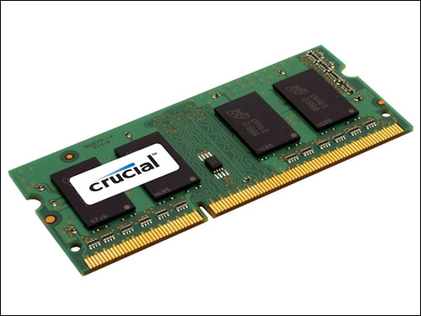
Virtual Memory
The actual implementation uses a combination of
  Hardware
  Software
Hardware
  random-access memory (RAM) (physical)
  disk storage (physical)
  special hardware (performing the abstraction )
Software
  and operating system software (abstraction)

Slide 49
Way to the Abstraction
Taking something physical and abstract it logical
Virtual memory
WRITE
(vadd value)
Operating
System
Special
hardware
RAM
Chips
Disk
storage
WRITE
(padd value)
READ(vadd)
READ(padd)
Abstraction
layer
Physical
layer

Slide 50
Subdivide Virtual Memory into More Manageable Units
One task of
  a compiler and
  the run-time system
To store the different program objects
  Program data
  Instructions
  Control information

Slide 51
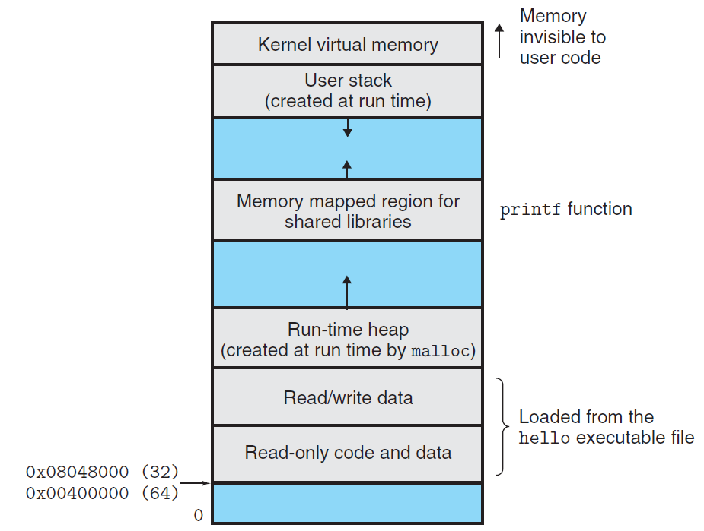

Slide 52
Byte Ordering
How should a large object be stored in memory?
For program objects that span multiple bytes
  What will be the address of the object?
  How will we order the bytes in memory?
A multi-byte object is stored as
  a contiguous sequence of bytes
  with the address of the object given by the smallest address of the bytes used

Slide 53
Byte Ordering
Little Endian
  Least significant byte has lowest address
  Intel
Big Endian
  Least significant byte has highest address
  Sun, IBM
Bi-Endian
  Machines can be configured to operate as either little- or big-endian
  Many recent microprocessors

Slide 54
Big Endian (0x1234567)
0x100
0x101
0x102
0x103
01
23
45
67

Slide 55
Little Endian (0x1234567)
0x100
0x101
0x102
0x103
67
45
23
01

Slide 56
How to Access an Object
The actual machine-level program generated by C compiler
  simply treats each program object as a block of bytes
The value of a pointer in C
  is the virtual address of the first byte of the above block of storage

Slide 57
How to Access an Object
The C compiler
  Associates type information with each pointer
  Generates different machine-level code to access the pointed value
    stored at the location designated by the pointer depending on the type of that value
The actual machine-level program generated by C compiler
  has no information about data types

Slide 58
Code to Print Byte Representation
typedef unsigned char *byte_pointer;
void show_bytes(byte_pointer start, int len)
{
int i;
for (i = 0; i < len; i++)
printf("0x%p\t0x%.2x\n",
start+i, start[i]);
printf("\n");
}

Slide 59
Code to Print Byte Representation
void show_int(int x) {
show_bytes((byte_pointer) &x, sizeof(int));
}
void show_float(float x) {
show_bytes((byte_pointer) &x, sizeof(float));
}
void show_pointer(void *x) {
show_bytes((byte_pointer) &x, sizeof(void *));
}

Slide 60
Features in C
typedef
  Giving a name of type
  Syntax is exactly like that of declaring a variable
printf
  Format string: %d, %c, %x, %f, %p
sizeof
  sizeof(T) returns the number of bytes required to store an object of type T
  One step toward writing code that is portable across different machine types

Slide 61
Features in C
Pointers and arrays
  start is declared as a pointer
  It is referenced as an array start[i]
Pointer creation and dereferencing
  Address of operator &
  &x
Type casting
  (byte_pointer) &x

Slide 62
Code to Print Byte Representation
void test_show_bytes(int val) {
int ival = val;
float fval = (float) ival;
int *pval = &ival;
show_int(ival);
show_float(fval);
show_pointer(pval);
}

Slide 63
Example
Linux 32: Intel IA32 processor running Linux
Windows: Intel IA32 processor running Windows
Sun: Sun Microsystems SPARC processor running Solaris
Linux 64: Intel x86-64 processor running Linux
With argument 12345 which is 0x3039

Slide 64
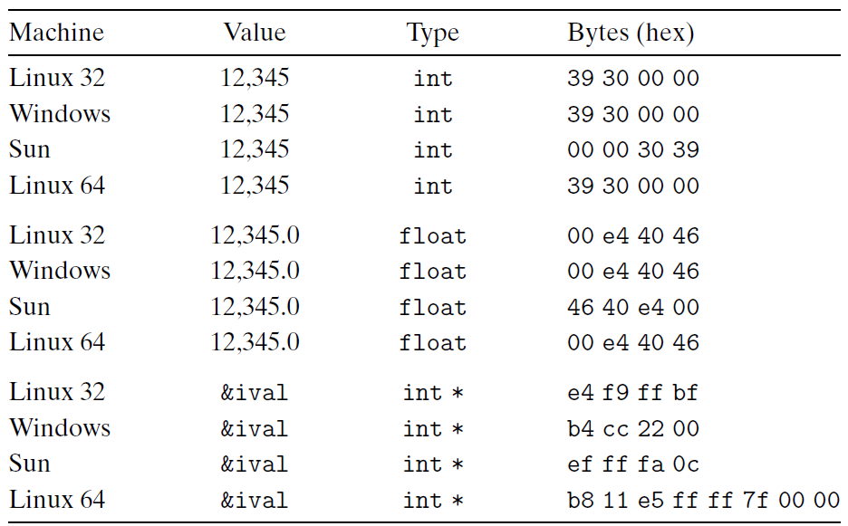
Example
Linux 32: Intel IA32 processor running Linux
Windows: Intel IA32 processor running Windows
Sun: Sun Microsystems SPARC processor running Solaris
Linux 64: Intel x86-64 processor running Linux

Slide 65
Representing Codes
int sum(int x, int y) {
return x + y;
}
Linux 32: 55 89 e5 8b 45 0c 03 45 08 c9 c3
Windows: 55 89 e5 8b 45 0c 03 45 08 5d c3
Sun: 81 c3 e0 08 90 02 00 09
Linux 64: 55 48 89 e5 89 7d fc 89 75 f8 03 45 fc c9 c3

Slide 66
Byte Ordering Becomes Visible
Circumvent the normal type system
  Casting
  Reference an object according to a different data type from which it was created
  Strongly discouraged for most application programming
  Quite useful and even necessary for system-level programming
Disassembler
  80483bd: 01 05 64 94 04 08->add %eax, 0x8049464
Communicate between different machines

Slide 67
Representing Strings
Strings in C
  Represented by array of characters
  Each character encoded in ASCII format
  String should be null-terminated Final character = 0
  \a \b \f \n \r \t \v
  \\ \? \’ \” \000 \xhh
char S[6] = "12345";
Linux S
Sun S
31
31
32
32
33
33
34
34
35
35
00
00

Slide 68
Representing Strings
Compatibility
  Byte ordering not an issue
    Data are single byte quantities
  Text files generally platform independent
    Except for different conventions of line termination character!
char S[6] = "12345";
Linux S
Sun S
31
31
32
32
33
33
34
34
35
35
00
00

Slide 69
Representing Strings
  /* strlen: return length of string s */
  int strlen(char *s)
  {
  char *p = s ;
  while (*p != ‘\0’)
  p++ ;
  return p-s ;
  }
  <string.h>

Slide 70
Representing Strings
  /* trim: remove trailing blanks, tabs, newlines */
  int trim(char s[])
  {
  int n;
  for (n = strlen(s)-1; n >= 0; n--)
  if ( s[n] != ‘ ‘ && s[n] != ‘\t’ && s[n] != ‘\n’)
  break;
  s[n+1] = ‘\0’;
  return n
  }

