Slide 1
Memory Hierarchy (Ⅲ)

Slide 2
Outline
Cache memory
Direct mapping caches
Set associative caches
Fully associative caches
Suggested Reading: 6.4

Slide 3
Outline
Cache memory
Direct mapping caches
Set associative caches
Fully associative caches

Slide 4
Cache Memory
CPU looks first for data in L1, then in L2, then in main memory
  Hold frequently accessed blocks of main memory in caches
CPU chip
register file
ALU
Cache
memory
system bus
memory bus
main
memory
bus interface
I/O
bridge

Slide 5
Inserting an L1 cache between the CPU and main memory
The tiny, very fast CPU register file
has room for four 8-byte words.
The transfer unit between
the CPU register file and
the cache is a 8-byte block.
line 0
The small fast L1 cache has room
for two 16-word blocks.
line 1
The transfer unit between
the cache and main
memory is a 16-word block
(64 bytes).
block 10
a b c d
...
The big slow main memory
has room for many 16-word
blocks.
block 21
p q r s
...
block 30
w x y z
...

Slide 6
Memory Accessing
For a memory accessing instruction
  movq A %rax
Access cache by A directly
If cache hit
  get the value from the cache
Otherwise,
  cache miss handling
  get the value

Slide 7
Generic Cache Memory Organization
Cache is an array
of sets.
Each set contains
one or more lines.
Each line holds a
block of data.
1 valid bit
per line
t tag bits
per line
B = 2^{b} bytes
per cache block
valid
tag
0
1
• • •
B–1
E lines
per set
set 0:
• • •
valid
tag
0
1
• • •
B–1
valid
tag
0
1
• • •
B–1
set 1:
• • •
S = 2^{s} sets
valid
tag
0
1
• • •
B–1
• • •
valid
tag
0
1
• • •
B–1
set S-1:
• • •
valid
tag
0
1
• • •
B–1

Slide 8
Cache Memory
Fundamental parameters
Parameters | Descriptions
S = 2^{s} E B=2^{b} m=log₂(M) | Number of sets Number of lines per set Block size(bytes) Number of physical(main memory) address bits

Slide 9
Cache Memory
Derived quantities
Parameters | Descriptions
M=2^{m} s=log2(S) b=log2(B) t=m-(s+b) C=B×E×S | Maximum number of unique memory address Number of set index bits Number of block offset bits Number of tag bits Cache size (bytes) not including overhead such as the valid and tag bits

Slide 10
Addressing caches
Physical Address A:
m-1
0
Split into 3 parts:
t bits
s bits
b bits
m-1
0
<tag>
<set index>
<block offset>

Slide 11
Outline
Cache memory
Direct mapping caches
Set associative caches
Fully associative caches

Slide 12
Direct-mapped cache
Simplest kind of cache
Characterized by exactly one line per set.
set 0:
valid
tag
cache block
E=1 lines per set
set 1:
valid
tag
cache block
• • •
set S-1:
valid
tag
cache block

Slide 13
Accessing Direct-Mapped Caches
Three steps
  Set selection
  Line matching
  Word extraction

Slide 14
Set selection
Use the set index bits to determine the set of interest
set 0:
valid
tag
cache block
selected set
set 1:
valid
tag
cache block
• • •
t bits
s bits
b bits
set S-1:
valid
tag
cache block
0 0 0 0 1
m-1
0
tag
set
index
block
offset

Slide 15
Line matching
Find a valid line in the selected set with a matching tag
=1?
(1) The valid bit must be set
0 1
2 3
4 5
6 7
8 9
10 11
12 13
14 15
selected set (i):
1
0110
(2) The tag bits in the cache line must match the tag bits in the address
= ?
t bits
s bits
b bits
0110
i
m-1
0
tag
set index
block offset

Slide 16
Word Extraction
0 1
2 3
4 5
6 7
8 9
10 11
12 13
14 15
selected set (i):
1
0110
W0
w7
block offset selects
starting byte
t bits
s bits
b bits
0110
i
100
m-1
0
tag
set index
block offset

Slide 17
Simple Memory System Cache
Cache
  16 lines
  4-byte line size
  Direct mapped
Tag
Index
Offset
11
10
9
8
7
6
5
4
3
2
1
0

Slide 18
Simple Memory System Cache
Idx | Tag | Valid | B0 | B1 | B2 | B3
0 | 19 | 1 | 99 | 11 | 23 | 11
1 | 15 | 0 | – | – | – | –
2 | 1B | 1 | 00 | 02 | 04 | 08
3 | 36 | 0 | – | – | – | –
4 | 32 | 1 | 43 | 6D | 8F | 09
5 | 0D | 1 | 36 | 72 | F0 | 1D
6 | 31 | 0 | – | – | – | –
7 | 16 | 1 | 11 | C2 | DF | 03

Slide 19
Simple Memory System Cache
Idx | Tag | Valid | B0 | B1 | B2 | B3
8 | 24 | 1 | 3A | 00 | 51 | 89
9 | 2D | 0 | – | – | – | –
A | 2D | 1 | 93 | 15 | DA | 3B
B | 0B | 0 | – | – | – | –
C | 12 | 0 | – | – | – | –
D | 16 | 1 | 04 | 96 | 34 | 15
E | 13 | 1 | 83 | 77 | 1B | D3
F | 14 | 0 | – | – | – | –

Slide 20
Address Translation Example
Address: 0x354
Tag
Index
Offset
11
10
9
8
7
6
5
4
3
2
1
0
0
0
1
1
0
1
0
1
0
1
0
0
  Offset: 0x0 Index: 0x05 Tag: 0x0D
  Hit? Yes Byte: 0x36

Slide 21
Line Replacement on Misses
Check the cache line of the set indicated by the set index bits
  If the cache line valid, it must be evicted
Retrieve the requested block from the next level
  How to get the block ?
Current line is replaced by the newly fetched line

Slide 22

Check the cache line
=1?
If valid bit is set, evict the line
0
1
2
3
4
5
6
7
selected set (i):
1
Tag

Slide 23
Get the Address of the Starting Byte
Consider memory address looks like the following
Clear the last bits and get the address A
m-1
0
xxx… … … xxx
<tag>
<set index>
<block offset>
m-1
0
000 … … …000
<tag>
<set index>
<block offset>

Slide 24
Read the Block from the Memory
Put A on the Bus (A is A’000)
CPU chip
register file
ALU
Cache
memory
system bus
memory bus
main memory
0
A
bus interface
I/O
bridge
x
A’

Slide 25
Read the Block from the Memory
Main memory reads A’ from the memory bus, retrieves 8 bytes x, and places it on the bus
CPU chip
register file
ALU
Cache
memory
system bus
memory bus
main memory
0
X
bus interface
I/O
bridge
x
A’

Slide 26

Read the Block from the Memory
CPU reads x from the bus and copies it into the cache line
CPU chip
register file
ALU
Cache
memory
system bus
memory bus
main memory
0
bus interface
I/O
bridge
x
A’

Slide 27

Read the Block from the Memory
Increase A’ by 1, and copy Y in A’+1 into the cache line.
CPU chip
register file
ALU
Cache
memory
system bus
memory bus
main memory
0
bus interface
I/O
bridge
Y
A’+1

Slide 28

Read the Block from the Memory
Repeat several times (4 or 8 )
CPU chip
register file
ALU
Cache
memory
system bus
memory bus
main memory
0
bus interface
I/O
bridge
W
A’+3

Slide 29
Cache line, set and block
Block
  A fixed-sized packet of information
    Moves back and forth between a cache and main memory (or a lower-level cache)
Line
  A container in a cache that stores
    A block, the valid bit, the tag bits
    Other information
Set
  A collection of one or more lines

Slide 30
Direct-mapped cache simulation
s=2
Example
M=16 byte addresses
B=2 bytes/block, S=4 sets, E=1 entry/set
t=1
b=1
x
xx
x
Address trace (reads):
0 [0000] 1 [0001] 13 [1101] 8 [1000] 0 [0000]
set
v
tag
data
0
0
1
0
2
0
3
0

Slide 31
Direct-mapped cache simulation
s=2
Example
M=16 byte addresses
B=2 bytes/block, S=4 sets, E=1 entry/set
t=1
b=1
x
xx
x
Address trace (reads):
0 [0000] 1 [0001] 13 [1101] 8 [1000] 0 [0000]
miss
(1)
0 [0000] (miss)
set
v
tag
data
0
1
0
m[0]m[1]
1
0
2
0
3
0

Slide 32
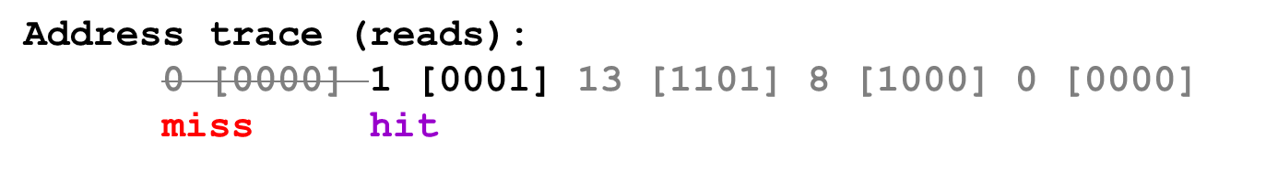
Direct-mapped cache simulation
s=2
Example
M=16 byte addresses
B=2 bytes/block, S=4 sets, E=1 entry/set
t=1
b=1
x
xx
x
(2)
1 [0001] (hit)
set
v
tag
data
0
1
0
m[0]m[1]
1
0
2
0
3
0

Slide 33
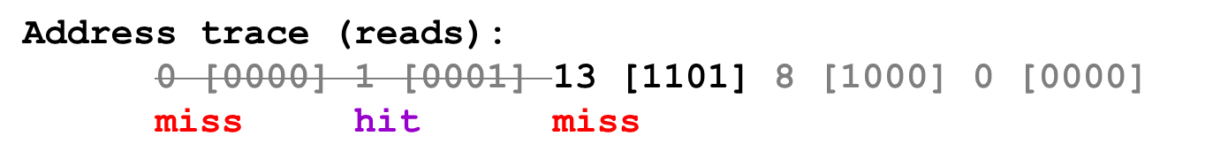
Direct-mapped cache simulation
s=2
Example
M=16 byte addresses
B=2 bytes/block, S=4 sets, E=1 entry/set
t=1
b=1
x
xx
x
(3)
13 [1101] (miss)
set
v
tag
data
0
1
0
m[0]m[1]
1
0
2
1
1
m[12]m[13]
3
0

Slide 34
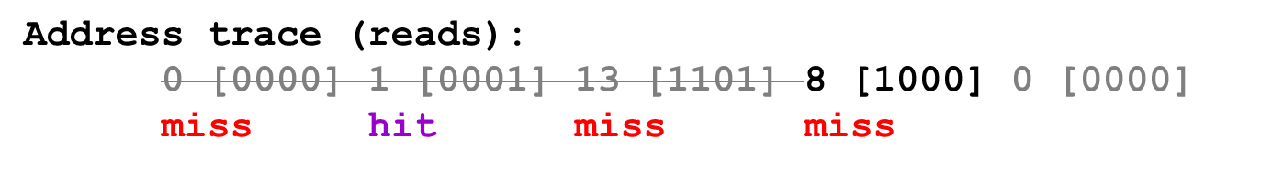
Direct-mapped cache simulation
s=2
Example
M=16 byte addresses
B=2 bytes/block, S=4 sets, E=1 entry/set
t=1
b=1
x
xx
x
(4)
8 [1000] (miss)
set
v
tag
data
0
1
1
m[8]m[9]
1
0
2
1
1
m[12]m[13]
3
0

Slide 35
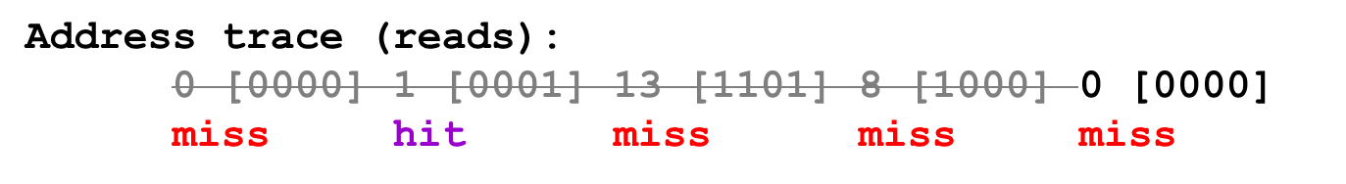
Direct-mapped cache simulation
s=2
Example
M=16 byte addresses
B=2 bytes/block, S=4 sets, E=1 entry/set
t=1
b=1
x
xx
x
(5)
0 [0000] (miss)
set
v
tag
data
0
1
0
m[0]m[1]
1
0
2
1
1
m[12]m[13]
3
0

Slide 36
Direct-mapped cache simulation
s=2
Example
M=16 byte addresses
B=2 bytes/block, S=4 sets, E=1 entry/set
t=1
b=1
x
xx
x
Address trace (reads):
0 [0000] 1 [0001] 13 [1101] 8 [1000] 0 [0000]
miss hit miss miss miss
(5)
0 [0000] (miss)
Thrashing!
set
v
tag
data
0
1
0
m[0]m[1]
1
0
2
1
1
m[12]m[13]
3
0

Slide 37
Conflict Misses in Direct-Mapped Caches
1 float dotprod(float x[8], float y[8])
2 {
3 float sum = 0.0;
4 int i;
5
6 for (i = 0; i < 8; i++)
7 sum += x[i] * y[i];
8 return sum;
9 }

Slide 38
Conflict Misses in Direct-Mapped Caches
Assumption for x and y
  x is loaded into the 32 bytes of contiguous memory starting at address 0
  y starts immediately after x at address 32
Assumption for the cache
  A block is 16 bytes
    big enough to hold four floats
  The cache consists of two sets
    A total cache size of 32 bytes

Slide 39
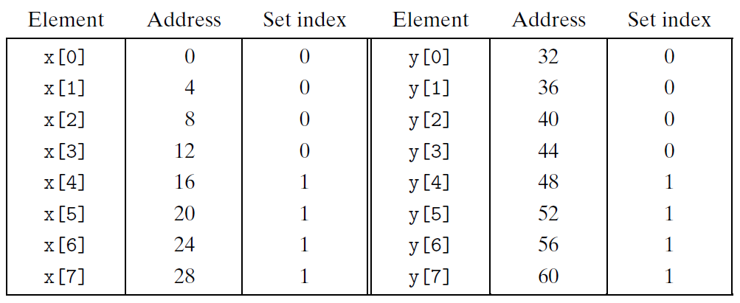
Conflict Misses in Direct-Mapped Caches
Trashing
  Read x[0] will load x[0] ~ x[3] into the cache
  Read y[0] will overload the cache line by y[0] ~ y[3]

Slide 40
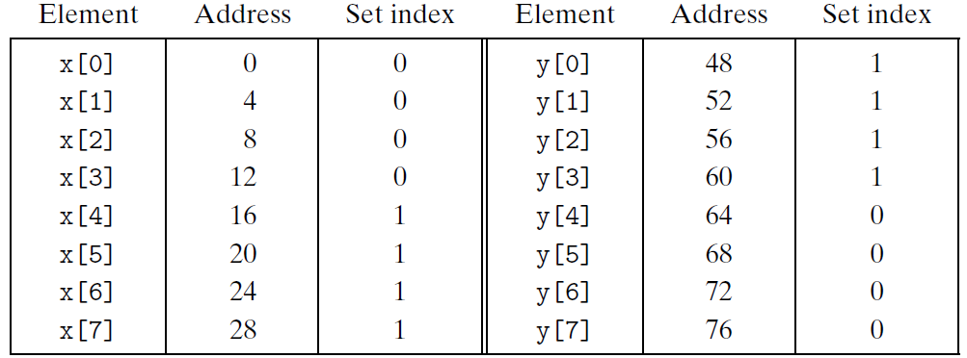
Conflict Misses in Direct-Mapped Caches
Padding can avoid thrashing
  Claim x[12] instead of x[8]

Slide 41
Direct-mapped cache simulation
 | Address bits
Address (decimal) | Tag bits (t=) | Index bits (s=2) | Offset bits (b=1) | Set number (decimal)
0 1 2 3 4 5 6 7 8 9 10 11 12 13 14 15 | 0 0 0 0 0 0 0 0 1 1 1 1 1 1 1 1 | 00 00 01 01 10 10 11 11 00 00 01 01 10 10 11 11 | 0 1 0 1 0 1 0 1 0 1 0 1 0 1 0 1 | 0 0 1 1 2 2 3 3 0 0 1 1 2 2 3 3

Slide 42
Why use middle bits as index?
Middle-Order
Bit Indexing
4-line Cache
00
0000
01
0001
10
0010
11
0011
0100
0101
0110
0111
1000
1001
1010
1011
1100
1101
1110
1111

Slide 43
Direct-mapped cache simulation
 | Address bits
Address (decimal) | Index bits (s=2) | Tag bits (t=1) | Offset bits (b=1) | Set number (decimal)
0 1 2 3 4 5 6 7 8 9 10 11 12 13 14 15 | 00 00 00 00 01 01 01 01 10 10 10 10 11 11 11 11 | 0 0 1 1 0 0 1 1 0 0 1 1 0 0 1 1 | 0 1 0 1 0 1 0 1 0 1 0 1 0 1 0 1 | 0 0 0 0 1 1 1 1 2 2 2 2 3 3 3 3

Slide 44
Why use middle bits as index?
High-Order
Bit Indexing
4-line Cache
00
0000
01
0001
10
0010
11
0011
0100
0101
0110
0111
1000
1001
1010
1011
1100
1101
1110
1111

Slide 45
Why use middle bits as index?
High-Order
Bit Indexing
Middle-Order
Bit Indexing
4-line Cache
00
0000
0000
01
0001
0001
10
0010
0010
11
0011
0011
0100
0100
0101
0101
0110
0110
0111
0111
1000
1000
1001
1001
1010
1010
1011
1011
1100
1100
1101
1101
1110
1110
1111
1111

Slide 46
Why use middle bits as index?
High-Order Bit Indexing
  Adjacent memory lines would map to same cache entry
  Poor use of spatial locality
Middle-Order Bit Indexing
  Consecutive memory lines map to different cache lines
  Can hold C-byte region of address space in cache at one time

Slide 47
Outline
Cache memory
Direct mapping caches
Set associative caches
Fully associative caches

Slide 48
Set associative caches
Characterized by more than one line per set
valid
tag
cache block
set 0:
E=2 lines per set
valid
tag
cache block
valid
tag
cache block
set 1:
valid
tag
cache block
• • •
valid
tag
cache block
set S-1:
valid
tag
cache block

Slide 49
Accessing set associative caches
Set selection
  identical to direct-mapped cache
valid
tag
cache block
set 0:
valid
tag
cache block
Selected set
valid
tag
cache block
set 1:
valid
tag
cache block
• • •
valid
tag
cache block
t bits
s bits
b bits
set S-1:
valid
tag
cache block
0 0 0 0 1
m-1
tag
set index
0
block offset

Slide 50
Accessing set associative caches
Line matching and word selection
  must compare the tag in each valid line in the selected set.
=1?
(1) The valid bit must be set.
0
1
2
3
4
5
6
7
1
1001
selected set (i):
1
0110
w₀
w₁
w₂
w₃
(2) The tag bits in one
of the cache lines must
match the tag bits in
the address
(3) If (1) and (2), then
cache hit, and
block offset selects
starting byte.
= ?
t bits
s bits
b bits
0110
i
100
m-1
tag
set index
0
block offset

Slide 51
Associative Cache
Cache
  16 lines
  4-byte line size
  2-way set associative
Tag
Index
Offset
11
10
9
8
7
6
5
4
3
2
1
0

Slide 52
Simple Memory System Cache
Idx | Tag | Valid | B0 | B1 | B2 | B3
0 | 19 | 1 | 99 | 11 | 23 | 11
0 | 15 | 0 | – | – | – | –
1 | 1B | 1 | 00 | 02 | 04 | 08
1 | 36 | 0 | – | – | – | –
2 | 32 | 1 | 43 | 6D | 8F | 09
2 | 0D | 1 | 36 | 72 | F0 | 1D
3 | 31 | 0 | – | – | – | –
3 | 16 | 1 | 11 | C2 | DF | 03

Slide 53
Simple Memory System Cache
Idx | Tag | Valid | B0 | B1 | B2 | B3
4 | 24 | 1 | 3A | 00 | 51 | 89
4 | 2D | 0 | – | – | – | –
5 | 2D | 1 | 93 | 15 | DA | 3B
5 | 0B | 0 | – | – | – | –
6 | 12 | 0 | – | – | – | –
6 | 16 | 1 | 04 | 96 | 34 | 15
7 | 13 | 1 | 83 | 77 | 1B | D3
7 | 14 | 0 | – | – | – | –

Slide 54
Address Translation Example
Address: 0x354
Tag
Index
Offset
11
10
9
8
7
6
5
4
3
2
1
0
0
0
1
1
0
1
0
1
0
1
0
0
  Offset: 0x0 Index: 0x05 Tag: 0x1A
  Hit? No

Slide 55
Set Associative Cache Simulation
s=1
Example
M=16 byte addresses
B=2 bytes/block, S=2 sets, E=2 entry/set
t=2
b=1
xx
x
x
Address trace (reads):
0 [0000] 1 [0001] 13 [1101] 8 [1000] 0 [0000]
set
v
tag
data
0
0
0
0
1
0
1
0

Slide 56
Set Associative Cache Simulation
s=1
Example
M=16 byte addresses
B=2 bytes/block, S=2 sets, E=2 entry/set
t=2
b=1
xx
x
x
Address trace (reads):
0 [0000] 1 [0001] 13 [1101] 8 [1000] 0 [0000]
miss
(1)
0 [0000] (miss)
v
tag
data
1
00
m[0]m[1]
0
0
0

Slide 57
Set Associative Cache Simulation
s=1
Example
M=16 byte addresses
B=2 bytes/block, S=2 sets, E=2 entry/set
t=2
b=1
xx
x
x
(2)
1 [0001] (hit)
set
v
tag
data
0
1
00
m[0]m[1]
0
0
1
0
1
0

Slide 58
Set Associative Cache Simulation
s=1
Example
M=16 byte addresses
B=2 bytes/block, S=2 sets, E=2 entry/set
t=2
b=1
xx
x
x
(3)
13 [1101] (miss)
set
v
tag
data
0
1
00
m[0]m[1]
0
0
11
m[12]m[13]
1
1
1
0

Slide 59
Set Associative Cache Simulation
s=1
Example
M=16 byte addresses
B=2 bytes/block, S=2 sets, E=2 entry/set
t=2
b=1
xx
x
x
(4)
8 [1000] (miss)LRU
set
v
tag
data
0
1
10
m[8]m[9]
0
1
11
m[12]m[13]
1
1
1
0

Slide 60
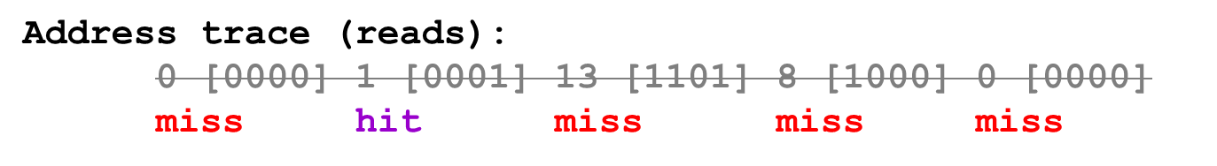
Set Associative Cache Simulation
s=1
Example
M=16 byte addresses
B=2 bytes/block, S=2 sets, E=2 entry/set
t=2
b=1
xx
x
x
(5)
0 [0000] (miss) LRU
set
v
tag
data
0
1
10
m[8]m[9]
0
1
00
m[0]m[1]
1
1
1
0

Slide 61
Line Replacement on Misses
If all the cache lines of the set are valid
  Which line is selected to be evicted ?
LFU (least-frequently-used)
  Replace the line that has been referenced the fewest times over some past time window
LRU (least-recently-used)
  Replace the line that was last accessed the furthest in the past
All of these policies require additional time and hardware

Slide 62
Outline
Cache memory
Direct mapping caches
Set associative caches
Fully associative caches

Slide 63
Fully associative caches
Characterized by all of the lines in the only one set
No set index bits in the address
valid
tag
cache block
set 0:
valid
tag
cache block
E=C/B lines in
the one and only set
…
valid
tag
cache block
t bits
b bits
tag
block offset

Slide 64
Accessing fully associative caches
Line match and Word selection
  must compare the tag in each valid line
=1?
(1) The valid bit must be set.
0
1
2
3
4
5
6
7
1
1001
0
0110
1
0110
w₀
w₁
w₂
w₃
0
1110
(2) The tag bits in one
of the cache lines must
match the tag bits in
the address
= ?
(3) If (1) and (2), then
cache hit, and
block offset selects
starting byte.
t bits
b bits
0110
100
m-1
tag
0
block offset

