Slide 1
Introduction to BillingCenter Configuration
21 January 2014
Notes:
Guidewire training materials contain Guidewire’s confidential information subject to confidentiality and non-disclosure agreements. You agree to use the information in this manual solely for the purpose of training to implement Guidewire’s software solutions. You also agree not to disclose the information in this manual to third parties or copy this manual without Guidewire’s prior written consent. Guidewire training may only be given by Guidewire employees or certified Guidewire partners under the appropriate agreement with Guidewire.

Slide 2
Lesson objectives
By the end of this lesson, you should be able to:
List examples of user interface elements unique to BillingCenter
Explain the purpose of business rules
Explain what a Gosu plugin is
Override a function to change default behavior in BillingCenter
This lesson uses the notes section for additional explanation and information. To view the notes in PowerPoint, choose View→Normal or View→Notes Page. If you choose to print the notes for the lesson, be sure to select “Print hidden slides.”

Slide 3
Lesson outline
BillingCenter user interface
BillingCenter business logic

Slide 4
BillingCenter user interface
User interface in BillingCenter base application is built almost entirely from functionality at platform level
BillingCenter
Data Model
User Inter.
Bus. Logic
Int. APIs
Guidewire Platform, with a common technology for configuring...
Data Model
User Interface
Business Logic
Integration APIs

Slide 5
Location groups in BillingCenter application
Some tabs have two location groups
DesktopGroup.pcf
PolicyGroup.pcf PoliciesGroup.pcf
SearchGroup.pcf
AccountGroup.pcf AccountsGroup.pcf
ProducerDetailGroup.pcf ProducersGroup.pcf
Admin.pcf (Visible only if user can view any administration screen)
Note: Blue indicates a search location group
Notes:
BillingCenter has extra behavior for the Account, Policy, and Producer tabs so that you can be taken to one of two different location groups:
If you click the tab name, you are taken to a search location group for accounts, policies, or producers.
If you click a link to a specific account, policy, or producer, you navigate to a typical location group.
This behavior is implemented by means of a forward, which immediately forwards the user to the appropriate location.

Slide 6
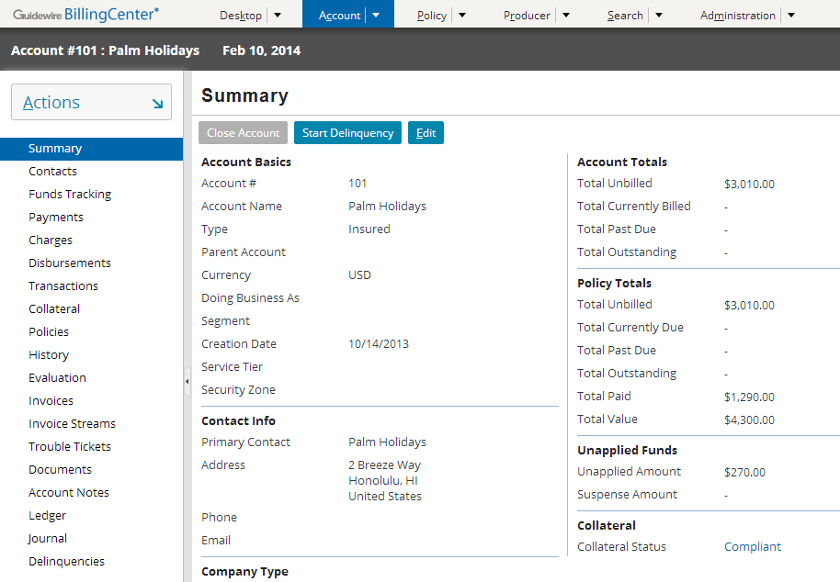
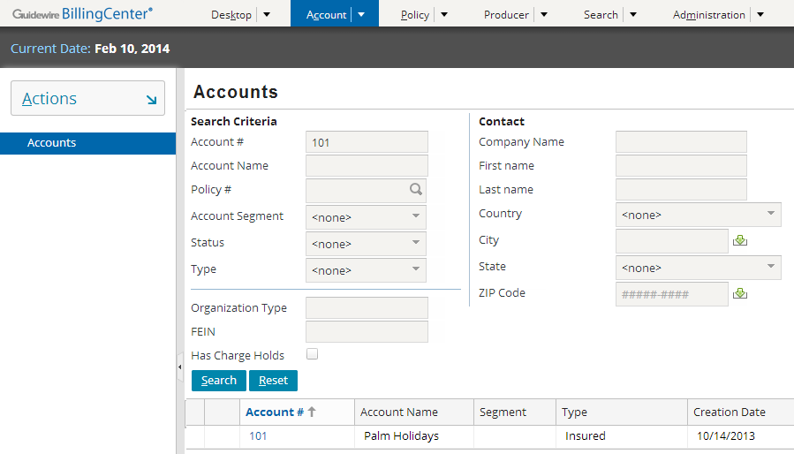
Account location groups
AccountGroup.pcf
AccountsGroup.pcf
Notes:
AccountsGroup is the search location group for accounts.
AccountGroup is the location group for a specific account.
Similarly, producers and policies have two location groups.

Slide 7
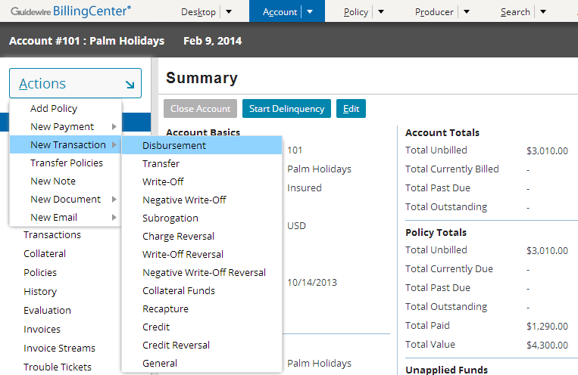
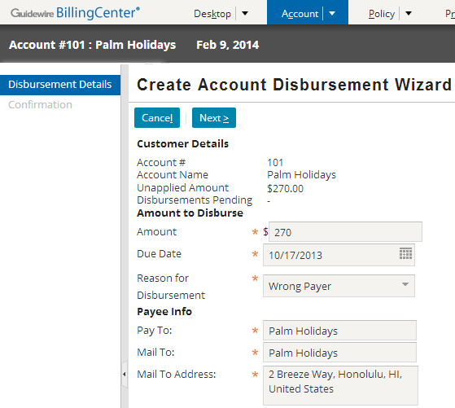
BillingCenter wizards
New Disbursement wizard
Notes:
The BillingCenter base application comes with several wizards, many of them accessible from the Account→New Transaction menu.

Slide 8
Lesson outline
BillingCenter user interface
BillingCenter business logic

Slide 9
BillingCenter business logic
BillingCenter uses business rules, plugins, classes, enhancements, and workflows to execute business logic required for bill processing
BillingCenter
Data Model
User Inter.
Bus. Logic
Int. APIs
Guidewire Platform, with a common technology for configuring...
Data Model
User Interface
Business Logic
Integration APIs
Notes:
The slides that follow discuss business rules and plugins. Classes, enhancements, and workflows are covered later in the course.
A class is a specification (think of it as a blueprint or pattern and a set of instructions) of how to construct something.
An enhancement is a set of code that enhances the functionality of an existing Guidewire type.
A workflow is a multi-step system process designed to manage a complex business process.

Slide 10
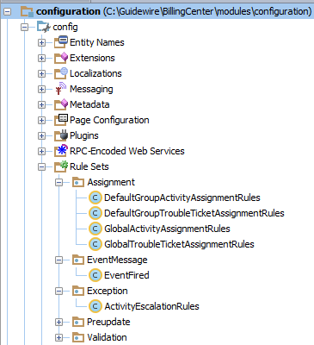
Business rule sets
A business rule set is a set of rules that execute a specific type of business logic
Examples:
Assignment - assign ownable objects to groups and users
Preupdate – take actions before data is committed to database

Slide 11
Business rule triggers
When an account is updated...
...execute these rule sets in this order
Every set of rules automatically executed under some given condition, known as rule triggers
Most triggers relate to creation of or change to instance of given entity
Some rule sets can also be called manually
Notes:
The behavior described above is true for all business rules in BillingCenter, but it is not true for all business rules in all Guidewire applications. For example, PolicyCenter submission rules are never called automatically, but instead are called explicitly by exposed Gosu code inside workflows.
Account Preupdate rules execute any work that needs to be done against the account just before it is committed to the database.
Guidewire BillingCenter uses events and messaging to communicate with external systems. Event-fired rules create message “payloads” in response to specific events.

Slide 12
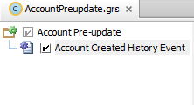
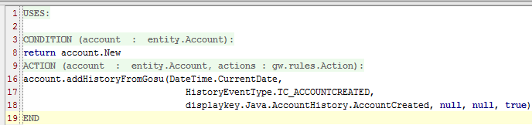
Simple business rule example
This preupdate rule writes a history record for a new account

Slide 13
How BillingCenter handles preupdate rules
Before committing a set of changed entities, BillingCenter:
Populates a list of preupdate rules for all new and changed entities
Executes internal “before update” logic
Typically, relevant plugin methods are executed during this phase
Executes the preupdate rules in the list
Only preupdate rules in the list are executed
No preupdate rule is executed for entities that are created or changed as a result of the internal logic
Notes:
Whenever a preupdate rule triggers functionality that adds, updates, or deletes database entities, the preupdate rules on those entities do not fire. This behavior is designed to prevent endless loops. However, it also means that a preupdate rule doesn't always fire when the associated base entity is changed.
It is tempting to make frequent use of preupdate rules because they are generally easy to code. However, you need to be aware of the limitation noted in the second bullet. For this reason, Guidewire recommends using plugins, which are discussed in the slides that follow.

Slide 14
Guidewire plugins
A plugin is a set of functions that BillingCenter invokes to perform an action or calculate a result
Plugins are implemented in either Gosu or Java
Plugins provide a means for customers to modify internal BillingCenter behavior
Plugins are the predominant model for Gosu configuration in BillingCenter
Every plugin has default behavior, so there is no requirement to modify any plugin
See BillingCenter Integration Guide for detailed information on plugins

Slide 15
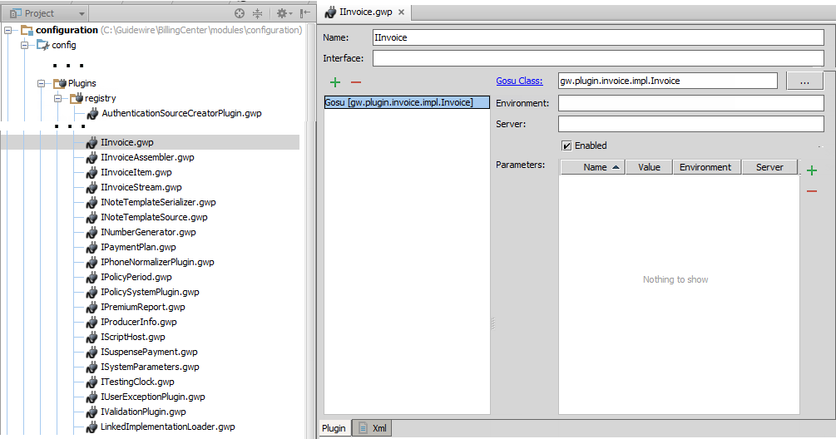
Plugin registry points to where plugin implementation is located
Class that implements IInvoice plugin
Configuration developers should not modify the registry
Notes:
The registry allows integration developers to change the location of the implementation.

Slide 16
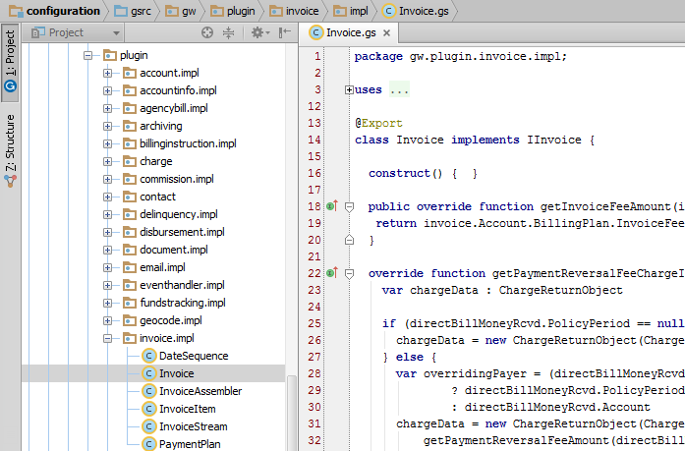
Example of class that implements a plugin
Location of class that implements IInvoice plugin
Make all modifications to a plugin in the implementation

Slide 17
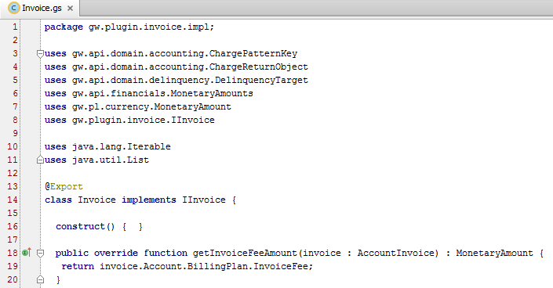
Simple example: plugin before customization
Before custom code
Allows you to customize the function that returns the invoice fee

Slide 18
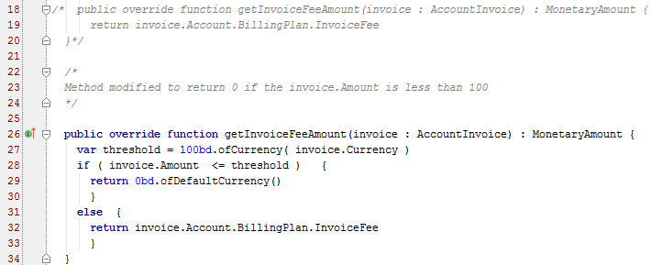

Simple example: plugin after customization
Original code is commented out—available for reference
Custom code added
Comment directly above method is generated into gosudoc
Notes:
In this example, the customer has requested a customization of the function to not always return the value in the InvoiceFee field of the billing plan.
Best practices for customizing functions include:
Comment out the original function. Make a copy of the function for editing with new logic.
Add a comment directly above your new function, describing what new logic you have added.
Use /* ..*/ style comments, and separate the "old-code" comment from the "explanation of new code" comment, because the comment directly above the function will be generated into Gosu documentation ("gosudoc"), as seen in the second screenshot.

Slide 19
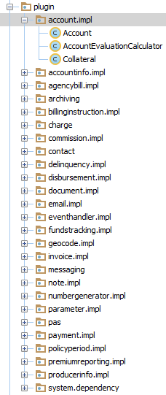
List of plugin implementation classes
Many functions in BillingCenter available to be customized
Best way to find them is to look through the implementations to see what is there
Non-exposed functionality may be requested of BillingCenter Product Management for future product planning

Slide 20
Plugin or business rule?
Both plugins and business rules
Are triggered at a predetermined time
Satisfy a specific business need
Provide the means for developers to configure BillingCenter behavior
With every release of BillingCenter, new Gosu plugins are introduced

Slide 21
How plugins and business rules compare
Plugins | Business rules
Require a plugin registry element | Have no registry
Implemented in Gosu or Java | Implemented in Gosu only
Are classes with all the capabilities of a class | Are code snippets that use a small set of methods you are expected to use
Always implement an interface that has at least one method
Always execute required logic | Often execute optional logic
Have no hierarchical structure | Are in a hierarchy—if parent rule is true, child rules are executed
Have no root entity | Tied to a single ("root") entity
Have functions you can configure | Have condition/action structure
Notes:
In most cases, business rule set has a small set of methods you are expected to use. For example, assignment rules use assignManually() and assignByRoundRobin().

Slide 22
Lesson objectives review
You should now be able to:
List examples of user interface elements unique to BillingCenter
Explain the purpose of business rules
Explain what a Gosu plugin is
Override a function to change default behavior in BillingCenter

Slide 23
Notices
Copyright © 2001-2014 Guidewire Software, Inc. All rights reserved.
Guidewire, Guidewire Software, Guidewire ClaimCenter, Guidewire PolicyCenter, Guidewire BillingCenter, Guidewire Reinsurance Management, Guidewire ContactManager, Guidewire Vendor Data Management, Guidewire Client Data Management, Guidewire Rating Management, Guidewire InsuranceSuite, Guidewire ContactCenter, Guidewire Studio, Guidewire Product Designer, Guidewire Live, Guidewire DataHub, Guidewire InfoCenter, Guidewire Standard Reporting, Guidewire ExampleCenter, Guidewire Account Manager Portal, Guidewire Claim Portal, Guidewire Policyholder Portal, ClaimCenter, BillingCenter, PolicyCenter, InsuranceSuite, Gosu, Deliver Insurance Your Way, and the Guidewire logo are trademarks, service marks, or registered trademarks of Guidewire Software, Inc. in the United States and/or other countries.
All other trademarks are the property of their respective owners.
This material is confidential and proprietary to Guidewire and subject to the confidentiality terms in the applicable license agreement and/or separate nondisclosure agreement.
This file and the contents herein are the property of Guidewire Software, Inc. Use of this course material is restricted to students officially registered in this specific Guidewire-instructed course, or for other use expressly authorized by Guidewire. Replication or distribution of this course material in electronic, paper, or other format is prohibited without express permission from Guidewire.
Guidewire products are protected by one or more United States patents.

