Slide 1
Introduction to the Product Model
20 August 2013
Notes:
Guidewire training materials contain Guidewire proprietary information that is subject to confidentiality and non-disclosure agreements. You agree to use the information in this manual solely for the purpose of training to implement Guidewire software solutions. You also agree not to disclose the information in this manual to third parties or copy this manual without prior written consent from Guidewire. Guidewire training may be given only by Guidewire employees or certified Guidewire partners under the appropriate agreement with Guidewire.

Slide 2
Lesson objectives
By the end of this lesson, you should be able to:
Describe the role that the product model plays in PolicyCenter
Define the primary entities of the product model
Describe how availability logic is used in the product model
Understand the concept of Grandfathering and Offerings
This lesson uses the notes section for additional explanation and information. To view the notes in PowerPoint, choose View→Normal or View→Notes Page. If you choose to print the notes for the lesson, be sure to select “Print hidden slides.”

Slide 3
Lesson outline
Product model basics
Primary patterns in the product model
Availability
New coverage availability
Grandfathering
Offerings

Slide 4
Product model
The product model is PolicyCenter feature that identifies the different types of policies, or products, that a given instance of PolicyCenter offers
For each product, the product model details all of the choices around what can be covered
Notes:
The product model can also be thought of a "product configurator".
The product model is a Guidewire feature unique to PolicyCenter. There is no real analog for the feature in ClaimCenter or BillingCenter.

Slide 5
Product model includes “policy file" information
What lines of business are available on this policy?
collision
What coverages can be added?
Limit: $2000
What are the coverage terms? What are the choices for deductibles? For limits?
$500
$2500
bodily injury
Limit: $5000
$5000

Slide 6
Product model includes information relevant to rating
What modifiers and schedule credits can be applied to the policy?
When can the policy be audited?
collision
Limit: $2000
$500
$2500
bodily injury
Limit: $5000
$5000
Notes:
A modifier is a value used by the rating engine to adjust the policy premium (or some portion of the premium). Modifiers capture information relevant to the pricing of a policy that are not necessarily tied to a specific exposure unit or coverage.
A schedule credit is a special type of modifier which does not capture fact but instead captures the judgment of the underwriter. A schedule credit is typically a decimal value between -1.00 and +1.00. A schedule credit is limited to a given range (such as between -0.2 and +0.2). Schedule credits frequently include text where the underwriter "justifies" the selected value.

Slide 7
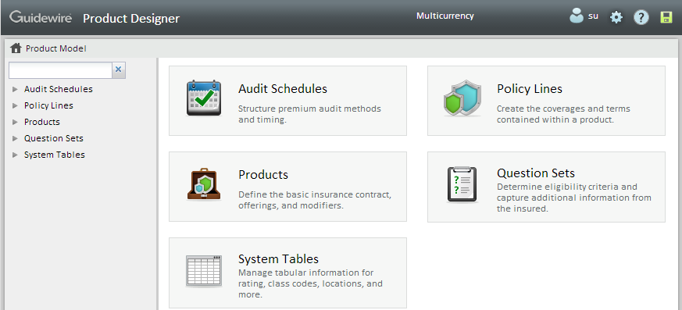
Configure product model using Product Designer
Product Designer is a web-based tool to define and edit product model information
Includes product model, system tables, and audit schedules information
Notes:
Product Designer makes it easier for non-developers such as business analysts to configure the product model, system tables and audit schedules. You use Product Designer from your web browser to edit PolicyCenter configuration files belonging to a development instance of PolicyCenter. Product Designer resides under <install directory>\productdesigner folder.

Slide 8
Lesson outline
Product model basics
Primary patterns in the product model
Availability
New coverage availability
Grandfathering
Offerings

Slide 9
Patterns
Collision Coverage for Wright Construction Auto #1: Mazda Miata (accepted: $1000 deduct.)
Collision Coverage for Wright Construction Auto #2: Ford Fiesta (accepted: $2000 deduct.)
Collision Coverage
Collision Coverage for Calloway Cheese Auto #1: Nissan Maxima (declined)
Product model consists of set of "patterns" or templates
Used during policy transactions to generate specific instances of policies and policy sub-objects

Slide 10
Primary patterns in the Product Model
Product
PolicyLinePattern
Coverage Pattern
CoverageTerm Pattern
Notes:
The PolicyCenter Product Model provides the definitions of the products that PolicyCenter offers. These definitions are called patterns, and it is the pattern that is responsible for creating the actual instances of a product, a policy line, or a coverage, for example. The product model contains a large number of patterns.
Most of the pattern entities have pattern in their name, the exception is the Product entity. The most important pattern entities are show in the diagram above. They are:
Product
PolicyLine Patterns
Coverage Patterns
CoverageTerm Patterns
The following slides describe the various core patterns.

Slide 11
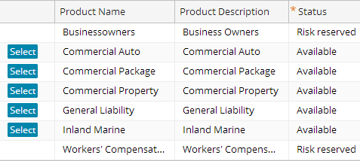
Products
The product entity is a pattern entity used to create policy instances
Notes:
A product is an offering available to an applicant at the Submission Manager screen in PolicyCenter. A product is a pattern used to create policy instances. Each product is listed on a separate row of the Submission Manager.

Slide 12
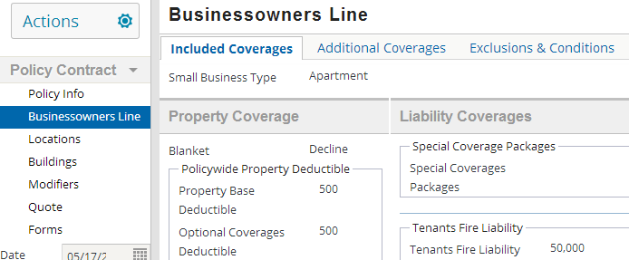
Policy line pattern
A policy line pattern is a collection of sub-patterns relevant to a specific line of business (such as business owner's or personal auto)
Notes:
PolicyCenter uses policy line patterns to create policy line instances.

Slide 13
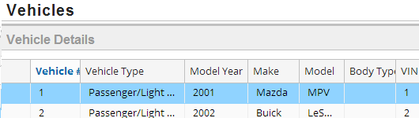
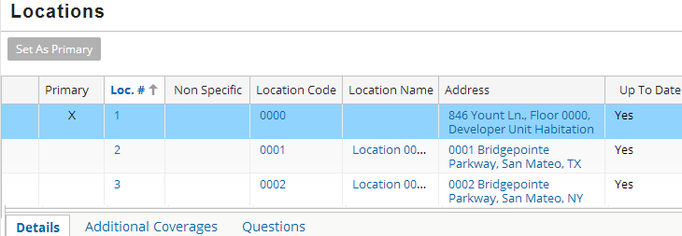
Coverable
A coverable is an exposure to risk that can be protected by the policy, such as:
A tangible property
A location
A jurisdiction
The policy itself
Notes:
A coverable is an exposure to risk that can be protected by the policy. A coverable may be a tangible property item, a location, a jurisdiction, or the policy itself. Within PolicyCenter, Guidewire makes the policy line a coverable to represent the named insureds. Coverages are attached only to coverables.

Slide 14
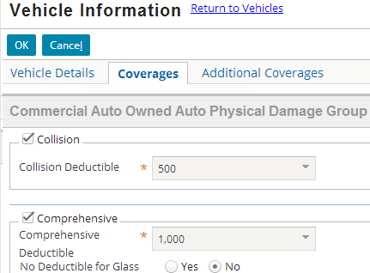
Coverage category
A coverage category is a group of coverage patterns
Coverage category
A coverage category groups a set of coverages (coverage instances) so that they are added to a policy at the same time

Slide 15
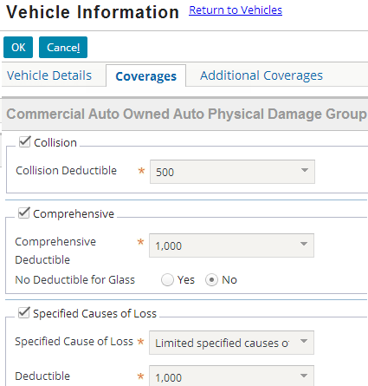
Coverage pattern
A coverage pattern creates an instance of coverage on a specific policy
Coverage instances
Notes:
A coverage pattern is a pattern used to create a coverage, which is a type of loss covered by a policy. Note that PolicyCenter always adds coverage categories, containing one or more coverages.

Slide 16
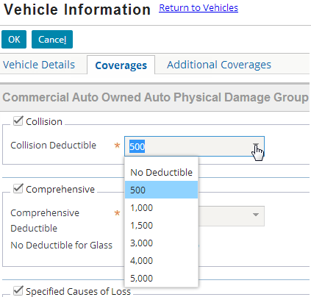
Coverage term pattern
A coverage term pattern creates an instance of a coverage term to measure or further define a specific coverage
CoverageTermPattern
Notes:
A coverage term pattern is a pattern used to create coverage terms. A coverage term is a value that specifies the extent, degree, or attribute of coverage. A limit is one example of a coverage term.

Slide 17
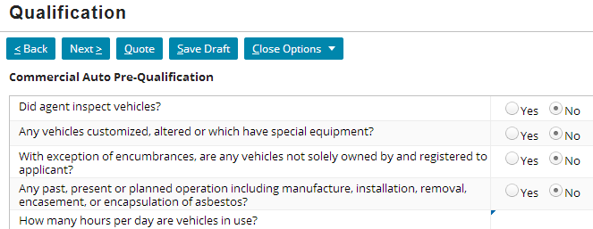
Question sets
Do you...?
A set of questions that gather data about potential risk – a "pattern" that creates answer "instances"
No
Question
Do you...?
Answer
Is the...?
Is the...?
Are there...?
Question
Yes
QuestionSet
Answer
Are there...?
Question
No
Answer
Notes:
A question set is a collection of questions that the applicant answers during the submission. The answers can be used to determine whether or not an applicant qualifies for a given product and can also be used to gather information relevant to the premium of the policy created from that product.

Slide 18
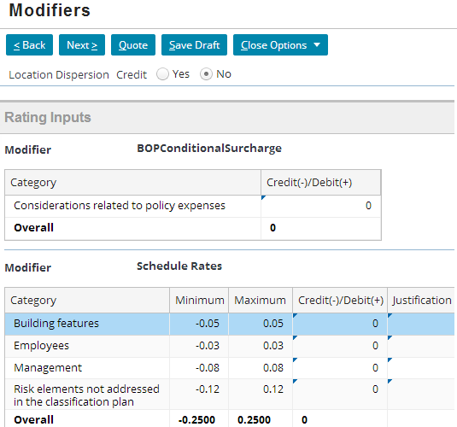
Modifier pattern
Modifier pattern creates an instance of a modifier that affects costs of a policy
ModifierPatternBase
Product Modifier Pattern
Modifier Pattern
PAModifier
BOPModifier
etc.
Notes:
A modifier pattern affects the rating of coverages on a policy. The cost or premium value changes based on modifier value.
Product level modifiers can also be added. They are called ProductModifiers. They are applied to product only for multi-line policies such as CPP (Commercial Package). They apply to all policy lines on a policy. An example is the “IRPM” (Individual Risk Premium Modification) which affects rating of coverages for all lines within CPP.

Slide 19
Exclusions
An exclusions define things that are explicitly not covered by the policy, so that the carrier leaves no exposure to claims in those areas
Notes:
Exclusions are categorized into three types:
Line-level Booleans
The majority of exclusions are simply examples of "exclude this type of thing from the policy". They can be thought of as booleans at a line level that the user chooses to select or not select, and forms inference can be driven from this. These exclusions can be put in the product model as an exclusion tied to the policyline with no terms associated.
Lists of Excluded Items
Many exclusions are lists of excluded things that get included on a schedule form. If something is being excluded, much less information needs to be collected about it than if it's covered. So, for example, a list of excluded locations is very different than a list of policy locations not only because they're functionally entirely different, but also because about all you need for an excluded location is a description. This type of exclusion cannot be modeled in the product model because the product model does not support lists for data entry. An example of this type of exclusion can be seen in WC. On the WC Options screen, there is a list of excluded workplaces collected. The excluded workplace is a separate entity with a few fields defined, and the policyline has an array of these entities.
Restrictions on a Particular Coverage
Some exclusions are related specifically to a particular coverage and optionally exclude something from that coverage. These exclusions are reasonably thought of as covterms and not modeled as separate exclusions in the product model. This type of exclusion can be seen in PA. The PIP Basic NY coverage has a typelist covterm for "Exclude Medical" that allows the user to optionally specify an exclusion from NY PIP.

Slide 20
Conditions
A condition defines the condition that apply towards a coverage
if …
then …
Notes:
Conditions might be optional values that apply to all the coverages on a policy, like an aggregate policy limit or a maximum covered item value. A common case is a deductible that's shared by many different coverages, but the coverages are each selected individually and might be attached to different coverables.
Also note that only optional conditions must necessarily be put into the product model. Standard conditions like "you will pay your bill" need not actually be in the product model and can simply be text on the standard policy forms.

Slide 21
Lesson outline
Product model basics
Primary patterns in the product model
Availability
New coverage availability
Grandfathering
Offerings

Slide 22
Availability
Patterns in product model are available based on:
As of, or until, a given date
Within (or never within) a given state
For (or never for) accounts in certain industries
Availability logic identifies when instances can be generated from the pattern
Notes:
Exactly which product model entities are available is a function of values stored on the policy itself. Often, the set of states named on the policy restrict the availability of a product model entity. For example, the product model may define that a particular kind of form is available in California and Nevada only. If the policy is for a building in New York, the form would not be available for selection from within PolicyCenter. Note, however, that it is possible for other properties of the policy to restrict the availability of a particular product model entity.

Slide 23
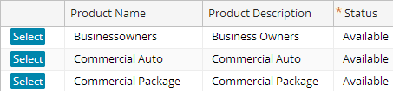

When patterns are unavailable
Available
Unavailable (simply not shown)
If a pattern is unavailable, that pattern is not exposed in PolicyCenter and instances cannot be created from the pattern
Notes:
Availability – as set in the product model (in Guidewire Product Designer) – determines if PolicyCenter exposes that pattern in the UI. In some cases, for example, in the Submission Manager, PolicyCenter applies other criteria as well.

Slide 24
Specifying availability
Availability can be specified in three different ways within Product Designer:
Availability table
Availability script
Grandfathering
Notes:
The performance for an availability lookup table is much better than that of an availability script. Consequently, Guidewire recommends that you specify availability through the availability table whenever possible. (Some product model screens contain an availability table only and do not contain an availability script field at all.)

Slide 25
Determining availability of an entity
Availability calculation is a multi step process as shown below:
Available by Lookup table?
Available by Script ?
Available by Offering ?
Entity is Available
Yes
Yes
Yes
No
Yes
No
Entity is Unavailable
No
Enabled by Grandfathering?
No
Notes:
PolicyCenter controls the availability of an entity through the use of the following mechanisms: lookup tables, availability scripts, grandfathering, and offerings. To determine if a particular product model entity is available, PolicyCenter first consults the appropriate lookup table to determine the initial set S of available entities. The set S may be a quite restricted subset of all the possible entities named in the product model. After PolicyCenter determines the initial set of available entities, it then applies an availability script (if one exits) to each member of S to possibly filter out more elements. The availability script is an arbitrary Boolean-valued Gosu expression that you can use to further limit the available elements. This availability script is often empty, in which case PolicyCenter considers all elements of S available. The availability script can only reduce which entities are available from within PolicyCenter.

Slide 26

Patterns with availability logic
Do you...?
Is the...?
Is the...?
Are there...?
Question
Product
QuestionSet
Offering Pattern
Exclusions, Conditions Pattern
Modifier Pattern
PolicyLinePattern
Coverage Pattern
CoverageTerm Pattern (Options and packages)
Notes:
All of the product model patterns have availability logic, except for policy line patterns.
There is no availability for policy line patterns because policy line patterns are so closely tied to products that availability logic would almost always be stored at the product level. There would never be a need to have a product available and yet not have an underlying policy line pattern available.
Note that Modifier patterns provide additional information for the rating engine to use to adjust the policy premium (or some portion of the premium).
The availability for product level patterns can be set through lookup table only.
The availability for coverage patterns can be set through lookup tables, availability scripts and grandfathering.
Availability in the user interface means that a coverage (or any other pattern on which the availability is set), either shows up or does not show up in the application.

Slide 27
Lesson outline
Product model basics
Primary patterns in the product model
Availability
New coverage availability
Grandfathering
Offerings

Slide 28
New coverage availability
Carrier has to take following steps to introduce a new coverage:
Provide to the state, details of the new coverage
Create rating rules for the new coverage
Underwriting rules to represent the coverage (forms)
Start date for the coverage
Product
New coverage

Slide 29
Coverage available for new business customers before renewal
Carriers may want to make a coverage or other pattern available to new business before allowing for renewal business
Product
New coverage
Renewal
Any other job (rewrite, submission etc.)
Notes:
Renewals start processing months in advance of their effective date and are subject to the availability rules in force on their effective date. Consequently, renewals may already exist when the state approves the coverage for the carrier. Hence one needs to set the availability date of any filed changes separately for new business and for renewals. The availability date of new business could be set much earlier than the availability date for renewals, because a submission rarely has a processing time of more than a week. (This is done by adding a Boolean column in the Availability lookup table.)

Slide 30
Lesson outline
Product model basics
Primary patterns in the product model
Availability
New coverage availability
Grandfathering
Offerings

Slide 31
Grandfather when discontinuing a coverage
Grandfathering concept allows carriers to continue to offer a coverage or other pattern to existing customers, even though it is not available to new customers
Grandfathering is determined by:
State
End effective date
Underwriting company
Notes:
A product model pattern may be grandfathered, meaning that it is available if it already exists on a policy, even if it is unavailable according to both its availability table and script. This permits product model entities to remain on a policy even past their "normal" expiration dates, but once the entity is removed from the policy it cannot be added back. Grandfathering may be restricted to a certain set of states.
If a carrier wishes to discontinue a coverage, they would update the state with their new rating rules, new forms, new underwriting rules, and when the changes will go into effect. Carriers will frequently not wish to irritate existing customers by changing their policies unnecessarily at renewal, so frequently the filed changes will only be used against new customers. Existing customers who already have the discontinued coverage will have their coverage "grandfathered" and allowed to continue indefinitely, even through renewals.
For example, the carrier could decide that a particular coverage is offered in California until December 2007 and then grandfathered until December 2009. This same coverage is also offered in Nevada until October 2007 and then grandfathered until May 2010.
(Continued)

Slide 32
(Notes only slide)
Notes:
Grandfathering use cases:
Unavailable for all use together
Not all discontinued patterns will be grandfathered. In some situations, the existing pattern can no longer be supported by the carrier and so must be discontinued from all use. The pattern should not be available at the next renewal period for existing business or to any new business, but should be available to policy changes on the existing period for existing business. (The existing reference date lookup logic is taking care of this appropriately already.)
Unavailable for new business, grandfathered if already in use
In the case of grandfathering, whether or not an existing coverage can continue to be used could be filed with language indicating that the coverage will be allowed to continue where it is already in use, but there will be no new usages. In this scenario, the decision of whether the pattern is available is make on a policy-by-policy basis, strictly depending upon whether the coverage is already present on the policy.

Slide 33
Example: Grandfathering a coverage
Consider the situation where:
Medical Payments coverage is made available until 08/01/2013 through availability table and
Grandfathered in California until 03/01/2014 to existing customers only who have a policy with that coverage
Notes:
The next couple of slides show the different case scenarios in the user interface with the above availability logic.

Slide 34
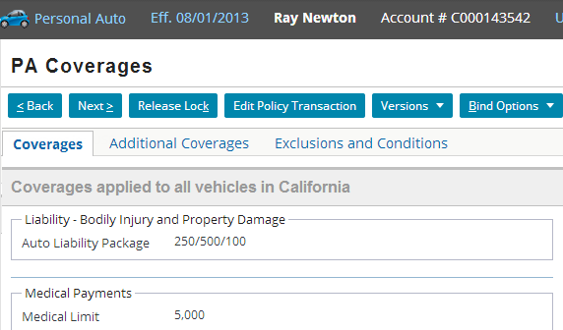
Result 1: Submission created on 08/01/13
Medical payments coverage is available
Notes:
First, the availability in the table is checked. Hence for the above submission created on 08/01/2013, the medical payments coverage is available.

Slide 35
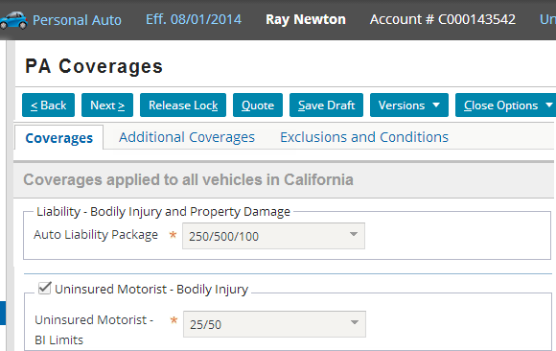
Result 2: Submission created on 08/01/14
Medical payment coverage is not available to Submission created on 08/01/2014 in California
Notes:
Note that the medical payment coverage is not available to the above submission since it is discontinued from 01/01/2014 to new customers as per the availability table - (EndEffectiveDate = 01/01/14 in the Availability table).

Slide 36
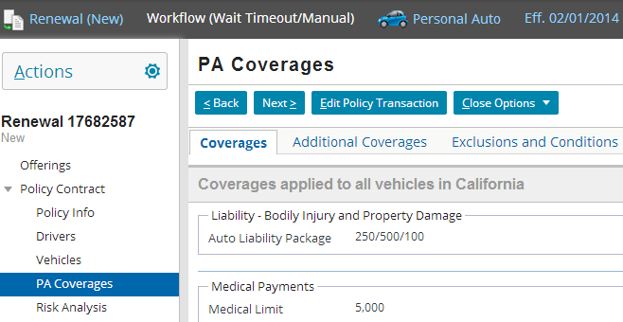
Result 3: Renewal created on 02/01/14 for existing customer in California
Medical payment coverage is Grandfathered in California until 03/01/2014, hence available
Notes:
The coverage is available for renewals since the policy was created on 08/01/2013 and the coverage is made available to existing customers only through Grandfathering specifying CA as a Grandfathered state.

Slide 37
Patterns with grandfathering availability
Product
Offering Pattern
Modifier Pattern
Exclusions, Conditions Pattern
PolicyLinePattern
Coverage Pattern
CoverageTerm Patterns, CovTerm Options and Packages

Slide 38
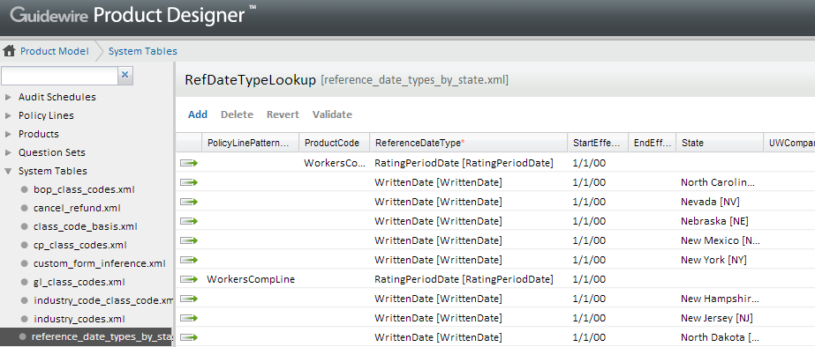
“Reference date” also determines availability
A reference date is the date compared against the start and end effective dates for a pattern
reference_date_types_by_state.xml system table in Product Designer
Notes:
Start and end effective dates determine availability. The date compared against the start and end effective dates for a pattern is known as the reference date. This is usually set by the carrier internally. The rating engine has the information about the effective date for rate. A bound policy has reference date for that policy term which is tied to the coverage and modifier of that policy.
The reference date type is determined by finding the state of the coverable or modifiable, the type of the policy line and the selected underwriting company in the reference date lookup table. The reference date types are:
Effective date: Effective date of the job being processed.
Written date: The date the job was created in the system. This type of reference date is often interpreted differently by different carriers. You can configure its default value.
Rating period date: The workers’ compensation anniversary date. This type is used only in workers’ compensation.
For example, consider a Policy with effective date Apr 1, 2008. For Apr 1, 2009, if nobody touches the policy the existing coverages are carried forward with same reference date. But if a new coverage is added to that policy effective July 1, 2009 the new rates for the newly added coverage get referenced, but the old coverages will keep the same rates unless somebody at the carrier’s office explicitly changes them.

Slide 39
Lesson outline
Product model basics
Primary patterns in the product model
Availability
New coverage availability
Grandfathering
Offerings

Slide 40
Offerings
Insurers need variations of policies depending on buyer
An Offering lets insurers define different product types based on existing product definitions
1
2
3
Carrier
BOP
Product
Policy
Set of Offerings
Notes:
Sometimes carriers have large numbers of variations around a few base products. Insurers want to be able to create these offerings quickly, often based on a similar pre-existing product. PolicyCenter provides the tools to quickly and easily create offerings based on an existing product definition. You start with the base product definition, and then simply tailor it to define your specific offering. The offerings would also allow customers to modify default values for coverages, coverage terms, etc.
It is also important to realize that, it will be possible to switch between different Offerings within a given Product, but switching between different Products would probably not be possible. Therefore, Offerings should be used in situations where it is expected that a producer might want to switch from one thing to another and not re-key their submission data.

Slide 41
Offerings availability
An offering can be made available based on:
Start and end date
Job type
State
Industry
Offerings question set answers
Do you...?
Is the...?
Are there...?

Slide 42
Offerings patterns in the product model
Modifier Pattern
PolicyLinePattern
Do you...?
Is the...?
CoverageTerm Patterns - CovTerm Options, and Packages
Are there...?
QuestionSet
Coverage Pattern
Notes:
Offerings inherit all the capabilities of the product model, because they are built on top of the product model. In particular, the availability of coverages and other product model elements is applied before the offering contents are calculated. Whether a given coverage appears to the user depends on the availability of the coverage as defined by the product model, as well as by the inclusion of the coverage in the offering.

Slide 43
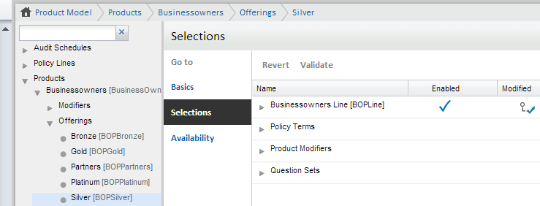
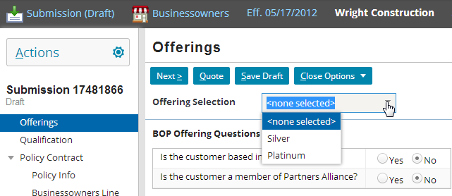
Configure Offerings in Product Designer
PD
PC
Offering selections
In PC, Offerings shows up as first step in Submission
Notes:
Offerings are defined in the product model. You can set the conditions when an offering is available in Product Designer. Offerings is the last check in product availability. If all other checks say that a coverage is available, then the offering is the final check that can set it to unavailable. If the other checks say that the coverage is unavailable, then the offering cannot make it available.
The process of creating a policy will begin with the user selecting an offering. If the user selects another offering, he'll see any associated questions. These work the same way as question sets at the product level -- they might disqualify him from a particular offering, and/or influence rating.
You can use offerings for the following use cases:
Business-specific products: An insurer offers a business program that consists of a set of common coverages. The insurer offers specialized products based on this business program. These specialized products are offered to retailers, auto shops, and the hospitality industry, among others. These specialized products offer coverage levels appropriate for each business type.
Affinity groups: Some insurers write policies that are based on a group membership of the insured. These affinity group policies offer a subset of the available coverages, group-specific default values, and possibly group-specific value choices for the coverage terms. Often the policy is subject to a special rate agreement, and so must obey various restrictions on the coverages and terms offered.
Programs or tiers of coverages: This is similar in concept to the affinity group. The classic example is Bronze, Silver, and Gold programs, where the user can choose increasing levels of coverage at increasing cost. Programs can also offer different coverages. An analogous case in commercial insurance is the creation of products for a particular industry, business profile, or franchisee.

Slide 44
Lesson objectives review
You should now be able to:
Describe the role that the product model plays in PolicyCenter
Define the primary entities of the product model
Describe how availability logic is used in the product model
Understand the concept of Grandfathering and Offerings

Slide 45
Review questions
Name one example of each of the following:
"Policy file" information defined in the product model
Business logic defined in the product model
Rating-relevant information in the product model
What is the difference between the pattern entities and the instance entities?
Name the three ways in which availability can be specified.
Notes:
Answers
1. a) Possible answers: products, exposure units, coverages
b) Possible answers: question sets, availability logic
c) Possible answers: coverage terms, modifiers, schedule credits
2. The pattern entities define how policies can be built. They are the blueprints for specific policies. The instance entities define the actual legally binding policies (or pre-binding submission drafts) created from those patterns.
3. Availability can be specified using:
Availability tables
Availability scripts
Grandfathering

Slide 46
Notices
Copyright © 2001-2013 Guidewire Software, Inc. All rights reserved.
Guidewire, Guidewire Software, Guidewire ClaimCenter, Guidewire PolicyCenter, Guidewire BillingCenter, Guidewire Reinsurance Management, Guidewire ContactManager, Guidewire Vendor Data Management, Guidewire Client Data Management, Guidewire Rating Management, Guidewire InsuranceSuite, Guidewire ContactCenter, Guidewire Studio, Guidewire Product Designer, Guidewire Live, Guidewire DataHub, Guidewire InfoCenter, Guidewire Standard Reporting, Guidewire ExampleCenter, Gosu, Deliver Insurance Your Way, and the Guidewire logo are trademarks, service marks, or registered trademarks of Guidewire Software, Inc. in the United States and/or other countries.
This material is Guidewire proprietary and confidential. The contents of this material, including product architecture details and APIs, are considered confidential and are fully protected by customer licensing confidentiality agreements and signed Non-Disclosure Agreements (NDAs).
This file and the contents herein are the property of Guidewire Software, Inc. Use of this course material is restricted to students officially registered in this specific Guidewire-instructed course, or for other use expressly authorized by Guidewire. Replication or distribution of this course material in electronic, paper, or other format is prohibited without express permission from Guidewire.
Guidewire products are protected by one or more United States patents.

