Slide 1
Introduction to Product Designer
01 November 2013
Notes:
Guidewire training materials contain Guidewire proprietary information that is subject to confidentiality and non-disclosure agreements. You agree to use the information in this manual solely for the purpose of training to implement Guidewire software solutions. You also agree not to disclose the information in this manual to third parties or copy this manual without prior written consent from Guidewire. Guidewire training may be given only by Guidewire employees or certified Guidewire partners under the appropriate agreement with Guidewire.

Slide 2
Lesson objectives
By the end of this lesson, you should be able to:
Use the new Product Designer tool
Manage users, workspaces, and change lists
Work with the product model, system tables, and audit schedules
This lesson uses the notes section for additional explanation and information. To view the notes in PowerPoint, choose View→Normal or View→Notes Page. If you choose to print the notes for the lesson, be sure to select “Print hidden slides.”

Slide 3
Lesson outline
Product Designer overview
Product Designer elements and User Interface
Product Designer administration
Creating and managing your change lists
System tables and audit schedules
Notes:
Use sentence case for topics.

Slide 4
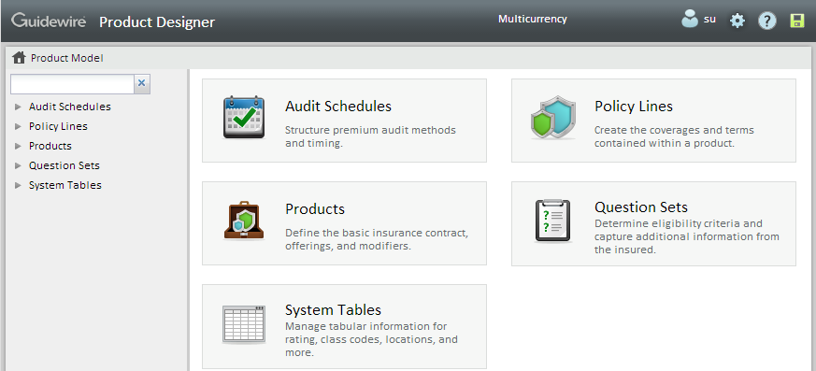
Product Designer
Product Designer is a web-based tool for business users to edit product model information in an easier way
Deployment process is simpler
Includes product model, system tables, and audit schedules information
Product Designer home page
Notes:
Product Designer makes it easier for non-developers such as business analysts to configure the product model, system tables and audit schedules.
Product Designer has been abbreviated as PD throughout this course.

Slide 5
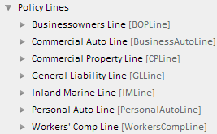
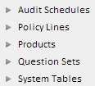
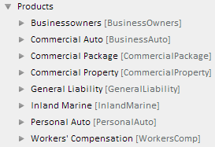
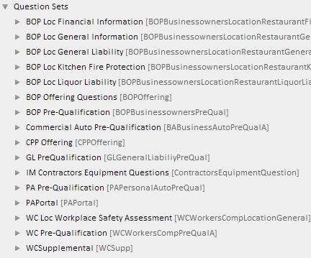
Product model nodes in Product Designer
Notes:
The product model in Product Designer, comes with the above products, policy lines, and question sets. Each of these can be individually configured to meet the customers requirements.
The Audit Schedules node is used for configuring audits.
The data model configuration requiring creating new tables for the product model is out of scope of this course and will not be discussed in this course.

Slide 6

Product Designer modes
Single-user mode: Standalone instance, PolicyCenter development environment
Multi-user mode: Shared instance, typically on a dedicated server
One user
Admin creates user accounts
UserA
UserB
UserC
Notes:
In the single-user mode too, the admin can create multiple user accounts and they all can log on to the same instance of Product Designer. A user with administrative privileges can create other users and manipulate changes made by users. When the admin creates the account they decide whether they want to give administrator privileges to that user.
Users perform all operations within a web browser.
For training purpose, we will be using single-user mode and everyone will be logging in as su in Product Designer as well as in PolicyCenter.

Slide 7
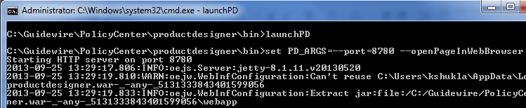
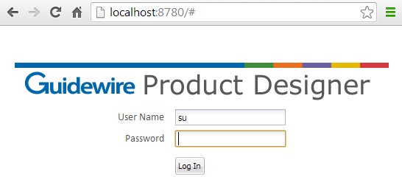
Running a single user instance of PD
Navigate to productdesigner/bin under PolicyCenter folder
Run launchPD.bat
Application starts in command window
Keep it open while using Product Designer
Closing it stops application server
Product Designer opens in default browser
http://localhost:8780/#
Notes:
When running in single-user mode, the following parameters can be used in the startup script, launchPD or launchPD.bat:
-port=nnnn - TCP port number to assign to the built-in application server. Default: 8780.
-openPageInWebBrowser - Automatically starts your default web browser and opens the Log In page of Product Designer after startup completes. Remove this parameter if you do not want your web browser to start up automatically.
Refer to the Product Designer Guide to see instructions on installing a multi-user instance of Product Designer.

Slide 8
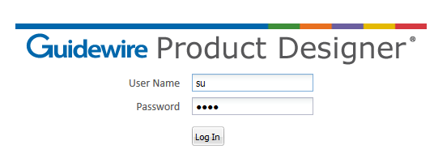
Login screen
For security purpose, password must be at least 4 letters long
gwgw instead of standard gw
Notes:
Guidewire recommends for security reasons that you create a new administrative user and delete the default user.
Note: Your Product Designer session automatically terminates after 120 minutes of inactivity. This timeout is not configurable. However, because Product Designer continually maintains all of your changes in the active change list until you commit them, after logging in again, none of your work is lost.

Slide 9
Lesson outline
Product Designer overview
Product Designer elements and User Interface
Product Designer administration
Creating and managing your change lists
System tables and audit schedules
Notes:
Use sentence case for topics.

Slide 10
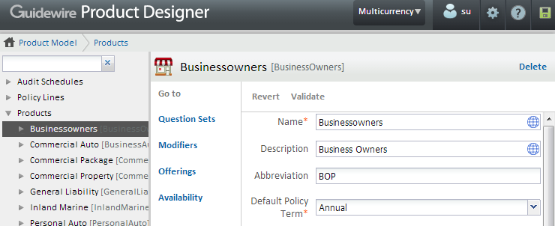
Product Designer basic navigation terminology
Click Product Designer link to go to home page at any time
Toolbar
Breadcrumbs – hierarchy of objects leading to current page
[Object] page
Go to links
Navigation Panel – tree view hierarchy
Notes:
Toolbar
The toolbar stretches across the top of every Product Designer page.
Breadcrumbs
Breadcrumbs appear below the toolbar. Product Designer uses hierarchical breadcrumbs. Hierarchical breadcrumbs represent the location of the current page in the tree hierarchy.
Navigation Panel
On the left side of each page, the Navigation Panel displays a hierarchical tree view. The tree contains all of the nodes of the objects that can be edited, with the selected node highlighted.
[Object] page
Typical Product Designer page, in the example above BusinessOwners product page.
Toolbar and Navigation Panel are always displayed.
The [Object] page and breadcrumbs update depending upon the element selected in the Navigation Panel on the left side.
Go to links
For convenience, click to navigate directly to the associated page. Some of the links under Go to are also available in the navigation tree.

Slide 11
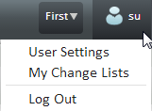
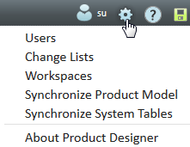
Common elements on a page in Product Designer
Displays/hides Help Panel
Toolbar
User Tools displays user menu
Options menu
User Tools
Displays/hides Changes Panel
Active change list
Options menu
Notes:
Toolbar
The toolbar stretches across the top of every Product Designer page. It contains the navigation elements as show above. Your user name appears adjacent to the user menu icon.
User menu
User Settings - Displays the User Settings page where you can change your user name, full name, user interface language, and regional format.
My Change lists - Displays the My Change Lists page where you can add and delete change lists see which of your change lists is active, and reassign change lists to other users.
Log Out - Logs you out of Product Designer and displays the login screen.
Options menu
Users - Displays the Users page where you can add or delete users and designate one or more users as administrators. Available only to administrators.
Change Lists - Displays the Change Lists page where you can add or delete change lists, see which of your change lists is active, and reassign change lists to users. Available only to administrators.
Workspaces - Displays the Workspaces page where you can add or delete workspaces. Available only to administrators.
Synchronize Product Model - Displays the Synchronize Product Model dialog box, enabling you to deploy your committed product model changes to a PolicyCenter server that is running in development mode.
Synchronize System Tables - Displays the Synchronize System Tables dialog box, enabling you to deploy your committed system table changes to a PolicyCenter server that is running in development mode.
About Product Designer - Displays the About Product Designer dialog box, which includes the Product Designer version number.

Slide 12
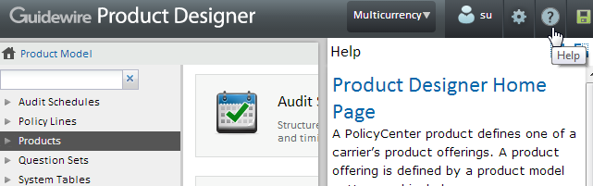
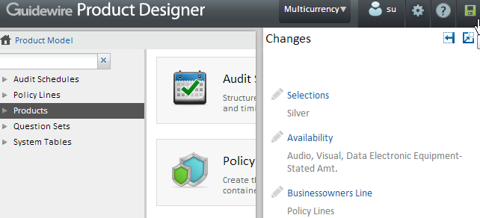
Help and Changes Panels on the toolbar
Help and Changes Panels slide in/out when opened/closed
Help Panel
Changes Panel
Icons:
Help Panel
Show Full Panel
Hide Panel
Changes made by user
Notes:
The Help Panel displays help on the current page in the Product Designer. In the example above, the Product Model home page is the current page so help on Product Model Page is displayed.
Changes Panel: Alternately displays/hides the Changes Panel and changes to indicate the state of your changes, as follows:
Greyed icon – You have not made any changes.
Green icon – You have made changes. Use the Changes page to commit or revert your changes.
Green with a red x at the bottom – You have made changes but there are validation errors.
Change Lists and Change List page are discussed in detail later in the lesson.

Slide 13
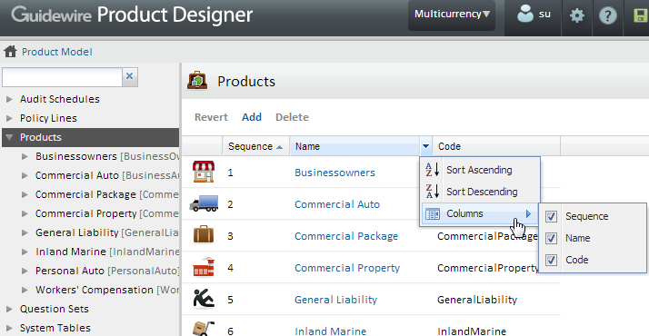
Common changes and operations in a page
Sequence decides order in which [object] appears in UI
Select a row and drag-n-drop row to change sequence
Click column name in header to sort by that column
Appears when mouse over
Sorted by Sequence
Column header
Show/hide columns
Notes:
Sequence
Sequences are relative numberings. You can drag and drop or change the sequence number to change the order listed. The Sequence column in the screenshot above decides order in which products appear in UI.
Common operations for all pages
Sort – Click any column header to sort by that column. Click again to reverse the sort order.
Change order – If the table is sorted by Sequence, drag a single row to a new position to change the order in which it appears in PolicyCenter. Alternatively, edit the sequence number to establish the required order. You can change the order of only one row at a time.
Edit – Click the blue item name to open a page where you can edit the item.
Show/hide columns – Click the triangle next to each column name that appears when you mouse over the column header. This displays sort options and columns sub-menu. Check-uncheck a column to show or hide it. By default all columns appear.

Slide 14
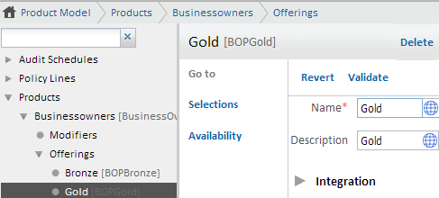
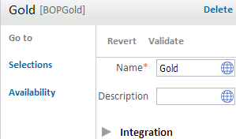
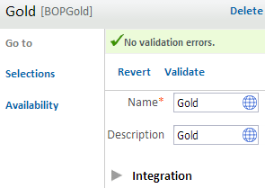
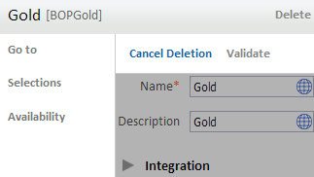
Revert, validate or delete object on a page
Revert
Validate
Delete
Notes:
Reverting a change removes your edits on the object.
Validating a change displays a validation message. Validation errors appear at the top of the page on a red background (shown on next slide). The errors are marked with x and appear on a red background. When no validation errors exist, clicking Validate displays the message No validation errors marked with a check mark on a green background as shown in the screenshot.
Deleting a page gives highlights what got deleted and gives you the options to Cancel Deletion. You can click on Cancel Deletion to retrieve your page.

Slide 15
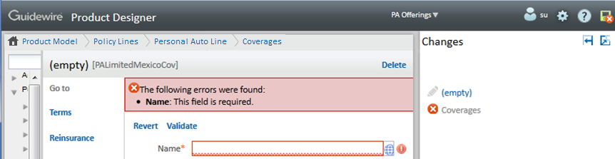
Errors
Errors appear on top of a page on a red background
Highlights field that has error
Changes icon in the toolbar displays a red x
Change list displays change with a red x indicating there are validation errors
Notes:
Product Designer validates changes as you move from one page to another. It indicates whether there are validation errors by displaying a red x on the Changes icon in the toolbar.
Additionally, when you are on any page that enables you to make changes to the product model or system tables, you can click Validate to manually validate your changes. Validation errors appear at the top of the page on a red background. The errors are marked with and appear on a red background.

Slide 16
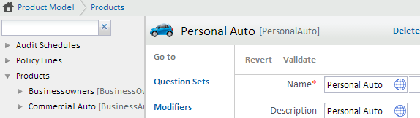
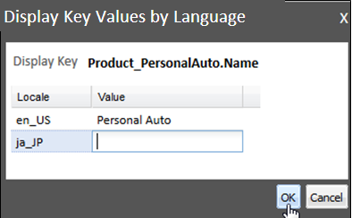
Localization
Every name and description can be localized
Click Translate icon
Notes:
You can edit the text of name and description directly in the field using the current language. You can set the current language in the User Settings page.
Click Translate icon to display the Display Key Values by Language dialog box, where you can enter or edit the text in any supported language.

Slide 17
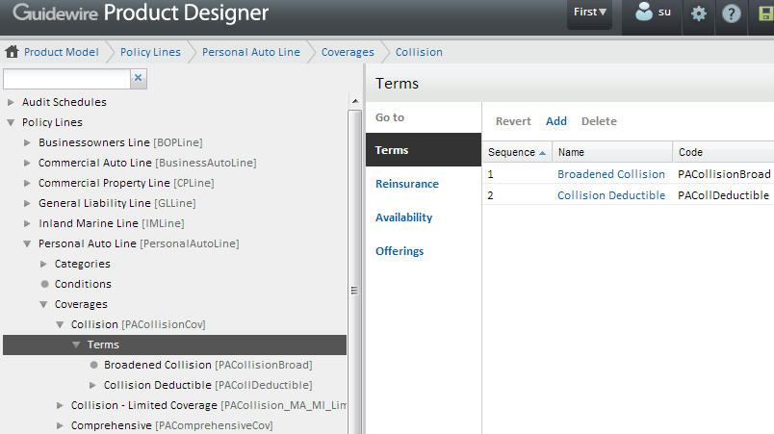
Viewing and editing elements in a node
Navigation Panel on left displays a hierarchical tree view
Right side page is element selected in Navigation Panel
Home page
Filter box
[Terms] page
ObjectName [Code]
Text in blue is a link
Triangles expand/collapse
Last element displayed with a dot
Select element to view details
Notes:
On the left side of each page, the Navigation Panel displays a hierarchical tree view. The tree contains all of the nodes of the objects that can be edited, with the selected node highlighted. Click the triangle icon to expand a node. Continue expanding nodes until you locate the node you want to select. Click a node label to select it. The corresponding page appears to the right of the Navigation Panel.
Filter box - Type the beginning characters of a node name. As you type, the filter hides every node in the tree except the nodes whose names or codes begin with the characters you typed. The code is the portion at the end of the label enclosed in square brackets. Note that the filtered tree also shows the parent nodes of each matching item, to help identify its location in the product model. Click the adjacent X to clear the filter and restore all nodes to the tree.

Slide 18
Lesson outline
Product Designer overview
Product Designer elements and User Interface
Product Designer administration
Creating and managing your change lists
System tables and audit schedules

Slide 19
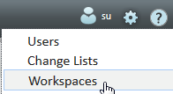
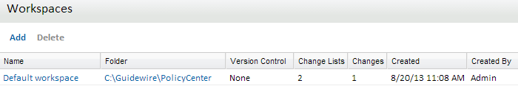
Workspaces
A workspace is named reference to root folder of a PolicyCenter instance
Only administrators can Add or Delete workspaces
Options menu
Default workspace is already created in base application
Administrators can create more workspaces
PD must have at least one workspace defined
Notes:
Users select a workspace when creating a change list to identify the PolicyCenter instance to which their changes are to be committed.
When running as single-user instance, Product Designer has a preconfigured workspace named Default workspace that uses the PolicyCenter instance in which it resides. If needed, you can define additional workspaces that point to other PolicyCenter instances.
When installed as a multi-user instance, you must define at least one workspace before anyone can use Product Designer. You define this initial workspace by running Product Designer. You are prompted to define a workspace as soon as you log in. As with a single-user instance, you also can define additional workspaces as needed.
Only users who are designated as Administrators can edit workspaces.
Version Control System column
Name of version control system, one of:
None – No version control system is configured.
Perforce – Perforce version control is configured.
Note Product Designer interacts directly with Perforce version management software to check out product configuration files, which you then must check in manually. You can use a different version control system by manually checking out files as needed prior to changing them. For details on using a version control system such as Perforce with Product Designer refer to the Product Designer Guide.

Slide 20
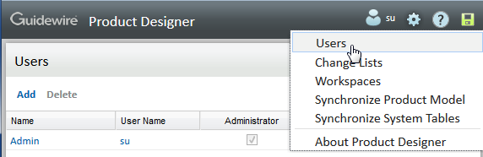
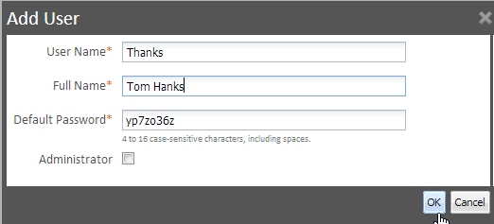
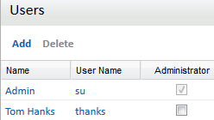
Users
Users can add or delete change lists
Administrative users can manage users, workspaces, and change lists for all users
Make a user administrator by clicking Administrator check box
Users page available to admins only
Notes:
An administrator user can create workspaces too in addition to adding or deleting change lists. In case of a single user system, the user is essentially the administrator.
You can click on user name to edit the user settings such as user name, full name, user interface language, and region format.
Users cannot add other users, but administrators can. Users can edit their own user settings, administrators can edit everyone’s.
Note: This setting affects Product Designer administration only. It has no effect on PolicyCenter administration.

Slide 21
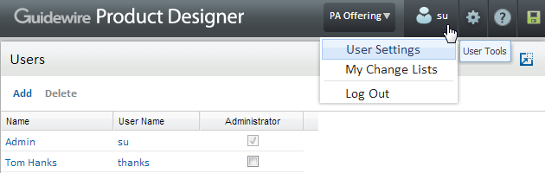
User menu
User Settings – displays user settings page to set user name, full name, language, format, and change password
My Change Lists – displays My Change Lists page to manage your change lists
Log Out – logs user out of Product Designer
Notes:
User menu
User Settings - Displays the User Settings page where you can change your user name, full name, user interface language, and regional format. User can also change their passwords using this page.
My Change lists - Displays the My Change Lists page where you can add and delete change lists see which of your change lists is active, and reassign change lists to other users.
Log Out - Logs you out of Product Designer and displays the login screen.

Slide 22
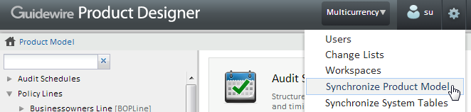
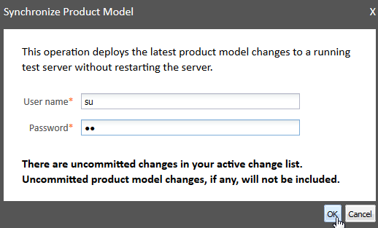
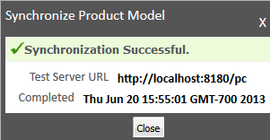
Synchronizing product model
Synchronize changes to product model after committing
PolicyCenter is in development mode
Prompts for username and password for PC user with admin permissions
Notes:
When you click on Synchronize Product Model it displays the Synchronize Product Model dialog box, enabling you to deploy your committed product model changes to a PolicyCenter server that is running in development mode.
The Synchronize Product Model dialog box prompts you for a user name and password. You must supply the PolicyCenter user name and password of a user who belongs to a role with appropriate permission.
A “Synchronization Successful” message is displayed if the synchronization is successful. During this process, it also performs all of the verification checks. If there is an error, Product Designer displays these at the bottom of the screen.
A user must have administration privileges in PolicyCenter to perform this task.
Alternatively, you can set PolicyCenter login information under Workspaces → PolicyCenter page. If you set the login information there, then the above dialog to enter login information will not appear. And the you will see the Synchronization Successful or error message at the end.

Slide 23
Lesson outline
Product Designer overview
Product Designer elements and User Interface
Product Designer administration
Creating and managing change lists
System tables and audit schedules

Slide 24
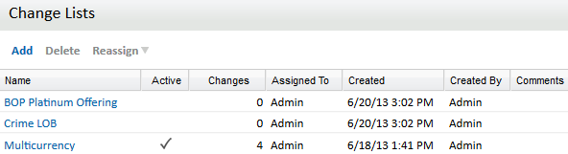
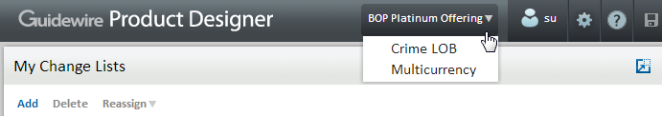
Change lists
A change list is a named collection of changes held in Product Designer until you decide either to commit or revert the changes
Change lists are displayed on toolbar to easily make another change list active
Change list you are currently working on
Notes:
Before you can make any changes in Product Designer, you must create a change list. You can add any number of change lists. The changes in each change list are independent from each other.
For example, a Business Analyst might be adding a new line of business in the Crime LOB change list. Another change might be in the BOP Platinum Offering change list, where they were told to make changes to this offering for a certain class of customers. Or Modify PA Qual Questions, where the company wants to change the qualification questions that they ask new personal auto customers.

Slide 25

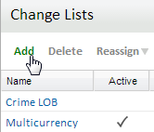
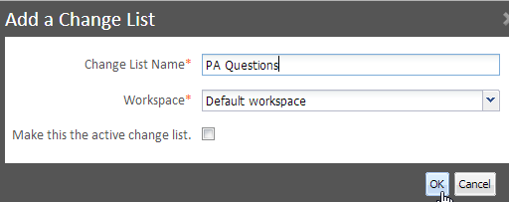
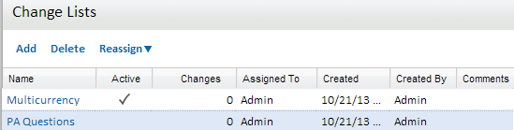
Adding and deleting your change lists
Add a change list
You can Delete or Reassign a change list after it is created
Select change list to delete or reassign
Notes:
You can create multiple change lists, and then select the active change list from among them. The active change list is the one you are using now. All changes you make become part of the active change list. Using multiple change lists enables you to group your changes into separate sets and independently commit each change list at the appropriate time.
Unless you assign it to another user, each change list and the changes it contains belong to you. Other users have their own change lists. A change list remains under your control unless you reassign it to another Product Designer user.
Note: If you have multiple change lists, the changes in each of your change lists are completely separate from one another. Until you commit them, the changes you make in one change list do not appear in your other change lists. Therefore, if you create a new change list, its state matches the state of the PolicyCenter instance as of the previous commit operation.

Slide 26
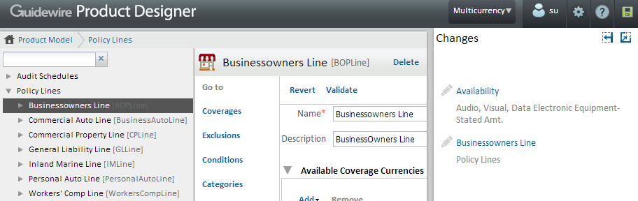
Creating changes in your change list
View your changes in Changes Panel
Go to any change and edit
Active change list
Changes in active change list

Slide 27
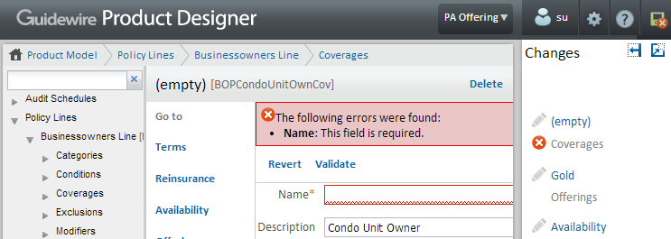
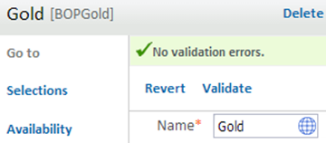
Validating your changes
PD validates changes as you move from one page to other
Additionally, click Validate to manually validate a change
Error or no error message appears on top of page
Change with error marked with red x

Slide 28
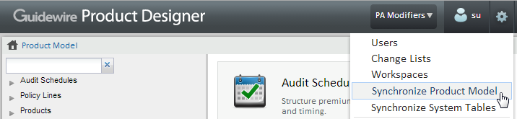
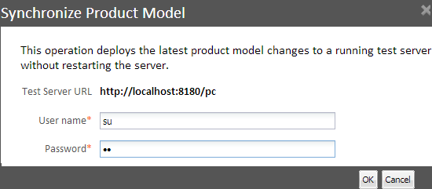
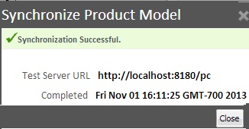
Synchronizing product model with PolicyCenter
Notes:
To synchronize the Product Model from Product Designer, select Options menu -> Synchronize Product Model.
Synchronizing the Product Model temporarily puts the server in maintenance mode and syncs the Product Designer data to the app-server data. During this process, it also performs all of the validations. If there is an error, Product Designer displays these in the top of the page you are working in or in the Changes Panel.
During this time, users cannot access the server. User must be connected to the server to synchronize the product model.

Slide 29
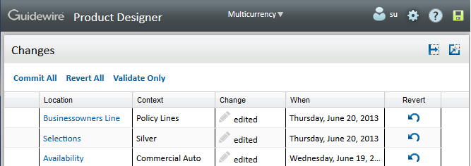

Commit or revert changes on Changes page
Configuration files are modified and no persistence in PD
Commit All validates your changes and if
No errors detected, writes your changes in active change list to PC configuration files
Errors exist, errors are displayed at top of page and all errors must be corrected before commit
You cannot rollback after committing
You can create multiple change lists and commit independently
Notes:
Finally, when you select Commit, Product Designer performs validation of all changes in your active change list and proceeds only if it does not detect any validation errors. Your commit operation is blocked until you resolve all errors in the change list.
Committing your changes means copying them to the application’s configuration files on the PolicyCenter server. Because your changes are in a change list, you can safely make changes and then later choose to commit or not commit some or all of those changes.
You can commit, revert, or validate all change lists. It is a good practice to validate all change lists before committing.
The only way you can rollback a commit is to use source control, which is not managed within Product Designer.
Column Description
Location Location of the changed object. Click this name to jump to the object so that you can examine the change.
Context Description or type of changed object.
Change Type of change, for example, edited, added, deleted.
When Date and time of the change.
Revert Click Revert icon to revert the single change described in this row. Reverting a change removes it from the change list.
Note: Product Designer commits changes in a logical order determined by the software. It does not commit changes in change list order, nor is it possible to influence the commit order of a single change list. If you need to control the order of changes, make your changes in separate change lists and commit the change lists in the required order.

Slide 30
Managing change lists
All users can:
Create their own change lists
Commit or revert changes in their active change list
Change their active change list
Assign their change lists to other users
Delete their own change lists
Administrative users can do all of the above plus:
Reassign any user’s change list to another user
Delete any user’s change list

Slide 31
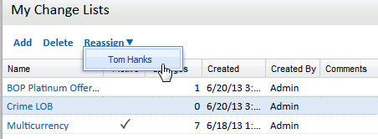
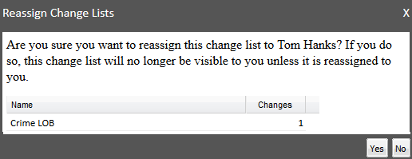
Assign a change list to another user
Enables user to review your changes and add more
Can be assigned back to you so you can review their changes
Change list is under your control unless reassigned
Go to [User] menu → My Change Lists → Reassign → Select User
2. Select user
1. Select change list to reassign
3. Confirm
Notes:
Assigning a change list to another user enables them to review your changes and perhaps make additional changes. They could then assign the change list back to you, enabling you to review their changes. When everyone is satisfied with the changes, you can commit them.
Unless you assign it to another user, each change list and the change it contains belong to you. Other users have their own change lists. Examples of when you might want to reassign a change list include:
You are sharing the project with another user, and now want the other user to review your changes or make additional changes.
You need a user with different skills or knowledge to complete the work you started.
You are busy and need to allow other users to do some of the work you started.
You are leaving the company and need to assign your work to other users.

Slide 32
Lesson outline
Product Designer overview
Product Designer elements and User Interface
Product Designer administration
Creating and managing your change lists
System tables and audit schedules
Notes:
Use sentence case for topics.

Slide 33
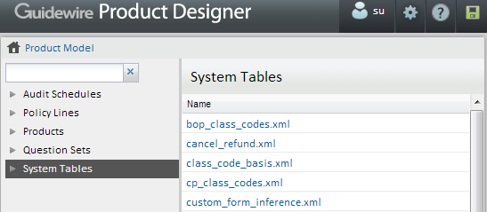
System tables
System tables are tables used to support business logic in PolicyCenter lines of business
PolicyCenter loads system tables into database at startup
Developers define system tables with needed columns as entities in data model using Studio
Business analysts can use PD to view and manage them
Notes:
System tables are used when there are cases that require additional metadata that a typelist cannot support. They are not really considered as one of the core entities for PolicyCenter.
Access system tables in Studio if you are configuring new system tables. Access system tables in Product Designer, if you are adding, removing, or changing data in an existing system table.

Slide 34
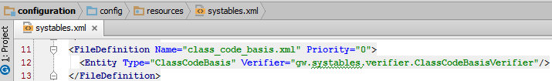
Configuring system tables
Defined in systables.xml at configuration → config → resources using Studio
Only files defined under systables.xml show up in Product Designer
System tables are specified using FileDefinition tag:
<FileDefinition Name=“string" Priority=“0-3“ … ExternallyManaged=“true/false">
Notes:
Configuration users must add new system table XML file to the systables folder and include the name of the new system table XML file in systables.xml in conformance with the schema defined in systables.xsd. If they do not:
• Studio does not consider the file to be a resource.
• Studio does not load it into the database.
• Studio does not display the system table in the PolicyCenter interface.

Slide 35
Attributes: Priority and ExternallyManaged
Priority attribute specifies order of loading systables during PolicyCenter startup
ExternallyManaged sets whether PD or an external system manages a particular system table
<<FileDefinition Name=“string" Priority=“0-3“ … ExternallyManaged=“true/false">
Notes:
Specify the order in which to load the systable files using the FileDefinition Priority attribute. As PolicyCenter loads the product model, it loads lower priority files before higher priority files. (PolicyCenter loads files with the same priority concurrently.) This is critical if there are dependencies between the system tables. For example, the line-specific class code system tables must be loaded prior to the industry codes system table. Therefore, Guidewire sets the priority for the class code files lower than priority value for the industry code file. For example,
class codes for gl, the priority is 1 and for industrycodes the priority is 2.
ExternallyManaged:
Possible values of the ExternallyManaged attribute and their meanings are:
true – You cannot view or edit the system table in Product Designer. You must use an external editor to view or make changes to the system table.
false (or not-specified) – You can edit and manage the system table values in Product Designer.
A typical use case for setting ExternallyManaged to true is when dealing with very large system tables. Very large system tables are not efficient to edit in Product Designer due to its page-at-a-time view of system table data.
Territory codes provide an example use case. Territory codes are a way of encoding a given geographical location for the purpose of rating. Therefore, the territory code system table, territory_codes.xml, can become very large, containing as many as a million entities. If you find that editing this system table is not practical using Product Designer, set the ExternallyManaged attribute for the territory code system table to true, as follows:
<FileDefinition Name="territory_codes.xml" Priority="0" ExternallyManaged="true">
<Entity Type="DB_Territory"/>
</FileDefinition>Setting ExternallyManaged to true affects only the ability of Product Designer to load the system table for viewing and editing. It does not affect the way in which PolicyCenter loads the system table during system startup.

Slide 36
Steps to add a new system table
Create a new data entity
Define entity and its attributes
Define system table as a new xml file in systables directory
Open systables.xml
Add an entry for new system table
Specify the attributes Priority and ExternallyManaged
Notes:
Refer to the Product Model Guide for more details on system table configuration.

Slide 37
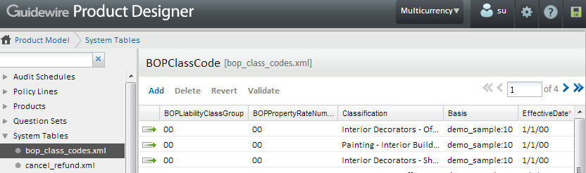
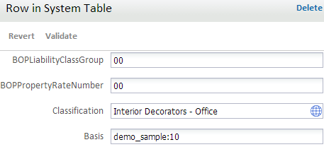
System tables
Modify tables as needed
Opens row for edit in its own page
Notes:
System tables are displayed in the Navigation Panel. Choose the table you want to edit. The table page displays all rows in the table. You can add, delete, revert or validate rows. Select row by clicking on it.
You can edit rows in a system table in their own page or in the table page also by directly editing contents of row in that page.

Slide 38
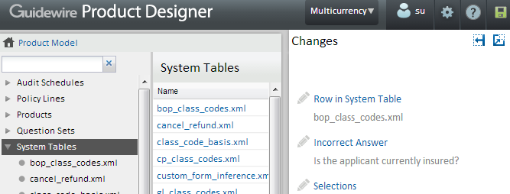
System table changes are added to change list
System table changes are committed and deployed like other changes in Product Designer
Options menu → Synchronize System Tables
Notes:
The logic of committing and deploying changes to system tables is the same as deploying product model changes using the synchronize Product Model command.

Slide 39

Audit schedules
Audit schedule page
Notes:
Changes made to audit schedules are also added to the Changes Panel along with other changes in the change list. These changes are also committed and deployed to PolicyCenter in the same way as other changes to the product model.

Slide 40
Lesson objectives review
You should now be able to:
Use the new Product Designer tool
Manage users, workspaces and change lists
Work with the product model, system tables, and audit schedules

Slide 41
Review questions
What is a workspace? Can any user create or remove a workspace?
What is a change list? Can users create multiple change lists?
Fill in the blanks:
The change list you are working in is called ____________ change list.
The left side which displays an hierarchical tree view is called ____________.
The ____________ menu displays the user settings, user change lists and an option to log out.
The ___________ menu displays the synchronize and administrative commands.
Notes:
Answers
Workspace is the connection to the PolicyCenter instance. Only administrator can create or remove workspaces.
A change list is a named collection of changes held in Product Designer until committed or reverted. Yes.
Fill in the blanks:
Active
Navigation Panel
User
Options

Slide 42
Notices
Copyright © 2001-2013 Guidewire Software, Inc. All rights reserved.
Guidewire, Guidewire Software, Guidewire ClaimCenter, Guidewire PolicyCenter, Guidewire BillingCenter, Guidewire Reinsurance Management, Guidewire ContactManager, Guidewire Vendor Data Management, Guidewire Client Data Management, Guidewire Rating Management, Guidewire InsuranceSuite, Guidewire ContactCenter, Guidewire Studio, Guidewire Product Designer, Guidewire Live, Guidewire ExampleCenter, Gosu, Deliver Insurance Your Way, and the Guidewire logo are trademarks, service marks, or registered trademarks of Guidewire Software, Inc. in the United States and/or other countries.
This material is Guidewire proprietary and confidential. The contents of this material, including product architecture details and APIs, are considered confidential and are fully protected by customer licensing confidentiality agreements and signed Non-Disclosure Agreements (NDAs).
This file and the contents herein are the property of Guidewire Software, Inc. Use of this course material is restricted to students officially registered in this specific Guidewire-instructed course, or for other use expressly authorized by Guidewire. Replication or distribution of this course material in electronic, paper, or other format is prohibited without express permission from Guidewire.
Guidewire products are protected by one or more United States patents.

