Slide 1
Integrating PolicyCenter with ClaimCenter
October 31, 2014
Notes:
Guidewire training materials contain Guidewire proprietary information that is subject to confidentiality and non-disclosure agreements. You agree to use the information in this manual solely for the purpose of training to implement Guidewire software solutions. You also agree not to disclose the information in this manual to third parties or copy this manual without prior written consent from Guidewire. Guidewire training may be given only by Guidewire employees or certified Guidewire partners under the appropriate agreement with Guidewire.

Slide 2
Describe the cross-application integration points between PolicyCenter and ClaimCenter
Enable policy search and retrieval
Enable large loss notification
Enable risk analysis

Slide 3
Overview of PC/CC integration
Policy search and retrieval
Large loss notification
Risk analysis

Slide 4



Cross-application integration points
Guidewire applications are designed to exchange information with other Guidewire applications
A cross-application integration point represents an exchange of information between two Guidewire applications
Notes:
Every Guidewire application is designed to exchange information with other Guidewire applications. Each point of exchange is known as a cross-application integration point. The cross-application integration points are designed to:
Require minimal work to enable
Require as little configuration work as possible to meet the needs of any customer
There are also cross-application integration points between:
ContactManager and BillingCenter
ContactManager and PolicyCenter
ContactManager and ClaimCenter
There are no cross-application integration points between BillingCenter and ClaimCenter.

Slide 5
Cross-application integration points
Consist of Guidewire integration mechanisms:
Plugins registry elements
Preupdate and event fired rules
Messaging destinations
Web service collections and APIs
Enablement consists of basic configurations:
Enable rules
Enable messaging destinations
Configure and enable plugins
Edit xml files
Refresh web service collections
GWP
Notes:
Cross-application integration points are built almost entirely from the standard Guidewire integration mechanisms. Some of the integration points use functionality that are not strictly integration mechanisms, such as xml files, assignment rules, and activity patterns.

Slide 6
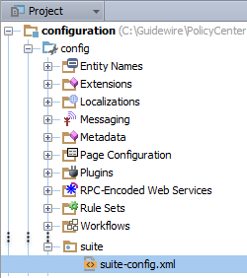
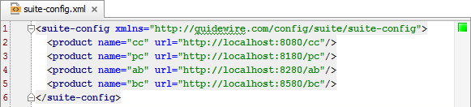
suite-config.xml
suite-config.xml specifies the Guidewire product URLs so that applications know where to connect to each other
Notes:
The suite-config.xml file exists in every Guidewire application. For a given instance of a Guidewire application, the file specifies the URLs required to connect to other Guidewire applications.
When enabling cross-application integration points, edit the file and specify the correct URLs for each application.

Slide 7


Cross-application integration points:
PolicyCenter and ClaimCenter
Policy Data
Policy search and retrieval
FNOL
Underwriting Notification
Large loss notifications
Claims View
Claim Financials
Risk analysis
Renewal Processing
Notes:
In the slide example, the diagram shows a high-level view of PolicyCenter and ClaimCenter integration.
Policy search and retrieval consists of ClaimCenter requesting policy summaries from PolicyCenter that match a given set of criteria (policy search) and then requesting one policy from a set of policy summaries (policy retrieval).
Large loss notification consists of ClaimCenter sending notification to PolicyCenter when the reserves associated to a given claim exceed a given threshold.
Risk analysis consists of PolicyCenter requesting information about claims filed against a given policy so that the risk of the policy can be assessed (typically when the policy is up for renewal).

Slide 8
Overview of PC/CC integration
Policy search and retrieval
Large loss notification
Risk analysis

Slide 9
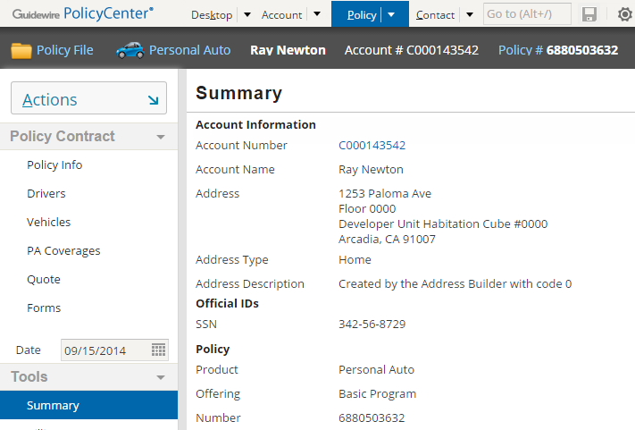
Policy search and retrieval during intake
Policy Data
Search for policy
FNOL
Retrieve loss date policy snapshot
Claim File
View in PolicyCenter as needed
Notes:
Policy search occurs on the first step of the New Claim wizard. It consists of taking the search criteria entered by the user, querying PolicyCenter for policies matching the criteria, and then displaying the search results for the user.
Policy retrieval typically occurs between the first and second steps of the New Claim wizard. It consists of retrieving a full copy of the policy selected by the adjuster in step 1 of the New Claim wizard, and then mapping the data in that policy to the ClaimCenter data model.
For a given ClaimCenter claim, adjusters can also view the policy for that claim in PolicyCenter.

Slide 10
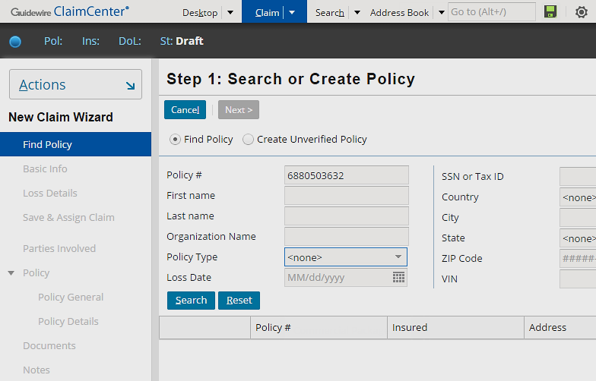
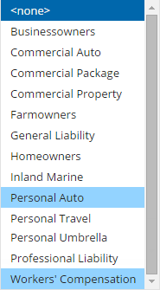
Policy search in PolicyCenter
Wizard Step 1 searches for policy
Personal auto and worker's comp policies are the default search configuration
Notes:
Step 1 of the New Claim wizard in ClaimCenter involves ensuring that a policy exists. This step enables you to direct ClaimCenter to search for an existing policy in PolicyCenter.
In the ClaimCenter base application, policy search against PolicyCenter is enabled for personal auto and worker's comp policies only. Searching for policies for other lines of business results in an error.

Slide 11
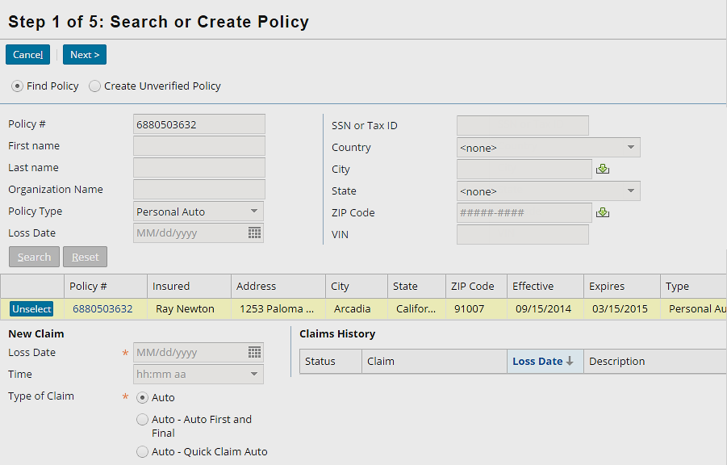
Policy details from PolicyCenter
New Claim wizard utilizes the policy and coverage dates, coverage types, and terms
Notes:
If the policy exists, the details are retrieved from PolicyCenter. The New Claim wizard utilizes the policy and coverage dates, coverage types, and terms. It also uses other information specified on the policy such as locations, classifications, and objects such as a vehicle or building.

Slide 12
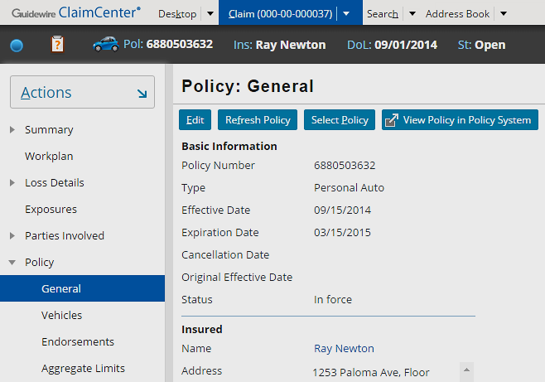
Viewing the policy in PolicyCenter
Requires user permissions and config.xml settings
Notes:
The "View Policy in Policy System" button is a navigation widget that pushes the user to the "View Policy" exit point.
In order for the button to be visible:
The value of the PolicySystemURL parameter in config.xml must be set.
The user must have the "viewpolicysystem" system permission.
When the user clicks the button, the user must also authenticate against PolicyCenter.

Slide 13

How does policy search and retrieval work?
New Claim Wizard
GWP
CC PolicySearch Integration
pc800.wsc
Policy Search PCPlugin
IPolicy Search Adapter
Notes:
Once it is enabled, policy search and retrieval works in the following way:
During the New Claim wizard, the user enters criteria and search for policies. The search results are a set of zero to many policy summaries. The user later selects a given policy summary, and the full details of the policy are retrieved.
Both search and retrieval trigger the IPolicyAdapter plugin. The plugin registry entry for this plugin points to gw.plugin.pcintegration.pc800.PolicySearchPCPlugin.
The PolicySearchPCPlugin class makes use of a web service collection that references the PolicyCenter web service, CCPolicySearchIntegration.
PolicyCenter publishes a CCPolicySearchIntegration web service collection (wsi.remote.gw.webservice.pc.pc800.ccpolicysearchintegration.CCPolicySearchIntegration) which contains methods called by PolicySearchPCPlugin for both policy search and policy retrieval.
In order to re-retrieve a copy of the policy from PolicyCenter during the policy refresh process, ClaimCenter also utilizes the IPolicyAdapter.
In the slide example, the diagram describes integration between PolicyCenter 8.0.2 and ClaimCenter 8.0.2. Later versions of either product may come with updated versions of resources that are more appropriate to use. For example, when integrating with a version of ClaimCenter later than 8.0.2, there may be a more up-to-date web service endpoint to use. If you are integrating products later than 8.0.2, consult the installation guides for each product to determine the best resources to use.

Slide 14
Steps to enable policy search and retrieval
PolicyCenter
ClaimCenter
Start PolicyCenter
[Optional] Update class and mapping files
Open IPolicySearchAdapter
Change the Gosu class
Edit the plugin configuration
Edit suite-config.xml
Refresh the Web Service collection WSDL
[Optional] Update class and mapping files
Deploy your changes
Notes:
The steps identify the 800 version of the plugin class and pertains to a PolicyCenter 8.0.2 integration with ClaimCenter. If you are integrating ClaimCenter with a version of PolicyCenter later than 8.0.2, consult the ClaimCenter Installation Guide for specific integration related configurations.

Slide 15
Start PolicyCenter
Step 1
gwpc dev-start
Starts PolicyCenter
CCPolicySearchIntegration web service starts
C:\Guidewire\PolicyCenter\bin>gwpc dev-start
dev-start: ==================================================== = Running main class: com.guidewire.commons.jetty.GWServerJettyServerMain
…
[JAVA] machine 2014-10-10 INFO ***** PolicyCenter ready *****

Slide 16
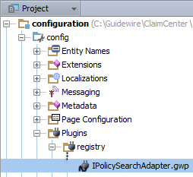
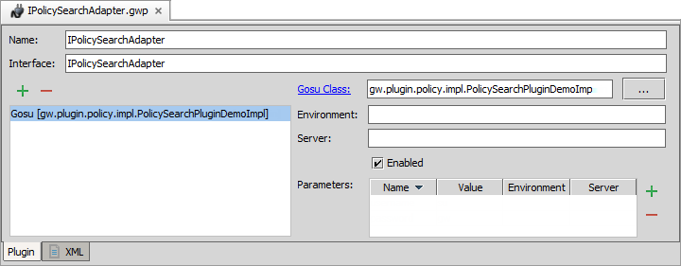
Open IPolicySearchAdapter
Step 2
In Guidewire Studio for ClaimCenter, open IPolicySearchAdapterPlugin.gwp

Slide 17
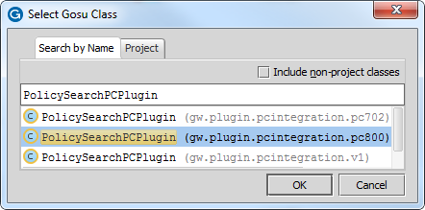
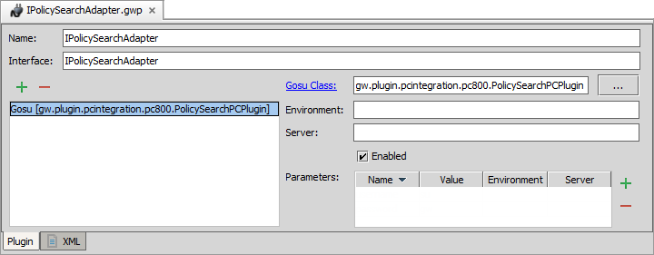
Change the Gosu class
Step 3
In Plugin Editor, change the Gosu class
Click ellipse (…)
Search for PolicySearchPCPlugin (pc800)
2
1

Slide 18
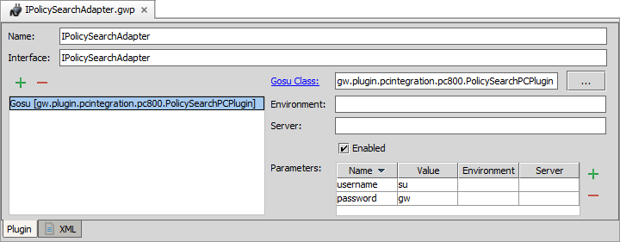
Edit the plugin configuration
Step 4
Enable, if disabled
Add username and password parameters
1
2
Notes:
In a development environment, the plugin registry element parameters can usually be set to "su" with a password of "gw".
In a production environment, the plugin registry element parameters should be set to an appropriate PolicyCenter user name and password for executing searches in PolicyCenter.

Slide 19
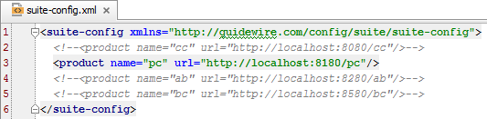
Edit suite-config.xml
Step 5
Specify the URL for PolicyCenter in suite-config.xml
Notes:
In a development environment, the web service URL does not need to be modified if both applications are on the same machine and ClaimCenter is using the default port (8080).
In a production environment, the web service URL may need to be modified if both applications are not on the same machine or if ClaimCenter is not using the default port (8080).

Slide 20
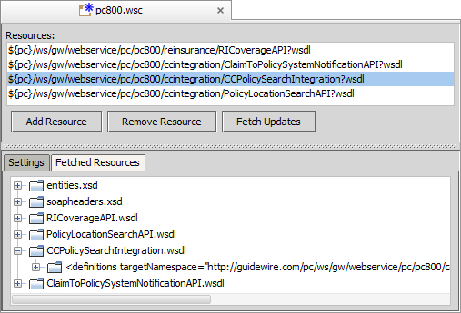
Refresh web service collection WSDL
Step 6
Open the pc800.wsc collection in Studio
…\gsrc\wsi\remote\gw\webservice\pc\pc800.wsc
To refresh the web service collection WSDL, click Fetch Updates
Notes:
The PolicyCenter server must be running in order to fetch the WSDL.

Slide 21
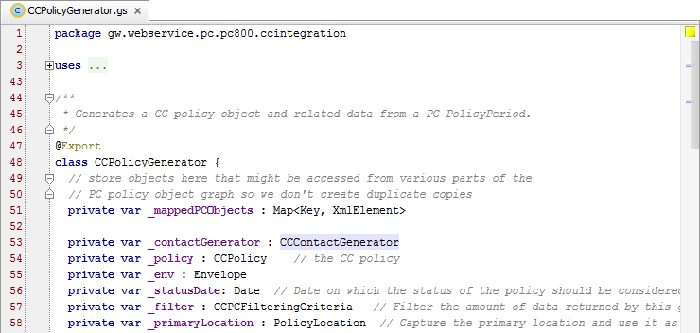
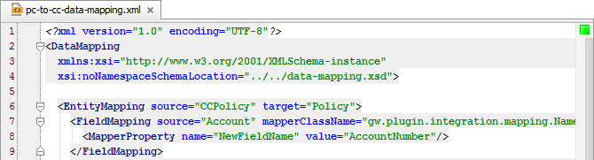
[Optional] Update class and mapping files
Step 7
In PolicyCenter, modify CCPolicyGenerator.cs
In ClaimCenter, modify pc-to-cc-data-mapping.xml
Notes:
You can find these resources in: …\PolicyCenter\modules\configuration\gsrc\gw\webservice\pc\pc800\ ccintegration\CCPolicyGenerator.gs and
…\ClaimCenter\modules\configuration\config\datamapping\pc\800\ pc-to-cc-data-mapping.xml
The logic to transform a PC policy into a CC policy is captured in several additional classes and files, including PolicyCenter's CCPolicy Generator class and ClaimCenter's pc-to-cc-data-mapping.
In certain cases, the class and the xml file may need to be customized.
In the base applications, policy search and retrieval is enabled only for two lines of business: personal auto and workers' comp. To modify the policy construction for these lines of business, and/or to add lines of business, one must modify the files that execute this transformation.
For further information on what the files are and how to modify them, you should refer to the ClaimCenter 8.0 Integration Guide, in the section on claim and policy integration.

Slide 22
Deploy your changes
Step 8
Restart Server
Reload Changed Classes
Plugin registry elements
Always required for cross-point integration
Class and mapping files
GWP
Plugin Registry
Gosu Class
Notes:
You must restart the server when you create or modify destinations, plugin registry elements, and/or reply plugins.

Slide 23
Overview of PC/CC integration
Policy search and retrieval
Large loss notification
Risk analysis

Slide 24
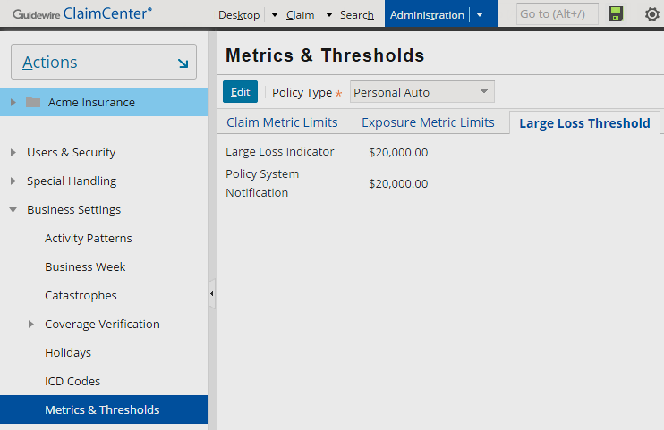
Large loss notification
When the gross total incurred for a claim reaches a predefined amount, ClaimCenter sends a notification to PolicyCenter
Large loss threshold amount varies with line of business
Notes:
Sending notifications to the policy’s underwriter helps in determining risk and ultimately granting a policy renewal (or not).
Sometimes a claim has a large loss associated with it. The amount of the large loss threshold is defined in ClaimCenter and varies depending on the line of business (policy type). For example, a personal auto large loss notification would generally be based on a smaller threshold than one for a homeowner’s policy. The large loss information is critical to an underwriter who uses the information in determining risk and ultimately granting (or denying) a policy renewal.
When a claim’s loss reaches the predefined threshold, ClaimCenter creates a message that results in an activity being created in PolicyCenter on the account. The underwriter needs this type of information in deciding whether to grant a policy renewal. If ClaimCenter has already sent a large loss notification to PolicyCenter for the claim, it does not send an additional notification.

Slide 25
Large loss notification actions
ClaimCenter
PolicyCenter
Policy type defines critical threshold
Notifies PolicyCenter when a claim reaches the critical threshold
Finds the policy
Adds a large loss UW referral reason to the Policy file
When certain policy jobs (renewal, rewrite, policy change) are initiated, UW referral reason is translated into new UW issue
Adds an activity on the policy's account to examine large loss

Slide 26
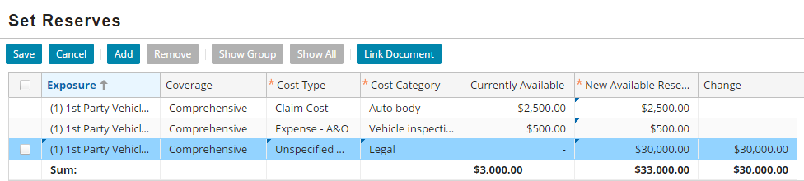
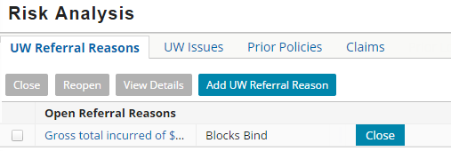

Large loss notification example
New Claim / New Reserve
Policy
Gross total incurred reaches large loss threshold for policy type
Account
Notes:
You can reach the large loss threshold in either of the following ways from the user interface:
(a) Create a claim in ClaimCenter with reserves such that gross total incurred on the claim exceeds the large loss gross total incurred threshold for the claim’s policy type, or
(b) Add a new reserve, or new eroding future scheduled payment, or new payment to an existing claim such that the gross total incurred for that claim exceeds the large loss gross total incurred threshold.
In the slide example, the new reserve of $30,000 pushes the gross total incurred for the claim above its large loss threshold. In this instance, ClaimCenter informs PolicyCenter. PolicyCenter creates an activity for the account to alert the underwriter of the large loss amount. In addition, PolicyCenter creates a UW referral reason and attaches it to the policy to block binding of the renewal until the issue is resolved.

Slide 27
Large loss notification process
EventFired: Policy System Notification
Preupdate LargeLoss Notification
Policy System Notification
Policy System Notification Transport
IPolicySystem Notification Plugin
GWP
ClaimToPolicySystem NotificationAPI
pc800.wsc
PCPolicySystem Notification Plugin
Notes:
Large loss notification is an cross-application integration that consists of a transaction, various rules, messaging destination, messaging plugins, and a web service API. A key aspect of the system architecture is to separate message creation (which most customers will not need to modify) from the message transport (which most customers would need to modify). The message transport plugin calls a predefined plugin. In most cases, customers will modify this predefined class. Once it is enabled, large loss notification works in the following way:
TPU5000 - Large Loss Notification is a preupdate rule that checks to see if a newly created or modified transaction exceeds a large loss notification threshold for the first time for a given claim. When the rule condition is met, the rule action adds a ClaimExceedsLargeLoss event to the claim.
The Policy System Notification messaging destination listens for the ClaimExceedsLargeLoss event and creates a MessageContext entity.
The EFRO6000 - Policy System Notification event fired rule is associated with the Policy System Notification messaging destination. From the Policy System Notification event, the rule executes in response to the ClaimExceedsLargeLoss event.
The gw.plugin.policy.impl.PolicySystemNotificationMessageTransport plugin class sends and acknowledges the message using the send() method of the IPolicySystemNotification predefined plugin class.
The IPolicySystemNotification predefined plugin class is gw.plugin.policy.notification.pc800.PCPolicySystemNotificationPlugin. This class sends the message using the wsi.remote.gw.webservice.pc.p800.ClaimToPolicySystemNotificationAPI, a web service in PolicyCenter.
This slide describes integration between PolicyCenter 8.0.2 and ClaimCenter 8.0.2. Later versions of either product may come with updated versions of resources that are more appropriate to use. (For example, when integrating with a version of PolicyCenter later than 8.0.2, there may be a more up-to-date web service endpoint to use.) If you are integrating products later than 8.0.2, you should consult the installation guides for each product to determine the best resources to use.

Slide 28
Steps to enable large loss notification
PolicyCenter
ClaimCenter
Start PolicyCenter
Enable rules
Enable the messaging destination
Enable the message transport plugin
Edit the IPolicySystemNotificationPlugin
Refresh the Web Service collection WSDL
Deploy your changes
Notes:
The steps identify the 800 version of the plugin class and pertains to a PolicyCenter 8.0.2 integration with ClaimCenter. If you are integrating ClaimCenter with a version of PolicyCenter later than 8.0.2, consult the ClaimCenter Installation Guide for specific integration related configurations.

Slide 29
Start PolicyCenter
Step 1
gwpc dev-start
Starts PolicyCenter
ClaimToPolicySystemNotificationAPI web service starts
C:\Guidewire\PolicyCenter\bin>gwpc dev-start
dev-start: ==================================================== = Running main class: com.guidewire.commons.jetty.GWServerJettyServerMain
…
[JAVA] machine 2014-10-10 INFO ***** PolicyCenter ready *****

Slide 30
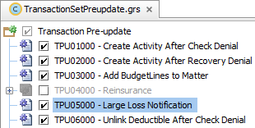
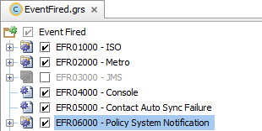
Enable rules
Step 2
Preupdate
EventMessage rules
TransactionSetPreupdate → TPU5000 - Large Loss Notification
EventFired → EFRO6000 - Policy System Notification

Slide 31
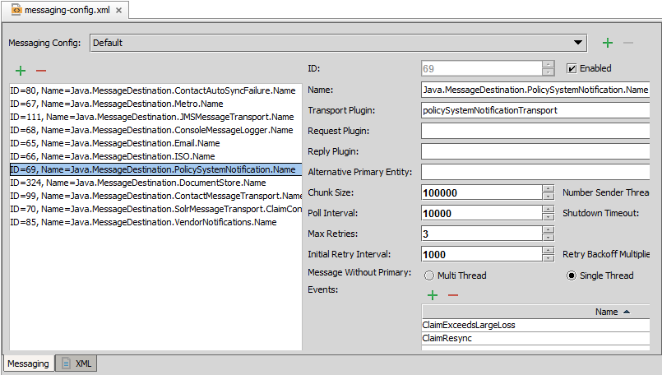
Enable the messaging destination
Step 3
Enable PolicySystemNotification messaging destination

Slide 32
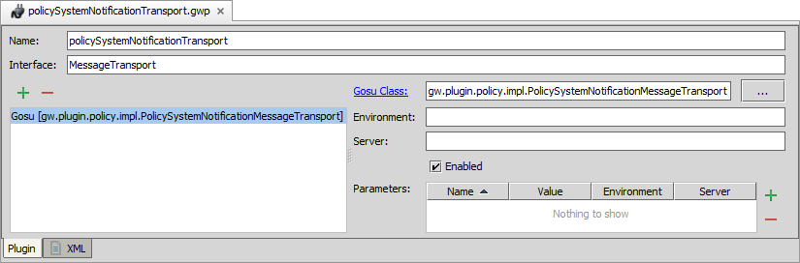
Enable the message transport plugin
Step 4
Enable the policySystemNotificationTransport plugin

Slide 33
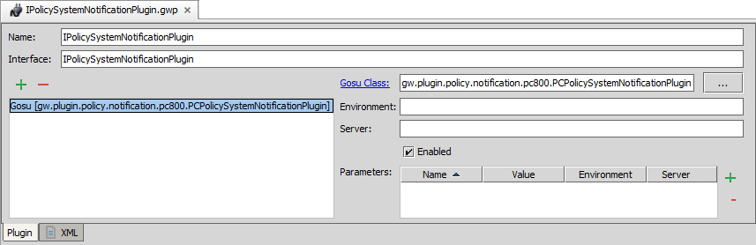
Edit IPolicySystemNotificationPlugin
Step 5
Open the IPolicySystemNotificationPlugin
Change the Gosu class to gw.plugin.policy.notification.pc800. PCPolicySystemNotificationPlugin
If disabled, enable plugin configuration
1
2

Slide 34
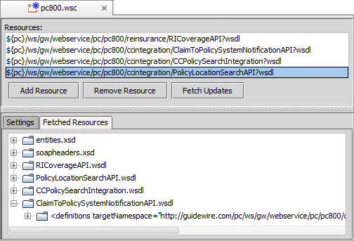
Refresh web service collection WSDL
Step 6
Open the pc800.wsc collection in Studio
…\gsrc\wsi\remote\gw\webservice\pc\pc800.wsc
To refresh the web service collection WSDL, click Fetch Updates
Notes:
The PolicyCenter server must be running in order to fetch the WSDL.

Slide 35
Deploy your changes
Step 6
Restart Server
Reload Changed Classes
Messaging destination
Plugin registry elements
Always required for cross-point integration
Class and mapping files
GWP
Plugin Registry
Messaging Destination
Rule Set Class (.grs)
Rule Class (.gr)
Notes:
You must restart the server when you create or modify destinations, plugin registry elements, and/or reply plugins.
You can deploy modified rules when the server is running in run or debug server process. If the rules exists in a new rule set, then you must restart the server.
When you activate a deactivated rule in a rule set or deactivate an activated rule in a rule set, you have modified the rule set (.grs) class.

Slide 36
Overview of PC/CC integration
Policy search and retrieval
Large loss notification
Risk analysis

Slide 37
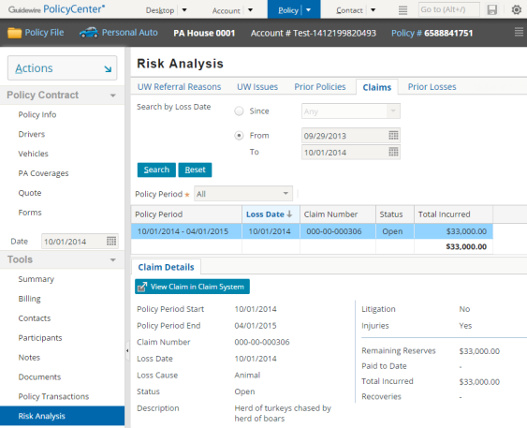
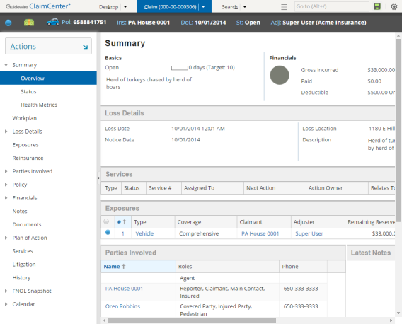
Claim information in PolicyCenter
Loss History
Claims
ClaimCenter provides loss history
View the claim in ClaimCenter
Notes:
From PolicyCenter, you can view losses on a policy or an account. In addition, you can review a claim in more detail in ClaimCenter.

Slide 38
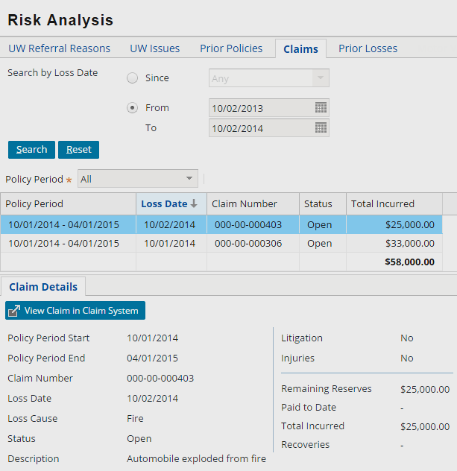
Claims search and view on a policy
Underwriter
Risk manager
To determine whether to renew a policy, underwriter or risk manager searches for claims
Filter by Policy Period
Select claim in results
View basic claim details
Open in ClaimCenter
1
2
4
3
Notes:
You can view loss claims from the Policy File (Tools → Risk Analysis → Claims).
As part of the decision to grant a policy renewal, it is primarily the underwriter and risk management staff who look for loss information from within a single policy. As the renewal date for a policy approaches, the underwriter looks at a particular policy period, examining the losses for the previous year to see if there is anything unusual. The underwriter assesses whether the level of claim activity is what can be reasonably expected for this type of business.
For the Policy Period drop-down list, the "All" selection requests that PolicyCenter sends ClaimCenter all the policy period numbers for the same policy to retrieve all the claims for the policy. A date range selection requests that PolicyCenter sends ClaimCenter the policy period numbers for the search date range so that ClaimCenter can provide PolicyCenter details about claims which occurred during that time.
When any claims are returned, the Policy Period filter enables you to filter the results for a given policy period or view all claims returned by the search.
As the renewal date for a policy approaches, the underwriter looks at a particular policy period, examining the losses for the previous year to see if there is anything unusual, for example, the level of claim activity.

Slide 39
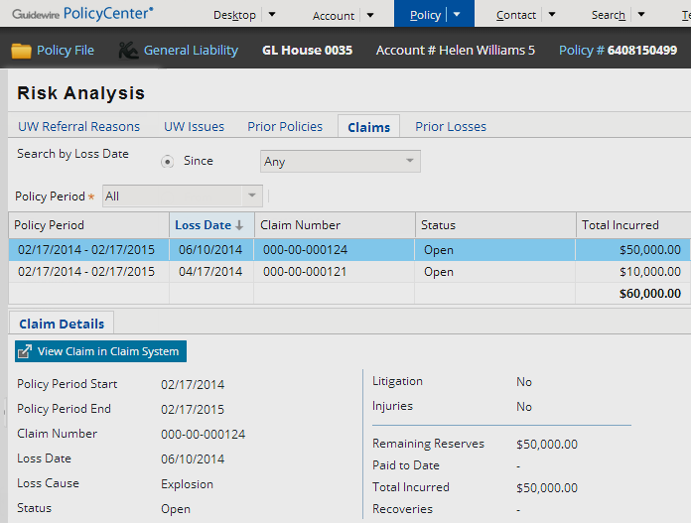
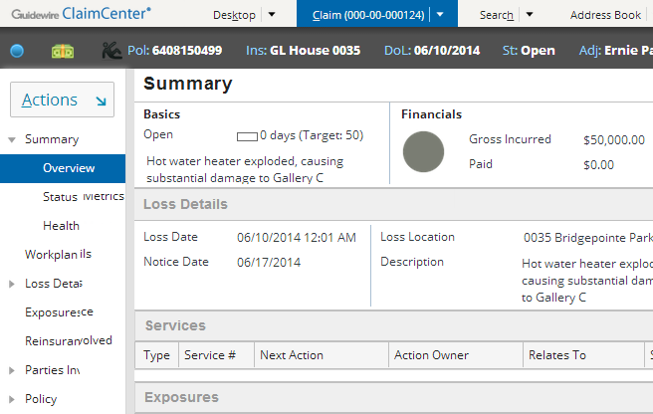
Viewing claim information for a policy
through an exit point to ClaimCenter
For a policy, underwriters with a ClaimCenter user account can view a claim in ClaimCenter
Notes:
For any policy, an underwriter with the correct ClaimCenter credentials can view more detailed claim information through an exit point in PolicyCenter to ClaimCenter.

Slide 40
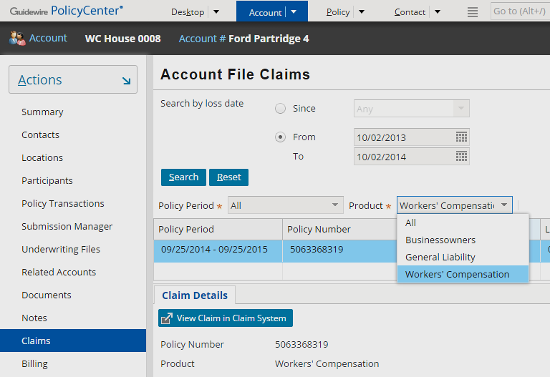
Accessing all claims for an account
Search all claims associated with the account
Filter by Policy Period
Filter by Product
Select claim in results
View basic claim details
Open in ClaimCenter
2
1
3
5
4
Notes:
From PolicyCenter, you can view all the claims associated with an Account file.
The Account → Claims page is similar to Policy → Claims page, except that this page allows you to get all the claims for the policies associated with the account. The claims that are retrieved from ClaimCenter are all claims logged against the policy periods on the account with a loss date that falls within the selected loss date criterion. Notice that the policy number and product are also shown on the page. Because there can be multiple products for the account, a product filter enables you to filter the claims based on the product type. The Product drop-down list shows only products for which the account has at least one policy.
There are several reasons to look at all the losses for a given account. For example, you may want to:
Evaluate the account to assign a score that will determine the pricing of policies
Determine whether this is a priority account that requires a dedicated claim resource
Analyze the claim activity for the account by product

Slide 41
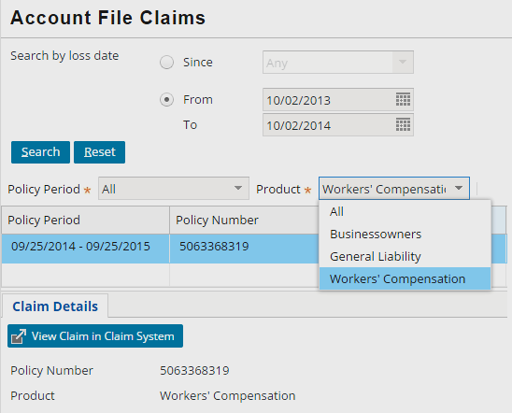
Viewing claim information for an account
through an exit point to ClaimCenter
For an account, underwriters with a ClaimCenter user account can view a claim in ClaimCenter
Notes:
For any account, an underwriter with a user account in ClaimCenter can view more detailed claim information through an exit point to ClaimCenter.

Slide 42
Renewal processing
During the renewal process, PolicyCenter automatically searches for policy claims
Same set of checks run for automated renewal workflow and manual renewal
Possible to configure the renewal process to create UW issues based on claim data
Severe UW issues block automatic processing, including renewal
Base application defines some claim-related UW issues
Manual claim review needed
Ratio of claims total incurred to policy written premium
Incidence of claims
Unable to retrieve claims information
Claim total incurred (highest cost claim)
Notes:
The renewal process is largely automated. When a renewal kicks off for a policy, PolicyCenter automatically executes the Evaluation rule sets at specific points in the process. The rules perform checks to identify and generate underwriting issues. When exceptions are generated due to blocking issues, these are caught and the renewal is then escalated to the underwriter's attention. When a new policy term is initiated, the evaluation checks likely include running a search for claims against the policy in ClaimCenter. In the default configuration, this is true for both automated and manual renewals.
The following UW issues are defined in the base application:
Manual claim review needed
Ratio of claims total incurred to policy written premium
Incidence of claims
Unable to retrieve claims information
Claim total incurred (highest cost claim)
All of the above issues are evaluated only for renewal jobs and can block bind.

Slide 43
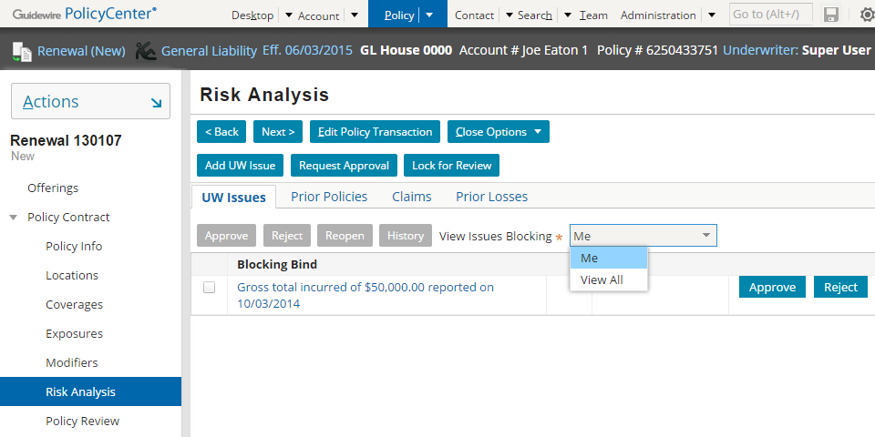
UW issues of a renewal job
For a policy renewal, the Risk Analysis UW Issues card view panel shows the issues that block the underwriter from binding the renewal
Notes:
In the slide example, the Risk Analysis screen contains a UW Issues card view panel. The card view panel shows the issues that block the binding of a policy renewal.
The View Issues Blocking drop-down list acts as a filter. A user can see the issues blocking the current user or all associated issues.

Slide 44


How does risk analysis work?
Renewal Processing / Claim Search
GWP
IClaim Search Plugin
GWClaim Search Plugin
CCClaim Search API
PCClaim Search Integration API
ViewClaim (exit point)
Claim SummaryLink (entry point)
Notes:
Once it is enabled, risk analysis works in the following way:
When a renewal is being processed (or when a user executes a claim search manually), the IClaimSearch predefined plugin is called.
The IClaimSearch plugin registry element points to gw.plugin.claimsearch.cc800.GWClaimSearchPlugin. This class calls the PCClaimSearchIntegrationAPI, which is declared in web service CCClaimSearchAPI.
If a user clicks the "View Claim in ClaimCenter" button, this button navigates to the PolicyCenter View Claim exit point, which in turn navigates to the ClaimSummaryLink entry point.

Slide 45
Steps to enable risk anaylsis
ClaimCenter
PolicyCenter
Start ClaimCenter
Open IClaimSearchPlugin
Change the Gosu class
Edit the plugin configuration
Edit configuration xml files
Refresh the Web Service collection WSDL
Deploy your changes

Slide 46
Start ClaimCenter
Step 1
gwcc dev-start
Starts ClaimCenter
PCClaimSearchIntegrationAPI web service starts
C:\Guidewire\ClaimCenter\bin>gwcc dev-start
dev-start: ==================================================== = Running main class: com.guidewire.commons.jetty.GWServerJettyServerMain
…
[JAVA] machine 2014-10-10 INFO ***** ClaimCenter ready *****

Slide 47
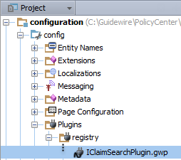
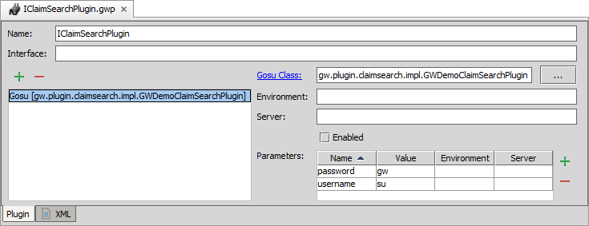
Open IClaimSearchPlugin
Step 2
In Guidewire Studio for PolicyCenter, open IClaimSearchPlugin.gwp

Slide 48
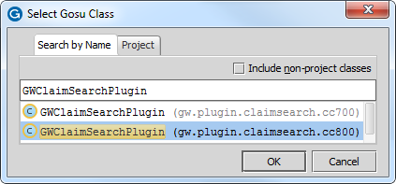
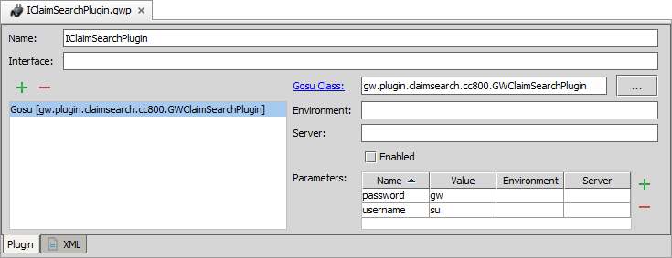
Change the Gosu class
Step 3
In Plugin Editor, change the Gosu class
Click ellipse (…)
Search for GWClaimSearchPlugin (cc800)
2
1

Slide 49

Edit the plugin configuration
Step 4
Enable, if disabled
Add username and password parameters
1
2
Notes:
In a development environment, the plugin registry element parameters can usually be set to "su" with a password of "gw".
In a production environment, the plugin registry element parameters should be set to an appropriate ClaimCenter user name and password for executing searches in ClaimCenter.

Slide 50
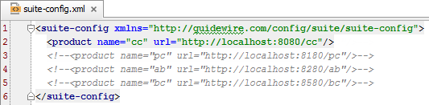

Edit configuration xml files
Step 5
Specify the URL for ClaimCenter in suite-config.xml
Add the exit point URL for ClaimCenter in config.xml
Notes:
In a development environment, the web service URL does not need to be modified if both applications are on the same machine and ClaimCenter is using the default port (8080).
In a production environment, the web service URL may need to be modified if both applications are not on the same machine or if ClaimCenter is not using the default port (8080).

Slide 51
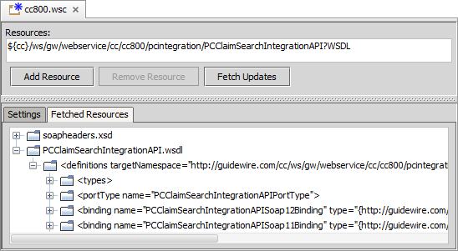
Refresh web service collection WSDL
Step 6
Open the cc800.wsc collection in Studio
…\gsrc\wsi\remote\gw\webservice\cc\cc800.wsc
To refresh the web service collection WSDL, click Fetch Updates
Notes:
The ClaimCenter server must be running in order to fetch the WSDL.

Slide 52
Deploy your changes
Step 7
Restart Server
Plugin registry elements
Always required for cross-point integration
GWP
Plugin Registry
Notes:
You must restart the server when you create or modify destinations, plugin registry elements, and/or reply plugins.

Slide 53
Describe the cross-application integration points between PolicyCenter and ClaimCenter
Enable policy search and retrieval
Enable large loss notification
Enable risk analysis

