Slide 1
GUnit Tests
20 June 2012
Notes:
GUnit Tests - <number>
Guidewire training materials contain Guidewire proprietary information that is subject to confidentiality and non-disclosure agreements. You agree to use the information in this manual solely for the purpose of training to implement Guidewire software solutions. You also agree not to disclose the information in this manual to third parties or copy this manual without prior written consent from Guidewire. Guidewire training may be given only by Guidewire employees or certified Guidewire partners under the appropriate agreement with Guidewire.

Slide 2
Lesson objectives
By the end of this lesson, you should be able to:
  Discuss the common uses for GUnit
  Create GUnit tests to unit test Gosu code
  Run GUnit tests and evaluate the results
  This lesson uses the notes section for additional explanation and information.
  To view the notes in PowerPoint, choose View→Normal or View→Notes Page.
  If you choose to print the notes for the lesson, be sure to select “Print hidden slides.”
Notes:
GUnit Tests - <number>

Slide 3
Lesson outline
Writing GUnit tests
Executing GUnit tests
GUnit test examples
Additional functionality
Notes:
GUnit Tests - <number>

Slide 4
GUnit overview
GUnit is used to configure and run repeatable tests of your Gosu code in a similar fashion as JUnit works with Java code.
  Available inside Studio
  Test any body of Gosu code except rules
  Does not allow testing of the user interface
  Can be run from Studio
  Can be automated as part of Continuous Integration
Notes:
GUnit Tests - <number>
Similar and compatible with JUnit 3.0
Continuous Integration is an automation of the application build process that can include execution of Unit tests.

Slide 5
Steps: Creating a test
Optionally create a new test class
Create a test method
Set up test data
Call the method being tested
Verify the results
Notes:
GUnit Tests - <number>
The test method you are creating can be placed in an existing test class or in a newly created class.

Slide 6
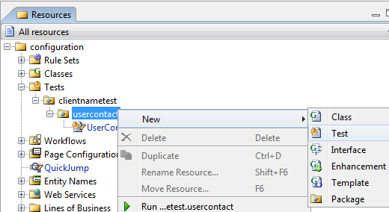
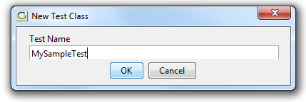
Step 1a: Optionally create a new test class
Use Studio to write GUnit Tests
Right-click on a test package and select New → Test
Recommended that the test class name end with Test
Notes:
GUnit Tests - <number>

Slide 7
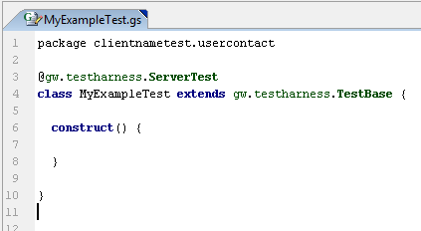
Step 1b: Review the test class
Tagged as a ServerTest
Extends gw.testharness.TestBase
Declare any constructs
Notes:
GUnit Tests - <number>
Constructs can be used to create variables or entities that are used throughout several tests.

Slide 8
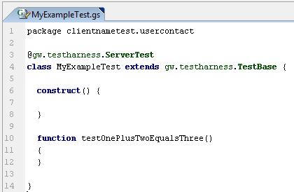
Step 2: Create a test method
Create a new function
  Function name
    Must start with test
    Should describe test being executed
Notes:
GUnit Tests - <number>

Slide 9
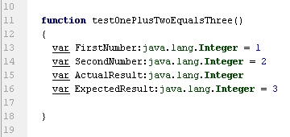
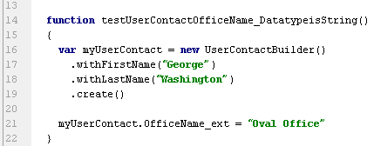
Step 3: Set up test data
Identify any classes
Declare variables
Create entities from entity builders
Notes:
GUnit Tests - <number>
Declare classes (entity builders or supporting testing classes)
Screen shots show two examples of creating data – one declaring variables and the other using an entity builder
Note that the first screen shot shows a simplified example that illustrates the setup and layout of the test function.

Slide 10
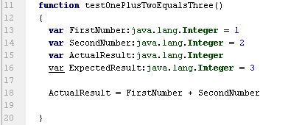
Step 4: Call the method being tested
Manipulate the test data
Calculate a value
Call a method
Notes:
GUnit Tests - <number>
More complex examples are provided later in the training.

Slide 11
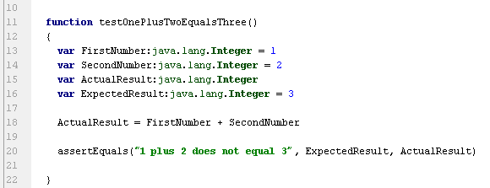
Step 5: Verify the results
Use verification functions
  assertTrue
  assertEquals
  assertNull
  assertNotNull
  And others
assertEquals() takes three arguments* (reason for failure, expected value, actual value)
Other assert statements (such as assertTrue(), assertNull()) take two arguments (reason for failure, actual value)
Notes:
GUnit Tests - <number>
AssertEquals can take two arguments (omitting the reason for failure).
If included, the reason for failure is displayed in the console.

Slide 12
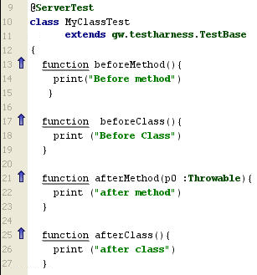
Before and after methods
Use to set up required
dependencies for tests and
to clean up afterwards
Two sets of before/after
methods:
  beforeMethod/afterMethod:
  Run before / after each test
  method is invoked
  beforeClass/afterClass:
  Run as test class is
  loaded / after all
  tests are executed
    Can initialize objects that are shared between tests
TestBase provides hooks for these methods
Notes:
GUnit Tests - <number>

Slide 13
Organizing tests
Tests should be organized into packages and classes
Test classes can have multiple test functions
Organizational considerations
  Test execution needs
    Functional areas
    Regression tests
    Local testing
    Continuous integration execution
  Performance
    Each class starts a server, executes tests, and stops the server
Notes:
GUnit Tests - <number>
Test Execution needs – Test might need to be organized by how they will be executed.
Functional Areas – If a specific functional area needs to be executed as a whole (Invoice or policy or claim)
Regression Tests – tests that need to run as a whole every time you want to regression test the application.
Local Testing – Similar to functional area organization, but allows a developer to run the right tests locally for what they are working on
Continuous Integration execution – for performance reasons, some tests may be executed on every build, some twice a day, and some once a day.
Performance – since a server starts and is stopped for each test class, loading a test class with more test functions can be more efficient, but test execution needs might conflict.

Slide 14
GUnit test annotations
An annotation is a string that starts with an "@" and provides metadata about a Gosu element
There are two types of GUnit test annotations that describe how test harness interacts with the system being used for testing
  Server runtime annotation
    Comes immediately before class definition
    Indicates how this test interacts with the Guidewire server
    For example, "@gw.testharness.ServerTest"
  Environmental tags
    Provide additional test functionalities
    Override default behavior of the system used in testing
Notes:
GUnit Tests - <number>
The @ServerTest annotation is optional, but it is added automatically by Studio whenever you create a GUnit test. Every GUnit test must extend TestBase, and TestBase includes the @ServerTest annotation. It does not need to be redeclared in any GUnit test, but having it in the GUnit test does no harm.
The test server is a "reduced footprint" Guidewire testing server. The test and server run in the same Java VM and in the same class loader. This allows the test to communicate with the server using standard variables. GUnit uses an embedded Jetty servlet container pointing at a web application to run the server tests.

Slide 15
GUnit test annotations: Environmental (1)
@ChangesCurrentTime
  Sets up mock system clock so test class can change current time
@ImportSampleData
  Imports sample data before test starts
  Creates new database with standard sample data, useful for multiple tests
  Not used in release builds
@ProductUnderTest
  Explicitly sets product being tested
    Usually inferred from test class package
    Used when Studio inference is not possible, as with gw.api tests
Notes:
GUnit Tests - <number>
Use the @IncludeModules test annotation to declare that a test is to be run with additional configuration modules. For example, suppose that you want to run a test with an alternate value for a display key. Assume the name of this test is gw.demo.MyTest, and it is located at ..\modules\configuration\resources\tests\gw\demo\MyTest.gs.
To set up the test module:
First, create a module root in the same directory as the test source and call it test-config.
Then, create a custom display properties file and place it in the correct location under the module root:locale\en_US\display.properties.
The full path to the custom display properties file would be the following:
..\modules\configuration\resources\tests\gw\demo\test-config\locale\en_US\display.properties
3. Finally, annotate the test class with the @IncludeModules annotation. The code would look similar to the following:
package gw.demo
uses gw.testharness.IncludeModules
uses gw.testharness.TestBase
@ServerTest @IncludeModules
public class MyTest extends TestBase {
}
When you run the test, Studio pulls the display key value from the display.properties file under the test-config directory root.
If you would like to use a directory other than the default test-config directory, you can specify an argument to @IncludeModules. For example:
@ServerTest @IncludeModules({"my-test-config"}) …

Slide 16
GUnit test annotations: Environmental (2)
@RunLevel
  Runs test at given run level
    Runlevel.NONE
    Runlevel.SHUTDOWN
    Runlevel.NO_DAEMONS (default)
    Runlevel.MULTIUSER
@SOAPLocalTest
  Required when testing web services
    This get the ‘soap.local’ namespace to work in GUnit
    Otherwise, the soap local typeloader is not loaded into the type system
Notes:
GUnit Tests - <number>
For a complete definition and additional tags refer to the product documentation.
Normally, the soap local typeloader is not loaded into the type system for performance and potential test-suite reliability reasons. The @SOAPLocalTest annotation overrides this behavior.

Slide 17
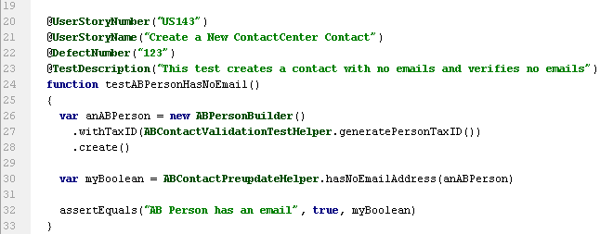
Custom annotations
Custom annotations are annotations created by a customer
  They can enhance traceability of a GUnit test
Notes:
GUnit Tests - <number>
Custom annotations provide a way to help enable traceability for your tests as you create them by added meta data properties for story numbers or defect numbers, and so on.

Slide 18
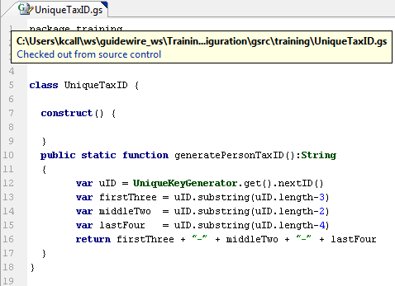
Creating test components
Entities that are used repeatedly
  Create classes that return the defined Entity
  Create constructs for re-use within a Test Class
Logic that is used repeatedly
  Create Test Helper classes/functions for code re-use
Notes:
GUnit Tests - <number>
Use test helper classes and construct statements to create re-usable entities or re-usable code for use within tests. This will help in test maintenance as a break may only need to be fixed in the re-usable code or entity, and not in all the tests that call the re-usable piece.
In this example, this is some code that creates somewhat unique tax-id’s in the SSN format to set ABContact tax ID’s. It can be reused throughout tests when creating an ABContact.

Slide 19
Lesson outline
Writing GUnit tests
Executing GUnit tests
GUnit test examples
Additional functionality
Notes:
GUnit Tests - <number>

Slide 20
Steps: Executing GUnit tests
Select the class or package of tests
Establish the Run/Debug Settings
Run the tests
Review the results
Notes:
GUnit Tests - <number>

Slide 21
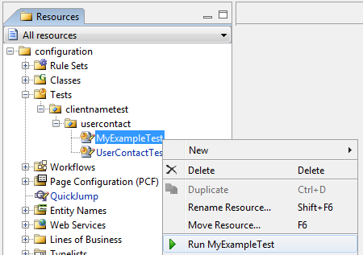
Step 1: Select the class or package of tests
Right click on the class or package
Select Run → testPackageOrClassName
Notes:
GUnit Tests - <number>
You can click on a test class or a test package. Running a test class will run all the tests in the class. Running a test package will run all the test classes in the package (or test classes in the children packages).
In this picture, only the test methods in the MyExampleTest class will be run. If clientnametest package was selected, then all classes in all packages underneath clientnametest would run.

Slide 22
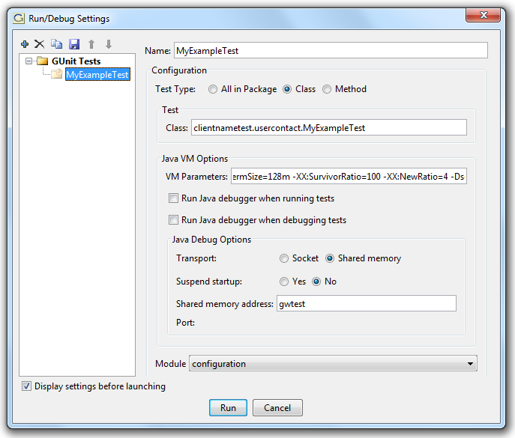
Step 2: Establish the run/debug settings
Test Type allows specifying the test(s) to run
Java VM Options allows memory and other configuration*
Module is always configuration
Click Run
Notes:
GUnit Tests - <number>
The Test Type allows you to specify to run all the tests in the package (and sub packages), or to run a specific class, or to run a specific test from a class.
*See product documentation for more information

Slide 23
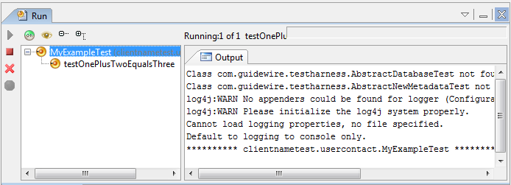
Step 3: Run the tests
Execution progress is output to the console
Suite Setup starts an in memory Jetty server
Tests are executed and results shown in the left panel
Suite Teardown stops the in memory Jetty server
Notes:
GUnit Tests - <number>
It is important to note that the server runs in memory, however the database is a physical H2 database (OOTB) as defined by the config.xml settings. This means that data that is committed to the database will remain there for the next test run. If a test is manually setting a unique key, you might run into test problems if that unique key already exists.
Also, changes made to the config/import directory are not applied to an existing database. Activity Patterns are loaded into a new database from the file in config/import. If activity patterns are added or modified in that file, etc., your tests won’t find those activity patterns without a database drop and test server restart.

Slide 24
Step 4: Review the results
Success is shown by
  Green OK circles
  Green status bar
Failure is shown by
  Red X circles
  Red status bar
  Message in the console
    Includes failure reason, expected and actual values
Notes:
GUnit Tests - <number>

Slide 25
Lesson outline
Writing GUnit tests
Executing GUnit tests
GUnit test examples
Additional functionality
Notes:
GUnit Tests - <number>

Slide 26
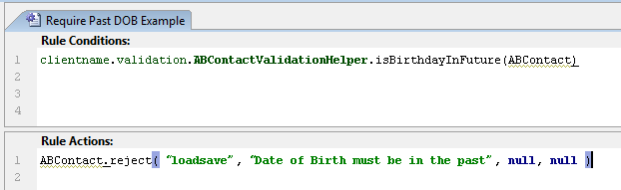
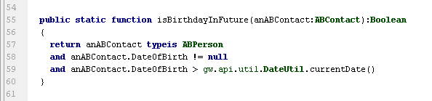
Example 1: Validation rule
ABContact Date of Birth should be in the past.
Notes:
GUnit Tests - <number>
The logic of the rule is written in a new client added Gosu Class.
This example, the function returns true of the birthday is in the future and the rule does the rejection.

Slide 27
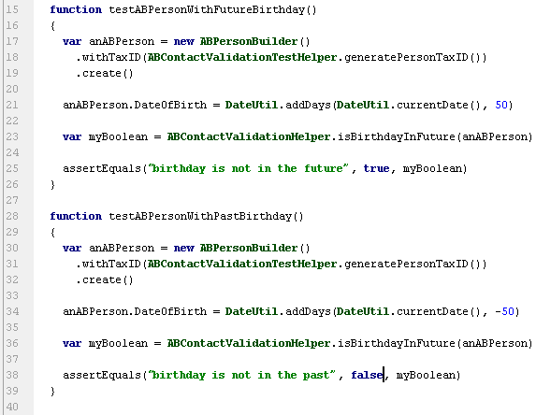
Example 1: Validation tests
Test a future birthday
Test a past birthday
Several others
  Null birthday
  Today birthday
  Etc.
Notes:
GUnit Tests - <number>
Other tests would include
Organization contact
Place contact
Null contact

Slide 28
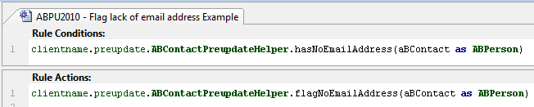
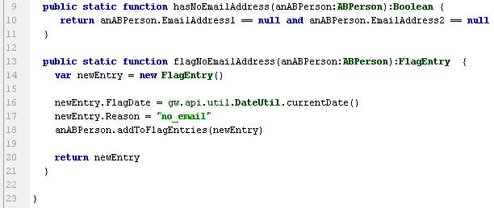
Example 2: Preupdate rule
Flag an ABPerson contact with no email address
Notes:
GUnit Tests - <number>
This rule flags an ABPerson contact if the contact has no email address.

Slide 29
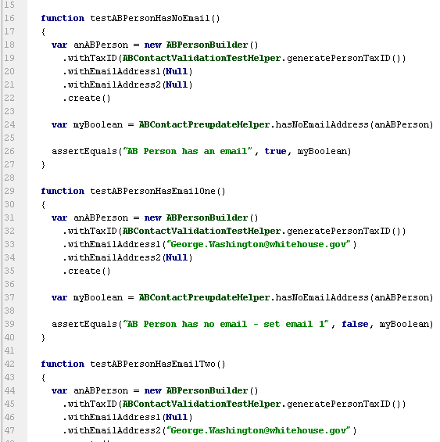
Example 2: Preupdate no email test
No email test
One email test
Two email test
Notes:
GUnit Tests - <number>
The example on the slide tests the first function of the rule, which determines whether there is no email address.
Other tests could include both emails set and so on.

Slide 30
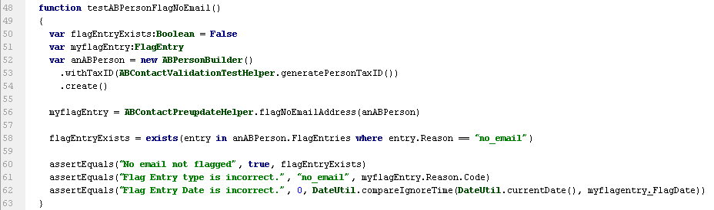
Example 2: Preupdate create flag test
Create the flag
  Test for existence
  Test for flag property values
Notes:
GUnit Tests - <number>
This test creates an ABPerson and flags the contact. Note that the way the logic is broken up, we don’t need to test that it has no email, we just need to test that the flag is created and that it has the correct properties.
We search the contact to find the no_email flag entry (if none exists, then we assume that something didn’t work correctly).
We also return the created flag entry and check its properties.

Slide 31
Lesson outline
Writing GUnit tests
Executing GUnit tests
GUnit test examples
Additional functionality
Notes:
GUnit Tests - <number>

Slide 32
Automating GUnit tests
Tests can be automated in continuous integration
Accelerator at http://guidewire.custhelp.com/
  Hudson reference implementation
  The GUnit accelerator
Notes:
GUnit Tests - <number>
This is an area that will be improved over the next several months and this will be flushed out in more detail as that happens.

Slide 33
EntityMock (for Java)
Person person = EntityMock.newEntityMock( Person.class);
person.setLastName("Doe");
//person.Bundle.commit(); //does not work
EntityMock is the Java utility class that helps in creating test data / test fixtures
There will be out-of-box mocks for base entities like Person, Address, and so on
Mock Entities are dataholders only and cannot traverse relationships – code and assign delegates to provide such increased functionality
Test data cannot be committed to the test database
Notes:
GUnit Tests - <number>
// Below is a technique for dealing with mock objects in unit test
// convert Xsd to entity and add to results
for( i = 0; i < xsdDocs.length; i++) {
entityDoc = xsdToEntity(xsdDocs[i]);
// This would fail in the standalone unit test case without a delegate, so do not call
if (serverMode.equals(ServerMode.SERVER)) {
results.addToSummaries(entityDoc);
}
}
if (serverMode.equals(ServerMode.SERVER)) {
results.setTotalResults(results.getSummaries().length);
} else { // for the Standalone case
results.setTotalResults(i);
}

Slide 34
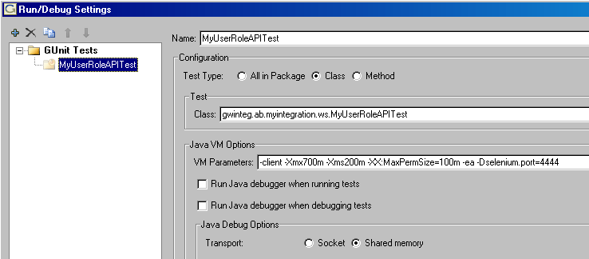
Configuring a test profile
Select All in Package to run all tests in package
  Can also run only one test method
Change the VM Parameters based on the test
  Increase heap size if you are:
    Testing a big class
    Running numerous tests
Notes:
GUnit Tests - <number>
VM args are as follows:
Xms : Initial heap size. Increasing this may improve the performance in early stages of long-running tests.
Xmx: Maximum heap size. This parameter controls how much heap memory at most this test will consume. If set too low, it may cause an out of memory error.
The rest of the args should remain as shown.

Slide 35
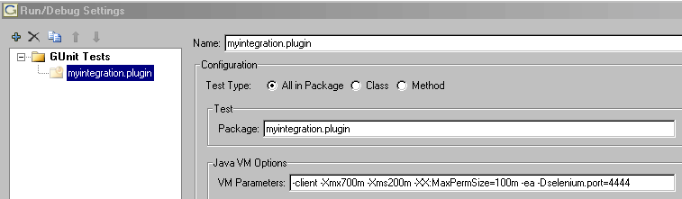
Running all tests that exist in a package
Different idea in GUnit of a "class of test classes"
  Similar to JUnit’s TestSuite
GUnit can work with a hierarchy of Test classes that you keep in parallel to the Gosu classes being tested
Run GUnit Tests at package level to include multiple test classes in the same run
Notes:
GUnit Tests - <number>
VM args are as follows:
Xms : Initial heap size. Increasing this may improve the performance in early stages of long-running tests.
Xmx: Maximum heap size. This parameter controls how much heap memory at most this test will consume. If set too low, it may cause an out of memory error.
The rest of the args should remain as shown.

Slide 36
Lesson objectives review
You should now be able to:
  Discuss the common uses for GUnit
  Create GUnit tests to unit test Gosu code
  Run GUnit tests and evaluate the results
Notes:
GUnit Tests - <number>

Slide 37
Review questions
What is GUnit used for?
What can be tested with GUnit?
What must a test method name start with?
What three parameters are usually passed to an assertEquals statement, and in what order?
What information is typically shown in the console when a test fails?
What considerations should be made when organizing tests?
How can annotations provide benefit to tests
Notes:
GUnit Tests - <number>
Answers
Used to configure and run repeatable tests of your Gosu code in a similar fashion as JUnit works with Java code. Loading Sample Data and Creating data for Unit Tests
Any body of Gosu code except rules
The word ‘test’
Failure Reason, Expected Value, Actual Value
Failure Reason, Expected Value, Actual Value
Packages and Classes are the organization tools. Functional areas, regression testing, local testing, and continuous integration builds should be considered in organizing your tests
Annotations provide metadata about your tests.

Slide 38
Notices
Copyright © 2001-2012 Guidewire Software, Inc. All rights reserved.
Guidewire, Guidewire Software, Guidewire ClaimCenter, Guidewire PolicyCenter, Guidewire BillingCenter, Guidewire Reinsurance Management, Guidewire ContactManager, Guidewire Vendor Data Management, Guidewire Client Data Management, Guidewire Rating Management, Guidewire InsuranceSuite, Guidewire ContactCenter, Guidewire Studio, Gosu, Deliver Insurance Your Way, and the Guidewire logo are trademarks or registered trademarks of Guidewire Software, Inc. in the United States and/or other countries.
This material is Guidewire proprietary and confidential. The contents of this material, including product architecture details and APIs, are considered confidential and are fully protected by customer licensing confidentiality agreements and signed Non-Disclosure Agreements (NDAs).
This file and the contents herein are the property of Guidewire Software, Inc. Use of this course material is restricted to students officially registered in this specific Guidewire-instructed course, or for other use expressly authorized by Guidewire. Replication or distribution of this course material in electronic, paper, or other format is prohibited without express permission from Guidewire.
    Guidewire products are protected by one or more of the following patents: U.S. Patents 6,073,109; 6,058,413; 5,734,837; 5,630,069; 5,208,748; 7,885,831; 7,788,296.
Notes:
Entity Builders - <number>

