Slide 1
Introduction to Guidewire Configuration
3 October 2013

Slide 2
Lesson objectives
By the end of this lesson, you should be able to:
Describe the product architecture for Guidewire products
Describe the primary components used to configure Guidewire products
Describe the relationship between the Guidewire platform and the Guidewire applications
Explain the basic functionality of TrainingApp
Start a development instance of a Guidewire application
Describe the purpose of Guidewire Studio
This lesson uses the notes section for additional explanation and information. To view the notes in PowerPoint, choose View→Normal or View→Notes Page. If you choose to print the notes for the lesson, be sure to select “Print hidden slides.”

Slide 3
Lesson outline
Guidewire product architecture
Guidewire configuration technology
The Guidewire platform
TrainingApp
Starting Guidewire applications
Guidewire Studio

Slide 4




Guidewire InsuranceSuite
Guidewire InsuranceSuite is a set of three core products that meet the core needs of property and casualty insurance carriers
All Guidewire products are part of a three-tier architecture
bill policy holders for policies, and pay commissions for policies to producers
create, modify, renew, and cancel policies
process claims to provide payments to claimants when covered losses occur
Notes:
Guidewire offers a set of applications designed to help property and casualty insurance companies expedite their policies, billing, and claim requirements:
ClaimCenter is an application designed to manage the process of reporting, verifying, and making payments on claims against a policy.
PolicyCenter is an application designed to issue, modify, and maintain data about policies.
BillingCenter is an application designed to issue and track the premium payments for policies and associated account charges.
Each application can function by itself, and each can be integrated with the other applications.
PolicyCenter can be integrated with BillingCenter, so that the two applications can share information about the payment expected, the payment schedule, and the possible cancellation of a policy if payments are not received.
PolicyCenter can be integrated with ClaimCenter, as ClaimCenter needs information about what was on the policy to determine if a loss is covered, and PolicyCenter needs to know what claims were filed to determine if the policy should be renewed and at what rate.
Although less common, BillingCenter can be integrated with ClaimCenter. This is typically done for business situations like subrogation in which the insured suffers a loss that a third party's insurance should pay for. ClaimCenter identifies that subrogation is expected, and BillingCenter manages the invoices sent to the third party's insurance provider.
There is a fourth application, ContactManager, which is used to manage information for contacts (such as auto repair, doctor, and legal vendors who participate in claims adjudication) and can be integrated with the other Guidewire applications.
Three-tier architecture is a client-server architecture in which the functional process logic, data storage and user interface are developed and maintained as independent modules on separate platforms. Three-tier architecture is one of the industry-standard software architectures.

Slide 5
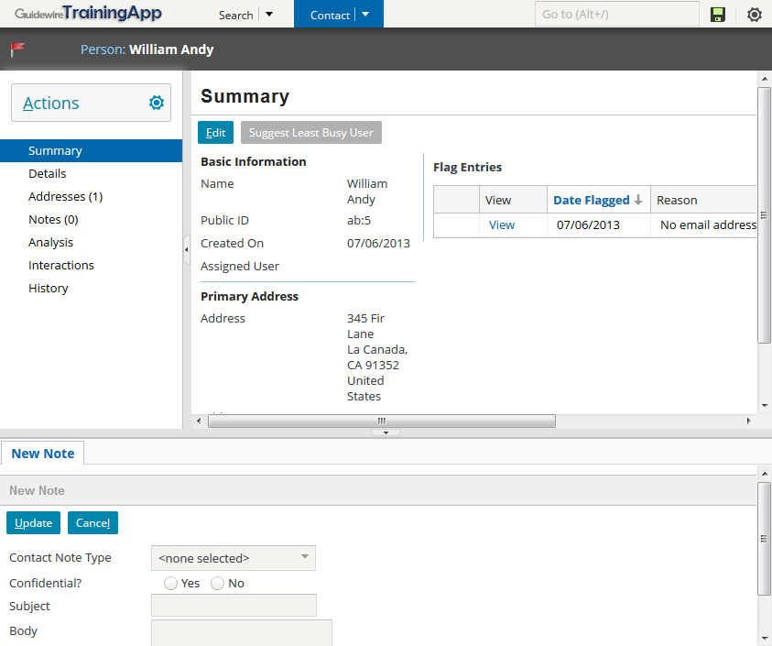
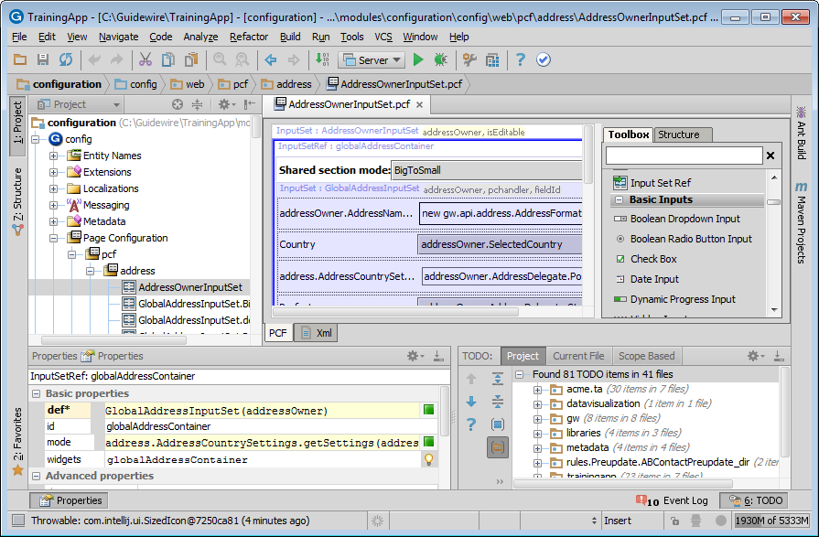
Guidewire 8.0 platform
The Guidewire 8.0 platform includes some significant improvements including:
Robust UI framework
Studio functionality moved to full-featured, industry-standard IDE (IntelliJ)
Notes:
All lessons covering platform functionality have been developed on TrainingApp, the platform application developed by Guidewire Education to simplify platform functionality discussions by separating the functionality from the core applications.

Slide 6
The application tier
App. Server Machine
J2EE Application Server
The application tier contains the functional process logic
Guidewire supports the following application servers:
WebSphere
WebLogic
Jetty (for development only)
Apache Tomcat
JBoss EAP
Notes:
Introduction to Guidewire Configuration - 6
All Guidewire applications are run within an application server. This is a robust piece of software that can run enterprise-wide applications. There are several different types of application servers. The type of application server used by Guidewire applications is a Java Enterprise Edition (Java EE) server. The platform was known as Java 2 Platform, Enterprise Edition or J2EE until the name was changed to Java EE in version 5.
Each Guidewire application is built and deployed as an Web Application Archive (WAR) or Enterprise Application Archive (EAR) file to the application server. It contains all the configuration, operational data and data definition files necessary to execute the application.
The application server is typically installed on a dedicated machine that does not host any other aspects of the architecture, such as the database. This machine must use an operating system supported by your third party application server vendor (or Guidewire, in the case of Apache Tomcat).
Guidewire supports the operating systems for which application servers provide customer support. For details, review the customer-viewable document Platform Matrix.
The Guidewire application (the center box) consists of a set of business rules, a user interface, a set of integration APIs, and a data model. The technology for configuring these application elements is platform-level (and common to all Guidewire applications), but the specific rules, UI, APIs, and data model for each application are distinct.
Refer to the "Guidewire Platform Support Matrix" for the latest and most complete information about the software Guidewire supports. You can access it from the customer portal by navigating to http://guidewire.hivelive.com/pages/home, selecting "Resources -> Documentation", and clicking "Platform Matrix".

Slide 7
The data tier
DB Machine
App. Server Machine
J2EE Application Server
Application Database
The data tier contains the business and operational database
Guidewire supports the following RDBMs:
Oracle Enterprise
Microsoft SQL Server
H2 for development only
Notes:
Introduction to Guidewire Configuration - 7
A relational database is a collection of data structure named tables that are linked (or related) to each other. The operational data for the Guidewire application is stored inside a relational database. This database is typically hosted on a machine other than the machine hosting the Java EE application server.
The war file contains a file named config.xml that specifies which database to connect to and how to establish the connection.
Refer to the "Guidewire Platform Support Matrix" for the latest and most complete information about the software Guidewire supports. You can access it from the customer portal by navigating to http://guidewire.hivelive.com/pages/home, selecting "Resources -> Documentation", and clicking "Platform Matrix".

Slide 8

The presentation tier
DB Machine
App. Server Machine
User Machines
J2EE Application Server
Application Database
The presentation tier contains the user interface
The Guidewire user interface is supported in these web browsers:
Internet Explorer 7.0, 8.0, or 9.0
Notes:
Introduction to Guidewire Configuration - 8
End-users connect to the application using a web browser. Each application generates a collection of standard HTML pages that are rendered by the browser. Each application is a server-side application. It dynamically generates the HTML pages and data within those pages. It makes only a minimal use of functionality in the client (the web browser). Because there are no static HTML files, you cannot use the browser's Back button. All navigation is controlled on the server side.
In a development environment, you do not have to stop the application to deploy configuration changes to the business rules or the user interface. You must stop the application to deploy configuration changes to the data model. You may or may not need to stop the application to deploy configuration changes to integration APIs, depending on the nature of the change.
In a production environment, configuration changes are typically made by rebuilding and redeploying the application's war file. This always involve stopping and restarting the application.
Refer to the "Guidewire Platform Support Matrix" for the latest and most complete information about the software Guidewire supports. You can access it from the customer portal by navigating to http://guidewire.hivelive.com/pages/home, selecting "Resources -> Documentation", and clicking "Platform Matrix".

Slide 9
External systems
DB Machine
App. Server Machine
User Machines
J2EE Application Server
Application Database
Policy Admin.
Authen- tication
Document Storage
Address Book
Check Printing
Notes:
Introduction to Guidewire Configuration - 9
Each application is typically integrated with a number of external systems. The connections to these systems are configured through the application APIs.

Slide 10
Gosu
DB Machine
App. Server Machine
User Machines
J2EE Application Server
Application Database
Policy Admin.
Authen- tication
Document Storage
Address Book
Check Printing
Notes:
Introduction to Guidewire Configuration - 10
Gosu is an open-source, publicly-available programming language created by Guidewire. It is similar to Java. Gosu is used to specify runtime business logic that:
Executes fundamental application behavior
Manages complex business processes
Specifies dynamic client-side behavior
Gosu can be used to affect behavior throughout the product architecture. This includes:
Application behavior (such as specifying business rule behavior, methods, and entity enhancements)
Client-side behavior in the web browser (such as reflecting the change of the value in one field in some other field)
Data model behavior (such as specifying which fields to concatenate for the "display name" of a given object)
Integration behavior (such as defining the behavior of a web service that responds to requests from external applications)
Guidewire developed Gosu for several reasons. First, there was a desire to have a single syntax that could be used to work with all of the elements relevant to Guidewire products (such as entities, display keys, classes, class enhancements, Java classes, permissions, and script parameters) even though these items have fundamentally distinct internal implementations. There was no existing language that provided this ability. Second, there was a desire to have a code auto-complete feature in Guidewire Studio, the primary tool used to complete Guidewire configuration tasks. This is possible only with a statically-typed language. Most scripting languages, such as JavaScript, Perl, Python, and Ruby, are dynamically-typed.

Slide 11
Lesson outline
Guidewire product architecture
Guidewire configuration technology
The Guidewire platform
TrainingApp
Starting Guidewire applications
Guidewire Studio

Slide 12


Guidewire configuration technology
database
application server
user interface
integration
Guidewire has four core areas of configuration technology
There is one area of technology for each tier of the architecture
There is a fourth area of technology for the development of integration points to external systems

Slide 13
Data tier is configured via data model entities
database
application server
user interface
data model entity
ABContact
Name
PublicID CreateTime
…
row in db table
ab_abcontact
Coverage
Notes:
A data model entity is an abstract definition of a group of objects used by the data tier, such as Address Book contacts, or ABContacts. It defines the information about the objects that must be stored in the database, such as Name, PublicID, and CreateTime. It is defined in a set of one or more XML files.
In most cases, each data model entity corresponds to a table in the database. The data model entity definition defines the table structure. Each instance of the data model entity is stored as one row in the database table.

Slide 14
Application tier is configured via Gosu
database
application server
user interface
data model entity
internal Gosu class
ABContact
ABContact
Name
PublicID CreateTime
…
Fields Name PublicID CreateTime ...
row in db table
ab_abcontact
anAB Contact
Coverage
instance of Gosu class
Notes:
A Gosu class is an abstract definition of a group of objects used by the application tier, such as Address Book contacts, or ABContacts. It defines the information about the objects that must be maintained in the application server's run-time environment, such as Name, PublicID, and CreateTime. It is defined in a set of one or more Gosu files that have a proprietary format and a ".gs" extension.
For every data model entity, the Guidewire application automatically creates an internal Gosu class with the same name. For every field in the data model entity, there is a field in the corresponding internal Gosu class. For example, the ABContact data model entity has a "Name" field, and the internal ABContact Gosu class also has a "Name" field.
Whenever the application needs to work with an instance of a data model entity (which is stored as a row in the corresponding database table), the application creates an instance of the corresponding Gosu class. The information from the database is then read into that instance. For example, if a user searches for the ABContact whose name is "Express Auto", then the application finds the row in the database table for ABContact, creates an instance of the ABContact Gosu class, and reads the data from that row into that instance.

Slide 15
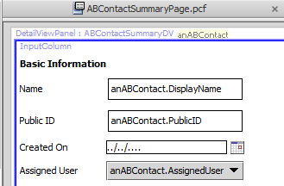
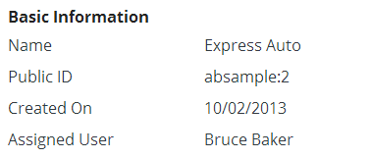
Presentation tier is configured via PCFs
database
application server
user interface
page configuration file
data model entity
internal Gosu class
ABContact
ABContact
Name
PublicID CreateTime
…
Fields Name PublicID CreateTime ...
UI form with data
row in db table
ab_abcontact
anAB Contact
Coverage
instance of Gosu class
Notes:
A PCF (Page Configuration File) is an abstract definition of a form or location used by the user interface tier, such as an "ABContactSummaryDV" detail view used to display information about ABContacts. It defines the information about the objects to be displayed in the user interface, such as a Name field, a PublicID field, and a CreateTime field. It is defined in a set of one or more XML files using the proprietary PCF XML schema definition.
There is a strong correspondence between data model entities and internal Gosu classes. Every data model entity has one internal Gosu class. There isn't necessarily a strong correspondence between internal Gosu classes and PCFs. The data for one Gosu class could be displayed in a single PCF, or it could be displayed across multiple PCFs. The separation of the user interface tier and the application server tier gives developers the freedom to display data in whatever way makes sense to end users without being constrained by how that data is maintained in the application server or how the data is stored in the database.

Slide 16
Data flow from database to user interface
database
application server
user interface
page configuration file
data model entity
internal Gosu class
ABContact
ABContact
Name
PublicID CreateTime
…
Fields Name PublicID CreateTime ...
UI form with data
read from db
display in UI
row in db table
ab_abcontact
anAB Contact
Coverage
instance of Gosu class
Notes:
Whenever a user needs to work with an instance of a data model entity, such as the ABContact named "Express Auto":
The application queries for the data row from the database table.
The application creates an instance of the corresponding Gosu class and reads the information into that instance.
The application sends the data in that instance to the web browser. The web browser displays the form as defined in the given PCF and populates the form with data from the instance.

Slide 17
Data flow from user interface to database
database
application server
user interface
page configuration file
data model entity
internal Gosu class
ABContact
ABContact
Name
PublicID CreateTime
…
Fields Name PublicID CreateTime ...
UI form with data
read from db
display in UI
row in db table
ab_abcontact
anAB Contact
Coverage
update to db
modify in UI
instance of Gosu class
Notes:
Whenever a user needs to save data, such as changing the name of the ABContact named "Express Auto":
The information is modified in the user interface and then posted to the application server.
The application server inserts data into the database table (if the object being saved in the UI is a new object) or updates data in the database table (if the object being saved in the UI is an existing object that has been modified).
Be aware that there is variation in when data modifications made in the user interface get sent to the application server and/or the database.
In some situations, data in the user interface is not immediately sent to the application server (or saved to the database).
In some situations, data in the user interface is sent to the application server but not immediately saved to the database.
In some situations, data in the user interface is sent to the application server and also saved to the database at the same time.
This issue is discussed in further detail later in the course.

Slide 18
Integration is done via integration mechanisms
database
application server
user interface
data model entity
internal Gosu class
page configuration file
ABContact
ABContact
Name
PublicID CreateTime
…
Fields Name PublicID CreateTime ...
ab_abcontact
anAB Contact
Coverage
integration
predefined plugins web services
messaging startable plugin
Notes:
Guidewire applications share information with external systems using a variety of industry-standard technologies. This can include:
Writing information to or reading information from an operating system file
Writing information to or reading information from an external database
Using remote procedure calls (such as web services) to share data with other applications directly
Using message queues to request data from external systems asynchronously
Guidewire applications have a set of integration mechanisms that make use of the industry-standard technologies listed above. This can include:
Predefined plugins - A predefined plugin is a Gosu or Java class which implements a set of methods called by internal code and is related to fundamental application behavior. For example, the authentication plugin implements methods that define how authentication is executed against an external authentication system, such as an LDAP server.
Web services - A Guidewire web service is written in Gosu. External applications can use it to make synchronous calls to Guidewire. For example, an ABContactAPI web service might allow external systems to retrieve information about a given contact, such as its phone number.
Messaging - Messaging is a Guidewire integration mechanism in which messages are asynchronously sent to external systems in response to the creation or change of business data. For example, you may want to verify a newly created bank account exists with the external financial system. If this verification is not needed immediately, you could use messaging.
Startable plugins - A startable plugin listens for requests from an external system that communicates with Guidewire via a mechanism such as JMS Messaging or TCP/IP. It is triggered by an incoming external request, and it typically processes the message asynchronously. For example, an external system may want to submit payments for a given ABContact. If the payments do not need to be processed immediately, you could process them with a startable plugin.

Slide 19
Lesson outline
Guidewire product architecture
Guidewire configuration technology
The Guidewire platform
TrainingApp
Starting Guidewire applications
Guidewire Studio

Slide 20
The Guidewire platform
ClaimCenter
PolicyCenter
BillingCenter
Data Model
User Inter.
Data Model
User Inter.
Data Model
User Inter.
App. Logic
Int. Mech.
App. Logic
Int. Mech.
App. Logic
Int. Mech.
Guidewire Platform, with a common technology for configuring...
Data Model
User Interface
Application Logic
Integration Mechanisms
Notes:
The Guidewire platform is layer of configuration technology that includes the functionality needed to define a Guidewire applications. For example, it includes:
The technology to define a data model
The technology to define a user interface
The technology to define application logic
The technology to define integration points
Every application uses this common technology to define its own data model, user interface, business logic, and integration points. Each application is distinct, but every application shares common abilities and configuration techniques with all the other applications.

Slide 21
Application-specific functionality
ClaimCenter
PolicyCenter
BillingCenter
Finan- cials
Group Access
Product Model
Job- flow
Billing Plan
Payment Plan
Fraud Detection
Claim Maturity
Role Assign.
Policy Validation
Charge Pattern
Delinq. Workflow
Data Model
User Inter.
Data Model
User Inter.
Data Model
User Inter.
App. Logic
Int. Mech.
App. Logic
Int. Mech.
App. Logic
Int. Mech.
Guidewire Platform, with a common technology for configuring...
Data Model
User Interface
Application Logic
Integration Mechanisms
Notes:
Each application also has application-specific functionality. For example:
The PolicyCenter-specific functionality includes:
The product model, which defines products, the policy lines assigned to each product, the coverages and coverables for the product, and the coverage terms for those coverages.
Jobflow, which defines how policy transactions (such as submissions, renewals, changes, and cancellations) are executed.
Role assignment, which defines how users are assigned responsibility for a given account, policy, or policy transaction.
Policy validation, which validates that a given policy is valid, quotable, bindable, or issuable.
The BillingCenter-specific functionality includes:
The management of invoices over the billing cycle from planned to billed to due and ultimately to paid.
The production of provider commission statements for business collected directly from the client and the production and reconciliation of account statements where the provider collects monies due.
The management of processing exceptions and events such as account statement queries. These are known as trouble tickets within BillingCenter.
The management of the escalation cycle invoked when a payment becomes overdue and the account becomes delinquent.
(continued)

Slide 22
Configuration courses
ClaimCenter
PolicyCenter
BillingCenter
Finan- cials
Claim Validation
Product Model
Job- flow
Billing Plan
Payment Plan
Claim Maturity
AB Integration
Role Assign.
Policy Validation
Charge Pattern
Delinq. Workflow
Application Configuration
Data Model
User Inter.
Data Model
User Inter.
Data Model
User Inter.
App. Logic
Int. Mech.
App. Logic
Int. Mech.
App. Logic
Int. Mech.
Guidewire Platform, with a common technology for configuring...
"Fundamental" Configuration
Data Model
User Interface
Application Logic
Integration Mechanisms
Notes:
Guidewire Education divides configuration technology into two categories: platform (also known as "fundamental") and "application-specific".
The "fundamental" configuration technology is the technology common to all Guidewire applications. One could think of it as the technology embedded within the Guidewire platform. This courses focuses on the fundamental configuration technology.
The "application-specific" technology is the technology added to each Guidewire application to enable it to do policy-specific, billing-specific, or claim-specific processing.
The integration technology is covered in the "Application Integration" courses. This course does not focus on integration technology.

Slide 23
Lesson outline
Guidewire product architecture
Guidewire configuration technology
The Guidewire platform
TrainingApp
Starting Guidewire applications
Guidewire Studio

Slide 24
TrainingApp
TrainingApp
TrainingApp is a "platform" application developed exclusively for training
Simplifies learning of fundamentals:
Simple examples of each "fundamental" configuration feature
Smaller number of entities and screens
Excludes complex functionality designed for policy, billing, and claims processing
Data Model
User Inter.
App. Logic
Int. Mech.
Guidewire Platform, with a common technology for configuring...
Data Model
User Interface
Application Logic
Integration Mechanisms
Notes:
TrainingApp is not sold as genuine Guidewire product. It is used and maintained exclusively by Guidewire Education.
The training application also has fundamental integration examples. These examples are discussed in the various "Application Integration" courses.

Slide 25
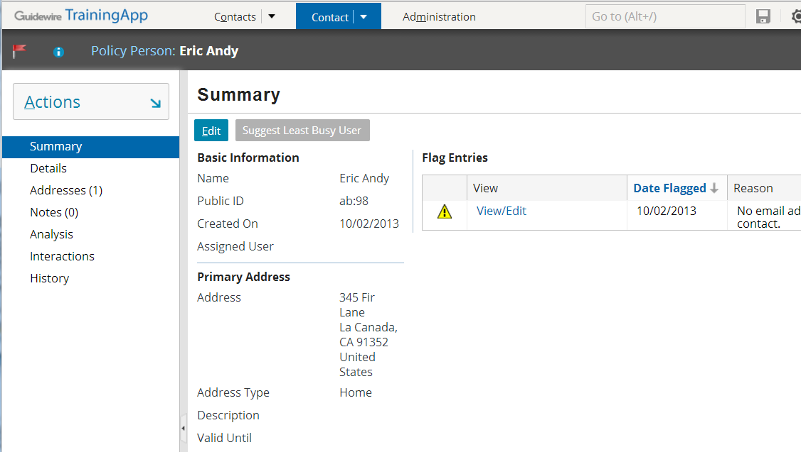
TrainingApp as a "business solution"
TrainingApp is designed to look like a mock contact management application
It is intended to store information about contacts for insurance carriers
Notes:
TrainingApp is based on Guidewire's ContactManager application. However, much of the ContactManager functionality has been removed or simplified to promote the learning of configuration fundamentals.

Slide 26
TrainingApp data model
FinanceManager
ABContact
AllAddresses
Address
History
History Entry
AssignedUser
FlagEntries
Flag Entry
FinancialSummary
ContactNotes
Contact Note
User
BankAccounts
Bank Account
Financial Summary
ServiceEvaluations
Service Evaluation
Notes:
The core of the TrainingApp data model consists of nine entities and a small number of relationships which all center around ABContact.
The ABContact entity stores contacts. ("AB" stands for "Address Book". Many insurance carriers refer to their contact application as an Address Book.) The ABContact entity is subtyped, which is represented in the diagram above by the three small rectangles inside the ABContact rectangle. This is discussed in more detail on the following slide.
The Address entity stores addresses. An ABContact has one to many addresses.
Each contact has a history, which is a list of important occurrences in the life of that contact. The HistoryEntry entity stores a single entry in the ABContact's history. Given that a history entry is created to note the creation of the contact, every ABContact has one to many history entries.
The FlagEntry entity stores a flag entry. A flag entry is an issue pertaining to the ABContact which someone should attend to. An ABContact is "flagged" when it has one or more open flag entries. An ABContact can have zero to many flag entries.
The ContactNote entity stores notes about the ABContact. A contact note is a free-form text entry used to capture miscellaneous information about the contact. An ABContact can have zero to many contact notes.
The BankAccount entity stores bank account information. An ABContact can have zero to many bank accounts.
The Service Evaluation entity stores information about a service evaluation, which evaluates the quality of the service provided by the contact and is most appropriate for vendor contacts such as doctors, lawyers, and auto repair shops. An ABContact can have zero to many service evaluations.
The User entity stores information about TrainingApp users. An ABContact may have zero or one assigned users.
The FinancialSummary entity stores information about an ABContact's financial summary. An ABContact may have zero or one financial summaries.

Slide 27
ABContact is subtyped
ABContact
primary subtypes
ABPerson
ABCompany
ABPlace
ABAdjud- icator
ABPerson Vendor
ABPolicy Person
ABCompany Vendor
ABPolicy Company
ABLegal Venue
AB Attorney
AB Doctor
AB LawFirm
ABMedical CareOrg
ABAuto TowingAgcy
ABAuto RepairShop
Notes:
ABContacts are organized into a set of subtypes. The organization of the hierarchy helps to model information about contacts. Information common to all contacts can be established at the ABContact level. It is automatically inherited by all of its subtypes. Information specific to an ABPerson can be put at the ABPerson level. It will be inherited by all of its subtypes, but information on the ABPerson subtype is not available to ABCompany or ABPlace.
In the ABContact hierarchy, an ABPolicyPerson is a person who owns a policy issued by the carrier (such as an individual with a personal auto policy). An ABPolicyCompany is a company that owns a policy issued by the carrier (such as a construction company with a workers' compensation policy).
There is one entity that participates in the hierarchy that does not appear in the diagram above: ABUserContact. This type of contact represents a TrainingApp user and is used to store his or her contact information (such as home phone numbers). It has been excluded because it is not relevant to the configuration work to be done with TrainingApp.
Subtyping is also used within the three primary applications. For example:
BillingCenter's Activity, Plan, and Contact entities
ClaimCenter's Transaction, Incident, and Contact entities
PolicyCenter's Job and Contact entities

Slide 28
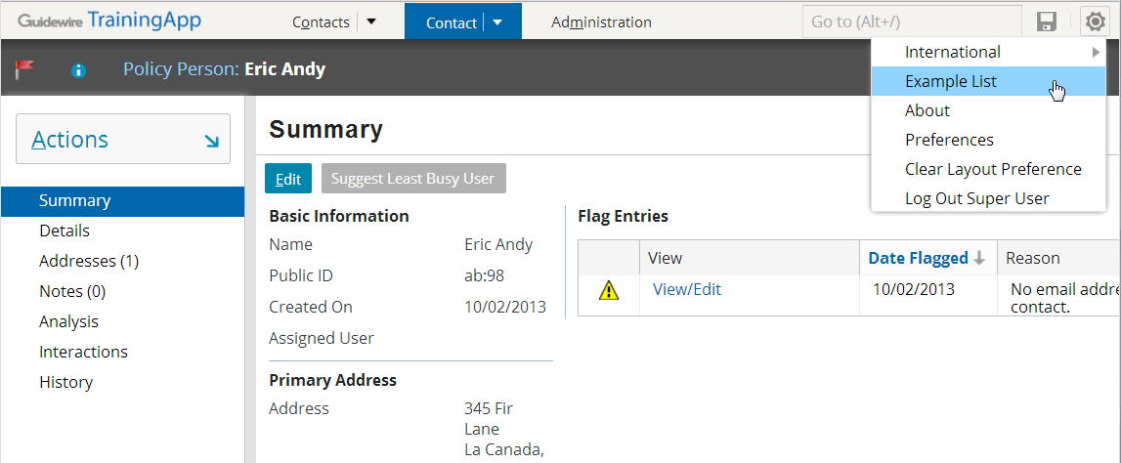
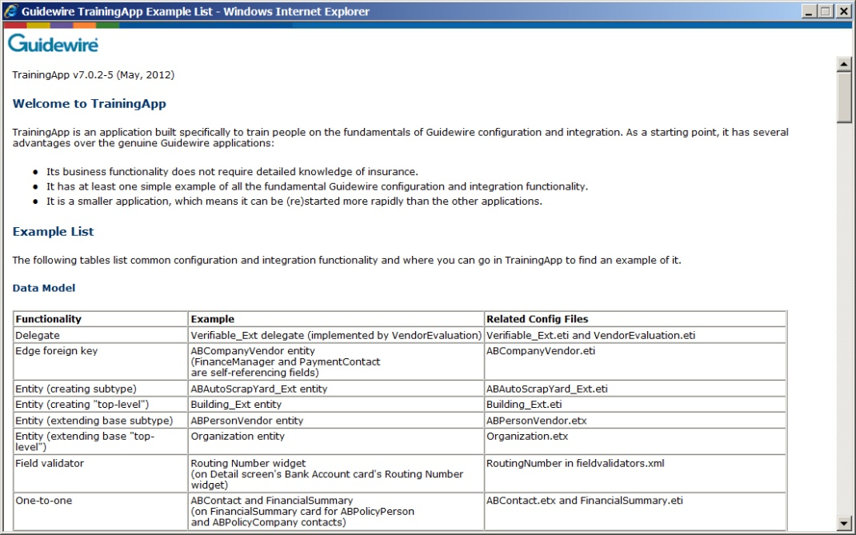
TrainingApp user interface
Examples of all fundamental UI configurations
List of where examples can be found
Notes:
The TrainingApp user interface is simple and straightforward.
Users can search for ABContacts on the Search tab. Once an ABContact is selected, it is displayed on the Contact tab.
The Contact tab has four pages for the high-level areas of ABContact information (summary, details, addresses, notes, interactions, and history).
The Details tab contains a set of cards (such as "Company Info", "Phone & Addresses", "Bank Accounts", "Vendor Info", and "Analysis" shown above.) Some of the cards appear for all contacts (such as "Phone & Addresses"). Others are conditional and appear only when it is appropriate for the type of ABContact. (For example, "Company Info" is displayed only for ABContacts that are ABCompanies. "Vendor Info" is displayed only for ABContacts that are ABPersonVendors or ABCompanyVendors.)
TrainingApp is incomplete by design. Certain portions of the user interface have incomplete functionality. Students complete the functionality during one of the Guidewire training courses.
TrainingApp also has at least one example of virtually every objective in the Configuration Fundamentals course. To find an example of any fundamental configuration technology, click the Example List link. This displays a list of examples arranged alphabetically by primary area (Data Model, User Interface, Gosu, and Cross-Section Functionality).

Slide 29
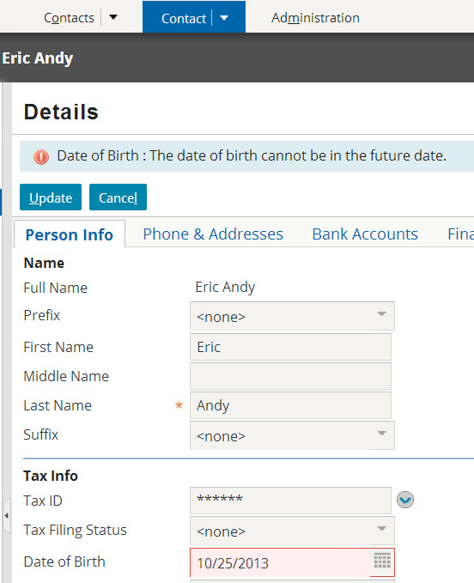
TrainingApp application logic
TrainingApp has examples of how Gosu can be used to express application logic, including:
Business rules
PCF methods
Enhancements
Static methods in Gosu classes
Script parameters
Widget attributes
Notes:
The screenshot above shows an example of application logic specified as a widget attribute. The "Date of Birth" widget has a validation expression that identifies the value provided cannot be greater than the current date. If this validation expression fails, then the update is blocked and the message "The data of birth cannot be in the future" is displayed in the user interface.

Slide 30
Lesson outline
Guidewire product architecture
Guidewire configuration technology
The Guidewire platform
TrainingApp
Starting Guidewire applications
Guidewire Studio

Slide 31
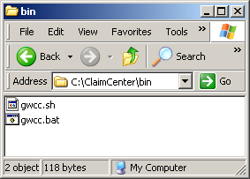
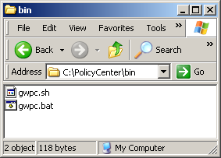
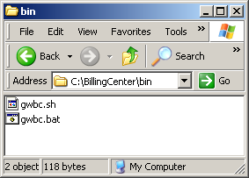
Parallel structure of Guidewire applications
All Guidewire applications have a similar directory structure and are started using the same basic tasks

Slide 32
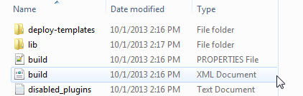

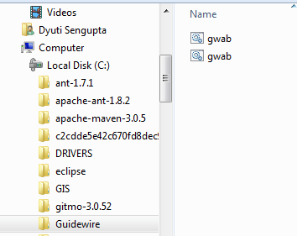
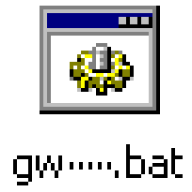
Files used to start application
build.xml defines administration tasks:
Starting application
Building web application archive (WAR) files
Generating data and security dictionaries
"gw" batch file used to launch tasks defined in build.xml
Located in <install>\bin
Notes:
Every application's build.xml file is in <installDirectory>\modules\ant.
Every application's gw--.bat file is in <installDirectory>\bin. The name of the gw batch files varies from application to application.
TrainingApp: gwta.bat
BillingCenter: gwbc.bat
ClaimCenter: gwcc.bat
ContactManager (Address Book): gwab.bat
PolicyCenter: gwpc.bat

Slide 33
Commonly performed tasks
 | Start Application in Dev Mode | Regenerate Dictionaries | Stop Application
TrainingApp | gwta dev-start | gwta regen-dictionary | gwta dev-stop
BillingCenter | gwbc dev-start | gwbc regen-dictionary | gwbc dev-stop
ClaimCenter | gwcc dev-start | gwcc regen-dictionary | gwcc dev-stop
ContactManager (AddressBook) | gwab dev-start | gwab regen-dictionary | gwab dev-stop
PolicyCenter | gwpc dev-start | gwpc regen-dictionary | gwpc dev-stop
Notes:
Every gw batch file and build task it references is prefixed by two-letter codes. The code for each product appears above in red. The code for ContactManager is "ab", which represents "Address Book".
Commonly PerformedTasks:
dev-start starts the given application in development mode.
regen-dictionary regenerates the data dictionary and the security dictionary.
dev-stop stops the application.
Note that—with the exception of the two-letter application code—the method for executing tasks is identical across all applications.

Slide 34
Applications can be run in one of two modes
Behavior | Development mode | Production mode
Available in QuickStart instance? | Yes | No
Contents of browser title bar | "DEV mode" + build number + application name + user name | Application name + user name
Access to internal tools | No restrictions | Restricted by permissions
Running dev commands from QuickJump box | Enabled | Disabled
Database exceptions logged at... | Error level | Warning level
Notes:
For every Guidewire application, there is a QuickStart instance that can be run using a Jetty application server and an H2 database. These instances are useful for learning, demo, and development. A QuickStart instance cannot be run in production mode, however.
The Internal Tools interface contains controls for developing and administering Guidewire applications. It can be accessed only if:
The EnableInternalDebugTools parameter in config.xml is set to true.
The server is running in development mode.
To access Internal Tools, enter ALT + SHIFT + T. (It does not matter which user you are logged in as.)
The QuickJump box appears in the upper right-hand corner of the user interface. By default, it contains the text "Go to (Alt+/)". Typically, end users use this box to quickly navigate to various claims, policies, accounts, producers, or contacts. In development mode, however, more powerful commands can be executed. For example, the "run ImportSampleData" command loads sample data into a Guidewire application.
There is no obvious performance overhead to running in development mode—the performance characteristics of a running development server should closely resemble those of the same server in production mode.
Keep in mind that the information on this slide is not exhaustive. There are additional behavior differences that are either more technical in nature or are application-specific. For more information, refer to the Guidewire documentation.

Slide 35

Starting Guidewire in development mode
All Guidewire applications display " **** ready **** " message when started
TrainingApp "ready" message references ContactManager
Notes:
To start any Guidewire end-user application in development mode:
At a command prompt, navigate to the bin directory of the installation.
Enter gwxx dev-start, where xx is the application's two-letter code.
When the message "***** application ready *****" appears, the application has started.
The command prompt window must remain open while the application is running. You can minimize it, however.
For more information on how to start a Guidewire end-user application in production mode, refer to the Installation Guide for the appropriate application.

Slide 36
Accessing application logon page
URL syntax:
http://hostName:port/appCode
Example:
Application | Port | App Code | App Name
TrainingApp | 8880 | AB | ContactManager
BillingCenter | 8580 | BC | BillingCenter
ClaimCenter | 8080 | CC | ClaimCenter
ContactManager | 8280 | AB | ContactManager
PolicyCenter | 8180 | PC | PolicyCenter
Notes:
TrainingApp's official application code and application name are "ab" and "ContactManager". This is a hard-coded aspect of Guidewire applications that cannot be customized.

Slide 37
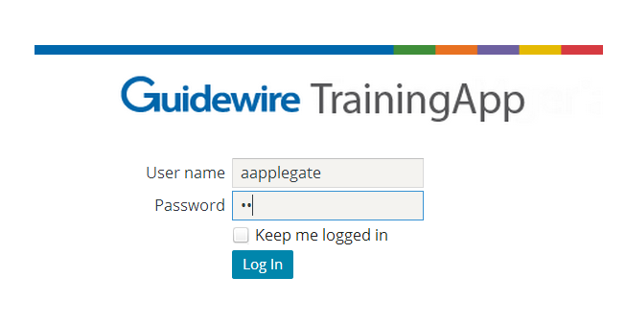
Logging on to the Guidewire applications
"su" (super user) account
Only account in default installation
Has all permissions, and special capabilities above what can be granted through permissions
"aapplegate" account
Not in default installation, but in sample data for every application
Represents basic end user with permissions typical to contact manager, adjuster, underwriter, or billing manager
Notes:
Because "su" has unique permissions behavior, "su" shouldn't be used during testing
"su" and all user accounts in Guidewire sample data have an initial password of "gw".
If a user checks the "Keep me logged in" field and logs in, then for the next seven days the user is logged in automatically whenever they navigate to the login page. (This works only if the application is hosted by the same application server.) An explicit logout will clear the "keep me logged in" state.
Note that the "Keep me logged in" functionality writes a cookies to the user's machine. As is the case with cookies, this may expose a security risk if other people get access to the cookie. (For example, someone could copy the cookie to another machine and then log in without entering a user name or password.) If there is a concern about browser cookie theft, administrators should remove this checkbox from the login page.

Slide 38
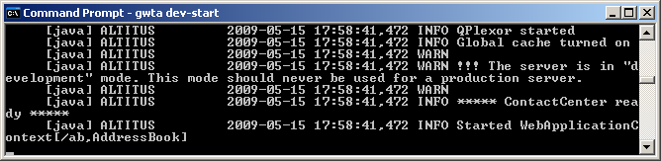
Stopping Guidewire applications
gwXX dev-stop is a clean shutdown process that safely releases application resources (such as ports)
If application is running in development mode:
Terminate the batch job (CTRL + C, y), OR
Execute gwXX dev-stop
If application is running in production mode:
Always stop app by executing gwXX dev-stop
Notes:
gwXX dev-stop
The gwXX dev-stop command executes a clean shutdown. For example, if the application is in the middle of writing to a file, dev-stop allows the process to complete before the shutdown. gwXX dev-stop also releases all application ports. You can execute a gwXX dev-stop automatically through a script or manually through a second command prompt window.
TrainingApp has a pre-built "Stop TrainingApp" shortcut in the Guidewire/TrainingApp directory that executes a "gwta dev-stop". To execute the command, simply double-click the shortcut.
Terminating the batch job
When you are working in development mode, you can also stop the Guidewire application by terminating the batch job. To do this, press CTRL + C and then respond to the "terminate batch job?" prompt with a "y" (for yes). This has the advantage of keeping the command prompt window open and retaining the history of previously executed commands. This is useful if you need to stop and later restart the application. However, in some cases, the server may not release the port number. When this occurs, you need to execute a gwXX dev-stop before you can restart the application.
You should never terminate the batch job for an instance running in production mode.
Additional notes
The command prompt window must remain open while the application is running. You can minimize it, however.

Slide 39
Lesson outline
Guidewire product architecture
Guidewire configuration technology
The Guidewire platform
TrainingApp
Starting Guidewire applications
Guidewire Studio

Slide 40


About Guidewire Studio
Integrated Developer Environment (IDE)
Gosu, XML, JAVA *
Refactoring
Plugin extensibility
Dynamic type support
Make, run and debug
Guidewire editors
IntelliJ IDEA 12.1.x community edition
No download needed; bundled with application
Physical file based project representation
Represents complete software solution
Support for version control systems, e.g. Git, GitHub, Subversion
* Within the Guidewire application project scope, limitations apply for Java development
Notes:
Guidewire Studio 8.0 is an Integrated Developer Environment (IDE) based on IntelliJ IDEA. Guidewire Studio comes bundled with your application as an application project. Guidewire Studio supports the IntelliJ IDEA directory-based format (.iml) that defines the application project. The file, configuration.iml, defines the base project contents.
A project is the highest level of organization in Guidewire Studio and includes project-wide settings as well as collections of modules and libraries. A project is an organizational unit that represents a complete software solution. With Guidewire Studio 8.0, it is much easier to identify, work with, manage, and version the project related resource. In Guidewire Studio 8.0, there is almost always a 1-to-1 relationship between the item being configured and the underlying file that is stored on the file system. In short, the project reflects the physical file locations on the disk.

Slide 41
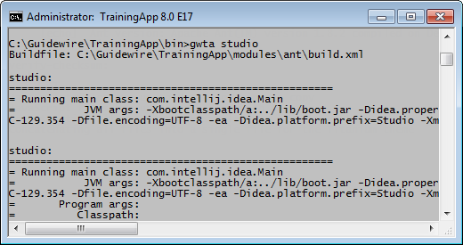
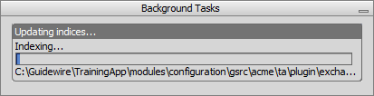
Starting Studio
To open the project, run
studio.bat
gwXX studio from the bin
Indexing influences startup times
First time longest
Subsequent starts faster
Possible to work while indexing!
Notes:
In the specific Guidewire application folder root, the .idea directory contains a set of configuration files (.xml). The configuration data for projects and their components is in plain text XML files. Each file contains only a portion of configuration data pertaining to a certain functional area which is reflected in the name of a file, for example, compiler.xml, encodings.xml, modules.xml. These files contain information specific to the project itself, such as names and locations of the project component modules and compiler settings. If using version control for your project, you may want to consider including certain project files. One exception is the workspace.xml file as this is specific to each individual Guidewire Studio user.
First time start up = Time taken to load the project + finish indexing for the first time.
Second time start up = Time taken to load the project + finish indexing for the second and third times.
In certain cases, you may want to rebuild your indexes. To rebuild you project indexes, you need to clean out the system caches. On the main menu, choose File → Invalidate Caches. Do not open a different app project with Guidewire Studio, use “xx studio” to start a different app. Guidewire Studio memory settings are in memory.properties.

Slide 42

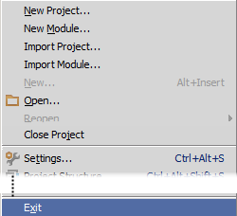
Exiting Studio
Do NOT close the project
File → Exit
To properly exit studio,
Or, in the Bin command window, enter the exit command

Slide 43
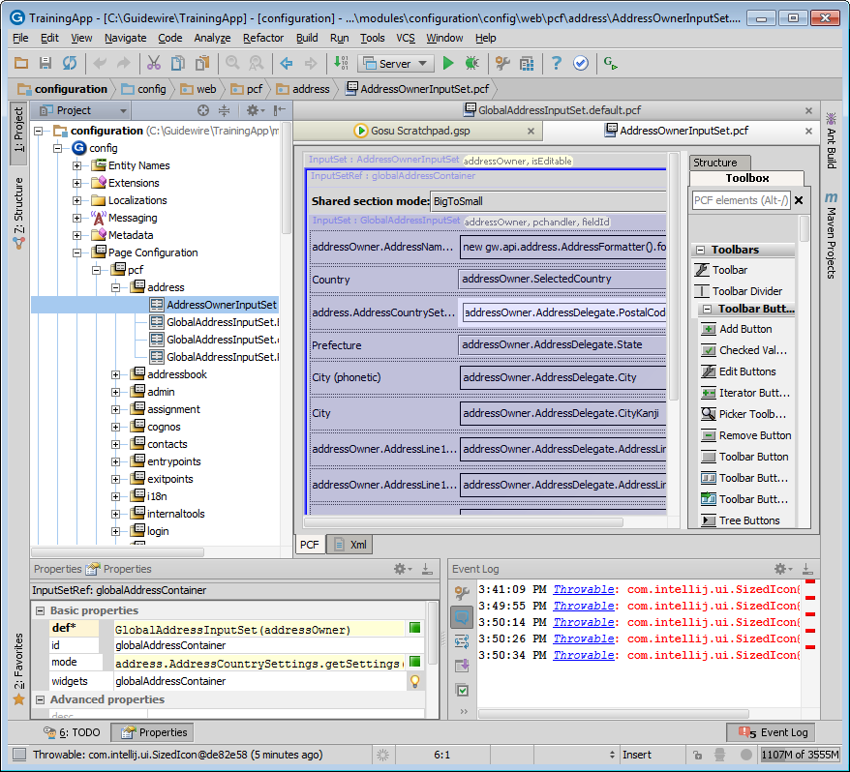
Anatomy of Guidewire Studio
Main menu and toolbar
Navigation bar
Tool Window
Editor
Tool Buttons
Tool Buttons
Tool Window
Tool Window
Tool Buttons
Status Bar
Notes:
1.Menus and toolbars - the main menu and toolbars let you carry out various commands.
2.Navigation bar that helps navigate through the project and open files for editing.
3.The status bar - indicates the status of your project, the entire IDE, and shows various warning and information messages.
4.The editor - here you create and modify the code.
5.Tool windows - secondary windows that provide access to various specific tasks (project management, source code search and navigation, running and debugging, integration with version control systems, etc.).

Slide 44
Main menu and Toolbar
Main menu
Main toolbar
Main menu commands
Open, edit and find files
View tool windows
Navigate class, file, symbol
Analyze dependencies
Refactor and analyze code
Make and rebuild
Run and debug
Gosu Scratchpad
Version control system
Main toolbar buttons
Open, save, and synchronize files
Undo and redo
Cut, copy and paste
Find and replace
Make project
Edit configurations, settings, and structure
Run and debug
Refresh PCF
Gosu Scratchpad
Notes:
Menus and toolbars let you carry out various commands. The main menu and toolbar contain commands that affect the entire project or large portions of it. Most command have an associated keyboard shortcut to enable quicker access to it.
The main menu contains commands for opening, creating projects, refactoring the code, running and debugging applications, keeping files under version control and more.
The main toolbar contains buttons that duplicate the essential commands for quicker access. You can hide the main toolbar, using the checked command on the toolbar context menu.
You can show or hide the main elements of the Guidewire Studio using the View menu.
Descriptions of the actions from all the menus and toolbar buttons are displayed in the left side of the Status bar.
If you know which action you want to perform, but do not know where to find the appropriate command, just press Ctrl+Shift+A and select the desired action from the suggestion list.

Slide 45
Lesson objectives review
You should now be able to:
Describe the product architecture for Guidewire products
Describe the primary components used to configure Guidewire products
Describe the relationship between the Guidewire platform and the Guidewire applications
Explain the basic functionality of TrainingApp
Start a development instance of a Guidewire application
Describe the purpose of Guidewire Studio

Slide 46
Review questions
What are the three tiers in the Guidewire application architecture?
What are the four fundamental areas of Guidewire configuration technology?
In which fundamental area of configuration are the following used?
Page configuration files (PCFs)?
Web services, messaging, and plugins?
Gosu?
Data model entities?
How do you start a Guidewire application?
How do you stop a Guidewire application?
Notes:
Answers
1. Data, application, presentation (or user interface)
2. Data model, user interface, business logic, integration mechanisms
3. a) User interface
b) Integration mechanisms
c) Business logic
d) Data model
4. Open a command prompt, navigate to the application \bin directory, and execute the start command ("gwXX dev-start" or "gwXX studio").
5. Close the command prompt (or, in the case of Studio, the application window)

