Slide 1
Introduction to the Data Model
5 Sept 2013
Notes:
Guidewire training materials contain Guidewire proprietary information that is subject to confidentiality and non-disclosure agreements. You agree to use the information in this manual solely for the purpose of training to implement Guidewire software solutions. You also agree not to disclose the information in this manual to third parties or copy this manual without prior written consent from Guidewire. Guidewire training may be given only by Guidewire employees or certified Guidewire partners under the appropriate agreement with Guidewire.

Slide 2
Lesson objectives
By the end of this lesson, you should be able to:
Describe the contents of a Guidewire data model
Identify information about a given application's data model
Reference entity fields using dot notation
This lesson uses the notes section for additional explanation and information. To view the notes in PowerPoint, choose View→Normal or View→Notes Page. If you choose to print the notes for the lesson, be sure to select “Print hidden slides.”

Slide 3
Lesson outline
Contents of the data model
The Data Dictionary
Objects and the data model

Slide 4
The data model
For each Guidewire application, the data model is the set of data objects and information about their relationships
Every Guidewire data model includes:
Entities
Entity fields
Typelists
Notes:
There are two other components to a Guidewire data model: field validators and abstract datatypes.
A field validator defines the format requirements for specific fields, such as a postal code that must consist of 5 characters, each of which is a digit 0 through 9.
An abstract data type defines a datatype that is built on top of a simple data type and is used to ensure the consistent definition of similar fields. For example, an ExchangeRate datatype could be defined as a decimal with a precision of 7 and a scale of 6. Then, any field that is intended to store exchange rate values could use this abstract data type, thereby ensuring that all exchange rate fields in the data model have been declared in the same way.

Slide 5
Data model entities
A data model entity is an abstract definition of a group of business objects used by the application
Examples: ABContact, User
ABContact
User
ID
Name
CreateTime PrefersContactByEmail Score AssignedUser AllAddresses VendorType
…
ID
Department JobTitle VacationStatus
…

Slide 6
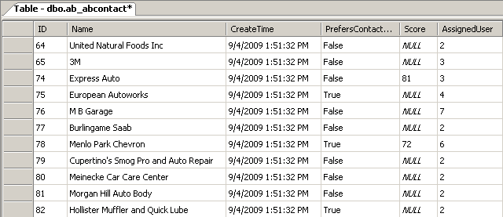
Data model entities in the database
In general, each entity is stored in its own database table
Exception to this include virtual entities and subtyped entities
ABContact
ID
Name
CreateTime PrefersContactByEmail Score AssignedUser AllAddresses VendorType
…
Notes:
There are two exceptions to the generalization above:
Virtual entities are entities constructed entirely with code. They exist during run-time, but the data inside them is neither read directly from the database nor written directly to the database. One example of this is BillingCenter's ProducerCodeRoleEntry entity. It is a "simple wrapper entity used to support modifying the producer codes by policy role". Its data is assembled from other physical entities.
Subtyped entities are entities that share a parent/child relationship. All fields in the parent entity are inherited by the child entity. A top-level subtyped entity and all of its child subtypes are stored in a single database table, as opposed to each having its own table.

Slide 7
Subtyped entities
Some entities are subtyped
Each subtype inherits all fields of its parent
Most Guidewire entities that are subtyped are also abstract
You cannot create instance of entity at top level
ABContact
ABPerson
ABAdjud- icator
ABPerson Vendor
ABPolicy Person
AB Attorney
AB Doctor
Notes:
The only major subtyped entity in TrainingApp is ABContact, which is abstract. This means that you cannot create instances of ABContact at the ABContact level. (In other words, you cannot create objects that are only ABContacts) You can create instances at the levels below ABContact (such as instances of ABPerson or ABCompany or ABPlace).
Major subtyped entities in ClaimCenter include: Contact, Incident, Transaction.
Major subtyped entities in PolicyCenter include: Contact, Job, Modifier, and Workflow.
Major subtyped entities in BillingCenter include: Contact, Activity, Plan, Invoice, and Workflow.

Slide 8
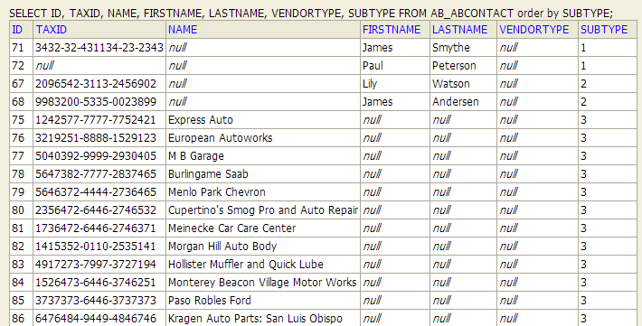
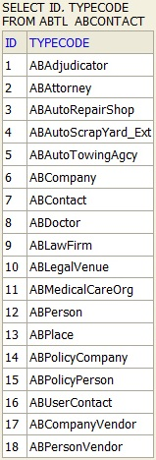
Subtypes in the database
All subtypes stored in one table
Table named after parent
Subtype column is a foreign key to a second table that stores subtype codes and names
Columns irrelevant to given subtype have null values
Notes:
The first screenshot above shows rows from the ab_abcontact table, which is the table that stores all instances of ABContact and its subtypes.
Whenever an entity is subtyped, a typelist is automatically created for it. This typelist contains one typecode for every subtype of the parent entity. Typelist tables are prefixed with "xxtl_", where "xx" is the two-letter application code. The second screenshot above shows the rows in the typelist table for ABContact.
In the first screenshot, you can see examples of 10 ABContacts. The first five (IDs 1 through 5) are ABContacts of type ABPerson. (They all have SUBTYPE codes of 12, which maps to ABPerson.) The next two (IDs 72 and 73) are ABContacts of type ABMedicalCareOrg. (They all have SUBTYPE codes of 11, which maps to ABMedicalCareOrg.) The final three (IDs 74 through 76) are ABAutoRepairShops.
The ABContact table has columns for all fields defined at the parent level and therefore relevant to all child subtypes (such as TAXID). It also has columns for all fields defined at any of the subtype levels. This includes columns defined at the ABPerson level (such as FIRSTNAME and LASTNAME) and columns defined at the ABCompany level (such as NAME). Notice that null values appear for columns not relevant to a given row's subtype. For example, the Health South row is for a medical care organization, and therefore the NAME column has a null value.

Slide 9
Entity fields
An entity field is a value (or set of values) used to define the state or nature of a specific instance of the entity
Example: ABContact's Name field
Four general types of entity fields
Data
Foreign key
Array key
Type key
ABContact
ID
Name
CreateTime PrefersContactByEmail Score AssignedUser AllAddresses VendorType
…
entity fields

Slide 10
Data fields
A data field stores a single value that does not reference any other object or table, such as:
A String value
A datetime value
A boolean value
An integer value
ABContact
ID
Name
CreateTime PrefersContactByEmail Score AssignedUser AllAddresses VendorType
…
Notes:
Data fields are declared in XML using the <column> tag. Therefore, they are sometimes referred to a "column fields". There are other types of fields beyond primitive value fields that are stored in database table columns, however. So one should not assume that the only fields that map to database columns are the "column fields". This course uses the term "data fields" to avoid this possible point of confusion.

Slide 11
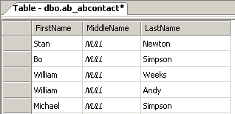
Data fields in the database
Data fields can be physical or virtual
Physical fields are defined in data model and stored as columns in given database table
Virtual fields are defined in code and are not stored in the database
ABContact
...
FirstName MiddleName LastName FullName (virtual)
…
FullName = FirstName + MiddleName + LastName
Notes:
In the example above, the FullName field is declared to be the combination of FirstName plus MiddleName plus LastName.
Virtual fields are declared as entity enhancements and are discussed in the "Gosu Enhancements" lesson.

Slide 12
Foreign key fields
A foreign key field stores a reference to a related object in the data model
ABContact
User
ID
Name
CreateTime PrefersContactByEmail Score AssignedUser AllAddresses VendorType
…
ID
Department JobTitle VacationStatus
…

Slide 13
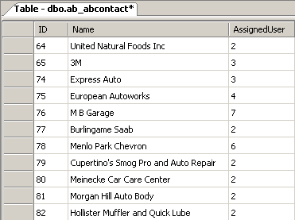
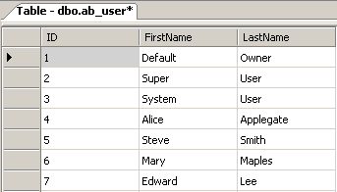
Foreign key fields in the database
Foreign key fields are stored as foreign key columns
ABContact
... AssignedUser …
Notes:
In the example in the screenshots above, the assigned user for European Autoworks is the user with a user ID of 4 (Alice Applegate).

Slide 14
Array key fields
An array key field stores references to a set of related objects in the data model
Array keys are not stored in database
ABContact
Address
ID
Name
CreateTime PrefersContactByEmail Score AssignedUser AllAddresses VendorType
…
ID
AddressLine1 AddressLine2 City State …
Notes:
Array keys are managed during run-time by code that queries the database for the appropriate set of objects.

Slide 15
Type key fields and typelists
A typelist is a predefined list of values that constrains a field
A type key field is a field associated with a specific typelist
Values in that field limited to those defined in typelist
typelist
ABContact
VendorType Auto Repair Shop Auto Glass Shop Towing Service
Fire Inspector Home Inspector Doctor Nurse …
ID
Name
CreateTime PrefersContactByEmail Score AssignedUser AllAddresses VendorType
…
type key field

Slide 16
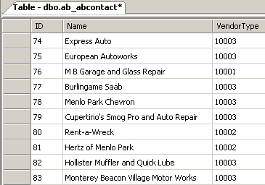
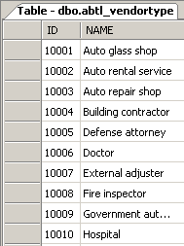
Typelists in the database
Each typelist is stored in its own table
Each type key is foreign key to typelist table
Notes:
Typelist tables are named <ApplicationCode>tl_<TypelistName>.

Slide 17
Data model configuration
Data model configuration consists of:
Adding new fields to base application entities
Creating new entities
Creating and modifying typelists
These tasks are discussed in following lessons

Slide 18
Lesson outline
Contents of the data model
The Data Dictionary
Objects and the data model

Slide 19
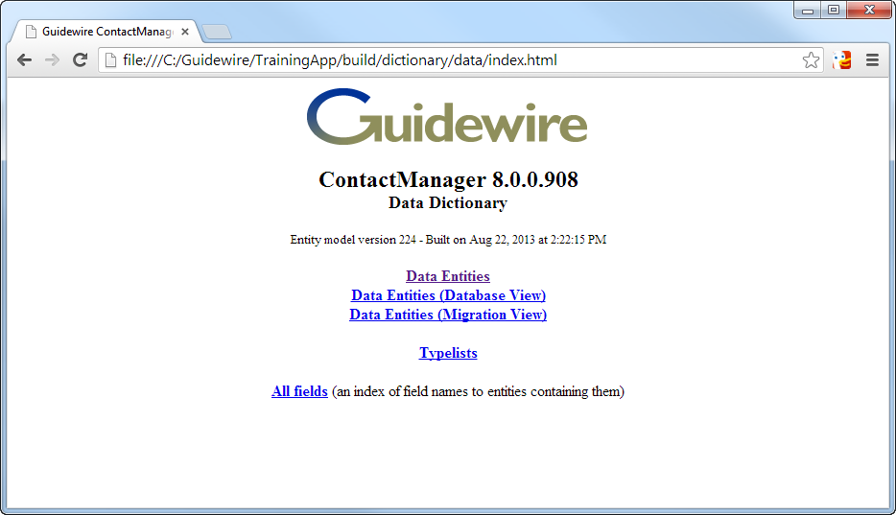
The Data Dictionary
The Data Dictionary is a collection of HTML pages that documents the entities and typelists in your application
After you modify data model, you can regenerate data dictionary
Two primary sections
Notes:
The data dictionary is located at: <install directory>\build\dictionary\data\index.html.
The entity pages of the Data Dictionary make use of active content. By default, Internet Explorer blocks active content and displays a warning bar that states "Internet Explorer has restricted this webpage from running scripts or ActiveX controls...". You can right-click the alert bar to allow the blocked content to run, but you have to do this every time you navigate to the Data Dictionary. Alternately, you can allow all active content in HTML pages on your machine to run automatically by doing the following:
Select Tools > Internet Options from the menu bar.
Click the Advanced tab.
Scroll down to the Security section. Enable the "Allow active content to run in files on 'My Computer'" option.
Restart Internet Explorer.
The Data Dictionary's conversion view is designed for data model work when converting data from a legacy application. This view provides a subset of the information in the standard view of the application entities that is more useful for those working on the conversion of legacy data. For more information on the conversion view, refer to the Configuration Guide for your product.

Slide 20
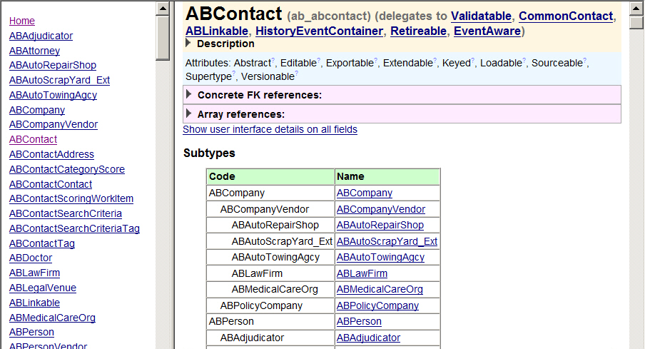
Entities in the Data Dictionary
Entities section lists each entity and information about it
To view information about given entity, click its name
Notes:
To view the Data Entities section of the data dictionary, click the "Data Entities" link on the Data Dictionary home page.

Slide 21
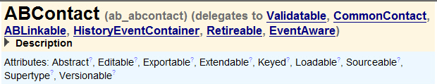

Entity header
Entity name and name of database table
Delegate entities (if any)
Delegates define fields and behaviors needed by multiple entities, such as "Assignable" or "ABLinkable (to other apps)"
Entity attributes (for definition of each, click " ")
Other entities with foreign key and array references to this entity
Notes:
A delegate is an abstract entity that defines a set of fields and methods needed by other entities to enable a specific type of behavior. Any entity that needs the behavior "delegates to" the delegate entity. For example, ClaimCenter has four entities that can be assigned to users: Claim, Exposure, Activity, and Matter. It also has an "Assignable" delegate entity that contains the fields needed for assignment (such as AssignedUser and AssignedGroup) and methods. The Claim, Exposure, Activity, and Matter entities all delegate to this entity and therefore all have these fields and methods.
The Data Dictionary lists delegates using the term "delegates to". However, when you configure one entity to reference another entity as a delegate, the keyword that you use is "implements". Therefore, the relationship between an entity and its delegate entities cal also be described with "implements", as in "ABContact implements CommonContact and ABLinkable".

Slide 22
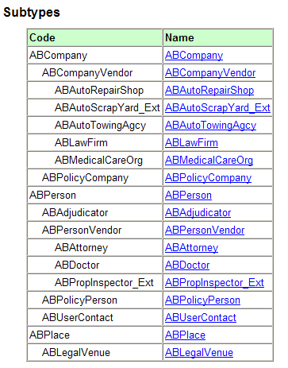
Subtypes list
If entity is subtyped, it has subtypes list
Identifies all child subtypes
Includes links to each subtype

Slide 23
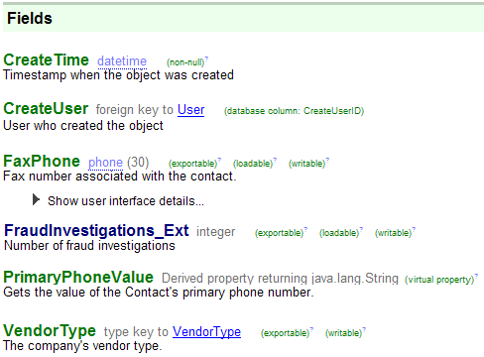
Fields
name
data type
properties
description
foreign keys have link to related entity
expandable list of UI files that display field (if field is used in UI)
extensions to entity in dark blue
virtual properties identified
type keys have link to typelist
Notes:
Both foreign keys and type keys include links to the related entity or typelist.
If a property is virtual, then its data type is listed as "Derived property returning <data type>" and it has the "virtual property" property. In the example above, PrimaryPhoneValue returns the home phone number if the contact's primary phone is set to "home", returns the work phone number if the contact's primary phone is set to "work", and returns the fax phone number if the contact's primary phone is set to "fax".
Virtual fields are displayed in green, whether they are extensions or part of the base application.

Slide 24
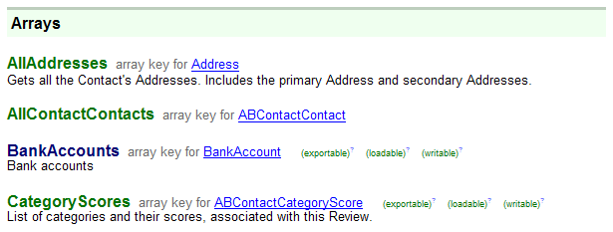
Arrays
Each array includes link to entity stored within array

Slide 25
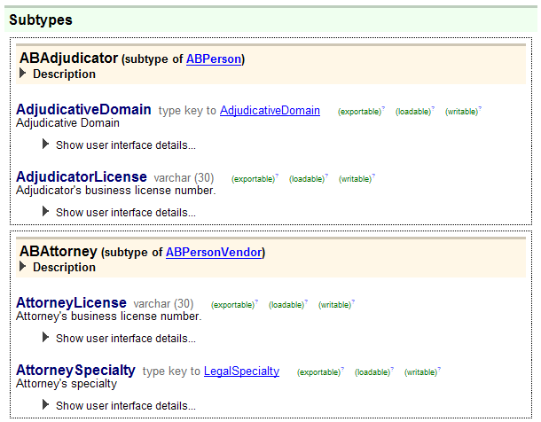
Subtype fields
If entity is subtyped, fields and arrays declared at each subtype level are listed in their own section

Slide 26
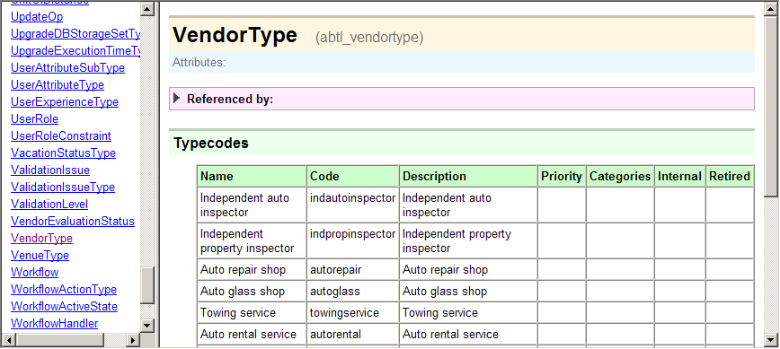
Typelists in the Data Dictionary
Typelists section lists each typelist and its typecodes
To view information about given typelist, click its name
Notes:
To view the Typelists section of the data dictionary, click the "Typelists" link on the Data Dictionary home page.
You can view the typecode and name for all elements in the list. You can also access typelists from the main page or from a type key field.

Slide 27
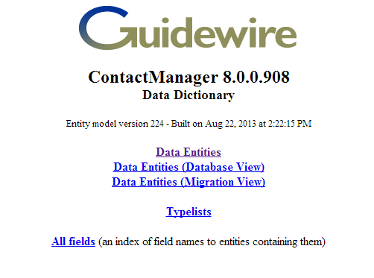
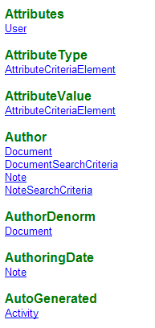
All fields
Alphabetic list of every field
For each field, entity or entities with that field are listed
Useful when looking for a field and you don't know on which entity it is declared
Notes:
In the example in the screenshot on the right:
There is an "Attributes" field on the User entity.
There is an "AttributeType" field on the AttributeCriteriaElement entity.
There is an "AttributeValue" field on the AttributeCriteriaElement entity.
There is an "Author" field on the Document, DocumentSearchCriteria, Note, and NoteSearchCriteria entities.
...and so on.

Slide 28
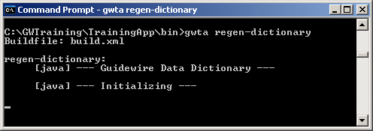
Generating Data Dictionary
You can (re)generate Data Dictionary:
After initial install (Data Dictionary is not pre-generated)
Any time you extend data model
To regenerate dictionary, from bin directory, execute:
gwXX regen-dictionary
where XX is application's two-letter code
Notes:
The codes for each application are:
TA for TrainingApp
CC for ClaimCenter
PC for PolicyCenter
BC for BillingCenter
AB (address book) for ContactManager
The regen-dictionary command also regenerates the Security Dictionary. This dictionary lists all system permissions and other information that pertains to controlling access to a Guidewire application.

Slide 29
Lesson outline
Contents of the data model
The Data Dictionary
Objects and the data model

Slide 30
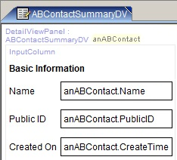

Data model entities in application architecture
database
application server
user interface
page configuration file
data model entity
internal Gosu class
ABContact
ABContact
Name
PublicID CreateTime
…
Fields Name PublicID CreateTime ...
UI form with data
read from db
display in UI
row in db table
ab_abcontact
anAB Contact
Coverage
update to db
modify in UI
instance of Gosu class
Notes:
For every data model entity, the application automatically creates an internal Gosu class with the same name. Whenever a row is read from a database table, an instance of the corresponding Gosu class is created, and the data is placed into that instance. The data in this instance can then be displayed in the user interface and modified by the user prior to saving the data. Whenever the data in a run-time instance of a database-backed class is changed and saved, that data gets written to the corresponding database table. If the data was initially read from the database (such as when a user looks for an existing ABContact and then modifies it), the existing database row is updated to reflect the changes. If the data was created entirely in the run-time environment (such as when a user creates a new ABContact), then a new row is inserted into the database table.
For every field in the data model entity, there is a field in the corresponding internal Gosu class. For example, the ABContact data model entity has a "FaxPhone" field, and the internal ABContact Gosu class also has a "FaxPhone" field.
Gosu classes that are automatically created from data model entities are sometimes referred to as "database-backed classes". This is because these classes have corresponding database tables, and instances of these classes can be saved to the database. It is also possible to create Gosu classes that are not database-backed. Instances of those classes can be created and modified during runtime, but they cannot be saved to the database. These types of classes are discussed in detail in the "Gosu Classes" lesson.
The Gosu classes that map to data model entities are internal and cannot be manipulated directly. However, it is possible to add things to them indirectly.
You can add fields to base application entities as discussed in the "Extending Base Entities" lesson.
You can add fields to a custom entity as discussed in the "Creating New Entities" lesson.
You can add methods to any entity as discussed in the "Enhancements" lesson.

Slide 31
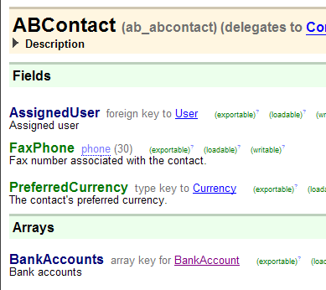
Dot notation
Dot notation is a coding technique used to identify data elements such as text fields, related objects or collections of objects.
Used in UI configuration and Gosu
Not used in data model configuration, but useful to discuss here because it relies on relationships in data model
Starts with object
Ends with field, related object, or related array
anABContact.FaxPhone

Slide 32
Dot notation syntax
Referencing data field on given object
object.field
anABContact.FaxPhone
Referencing field on related object
object.foreignKey.field
anABContact.AssignedUser.JobTitle
anABContact
FaxPhone
anABContact
(User object)
AssignedUser
JobTitle

Slide 33
Dot notation syntax
Referencing array on given object
object.array
anABContact.BankAccounts
Referencing field at subtype level
(object as subtype).field
(anABContact as ABPerson).DateOfBirth
anABContact
(array of BankAccount objects)
BankAccounts
anABContact
ABPerson
DateOfBirth
Notes:
Refercning fields at the subtype level is discussed in detail in the "Subtypes" lesson and in the "Atomic Widgets" lesson.

Slide 34
Lesson objectives review
You should now be able to:
Describe the contents of a Guidewire data model
Identify information about a given application's data model
Reference entity fields using dot notation

Slide 35
Review questions
For each of the following, identify if it is stored as a database table, as a table column, or not stored in the database at all:
An entity (such as ABContact)
A physical data field (such as ABContact.CreateTime)
A virtual data field (such as ABContact.FullName)
A foreign key field (such as ABContact.AssignedUser)
An array key field (such as ABContact.AllAddresses)
A typelist (such as VendorType)
A type key field (such as ABContact.VendorType)
Name two circumstances in which you would execute the regen-dictionary command.
(continued)
Notes:
Answers
1. a) A table
b) A column
c) Not stored in the database (Technically, the source values are probably stored in the database. But the value of a virtual field itself is not stored as a separate value.)
d) A column (specifically a foreign key column to the relevant entity's table)
e) Not stored in the database
f) A table
g) A column (specifically a foreign key column to the typelist's table)
2. Possible answers: You would execute regen-dictionary when you install the application and whenever you extend the data model. You could also execute the command when you modify system permissions or some other aspect of access and therefore need to regenerate the Security Dictionary.

Slide 36
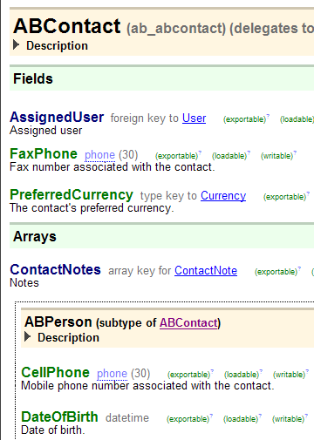
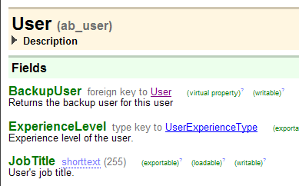
Review questions
For the object "myContact" of type ABContact, what is the dot notation for the object's:
Preferred currency?
Notes?
Level of experience of myContact's assigned user?
Mobile phone (if it is a person)
Notes:
Answers
3. a) myContact.PreferredCurrency
b) myContact.ContactNotes
c) myContact.AssignedUser.ExperienceLevel
d) (myContact as ABPerson).CellPhone

Slide 37
Notices
Copyright © 2001-2013 Guidewire Software, Inc.
All rights reserved. Guidewire, Guidewire Software, Guidewire ClaimCenter, Guidewire PolicyCenter, Guidewire BillingCenter, Guidewire Reinsurance Management, Guidewire ContactManager, Guidewire Vendor Data Management, Guidewire Client Data Management, Guidewire Rating Management, Guidewire InsuranceSuite, Guidewire ContactCenter, Guidewire Studio, Guidewire Product Designer, Guidewire Live, Guidewire DataHub, Guidewire InfoCenter, Guidewire Standard Reporting, Guidewire ExampleCenter, Gosu, Deliver Insurance Your Way, and the Guidewire logo are trademarks, service marks, or registered trademarks of Guidewire Software, Inc. in the United States and/or other countries.
Guidewire products are protected by one or more United States patents.

