Slide 1
Extending Base Entities
6 Sept 2013
Notes:
Guidewire training materials contain Guidewire proprietary information that is subject to confidentiality and non-disclosure agreements. You agree to use the information in this manual solely for the purpose of training to implement Guidewire software solutions. You also agree not to disclose the information in this manual to third parties or copy this manual without prior written consent from Guidewire. Guidewire training may be given only by Guidewire employees or certified Guidewire partners under the appropriate agreement with Guidewire.

Slide 2
Lesson objectives
By the end of this lesson, you should be able to:
Describe the layers of base application entities
Define entity extension
Extend entities in the base application
This lesson uses the notes section for additional explanation and information. To view the notes in PowerPoint, choose View→Normal or View→Notes Page. If you choose to print the notes for the lesson, be sure to select “Print hidden slides.”

Slide 3
Lesson outline
Layers of base application entities
Entity extensions (*.etx)
Extending base entities

Slide 4
Two "layers" of entities in base applications
Claim Center
Policy Center
Billing Center
Entities are declared in "eti" files
Application-level entities are specific to given application
Platform-level entities are common to all Guidewire applications
Claim
Quote
Invoice
Guidewire Platform
Activity
User
Notes:
As shown in the example above, Activity and User are entities common to all Guidewire applications. Claim is specific to ClaimCenter. Quote is specific to PolicyCenter. Invoice is specific to BillingCenter.
Entities are defined in XML files known as "eti" (entity) files.
Platform-level entity files are stored in <application>/modules/pl/config/metadata. For example, in the classroom environment, the path to the XML file that declares the Activity entity is TrainingApp/modules/pl/config/metadata/Activity.eti.
Application-level entity files are stored in <application>/modules/<applicationCode>/config/metadata. For example, in the classroom environment, the path to the XML file that declares the ABPerson entity is TrainingApp/modules/ab/config/metadata/ABPerson.eti. Note that TrainingApp is built on ContactManager, whose internal application code is "ab".

Slide 5
Customer entity extensions
CC
PC
BC
Extends base application entity from either layer as needed for given implementation
Stored in "etx" files
Customers can:
Modify entities in base application
Create new entities
Claim.etx
Quote.etx
Invoice.etx
Activity.etx
User.etx
Claim
Quote
Invoice
Guidewire Platform
Activity
User
Notes:
There are also "eix" files, which are extensions to platform-layer entities created by Guidewire development to meet the needs of a given application's base data model. For example, the Activity entity has different needs in each application:
ClaimCenter needs an Activity.Claim field
PolicyCenter needs an Activity.Job field
BillingCenter needs an Activity.TroubleTicket field
Even though they are visible in Studio, customers cannot create or modify eix files.
In a given application, a platform-level entity can have both eix and etx files. The eix file contains extensions to the platform-level entities that are required for the base application and cannot be modified. The etx file contains extensions to the platform-level entity that are potentially of use, but these extensions can be modified or removed.

Slide 6
Base application entities and Gosu classes
database
application server
ABContact
ABContact
ABContact .eti
Fields ID Name FaxPhone WebAddress_Ext ...
ID
Name FaxPhone WebAddress_Ext
…
internal Gosu class
ABContact .etx
ab_abcontact
anABContact
row in database table
instance of Gosu class
Coverage
read from db
save to db
Notes:
For a base application data model entity, the entity is defined by both its original .eti file and the extending .etx file, if one exists. All of the fields also become a part of the internal Gosu class, regardless of which file they are declared in.
For fields that are added to a base application entity, Guidewire recommends that the field name should end with "_Ext" (or start with "Ext_"). This is shown above in the name of the "WebAddress_Ext" field.
Clarifying Terminology
Students coming from an OOP background should be aware that the term "extend" gets used in OOP differently than it does in Guidewire.
In OOP, the term "extend" is used to refer to creating a new subclass that extends some parent superclass.
In Guidewire data model configuration, the term "extend" is sometimes used to refer to adding new fields to an existing base application entity. In this sense, no new subclass or subtype entity is getting created. One is simply adding additional fields to an existing base application entity.

Slide 7
Lesson outline
Layers of base application entities
Entity extensions (*.etx)
Extending base entities

Slide 8
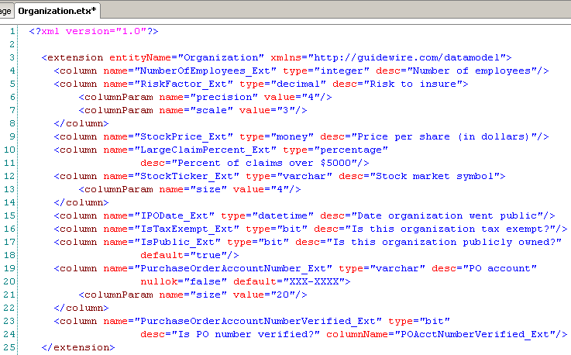
Extend an entity
Organization
Organization.etx
Prior to 8.0, the only way to extend an entity was to change the XML file associated with the extension.
Extends only one entity per file
Each base application entity can have at most one etx file
Notes:
Because eix (entity internal extension) files are neither created nor modified by configuration developers, this lesson does not discuss their structure.
If you need to make multiple extensions to a single entity at different points in time, all extensions for that entity should be added to the same etx file.

Slide 9
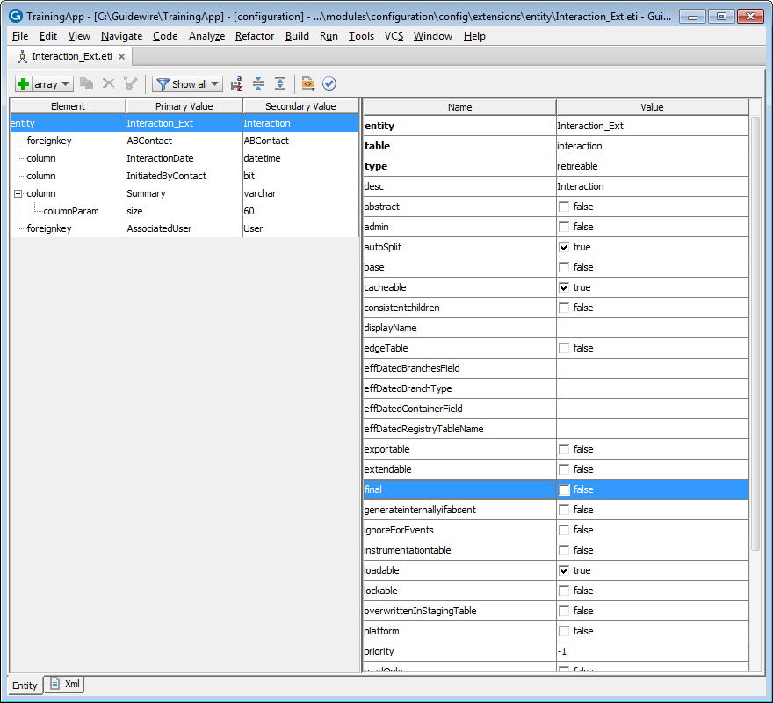
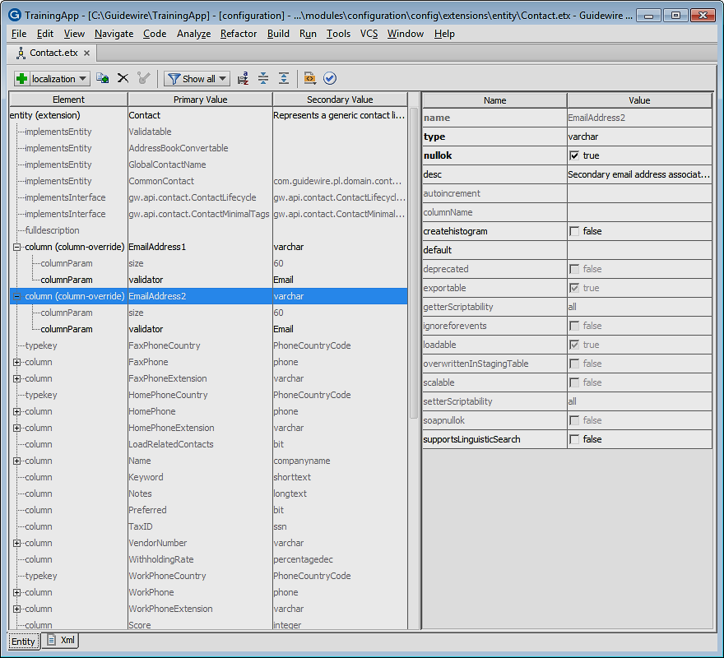
Entity editor
In 8.0, you can view, define and edit an entity, entity extension, or internal entity extension using the editor
/extensions/entity/
ETI and ETX files
/metadata/entity/
ETI and EIX files
View file as XML
Consists of
Editor toolbar
Element tree pane
Attribute pane
Base is Metadata Editor
Notes:
You can define and edit an entity and entity extension located in the /configuration/config/extensions/entity folder. The Entity editor allows you to view an entity or internal entity extension located in the /configuration/config/metadata/entity folder. Files in the /metadata/ folder are read-only.
To create an entity, in Project view, navigate to the /configuration/config/Extensions/Entity folder. Open the folder context menu. Select Entity. In the Entity dialog, name the Entity, define the Entity Type, specify a Description, name the physical database Table, select a Type, and mark if the entity is Extendable, Exportable, and/or Final. Click OK.
To create an entity extension, in Project view, navigate to the /configuration/config/extensions/entity folder. Open the folder context menu. Select Entity Extension. In the Entity Extension dialog, select the entity to extend and specify a suffix, such as EXT. Click OK.
The Metadata Editor is the base editor for both the Entity editor and Typelist editor. The Entity editor is, by default, an Enabled Editor. You can configure the Metadata editor in Guidewire Studio settings. (In the Menu bar, select File, then select Settings… . In the Settings dialog, in the navigation pane, in IDE Settings, expand Guidewire Studio and select Metadata Editor.)

Slide 10
Creating an entity extension (etx)
Two (2) ways to create an entity extension in Project view
Entity extension (ETX) file created in /Extensions/Entity/
Select ETI or EIX in /metadata/Entity/
Context menu → New → Entity Extension
Enter filename suffix, e.g. EXT
Select /Extensions/Entity
Context menu → New → Entity Extension
Enter filename suffix, e.g. EXT
Notes:
Studio creates an entity extension (ETX) in the /configuration/config/extensions/entity folder.

Slide 11
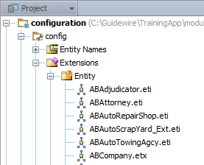


Creating an entity extension (2)
For an entity (ETI) located in /Extensions/Entity/
NOT possible to create entity extension (ETX) for an ETI in this folder
For an entity extension (ETX) located in /Extensions/Entity/
View or edit the ETX file
Theoretically possible to create an extension of an extension, but not recommended
Notes:
It is not possible to create an entity extension (ETX) for an entity (ETI) that already exists in the /Extensions/Entity/ folder. Simply edit the existing ETI file located in this folder.
You can create an entity extension for an entity extension, but it is easier to just edit the entity extension. Guidewire will merge the extensions at runtime.

Slide 12
Primary tags of etx file
<extension>
Defines entity to be extended
Primary subtags
<column>
Declares data field (storing simple values such as strings, booleans, datetimes or integers)
<foreignkey>
Declares foreign key field
<array>
Declares array
<typekey>
Declares field constrained by specific typelist
Notes:
The four primary subtags listed above are common to entity extension (<extension>), entity declaration (<entity>), subtype extension (<extension>), and subtype declaration (<subtype>).

Slide 13
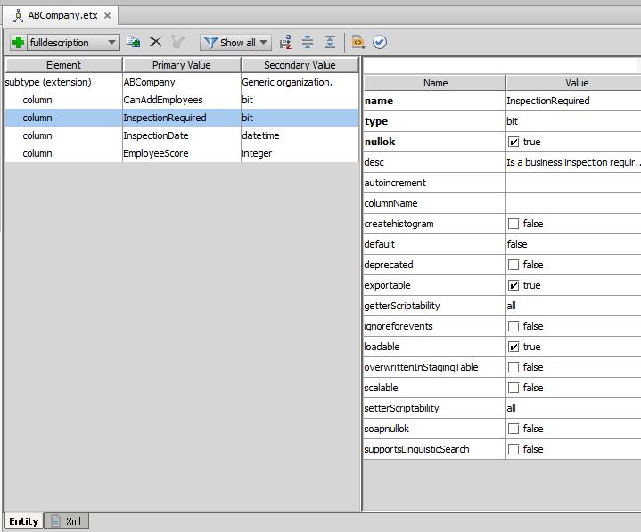
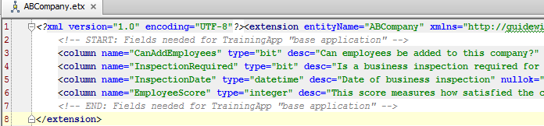
Sample etx file
Validate changes
Notes:
The etx file is viewable in the Entity editor, but does not require direct editing. Use the Entity editor to make changes to the extension file, and validate the changes after you have finished making changes.

Slide 14
Lesson outline
Layers of base application entities
Entity extensions (*.etx)
Extending base entities

Slide 15
Steps to extending base application entity
Has entity already been extended?
Yes: Open existing etx file
No: Create new etx file
Populate the extension file using the Entity editor
Validate the changes
Optionally regenerate Data Dictionary (to check for errors)
Restart application server

Slide 16

Step 1A: (If etx file exists) Open etx file
CTRL + Shift + N, entityName
open file
Open a dialog box (CTRL + Shift + N) and entering "entityName.“ to check if the file exists
If file exists, it appears in the dialog box
Click the file to open it
If no file exists, you need to create it

Slide 17
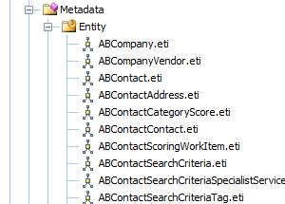
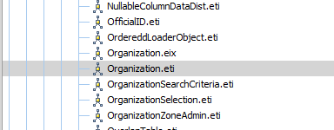

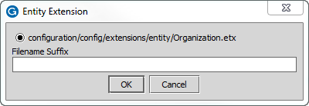
Step 1B: (No etx file exists) Create etx file
You can create an etx file from the entity declaration (eti) file by:
Locating the eti file
Right-clicking and selecting “New → Entity Extension"
Enter an extension if desired
Click “OK”
Notes:
There are several ways you can find a given entity's eti file:
You can look for the eti file under Data Model config/metadata/ (if the entity is a platform entity) or Data Model Extensions/metadata/XX, where XX is the application's two-letter code (if the entity is an application-specific entity).
You can search for the file using the “Enter file name" dialog box (as shown on the previous slide). When you select the file in the dialog box, the necessary directories in the resource pane are expanded and the file is highlighted. You may need to scroll up or down to find the highlighted file, however.
You can also manually create an etx file. To do this, right-click the extensions directory and select New > Other File from the context menu. You must provide a name for the file, which must be EntityName.etx.

Slide 18
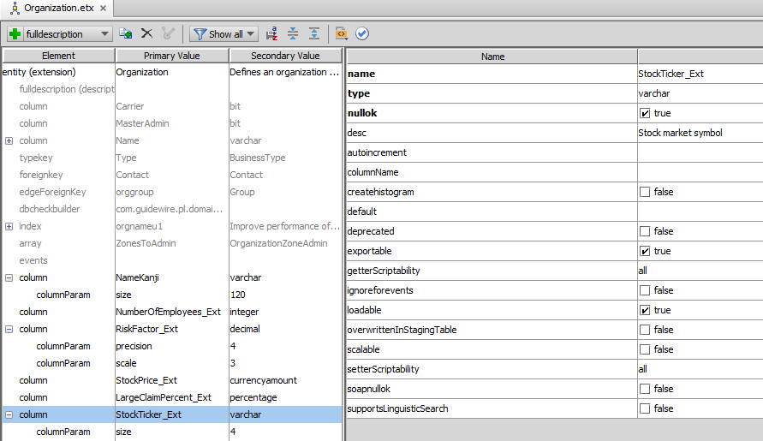
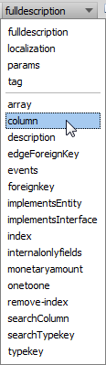
Step 2: Edit the extension using the editor
Make edits to fields here
Add elements here

Slide 19
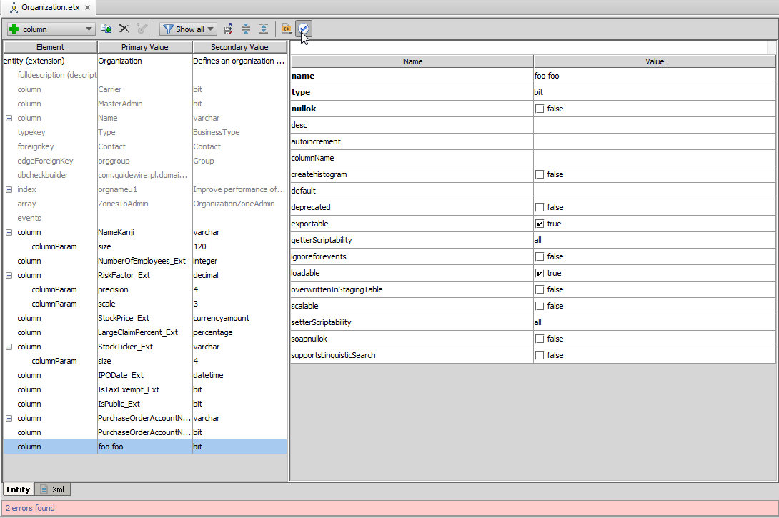
Step 3: Validate the edits
Validate edits
Errors reported
Notes:
On completion of editing the extension, you must validate the changes. Any invalid fields or values are reported at the bottom of the screen. In this example, no space is allowed for the column name. Changing it to a single string will remove the error.

Slide 20
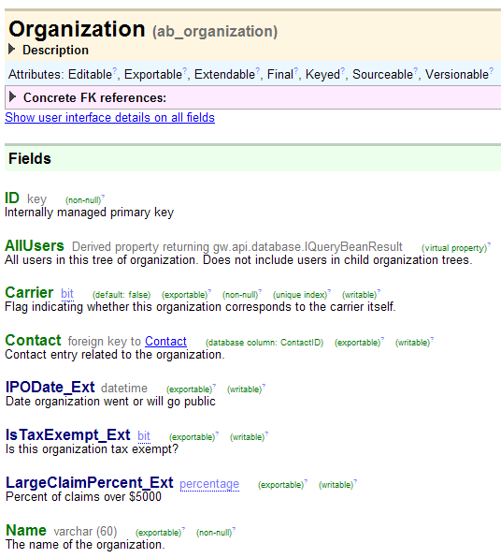
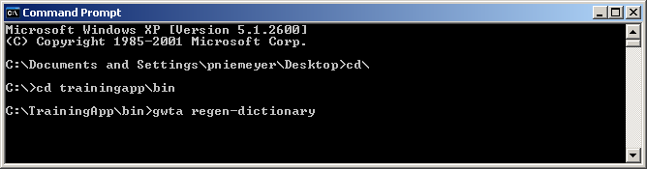
Step 4: Optionally regenerate dictionary
Not required
Updates Data Dictionary to include new fields
Base field names are green
Extension field names are blue
Notes:
This is not necessary, but may help clarify the data model configuration to the user.

Slide 21
Step 5: Restart application server
During start-up, Guidewire application compares physical database to data model as defined in the extension file
If there are differences, Guidewire upgrades database
You are not required to restart Studio to deploy data model changes, but Studio will not know about data model extensions until it is restarted
Notes:
Technically speaking, the automatic database upgrade process described above occurs only if the database autoupgrade option in config.xml is set to true. An example of the database tag, as used for TrainingApp, appears below, with the relevant option in bold. For H2, the database used in training, this option is set to true by default. For other database platforms, this option is set to false by default.
<!-- H2 (meant for demo/quickstart use only!) -->
<database name="ContactCenterDatabase" driver="dbcp" dbtype="h2" autoupgrade="true" checker="false"
printcommands="false" verifyschema="false">
<!-- <param name="jdbcURL" value="jdbc:h2:file:/GWTraining/TrainingApp/db/ta"/> -->
<!-- <param name="jdbcURLtest" value="jdbc:h2:file:/GWTraining/TrainingApp/db/tatest"/> -->
<param name="jdbcURL" value="jdbc:h2:file:/GWTraining/TrainingApp60/db/ta"/>
<param name="jdbcURLtest" value="jdbc:h2:file:/GWTraining/TrainingApp60/db/tatest"/>
<param name="stmtPool.enabled" value="false"/>
<param name="maxWait" value="30000"/>
</database>

Slide 22
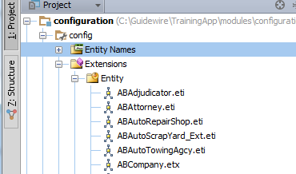
extensions and metadata directories
In the base application, some entities are declared or extended in extensions directory
These entities or extensions are optional (not required for application functionality) and can be modified or logically removed
Some entities are declared or extended in metadata directory
These entities or extensions are required for application functionality and cannot be modified or removed
Notes:
Entities that are declared in the base application in the extensions directory (such as ABAdjudicator in the screenshot above) can be thought of as "suggested" entities. Customers have the ability to modify or remove these entities without compromising application functionality. If a customer chooses to keep and modify such an entity, Guidewire recommends that additional extensions should be added to the existing .eti file (as opposed to creating an additional .etx file). This keeps all modifiable information about the entity in a single file.
Customers can remove an entity that is declared in the extensions directory. This cannot be done by deleting the file and dropping the database, however, as the missing file will cause a checksum error when the application is restarted.
To remove an entity that is declared in the extensions directory (such as ABAdjudicator in the screenshot above):
Open the .eti file.
Replace the contents of the original file with: <?xml version="1.0"?> <deleteEntity name="<entityName>"/>
To modify entity extensions that are declared in the extensions directory (such as Organization in the screenshot above):
Open the .etx file.
Modify the contents of the file as desired.
In both cases, if the original entity or extensions are already part of the data model, then you will need to drop the database first (using gwXX dev-dropdb) and then restart the server.

Slide 23
Lesson objectives review
You should now be able to:
Describe the layers of base application entities
Describe where an entity extension is stored
Extend entities in the base application

Slide 24
Review questions
What are the two "layers" of base application entities?
How many etx files can a given entity have?
What is the primary tag of an etx file?
Using the Entity editor, determine for <column> tags:
What datatype do you enter for fields that will store boolean values? String values?
Which data types require columnParam tags?
What happens when you regenerate the Data Dictionary?
When does a Guidewire application actually modify the physical structure of the database?
Notes:
Answers
The platform layer and the application layer.
One.
<extension>
a) bit, varchar; b) varchar (which requires size) and decimal (which requires precision and scale)
You would want to regenerate the Data Dictionary whenever you extend the data model. This can identify any flaws in the new XML. It also updates the Data Dictionary to include the new fields (or entities) that you have created.
The physical structure of the database is modified only during start-up.

Slide 25
Notices
Copyright © 2001-2013 Guidewire Software, Inc. All rights reserved.
Guidewire, Guidewire Software, Guidewire ClaimCenter, Guidewire PolicyCenter, Guidewire BillingCenter, Guidewire Reinsurance Management, Guidewire ContactManager, Guidewire Vendor Data Management, Guidewire Client Data Management, Guidewire Rating Management, Guidewire InsuranceSuite, Guidewire ContactCenter, Guidewire Studio, Guidewire Product Designer, Guidewire Live, Guidewire DataHub, Guidewire InfoCenter, Guidewire Standard Reporting, Guidewire ExampleCenter, Gosu, Deliver Insurance Your Way, and the Guidewire logo are trademarks, service marks, or registered trademarks of Guidewire Software, Inc. in the United States and/or other countries.
Guidewire products are protected by one or more United States patents.

