Slide 1
Creating New Entities
9 September 2013
Notes:
Guidewire training materials contain Guidewire proprietary information that is subject to confidentiality and non-disclosure agreements. You agree to use the information in this manual solely for the purpose of training to implement Guidewire software solutions. You also agree not to disclose the information in this manual to third parties or copy this manual without prior written consent from Guidewire. Guidewire training may be given only by Guidewire employees or certified Guidewire partners under the appropriate agreement with Guidewire.

Slide 2
Lesson objectives
By the end of this lesson, you should be able to:
Describe how custom entities are added to an application
Create foreign keys and arrays on entities
Create new entities
List the features relevant to advanced data model design situations
This lesson uses the notes section for additional explanation and information. To view the notes in PowerPoint, choose View→Normal or View→Notes Page. If you choose to print the notes for the lesson, be sure to select “Print hidden slides.”

Slide 3
Lesson outline
Custom entities
Entity declaration files
Foreign keys and arrays
Defining new entities
Advanced data model design features

Slide 4
Review: Entities in base applications
Claim Center
Policy Center
Billing Center
Claim
Quote
Invoice
Application-level entities are specific to given application
Platform-level entities are common to all Guidewire applications
Guidewire Platform
Activity
User
Notes:
As shown in the example above, Activity and User are entities common to all Guidewire application. Claim is specific to ClaimCenter. Quote is specific to PolicyCenter. Invoice is specific to BillingCenter.
Entity definitions are stored in XML files known as "eti" (entity) files. You create entities using the Studio UI.
Platform-level entity files are stored in <application>/modules/pl/config/metadata. Application-level entity files are stored in <application>/modules/<applicationCode>/config/metadata.

Slide 5
Custom entities
Claim Center
Policy Center
Billing Center
Customers can add third layer of "custom entities"
MedCase
Trailer
PhoneCall
custom entities
Claim
Quote
Invoice
base application entities
Guidewire Platform
Activity
User
Notes:
The example above has three theoretical custom entities that could be added to each application, including:
A ClaimCenter MedCase entity, which stores custom medical information about an injury for which there is a legal dispute.
A PolicyCenter Trailer entity, which stores information about trailers that can be covered on Personal Auto policies.
A BillingCenter PhoneCall entity, which stores information about phone conversations that occur with payers on delinquent accounts.
Keep in mind that all three products have robust base applications that meet the needs that are common to most carriers. Custom entities are typically created to meet business needs that are not common to the majority of insurance carriers.

Slide 6
Declaring entities
Claim Center
Policy Center
Billing Center
All entities are declared in eti (entity) files
Base application contains eti files for base app entities
Developers can create new eti files for custom entities
MedCase
Trailer
PhoneCall
MedCase _Ext.eti
Trailer _Ext.eti
Phone Call_Ext.eti
Claim
Quote
Invoice
Claim.eti
Quote.eti
Invoice.eti
Guidewire Platform
Activity
User
Activity.eti
User.eti
Notes:
In the base application, there are two directories in which eti files are stored:
Platform-level entity files are stored in <application>/modules/pl/config/metadata.
Application-level entity files are stored in <application>/modules/<applicationCode>/config/metadata.
eti files for custom entities are stored in <application>/modules/configuration/config/extensions.

Slide 7
Custom entities and Gosu classes
database
application server
Building_Ext
Building_Ext
NumOfEmployees InspectionDate HasParking
…
Fields NumOfEmployees InspectionDate HasParking ...
Building _Ext.eti
internal Gosu class
abx_building
aBuilding
row in database table
instance of Gosu class
Coverage
read from db
save to db
Notes:
For a customer data model entity, the fields of the entity come from the .eti file. Theoretically, you could extend a custom data model entity with a second .etx file, but this is not considered good practice. The best practice is to have all fields for a custom data model entity in a single .et file. Like base application entities, all of the fields in the custom entity's .eti file become a part of the internal Gosu class.
For custom entities, Guidewire recommends that the entity name should end with "_Ext" (or start with "Ext_"). This is shown above in the name of the "Building_Ext" entity. The names of the fields in the custom entity do not need to start or end with any prefix.
Clarifying Terminology
Students coming from an OOP background should be aware that the term "extend" gets used in OOP differently than it does in Guidewire.
In OOP, the term "extend" is used to refer to creating a new subclass that extends some parent superclass.
In Guidewire data model configuration, the term "extend" is sometimes used to refer to adding new fields to an existing base application entity. In this sense, no new subclass or subtype entity is getting created. One is simply adding additional fields to an existing base application entity. Custom entities are typically defined in a single .eti file that customers can edit as needed. Because there is usually no .etx file, you don't usually refer to "extending" a custom entity. You simply add new fields to it.

Slide 8
Lesson outline
Custom entities
Entity declaration
Foreign keys and arrays
Defining new entities
Advanced data model design features

Slide 9
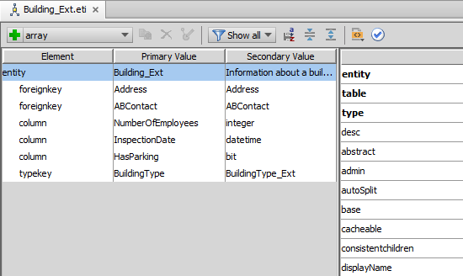
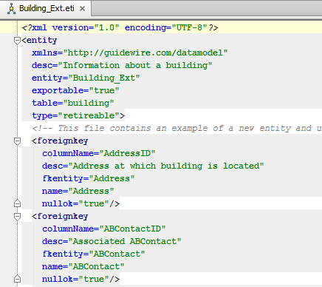
Entity declaration (eti) files
Building_Ext
Entity editor
Edit using Entity editor
Creates only one entity
Each entity can have at most one eti file
XML
Building_Ext.eti
Notes:
If you create an entity and then later need to add fields to the entity, you should add the new fields to the existing eti file.

Slide 10
Primary tags of eti file
<entity>
Defines entity to be created
Primary subtags (same as for <extension>)
<column>
Declares data field (storing simple values such as Strings, booleans, datetimes or integers)
<foreignkey>
Declares foreign key field
<array>
Declares array
<typekey>
Declares field constrained by specific typelist
Notes:
The four primary subtags listed above are common to entity extension (<extension>), entity declaration (<entity>), subtype extension (<extension>), and subtype declaration (<subtype>).

Slide 11
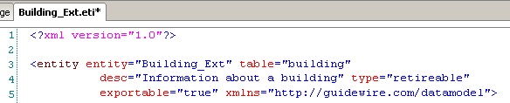
XML description and <entity> tags
First tag must be <?xml version="1.0"?>
Entity tag syntax:
<entity entity="EntityName_Ext" table="tablename" desc="DescString" type=“type (typically retireable)" xmlns="http://guidewire.com/datamodel">
...
</entity>
For entity name, Guidewire recommends CamelCase and ending name in "_Ext"
Notes:
The first tag, "<?xml version="1.0">, describes the XML used in the file. In this case, it identifies the version of XML used in the file.
Additional notes on entity tag attributes:
entity: Guidewire recommends the entity name be in CamelCase. (CamelCase is a style of capitalization in which several words are joined together with the first character of each word capitalized. Examples include "ClaimCenter" and "JavaScript". This is the preferred naming strategy for entities and variables, though for variables it is preferable to make the first letter lowercase.) Guidewire also recommends the name end in "_Ext" to distinguish the entity from base application entities.
table: Guidewire recommends that table names be in lower case. For loadable tables (ones that can be loaded through staging tables), the table name must be 25 characters or less. For non-loadable tables (ones that cannot be loaded through staging tables), the table name must be 26 characters or less.
desc: The "desc" string appears as the entity description in the Data Dictionary.
type: There are two types of entities in Guidewire: retireable and editable. Retireable is the most common type of entity. Once an instance of a retireable data object exists in the database, it is never physically deleted. Instead, it is logically deleted (or "retired"). For example, if you select a retireable object in a list view and then click Delete, the data is preserved in the database, but the Retired column for the row represented by that object holds an integer. Any non-zero value here means the object is retired. An editable entity has no "Retired" field and therefore can only be physically deleted from the database.
(continued)

Slide 12
Optional <entity> tag attributes
exportable="value"
Defaults to "false"
When set to "true", entity is available to application SOAP APIs (which means its data can be exposed to external systems)
Notes:
If an entity is exportable, then all of its arrays must be exportable. All of the entity's arrays must point to other exportable entities. The application will not start if there is an exportable entity with one or more arrays pointing to non-exportable entities.

Slide 13
Lesson outline
Custom entities
Entity declaration files
Foreign keys and arrays
Defining new entities
Advanced data model design features

Slide 14
Foreign keys and arrays
ABContact
Buildings
Building _Ext
AddressID
Address
(array key)
(foreign key)
Typically, entities are not isolated in data model
Two ways in which one entity can reference another
Foreign key
Pointer to single instance of some other entity
Maintained by foreign key column in database table
Example: each Building can have one address
Array key
Collection of pointers to instances of some other entity
Maintained by code during runtime
Example: each ABContact can have zero to many buildings

Slide 15
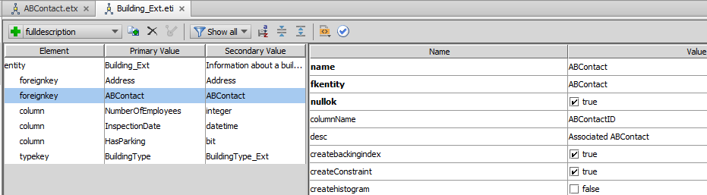
Foreign key – Studio
The foreign key defined in Building_Ext associates the array to ABContact
Both Address and ABContact appear as foreign keys in Building_Ext

Slide 16
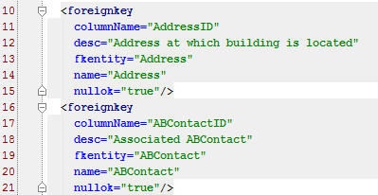
<foreignkey> in XML
Syntax:
<foreignkey name="FieldName" columnName="FieldNameID" fkentity="OtherEntity" desc="DescString"/>
Recommended naming convention:
For name, end field with "_Ext" only when field is added to base entity
Include columnName attribute and set it to field name + "ID"
Example:
Notes:
The columnName attribute is an optional attribute that specifies the actual name of the column in table created for this entity. This is useful when you want the database column name to differ from the field as referenced by Guidewire.
If a foreign key field is added to a base application entity, then the suffix should be "_ExtID".
For a complete reference of the <foreignkey> syntax, refer to the application's Configuration Guide.

Slide 17
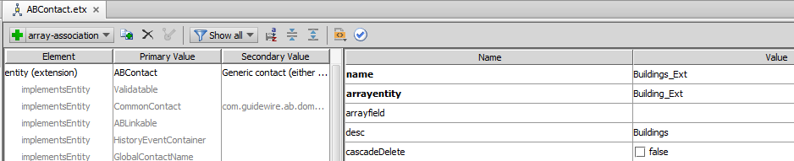
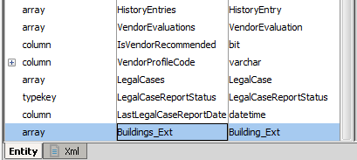
Array – Studio
Array definition for Buildings_Ext in entity ABContact

Slide 18
<array> tag
Syntax:
<array name="ArrayName" arrayentity="OtherEntity" desc="DescString"/>
Recommended naming convention for name:
Using plural form of name
Using "_Ext" suffix only when field added to base entity
Example:
Notes:
Note that the value of the arrayentity attribute must match exactly the name of the entity it references.
For a complete reference of the <array> syntax, refer to the application's Configuration Guide.

Slide 19
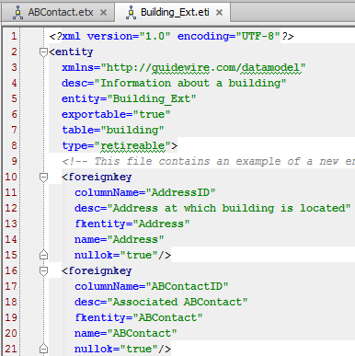
Each array requires "reverse" foreign key
If entity A has array of entity B, then entity B must have foreign key pointing to entity A
Notes:
Keep in mind that arrays are maintained in code. The code assembles the array by executing queries against the database. In order to do this, the application must be able to query for all members of a given array. It can do this only if each member has a foreign key referencing its parent.
Many-to-many relationships
You can also create many-to-many relationships. To do this, you must work with three entities: the two entities on the outside of the relationship and a "join" entity that connects the two. Each outer entity should have an array of the join entity. The join entity should have two non-nullable foreign keys, one to each end of the relationship. It should also have a unique index on the pair of foreign keys.
For example, assume you had a Client entity and a LawFirm entity. A client can be represented by many law firms. A law firm can represent many clients. Each entity would have an array as shown below:
On Client:
<array name="ClientLawFirm" arrayentity="ClientLawFirm"/>
On LawFirm:
<array name="ClientLawFirm" arrayentity="ClientLawFirm"/>
The join entity would look like this:
<entity xmlns="http://guidewire.com/datamodel" entity="ClientLawFirm" table="clientlawfirm" type="versionable" desc="Join entity modeling many-to-many relationship between Client and LawFirm">
<foreignkey name="Client" columnName="ClientID" fkentity="Client" nullok="false"/>
<foreignkey name="LawFirm" columnName="LawFirmID" fkentity="LawFirm" nullok="false"/>
<index name="clientlawfirm" unique="true">
<indexcol keyposition="1" name="ClientID"/>
<indexcol keyposition="2" name="LawFirmID"/>
</index>
</entity>

Slide 20
Lesson outline
Custom entities
Entity declaration files
Foreign keys and arrays
Defining new entities
Advanced data model design features

Slide 21
Steps to create an entity
In Project view, navigate to folder: /configuration/config/Extensions/Entity
Create new entity
Context menu → Entity
Entity dialog, enter details
Add child elements and define attributes
Validate
Restart application server
Create file
Define variables
Code Default return value
Create additional names
Restart Server
Code return values
Notes:
To create an entity, in Project view, navigate to the /configuration/config/Extensions/Entity folder. Open the folder context menu. Select Entity. In the Entity dialog, name the Entity, define the Entity Type, specify a Description, name the physical database Table, select a Type, and mark if the entity is Extendable, Exportable, and/or Final. Click OK.
To create an entity extension, in Project view, navigate to the /configuration/config/extensions/entity folder. Open the folder context menu. Select Entity Extension. In the Entity Extension dialog, select the entity to extend and specify a suffix, such as EXT. Click OK.

Slide 22
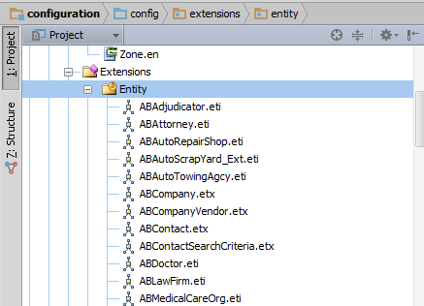
Step 1: Navigate to folder
In Project view, navigate to folder: /configuration/config/Extensions/Entity

Slide 23
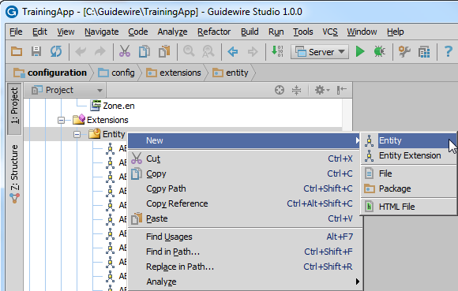
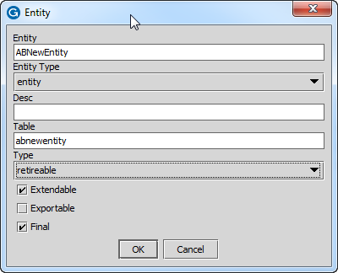
Step 2: Create new entity

Slide 24
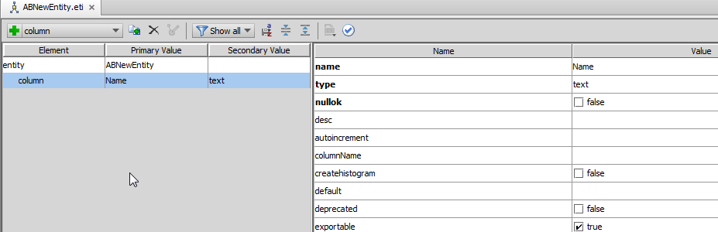
Step 3: Add child elements and attributes
Elements
Attributes

Slide 25
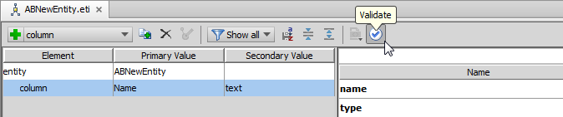
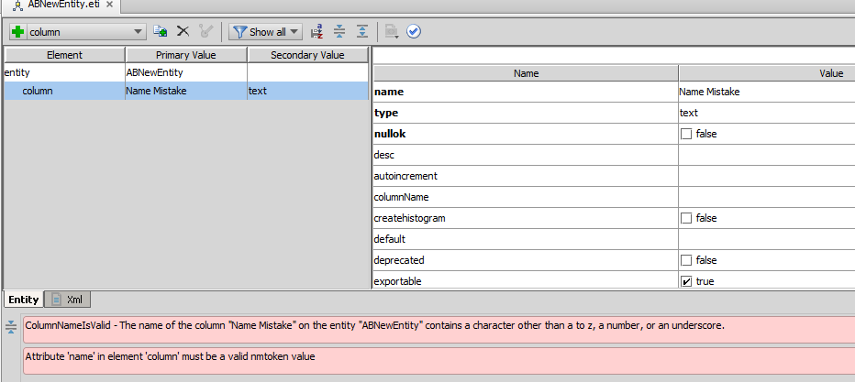
Step 4 and 5: Validate and restart server
Validation reports problems with the entity creation
Notes:
After verifying the validity of the entity and all attributes, restart the application server to effect changes.

Slide 26
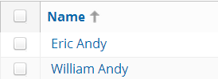
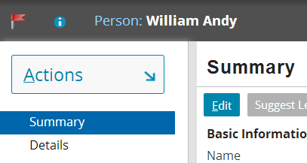
Entity names
Every entity has internally declared DisplayName field
It names each instance of that entity
It is used when entity must be named in user interface
Notes:
Entity names are used:
Whenever object as a whole is displayed; for example, in dropdown that lists ABContacts.
Whenever object's DisplayName is explicitly referenced; for example, in an info bar widget with its value property set to ABContact.DisplayName.
As of ClaimCenter 6.0, PolicyCenter 4.0, and BillingCenter 3.0, the DisplayName field does not appear in the Data Dictionary. It is available on every entity, however.

Slide 27
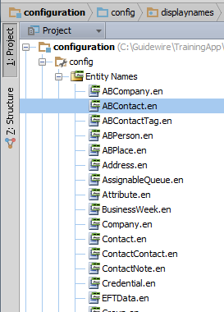
Defining entity names
Entity names defined using Gosu
Many base entities have entity names in base application
For new entities that will be displayed in the UI, entity name must be created
This is discussed in "Entity Names" lesson (which comes after section on Gosu)

Slide 28
Lesson outline
Custom entities
Entity declaration files
Foreign keys and arrays
Defining new entities
Advanced data model design features
Notes:
Creating New Entities - 28

Slide 29
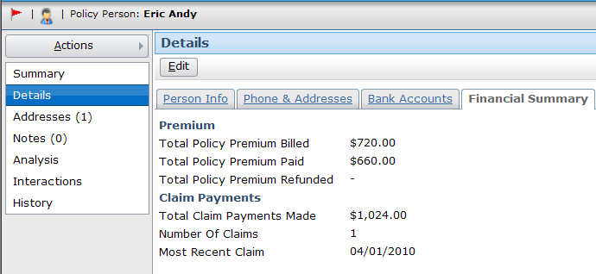
One-to-ones
ABContact
FinancialSummary
foreign key
ID FinancialSummaryID
ID ABContactID
one-to-one
A one-to-one is used to identify that two foreign key relationships are in fact the same relationship
Notes:
In some circumstances, it makes sense to split information about a single logical entity across multiple physical entities. For example, an ABContact has financial summary information as shown above (such as the amount of premium billed, number of claims filed, and total claim payments made). This information applies only to ABContacts that are policy holders (ABPolicyPerson and ABPolicyCompany). Theoretically, this information could be stored directly on the ABContact entity. This would make the entity very "wide" (it would have a large number of columns), however, and many of the rows would store null values (the rows that applied to non-policy contacts.)
When information is split across entities in this manner, the entities have a one-to-one relationship. For example, every ABContact has (at most) one FinancialSummary, and every financial summary applies to (at most) one ABContact.
When working in the application, it is often useful to be able to navigate from either side of the relationship to the other side of the relationship. The Guidewire data model does not allow two or more entities to point to one another in a cyclical manner using only foreign keys, however. This is because Guidewire cannot easily determine the order in which rows can safely be written to the database when a data model cycle exists.
This type of relationship can be modeled using a one-to-one. A one-to-one is a special foreign key that is put on the parent entity. (The parent is the entity that can exist even if there is no instance of the child entity. For example, you can have an ABContact with no financial summary, but you cannot have a financial summary with no ABContact.) It identifies that the rows in the parent table should be written first and the rows in the child table should be written second. This establishes a safe order for writing objects to the database.
For more information on one-to-ones, refer to the "Advanced Data Model Features" lesson or the Configuration Guide.

Slide 30
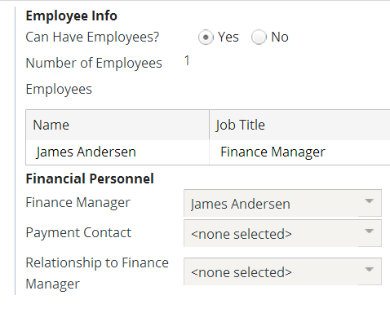
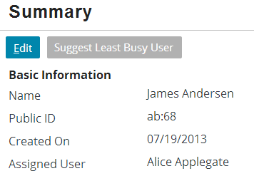
Edge foreign keys
ABContact
ABCompany
ABPerson
edge foreign key
An edge foreign key lets either:
An entity reference itself, or
Two or more entities reference each other
Notes:
In some cases, an entity needs to refer to itself. This could occur both for a non-subtyped entity (every Group has a parent group) or a subtyped entity when one subtype refers to another (every ABCompany—which is an ABContact—can have a finance manager who is an ABPerson, which is also an ABContact).
The Guidewire data model does not let an entity reference itself, or two or more entities reference one another in a cyclical manner, using only foreign keys. This is because Guidewire cannot easily determine the order in which rows can safely be written to the database when a data model cycle exists.
An edge foreign key is a special foreign key that actually stores relationships in a separate table known as an "edge table". Whenever information is written to the database, the objects themselves are written first, and then information is written to the edge table. This ensures that the relationship information does not reference non-existent rows.
The same principal is true for two or more entities that reference one another in a cyclical fashion. The cycle can be implemented using an edge foreign key, which allows all the individual rows to be written first, and the relationships among the rows to be written afterwards.
For more information on edge foreign keys, refer to the "Advanced Data Model Features" lesson or the Configuration Guide.

Slide 31
Delegates
delegate
entities implementing delegate
Assignable
Assignable
Assignable
Activity
ContactNote
AssignedUser AssignedGroup
ID Status Escalated AssignedUser AssignedGroup
ID Subject NoteType AssignedUser AssignedGroup
A delegate is a virtual entity consisting of database fields, or methods, or both that can be reused by multiple entities
Delegates bundle together data and functionality that is needed by multiple unrelated entities
Customers can implement existing delegates and create and implement new delegates
Notes:
Guidewire offers at least three different features for sharing functionality across the data model: delegates, subtypes, and interfaces. A delegate is designed for situations where multiple entities need common functionality but are distinctly different.
Delegates are often used over subtypes because subtyping can be impractical. The entities in question share only a small set of fields in common and it would be impractical to store them in a single table. You might also need to give one entity delegate A, another delegate B, and a third delegates A and B. Subtyping would require all these entities to be in a single table.
Delegates are often used over interfaces because interfaces do not define database fields.
For more information on delegates, refer to the "Advanced Data Model Features" lesson or the Configuration Guide.

Slide 32
Lesson objectives review
You should now be able to:
Describe how custom entities are added to an application
Describe the structure of an entity XML file
Create foreign keys and arrays to entities
Create new entities
List the features relevant to advanced data model design situations

Slide 33
Review questions
What is the difference between an etx file and an eti file?
Does the base application have existing entities? Can developers create new entities files?
If the ABLawyer entity has an array of Cases, what type of field is required on the Case entity?
To deploy data model changes, are you required to:
Identify changes in the Data Dictionary
Restart the application server?
Restart Studio?
Notes:
Answers
An etx file contains an <extension> tag and extends a base application entity. An eti file contains an <entity> tag and defines a new entity.
Yes; these are the files that declare the entities in the base application. Yes; these are the files that define custom entities.)
A foreign key pointing back to ABLawyer.
a) No, although it can be useful as a way of identifying flaws in the XML
b) Yes
c) No, though you must do it before working with the data model extensions in Studio

Slide 34
Notices
Copyright © 2001-2013 Guidewire Software, Inc. All rights reserved.
Guidewire, Guidewire Software, Guidewire ClaimCenter, Guidewire PolicyCenter, Guidewire BillingCenter, Guidewire Reinsurance Management, Guidewire ContactManager, Guidewire Vendor Data Management, Guidewire Client Data Management, Guidewire Rating Management, Guidewire InsuranceSuite, Guidewire ContactCenter, Guidewire Studio, Guidewire Product Designer, Guidewire Live, Guidewire DataHub, Guidewire InfoCenter, Guidewire Standard Reporting, Guidewire ExampleCenter, Gosu, Deliver Insurance Your Way, and the Guidewire logo are trademarks, service marks, or registered trademarks of Guidewire Software, Inc. in the United States and/or other countries.
Guidewire products are protected by one or more United States patents.

