Slide 1
Subtypes
10 October 2013

Slide 2
Lesson outline
Subtype basics
Extending base application subtypes
Defining new subtypes

Slide 3
Subtypes
ABContact
primary subtypes
ABPerson
ABCompany
ABPlace
ABAdjud- icator
ABPerson Vendor
ABPolicy Person
ABCompany Vendor
ABPolicy Company
ABLegal Venue
AB Attorney
AB Doctor
AB LawFirm
ABMedical CareOrg
ABAuto TowingAgcy
ABAuto RepairShop
Notes:
A subtype is an entity that is a child to some parent entity and inherits all fields from the parent.
ABContacts are organized into a set of subtypes. The organization of the hierarchy helps to model information about contacts. Information common to all contacts can be established at the ABContact level. It is automatically inherited by all of its subtypes. Information specific to an ABPerson can be defined at the ABPerson level. It is inherited by all of its subtypes, but information on the ABPerson subtype is not available to ABCompany or ABPlace.
In the ABContact hierarchy, an ABPolicyPerson is a person who owns a policy issued by the carrier (such as an individual with a personal auto policy). An ABPolicyCompany is a company which owns a policy issued by the carrier (such as a construction company with a workers' compensation policy).
There is one entity that participates in the hierarchy that does not appear in the diagram above: ABUserContact. This type of contact represents a TrainingApp user and is used to store his or her contact information (such as home phone numbers). It has been excluded because it is not relevant to the configuration work to be done with TrainingApp.
Subtyping is also used within the three primary applications. For example:
BillingCenter's Activity, Plan, and Contact entities
ClaimCenter's Transaction, Incident, and Contact entities
PolicyCenter's Job and Contact entities

Slide 4
Additional parent and subtype examples
All applications
Contact: Person, Company, Place, ...
ClaimCenter
Transaction: Payment, Recovery, Reserve, ...
PolicyCenter
Job: Submission, Renewal, Cancellation, Reinstatement, ...
PlanDetail: BillingPlanDetail, PaymentPlanDetail, ...
BillingCenter
Plan: BillingPlan, CommissionPlan, DelinquencyPlan, ...
ChargePattern: ImmediateCharge, ProRataCharge, ...
Notes:
In ClaimCenter:
A transaction is used to denote the movement of money either into a reserve line or from a reserve line to a payment.
In PolicyCenter:
A job is used to manage a policy transaction, which either creates or modifies a policy.
A plan detail is used to manage plans, which typically identify how the insured will be billed for or will pay for the policy. This information is passed to the billing system.
In BillingCenter:
A plan is used to store information about how a billing instruction coming from a policy administration system should be divided into invoices or statements.
A charge pattern is used to divide a charge from the billing instruction (such as a premium for coverages on the policy or a tax mandated by the government) into invoice items.

Slide 5
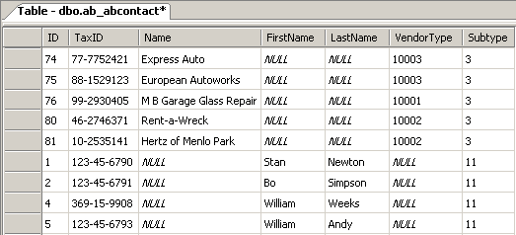
Review: Subtypes in the database
All subtypes stored in one table named after parent
Subtype column identifies subtype of each row
Columns irrelevant to given subtype have null values
auto repair shops
persons
Notes:
The screenshot above shows an example of the ab_abcontact table. It shows at least two subtypes: auto repair shop (with a subtype value of 3) and person (with a subtype value of 11). The screenshot shows columns defined at the parent level and therefore relevant to all child subtypes (such as TaxID), columns declared for the auto repair shop subtype (such as Name and VendorType), and columns declared for the person subtype (such as FirstName and LastName). Notice that NULL values appear for columns not relevant to a given row's subtype. For example, the Stan Newton row is for a person, and therefore the VendorType column has a null value.

Slide 6
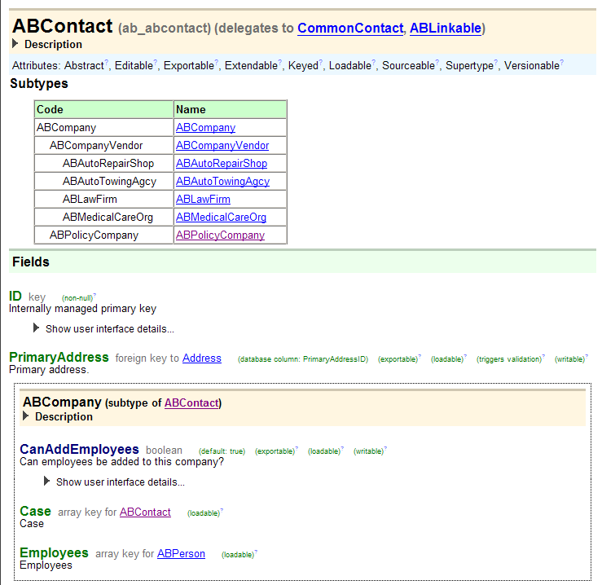
Subtypes in the Data Dictionary
Parent entity
List of subtypes
Fields at parent level
Fields at subtype level

Slide 7
Subtypes and Gosu classes
database
application server
ABContact
ABContact
Fields ID PrimaryAddress ...
internal Gosu class
ABContact .eti
ID PrimaryAddress
…
ABCompany
ABCompany
Fields ID PrimaryAddress Employees ...
internal Gosu class
ABCompany .eti
ID PrimaryAddress Employees
…
ab_abcontact
anABCompany
row in database table
instance of Gosu class
Coverage
read from db
save to db
Notes:
In object-oriented design, a class can be extended by a child class, or "subclass". Every field and method declared at the parent class is added to the child class automatically. This design feature is known as inheritance.
Guidewire subtypes also make use of inheritance. Every subtype has its own internal class. This class inherits all fields and methods of the parent class.
In most cases, a database table corresponds to one data model entity, and therefore one database-backed Gosu class. One exception to this is where subtypes are concerned. If an entity is subtyped, then the database table corresponds to the top-level data model entity and all of its subtype entities. The table then also corresponds to one top-level database-backed Gosu class and all of its subclasses.
In the diagram above, the row in the database table that corresponds to anABCompany is not shown as a continuous strip of gray, but rather as a discontinuous set of gray strips. This is to emphasize the fact that the table for a subtyped entity has columns that don't apply to all subtypes. For example, the "ab_abcontact" table has columns for FirstName and LastName. These fields only apply to ABContacts that are of type ABPerson. For ABCompanies (such as anABCompany), those columns will have null values.

Slide 8
Lesson outline
Subtype basics
Extending base application subtypes
Defining new subtypes

Slide 9
Extending base application subtypes
Select the entity to extend in Metadata → Entity
Give the extension a suffix
Locate the base application subtype extension
Add fields to the extension in Entity → Extension

Slide 10
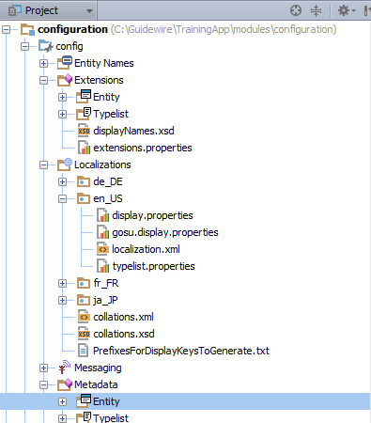


Step 1: Select the entity subtype to extend
In Metadata → Entity, select the entity you want to extend. In this example, the entity being extended is ABCompany.eti

Slide 11
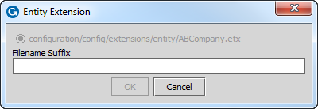
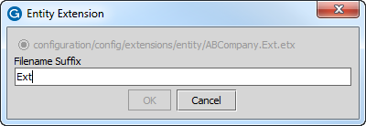
Step 2: Give the extension a suffix
Guidewire suggests Ext as the filename suffix for entity extensions

Slide 12
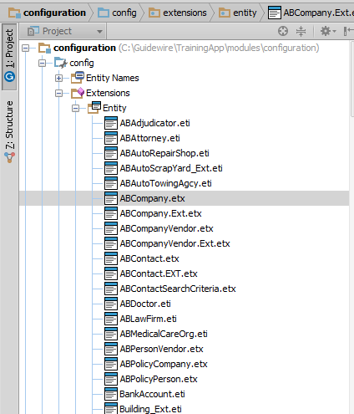
Step 3: Locate extension
New subtype appears in Extensions → Entity
You add fields to the new subtype here, in the Extensions → Entity location

Slide 13
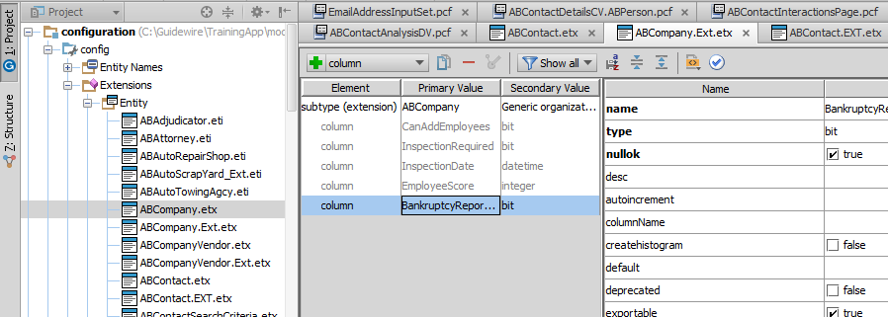
Step 4: Add fields to extension
Add fields
Example of added field

Slide 14
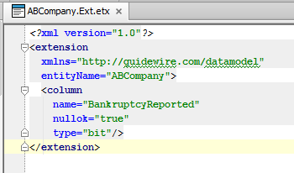
Entity extension (etx) files
ABCompany.Ext.etx
ABCompany.Ext.etx
Used to extend base application "top-level" entities and subtypes
<extension> tag used for both "top-level" entities and subtype entities
Notes:
If you need to make multiple extensions to a single subtype at different points in time, all extensions for that subtype should be added to the same etx file.

Slide 15
Sample etx file (for subtypes)
<extension> tag simply names subtype as entity to extend
XML namespace inferred from parent

Slide 16
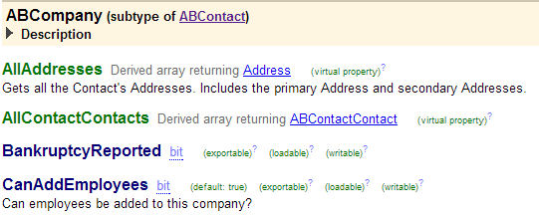
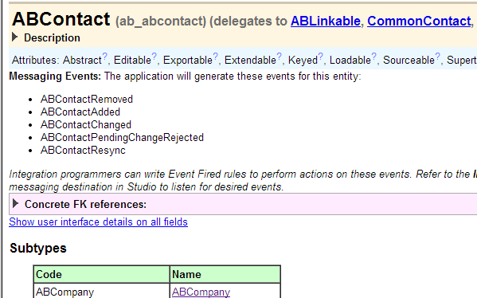
The extended subtype in the Data Dictionary

Slide 17
Lesson outline
Subtype basics
Extending base application subtypes
Defining new subtypes

Slide 18
Steps in defining a new subtype
Add a new entity through the UI
Specify the subtype name
Specify the supertype (the parent)
Notes:
Adding a new subtype is similar to the process of adding an entity. However, it requires details including the subtype specification, and the supertype.

Slide 19
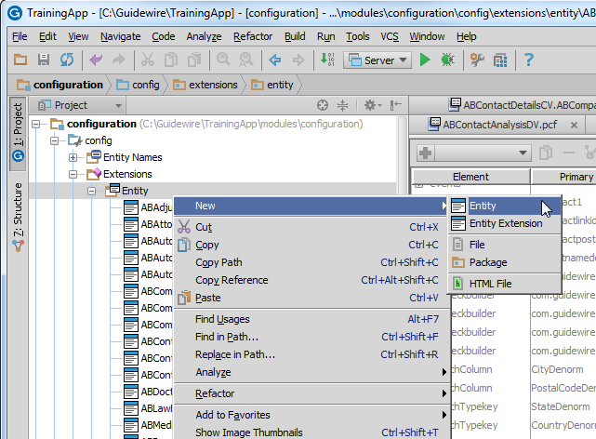
Step 1: Add a new entity through the UI

Slide 20
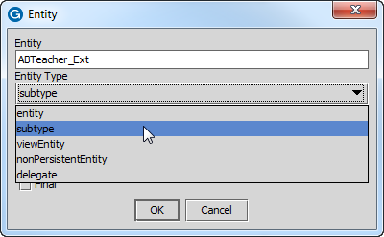
Step 2: Specify the subtype name and entity type
Subtype name
Entity type

Slide 21
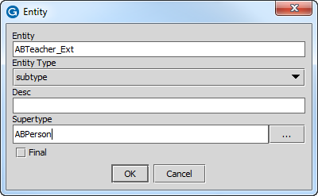
Step 3: Specify the supertype
Supertype name

Slide 22
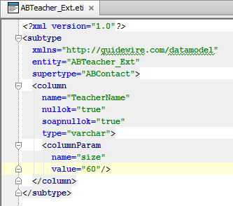
Entity declaration (eti) files
ABTeacher_Ext
ABTeacher_Ext.eti
Used to create new "top-level" entities and subtypes
<entity> tag used for "top-level" entities
<subtype> tag used for subtype entities
Both tags (and <extension> tag) share same set of subtags
Notes:
If you create an entity and then later need to add fields to the entity, you should add the new fields to the existing eti file.

Slide 23
<subtype> tag
Subtype tag syntax:
<subtype entity="EntityName" supertype="ParentEntity" displayName="DisplayStringForEntityType">
</subtype>
For subtype name:
Guidewire recommends CamelCase and ending name in "_Ext"
Name must be 22 characters or less
Do not specify a table name
You do not need to specify an XML namespace, but if you do it must be the same as the parent's XML namespace
Notes:
As is the case with all data model files, the first tag must be <?xml version="1.0"?>
The entity attribute
Guidewire recommends the entity name should be in CamelCase. CamelCase is a style of capitalization in which multiple words are joined together with the first character of each word capitalized. Examples include "ClaimCenter" and "JavaScript". This is the preferred naming strategy for entities and variables, though for variables it is preferable to make the first letter lowercase. Guidewire also recommends ending the name with "_Ext" to distinguish the entity from base application entities. For every subtyped entity, Guidewire applications create a typelist. These typelists list all of the subtypes for the top-level entity. The typelists consist of a set of typecodes, one typecode for each subtype. The "code" of each typecode is the subtype's name. Guidewire imposes a 22-character maximum on typecode codes, however. Therefore, the name of any given subtype cannot exceed 22 characters. If you do create a subtype with 23 or more characters, any attempt to restart the server or regenerate the data dictionary will fail.
The supertype attribute
This identifies the entity that is to be the immediate parent of the new subtype.
(continued)

Slide 24
Primary <subtype> subtags
Primary subtags (same as for <extension> and <entity>)
<column>
Declares data field (storing simple values such as Strings, booleans, datetimes or integers)
<foreignkey>
Declares foreign key field
<array>
Declares array
<typekey>
Declares field constrained by specific typelist
Notes:
The four primary subtags listed above are common to entity extension (<extension>), entity declaration (<entity>), subtype extension (<extension>), and subtype declaration (<subtype>).

Slide 25
Completed eti file for subtypes
<subtype> eti files and <entity> eti files differ only in the first data model tag
Share common set of subtags (<column>, <foreignkey>, <array>, and <typekey>)
Share common set of recommended naming conventions

Slide 26
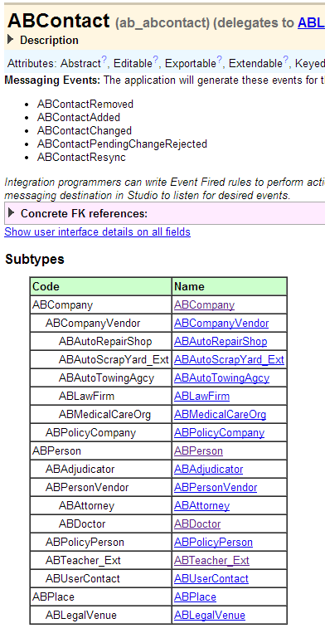
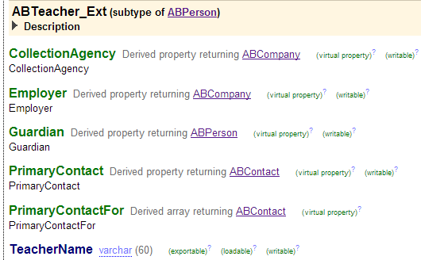
The new subtype in the Data Dictionary

Slide 27
Steps to create or modify subtypes
(Same steps for creating or modifying a "top-level" entity)
Create or modify file
Extending subtype and etx file already exists?
Then modify existing file
Extending subtype and no etx file exists?
Create new etx file named "subtypeName.Ext.etx"
Creating new subtype?
Create eti file named "subtypeName_Ext.eti"
Add child tags to file as needed and save file
Optionally regenerate Data Dictionary (to check for errors)
Restart application server
Restart Studio to work with new or modified subtype

Slide 28
Lesson objectives review
You should now be able to:
Describe the role of subtypes in the data model
Create new subtypes
Extend existing subtypes

Slide 29
Review questions
Given the tags <extension>, <entity>, and <subtype>, which tag corresponds to:
Adding fields to a base application "top-level" entity?
Creating a new "top-level" entity?
Adding fields to a base application subtype?
Creating a new subtype?
When you create a new subtype, you cannot specify a table name for the new subtype. Why?
Notes:
Answers
1. a) <extension>
b) <entity>
c) <extension>
d) <subtype>
2. You cannot specify a table name because the new subtype is put into the same table as its parent.

