Slide 1
Typelists
11 Sept 2013
Notes:
Guidewire training materials contain Guidewire proprietary information that is subject to confidentiality and non-disclosure agreements. You agree to use the information in this manual solely for the purpose of training to implement Guidewire software solutions. You also agree not to disclose the information in this manual to third parties or copy this manual without prior written consent from Guidewire. Guidewire training may be given only by Guidewire employees or certified Guidewire partners under the appropriate agreement with Guidewire.

Slide 2
Lesson objectives
By the end of this lesson, you should be able to:
Describe the functionality of a typelist
Create simple typelists
Create fields constrained by typelists
Create typekey fields that reference typelist filters
This lesson uses the notes section for additional explanation and information. To view the notes in PowerPoint, choose View→Normal or View→Notes Page. If you choose to print the notes for the lesson, be sure to select “Print hidden slides.”

Slide 3
Lesson outline
Typelist basics
Simple typelists
Fields constrained by typelists
Filtered typelists

Slide 4
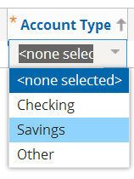
What is a typelist?
A typelist is a predefined list of values used to constrain a field
When rendered in UI, typically appears as dropdown
Account Type typelist

Slide 5
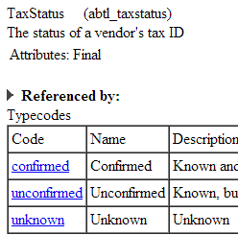
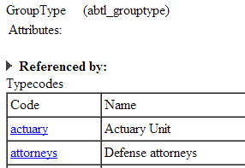
Kinds of typelists
Internal
In base application and cannot be modified
Required for internal application logic
Shown as "Final" in Data Dictionary
Extendable
In base application and can be modified
New codes can be added
May also include internal codes that cannot be modified
Custom
Not found in base application
Created as configuration

Slide 6
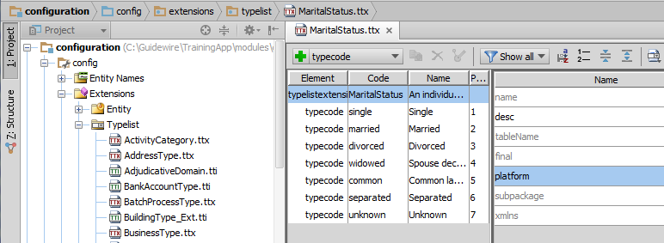
The typelist editor
All typelist configuration done in Studio's typelist editor
Notes:
Similar to entity definitions, typelist definitions are stored in XML files. There are three types of typelist files:
tti, which define the typelist (at either the platform or application level for either base application typelists or custom typelists)
tix, which are internal extensions to platform-level typelists for the needs of a specific application
ttx, which are exposed (non-internal) base application extensions or custom extensions
Developers should always create and modify typelists through Studio. Guidewire does not recommend manipulating the XML files directly.
In some cases, typelists in Studio appear with a grayed-out icon (such as ManageWorkflowActionType in the screenshot above). This occurs when the typelist is managed internally by the application, as opposed to being managed by an externally exposed XML file. In many cases, internally managed typelists are also internal typelists and explicitly have the "Final" attribute. There are some typelists, however, that can have typecodes added to them (and therefore are not final) but are still managed internally. One example is the ABContact typelist, which is used by ABContact to identify the specific subtype of each instance. (Is a given instance of ABContact an ABPerson? An ABPersonVendor? An ABDoctor?) You can add new subtypes to ABContact, which causes new typecodes to be added to this typelist. The typelist is managed internally and not as an exposed XML file, however, so the ABContact typelist appears in the typelist editor with a grayed-out icon.

Slide 7
Lesson outline
Typelist basics
Simple typelists
Fields constrained by typelists
Filtered typelists

Slide 8
Steps to create and use new typelist
Create typelist
Define typecodes
Create typekey field on appropriate entity
Optionally regenerate Data Dictionary (to check for errors)
Restart application server
Notes:
A simple typelist is a typelist that does not make use of filtering. Filtered typelists are discussed later in this lesson.

Slide 9
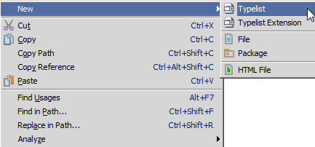
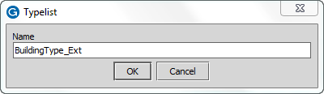
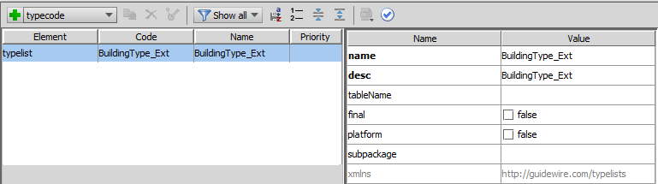
Step 1: Create the typelist
Naming convention is for custom typelists to end in "_Ext"
Notes:
The maximum length for a typelist name is 25 characters.
By default, Guidewire uses xxtl_<typelist name> as the name of the typelist table (where "xx" is the application's code). If you want a different table name, you can override the default value by specifying a value in the "Table name" field in Studio. If you override the default value, the table name becomes xxtl_<table name>. Guidewire restricts the typelist table name to ASCII letters, digits, and the underscore character. Guidewire also places limits on the length of the name. Guidewire imposes these restrictions because of the restrictions imposed by the various relational database management systems (RDBMS) with which Guidewire applications interact. If you choose, however, you can override the name of the typelist and thus the table name stored in the database.
A "final" typelist is a typelist to which no additional typecodes can be added. All custom typelists are non-final.

Slide 10
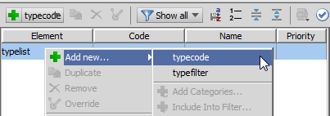
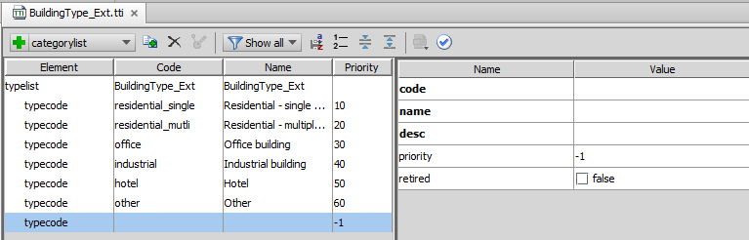
Step 2: Define the typecodes
If two or more codes have same Priority, they are sorted alphabetically by Name.
internal reference (unique within typelist, <=50 char)
value shown in UI
Data Dictionary description
sort order in UI
disabled?
Notes:
First add a new typecode through the UI. After adding the new typecode, add details for the typecode.
Typecode attributes:
Code A unique ID for internal use. It must be 50 characters or fewer. It can contain letters, numbers, and any of the following: "_", ".", "-", ":". It may not contain spaces.
Name The value displayed in the UI.
Description The description listed in Data Dictionary.
Priority The position in the dropdown in the UI. (Items are sorted first by priority and then by name. Items with priority -1 appear at the end of the list sorted by name.)
Retired "true" will retire (disable) typecode
If a list view is sorted based on a typekey field, then the rows are sorted using standard typecode sorting (first by priority and then by name, and items with a priority of -1 appearing at the end of the list). For example, if a list of buildings included a "BuildingType" column and the user clicks the column header (thereby sorting the list by building type), all "residential - single dwelling" buildings will be listed before any "residential - multiple dwelling" buildings. This is because the single dwelling typecode has a lower priority (10).
In a production environment, you should never delete a typecode or modify the typecode's "code" value. Either of these behaviors can cause problems because there could be existing objects that reference the altered or deleted typecode. In situations like this, you should mark the typecode's "retired" value as true. This preserves the typecode for objects that already make use of the typecode, but it prevents the use of the typecode by new objects or by existing objects that don't already use the code. For example, assume you have a "Color" typelist that is used by the Vehicle entity and you retire the typecode "brown". Any existing vehicle with the color "brown" will be unaffected. But new vehicles cannot be set to brown and existing vehicles that are not brown cannot be changed to brown.

Slide 11
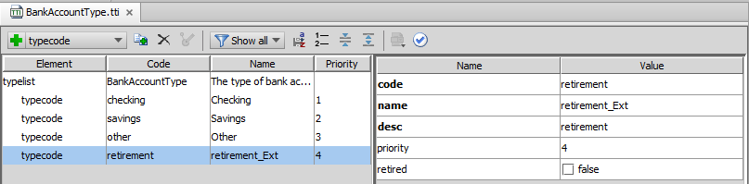
Typecodes for base application typelists
Base application typelist
For base app typelists, new typecodes should end in _Ext

Slide 12
Lesson outline
Typelist basics
Simple typelists
Fields constrained by typelists
Filtered typelists

Slide 13
Typekey fields
A typekey field is a field associated with a specific typelist
Values in that field limited to those defined in typelist
Building_Ext
BuildingType_Ext Residential - single Residential - multi Office Industrial Hotel Other
ID
ABContact
Address BuildingType InspectionDate HasParking
…

Slide 14
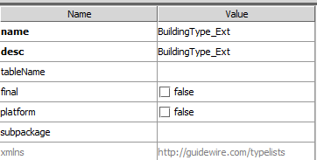
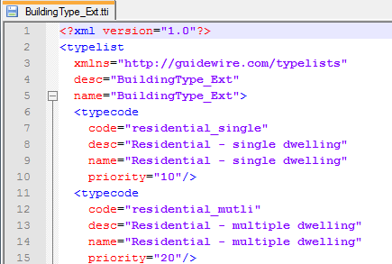
Step 3: Create typekey field
Valid child for <extension>, <entity>, or <subtype>
Syntax:
<typekey name="FieldName" typelist="Typelist" desc="DescString"/>
Examples:

Slide 15
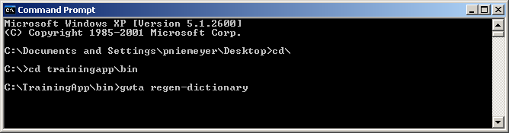
Step 4: Optionally regenerate dictionary
Regenerating the Data Dictionary is not required, but can identify flawed XML (particularly with typekey fields)
Notes:
Creating New Entities - 15

Slide 16
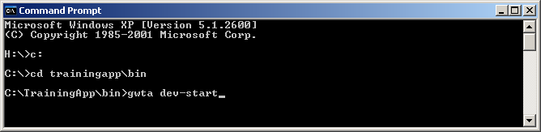
Step 5: Restart application server
During start-up, Guidewire upgrades database if there are changes to data model (including typelists and typecodes)
You must restart Studio for it to know about new typekeys
It already "knows" about new typelists and typecodes
Notes:
Creating New Entities - 16
The automatic database upgrade process described above occurs only if the database autoupgrade option in config.xml is set to true. An example of the database tag, as used for TrainingApp, appears below, with the relevant option in bold. For H2, the database used in training, this option is set to true by default. For SQL Server and Oracle, this option is set to false by default.
<!-- H2 (meant for demo/quickstart use only!) -->
<database name="ContactCenterDatabase" driver="dbcp" dbtype="h2" autoupgrade="true" checker="false"
printcommands="false" verifyschema="false">
<!-- <param name="jdbcURL" value="jdbc:h2:file:/GWTraining/TrainingApp/db/ta"/> -->
<!-- <param name="jdbcURLtest" value="jdbc:h2:file:/GWTraining/TrainingApp/db/tatest"/> -->
<param name="jdbcURL" value="jdbc:h2:file:/GWTraining/TrainingApp60/db/ta"/>
<param name="jdbcURLtest" value="jdbc:h2:file:/GWTraining/TrainingApp60/db/tatest"/>
<param name="stmtPool.enabled" value="false"/>
<param name="maxWait" value="30000"/>
</database>

Slide 17
Lesson outline
Typelist basics
Simple typelists
Fields constrained by typelists
Filtered typelists

Slide 18
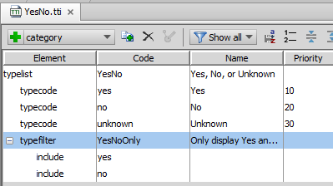

Filtering typelists
You can configure typelists so that, under given circumstances, some values are "filtered out" and do not appear
Two mechanisms for doing this
Filters
Categories
"Unknown" typecode does not appear
Notes:
A typelist filter is a named subset of typecodes in typelist. It is declared at the typelist level.
A typelist category is a "parent value" that must be present for a given "child value" to be available. It is declared at the typecode level.

Slide 19
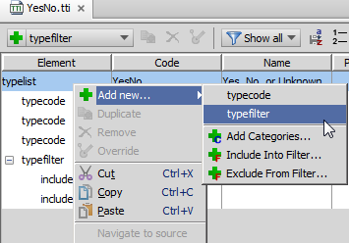
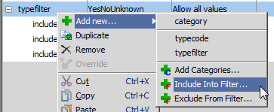
Creating typelist filters
A typelist filter is a named subset of typecodes in typelist
To create a typelist filter:
On the typelist, click Add new… → typefilter
On the typefilter, click Add new… → Include Into Filter

Slide 20
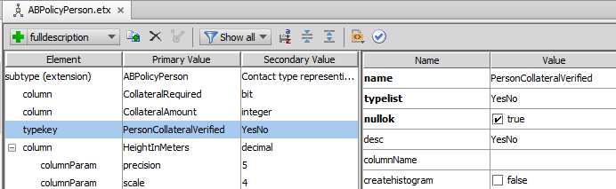
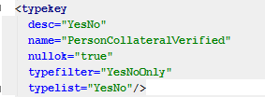
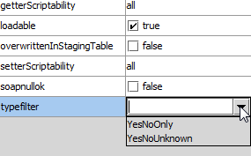
Referencing typelist filters

Slide 21
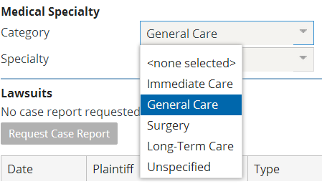
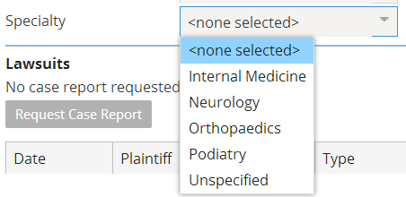
Typecode categories
Typecodes parents determine which child typecodes appear – these are dependent dropdowns, covered in a later lesson

Slide 22
Lesson objectives review
You should now be able to:
Describe the functionality of a typelist
Create simple typelists
Create fields constrained by typelists
Create typekey fields that reference typelist filters

Slide 23
Review questions
What is the difference between an "internal" typelist and an "extendable" typelist?
What restrictions exist around the value for a typecode's code?
What determines the order in which typecodes are listed in the user interface?
What is the difference between these two tags:
A <typekey> tag with just a typelist attribute
A <typekey> tag with a typelist and typefilter attribute
Notes:
Answers
An internal typelist cannot be extended. An extendable typelist can be extended.
The typecode must be unique within the typelist and must have 50 characters or fewer. (It also must contain no characters other than alphanumerics, underscores, periods, commas, hyphens, and colons.
The priority and then the name determines the sort order. Entries with priority -1 appear at the end of the list
The first field is limited to all the values in the typelist. The second field is limited to some named subset of values in the typelist.

Slide 24
Notices
Copyright © 2001-2013 Guidewire Software, Inc. All rights reserved.
Guidewire, Guidewire Software, Guidewire ClaimCenter, Guidewire PolicyCenter, Guidewire BillingCenter, Guidewire Reinsurance Management, Guidewire ContactManager, Guidewire Vendor Data Management, Guidewire Client Data Management, Guidewire Rating Management, Guidewire InsuranceSuite, Guidewire ContactCenter, Guidewire Studio, Guidewire Product Designer, Guidewire Live, Guidewire DataHub, Guidewire InfoCenter, Guidewire Standard Reporting, Guidewire ExampleCenter, Gosu, Deliver Insurance Your Way, and the Guidewire logo are trademarks, service marks, or registered trademarks of Guidewire Software, Inc. in the United States and/or other countries.
Guidewire products are protected by one or more United States patents.

