Slide 1
The User Interface Architecture
12 August 2013
Notes:
Guidewire training materials contain Guidewire proprietary information that is subject to confidentiality and non-disclosure agreements. You agree to use the information in this manual solely for the purpose of training to implement Guidewire software solutions. You also agree not to disclose the information in this manual to third parties or copy this manual without prior written consent from Guidewire. Guidewire training may be given only by Guidewire employees or certified Guidewire partners under the appropriate agreement with Guidewire.

Slide 2
Lesson objectives
By the end of this lesson, you should be able to:
Describe the user interface architecture
Describe what a PCF file is
Create new PCF folders and files
Open and edit PCF files
Deploy UI changes
This lesson uses the notes section for additional explanation and information. To view the notes in PowerPoint, choose View→Normal or View→Notes Page. If you choose to print the notes for the lesson, be sure to select “Print hidden slides.”

Slide 3
Lesson outline
User interface architecture
PCF files
Creating and opening PCF files
Modifying PCF files
Deploying UI changes

Slide 4
Guidewire application UI framework
The PCF (Page Configuration File) object model is a proprietary application framework used to create all Guidewire end-user interfaces
Two high-level categories of PCF elements
PCF Element
Widget
Location
displayable elements of UI; converted into HTML
place in application which user (or application itself) can navigate to
Notes:
A widget is a PCF element that can be converted into HTML and displayed.
A location is a PCF element that a user (or the application itself) can navigate to. It is used to define how users move from one area of user interface to the next.
The PCF object model is container-based. Each screen element is modeled as an object, which may contain other objects. The hierarchical structure simplifies the task of locating and modifying visual elements. Furthermore, each element can be declared as an independent and therefore reusable element.

Slide 5
Atomic widgets
PCF Element
Widget
Location
Atomic Widget
Container Widget
An atomic widget is an atomic piece of interface content or functionality
Used to display individual data values or execute individual actions
Input
Cell
Button
Notes:
Atomic widgets are individual field items such as inputs, cells, or buttons. They will always be defined within a container widget or location.

Slide 6
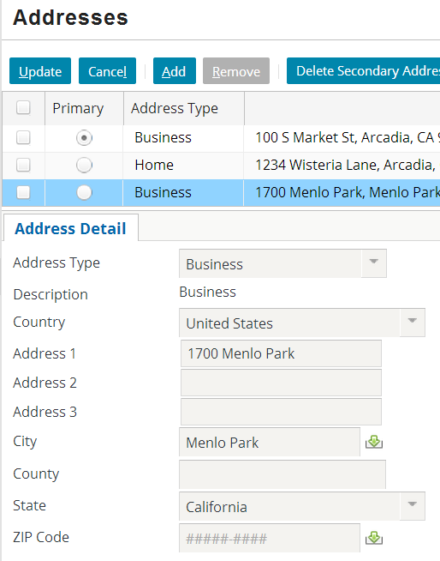
Atomic widgets: examples
Button
Cell
Atomic Widget
Input
Input
Cell
Button

Slide 7
Container widgets
PCF Element
Widget
Location
Atomic Widget
Container Widget
A container widget is a collection of atomic widgets and/or other container widgets
Used to organize data and functionality into logical groups
Detail View
Input Set
List View
Card View
ListDetail View
Screen
Notes:
Container widgets hold other widgets. Each one can be defined either in its own file or as a child container within some other PCF element file.

Slide 8
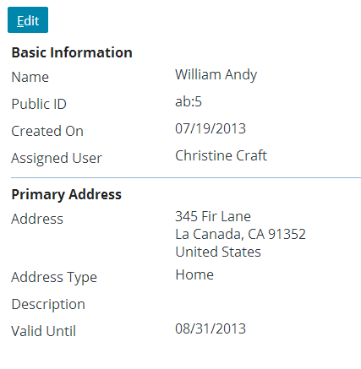
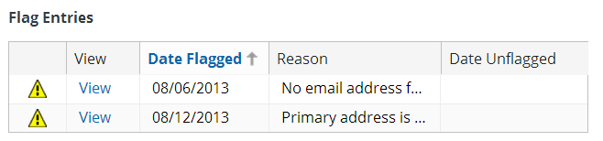
Primary views and input sets
A primary view is a reusable panel designed to organize atomic widgets
Detail views
List views
An input set is a collection of inputs that can be reused by many detail views
Detail view
Input set
List view

Slide 9
Detail views
Typically:
Focus on a single record
Allow the user to:
View or edit an existing record
Create a new record
Use many atomic widgets to display a large amount of information
Organized in columns
Can be referenced by screens and secondary views
Detail view
Notes:
Detail views are generally designed to use widgets to organize and manage a collection of related pieces of information that constitute a single “record”. The most obvious example is the set of individual fields of an instance of an entity such as User, Claim, or Policy. There are no constraints imposed by the system as to what information can be displayed by a detail view, however; the view could present information from multiple entities that do not even have to be related to one another, in addition to information that does not derive from an entity at all (such as calculated or static values). The purpose of a detail view, however, and the recommended practice behind their use is to present the user with all of the detailed information that is relevant to that interface, and no information that is irrelevant. In general this means displaying information about the fields of a particular entity and possibly fields from a small number of closely related entities.
Detail views must contain at least one column and can contain as many columns as necessary to present the widgets in the most effective way for the user.

Slide 10
List views
Typically:
Allow the user to view information about multiple records at the same time
Use a small number of atomic widgets to display the most relevant information
Organized in tables
Can be referenced by screens and secondary views
List view
Notes:
Just as a detail view is designed to allow the user to view detailed information about a single record, a list view is designed to allow the user to view summary information about a collection of records.

Slide 11
Input sets
Can contain atomic widgets
Can be reused by detail views
Cannot be referenced by secondary views
Cannot have a toolbar directly associated with them
Input set

Slide 12
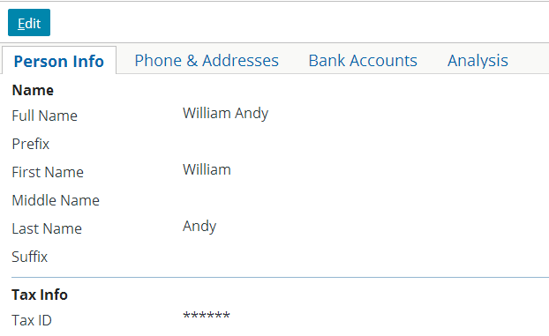
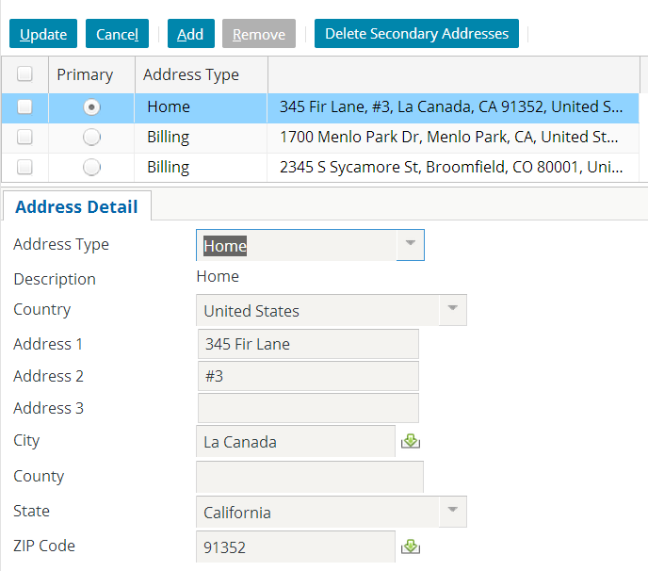
Container widgets: secondary views
A secondary view is used to organize primary views
A card view is a collection of cards, each with one or more detail views or list views
A listdetail view contains a list on top and detailed information about the selected list item on bottom
Card view
Listdetail view

Slide 13
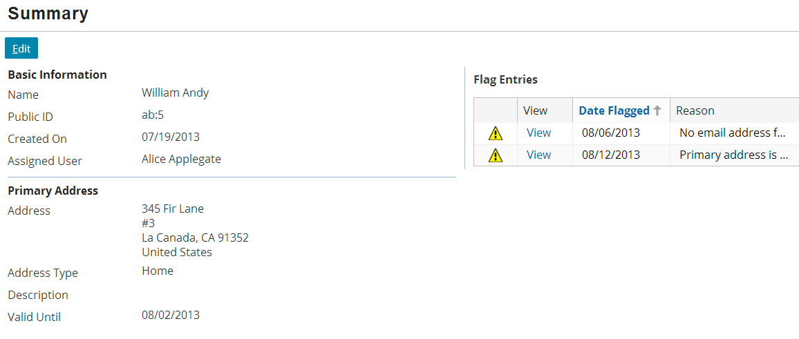
Container widgets: screens
Screens are top-level containers
Every atomic widget, primary view, and secondary view is contained (directly or indirectly) in a screen
Screen

Slide 14
Container widget hierarchy
screen a top-level container one can navigate to
Screen
secondary views collections of primary views organized for usability
Card View / ListDetail View
primary views a single object (and its related data) or set of objects
Detail View
List View
Input Sets
atomic widgets individual elements of data and/or functionality
Atomic Widgets
Notes:
Container widgets can be classified in four categories:
The lowest level is comprised of atomic widgets.
Atomic widgets can be directly contained only by primary views (detail views and list views). The purpose of a primary view is to organize atomic widgets into logical groups.
Secondary views (card views and listdetail views) are used to organize primary views. Secondary views cannot directly contain most atomic widgets.
Screens are the top-level containers. Screens are used to connect what is displayed in the user interface with how users navigate through the user interface. A screen can directly contain both primary views and secondary views, but it cannot directly contain most atomic widgets.
Input sets do not readily fall into any of these categories. Input sets fit some of the attributes of primary views. They can contain atomic widgets and organize them into logical groups. Input sets cannot be referenced directly by secondary views or screens, however; they must be embedded into detail views. Also, they cannot have toolbars directly associated with them.

Slide 15
Locations
PCF Element
Widget
Location
Atomic Widget
Container Widget
Location Group
Page
A location is a PCF element that a user can navigate to
Used to define how user moves from one area of user interface to the next
Discussed in detail in "Locations" lesson
Wizard
Popup
Worksheet
Forward
Exit Point

Slide 16
Container widgets and locations
Page
Wizard
Locations reference screens
Screens form the bridge between what is displayed in application and how one moves through application
Screen
Popup
Worksheet
Card View / ListDetail View
Detail View
List View
Input Sets
Atomic Widgets
Notes:
Notice that only a subset of locations reference screens:
LocationGroups reference a collection of Page locations, which then reference screens
Forwards redirect to any other location types, which may contain screens
Exit Points reference external URLs, which define non-application screens

Slide 17
Review: PCF classification hierarchy
PCF Element
Widget
Location
Atomic Widget
Container Widget
Location Group
Detail View
Page
Input
Input Set
Wizard
Cell
Popup
List View
Button
Worksheet
Card View
Forward
ListDetail View
Exit Point
Screen
Notes:
At the top level, PCF elements are split between widgets and locations.
This lesson will only be dealing with the high-level classifications of widgets (both atomic and container) and locations. Discussions of specific widgets and locations will follow in future lessons.

Slide 18
Lesson outline
User interface architecture
PCF files
Creating and opening PCF files
Modifying PCF files
Deploying UI changes

Slide 19
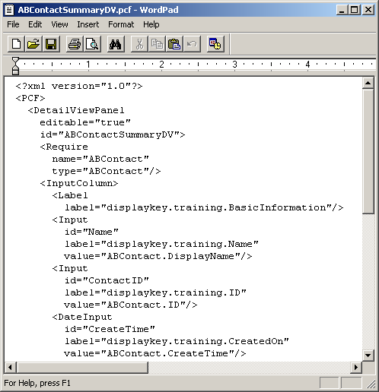
PCF files
A PCF file is an XML file that defines a location or container widget
May also:
Define child containers
Reference other containers
Include atomic widgets
Notes:
A PCF is an XSD-validated XML document containing elements that describe the structure, layout, and behavior of the web user interface.
The majority of this content is defined at the application level, though some is defined at the platform level.

Slide 20
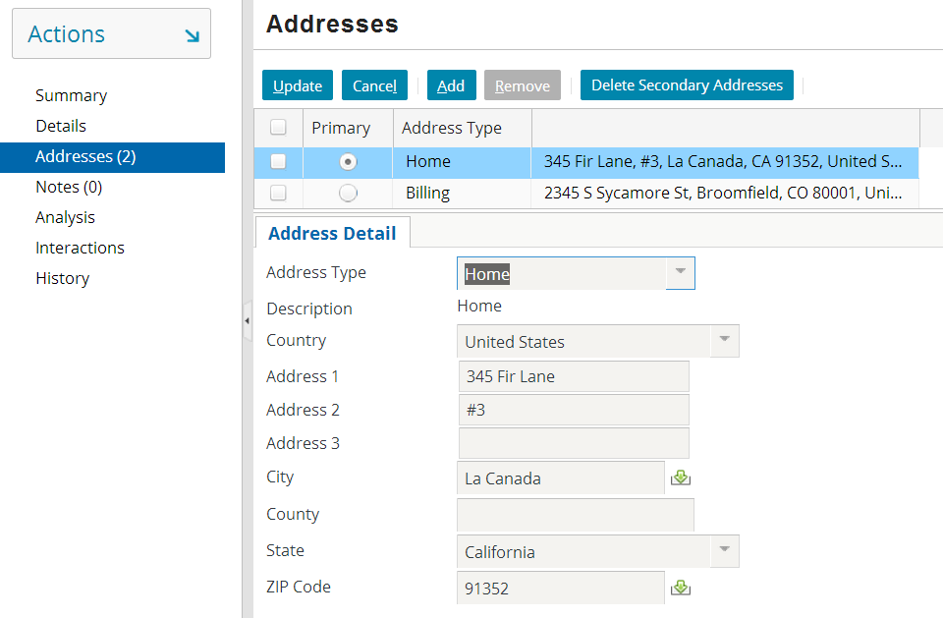
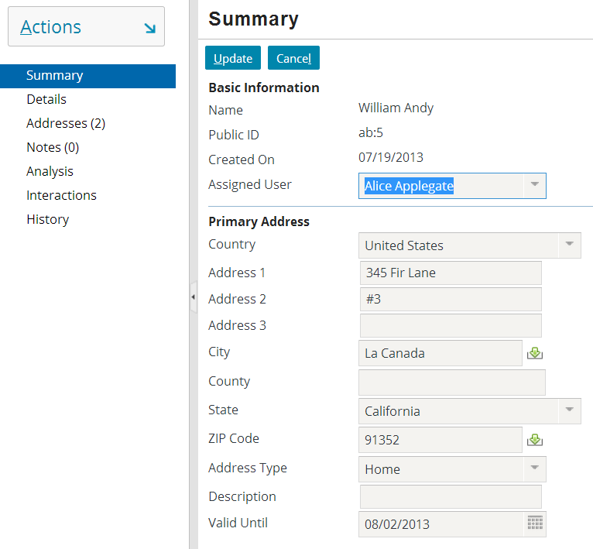
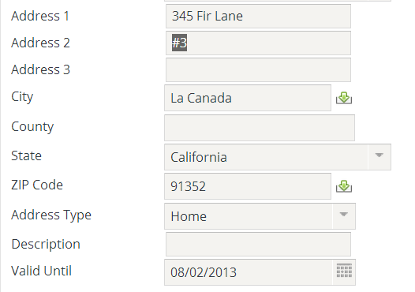
PCF files enable reusability of containers
ABContact AddressesLDV.pcf
ABContactSummaryDV.pcf
BasicAddressInputSet.pcf
Notes:
When a container widget is declared in its own PCF file, it can be referenced by any number of other containers.

Slide 21
Valid parent objects for PCF files
PCF Element
Widget
Location
Atomic Widget
Container Widget
Location Group
Detail View
Page
Input
Input Set
Wizard
Cell
Popup
List View
Button
Worksheet
Card View
Forward
Elements in blue can be parent object in PCF.
ListDetail View
Exit Point
Screen
Notes:
Every PCF file declares either a container widget or a location. It is not possible to create a PCF file that declares only a single isolated atomic widget.

Slide 22
Two pcf directories
Base directory:
Stores base files, which should never be modified
Configuration directory stores:
Copies of customized base files
New files
Notes:
The base directory is named <installDirectory>\modules\<appCode>. It contains a directory named base\config\web\pcf that contains the base PCF files.
The configuration directory is named <installDirectory>\modules\configuration. It contains a directory named \config\web\pcf that contains the new PCF files and copies of the base PCF files that have been modified. By default, \base is compressed and must be extracted if you intend to replace the existing pcf files. Be sure to make a backup of the base files before you replace the existing pcf files with the base files.

Slide 23

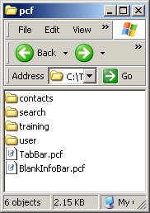
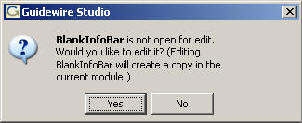

Review: Editing base files
If you modify base file, Studio copies it into configuration directory
attempt to modify PCF file
Notes:
Whenever you attempt to edit a base PCF file, Studio displays a "would you like to edit it" dialog box. If you click yes, Studio makes a copy of the file in the configuration directory. This copy then takes precedence over the original base copy. Studio also modifies the file name as displayed in the resource tree by changing the name to blue text and adding a pencil icon onto the file icon.

Slide 24
Lesson outline
User interface architecture
PCF files
Creating and opening PCF files
Modifying PCF files
Deploying UI changes

Slide 25
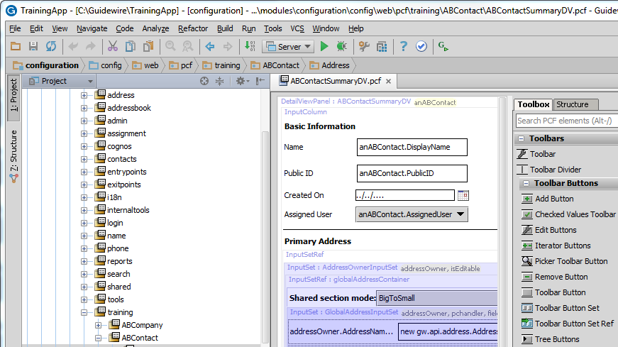
PCF editor
resources tree
canvas
toolbox
Notes:
The PCF editor is a Studio interface used to create and modify PCF files. It has three primary areas of functionality:
Resources tree, which is used to create and open PCF files.
Canvas, which is used to modify PCF files.
Toolbox, which is used to add elements to PCF files.

Slide 26
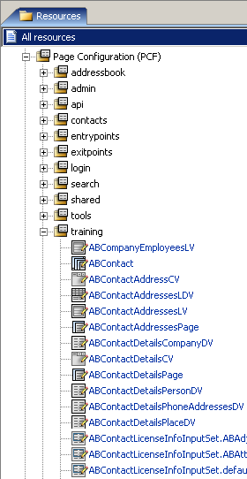
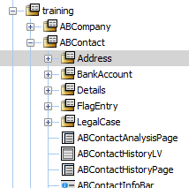
Resources tree
PCF folders used to group related PCF files for configuration convenience
PCF files declare container widgets or locations and their contents
Suffix often identifies contents
Notes:
There is no technology requirement regarding the folder in which a PCF file must be placed. Any PCF file in any folder can reference content in another PCF file in any other PCF folder. The grouping of files into folders is done solely to ease the work of the developer.
Guidewire recommends that suffixes be used with PCF file names to indicate the contents of the file. In some cases, the suffix is required. Common suffixes include:
DV - detail view
LV - list view
InputSet - input set
CV - card view
LDV - listdetail view
Screen - screen
LG - location group
Wizard - wizard

Slide 27
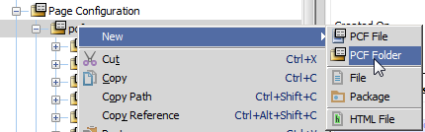
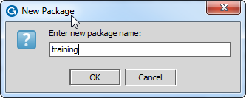

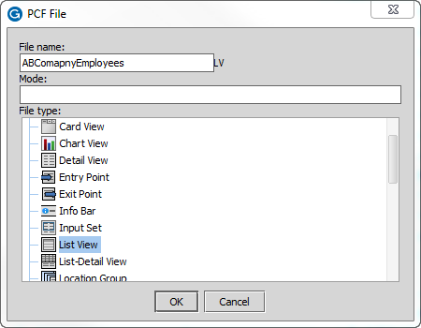
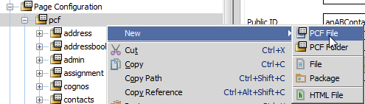
Creating new folders and files
New PCF folder
New PCF file
Notes:
To create a new PCF folder:
Right-click the folder to be the parent of the new folder. Select New -> PCF folder.
Specify a name.
Click OK.
To create a new PCF file:
Right-click the folder to be the parent of the new file. Select New -> PCF file.
Specify a name for the file.
Click the appropriate file type. Studio may add a suffix to the file based on the type selected.
Click OK.
Each lesson that discusses a specific type of PCF file reviews the process for creating that type of file.
You cannot use underscores (_) in a PCF file name.
You can use a space in a PCF folder name, but you cannot use a space in a PCF file name.

Slide 28
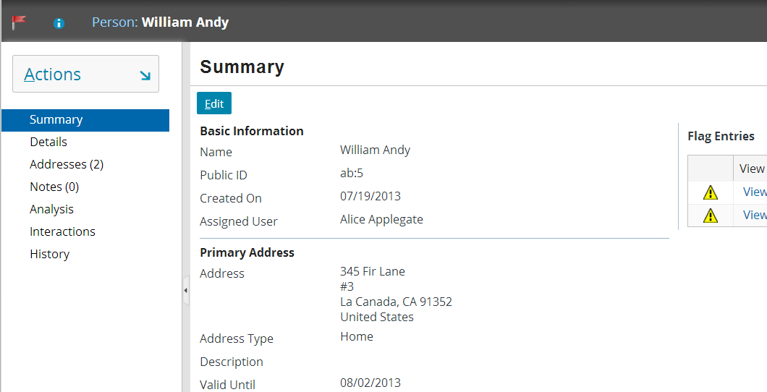
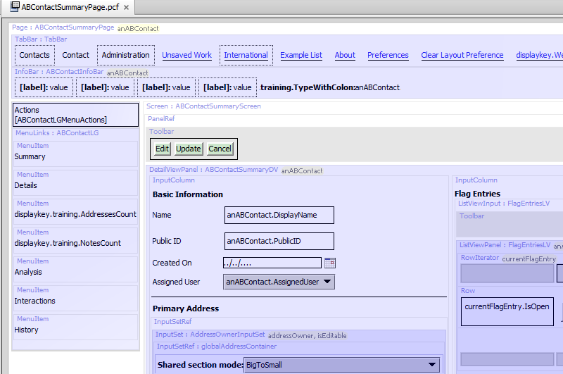
Opening existing files (ALT+SHIFT+E)
ALT + SHIFT + E
Useful for work in container widgets, pages, and popups
Notes:
If you have both the application and Studio running, you can enter ALT + SHIFT + E to have Studio automatically open the location being viewed in the application. Non-wizard locations typically reference a single screen. From the screen, you can navigate in Studio to the file you wish to edit. This technique is useful for most UI configuration in ClaimCenter and BillingCenter, where the majority of the UI configuration is done outside of wizards.
Technically, the ALT + SHIFT + E shortcut is unsupported. While there may be circumstances where it doesn't work, there should never be any negative consequences in attempting to use it.

Slide 29
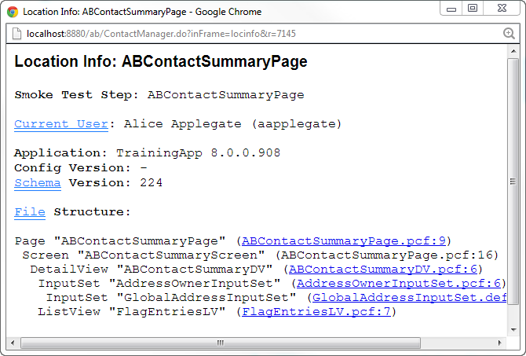
Opening existing files (ALT+SHIFT+I)
ALT + SHIFT + I
Useful for work in locations that reference containers (such as wizards and location groups)
Notes:
Wizards and location groups contain multiple screens. Therefore, if you ALT + SHIFT + E from one of these locations, the application presents a list of screen names.
When working with a wizard or location group, the easiest way to open the file you are viewing is typically to use the Location Info window to determine the name of the file, and then to open the file by name in Studio.
To open the Location Info window, enter ALT + SHIFT + I. This window includes the file structure, which lists the location, screen, and any child container widgets. For each location and container widget, the name of the file in which it is stored is listed.
This technique is useful for most UI configuration in PolicyCenter, where the majority of the UI configuration is done within wizards.
Location Info is also useful:
If Studio is not running.
If you are viewing a modal file. Location Info identifies the mode currently displayed. Going directly to the PCF editor shows you the "first" mode until you choose another.
Guidewire applications also include a "widget inspector", which is a dialog box that contains information about all the PCF files and widgets referenced in the active screen. To view the widget inspector, press ALT + SHIFT + W in the application.

Slide 30
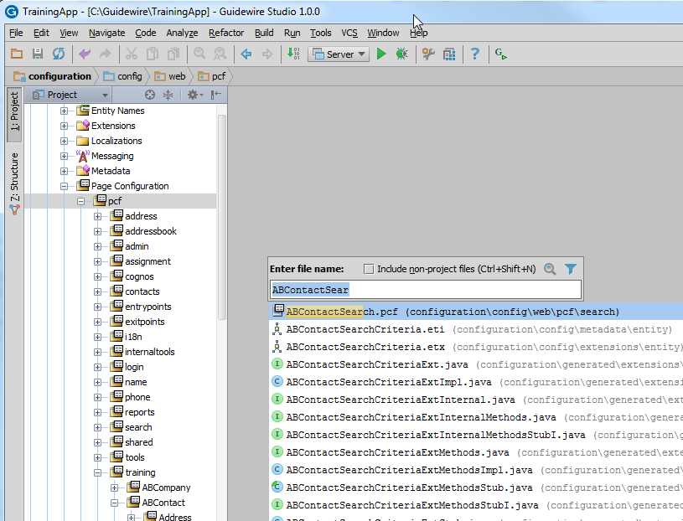
Opening existing files in Studio (CTRL + N)
CTRL + Shift + N
Useful for work in wizards
Notes:
In Studio, you can press CTRL + Shift + N to get a "name" dialog box. If you enter a string into this box, Studio displays all PCF files with that string in the name. If you click a PCF file in the list, Studio opens it for you. This is useful in two situations:
You are already in Studio, you know a portion of the name of the PCF file you need to open, and it is too cumbersome to navigate to the appropriate location in the user interface.
You want to open a container referenced in a wizard and you have already determined the name of the file to open from the Location Info window.

Slide 31
Lesson outline
User interface architecture
PCF files
Creating and opening PCF files
Modifying PCF files
Deploying UI changes

Slide 32
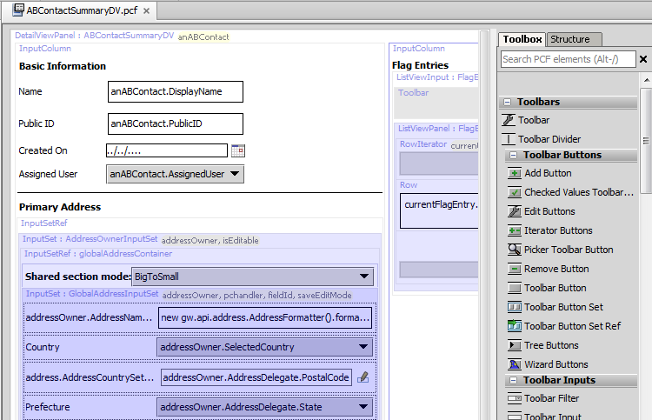
PCF editor: canvas and toolbox
Notes:
The PCF editor contains a canvas that provides a graphic display of the contents of the file. From the canvas, you can select an item to display and edit its properties. You can also move and delete existing items.
The toolbox is a list of widgets. To add elements to a PCF file, you select the corresponding tool in the toolbox and drag it onto the canvas.

Slide 33
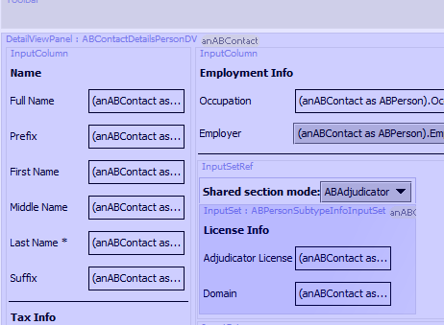
Embedded containers
White - defined in this file
Light blue -defined in other file that is referenced by this file
Dark blue - defined in file referenced by referenced file
Notes:
You can not see the Properties panel for any element that is not defined in the current PCF file. You need to open the actual file where it is defined.
Files can be nested as deep as necessary, in which case the color of the shaded area will be progressively deeper. Double-clicking at any level will open the selected file directly.

Slide 34
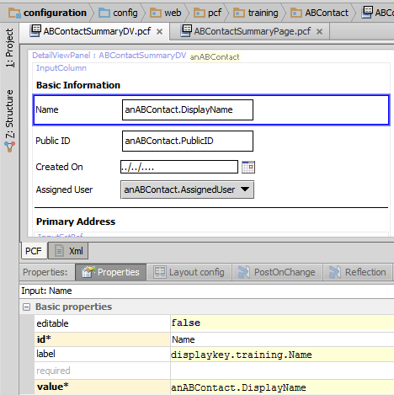
PCF element properties
All PCF elements have properties
Displayed in tabs underneath canvas
Click object to view or edit its properties
Click link at top of canvas to display file-level properties
properties for selected element
Notes:
To view properties of a PCF file, click its title link in the upper-left corner.
To view properties of any element, click that element.
To modify properties, modify the value and click Save.
Required properties have an asterisk and the property name appears against a yellow background.
If you select a property, variable, or entry point, an "X" icon appears on the right-hand side of the cell for that property, variable, or entry point. You can click the "X" to restore the selected property, variable, or entry point to its default value.

Slide 35
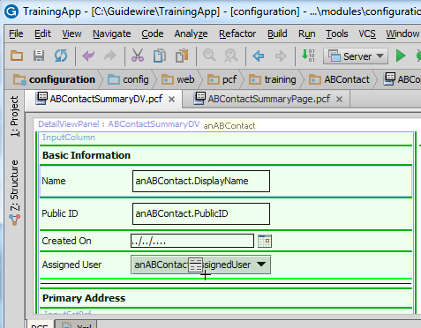
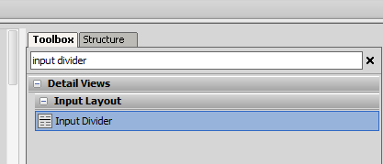
Adding PCF elements
Light green line - new widget will be placed here
Dark green line - new widget could be placed here
Notes:
To add a new widget to a PCF file, select the appropriate tool from the toolbox and drag the widget onto the canvas. As soon as you drag onto the canvas, a series of green lines appear.
Dark green lines indicate places where the widget can legally be placed.
A single light green line indicates the place where the widget will be placed if you release the mouse.

Slide 36
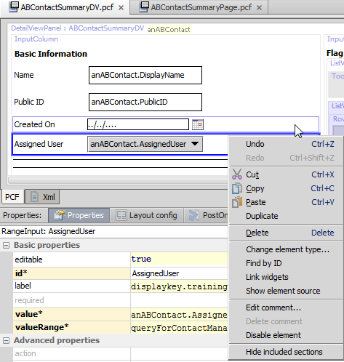
Editing PCF elements
To move element, simply drag and drop it to desired location
Additional edit functionality available by right-clicking widget
Delete
Duplicate
Cut-and-paste or copy-and-paste
Add comments

Slide 37
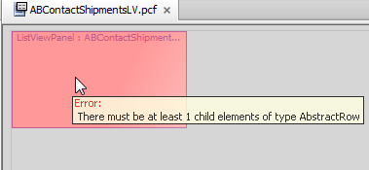
Error messages
If a PCF file has an error in it:
Either a red background or a red outline appears
You can mouse over the file to see a popup describing the error

Slide 38
Lesson outline
User interface architecture
PCF files
Creating and opening PCF files
Modifying PCF files
Deploying UI changes

Slide 39
When are PCF files loaded?
Production instance
PCF files loaded only when application server starts
Development instance
PCF files loaded when application server starts
Can be reloaded at any time if Internal Tools is enabled

Slide 40

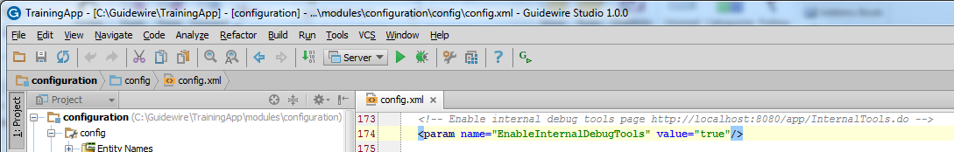
Enabling reload of PCF files
In config.xml, set:
EnableInternalDebugTools to true
Notes:
In order to reload PCF files without restarting the server, you must enable Internal Tools.

Slide 41
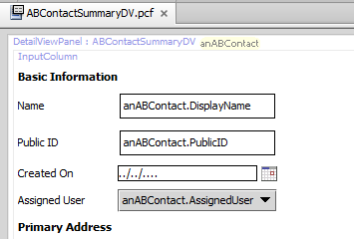
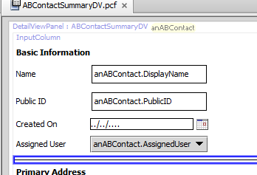
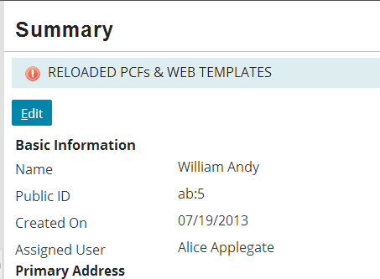
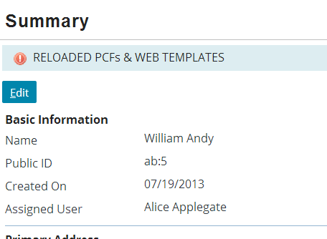
Reloading PCF files
make configuration change in Studio
...then, while location is in read-only mode,...
ALT + SHIFT + L
Note: only works if DCEVM is installed
Notes:
To reload modified PCF files, enter ALT + SHIFT + L in the browser.
A location can be in one of two modes: read-only or edit. When a location is in read-only mode, none of the widget values are editable. If the location can be put into Edit mode, then there is also a visible Edit button. When a location is in edit mode, some (or all) of the widget values are editable. Also, the Edit button is not visible, but there are visible Update and Cancel buttons. If a location is in edit mode, click Update or Cancel as appropriate to put it into read-only mode.
If you reload PCF files while in edit mode, you can experience unpredictable results. For the current location, where there is a data modification in progress, the new PCFs may not be reloaded. Therefore, Guidewire recommends reloading PCF files while in read-only mode as it provides for more predictable results.
To be able to reload PCFs with the Alt + Shift + L command, you must have the Dynamic Code Evolution Virtual Machine (DCEVM) installed. If you do not have the DCEVM installed then you must restart the server for changes to take effect. Guidewire recommends that you install the DCEVM in development environments for a more efficient experience. The DCEVM should not be installed in production environments.

Slide 42
Lesson objectives review
You should now be able to:
Describe the user interface architecture
Describe what a PCF file is
Create new PCF folders and files
Open and edit PCF files
Deploy UI changes

Slide 43
Review questions
Define the broad purpose for each element category:
Atomic widgets
Container widgets
Locations
What does a PCF file define?
What does each PCF editor convention mean?
A container widget shaded light blue
A container widget shaded dark blue
A light green line
A dark green line
A red background
How do you deploy PCF changes?
Notes:
Answers
1. a) Atomic widgets display individual elements of data and/or functionality.
b) Container widgets group atomic widgets into logical groups.
c) Locations define how users move from one place in the application to the next.
2. A PCF file defines a container widget or location and its contents.
3. a) The container widget is referenced by the current PCF file. (Its contents are contained in another file.)
b) The container widget is referenced by some container widget referenced by the current PCF file. (It is in a "grandchild" file.)
c) For the currently selected widget tool, a new widget of that type will be placed in the current location.
d) For the currently selected widget tool, a new widget of that type could be placed in the current location.
e) The PCF file has an error in it.
4. Assuming that internal tools is enabled in config.xml, go to the application (the front end) and press ALT + SHIFT + L.

Slide 44
Notices
Copyright © 2001-2013 Guidewire Software, Inc. All rights reserved.
Copyright © 2001-2013 Guidewire Software, Inc. All rights reserved. Guidewire, Guidewire Software, Guidewire ClaimCenter, Guidewire PolicyCenter, Guidewire BillingCenter, Guidewire Reinsurance Management, Guidewire ContactManager, Guidewire Vendor Data Management, Guidewire Client Data Management, Guidewire Rating Management, Guidewire InsuranceSuite, Guidewire ContactCenter, Guidewire Studio, Guidewire Product Designer, Guidewire Live, Guidewire DataHub, Guidewire InfoCenter, Guidewire Standard Reporting, Guidewire ExampleCenter, Gosu, Deliver Insurance Your Way, and the Guidewire logo are trademarks, service marks, or registered trademarks of Guidewire Software, Inc. in the United States and/or other countries.
Guidewire products are protected by one or more United States patents.

