Slide 1
Atomic Widgets
8 August 2013
Notes:
Guidewire training materials contain Guidewire proprietary information that is subject to confidentiality and non-disclosure agreements. You agree to use the information in this manual solely for the purpose of training to implement Guidewire software solutions. You also agree not to disclose the information in this manual to third parties or copy this manual without prior written consent from Guidewire. Guidewire training may be given only by Guidewire employees or certified Guidewire partners under the appropriate agreement with Guidewire.

Slide 2
Lesson objectives
By the end of this lesson, you should be able to:
Create atomic widgets
Bind an atomic widget to the data model
Create and modify widget labels
Use optional widget properties
This lesson uses the notes section for additional explanation and information. To view the notes in PowerPoint, choose View→Normal or View→Notes Page. If you choose to print the notes for the lesson, be sure to select “Print hidden slides.”

Slide 3
Lesson outline
Atomic widget basics
Creating widgets
Binding widgets to the data model
Widget labels
Optional properties

Slide 4
Review: Atomic widgets
PCF Element
Widget
Location
Atomic Widget
Container Widget
An atomic widget is an atomic piece of interface content or functionality
Used to display individual data values or execute individual actions
Input
Cell
Button
Notes:
Atomic widgets are individual field items such as inputs, cells, or buttons. They are always defined within a container widget or location.
The vast majority of atomic widgets are either inputs (belonging to detail views or input sets), cells (belonging to list views), or buttons (typically belonging to toolbars). Atomic widgets also appear on tab bars and in menus. These represent probably a small amount of the total atomic widgets, however.
Guidewire applications include a "widget inspector", which is a dialog box that contains information about all the PCF files and widgets referenced in the active screen. To view the widget inspector, press ALT + SHIFT + W in the application.

Slide 5
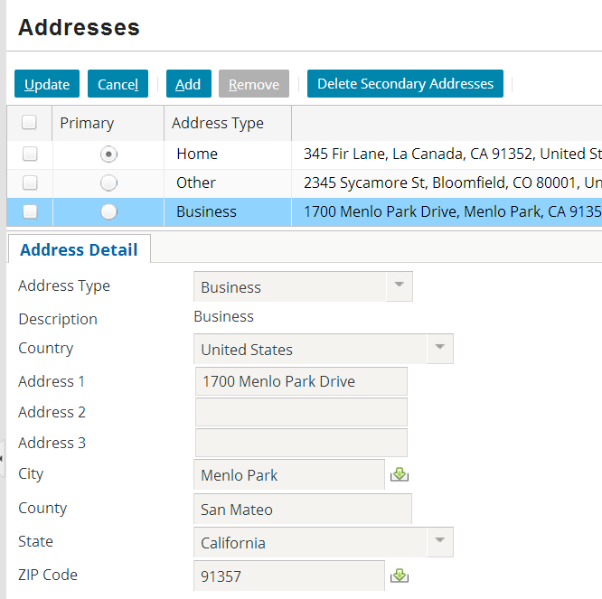
Basic types of atomic widgets
Inputs, used to display and edit data in detail views
Cells, used to display and edit data in list views
Buttons
Used to execute actions
Typically in toolbars
Layout widgets
Button
Cell
Input

Slide 6
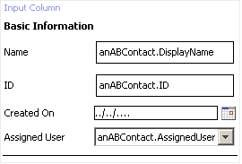
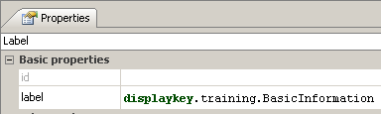

Layout widgets
toolbox
toolbox
For label widgets, specify only label property
For input divider widgets, no properties to specify

Slide 7
Steps to creating an atomic widget
Find tool for given type of widget in PCF editor toolbox
Drag tool onto PCF editor canvas
Specify required properties
ID
If widget displays data, which field does data come from?
Specify label
Optionally specify additional properties

Slide 8
Lesson outline
Atomic widget basics
Creating widgets
Binding widgets to the data model
Widget labels
Optional properties

Slide 9
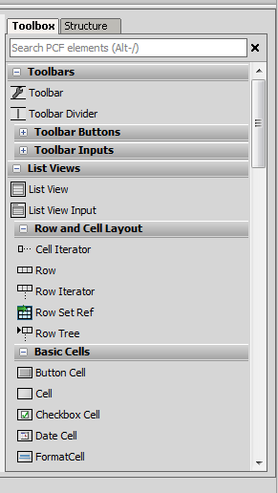
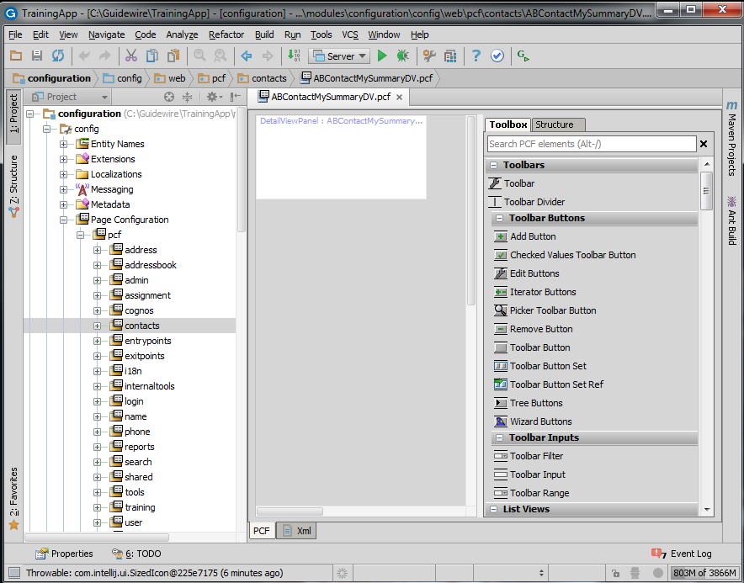
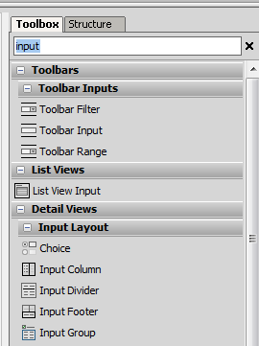
Step 1: Find widget tool
all elements
filtered
Notes:
Atomic widgets are created by dragging a widget tool onto a container widget, such as a detail view, list view, or toolbar.
The widget tools are listed in the Toolbox tab, which appears on the right side of the PCF editor. Initially, all widget tools are listed. You can, however, enter a string into the filter field, which causes the Toolbox to list only widgets whose descriptions contain that string. (To view a widget tool description, mouse over the name of the widget tool in the Toolbox. The description appears in a tooltip.)

Slide 10
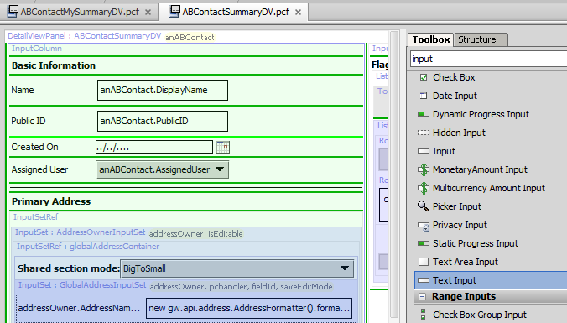
Step 2: Drag tool onto PCF canvas
Light green line - current place where new widget will go
Dark green line - places where new widget can go

Slide 11
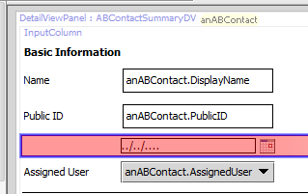
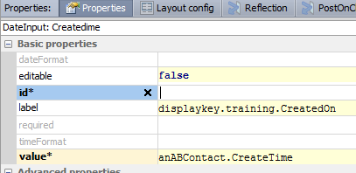
Step 3a: Specify ID property
IDs are not required for all types of widgets
If ID is required, then property is listed as "id*"
When required, ID does not need to be unique globally, but must be unique within a given PCF
Notes:
Most atomic widgets require IDs. However, some widgets, such as labels and dividers, do not require IDs.

Slide 12
Lesson outline
Atomic widget basics
Creating widgets
Binding widgets to the data model
Widget labels
Optional properties

Slide 13
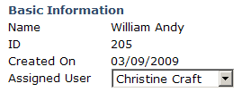
Base objects for container widgets
ABContact
ABContactSummaryDV
ID
CreateTime
Container widgets often have at least one required object
If container displays data, the data comes from that object
Notes:
There are container widgets that do not have any required objects. These are:
Containers that display only static information; for example, the detail view on the "NoContact" page is displayed if a user clicks the Contact tab without ever having searched for a contact. This detail view contains a single static label that states "You have not yet viewed any contacts. To view a contact, you must first search for it on the Search tab."
Some search screens; search screens typically have no required object and display no data initially. If you execute a search, then the data in the search results is displayed. This data comes from the search itself, though, and not from any required object.

Slide 14
Each data widget is tied to one field
ABContact 205
ID
205
ta_abcontact
CreateTime
2009-03-09
ID
CreateTime
Coverage
205
2009-03-09
Each input and cell widget is bound to one field from base object
Displays data in that field
If widget is editable, changes made in widget are written to database when data is committed

Slide 15
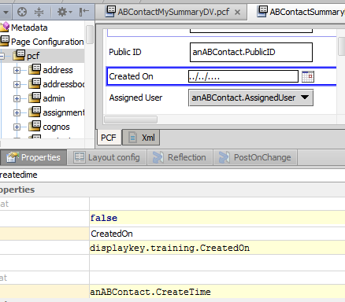
Step 3b: Specify value property
For given widget, value property identifies which field widget is bound to
Lists container widget's base object and one field on that object or on related object
Uses dot notation

Slide 16
Dot notation and subtyped objects
run-time memory
var JLee : ABContact
ABContact
Name: James Lee EmailAddress: null Subtype: ABDoctor
FirstName: James Gender: male LastName: Lee
MedicalLicense: AB3244
JLee
ABContact fields
ABPerson fields
(JLee as ABDoctor)
ABDoctor fields
Server infers structure of object based on datatype as specified in PCF file
(next object)
Notes:
When a Guidewire application retrieves data from the database, it stores that data as an object in runtime memory. It works with the in-memory information until the data needs to be committed or re-retrieved from the database.
When an object is created, all of the information about the object is copied into memory. If the object is subtyped, then data for all the fields at every relevant subtype level is retrieved. For example, if an object is an ABDoctor, then information is copied over for fields at the ABContact, ABPerson, ABPersonVendor, and ABDoctor levels. Fields associated with ABPlace, ABCompany, or ABAttorney are irrelevant and ignored.
When an object is referenced, the server uses the datatype of the reference to understand the structure of the information in memory. For example, assume that there is an object named "JLee" that stores information about an ABDoctor. If there is a reference to this object with a datatype of "ABDoctor", then the server knows that the object will have ABContact fields, ABPerson fields, ABPersonVendor fields, and ABDoctor fields. If there is a reference to this object with a datatype of "ABPerson", then the server knows that the object will have ABContact fields and ABPerson fields, but it will assume that the object has no fields beyond the ABPerson fields. There may be additional fields with information at the ABPersonVendor and ABDoctor levels, but the server will be unaware of them.
In some cases, a method or user interface container receives a reference to an object, and the reference uses a "high-level" datatype (such as ABContact). This reference cannot be used as-is to access fields below the specified level because the server assumes those fields don't exist. There is a programming technique known as casting in which you explicitly state the datatype for a subtyped object. This is done using the syntax "as <datatype>", where <datatype> is the datatype that you want to explicitly identify. When you cast a reference, you are providing the server with more information about the structure of the object. A casted reference can access fields that an uncasted reference cannot.

Slide 17
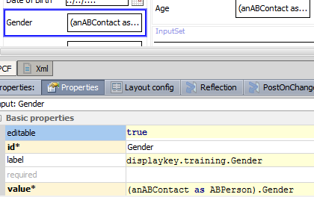
Pointing to fields at subtype level
If base object has supertype datatype, but desired field is at subtype level, you must cast the object
Syntax: (object as Subtype).subtypeField
ABContact
ABPerson
Gender

Slide 18
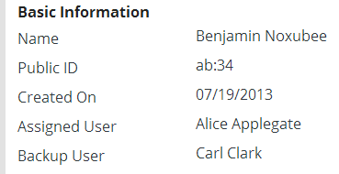

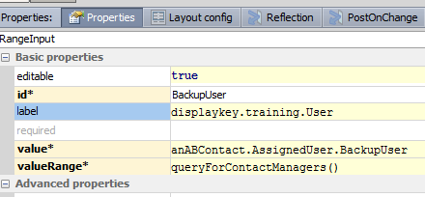
Pointing to fields on related objects
ABContact (Benjamin Noxubee)
User (Alice Applegate)
User (Carl Clark)
AssignedUser
BackupUser
Notes:
In some cases, the desired field is on a related object. The syntax to reference fields on related objects is as follows:
object.foreignKeyToRelatedObject.Field

Slide 19
Lesson outline
Atomic widget basics
Creating widgets
Binding widgets to the data model
Widget labels
Optional properties

Slide 20
Structure, function, and text
ABContactSummaryDV.pcf
ABContactSummaryDV
Label1
Label2
anABContact.DisplayName
Label3
anABContact.ID
Label4
anABContact.CreateTime
Label5
anABContact.AssignedUser
PCF file defines structure and function of containers
Guidewire recommends PCF file should not contain any display text (such as label text)
Simplifies enabling application to accommodate users of different locales
Allows for labels with dynamic content

Slide 21


Display keys
ABContactSummaryDV.pcf
display key: Name Locale Value English Name Spanish Nombre French Nom
Label:displaykey.Name
anABContact.DisplayName
John Miller locale: English
Jean-Luc Monet locale: French
Notes:
A display key is a locale-neutral reference to a text string displayed on the user interface. Every display key has one or more locale values. When a PCF file references a display key, the application converts the display key to one of the locale values depending on the user's locale. In the example above, the display key "Name" is converted to "Name" for users with their locale set to English, "Nombre" for users with their locale set to Spanish, and "Nom" for users with their locale set to French.

Slide 22
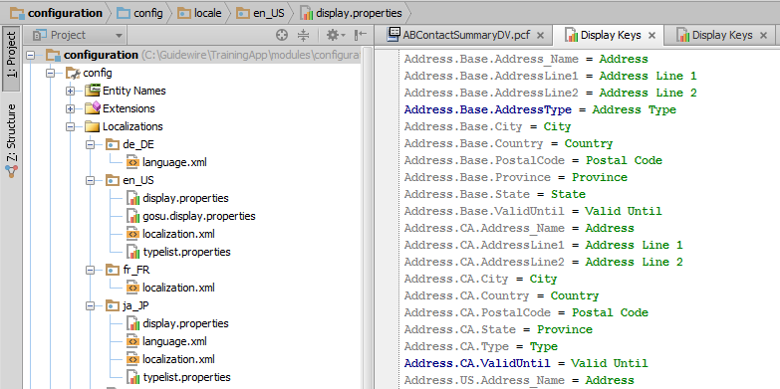
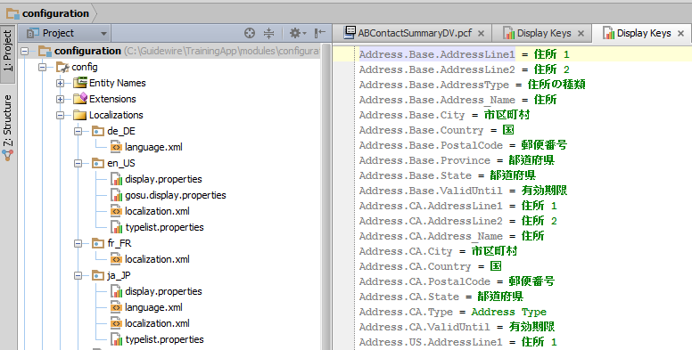
Display key structure
Display key editor stores display keys in hierarchy
Guidewire recommends creating customer display keys under node named "Ext"

Slide 23
Viewing display keys from widget
Ctrl + click
To view virtually any item referenced in property of PCF file:
Hold down Ctrl key
Click reference to item
Notes:
The above technique works for a variety of items. For example, a detail view can be embedded in a screen using a PanelRef widget. The PanelRef has a property that names which detail view to embed. From the PanelRef widget, you can hold down Ctrl and click the name of the referenced detail view to open the detail view file.

Slide 24
Steps to creating an atomic widget
Find tool for given type of widget in PCF editor toolbox
Drag tool onto PCF editor canvas
Specify required properties
ID
If widget displays data, which field does data come from?
Specify label
Guidewire recommends using "Ext" prefix
In a given widget property, specify the display key name
Optionally specify additional properties

Slide 25
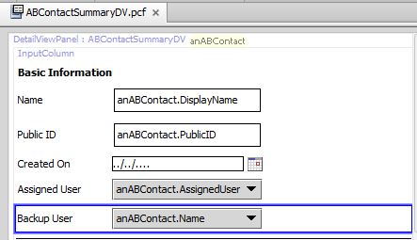
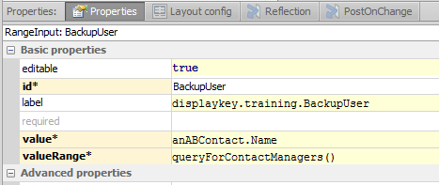
Step 4: In widget property, specify display key name
Syntax for referencing display keys: displaykey.KeyName
Recommended naming convention:
Start key with "Ext."
End with text to be used for label (with spaces removed)
Examples:
displaykey.Ext.Name
displaykey.Ext.CreatedOn
Notes:
A display key name cannot have a space in it.
To reference a display key, the property (in the example above, it is a label property) must start with "displaykey." and it must identify the name of a display key. If a display key is referenced but does not exist, you will get a compile error when you (re)load the metadata.
The screenshot above shows a TrainingApp display key. All TrainingApp display keys start with "training.". The recommended naming convention for customer display keys, however, is to start with "Ext.".

Slide 26
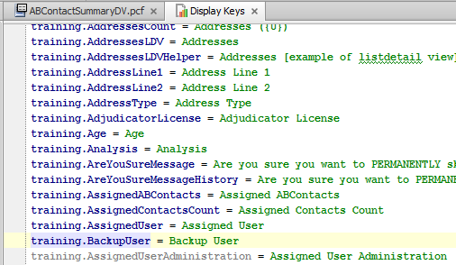
Editing display keys
CTRL + click
For most properties that reference other files, you can CTRL + click on property to open referenced file
Notes:
Embedded display keys in display keys
It is possible for a display key to reference another display key. The syntax for this is: { displayKeyToEmbed }
Two examples of this from ClaimCenter are listed below. Note that in the first example, the new display key consists entirely of an embedded display key. In the second example, the new display key contains text of its own ("Unable to build the report tree for") and an embedded display key.
Web.Admin.AddReportGroup Add Report Permission Set
Web.Admin.NewReportGroup {Web.Admin.AddReportGroup}
Web.Admin.ReportAdmin.UnableToBuildReportTree Unable to build the report tree for {Web.Admin.SREEReports}
Web.Admin.SREEReports Reports
You should be aware that embedding display keys in one another can make UI changes both easier and more difficult. It can ease the process of changing a given term. (For example, changing "POs" to "Purchase Orders" could be easier if the term exists in only one display key that is embedded in other display keys). It can complicate the translation process, however, if you want to implement a multi-lingual instance of the Guidewire application. Word order varies from language to language, and when you embed display keys in display keys, you start to "hard code" the word order. A given phrase may consist of contiguous words in one language but not in the other.

Slide 27
Specifying multiple locale values
If application is configured to support multiple user locales, you can specify display values for each locale in the individual file

Slide 28
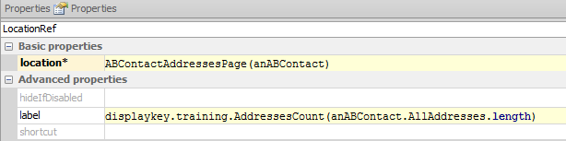

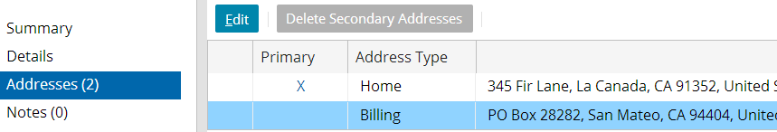
Display keys with dynamic content
In display keys, {x} is place-holder for data passed into display key
Notes:
A display key can have one or more arguments. Each argument is noted by "{X}", where X is an integer. If there is only one argument, then the integer should be 0. If there are multiple arguments, then the arguments should be numbered starting with 0. When there are multiple arguments, the first argument listed in the label property is assigned to the {0} position, the second to the {1} position, and so on.
In the example above, the label property specifies a display key with an argument. It is also passed a value, specifically the length of the AllAddresses array. The label is rendered using the named display key with the argument is the designated location.
As an example of a display key with multiple arguments, consider a display key "training.DataChanged", which has the value: 'The object you are trying to update was changed by {1} at {0}. Please cancel and retry your change.'. At runtime, the values "Jan 13, 2009 11:32 AM" and "Alice Applegate" are passed to the display key. The message displayed would be:
The object you are trying to update was changed by Alice Applegate at Jan 13, 2009 11:32 AM. Please cancel and retry your change.

Slide 29
Lesson outline
Atomic widget basics
Creating widgets
Binding widgets to the data model
Widget labels
Optional properties

Slide 30
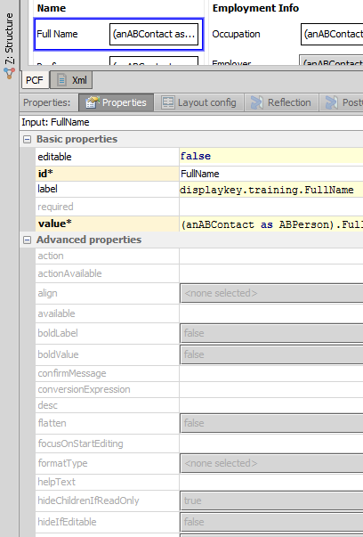
Optional widget properties
In addition to ID, label, and value, most widgets have large number of properties that can further enhance their behavior

Slide 31
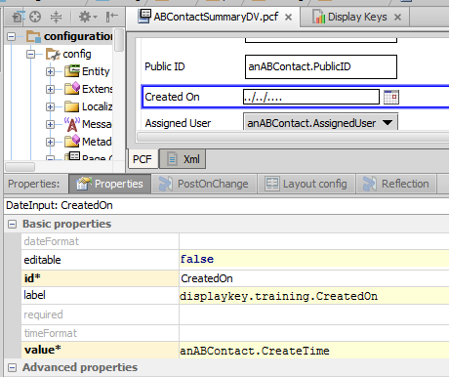
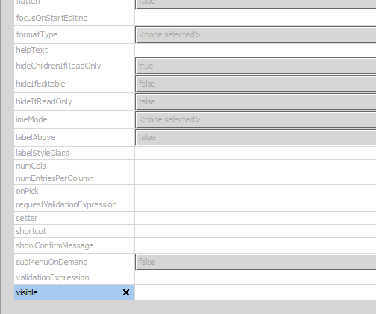
Commonly used optional properties
By default, widgets are:
Visible
Not required
Not editable
If editable is true:
If required (and editable) are true:
Notes:
Visible is typically not set to "false". It is either set to "true" or it is set to an expression that renders the widget visible or not visible based on conditional logic. Setting widget properties to conditional expressions is discussed in the "Server-Side Widget Behavior" lesson.

Slide 32

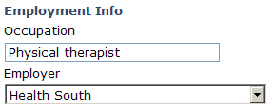
Examples of other optional properties
outputConversion
inputConversion
9400-3256-2211-5423
ACME
align
labelAbove
Notes:
outputConversion is a Gosu expression property that modifies the value stored in the database before it is displayed in the user interface. For example, it can be used to mask all but the last 4 digits of a credit card number.
inputConversion is a Gosu expression property that modifies the value displayed in the user interface before it is stored in the database. For example, it can be used to convert any entered stock symbol into all upper-case characters.
align is a property that can be set to either "left", "center", or "right". It impacts the alignment of data in the corresponding widget.
labelAbove is a boolean property for widgets with labels and fields. When set to true, the widget's label is displayed above the field, rather than to the left of the field. In the screenshot above, the Occupation and Employer widgets have labelAbove set to true. The "Employment Info" widget is a label widget with no field.

Slide 33


Standard input widget
Input widget is rendered as:
Text field (when underlying field is numeric or varchar), or
Date-formatted field (when underlying field is datetime), or
Dropdown (when underlying field is typekey), or
Yes and no radio buttons (when underlying field is boolean)
Input widget has only "standard input" properties

Slide 34
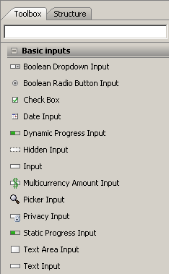
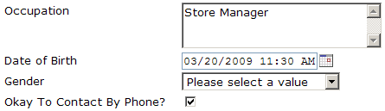
Specialized widgets have extra properties
Specialized widgets include additional properties for finer level of control
text area input with 3 rows of height
date input with "long" formats
typekey input with custom "<none selected>" text
check box input (with boolean as check mark)
Notes:
One mechanism that can be used for validation of user-entered data is input masks. An input mask is a pattern applied to a field that identifies how data should be entered into the field. For example, a mask of "(###) ###-####" could be used for a telephone field to identify that the field takes nine digits. Each "#" represents a character that the user can enter. The (, ), and - are "hard-coded" into the field.
Input masks can be added to a Guidewire application through the use of a data model feature known as a field-level validator. These are discussed in the "Field-Level Validation" lesson.
Input masks can also be added to given widgets of type text input and cell input through the widgets' inputMask property. This property takes a Gosu expression that returns a string to use as the input mask. If none is specified then the input mask on the value's field validator will be used, if one is specified. This field should only be necessary in cases where the data type has no mask or where the mask needs to be conditional. The input mask returned should be of the same format as a mask specified using the input-mask attribute on a field validator (using # for wildcards). The input mask is recalculated on every render, which means that if the mask is conditional and dependent on other data on this page that it can change from one request to the next.

Slide 35
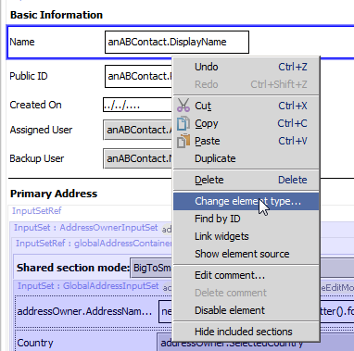
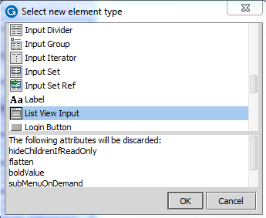
Changing an atomic widget's type
To change the type of an atomic widget:
Right-click widget
Select "Change element type..."
Select new element type in list of types
Click OK
If change will cause loss of attribute values, those attributes are listed in dialog box

Slide 36
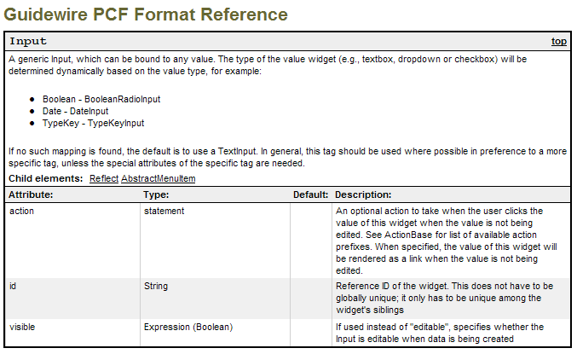
Documentation for all widget properties
This file is: <Application>\modules\pcf.html
Notes:
The PCF Format Reference defines the properties for every widget, including the type of value the property takes and a description of the widget. Note that the PCF Format Reference refers to widget properties as "attributes".
The PCF Format Reference is located in <ApplicationRootDirectory>\modules. It is named "pcf.html".

Slide 37
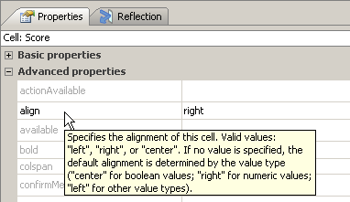
Studio tooltip help
If you mouse over a property name, a tooltip displays Description text of that property from PCF reference
Does not display property value type or defaults

Slide 38
Review: Steps to creating an atomic widget
Find tool for given type of widget in PCF editor toolbox
Drag tool onto PCF editor canvas
Specify required properties
ID
If widget displays data, which field does data come from?
Specify label
In a given widget property, specify the display key name
Specify a locale value
If necessary, specify additional locale values
Optionally specify additional properties

Slide 39
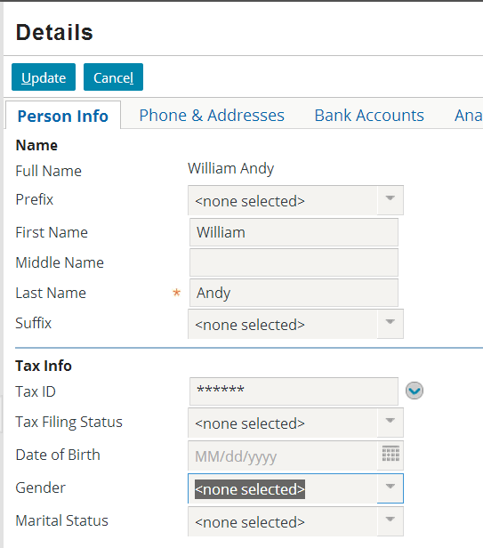
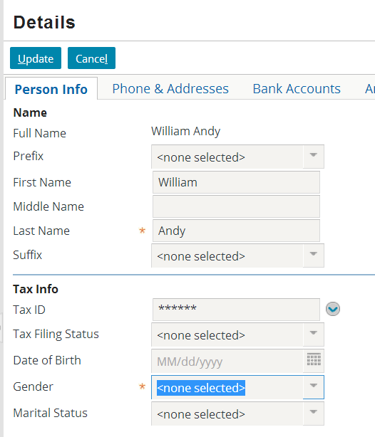
Review: Deploying UI changes
You can deploy UI changes in the application by entering ALT + SHIFT + L
Notes:
In general, you should reload PCF files while in read-only mode. The screenshots above show the location in edit mode so that the changes to the widgets are evident. The field “Gender” goes from not being required to being required.

Slide 40
Lesson objectives review
You should now be able to:
Create simple atomic widgets
Bind an atomic widget to the data model
Create and modify widget labels
Use optional widget properties

Slide 41

Review questions
What must you specify in a widget's "value" property?
When would you see the keyword "as" in the value property?
What is a display key?
If you create a widget and specify only the ID, name, and label, is the widget visible? Editable? Required?
The screenshot shows a standard input widget. The customer requires a "long" date format, but the widget does not have any date format property. How could you implement this requirement?
Notes:
Answers
1. You must specify the field in the data model that the widget is bound to.
2. You would see the "as" when the container's base object is subtyped, and the field to which the widget must be bound is at one of the subtype levels.
3. A display key is an abstract display value referenced by a widget's label property. It can have one or more locale-specific values, and when the UI is rendered, the value matching the user's locale is used.
4. The widget will be visible, not editable, and not required.
5. You would need to recreate the widget using a date input. The date input widget contains properties to more finely control the widget behavior, such as the date format.

