Slide 1
Editable Detail Views
8 August 2013
Notes:
Guidewire training materials contain Guidewire proprietary information that is subject to confidentiality and non-disclosure agreements. You agree to use the information in this manual solely for the purpose of training to implement Guidewire software solutions. You also agree not to disclose the information in this manual to third parties or copy this manual without prior written consent from Guidewire. Guidewire training may be given only by Guidewire employees or certified Guidewire partners under the appropriate agreement with Guidewire.

Slide 2
Lesson objectives
By the end of this lesson, you should be able to:
Describe the interaction between toolbars and detail views
Create a toolbar with Edit/Update buttons
This lesson uses the notes section for additional explanation and information. To view the notes in PowerPoint, choose View→Normal or View→Notes Page. If you choose to print the notes for the lesson, be sure to select “Print hidden slides.”

Slide 3
Lesson outline
Detail view toolbars
Edit buttons

Slide 4
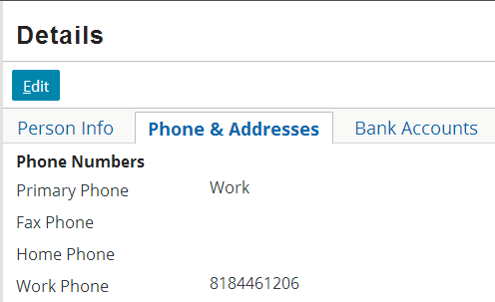
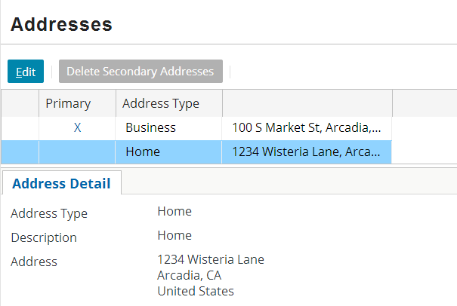
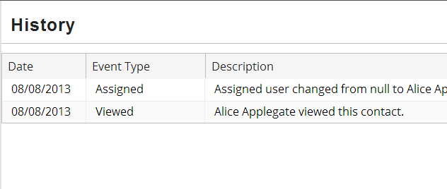
Toolbars
A toolbar is a row of widgets associated with a container widget that lets the user take action on the data in the container widget
Can be associated with most types of container widgets
Notes:
Toolbars can be associated with screens, listdetail views, card views, list views, and detail views. They cannot be associated with input sets.
Typically, a toolbar has buttons on it. There are some examples of list views with toolbars that have no buttons, however (as shown in the third example on the slide above). In these situations, the toolbar is needed because the number of items in the list is greater than what can be displayed at one time, and controls are needed to let the user page through the results. The "page through" controls appear on the right of the toolbar.

Slide 5
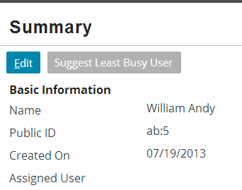
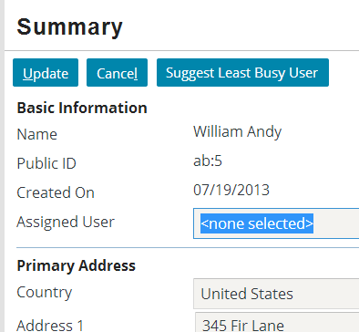
Detail view toolbars
Commonly includes set of three buttons used to edit data in detail view
Edit
Enter edit mode
Update
Commit changes and return to read-only mode
Cancel
Discard changes and return to read-only mode

Slide 6
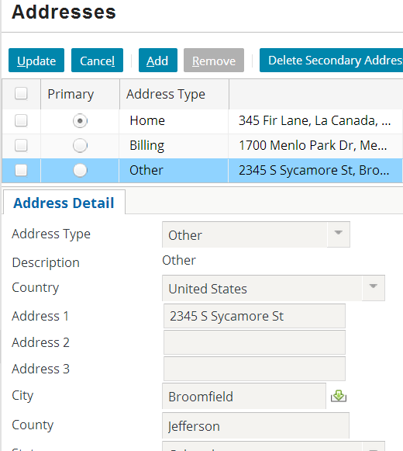
Editable hierarchy
For widget to be editable, every container it resides in must also be editable
screen is editable
listdetail view is editable
card view is editable
detail view is editable
Notes:
The default value for the editable property of a container widget is true, so container widgets are editable by default.
The default value for the editable property of an atomic widget is false, so atomic widgets such as inputs are read-only by default.

Slide 7
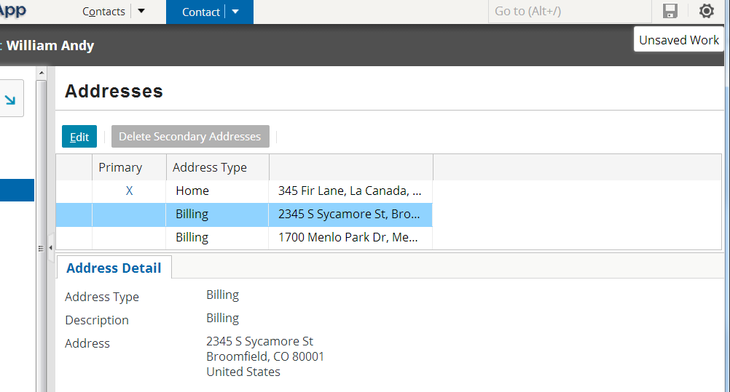
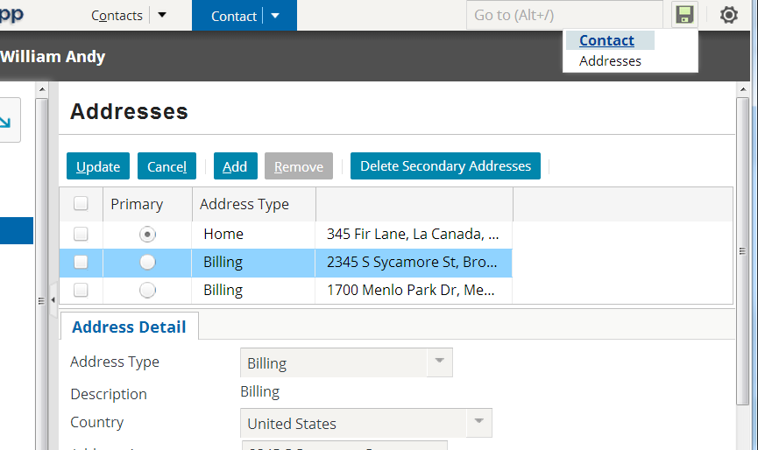
Unsaved Work menu
Whenever you enter edit mode, application automatically adds entry to Unsaved Work menu
Entry remains until data is committed or you log off
Users can use Unsaved Work menu to return to unsaved work, even after they navigate away from screen in progress

Slide 8
Lesson outline
Detail view toolbars
Edit buttons

Slide 9
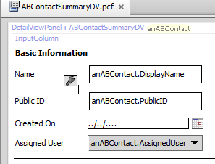
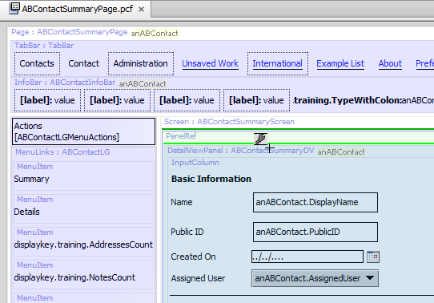
Where can you place a toolbar?
Toolbars cannot be added directly to detail views
They can be added only to panel refs, secondary views, and screens
no green lines
green lines
Notes:
Secondary views include card views and listdetail views. (Secondary views are collections of primary views, such as detail views and list views.)

Slide 10
Steps to create edit buttons
Locate panel ref that references detail view
Add toolbar
Add edit buttons
Reload UI metadata

Slide 11
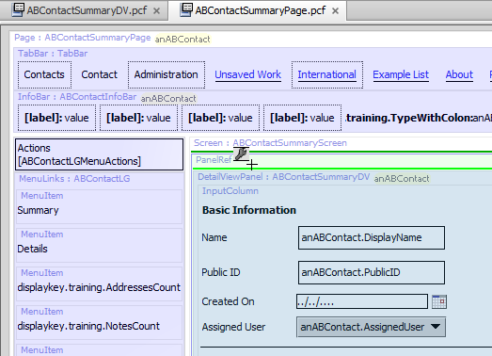
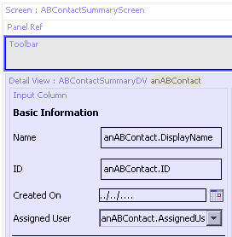
Step 1: Locate panel ref Step 2: Add toolbar
Notes:
If you declare the detail view inline and you want to add a toolbar to it, you have to create a panel ref and put the toolbar and the detail view in the panel ref. The panel ref will not have a specified def property. Its sole purpose is to associate the toolbar with the detail view.

Slide 12
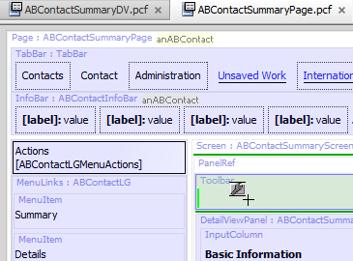
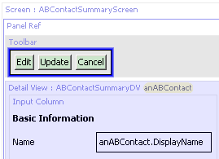
Step 3: Add edit buttons
One tool contains all three buttons
Notes:
The Edit Buttons tool contains all three buttons needed to make edits: Edit, Update, and Cancel. The buttons also already have the appropriate visibility logic. The Edit button is visible only when the location is in read-only mode. The Update and Cancel buttons are visible only when the location is in edit mode.

Slide 13
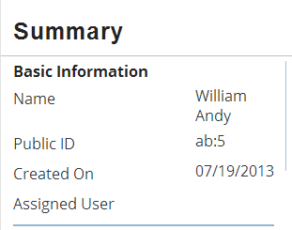
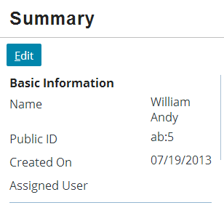
Step 4: Reload UI metadata
Deploy UI changes by entering ALT + SHIFT + L

Slide 14
Lesson objectives review
You should now be able to:
Describe the interaction between toolbars and detail views
Create a toolbar with Edit/Update buttons

Slide 15
Review questions
A screen contains a card view that contains a detail view. The detail view contains an input. To allow the end user to change the value of the input, what must be set to editable?
If you want to implement a toolbar for a detail view, what PCF element do you add the toolbar to? (Hint: It is not the detail view itself.)
A given detail view has a blank toolbar. The toolbar requires an Edit button, an Update button, and a Cancel button. In the PCF editor, how many tools must you locate in the toolbox and drag onto the canvas to implement this requirement?
Notes:
Answers
1. The input widget and all of the containers that directly or indirectly contain it must be editable. The input, the detail view, the card view, and the screen must all be editable.
2. The toolbar is added to the panel ref that references the detail view.
3. You need to drag only one tool, the "Edit Buttons" tool. This tool contains all three buttons.

