Slide 1
Input Sets
8 August 2013
Notes:
Guidewire training materials contain Guidewire proprietary information that is subject to confidentiality and non-disclosure agreements. You agree to use the information in this manual solely for the purpose of training to implement Guidewire software solutions. You also agree not to disclose the information in this manual to third parties or copy this manual without prior written consent from Guidewire. Guidewire training may be given only by Guidewire employees or certified Guidewire partners under the appropriate agreement with Guidewire.

Slide 2
Lesson objectives
By the end of this lesson, you should be able to:
Describe how input sets are used to create sets of inputs that can be reused
Implement input sets
This lesson uses the notes section for additional explanation and information. To view the notes in PowerPoint, choose View→Normal or View→Notes Page. If you choose to print the notes for the lesson, be sure to select “Print hidden slides.”

Slide 3
Lesson outline
Input set basics
Implementing input sets

Slide 4
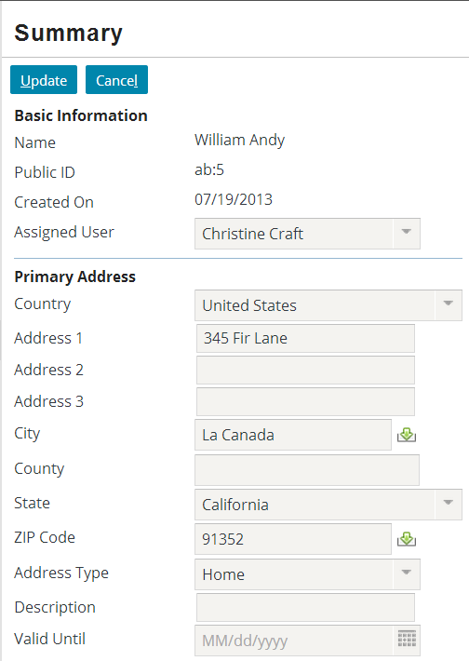
Input sets
An input set is a named group of widgets
Can contain only widgets that can be put in detail views
Uses:
Reuse single set of inputs across multiple detail views
Extend single instance of visibility or editability logic across multiple widgets
BasicAddress InputSet
Notes:
An input set is a set of widgets that can be reused in multiple detail views. Input sets give developers the ease of creating the widget set once and then referencing it wherever it is needed.

Slide 5
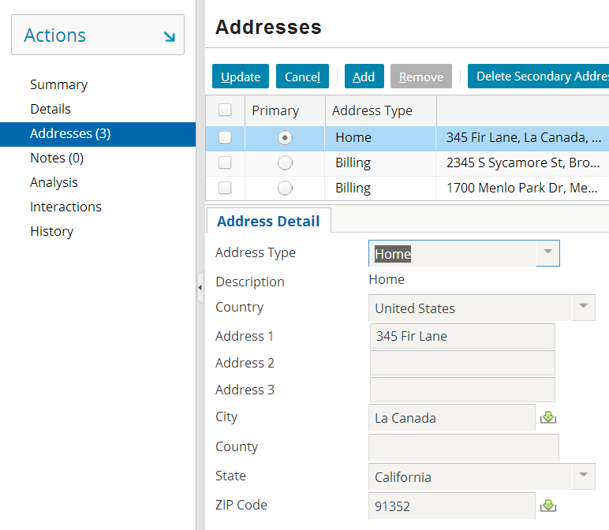
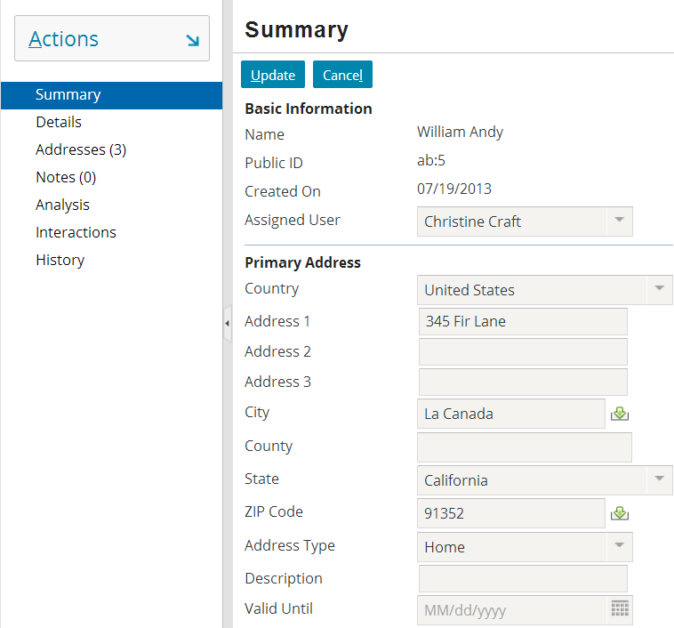
Example of input set reuse
BasicAddressInputSet used on both Summary detail view and Addresses listdetail view
Notes:
Input sets are typically used to define a set of widgets that are reused as a unit in multiple detail views. You could declare the widgets separately every time they get used. This would be redundant, however, and if there is a possibility that the visual treatment of the widgets may change, then creating the widget separately could create overhead.

Slide 6
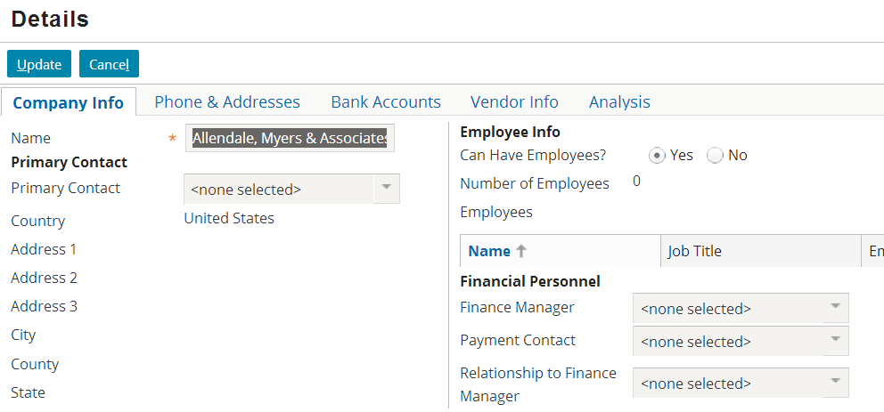
Example of logic extended over inputs
Finance personnel widgets needed only if company is vendor
To prevent repeating visibility condition:
Inputs put into input set
Visibility set at input set level
Notes:
There is a small number of cases where input sets are used not for reusability but instead to declare a single editable or visible condition that has the same value across a set of widgets. Once again, this is a convenience. The same effect could be achieved by declaring the editable or visible attribute in each widget, but this would take more time than declaring it at the input set level.

Slide 7
Input set contents
Like detail views, input sets can contain:
Inputs
Input dividers
Labels
Embedded list views
Unlike detail views, input sets cannot:
Contain input columns

Slide 8
What can contain an input set?
screen a top-level container one can navigate to
Screen
secondary views collections of primary views organized for usability
Card View / ListDetail View
primary views a single object (and its related data) or set of objects
Detail View
List View
Input Sets
atomic widgets individual elements of data and/or functionality
Atomic Widgets
Notes:
Although it is not reflected in the diagram:
An input set can be added or referenced only inside a detail view input column. In practice, this is not often an issue as Studio automatically adds an input column to a detail view if you attempt to add an input set where there isn't already an input column.
An input set can contain child input sets.
An input set can contain a list view if the list view is referenced using the ListViewInput tag. In practice, though, there is rarely a need to include a list view in an input set.

Slide 9
Lesson outline
Input set basics
Implementing input sets

Slide 10
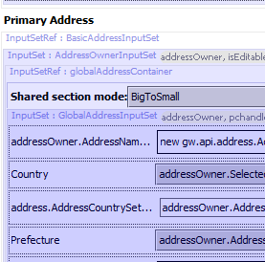
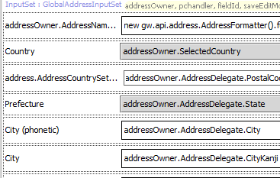
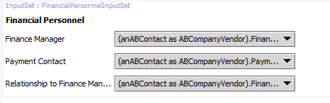
Declaring input sets
For reuse, must be declared in separate file and referenced as an "Input Set Ref"
If created to extend visible or editable conditions, or both, typically declared inline
Notes:
The two use cases for input sets—reusability and shared logic—are not mutually exclusive. It is possible to have an input set that extends a single visible or editable condition across its contents and gets reused under multiple circumstances.

Slide 11
Steps to implement "shared logic" input set
Create input set inline
Specify appropriate logic at input set level
Add atomic widgets to input set
Reload UI metadata

Slide 12
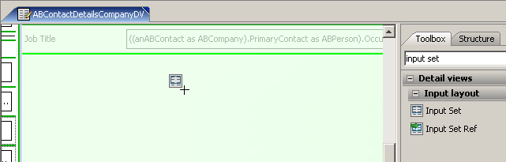
Step 1: Create input set inline
Inline input sets created using Input Set widget
Inline input sets have access to all required variables from parent
Therefore, inline input sets typically have no objects specified on Required Variables tab
Notes:
If an input set is created solely for the purpose of declaring logic across multiple widgets, then the input set widget (as opposed to the input set ref widget) is used.
An input set can be added or referenced only inside a detail view input column. In practice, this is not often an issue as Studio automatically adds an input column to a detail view if you attempt to add an input set where there is not already an input column.

Slide 13
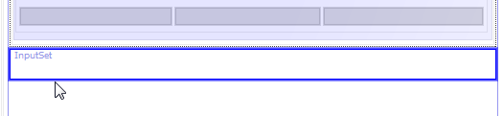
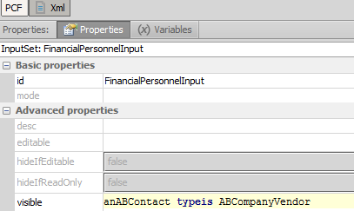
Step 2: Specify logic at input set level
Notes:
Any editable or visible logic specified at the input set level inherently affects all widgets in the input set.

Slide 14
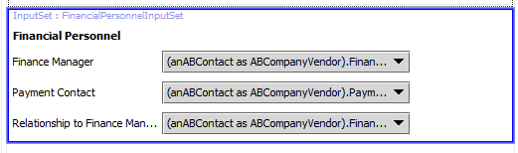
Step 3: Add atomic widgets to input set
This is the same as for detail views or reusable input sets

Slide 15
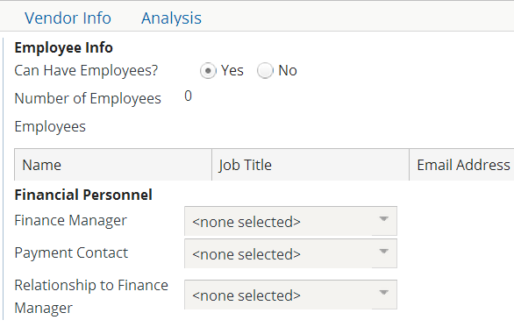
Step 4: Reload UI metadata
ALT + SHIFT + L

Slide 16
Steps to implement reusable input set
Create input set PCF
Specify the required variable(s)
Add atomic widgets to input set
Reference input set from parent container(s)
Reference can optionally include "shared logic"
Reload UI metadata

Slide 17

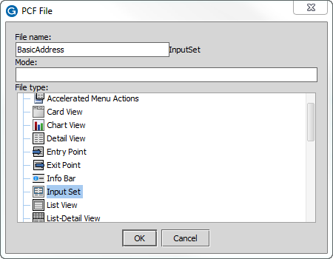
Step 1: Create input set PCF
Notes:
To create an input set PCF file:
Right-click the PCF folder in which the input set should be created, and select New > PCF File.
Specify a name for the input set and select "Input Set" for the file type. The file will automatically have an "InputSet" suffix.

Slide 18
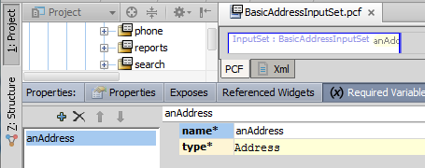
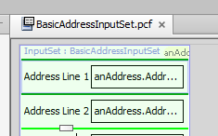
Step 2: Specify required variable(s); Step 3: Add atomic widgets to input set
Notes:
Like a detail view, an input set typically has at least one required variable. This stores the object passed to the input set by the parent container, and it is typically the object whose data is displayed in the input set.
Atomic widgets are added to an input set in exactly the same way that they are added to a detail view.

Slide 19
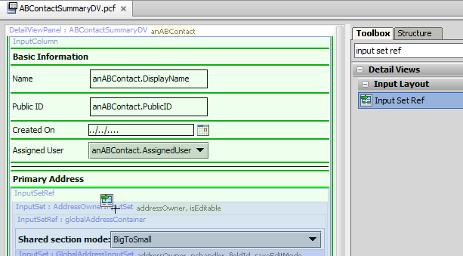
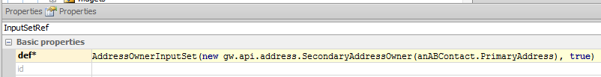
Step 4: Reference input set
Notes:
A detail view is embedded in a parent container using a "Panel Ref" widget. In a similar manner, an input set is embedded in a parent container using an "Input Set Ref" widget.
To reference an input set from a parent container:
Add an input set ref widget at the appropriate place in the parent container.
In the input set ref's def property, specify the input set name. After the name, inside parentheses, specify the required object(s) to pass to the input set.
In the example above, the BasicAddressInputSet is referenced by the ABContactSummaryDV parent container. The def property specifies the input set to include and specifies that the ABContact's primary address should be passed to the input set.
Similar to the Input Set itself, an InputSetRef has editable and visible attributes. You could add conditions to either of these to make that use of the input set conditionally visible , or editable, or both.
An input set can be added or referenced only inside a detail view input column. In practice, this is not often an issue as Studio automatically adds an input column to a detail view if you attempt to add an input set ref where there is not already an input column.

Slide 20
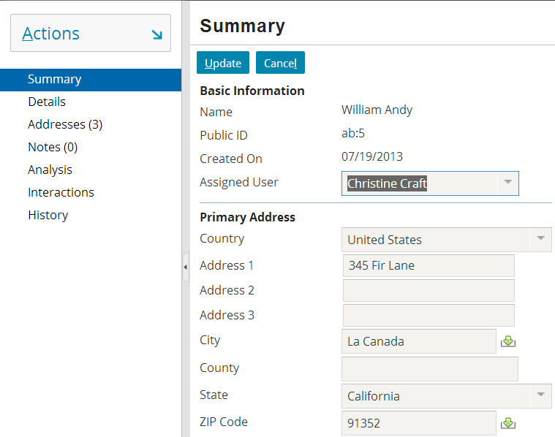
Step 5: Reload UI metadata
ALT + SHIFT + L

Slide 21
Lesson objectives review
You should now be able to:
Describe how input sets are used to create sets of inputs that can be reused
Implement input sets

Slide 22
Review questions
What are the two primary use cases for input sets?
Which of the following can be included in input sets:
Embedded list views
Inputs
Input columns
Input dividers
Labels
What is the difference between the "input set" widget and the "input set ref" widget?
Notes:
Answers
1. Reuse of widgets across detail views; logic shared across multiple widgets
2. a) Yes
b) Yes
c) No
d) Yes
e) Yes
3. The "input set" widget is used to create inline input sets. The "input set ref" widget is used to reference reusable input sets.

